Slide 1



Zooming in on Wide-area Latencies to a Global Cloud Provider
Yuchen Jin, Sundararajan Renganathan, Ganesh Ananthanarayanan, Junchen Jiang, Venkat Padmanabhan, Manuel Schroder, Matt Calder, Arvind Krishnamurthy

Slide 2









TL;DR
When clients experience high Internet latency degradation to cloud services, where does the fault lie?
Cloud services: high latency → lower user engagement ☹
1. BlameIt: A tool for Internet fault localization to ease the lives of network engineers with automation & hints
2. BlameIt uses a hybrid approach (passive + active)
Use passive end-to-end measurements as much as possible
Issue selected active probes for high-priority incidents
3. Production deployment of passive BlameIt at Azure
Correctly localizes the fault in all 88 incidents with manual reports
72X lesser probing overhead

Slide 3




Public Internet communication is weak
Congestions inside/between AS(es)
Path updates inside an AS
AS-level path changes
Maintenance issues in client’s ISP
Intra-DC and inter-DC communications have seen rapid improvement
DC2
edge4
Cloud Network
DC1
edge3
edge1
edge2
Internet segment is the weak link!
(little visibility/control)

Slide 4

When Internet perf is bad (RTT inflates), where in the path is to blame?
Problem at cloud end
Investigate server issue
Investigate edge-DC connection
Re-route around the faulty AS
Contact other AS’s network operations center (NOC)
Contact ISP if issue is widespread
Cloud (e.g., Azure, AWS)
Client ISP (e.g., Comcast AS)

Slide 5
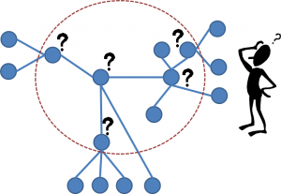
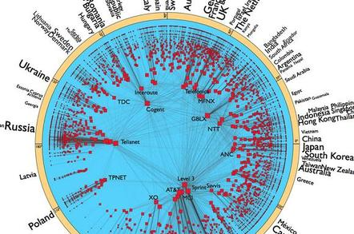
When Internet perf is bad (RTT inflates), where in the path is to blame?
Passive analysis of end-to-end latency
Network tomography for connected graphs
Under-constrained due to insufficient coverage of paths
Active probing for hop-by-hop latencies
Frequent probes from vantage points worldwide
→ Prohibitively expensive at scale
Network tomography [JASA’96, Statistical Science’04], Boolean tomography [IMC’10], Ghita et al. [CoNEXT’11], VIA [Sigcomm’16], 007 [NSDI’18]
iPlane [OSDI’06], WhyHigh [IMC’09], Trinocular [Sigcomm’13], Sibyl [NSDI’16], Odin [NSDI’18]

Slide 6
BlameIt: A hybrid approach
Coarse-grained blame assignment using passive measurements
CLOUD SEGMENT
MIDDLE SEGMENT
CLIENT SEGMENT
Fine-grained active traceroutes only for (high-priority) middle-segment blames

Slide 7
Outline
Coarse-grained fault localization with passive measurements
Fine-grained localization with active probes
Evaluation

Slide 8
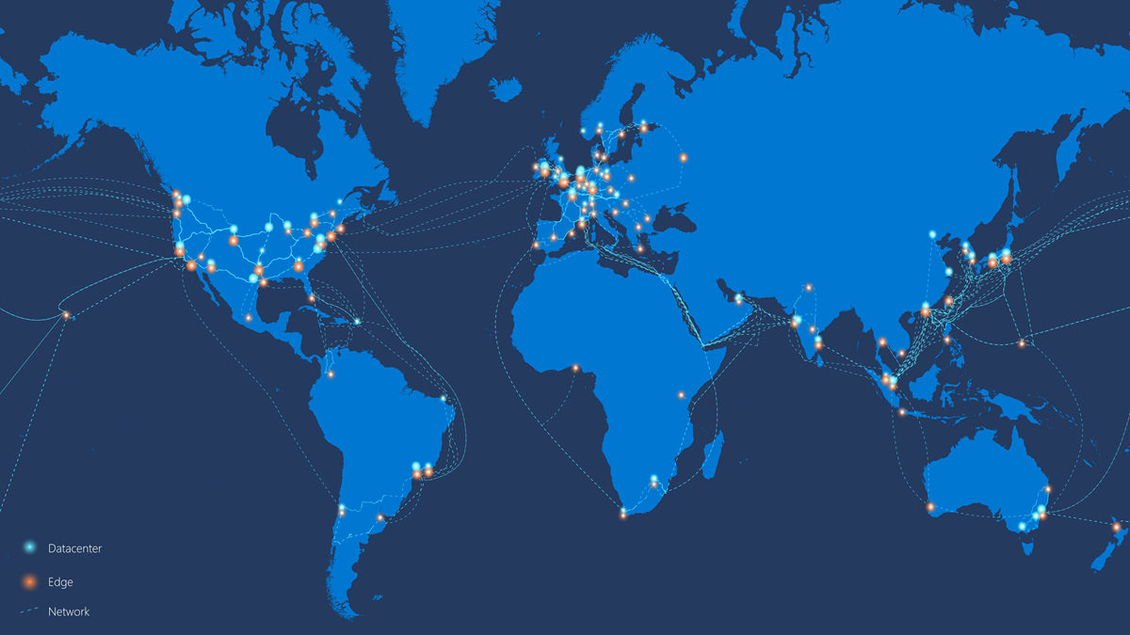

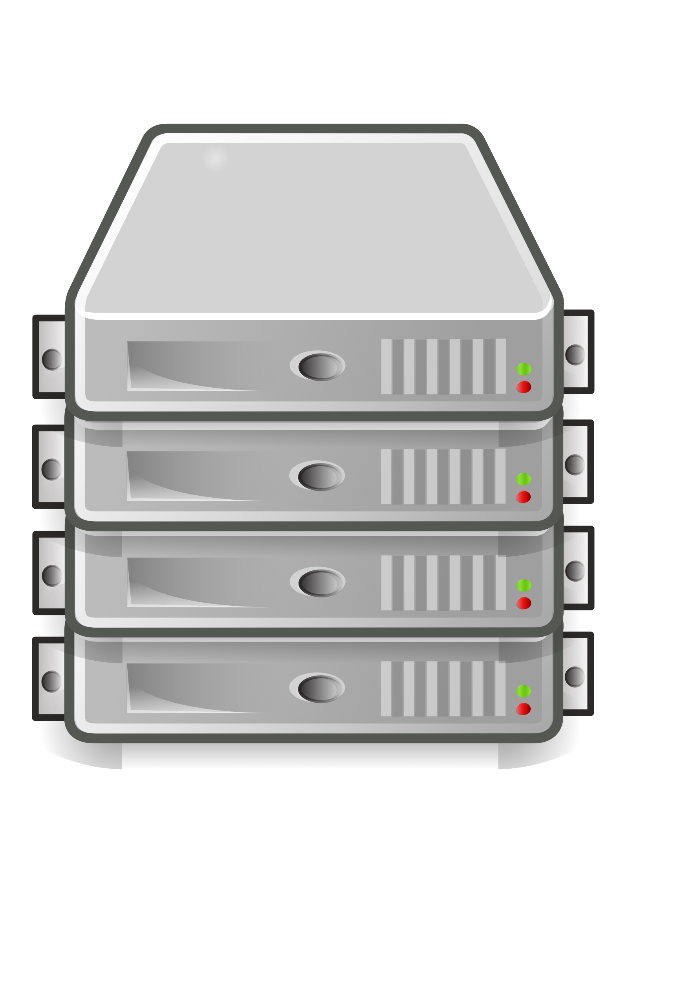
Architecture
Hundreds of edge locations
Hundreds of millions of clients
TCP handshake
SYN
ACK
SYN/ACK
client IP, device type,
timestamp, RTT
Data analytics cluster

Slide 9
Quartet
Quartet: {client IP /24, cloud location, mobile (or) non-mobile device, 5 minute time bucket}
Better spatial and temporal fidelity
> 90% quartets have at least 10 RTT samples
A quartet is “bad” if its average RTT is over the badness threshold
Badness thresholds: RTT targets varying across regions and device connection types.
Quartet:
{10.0.6.0/24,
NYC Cloud,
mobile,
time window=1}
→ average RTT: 34ms
{10.0.6.2, NYC Cloud, mobile, 02:00:33}: 32ms
{10.0.6.7, NYC Cloud, mobile, 02:02:25}: 34ms
{10.0.6.132, NYC Cloud, mobile, 02:04:49}: 36ms

Slide 10
BlameIt for localizing Internet fault
1. Identify “bad” quartets. {IP-/24, cloud location, mobile (or) non-mobile device, time bucket}
2. For each bad quartet,
Start from the cloud, keep passing the blame downstream if no consensus
τ = 80%
If (> τ) quartets to the cloud have RTTs > cloud’s expected RTT
If (> τ) quartets sharing the middle segment (BGP path) have RTTs > middle’s expected RTT
Good RTT to another cloud
Chicago
Blame the middle segment
NYC
Ambiguous
Blame the cloud
Else
Blame the client
If not sufficient RTT samples
Insufficient

Slide 11

Key empirical observations
Only one AS is usually at fault
E.g., Either the client or a middle AS is at fault, but not both simultaneously
Smaller “failure set” is more likely than a larger set
E.g., If all clients connecting to a cloud location see bad RTTs, it’s the cloud’s fault
(and not all the clients being bad simultaneously)
➔Hierarchical elimination of the culprit starting with the cloud, and stop when we are sufficiently confident to blame a segment

Slide 12
Learning cloud/middle expected RTT
Each cloud location’s expected RTT is learnt from previous 14 days’ median RTT
Each middle segment’s expected RTT is learnt from previous 14 days’ median RTT
P(RTT)
cloud location’s expected RTT is 40ms
> τ (=80%) quartets to the cloud have RTT higher than its expected RTT (40ms)
RTT(ms)
30
35
40
50
55

Slide 13
Outline
Coarse-grained fault localization with passive measurements
Fine-grained localization with active probes
Evaluation

Slide 14
BlameIt: A hybrid approach
Coarse-grained blame assignment using passive measurements
CLOUD SEGMENT
MIDDLE SEGMENT
CLIENT SEGMENT
Fine-grained active traceroutes only for (high-priority) middle-segment blames

Slide 15
Approach for localizing middle-segment issues
Background traceroute: obtain the picture prior to the fault.
On-demand traceroute: triggered by the passive phase of BlameIt
Blame the AS with greatest increase in contribution!
AS 8075
AS m₁
AS m₂
AS client
Background traceroute
Contribution of AS m₁ = 6 – 4 = 2ms
4ms
6ms
8ms
9ms
On-demand traceroute
Contribution of AS m₁ = 60 – 4 = 56ms
4ms
60ms
62ms
64ms

Slide 16
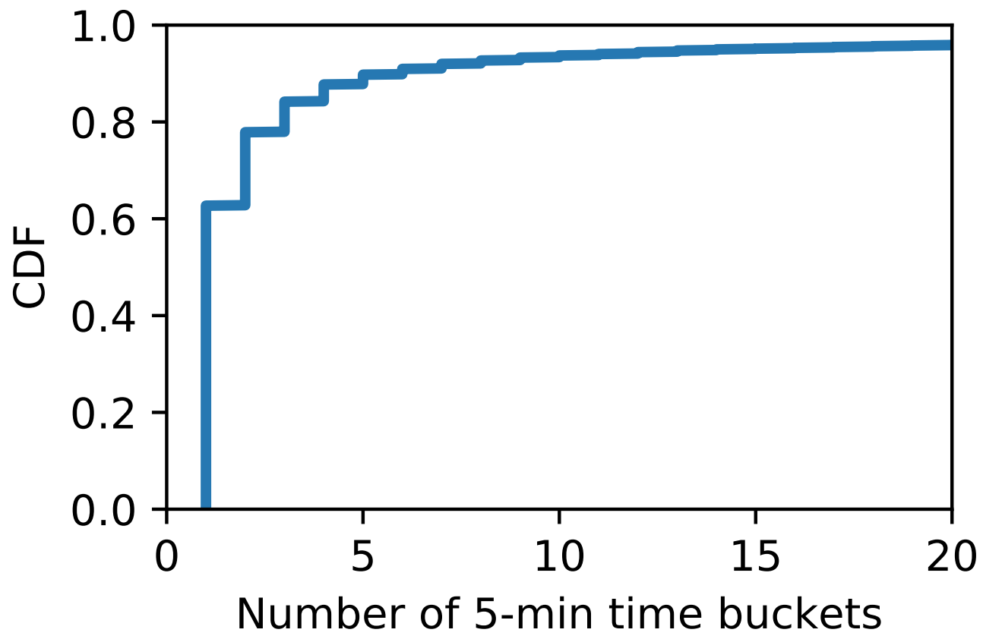
Key observations for optimizing probing volume
Internet paths are relatively stable
Background traceroutes need to be updated only when BGP path changes
Not all middle-segment issues are worth investigating
Most issues are fleeting!
> 60% issues last <= 5 mins
Prioritize traceroutes for long-standing incidents!

Slide 17
Optimizing background traceroutes
Issued periodically to each BGP path seen from each cloud location
We keep it to two per day hitting a “sweet spot” of high localization accuracy and low probing overhead
Triggered by BGP churn i.e. BGP path change at border routers
Whenever AS-level path to a client prefix changes at border routers

Slide 18
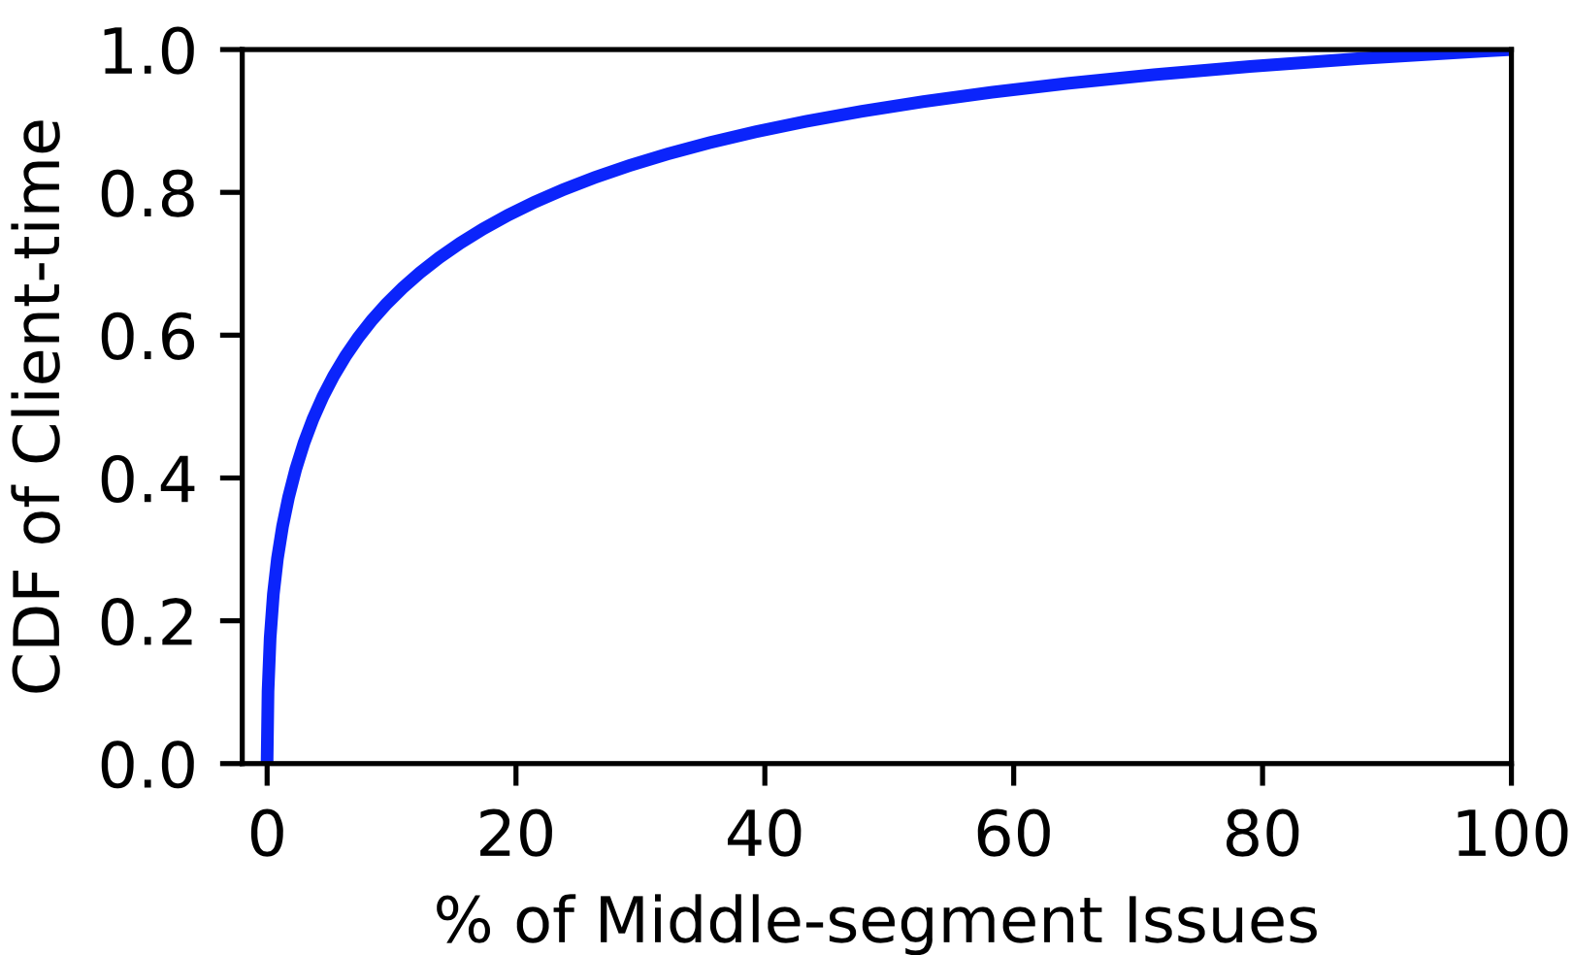
Optimizing on-demand traceroutes
Approximate damage of user experience: number of affected users (distinct IP addresses) X the duration of the RTT degradation
“client-time product”
Concentration of issues
If ranked by client-time product, top 20% middle segments cover 80% damages of all incidents
BlameIt uses estimated client-time product to prioritize middle-segment issues

Slide 19
Outline
Coarse-grained fault localization with passive measurements
Fine-grained localization with active probes
Evaluation

Slide 20
Evaluation highlights
We compare the accuracy of BlameIt’s result to 88 incidents in production having labels from manual investigations done by Azure
BlameIt correctly pinned the blame in all the incidents

Slide 21
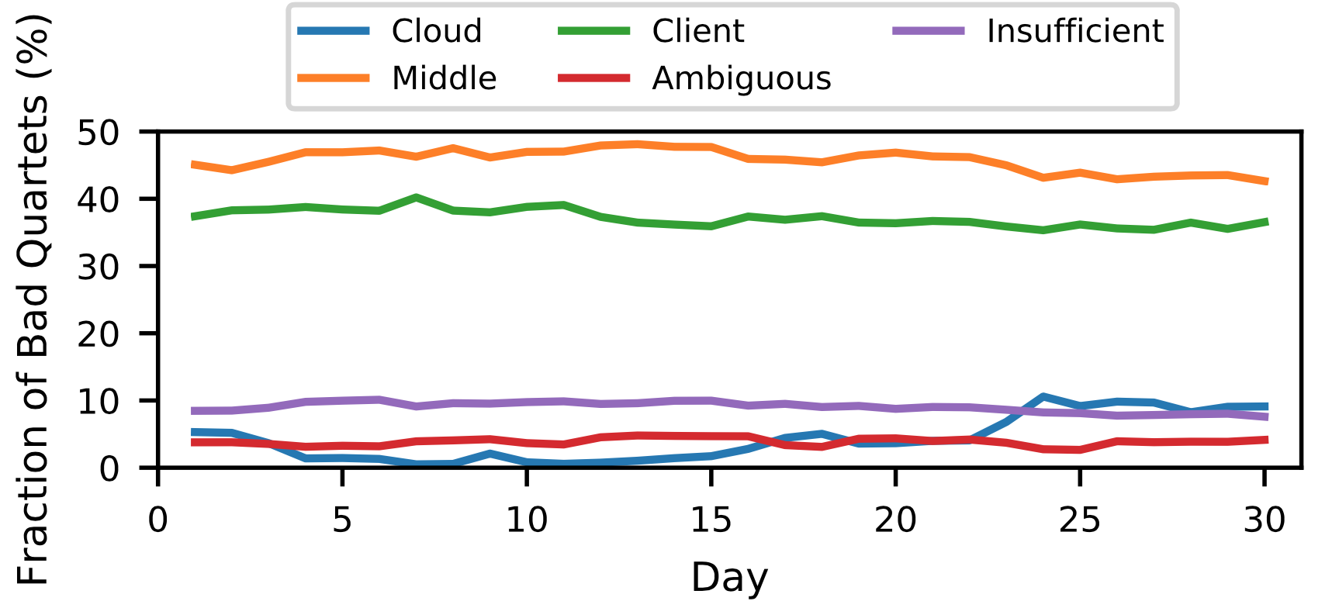
Blame assignments in production
Blame assignments worldwide over a month
Fractions are generally stable
Cloud segment issues account for <4% of bad quartets
Well maintained by Azure
“Ambiguous” and “Insufficient” have a large fraction

Slide 22
Real-world incident: Peering Fault
A high-priority latency issue affecting many customers in the US
BlameIt caught it and correctly blamed the middle segment
Issue was due to changes in a peering AS with which Azure peers at multiple locations
(Other) Monitoring Systems | Why didn’t it catch the issue? | How BlameIt succeeded?
Periodic traceroutes from Azure clients | Clients issuing traceroutes weren’t affected (limited number of clients) | Considers all the clients hitting Azure (using passive measurements)
Monitoring System | Why it didn’t catch the issue? | How BlameIt avoids this problem
Users download web objects to measure latency | Deployed conservatively to limit overheads | Passive data used to issue selective active probes
Monitoring System | Why it didn’t catch the issue? | How BlameIt avoids this problem
Monitors RTTs to Azure in each {AS, metro} | No single {AS, metro} was badly affected though many clients affected countrywide | Goes more fine-grained by using BGP-paths and client IP-/24s
BlameIt is able notice widespread increases in latency without prohibitive overheads

Slide 23
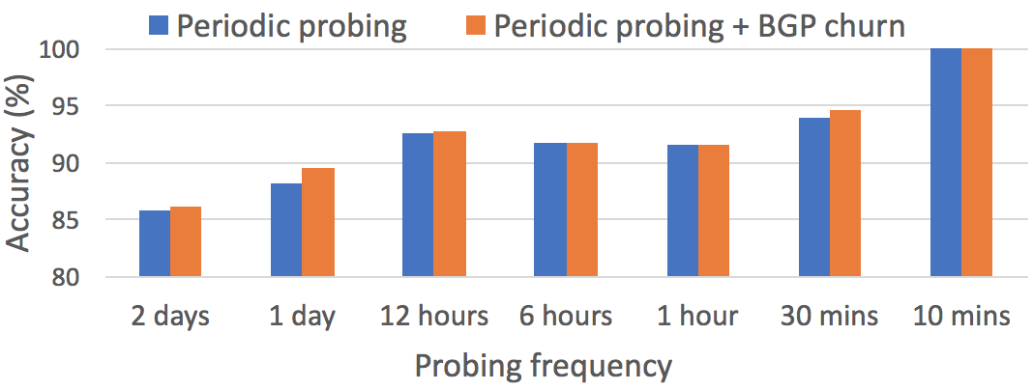
Finding the best background traceroute frequency
Central tradeoff: traceroute overhead vs AS-level localization accuracy
Experiment setup: Traceroutes from 22 Azure locations to 23,000 BGP prefixes for two weeks
Accuracy metric: Relative localization accuracy with most fine-grained scheme as ground truth
72X cheaper!
Probing scheme can be configured by the operators

Slide 24
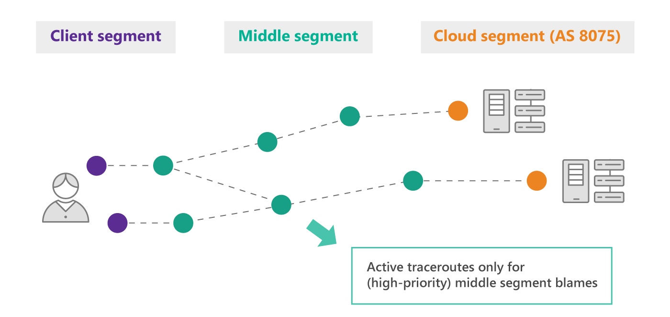
BlameIt Summary
➔ Ease the work of network engineers with automation & hints to investigate WAN latency degradation
Hybrid (passive + active) approach
Deployment at Azure produces results with high accuracy at low overheads

