Slide 1
Stable and Practical AS Relationship Inference with ProbLink
Yuchen Jin¹ , Colin Scott², Amogh Dhamdhere³,
Vasileios Giotsas⁴, Arvind Krishnamurthy¹, Scott Shenker²
¹University of Washington, ²UC Berkeley, ³CAIDA, ⁴Lancaster University

Slide 2

Autonomous System (AS) and BGP
AS 4
AS 1
ASes:
Google
Comcast
UW
AS 3
AS 2
AS 5

Slide 3
AS Relationships
ASes keep relationships confidential!
Peering
AS 4
AS 1
AS 3
Provider
$$$
AS 2
AS 5
Customer
Customer-to-provider (Cust-Prov) | Customer AS pays the provider AS for transit
Peer-to-peer (Peer-Peer) | Settlement free

Slide 4
Motivation
AS relationship inference application domains
Understanding Internet evolution
Identifying malicious ASes
Detecting network congestion
A research problem which has been studied for ~2 decades
Gao (2001)
Subramanian et al. (2002)
Di Battista et al. (2003)
Dimitropoulos et al. (2007)
AS-Rank (2013)
99% accuracy (1% error rate)
How does AS-Rank perform for actual applications?

Slide 5
Case Study: Route Leak Detection
On November 5, 2012, Google’s services cannot be accessible in Asia for half an hour.
AS Path: 3491, 23947, 15169
Prefix: 8.8.8.0/24
AS Path: 3491, 15169
Prefix: 8.8.8.0/24
AS 3491
PCCW
Provider
Peer-Peer
Data
AS Path: 23947, 15169
Prefix: 8.8.8.0/24
AS Path: 23947, 15169
Prefix: 8.8.8.0/24
Data
AS Path: 15169
Prefix: 8.8.8.0/24
Customer
AS 23947
Moratel
AS 15169
Google
Peer-Peer

Slide 6
Case Study: Route Leak Detection
Valley-free assumption:
Path consists of Cust-Prov links, followed by zero or one Peer-Peer link, followed by Prov-Cust links. (uphill – cross – downhill)
Valley-free:
Valley-free violation:
B
Peer-Peer
C
PCCW
Cust-Prov
Prov-Cust
A
Moratel
Peer-Peer
Google

Slide 7
Route Leak Detection
Detection method: Check valley-free violations
AS relationship validation dataset:
relationships encoded using the Community attribute in BGP paths
E.g., AS209 (CenturyLink) uses the Community 13570 to tag routes received from customers

Slide 8
Route Leak Detection Using AS-Rank
Detect route leaks using AS-Rank:
Low precision: only 20% of the route leaks detected using AS-Rank were real route leaks
Low recall: 78% of the real leaks were missed

Slide 9
Outline
AS-Rank does not meet the demands of actual applications.
We develop a simple inference algorithm CoreToLeaf that achieves accuracy comparable to AS-Rank.
Most links in the validation dataset are relatively easy to infer.
We identify different subsets of the validation dataset that are hard to infer.
We develop ProbLink - a probabilistic AS relationship inference algorithm.
Evaluation

Slide 10
A Simple Algorithm: CoreToLeaf
Infer a transit-free clique (i.e., Tier-1) ASes.
For each path that traverses a Tier-1:
Tier-1
Cust-Prov
Prov-Cust
A
B
3356
C
D
BGP path1
Conflict
can
occur!
Cust-Prov
Prov-Cust
BGP path2
E
F
209
D
C
Label all remaining unclassified links as Peer-Peer.

Slide 11
CoreToLeaf vs. AS-Rank
April 1st, 2017
Algorithm | Validation dataset |  | Conflict (%) | Route Leak Detection
 | Precision | Recall |  | Precision | Recall
 | (%) | (%) |  | (%) | (%)
CoreToLeaf | 97.0 | 97.3 | 0.12 | 19.8 | 22.1
AS-Rank | 98.4 | 98.6 | 0 | 8.1 | 5.6
Implications:
Most links are easy to infer
Need to focus on hard links

Slide 12
Extract Hard Links
Use gradient boosting decision tree to calculate feature importance
Category | CoreToLeaf error (%) | AS-Rank error (%)
Max node degree < 100 | 13.7 | 8.6
Observed by 50-100 VPs | 4.7 | 9.3
Non-VP & Non-Tier1 | 5.3 | 9.0
Unlabeled Stub-clique | 95.5 | 33.4
Conflict | 100 | 8.1
April 1st, 2017
Fraction of hard links in the validation dataset are 3X fewer than that in the overall links
The validation dataset is skewed to easy links

Slide 13
Outline
AS-Rank does not meet the demands of actual applications.
We develop a simple inference algorithm CoreToLeaf that achieves accuracy comparable to AS-Rank.
Most links in the validation dataset are relatively easy to infer.
We identify different subsets of the validation dataset that are hard to infer.
We develop ProbLink - a probabilistic AS relationship inference algorithm.
Evaluation

Slide 14
Feature Design
The structure of paths that use the link
Triplet feature
The structure of paths that do not use the link
Non-path feature
Connectivity properties of the link
Distance to clique
Number of VPs observing a link
Co-located IXP/peering facility

Slide 15

Triplet Feature
Intuition: Most triplets are valley-free compliant, but we should tolerate some valleys.
Likelihood of valleys is derived from data
t₁
t₂
t₃
A
B
C
D
t $∈$ {Cust-Prov, Prov-Cust, Peer-Peer}
Definition: Attribute probabilistic values for the relationships of the first and the last links given the relationship of the middle link – P(t₁, t₃|t₂)

Slide 16
Non-path Feature
Intuition: If none of the Peer-Peer/Prov-Cust links coming into an AS are followed by a specific link, then the link is likely not a Prov-Cust link.
Definition: Attribute probabilistic values for the number of previous Peer-Peer/Prov-Cust links given the relationship of the next link.
– P(# Peer-Peer + # Prov-Cust | t)
X
No path contains:
X-B-C
Y-B-C
Z-B-C
Y
Prov-Cust
t
Z
B
C
Peer-Peer

Slide 17
Connectivity Features
t
AS₁
AS₂
Distance to clique feature: P(dist(AS₁), dist(AS₂) | t)
Intuition:
High-tier ASes are closer to clique ASes than low-tier ASes
Peer-Peer links are typically between the ASes in the same tier
Vantage point feature: P(# VPs observing AS₁ -- AS₂| t)
Intuition: Prov-Cust links are more likely to be seen by more VPs
Co-located IXP and co-located peering facility feature:
(extracted from PeeringDB) P(# IXPs/facilities| t)
Intuition: The more IXPs or facilities two ASes are co-located in, the more likely they are peering with each other

Slide 18

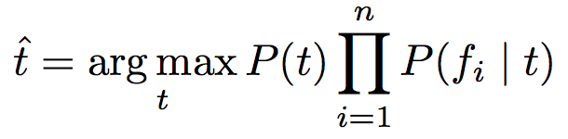
ProbLink Algorithm
Use CoreToLeaf to come up with an initial labeling
Repeat:
Compute the conditional probability distribution of each feature based on current labels
E.g., P(# VPs observing a link| t)
Predict new label for each link using Naïve Bayes and conditional probability distributions
Stop upon convergence

Slide 19
Outline
AS-Rank does not meet the demands of actual applications.
We develop a simple inference algorithm CoreToLeaf that achieves accuracy comparable to AS-Rank.
Most links in the validation dataset are relatively easy to infer.
We identify different subsets of the validation dataset that are hard to infer.
We develop ProbLink - a probabilistic AS relationship inference algorithm.
Evaluation

Slide 20
Accuracy Comparison
How well can ProbLink perform across years?
Compare inference error rates to that of AS-Rank:
The whole validation dataset: 1.7X improvement
Hard links: 1.8X to 6.1X improvement
Category | AS-Rank error (%) | ProbLink error (%) | Improvement
Observed by 50-100 VPs | 8.8 | 1.5 | 5.9X
Non-VP & Non-Tier1 | 4.4 | 1.7 | 2.6X
Unlabeled Stub-clique | 33.6 | 5.5 | 6.1X
Conflict | 6.8 | 3.8 | 1.8X
Max node degree < 100 | 8.6 | 4.4 | 2.0X

Slide 21
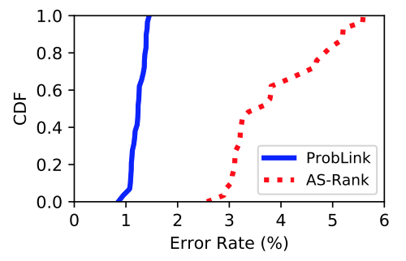
Stability Analysis
AS-Rank is sensitive to snapshot selection
ProbLink is consistently stable
30 consecutive 1-day snapshots

Slide 22
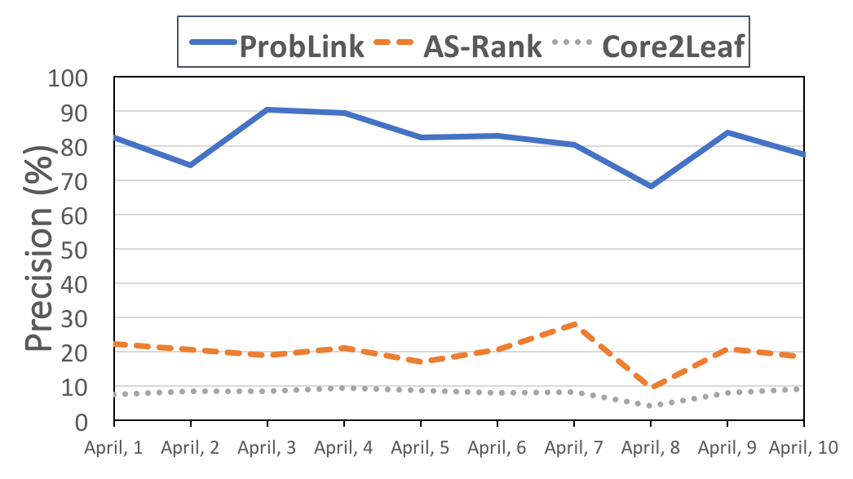
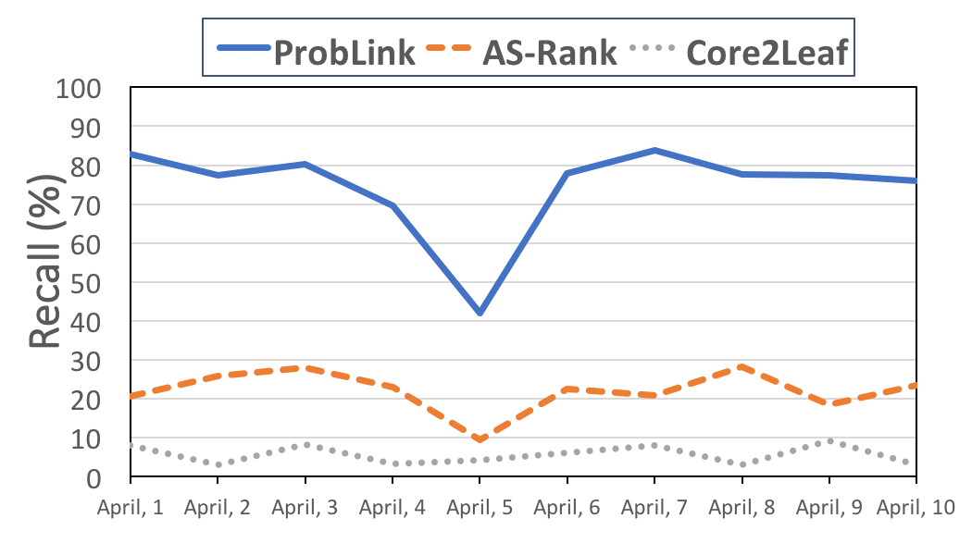
Route Leak Detection
Route leak detection method: Check valley-free violations
Precision
Recall
ProbLink | 81.1%
AS-Rank | 19.8%
CoreToLeaf | 8.1%
ProbLink | 76.2%
AS-Rank | 22.1%
CoreToLeaf | 5.6%

Slide 23
Practical Applications
Improvements over AS-Rank:
Route leak detection
Precision: 4.1X
Recall: 3.4X
Complex relationship inference
Reveals 27% more complex relationships
Predicting the impact of selective advertisement
Increases the precision by 34%

Slide 24
Conclusion
High accuracy in validation dataset does not translate to high application-level performance
Most links in the validation dataset are easy to infer
Constructed hard links sets and use them as benchmarks
Developed ProbLink and allow for integration of many noisy but useful attributes
Demonstrated that ProbLink is more effective and stable for real applications than previous techniques

