Slide 1

FACT-BASED NEWS VERIFICATION SYSTEM
A Hybrid System with BERT Classification, GNews Evidence Retrieval, and
Fine-tuned NLI Verification
Group1
Sun Yuchen A0326248B
Zhao Jiahui A0329852U
Zhang Yuxuan A0285664N
01

Slide 2
Agenda: From Problem Context to Evidence-based Verification
01
Background & Motivation
02
Business Problem, Objectives & Scope
Why fast, transparent news verification is needed
Why fake/real labels are insufficient, and what the system covers
03
Data and Evidence Resources
04
Solution Overview
FakeNewsNet-style data, factual-consistency NLI data, and GNews
BERT prior + GNews retrieval + DeBERTa-NLI verification
05
Implementation Architecture
06
Evaluation Results
Runtime workflow, modules, aggregation, sentiment, topic, and chat UI
BERT baseline, NLI fine-tuning, and metric improvements
07
Demo / Case Study & Error Analysis
08
Future Work & Conclusion
Sentence-level evidence trail and realistic failure modes
Retrieval, data, aggregation, and final takeaway
02

Slide 3
Background & Motivation: Why News Verification Matters
Online news moves faster than manual fact-checking.
Readers often see claims that look professional, neutral, and credible — but may still be unsupported, outdated, or false.
NEWS OVERLOAD
Real report
Speed gap
Trust gap
Real report
Unsupported claim
News spreads immediately; verification takes time.
Readers need visible evidence, not only model scores.
Unsupported claim
Misleading context
Misleading context
Outdated evidence
AI content
Mixed truth
Outdated evidence
Generated or rewritten content makes surface style less reliable.
One article may combine supported and unsupported statements.
Need: a transparent first-pass verification assistant.
03

Slide 4
Business Problem: Why Binary Fake/Real Classification Fails
A high-accuracy classifier can still fail in real use because it gives a document-level label without checking evidence.
NO EXPLAINABILITY
SOURCE & TOPIC BIAS
MIXED-TRUTH ARTICLES
A fake/real score cannot pinpoint which sentence or claim is false.
Models may learn source reputation, topic patterns, or writing style shortcuts.
Real articles often blend verified facts with outdated or unsupported claims.
Business need: verify sentence-level factual statements with retrievable external evidence, not only classify the whole article.
04

Slide 5
Business Value: Transparent First-pass Verification
The system is not a replacement for professional fact-checking. It is a fast assistant that helps users inspect evidence before trusting or sharing news.
Students
Journalists
Researchers
General readers
Check news used in assignments or discussions.
Quickly inspect claims before deeper investigation.
Explore misinformation cases and evidence trails.
See why an article is likely true, false, or unverified.
Sentence-level evidence
Traceable sources
Explainable verdict
Users can inspect specific claims, not only final labels.
Evidence includes source, date, URL, and snippet.
Supported, Refuted, and NEI labels are visible.
05

Slide 6
Proposed Solution: Evidence-based Verification Assistant
Move from style-based fake/real classification to evidence-backed sentence verification.
Article
→
Sentence units
→
External evidence
→
NLI reasoning
→
Final verdict
user input
claim-like pieces
GNews retrieval
support / refute / NEI
likely true / false / unverified
Core design 01
Core design 02
Core design 03
BERT provides a fast article-level prior only.
GNews connects the system to live external evidence.
Fine-tuned NLI performs semantic evidence verification.
06

Slide 7
System Overview: High-level Workflow
1
2
3
4
Input & Clean
Retrieve
Verify
Explain
User submits a news article; the system removes URLs and normalizes text.
Each sentence is used to query GNews and collect evidence candidates.
Fine-tuned DeBERTa-NLI compares evidence with each sentence.
The final verdict is shown with sentence labels, evidence, sentiment, topics, and chat UI.
Storyline: verify claims with evidence first, then aggregate sentence-level results into an explainable article-level verdict.
07

Slide 8
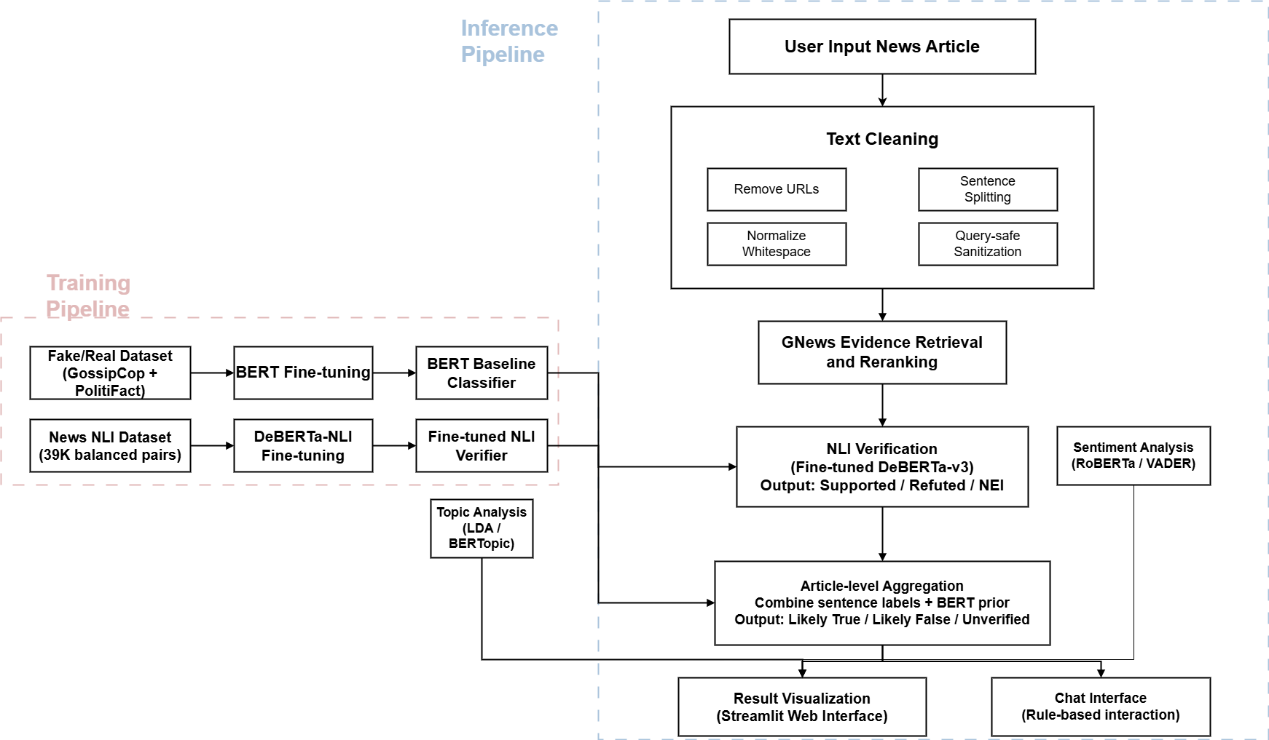
Implementation Architecture: From Article Input to Evidence-backed Verdict
The system separates training and inference.
During training, we fine-tune:
• BERT as an article-level prior
• DeBERTa-NLI as the sentence-level verifier
During inference, each article sentence is matched with GNews evidence and classified as: Supported / Refuted / NEI
The final verdict is generated by aggregating sentence-level NLI results with the BERT prior.
08

Slide 9
Datasets Used: Each Source Has a Different Role
23,196 rows
39,000 pairs
Live source
small JSON
Fake/Real Data
News NLI Data
GNews API
Claim Extraction Data
GossipCop + PolitiFact title-level examples for BERT screening.
Balanced premise-hypothesis-label samples for DeBERTa verifier fine-tuning.
Runtime evidence source, not a training dataset.
Auxiliary Flan-T5 claim extraction dataset with rule fallback.
Important distinction: offline models are trained before deployment; GNews supplies current evidence during runtime.
09

Slide 10
Implementation Detail 1: BERT Baseline Classifier
Role in system: article-level prior, not the final fact checker.
The local data are mainly title/headline-level. Therefore, BERT estimates whether the input resembles fake or real examples, while factual verification is delegated to retrieval + NLI.
0.8752
0.9189
0.8245
68.0%
Accuracy
Binary F1
Macro-F1
Fake Recall
after fine-tuning
Takeaway: useful for fast screening, but not sufficient because 368 fake items were still predicted as real.
10

Slide 11
Implementation Detail 2: Sentence-level GNews Retrieval
STEP 01
STEP 02
STEP 03
Sentence splitting
GNews search
Evidence reranking
Preserve original sentence wording for more reliable search.
Query-safe sanitation, punctuation cleanup, and length control.
Rank by lexical overlap, entities, numbers, source credibility, and deduplication.
Retriever output
Top evidence candidates with title, description, content snippet, source, publication date, URL, and relevance score.
Implementation value: every sentence can be traced to the query it triggered and the evidence selected for NLI verification.
11

Slide 12
Implementation Detail 3: Fine-tuned DeBERTa-NLI Verifier
PREMISE
Contradiction → Refuted
Retrieved evidence snippet
→
Fine-tuned DeBERTa-v3 NLI
→
chunked evidence strongest signal echo discounting
Neutral → NEI
HYPOTHESIS
→
Sentence from input article
Entailment → Supported
Why NLI: it models contradiction, paraphrase, and semantic relevance better than simple keyword overlap.
12

Slide 13
Implementation Detail 4: Aggregation, Interpretability, and UI
Many supported
Many refuted
Mostly NEI
Likely True
Likely False
Unverified
Sentiment Analysis
LDA Topic Analysis
Streamlit Chat
RoBERTa sentiment with VADER and keyword fallback; tone interpretation only.
CountVectorizer + LDA with optional BERTopic; dataset exploration only.
Rule-based interface that triggers existing functions and caches pipeline outputs.
Honesty point: sentiment, topics, and chat improve usability, but they are not direct truth-verification signals.
13

Slide 14
Evaluation Design: What We Tested and Why
BERT baseline
NLI verifier
Fine-tuning impact
End-to-end case
4,640 held-out samples
Test whether the classifier is a useful article-level prior.
4,500 balanced NLI test pairs
Test whether retrieved evidence can be semantically matched to claims.
Pretrained vs fine-tuned
Measure how much domain-specific news training improves performance.
sentence → evidence → label
Check whether the evidence trail is understandable in a real use case.
Metrics used
Accuracy
Precision
Recall
F1
Macro-F1
Confusion Matrix
Evaluation question: are the trained components reliable enough to support a practical evidence-based verification workflow?
14

Slide 15
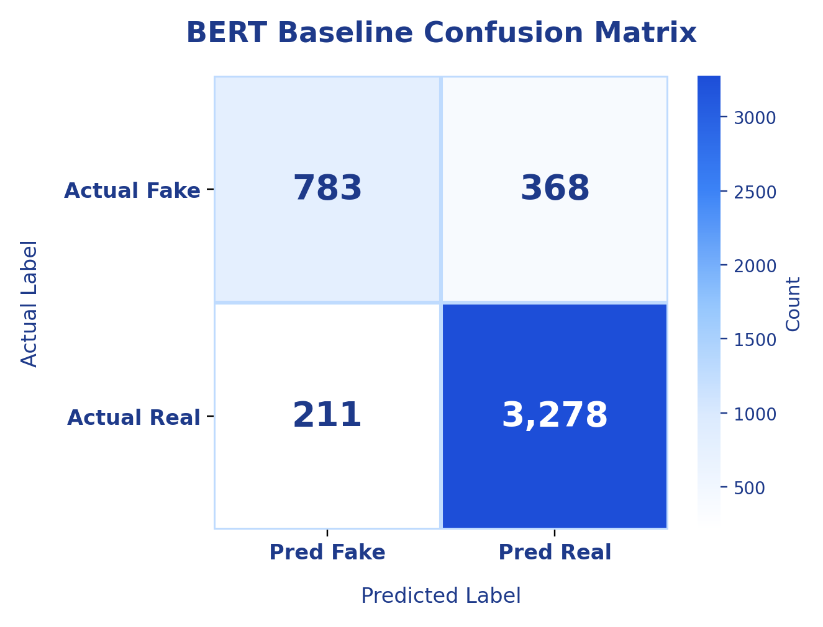
Evaluation Result 1: BERT Baseline Is Useful but Not Enough
Held-out test set: 4,640 samples
0.8752
0.9189
0.8245
Accuracy
Binary F1
Macro-F1
Macro-F1 comparison
0.8245
0.4292
0.4802
Majority
Untrained BERT
Fine-tuned BERT
Interpretation: BERT improves after fine-tuning, but missed fake cases justify evidence-based verification.
15

Slide 16
Evaluation Result 2: News-specific NLI Fine-tuning Is the Main Upgrade
Held-out test set: 4,500 balanced NLI pairs
Per-class F1 improvement
+18.36 pp
0.8643
0.9072
Macro-F1 gain
Fine-tuned Macro-F1
Entailment F1
Contradiction
0.647 → 0.845
Overall metric comparison
Neutral
0.664 → 0.841
0.8644
0.8649
0.8644
0.8643
0.6816
0.7200
0.6816
0.6807
Entailment
0.731 → 0.907
Accuracy
Macro-P
Macro-R
Macro-F1
Operational takeaway: contradiction recall increased from 52.13% to 81.87%, reducing missed refuting evidence.
Values shown above each bar: original DeBERTa-v3 vs fine-tuned News NLI.
Original DeBERTa-v3
Fine-tuned News NLI
16

Slide 17
Demo / Case Study: Make the Evidence Trail Visible
Sentence unit
Top evidence
NLI label
Why it matters
Brockman disclosed financial ties and a nearly $30B stake.
Reuters
Supported
Strong evidence match for financial-interest statement.
Musk filed a lawsuit over the for-profit versus nonprofit issue.
Economic Times
Supported
Evidence directly addresses litigation context.
The trial and ChatGPT launch happened in 2022.
MarketScreener
NEI → Supported
NLI helps avoid overreacting to unrelated numbers.
Main error sources
Retrieval errors
Snippet truncation
Multi-fact sentences
Aggregation sensitivity
related but insufficient evidence
weak premise quality
one sentence contains mixed claims
one wrong refuted label may dominate
17

Slide 18
Future Work and Conclusion
Next improvements
Better retrieval
Final message
1
sentence selection, reranking, and source filtering
More validated NLI data
BERT prior
2
manual claim-evidence pairs for cleaner evaluation
Confidence weighting
GNews evidence
3
calibrated aggregation instead of simple counting
Longer verification
NLI reasoning
4
multi-hop evidence and long article-body verification
Explainable verdict
The system is a transparent evidence-based verification assistant, not a replacement for professional fact-checking.
Conclusion: evidence-backed sentence verification is more transparent than pure article-level fake/real classification.
18

