Slide 1

FACT-BASED NEWS VERIFICATION SYSTEM
A Hybrid System with BERT Classification, GNews Evidence Retrieval, and
Fine-tuned NLI Verification
Group1
Sun Yuchen A0326248B
Zhao Jiahui A0329852U
Zhang Yuxuan A0285664N
01

Slide 2
Agenda: From Problem Context to Evidence-based Verification
01
Background & Motivation
02
Business Problem, Objectives & Scope
Why fast, transparent news verification is needed
Why fake/real labels are insufficient, and what the system covers
03
Data and Evidence Resources
04
Solution Overview
FakeNewsNet-style data, factual-consistency NLI data, and GNews
BERT prior + GNews retrieval + DeBERTa-NLI verification
05
Implementation Architecture
06
Evaluation Results
Runtime workflow, modules, aggregation, sentiment, topic, and chat UI
BERT baseline, NLI fine-tuning, and metric improvements
07
Demo / Case Study & Error Analysis
08
Future Work & Conclusion
Sentence-level evidence trail and realistic failure modes
Retrieval, data, aggregation, and final takeaway
02

Slide 3
Background & Motivation: The Verification Gap
Online news and social-media links spread faster than manual verification workflows.
Readers need quick screening, but they also need a visible reason to trust the result.
Speed gap
Trust gap
EVIDENCE GAP
Fast reporting
News spreads in minutes; checking claims manually takes much longer.
A model score is not enough without the evidence behind it.
Fast reporting
Unsupported facts
Unsupported facts
Missing context
Style gap
Mixed truth
Missing context
Outdated evidence
Professional wording can still contain false, outdated, or unverifiable claims.
One article may combine supported, refuted, and insufficiently evidenced statements.
Outdated evidence
Need: a transparent first-pass verification assistant that links claims to evidence.
03

Slide 4
Business Problem, Objectives & Scope
A fake/real classifier gives a quick document-level label, but it cannot explain which factual statements are supported, refuted, or uncertain.
DOCUMENT-LEVEL LABELS
SHORTCUT LEARNING
PRACTICAL SCOPE
The output does not identify which sentence or claim deserves human review.
Models may learn source, topic, or writing-style patterns instead of factual correctness.
English text news, sentence-level evidence checking, and first-pass support/refute/NEI screening.
Objective
Combine a BERT prior with GNews retrieval and fine-tuned NLI to produce an explainable article-level verdict.
04

Slide 5
Business Value: Faster Triage with Inspectable Evidence
The system reduces first-pass verification effort by retrieving external evidence and showing which statements need attention before users trust or share an article.
General readers
Students
Journalists
Researchers
Check suspicious articles before sharing them.
Learn the difference between style-based classification and evidence-based verification.
Surface unsupported statements before deeper editorial review.
Inspect misinformation cases, topics, sentiment, and evidence trails.
Sentence-level evidence
Traceable sources
Explainable verdict
Users can inspect specific supported, refuted, and NEI statements.
Evidence shows source, date, URL, snippet, and relevance context.
The final article label is tied back to BERT prior plus sentence-level NLI results.
05

Slide 6
Proposed Solution: Hybrid Evidence-based Verification
The system keeps BERT as a fast article-level prior, then verifies sentence-level claims against external news evidence.
Article input
Sentence units
GNews evidence
NLI verification
Final verdict
cleaned news text
preserve original wording
retrieval + reranking
supported / refuted / NEI
likely true / false / unverified
Core design 01
Core design 02
Core design 03
BERT is a prior, not the final judge.
GNews supplies live external evidence at runtime.
Fine-tuned DeBERTa-NLI performs semantic evidence checking.
06

Slide 7
System Overview: Runtime Workflow
1
2
3
4
Clean & Screen
Split & Retrieve
Rerank & Verify
Aggregate & Explain
Normalize the article and produce a BERT fake/real prior for fast screening.
Use sentence-level search units to query GNews and collect candidate evidence.
Rank evidence by overlap, entities, numbers, and source credibility; verify with DeBERTa-NLI.
Combine sentence labels with the BERT prior and show evidence, sentiment, topics, and chat output.
Storyline: classification gives the prior; retrieval + NLI provide the evidence trail behind the final verdict.
07

Slide 8
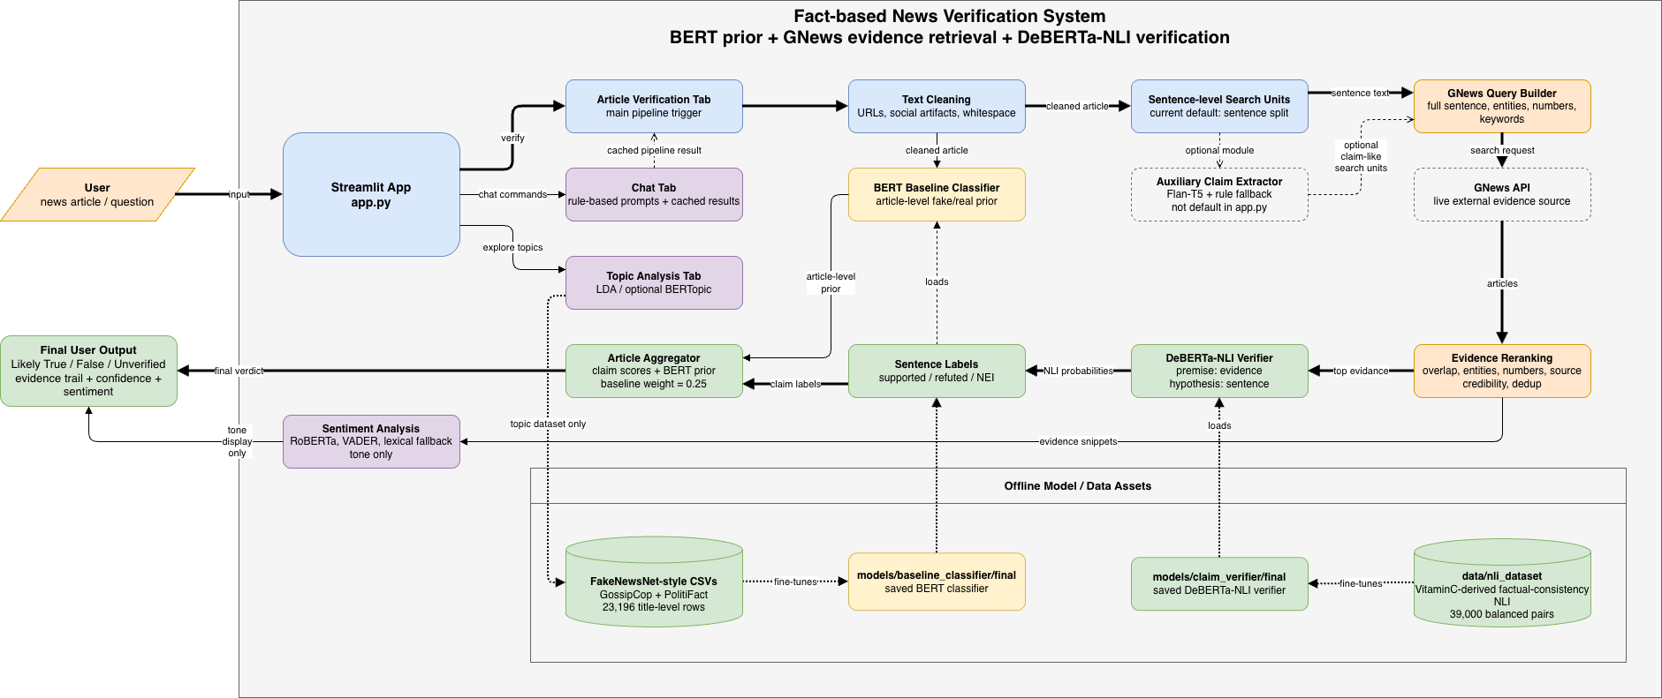
Implementation Architecture: Runtime Path and Offline Assets
Read left to right: Streamlit app -> BERT prior + GNews evidence -> DeBERTa-NLI sentence labels -> article-level verdict.
08

Slide 9
Data and Evidence Resources: Separate Training Data from Live Evidence
23,196 titles
39,000 pairs
Live evidence
auxiliary JSON
Fake/Real Data
Factual-consistency NLI Data
GNews API
Claim Extraction Data
GossipCop + PolitiFact title-level examples for the BERT screening prior.
30K train / 4.5K validation / 4.5K test; balanced support, refute, and NEI labels.
Runtime source for external articles; not used as model training data.
Flan-T5 claim extraction retained as an auxiliary module with rule fallback.
Important distinction: learned models are trained offline; GNews supplies current evidence during inference.
09

Slide 10
Implementation Details
BERT Baseline as a Prior
Sentence-level GNews Retrieval
Role in system: fast article-level screening, not final factual verification.
STEP 01
Sentence search units
The fake/real data are mostly title-level, so BERT estimates a prior while sentence-level truth checking is handled by GNews retrieval and NLI.
Default to original sentence wording because claim rewriting can hurt search reliability.
Retriever output
0.8752
0.9189
Top evidence with title, source, date, URL, snippet, relevance score, and credibility signal.
STEP 02
GNews query builder
Accuracy
Binary F1
Sanitize URLs, punctuation, length, entities, numbers, and keywords for API-safe search.
Implementation value
0.8245
68.0%
Every sentence can be traced from query to evidence candidate to NLI label.
Macro-F1
Fake Recall
STEP 03
after fine-tuning
Evidence reranking
Takeaway: strong enough for screening, but 368 fake items were still predicted as real, so evidence verification is necessary.
Rank returned titles, descriptions, and snippets by overlap, entities, numbers, source relevance, and credibility.
Takeaway: strong enough for screening, but 368 fake items were still predicted as real, so evidence verification is necessary.
10

Slide 11
Implementation Details (Cont.)
Fine-tuned DeBERTa-NLI Verifier
Aggregation, Interpretability, and UI
HYPOTHESIS
PREMISE
Sentiment Analysis
Article sentence to verify
Retrieved evidence passage
Mostly supported
RoBERTa sentiment with VADER fallback; tone display only, not a truth signal.
Likely True
Topic Analysis
Fine-tuned DeBERTa-NLI
Many refuted
Likely False
LDA with optional BERTopic for dataset exploration and article-topic inspection.
MNLI/FEVER/ANLI checkpoint |
chunked evidence |
strongest credibility-weighted signal
Streamlit Chat
Weak evidence / NEI
Rule-based chat interface reuses cached pipeline results from the verification workflow.
Unverified
Contradiction -> Refuted
Neutral -> NEI
Entailment -> Supported
Why NLI: it separates support, contradiction, and insufficient evidence better than lexical overlap alone.
Honesty point: sentiment, topics, and chat improve usability; the factual verdict comes from BERT prior plus sentence-level NLI labels.
12

Slide 12
Evaluation Design: What We Tested and Why
BERT baseline
NLI verifier
Fine-tuning impact
End-to-end case
4,640 held-out samples
Test whether the classifier is a useful article-level prior.
4,500 balanced NLI test pairs
Test whether retrieved evidence can be semantically matched to claims.
Pretrained vs fine-tuned
Measure how much domain-specific news training improves performance.
sentence → evidence → label
Check whether the evidence trail is understandable in a real use case.
Metrics used
Accuracy
Precision
Recall
F1
Macro F1
Confusion Matrix
Evaluation question
Are the trained components reliable enough to support a practical evidence-based verification workflow?
14

Slide 13
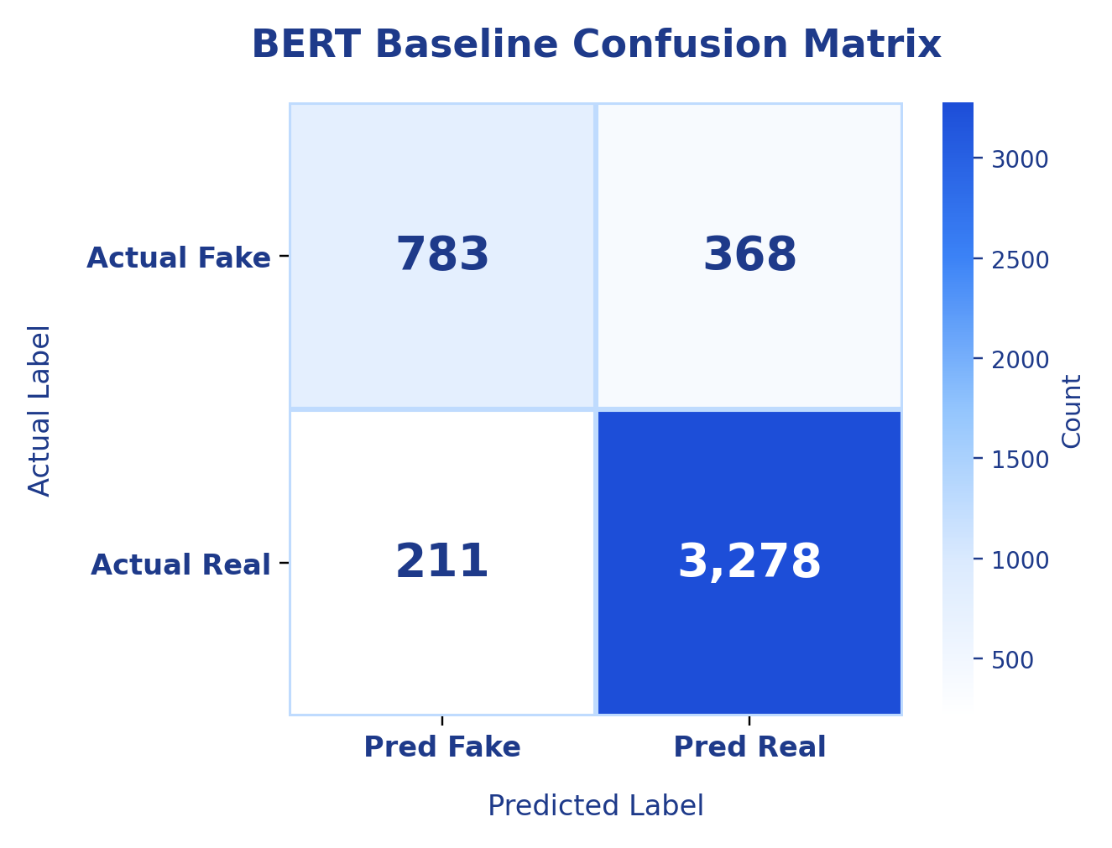
Evaluation Result 1: BERT Baseline Is Useful but Not Enough
Held-out test set: 4,640 samples
0.8752
0.9189
0.8245
Accuracy
Binary F1
Macro-F1
Macro-F1 comparison
0.8245
0.4292
0.4802
Majority
Untrained BERT
Fine-tuned BERT
Interpretation: BERT improves after fine-tuning, but missed fake cases justify evidence-based verification.
15

Slide 14
Evaluation Result 2: News-specific NLI Fine-tuning Is the Main Upgrade
Held-out test set: 4,500 balanced NLI pairs
Per-class F1 improvement
+18.36 pp
0.8643
0.9072
Macro-F1 gain
Fine-tuned Macro-F1
Entailment F1
Contradiction
0.647 → 0.845
Overall metric comparison
Neutral
0.664 → 0.841
0.8644
0.8649
0.8644
0.8643
0.6816
0.7200
0.6816
0.6807
Entailment
0.731 → 0.907
Operational takeaway: contradiction recall increased from 52.13% to 81.87%, reducing missed refuting evidence.
Accuracy
Macro-P
Macro-R
Macro-F1
Values shown above each bar: original DeBERTa-v3 vs fine-tuned News NLI.
Original DeBERTa-v3
Fine-tuned News NLI
16

Slide 15
Illustrative Case Study: Making the Evidence Trail Visible
Sentence unit | Top evidence | NLI label | Why it matters
Brockman disclosed financial ties and a nearly $30B stake. | Reuters | Supported | Strong evidence match for financial-interest statement.
Musk filed a lawsuit over the for-profit versus nonprofit issue. | Economic Times | Supported | Evidence directly addresses litigation context.
The trial and ChatGPT launch happened in 2022. | MarketScreener | NEI → Supported | NLI helps avoid overreacting to unrelated numbers.
Main error sources
Retrieval errors
Snippet truncation
Multi-fact sentences
Aggregation sensitivity
related but insufficient evidence
weak premise quality
one sentence contains mixed claims
one wrong refuted label may dominate
17

Slide 16
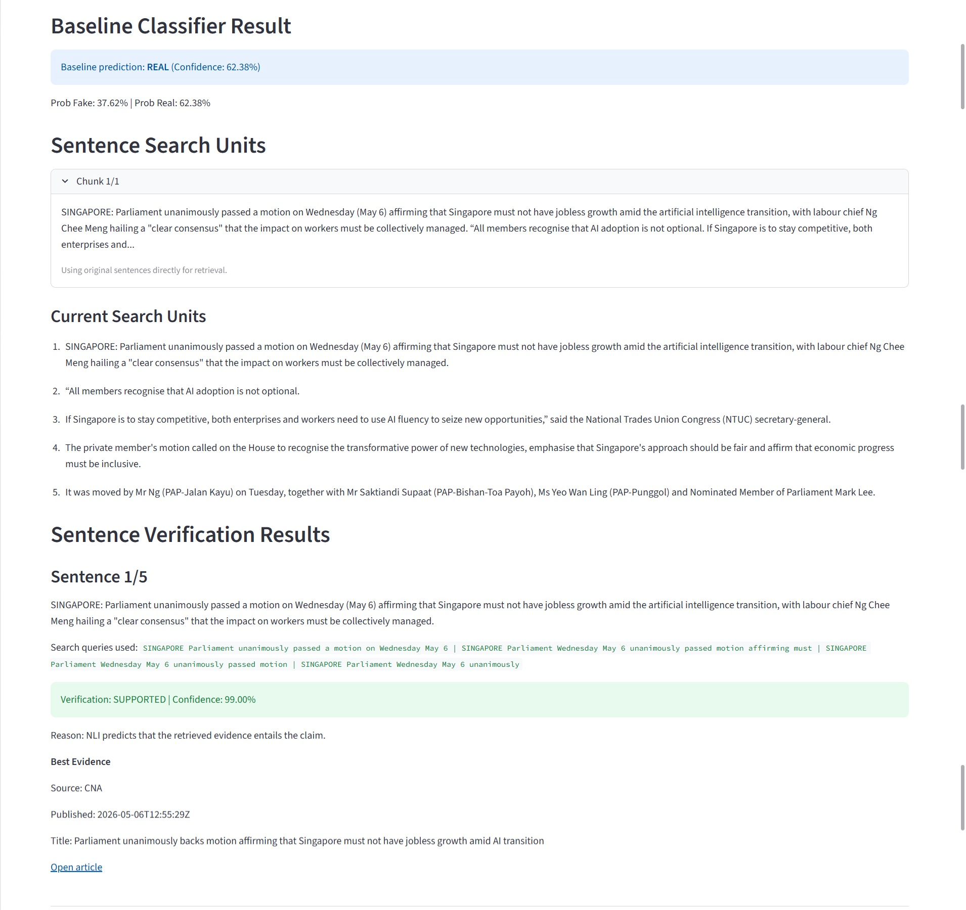
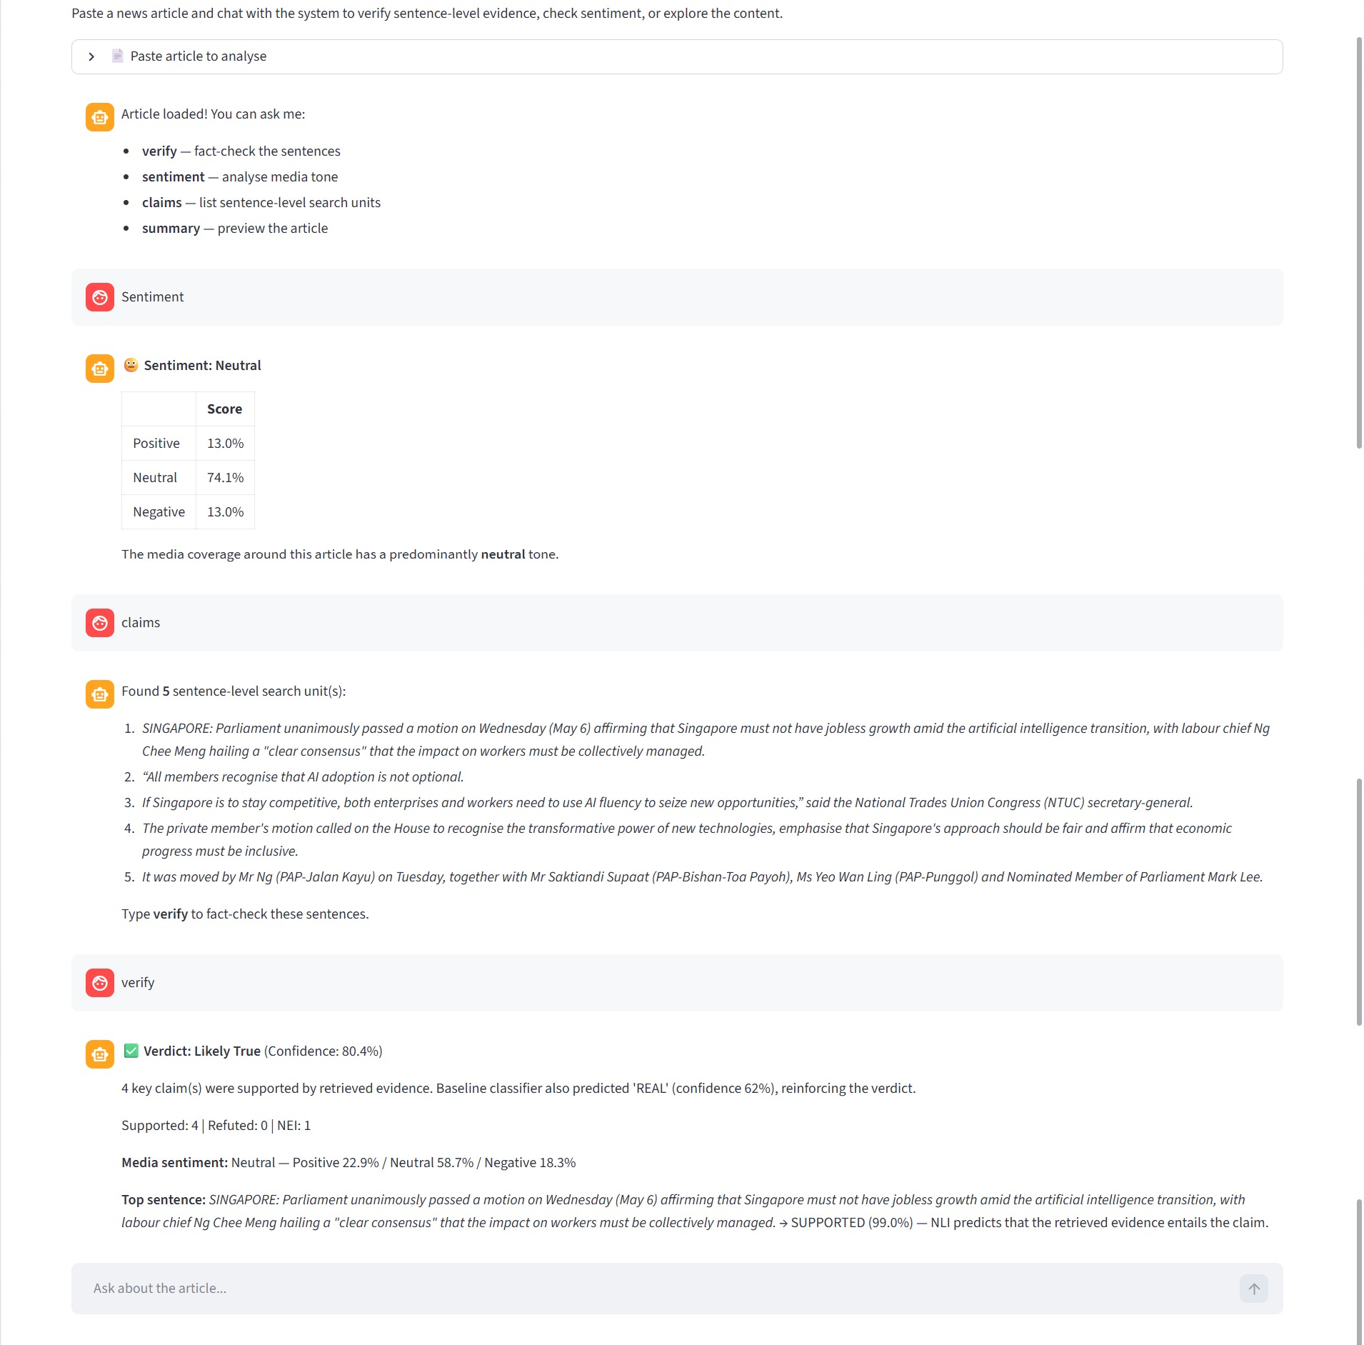
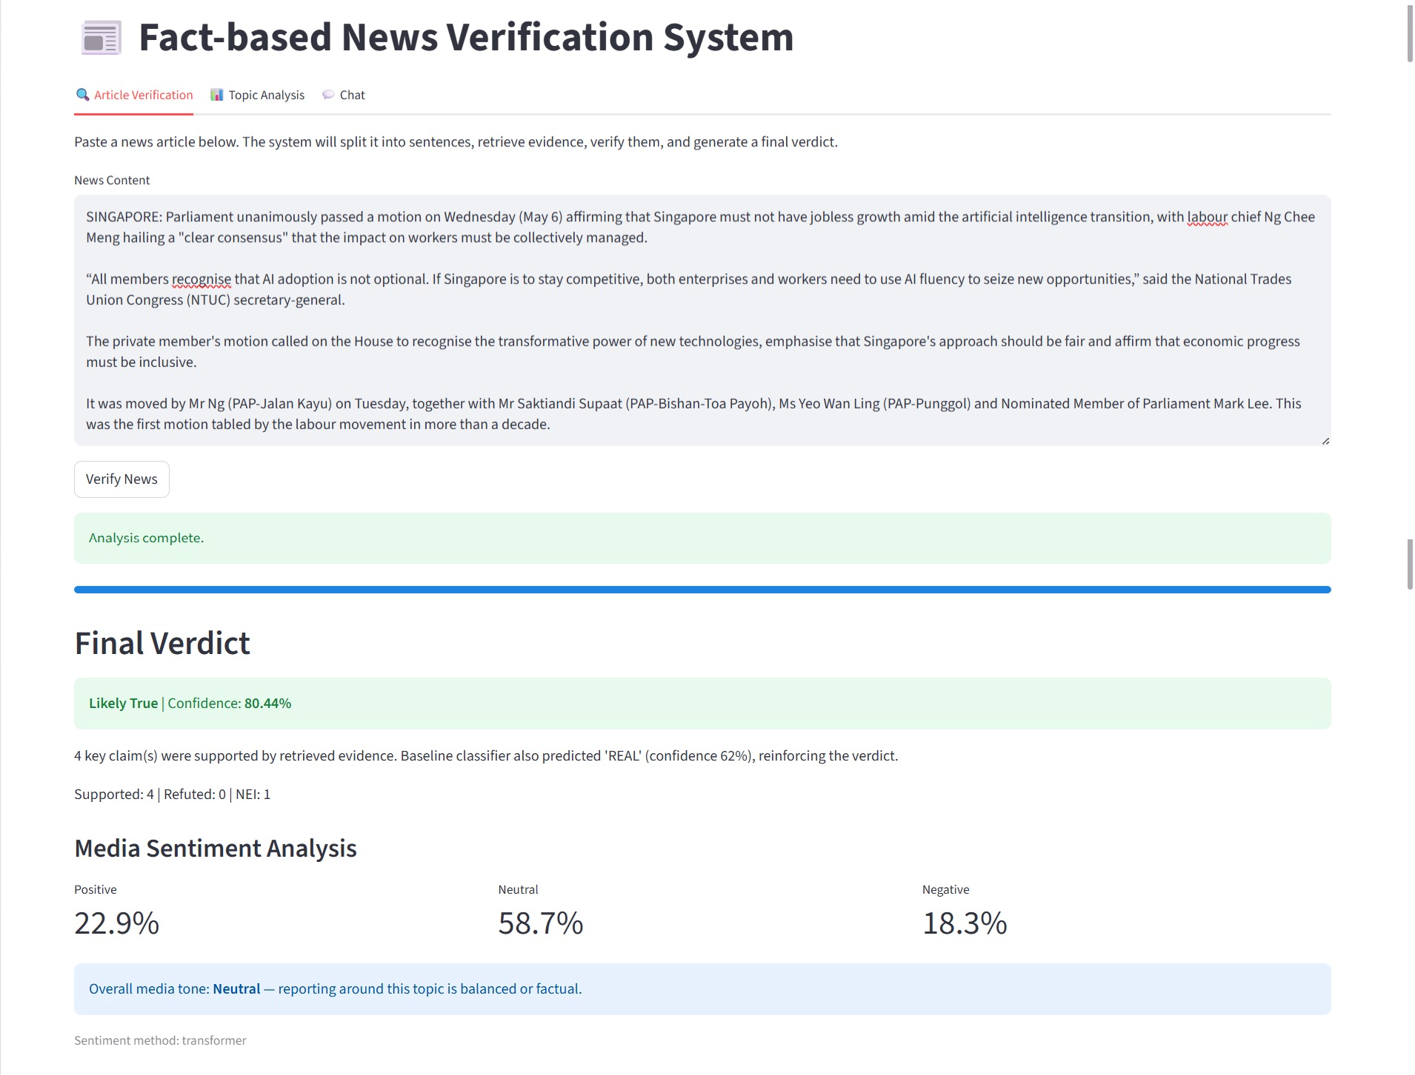
Demo: End-to-end Evidence Trail in Streamlit
A single article run shows how the app moves from input and BERT prior to sentence-level evidence, final verdict, sentiment, and chat interaction.
STEP 01
STEP 02
STEP 03
Article input + verdict
Sentence-level evidence
Chat-style inspection
The app returns Likely True, confidence, supported/refuted/NEI counts, and media sentiment.
Each sentence becomes a search unit; retrieved evidence is verified with NLI and linked to a source.
The chat tab reuses cached pipeline results for sentiment, claims, and final summary.
17

Slide 17
Future Work and Conclusion
Next improvements
Final message
1
Better retrieval
BERT prior
sentence selection, reranking, and source filtering
2
More validated NLI data
GNews evidence
manual claim-evidence pairs for cleaner evaluation
3
Confidence weighting
NLI reasoning
calibrated aggregation instead of simple counting
4
Longer verification
Explainable verdict
multi-hop evidence and long article-body verification
The system is a transparent evidence-based verification assistant, not a replacement for professional fact-checking.
Conclusion
Evidence-backed sentence verification is more transparent than pure article-level fake/real classification.
18

