Slide 1

A Data-Driven Optimal Production Control Strategy for Unconventional Reservoirs
Yuchen Zhang
Notes:
The “data-driven” here means the strategy make decision purely based on production data and need no prerequisite knowledge of the reservoir properties.
Unconventional Reservoir here denotes the oil reservoir with very low permeability like shale oil reservoir or tight oil reservoir.

Slide 2
Outline of Thesis
Question this study answered
Underlying Physics
Optimization Solution
Data-driven algorithm
Conclusion and Recommendation
Notes:
I will also present the optimization solution for production plan scheduling. The optimization solution, however, is not our focus. But it is a useful tool to evaluate our algorithm. (to generate the optimal well strategies and they can be served as a reference solution and used for )
Moreover, I will introduce a data-driven algorithm which is the main contribution of the thesis.
Finally, the conclusion and the recommendation for the application of this algorithm will be covered in the last part.

Slide 3
Questions answered in this study
1. Do we need choke management for unconventional oil reservoir with solution gas?
Answer: Depends on the reservoir property (relative permeability)
2. How do we know a reservoir or a well need to do choke management?
Answer: By observe the pattern of history data

Slide 4
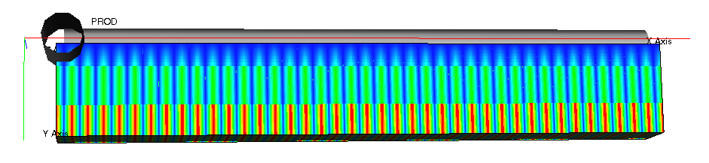
Underlying Physics – Reservoir Model (Gridding)
Reservoir Parameters
grid dimension | 1720 | 23 | 1
reservoir dimension | 2000 ft | 300 ft | 200 ft
single fracture dimension | 0.01 ft | hf 150ft | 200ft
permeability of fracture | 1000 md
permeability of matrix | 100 nd
fracture half length | 150ft
¼ of the real reservoir
40 half fractures
Log grid refinement
P_{i}= 6000psi; P_{b}= 5000 psi
Notes:
For a real reservoir, it has 20 fracturing stages and 4 fractures for each stage. So there are totally 80 fractures.
The simulation model used in this study represents ¼ of the real reservoir, so there are 40 half fractures intersecting with the horizontal wellbore
Log grid refinement is applied around the fractures and wellbore
Initial pressure = 6000psi; Bubble Point pressure = 5000 psi

Slide 5
Underlying Physics – Reservoir Model (PVT)

Slide 6
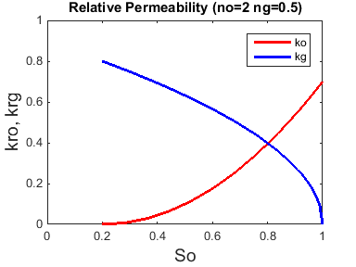
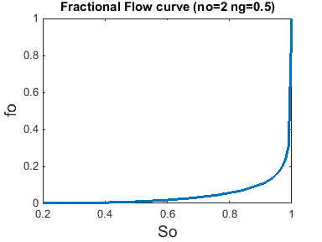
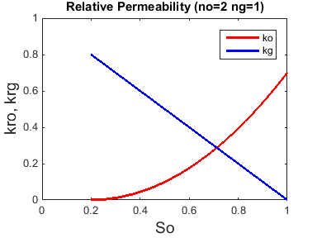
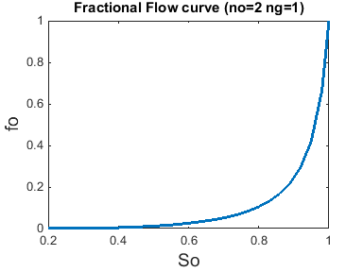
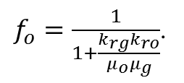
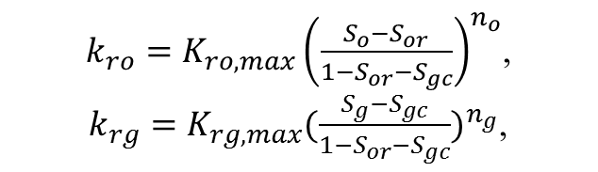
Underlying Physics – Reservoir Model (Relative Permeability)
Type A Curve,
Corey’s Model,
$k_{ro}=K_{ro,max}{\left(\frac{S_{o}−S_{or}}{1−S_{or}−S_{gc}}\right)}^{n_{o}}$,
$k_{rg}=K_{rg,max}{(\frac{S_{g}−S_{gc}}{1−S_{or}−S_{gc}})}^{n_{g}}$,
ng = 0.5
Generate Oil Flow Fraction,
$f_{o}=\frac{1}{1+\frac{k_{rg}k_{ro}}{μ_{o}μ_{g}}}$.
ng = 1
Notes:
We use corey’s model to generate four synthetic relative permeability curves. Basically, we altering to be 0.5, 1, 2, 4……
For ng = 0.5 and ng = 1 case, the fractional flow curve has a concave shape. It means that the derivative of the oil fraction function is monotonically increasing with the saturation. We call this type of fractional flow/relative permeability curve type A curve
For ng = 2 and ng =4 case, the fractional flow curve

Slide 7
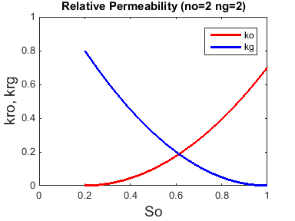
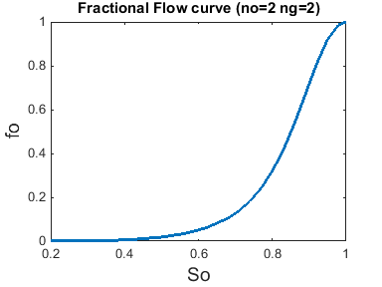
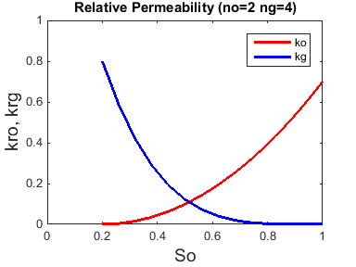
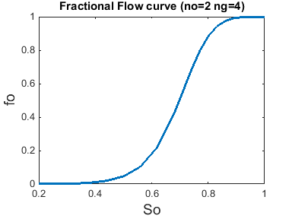
Underlying Physics – Reservoir Model (Relative Permeability)
Type B Curve,
Corey’s Model,
$k_{ro}=K_{ro,max}{\left(\frac{S_{o}−S_{or}}{1−S_{or}−S_{gc}}\right)}^{n_{o}}$,
$k_{rg}=K_{rg,max}{(\frac{S_{g}−S_{gc}}{1−S_{or}−S_{gc}})}^{n_{g}}$,
ng = 2
Generate Oil Flow Fraction,
$f_{o}=\frac{1}{1+\frac{k_{rg}k_{ro}}{μ_{o}μ_{g}}}$.
ng = 4
Notes:
For ng = 2 and ng =4 case, the derivative of the oil fraction function is no longer monotonic and the curve shows an S-shape. This type of curve is named Type B curvel.
The four different types relative permeability curves are very important to this study.
We’ll see different reservoir response pattern generated by these cases. Those difference are mostly influenced by the property of relative permeability.

Slide 8
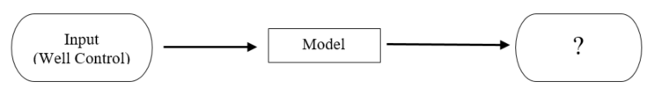
Underlying Physics – Wellhead OGR Response
Test 1
Test 2
B
B
A
A
ng = 0.5 and ng = 1 (type A): OGR drops when P_{b} is reached
ng = 2 and ng = 4 (type B): OGR rises and then drops
ng = 0.5 and ng = 1 (type A): OGR increase when BHP is kept constant
ng = 2 and ng = 4 (type B): OGR almost keeps constant when BHP holds
Notes:
As it was mentioned above the data-driven algorithm rely on the reservoir surface response to make decision. We made two tests to check how the reservoir response to different BHP control.
Reservoir response we studied here is the OGR. OGR – production oil – gas ratio. We didn’t use the more commonly used gas oil ratio, because the OGR is more intuitive in the context of the algorithm and it will be easy to interpret. An extra thing we should pay attention is that the increase of OGR implys that more proportion of oil coming out from the wellhead which is what we would like to see
Let’s focus on the test 1 first. The BHP is controlled to drop 6000 psi all the way to 1000 psi.
For ng = 0.5 and ng = 1 cases or type A cases, the OGR will decline immediately once the bubble point pressure is reached.
For ng = 2 and ng = 4 cases or type B cases, the OGR will rise before it start to decline.
This observation is important that it tell us that we can use the OGR response at the Bubble Point to distinguish type A reservoir from type B reservoir.
Now let’s take a look at the second test. The BHP is controlled to drop first and then suddenly hold. Before the pressure hold, the reservoir responses are the same as the first test. When the pressure starts to hold, the OGR will slight increase for type A cases and remain constant for type B cases.
To sum up, the test 1 provides significant insight into the reservoir fluid properties. The second test tells us that by holding BHP, the surface OGR will increase for type A reservoir which would probably benefit the final NPV.
But, why the reservoirs response distinctly and why the OGR increases for type A reservoir?

Slide 9
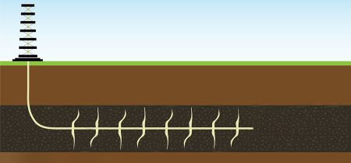
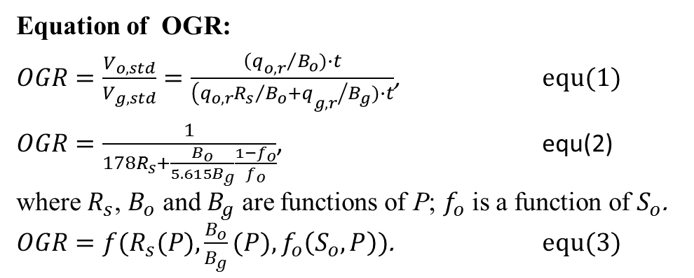
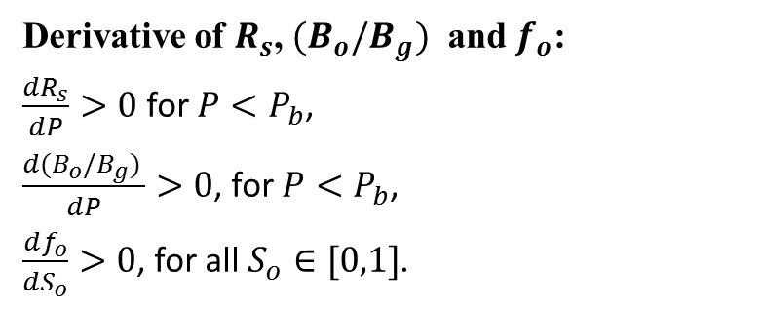
Underlying Physics – OGR vs Underground Variables(Pressure and Saturation)
Equation of OGR:
$OGR=\frac{V_{o,std}}{V_{g,std}}=\frac{{{\left(q\right.}_{o,r}}/{B_{o}})∙t}{{{\left(q_{o,r}{R_{s}}/{B_{o}}+q\right.}_{g,r}}/{B_{g}})∙t}$, equ(1)
$OGR=\frac{1}{178R_{s}+\frac{B_{o}}{5.615B_{g}}\frac{1−f_{o}}{f_{o}}}$, equ(2)
where $R_{s}$, $B_{o}$ and $B_{g}$ are functions of P; $f_{o}$ is a function of $S_{o}$.
$OGR=f(R_{s}(P),\frac{B_{o}}{B_{g}}(P),f_{o}\left(S_{o},P\right))$. equ(3)
OGR
P S_{o}
Derivative of $R_{s}$, $(B_{o}/B_{g})$ and $f_{o}$:
$\frac{dR_{s}}{dP}>0$ for $P<P_{b}$,
$\frac{d(B_{o}/B_{g}) }{dP}>0$, for $P<P_{b}$,
$\frac{df_{o}}{dS_{o}}>0$, for all $S_{o}∈[0,1]$.
Retrieved from http://www.j1soilandgas.com/environmental.php
Notes:
In order to understand the underlying physics of the OGR response, OGR is written as a function of underground variables. We are trying to relate surface with the underground.
OGR can be written as a function of solution gas oil ratio (Rs), oil formation volume factor Bo, gas formation volume factor Bg and oil flow fraction fo.
where $R_{s}$, $B_{o}$ and $B_{g}$ are monotonic increasing functions of P; $f_{o}$ is a monotonic increasing function of $S_{o}$ when $P<P_{b}$.

Slide 10
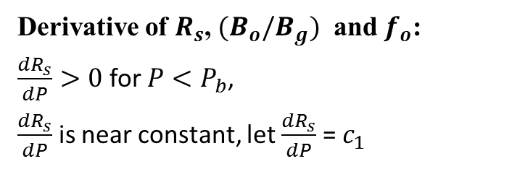

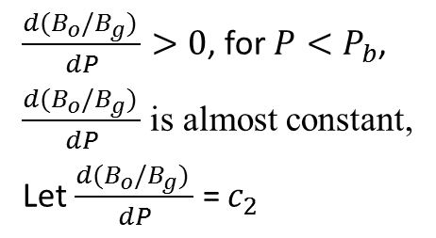
Underlying Physics – OGR vs Underground State variable
Derivative of $R_{s}$, $(B_{o}/B_{g})$ and $f_{o}$:
$\frac{dR_{s}}{dP}>0$ for $P<P_{b}$,
$\frac{dR_{s}}{dP}$ is near constant, let $\frac{dR_{s}}{dP}$ = $c_{1}$
$\frac{d(B_{o}/B_{g}) }{dP}>0$, for $P<P_{b}$,
$\frac{d(B_{o}/B_{g}) }{dP}$ is almost constant,
Let $\frac{d(B_{o}/B_{g}) }{dP}$ = $c_{2}$
$\frac{df_{o}}{dS_{o}}>0$, for all $S_{o}∈[0,1]$.
Notes:
When it is below the bubble point pressure ,the Rs is a increasing function of P. Derivative of Rs wrt P is always greater than zero.
It is also true of Bo/Bg.
And since we don’t consider the effect of capillary pressure and gravity on the fractional flow curve in this study, the fo is a monotonic increasing function of saturation.

Slide 11
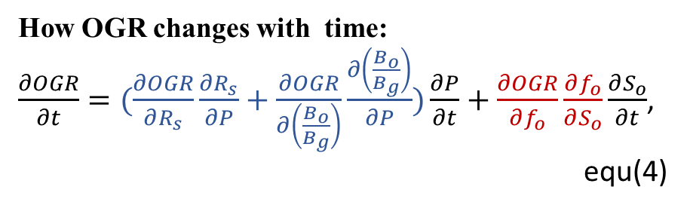
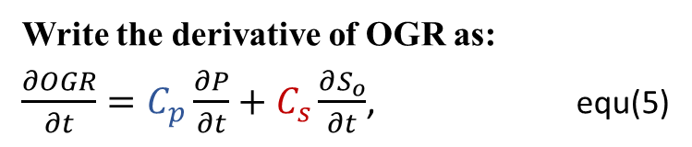
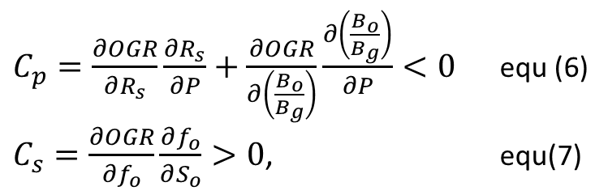
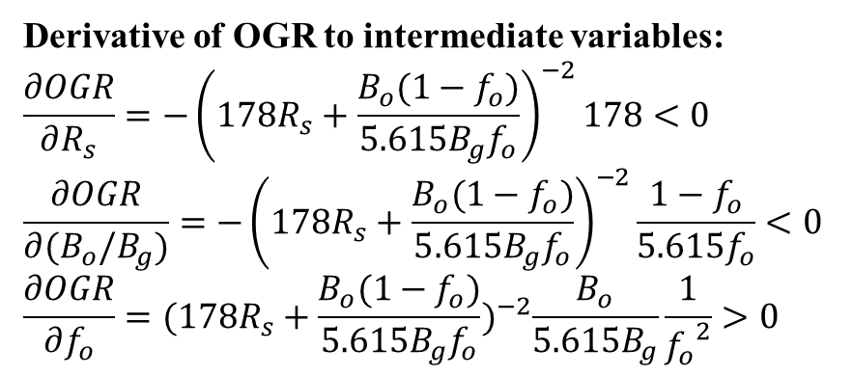
Underlying Physics – OGR vs Underground State variable
Write the derivative of OGR as:
$\frac{∂OGR}{∂t}=C_{p}\frac{∂P}{∂t}+C_{s}\frac{∂S_{o}}{∂t}$, equ(5)
How OGR changes with time:
$\frac{∂OGR}{∂t}=(\frac{∂OGR}{∂R_{s}}\frac{∂R_{s}}{∂P}+\frac{∂OGR}{∂\left(\frac{B_{o}}{B_{g}}\right)}\frac{∂\left(\frac{B_{o}}{B_{g}}\right)}{∂P})\frac{∂P}{∂t}+\frac{∂OGR}{∂f_{o}}\frac{∂f_{o}}{∂S_{o}}\frac{∂S_{o}}{∂t}$,
equ(4)
$C_{p}=\frac{∂OGR}{∂R_{s}}\frac{∂R_{s}}{∂P}+\frac{∂OGR}{∂\left(\frac{B_{o}}{B_{g}}\right)}\frac{∂\left(\frac{B_{o}}{B_{g}}\right)}{∂P}<0$ equ (6)
$C_{s}=\frac{∂OGR}{∂f_{o}}\frac{∂f_{o}}{∂S_{o}}>0$, equ(7)
Derivative of OGR to intermediate variables:
$$\frac{∂OGR}{∂R_{s}}=−{\left(178R_{s}+\frac{B_{o}(1−f_{o})}{5.615B_{g}f_{o}}\right)}^{−2}178<0$$
$$\frac{∂OGR}{∂(B_{o}/B_{g})}={−\left(178R_{s}+\frac{B_{o}(1−f_{o})}{5.615B_{g}f_{o}}\right)}^{−2}\frac{1−f_{o}}{{5.615f}_{o}}<0$$
$$\frac{∂OGR}{∂f_{o}}={({178R}_{s}+\frac{B_{o}(1−f_{o})}{{5.615B_{g}f}_{o}})}^{−2}\frac{B_{o}}{5.615B_{g}}\frac{1}{{f_{o}}^{2}}>0$$
Conclusion:
BHP negatively correlate to OGR
Saturation positively correlate to the OGR
Notes:
So in order to study the OGR change, we write down the full derivative of the OGR w.r.t time which is given by equ (4)
Note that GOR is function of Rs, Bo/Bg and fo, and these three intermediate variables are functions of pressure or saturation.
So finally we can divide the OGR derivative into a pressure contribution part (which is the first term here) and a saturation contribution part (which is the second term here).
Equ(4) can be simplified as equ(5) where Cp denotes “pressure contribution rate” which means the OGR variation per unit pressure change and Cs represents “saturation contribution rate”
And Cp and Cs can be written as equ(6) and equ(7)

Slide 12
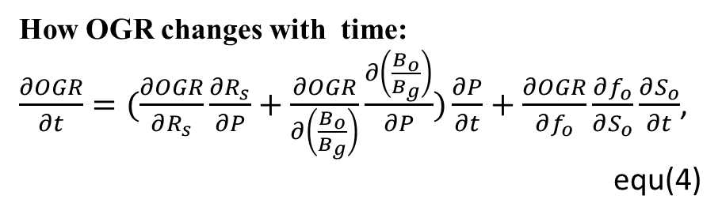
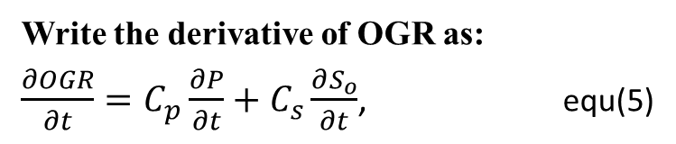
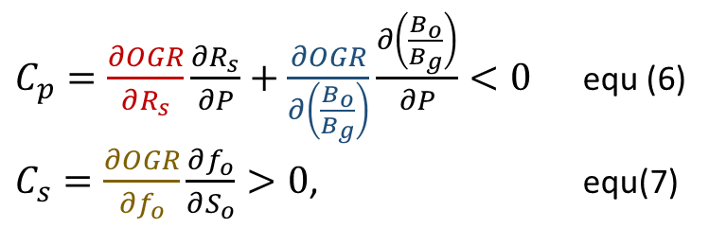
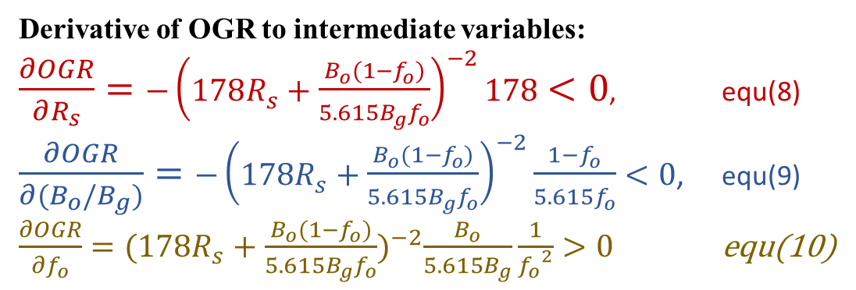
Underlying Physics – OGR vs Underground State variable
Write the derivative of OGR as:
$\frac{∂OGR}{∂t}=C_{p}\frac{∂P}{∂t}+C_{s}\frac{∂S_{o}}{∂t}$, equ(5)
How OGR changes with time:
$\frac{∂OGR}{∂t}=(\frac{∂OGR}{∂R_{s}}\frac{∂R_{s}}{∂P}+\frac{∂OGR}{∂\left(\frac{B_{o}}{B_{g}}\right)}\frac{∂\left(\frac{B_{o}}{B_{g}}\right)}{∂P})\frac{∂P}{∂t}+\frac{∂OGR}{∂f_{o}}\frac{∂f_{o}}{∂S_{o}}\frac{∂S_{o}}{∂t}$,
equ(4)
$C_{p}=\frac{∂OGR}{∂R_{s}}\frac{∂R_{s}}{∂P}+\frac{∂OGR}{∂\left(\frac{B_{o}}{B_{g}}\right)}\frac{∂\left(\frac{B_{o}}{B_{g}}\right)}{∂P}<0$ equ (6)
$C_{s}=\frac{∂OGR}{∂f_{o}}\frac{∂f_{o}}{∂S_{o}}>0$, equ(7)
Derivative of OGR to intermediate variables:
$\frac{∂OGR}{∂R_{s}}=−{\left(178R_{s}+\frac{B_{o}(1−f_{o})}{5.615B_{g}f_{o}}\right)}^{−2}178<0$, equ(8)
$\frac{∂OGR}{∂(B_{o}/B_{g})}={−\left(178R_{s}+\frac{B_{o}(1−f_{o})}{5.615B_{g}f_{o}}\right)}^{−2}\frac{1−f_{o}}{{5.615f}_{o}}<0$, equ(9)
$\frac{∂OGR}{∂f_{o}}={({178R}_{s}+\frac{B_{o}(1−f_{o})}{{5.615B_{g}f}_{o}})}^{−2}\frac{B_{o}}{5.615B_{g}}\frac{1}{{f_{o}}^{2}}>0$ equ(10)
Conclusion:
BHP negatively correlate to OGR
Saturation positively correlate to the OGR

Slide 13


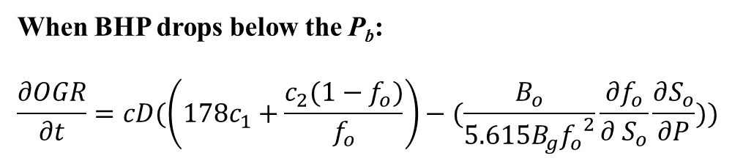
Underlying Physics – OGR vs Underground State variable
When BHP drops below the P_{b}:
$$\frac{∂OGR}{∂t}=cD(\left({178c}_{1}+\frac{c_{2}(1−f_{o})}{f_{o}}\right)−(\frac{B_{o}}{{5.615B}_{g}{f_{o}}^{2}}\frac{∂f_{o}}{∂ S_{o}}\frac{∂S_{o}}{∂P}))$$
Test 1
${(178c}_{1}+\frac{c_{2}(1−f_{o})}{f_{o}})$: pressure contribution
$(\frac{B_{o}}{{5.615B}_{g}{f_{o}}^{2}}\frac{∂f_{o}}{∂ S_{o}}\frac{∂S_{o}}{∂P})$: saturation contribution
Notes:
For ng = 0.5 case, the derivative of fo is extremely large at the beginning. Subsequently the So contribution term will be very large and gives out a negative OGR response. A more physical explanation is that as pressure goes below bubble point, the saturation will decrease and a slight reduction on oil saturation will significantly undermine the oil mobility.
On the other hand, for ng = 4 case, the derivative of fo is almost 0 at the beginning. So pressure contribution will dominate and a positive OGR response is expected.

Slide 14
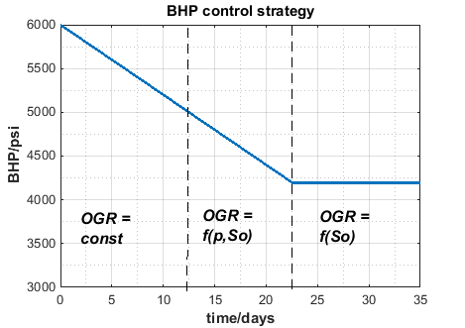
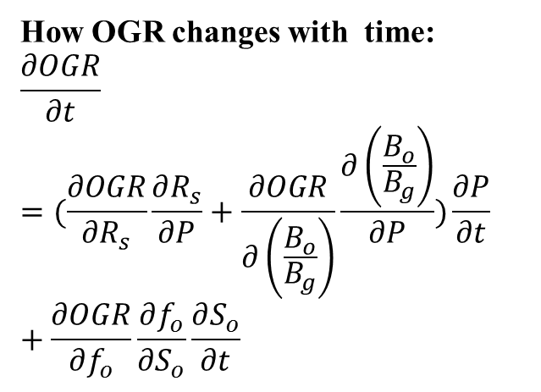
Underlying Physics – OGR vs Underground State variable
How OGR changes with time:
$$\frac{∂OGR}{∂t}=(\frac{∂OGR}{∂R_{s}}\frac{∂R_{s}}{∂P}+\frac{∂OGR}{∂\left(\frac{B_{o}}{B_{g}}\right)}\frac{∂\left(\frac{B_{o}}{B_{g}}\right)}{∂P})\frac{∂P}{∂t}+\frac{∂OGR}{∂f_{o}}\frac{∂f_{o}}{∂S_{o}}\frac{∂S_{o}}{∂t}$$
Above the P_{b}:
The OGR is constant
BHP drops below the P_{b}:
The OGR variation is influenced by P and S_{o} contributions
BHP holds below the P_{b}:
The OGR only depends on S_{o}, and S_{o} contribute positively to the OGR
Notes:
Let’s check the OGR relates to pressure and saturation for different production stages.
Well, above the bubble point pressure, the OGR is almost constant because no gas is coming out from the liquid and So remain to be unchanged. So this term … And Rs and Bo/Bg derivative are both very small. So this term…
The BHP drops below the bubble point, the OGR variation is the interaction of P and So contribution. The OGR variation depends on Cp and Cs as well as the Pressure and Saturation change rate
And finally, when the BHP holds below the Pb, this term… OGR will only determined by the saturation and the saturation contributes positively to the OGR.

Slide 15
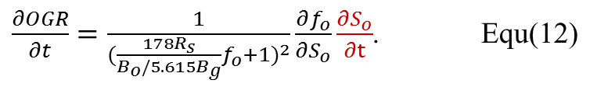
Underlying Physics – Saturation Build-up
Test 2
ng = 0.5 and ng = 1 (type A): OGR increase when BHP is kept constant
ng = 2 and ng = 4 (type B): OGR almost keeps constant when BHP holds
$\frac{∂OGR}{∂t}=\frac{1}{{(\frac{178R_{s}}{B_{o}/5.615B_{g}}f_{o}+1)}^{2}}\frac{∂f_{o}}{∂S_{o}}\frac{∂S_{o}}{∂t}$. Equ(12)

Slide 16
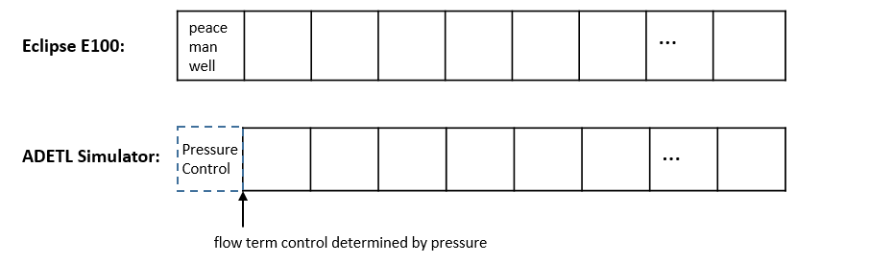
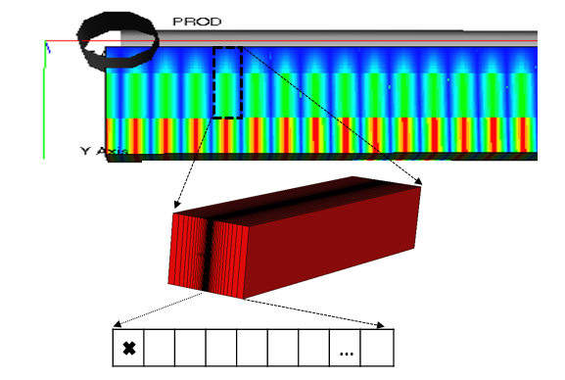
Underlying Physics – Saturation Build-up
Eclipse E100:
Peaceman well model which denote the effect of a well by a real block with sink
ADETL Simulator:
Pressure boundary model which characterize a infinite conductivity fracture.
Notes:
To study the OGR build up phenomenon for test 2, a 1D simplified model is built.
Two simulator are used to verify the results.
The first simulation tool applied is the Eclipse E100.
The second simulator is build upon the ADETL framework developed by Dr. Younis. #I modify the simulator and make it possible to apply the pressure control boundary condition.
So the difference between the two simulators is that the E100 implement Peaceman Model to characterize the effect of wells. Fracture is grid block with every large permeability. Pressure gradient is allowed within this block. On the other hand ADETL simulator represent the fracture by a boundary pressure control which is equivalent to a infinite conductivity fracture.

Slide 17
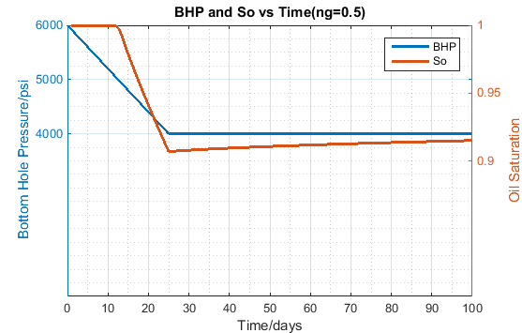
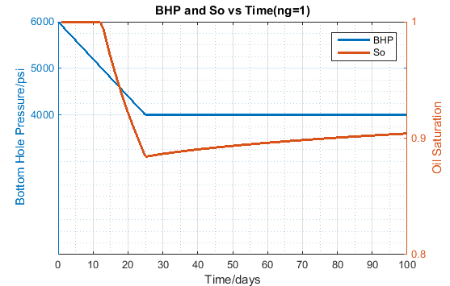
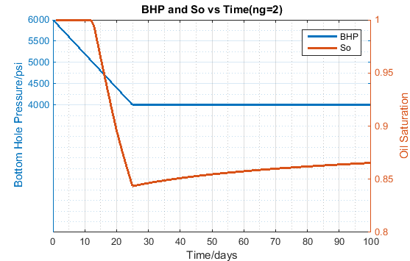
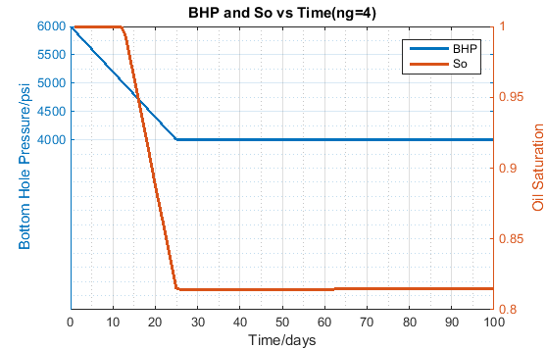
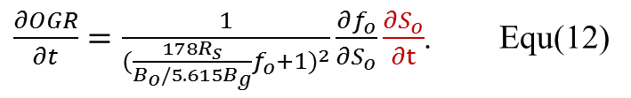
Underlying Physics – The Temporal Trend of Underground Saturation
$\frac{∂OGR}{∂t}=\frac{1}{{(\frac{178R_{s}}{B_{o}/5.615B_{g}}f_{o}+1)}^{2}}\frac{∂f_{o}}{∂S_{o}}\frac{∂S_{o}}{∂t}$. Equ(12)
S_{o} drops simultaneously with the pressure when the BHP below P_{b}
S_{o} builds up the pressure holds for all cases except ng = 4
Notes:
To study temporal trend of the underground saturation, simulations are run on the model that the BHP is scheduled to drop and hold at 4000 psi.
First, we see that as the pressure drops, the So will drops simultaneously. Which proves our previous assumption.
Another very important observation is that as the pressure holds, So will start to increase except for ng =4 case.
That gives a good explanation for the results of test 2. The equ(12) gives the relation between OGR response and saturation when the pressure is kept constant

Slide 18
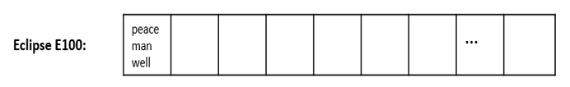

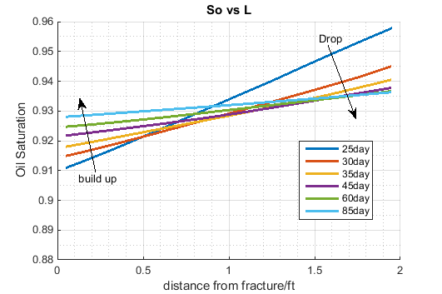
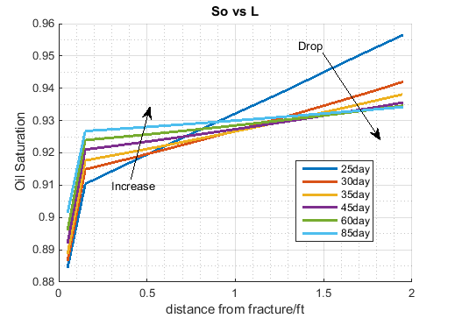
Underlying Physics – Saturation Build-up
The BHP starts to be held at 25th day.
The saturation build up within a small proximity to the fracture and decrease for the grids far away from the fracture
Notes:
We got the saturation profile for BHP hold period from both simulators.
Note that the BHP is held at 25th day. Both results show that the saturation goes up as the BHP holds. Which is consistent with our previous observation. However, this build-up only happened within a small proximity to the fracture. The saturation of the grids far away from the fracture will continue to decrease even the BHP stop dropping.
The saturation build-up will have a positive influence to the surface OGR, but what is the physics behind this build-up phenomenon

Slide 19
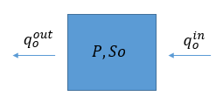
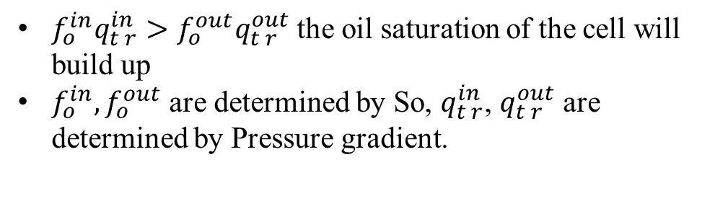
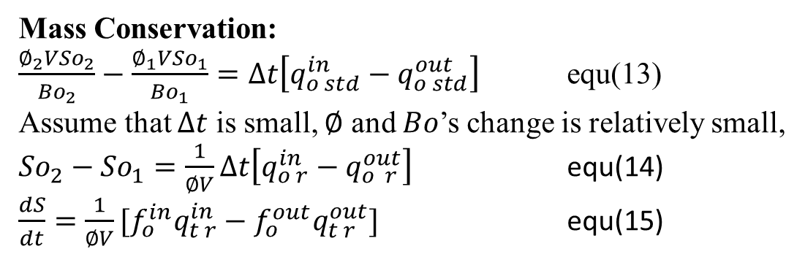
Underlying Physics – Saturation Build-up
Mass Conservation:
$\frac{∅_{2}{VSo}_{2}}{{Bo}_{2}}−\frac{∅_{1}{VSo}_{1}}{{Bo}_{1}}=∆t\left[q_{o std}^{in}−q_{o std}^{out}\right]$ equ(13)
Assume that $∆t$ is small, $∅$ and $Bo$’s change is relatively small,
${So}_{2}−{So}_{1}=\frac{1}{∅V}∆t\left[q_{o r}^{in}−q_{o r}^{out}\right]$ equ(14)
$\frac{dS}{dt}=\frac{1}{∅V}[{f_{o}^{in}q}_{t r}^{in}−f_{o}^{out}q_{t r}^{out}]$ equ(15)
${f_{o}^{in}q}_{t r}^{in}>f_{o}^{out}q_{t r}^{out}$ the oil saturation of the cell will build up
$f_{o}^{in}{,f}_{o}^{out}$ are determined by So, $q_{t r}^{in}$, $q_{t r}^{out}$ are determined by Pressure gradient.
Notes:
A 1D one-cell analysis is carried out to explain the build-up. The one-cell mass conservation can be written in the form of equ(12).
Derive from the one-cell mass conservation and ignore the minor effect of rock and fluid compressibility, we can finally get equ(14).
It shows that the saturation change of cell is determined by fo and qt flow at the inlet and outlet face. If ${f_{o}^{in}q}_{t r}^{in}>f_{o}^{out}q_{t r}^{out}$, the So of the cell will build up.
Well here, the $f_{o}^{}$ is determined by the So and qt depends on the pressure gradient.
If we could get the profile for fo and pressure gradient, we may figure why the saturation will build up.
Explanation on one-cell model

Slide 20
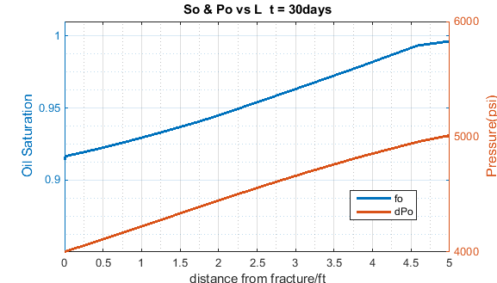
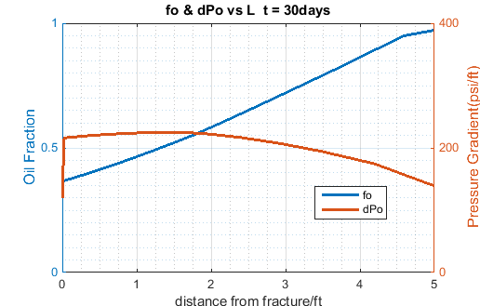
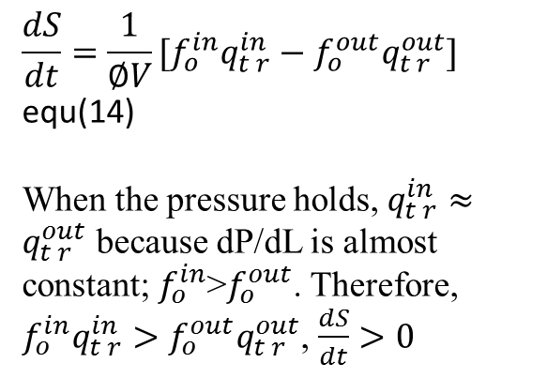
Underlying Physics – Saturation Build-up
After Pressure hold
Profile of S_{o} and P
Profile of f_{o} and Pressure gradient
$$\frac{dS}{dt}=\frac{1}{∅V}[{f_{o}^{in}q}_{t r}^{in}−f_{o}^{out}q_{t r}^{out}]$$
equ(14)
When the pressure holds, $q_{t r}^{in}≈q_{t r}^{out}$ because dP/dL is almost constant; $f_{o}^{in}$>$f_{o}^{out}$. Therefore, ${f_{o}^{in}q}_{t r}^{in}>f_{o}^{out}q_{t r}^{out}$, $\frac{dS}{dt}>0$
outlet
inlet

Slide 21
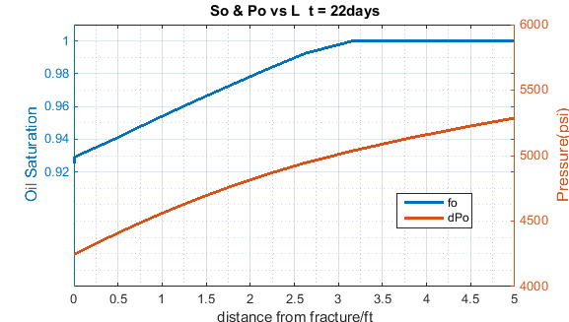
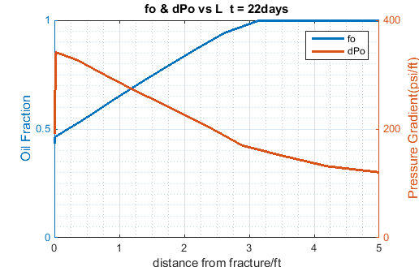
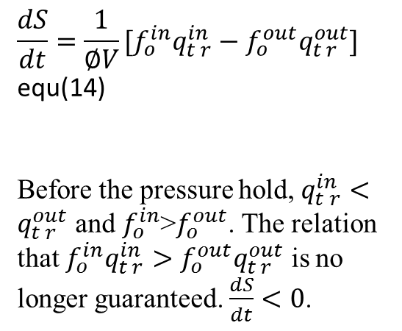
Underlying Physics – Saturation Build-up
Before Pressure hold
Profile of S_{o} and P
Profile of f_{o} and Pressure gradient
$$\frac{dS}{dt}=\frac{1}{∅V}[{f_{o}^{in}q}_{t r}^{in}−f_{o}^{out}q_{t r}^{out}]$$
equ(14)
Before the pressure hold, $q_{t r}^{in}<q_{t r}^{out}$ and $f_{o}^{in}$>$f_{o}^{out}$. The relation that ${f_{o}^{in}q}_{t r}^{in}>f_{o}^{out}q_{t r}^{out}$ is no longer guaranteed. $\frac{dS}{dt}<0$.
outlet
inlet

Slide 22
Underlying Physics – Conclusion
1. P, S_{o} vs time
(1) When the BHP drops below P_{b}, the oil saturation decreases simultaneously with the pressure. (2) When the BHP is kept constant after a dramatic drawdown, the saturation of hydraulic fracture, as well as its proximity, will build up.
2. OGR vs P, S_{o}
The wellhead OGR response is a combination of both pressure and saturation contributions. When the BHP drops below the P_{b} and the if oil flow fraction is sensitive to the saturation, the contribution of saturation will dominate. Otherwise, pressure contribution will dominate.

Slide 23
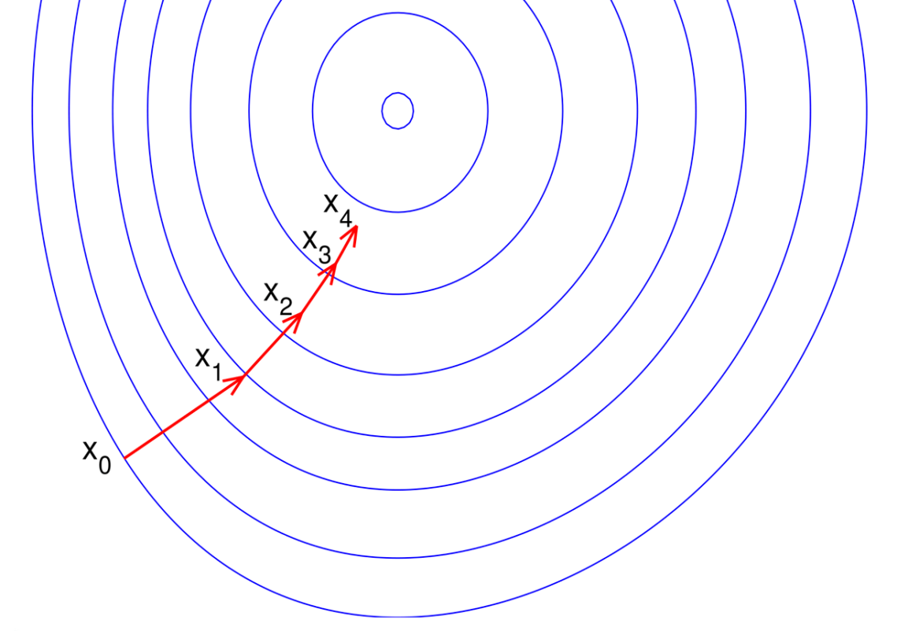
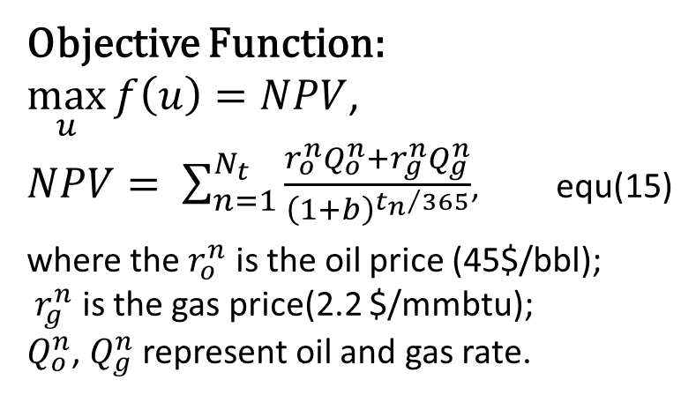

Computational Optimization – Introduction on the Algorithm
Objective Function:
$\max_{u}{f\left(u\right)}=NPV$,
$NPV= \sum_{n=1}^{N_{t}}{\frac{r_{o}^{n}Q_{o}^{n}+r_{g}^{n}Q_{g}^{n}}{{\left(1+b\right)}^{{t_{n}}/{365}}}}$, equ(15)
where the $r_{o}^{n}$ is the oil price (45$/bbl);
$r_{g}^{n}$ is the gas price(2.2 $/mmbtu);
$Q_{o}^{n}$, $Q_{g}^{n}$ represent oil and gas rate.
Steepest Ascend Algorithm
$$x^{k+1}=x^{k}+α_{k}\frac{d_{k}}{{\left\|d_{k}\right\|}_{∞}}$$
$$d_{k}=∇\hat{f}$$
Optimization solution is used in two ways:
compare it with the greedy method to explore the potential of the reservoir
compare it with the data-driven solution to evaluate the algorithm
Notes:
As was mentioned above, the optimization algorithm is to approach an optimal well control step by step in a variable space.
The obj is NPV which is given by equ15. Ro is … Rg is …
In this study, we will utilize the optimization solution in ways
1 . First, compare it with the greedy method to explore the potential of the reservoir
2. Second, compare it with the data-driven solution to evaluate the algorithm

Slide 24


Computational Optimization – Solution and Comparison
ng = 0.5
“hold period”: the period that BHP drops very slowly at the beginning of production.
BHP drop slow down when S_{o} in the strong response zone and accelerate when S_{o} is in the weak response zone
Slowing down the BHP drop helps improve final NPV
$\frac{∂OGR}{∂t}=\frac{1}{{(\frac{178R_{s}}{B_{o}/5.615B_{g}}f_{o}+1)}^{2}}\frac{∂f_{o}}{∂S_{o}}\frac{∂S_{o}}{∂t}$.
Equ(16)
Notes:
The optimization choose to drop the BHP fast at the beginning and then suddenly slow down the pressure drop. And after about 100 day, drop the BHP will drop with a increasing rate again.
We make two definition here. First, we define the period that BHP drops very slowly at the beginning of the production as ‘hold period’. Second, we divide the fraction flow curve into two parts, a strong response part where the curve is very steep and a weak response part where the curve is less steep. While within the strong response part, the OGR is sensitive to the saturation change. However, when it is in the weak response zone, the saturation will not have much influence on the OGR
When the reservoir is operating in the hold period, the oil saturation is within the strong response part. Within this region, fo derivative is very large. Slowing down the pressure drop and subsequent So decline will slow the OGR decrease significantly.
And as the production continues, the saturation will go into the weak response part. Now the slowing down the pressure drop becomes meaningless.
So two conclusion can be made: 1. optimization well control pattern shows that …
2. second, the slowing down the BHP drop helps improve the final NPV
Here, Strategy 1 means the greedy method.
More proportion of oil will flow to the surface.

Slide 25


Computational Optimization – Solution and Comparison
ng = 1
BHP drop faster in hold period because weaker strong response zone
Hold period lasts longer because wider strong response zone
$\frac{∂OGR}{∂t}=\frac{1}{{(\frac{178R_{s}}{B_{o}/5.615B_{g}}f_{o}+1)}^{2}}\frac{∂f_{o}}{∂S_{o}}\frac{∂S_{o}}{∂t}$.
Notes:
For ng = 1 case, we will also observe a ‘hold period’.
But the BHP drops faster compared with the last case. It is because the strong response part is not as strong as the previous case. I mean the curve is less steep. Therefore the saturation decrease will have less severe negative influence to the OGR.
The ‘hold period’ also last longer because the strong response zone is wider. It takes more time for saturation to fall into the weak response part.
For this case ,the optimization solution increase the final NPV by 15%.

Slide 26

Computational Optimization – Solution and Comparison
ng = 2
BHP drops lower before the hold period starts
Less improvement on final NPV
$\frac{∂OGR}{∂t}=\frac{1}{{(\frac{178R_{s}}{B_{o}/5.615B_{g}}f_{o}+1)}^{2}}\frac{∂f_{o}}{∂S_{o}}\frac{∂S_{o}}{∂t}$.
Notes:
For ng = 2 case, the BHP drops much lower before the hold period starts. Well, this is because there is a weak response part at the leftmost part of the fractional flow curve.
Slowing pressure drop at this region will not slow down the decrease of the OGR. So the algorithm choose to skip this weak response part.
Also we see there is less improvement on the NPV compared with previous cases.

Slide 27

Computational Optimization – Solution and Comparison
ng = 4
Optimized solution is the same as Strategy1 (greedy method)
No hold period because of the leftmost very wide weak response zone
No improvement on NPV
$\frac{∂OGR}{∂t}=\frac{1}{{(\frac{178R_{s}}{B_{o}/5.615B_{g}}f_{o}+1)}^{2}}\frac{∂f_{o}}{∂S_{o}}\frac{∂S_{o}}{∂t}$.
Notes:
For the last case, the optimization solution overlap with the Strategy 1. We observe no hold period in this solution.
Well this is reasonable because the weak response is too wide to pass through.
And obviously, no improvement is made in this case.

Slide 28
Computational Optimization – Conclusions
ng = 2 and ng =4 (type B) cases have little space to improve, greedy method is already a very good solution
For ng = 0.5 and ng =1 (type A) cases, slowing down pressure drop will benefit final NPV(cumulative oil production)
Notes:
So based on the comparison of the four cases, we could conclude that
First,

Slide 29

Data-Driven Algorithm – The Algorithm
Step 1: Classify reservoirs into type A reservoirs and type A reservoirs
Use OGR response at BHP=P_{b} to infer reservoir fluid properties
Apply greedy well control for type B reservoir
Step 2:Apply drop-hold-cycles(DHCs) on type A reservoir
Retrieve reservoir information by keeping BHP constant
Get the response rate of the DHC and determine next step well control (either do another DHC or terminate DHC and drops BHP with a reduce rate)
Type A? Type B?
Average OGR response
Average OGR response
Average OGR response
Notes:
For type B reservoir, we know from the previous study that the greedy method is good enough
For type A reservoir, dropping BHP too fast may undermine the productivity
A basic idea here is to first distinguish reservoir B from reservoir A. If it is reservoir B, just ….
Second to carry out a pressure drop and hold alternatively to “slowing down’ the pressure drop.

Slide 30


Data-Driven Algorithm – The Algorithm
Algorithm
Drop the pressure to $P_{b}$ with maximum pressure drop rate (MPDR)
$N_{c}=0$
Try the first DHC, if $\frac{∂OGR}{∂t}>0$ at the start of the first DHC, which indicates it is a type B reservoir
Stop doing DHC and return Strategy 1(Greedy way);
Else,
DO
DHC
$N_{c}++$
Compute response rate for hold period
IF (response rate < minimum response rate)
Drop BHP to $P_{low}$ with slope MPDR/$N_{c}$
Break the loop
ENDDO
ENDIF
The maximum pressure drop rate (MPDR)
The minimum response rate (MRR)
The Drop Interval (d)
The Hold-Drop-Ratio (r)
Notes:
MPDR (set to be 80 psi/day in this study) is usually limited by the capability of the bottom hole choke
while other three parameters depend mostly on human choice

Slide 31

Data-Driven Algorithm – The Algorithm
OGR response will damps
The DHC terminates as the response rate becomes smaller than a threshold value

Slide 32
Data-Driven Algorithm – The Solution
MPDR = 80psi/day, d = 5days, r = 16, MRR = 1e-4
ng = 0.5
Total Oil production rate
The algorithm run 2 DHCs before termination
The saturation dropped into the weak response region when the second DHC was carried out
The performance is as good as optimized well control
Notes:
the algorithm run 2 DHC before termination, which indicates that the response rate of the first hold period is strong, but decreased for the second DHC.
the saturation dropped into the weak response region when the second DHC was carried out

Slide 33
Data-Driven Algorithm – The Solution
MPDR = 80psi/day, d = 5days, r = 16, MRR = 1e-4
ng = 0.5
Oil production rate
The algorithm run 2 DHC before termination
The saturation dropped into the weak response region when the second DHC was carried out
The performance is as good as optimized well control
Notes:
the algorithm run 2 DHC before termination, which indicates that the response rate of the first hold period is strong, but decreased for the second DHC.
the saturation dropped into the weak response region when the second DHC was carried out

Slide 34
Data-Driven Algorithm – The Solution
MPDR = 80psi/day, d = 5days, r = 16, MRR = 1e-4
ng = 1
Total Oil production rate
It took more cycles for the saturation to fall into the weak response part
The performance is comparable to the optimized solution

Slide 35
Data-Driven Algorithm – Parameter Selection (hold-drop-ratio)
ng = 1; r = 4,16 or 32
The value of hold-drop-ratio (r) determines the ‘average drop rate’ of the DHC period
Choice of r is a trade off between performance and risk
Reservoir with narrower and steeper strong response zone.
Notes:
A larger r indicates a smaller average drop rate since more proportion of time is applied to hold the pressure, and it can be risky because longer hold time wastes the opportunity to increase drawdown for better productivity.

Slide 36
Data-Driven Algorithm – Parameter Selection
ng = 1; r=16; d = 3 or 5
The value of drop interval (d) determines the frequency to retrieve information from the reservoir
The final production is not sensitive to the choice of d
The algorithm is stable, different parameter setting does not make much difference
Notes:
An important aspect is that different parameter setting for the algorithm did not make very big difference regarding final NPVs. This implies that the algorithm performance is quite stable, and few efforts are required to take on the parameter selection. For all cases we have tested, parameter setting in Section 4.2 (r = 16 and d = 5) is a desirable choice.

Slide 37
Conclusion
1. Type A reservoir vs Type B reservoir
The optimization results indicate that type A reservoir would benefit from slowing down pressure drop and type B reservoirs have limited room for improvement.
2. Data-driven solution vs Optimization solution
Based on simulation results, the proposed data-driven algorithm is capable of increasing the five-year Oil production for type A reservoirs by up to 35% and guaranteeing a optimal/near-optinal solution for type B reservoirs

Slide 38
Recommendation
Apply Strategy 1(Greedy method)
Apply Strategy DHCs:
Start DHCs: record OGR data and bootstrap multiple ensembles of the OGR data; make sure the data is collected as (t, OGR) pairs;
Fit lines for each ensemble and treat the slope of each line as the samples of response rate;
Compute the 95% confidence interval for the response rate; If the lower bound of the interval is greater than the minimum response rate, return to step 3 and keep doing DHC. Otherwise, terminate the DHCs.

Slide 39





Recommendation
Sets of ensemble Data
Ensembles Generating Process:
Full Data

Slide 40
A Data-driven Optimal Production Control Strategy for Unconventional Reservoir
Yuchen Zhang
Notes:
Thanks for coming here to listening my presentation. Today, the topic that I gonna present is …..
Acknowlege

Slide 41



Underlying Physics – OGR vs Underground State variable
Test 1
When BHP drops below the P_{b} (treat S_{o} as a dependent of P):
$\frac{∂OGR}{∂t}=\frac{∂P}{∂t}{\left(178R_{s}+\frac{B_{o}(1−f_{o})}{{5.615B}_{g}f_{o}}\right)}^{−2}$ $(\frac{B_{o}}{{5.615B}_{g}{f_{o}}^{2}}\frac{∂f_{o}}{∂ S_{o}}\frac{∂S_{o}}{∂P}−$ $\left({178c}_{1}+\frac{c_{2}(1−f_{o})}{f_{o}}\right))$ equ(11)
${178c}_{1}+\frac{c_{2}(1−f_{o})}{f_{o}}$: pressure contribution term
$\frac{B_{o}}{{5.615B}_{g}{f_{o}}^{2}}\frac{∂f_{o}}{∂ S_{o}}\frac{∂S_{o}}{∂P}$ : saturation contribution term
Since $\frac{∂P}{∂t}$ <0, the OGR increases if ${178c}_{1}+\frac{c_{2}(1−f_{o})}{f_{o}}>\frac{B_{o}}{{5.615B}_{g}{f_{o}}^{2}}\frac{∂f_{o}}{∂ S_{o}}\frac{∂S_{o}}{∂P}$ (the pressure contribution dominate)
The shapes of fractional flow curve makes difference, more specifically, $\frac{{df}_{o}}{dS_{o}}$ at $S_{o}=1$ determines $\frac{∂OGR}{∂t}$ at the bubble point.
Notes:
Now let’s try to explain the observation of the test 1. In this part, we assume that the saturation is a dependent of pressure and as the pressure drops below bubble point, we asume saturation will drops simultaneously with pressure.
Subtitling all derivative of intermediate variables into the equation of OGR derivative, we get equ(11)
As it was concluded above that when pressure drops below the Pb, the OGR is the interaction of P contribution and So contribution. Group up this part, we can consider it as a pressure contribution term.
And first part can be treated as the saturation contribution term.
So if >, then OGR increases. But why only ng=2 and ng =4 cases have this the OGR increase at the Pb.
It is because their fractional flow curves have different shapes. It will influence the value of the saturation contribution term. Here is a example,

Slide 42
Computational Optimization – Solution and Comparison
ng = 0.5
“hold period”: the period that BHP drops very slowly at the beginning of production.
BHP drop slow down when S_{o} in the strong response zone and accelerate when S_{o} is in the weak response zone
Slowing down the BHP drop helps improve final NPV
$\frac{∂OGR}{∂t}=\frac{1}{{(\frac{178R_{s}}{B_{o}/5.615B_{g}}f_{o}+1)}^{2}}\frac{∂f_{o}}{∂S_{o}}\frac{∂S_{o}}{∂t}$.
Equ(16)
Notes:
The optimization choose to drop the BHP fast at the beginning and then suddenly slow down the pressure drop. And after about 100 day, drop the BHP will drop with a increasing rate again.
We make two definition here. First, we define the period that BHP drops very slowly at the beginning of the production as ‘hold period’. Second, we divide the fraction flow curve into two parts, a strong response part where the curve is very steep and a weak response part where the curve is less steep. While within the strong response part, the OGR is sensitive to the saturation change. However, when it is in the weak response zone, the saturation will not have much influence on the OGR
When the reservoir is operating in the hold period, the oil saturation is within the strong response part. Within this region, fo derivative is very large. Slowing down the pressure drop and subsequent So decline will slow the OGR decrease significantly.
And as the production continues, the saturation will go into the weak response part. Now the slowing down the pressure drop becomes meaningless.
So two conclusion can be made: 1. optimization well control pattern shows that …
2. second, the slowing down the BHP drop helps improve the final NPV
Here, Strategy 1 means the greedy method.
More proportion of oil will flow to the surface.

Slide 43
Computational Optimization – Solution and Comparison
ng = 1
BHP drop faster in hold period because weaker strong response zone
Hold period lasts longer because wider strong response zone
$\frac{∂OGR}{∂t}=\frac{1}{{(\frac{178R_{s}}{B_{o}/5.615B_{g}}f_{o}+1)}^{2}}\frac{∂f_{o}}{∂S_{o}}\frac{∂S_{o}}{∂t}$.
Notes:
For ng = 1 case, we will also observe a ‘hold period’.
But the BHP drops faster compared with the last case. It is because the strong response part is not as strong as the previous case. I mean the curve is less steep. Therefore the saturation decrease will have less severe negative influence to the OGR.
The ‘hold period’ also last longer because the strong response zone is wider. It takes more time for saturation to fall into the weak response part.
For this case ,the optimization solution increase the final NPV by 15%.

Slide 44
Computational Optimization – Solution and Comparison
ng = 2
BHP drops lower before the hold period starts
Less improvement on final NPV
$\frac{∂OGR}{∂t}=\frac{1}{{(\frac{178R_{s}}{B_{o}/5.615B_{g}}f_{o}+1)}^{2}}\frac{∂f_{o}}{∂S_{o}}\frac{∂S_{o}}{∂t}$.
Notes:
For ng = 2 case, the BHP drops much lower before the hold period starts. Well, this is because there is a weak response part at the leftmost part of the fractional flow curve.
Slowing pressure drop at this region will not slow down the decrease of the OGR. So the algorithm choose to skip this weak response part.
Also we see there is less improvement on the NPV compared with previous cases.

Slide 45
Computational Optimization – Solution and Comparison
ng = 4
Optimized solution is the same as Strategy1 (greedy method)
No hold period because of the leftmost very wide weak response zone
No improvement on NPV
$\frac{∂OGR}{∂t}=\frac{1}{{(\frac{178R_{s}}{B_{o}/5.615B_{g}}f_{o}+1)}^{2}}\frac{∂f_{o}}{∂S_{o}}\frac{∂S_{o}}{∂t}$.
Notes:
For the last case, the optimization solution overlap with the Strategy 1. We observe no hold period in this solution.
Well this is reasonable because the weak response is too wide to pass through.
And obviously, no improvement is made in this case.

Slide 46
Data-Driven Algorithm – The Solution
ng = 0.5
MPDR = 80psi/day, d = 5days, r = 16, MRR = 1e-4
The algorithm run 2 DHC before termination
The saturation dropped into the weak response region when the second DHC was carried out
The performance is as good as optimized well control
Notes:
the algorithm run 2 DHC before termination, which indicates that the response rate of the first hold period is strong, but decreased for the second DHC.
the saturation dropped into the weak response region when the second DHC was carried out

Slide 47
Data-Driven Algorithm – The Solution
ng = 1
MPDR = 80psi/day, d = 5days, r = 16, MRR = 1e-4
It took more cycles for the saturation to fall into the weak response part
The performance is comparable to the optimized solution

Slide 48
Data-Driven Algorithm – Parameter Selection (hold-drop-ratio)
ng = 1, r = 4,16 or 32
The value of hold-drop-ratio (r) determines the ‘average drop rate’ of the DHC period
Choice of r is a trade off between performance and risk
Reservoir with narrower and steeper strong response zone.
Notes:
A larger r indicates a smaller average drop rate since more proportion of time is applied to hold the pressure, and it can be risky because longer hold time wastes the opportunity to increase drawdown for better productivity.

Slide 49
Data-Driven Algorithm – Parameter Selection
ng = 0.5, d = 3 or 5
The value of drop interval (d) determines the frequency to retrieve information from the reservoir
The final NPV is not sensitive to the choice of d
The algorithm is stable, different parameter setting does not make much difference
Notes:
An important aspect is that different parameter setting for the algorithm did not make very big difference regarding final NPVs. This implies that the algorithm performance is quite stable, and few efforts are required to take on the parameter selection. For all cases we have tested, parameter setting in Section 4.2 (r = 16 and d = 5) is a desirable choice.

