Slide 1
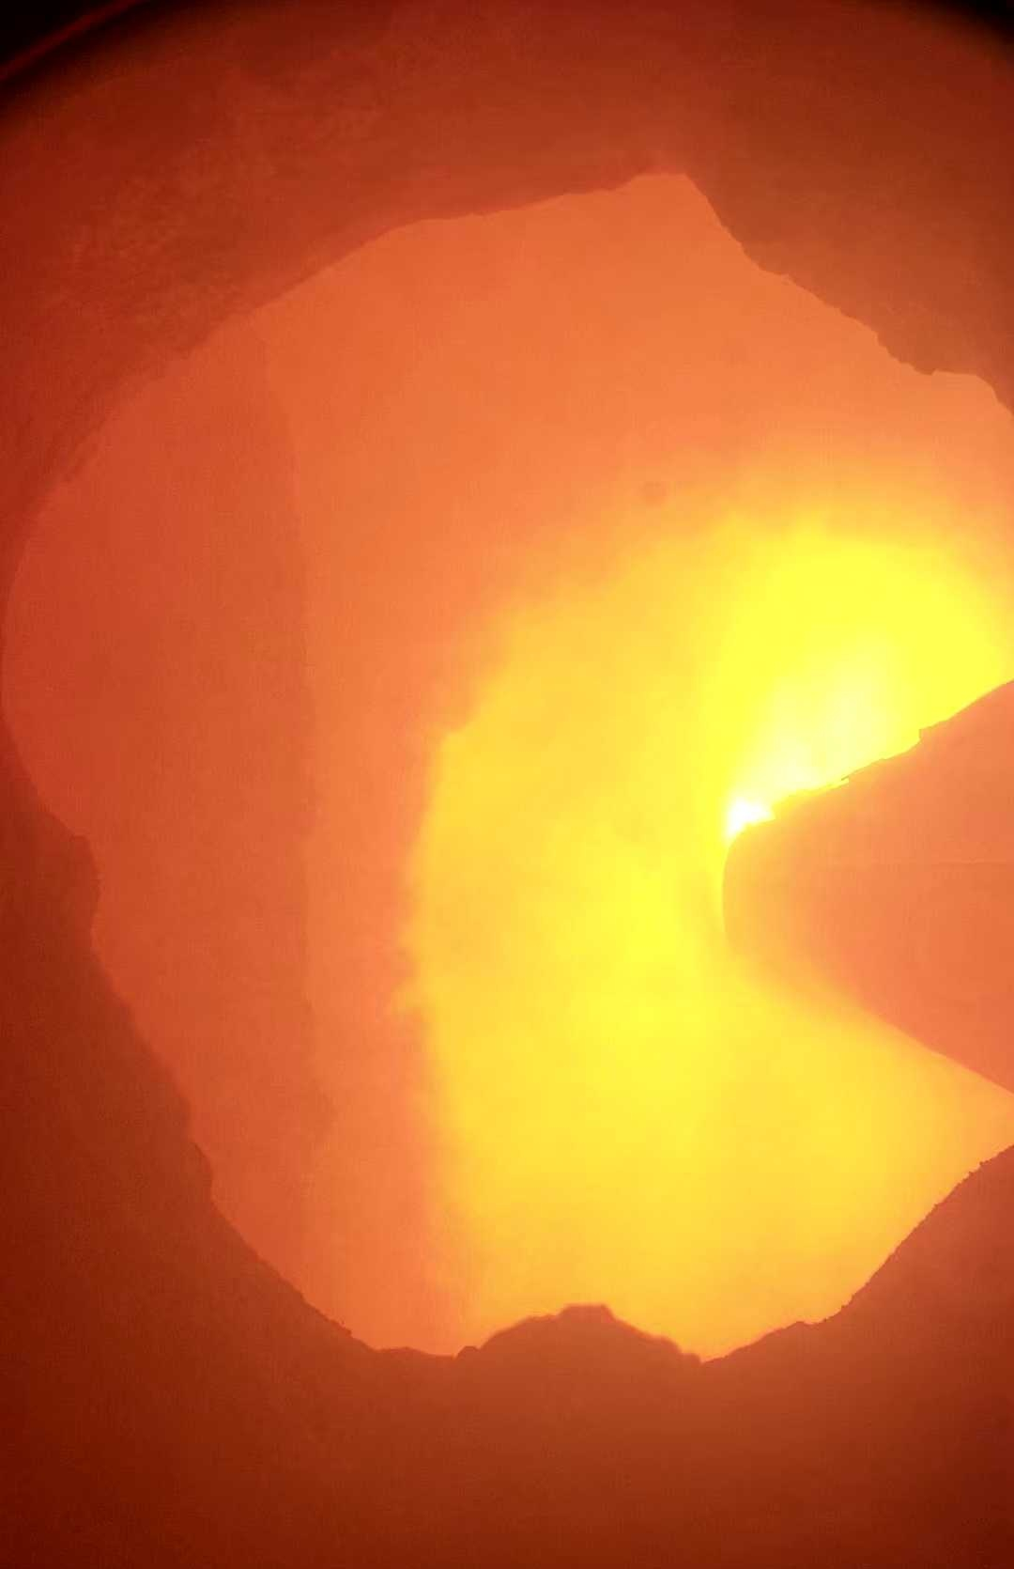



Expanded variable sequences
$$(L × N)$$
DCS database
Dynamic kiln model
X₁₁ | X₁₂ | X_{1m} | X_{1n}
X₂₁ | X₂₂ | X_{2m} | X_{2n}
X₃₁ | X₃₂ | X_{3m} | X_{3n}
X_{l1} | X_{l2} | X_{lm} | X_{ln}
Output f-CaO estimation
Variable classification
Real-time kiln modeling
Y
TSFE&F
network
I₁₁ | I₁₂ | I₁₃ | I_{1o}
I₂₁ | I₂₂ | I₂₃ | I_{2o}
I₃₁ | I₃₂ | I₃₃ | I_{3o}
I_{lo} | I_{lo} | I_{lo} | I_{lo}
Image database
Flame image sequences
$$(L × C × H × W)$$
3DCNN attention
ISFE network
Image feature sequences
$$(L × O)$$
End-to-end f-CaO content modeling

