Slide 1
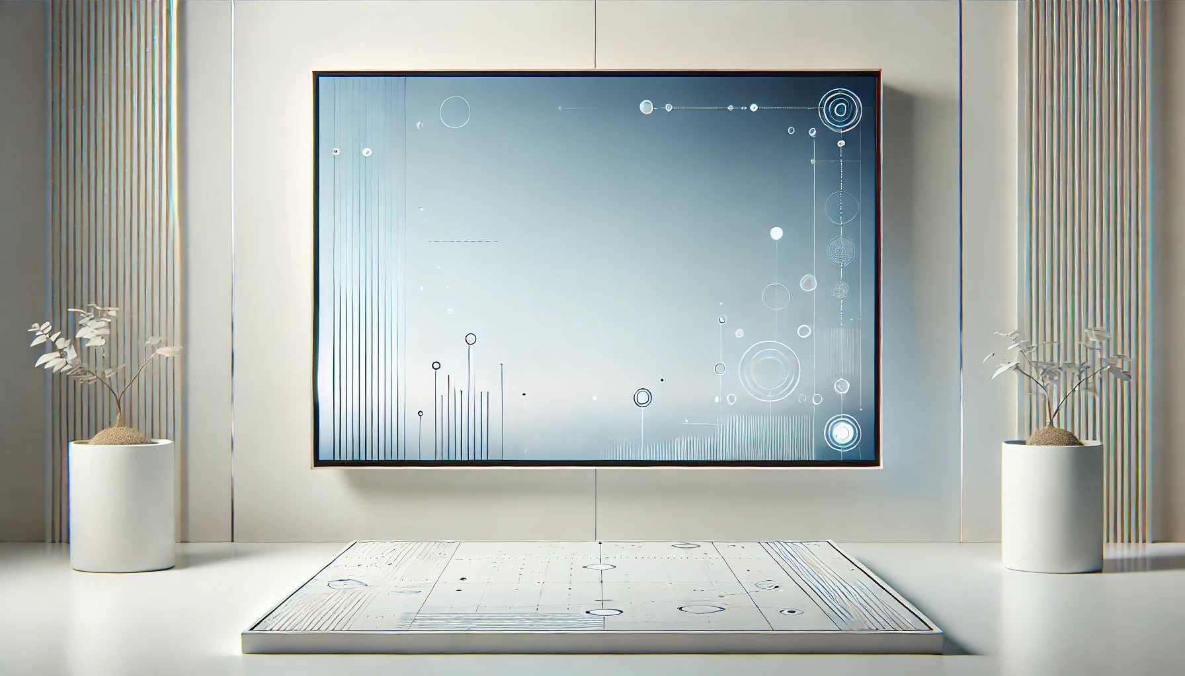
自我介紹
(NIZIMA LIVE)
Notes:
【Prompt】
A modern, minimalist interior scene with a large futuristic digital display on the wall. The display features abstract geometric shapes, circles, and thin lines, resembling a high-tech interface or data visualization. The room is sleek, with clean white walls and subtle vertical ridges on either side of the display. Two small white potted plants with delicate, minimalistic branches are placed symmetrically on both sides of the display. The setting has a calm, futuristic atmosphere with soft lighting that enhances the smooth textures and sharp lines, giving the space a clean, high-tech feel.
【Context】
今天來跟大家進行簡單的自我介紹

Slide 2
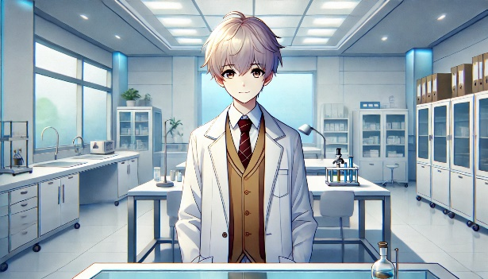
目 標
Notes:
【Prompt】
An anime-style young male scientist stands confidently in a bright, modern laboratory. He has short, light-colored hair and wears a white lab coat over a brown vest and tie, giving him a professional yet approachable appearance. The laboratory is spacious, filled with clean, white cabinets, shelves, and lab equipment like flasks and test tubes. Large windows on the left allow natural light to flood the room, while bright overhead lights create a well-lit working environment. The overall mood is one of calm focus and precision, with a sense of advanced research taking place.
【Context】
哈囉~我是小白，一名立志成為法醫的醫學院學生。我的綽號來自於我一頭白髮。

Slide 3
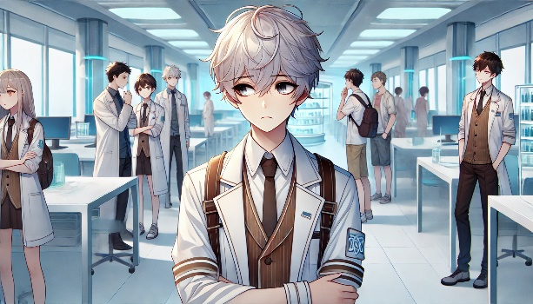
阻 礙
Notes:
【Prompt】
An anime-style scene set in a bustling, futuristic laboratory filled with young scientists and researchers. The main character, a young male with light gray hair, stands at the forefront with a serious or contemplative expression, arms crossed. He wears a white lab coat over a brown vest and tie, with a badge on his sleeve, suggesting his scientific role. Surrounding him are several other young researchers in lab coats, some engaged in conversation while others are working or observing. The laboratory is bright and modern, with sleek workstations, large windows letting in natural light, and advanced equipment in the background. The overall atmosphere reflects a collaborative, research-driven environment, with a mix of focus and casual interaction among the characters.
【Context】
雖然身高不高，常常被同學瞧不起，也沒有人願意和我一起進行實驗，但我從未放棄過我的夢想。

Slide 4
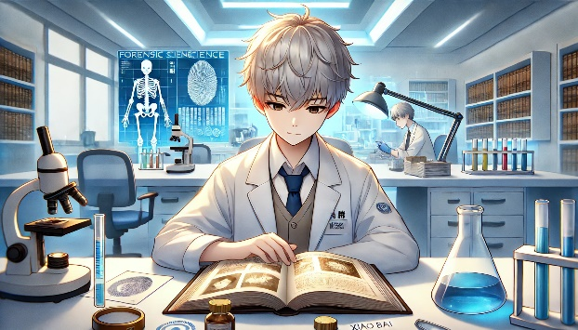
努 力
Notes:
【Prompt】
An anime-style scene set in a high-tech forensic science laboratory. The main character, a young male scientist with silver-gray hair, is deeply focused on studying a large, open book with fingerprint images. He wears a white lab coat, a vest, and a tie, giving him a professional appearance. Surrounding him are various lab tools, including a microscope, beakers filled with blue liquid, and scientific instruments. In the background, a large digital screen displays forensic science data, such as a skeleton and a fingerprint, contributing to the advanced and futuristic feel of the setting. Another scientist works in the background, adding to the sense of a busy, research-focused environment. The lighting is bright and cool, with shelves full of scientific books lining the walls, creating a serious and studious atmosphere.
【Context】
面對孤獨，我努力自學，研究各種書籍，甚至自己進行實驗。雖然這些努力並不容易，但我始終相信，知識是最強的武器。某天，我在實驗室裡發現了一個關鍵的線索，這個發現讓我倍感振奮。

Slide 5
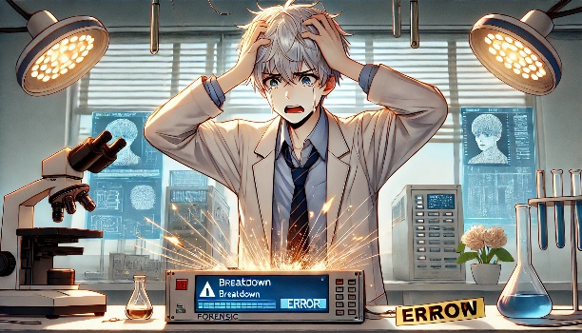
意 外
Notes:
【Prompt】
An anime-style scene featuring a young male scientist in a moment of panic inside a high-tech forensic laboratory. The character, with silver-gray hair and wearing a lab coat, is holding his head in distress as sparks fly from a malfunctioning machine in front of him. The device displays warning messages like 'Breakdown' and 'Error,' heightening the sense of urgency. Surrounding the character are various laboratory tools, including a microscope, flasks, and test tubes with blue liquid. Digital forensic displays in the background show detailed images of fingerprints and a facial profile, emphasizing the forensic science theme. The lighting is dramatic, with overhead lab lights shining on the chaotic scene, adding to the intense atmosphere of technological failure and the character's frustration.
【Context】
然而，意外發生了——我的實驗器材因故障而損壞，讓我一度絕望。

Slide 6
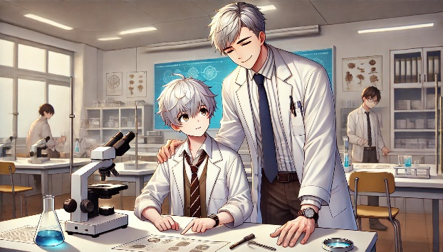
轉 彎
Notes:
【Prompt】
An anime-style scene set in a calm and professional science laboratory, featuring a warm interaction between a young male scientist and an older mentor figure. The younger character, seated at a lab desk with a microscope and research papers, has silver-gray hair and is dressed in a lab coat over a brown vest and tie. He looks up with admiration at the older man, who stands beside him with a gentle smile, placing a reassuring hand on the younger one's shoulder. The mentor, also dressed in a white lab coat with a tie, has gray hair and a warm, encouraging expression. In the background, other researchers are quietly working, and the room is filled with scientific equipment, charts, and beakers with blue liquid. The scene conveys a sense of mentorship, support, and collaboration in a peaceful academic environment.
【Context】
就在我考慮放棄的時候，我遇到了一位熱心的教授，他願意指導我，讓我重新燃起了希望。
透過他的幫助，我不僅修復了實驗器材，還將我的研究推向新的高峰。

Slide 7
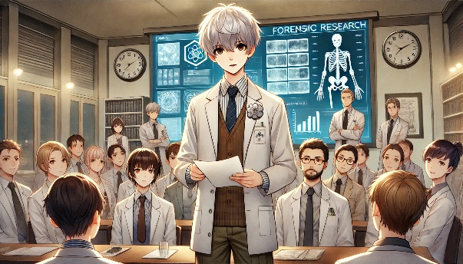
結 果
Notes:
【Prompt】
An anime-style scene in a formal forensic research presentation. A young male scientist with silver-gray hair stands at the center, holding a paper as he presents findings to a group of attentive colleagues. He is dressed in a white lab coat over a brown vest and tie, exuding professionalism. The audience, also wearing lab coats, listens carefully, with expressions of focus and interest. Behind the presenter, a large digital screen displays forensic research data, including images of a skeleton, fingerprints, and various scientific charts. The setting is a well-lit conference room or classroom, with a clock on the wall and shelves of books in the background. The atmosphere is serious and academic, with the young scientist confidently leading the discussion in front of his peers and seniors.
【Context】
最終，我成功地完成了一個重要的法醫案例，得到了同學們的認可。這讓我意識到，堅持和努力總會帶來意想不到的轉機。

Slide 8
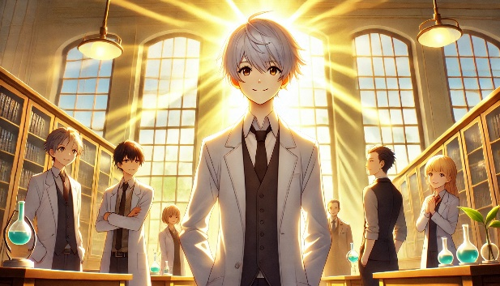
結 局
Notes:
【Prompt】
An anime-style scene set in a grand, well-lit laboratory with tall, arched windows that allow golden sunlight to stream into the room. The central character, a young male scientist with silver hair, stands confidently at the center, illuminated by the radiant sunlight behind him, creating a halo effect. He wears a white lab coat over a vest and tie, and smiles warmly, exuding leadership and optimism. Surrounding him are several other researchers, both male and female, also dressed in lab coats. They are positioned casually around the lab, some holding flasks with blue liquid, while others engage in quiet conversation. The scene captures a moment of camaraderie and success in a bright, inspiring environment, with the golden rays of sunlight symbolizing achievement and hope.
【Context】
現在，我的夢想依然在路上，未來還有更多的挑戰等著我，但我相信，勇敢追尋才能創造自己的故事。

