Slide 1
Presentation @ CEResearch Predicting Compound-Protein Interactions From Statistical Learning Perspective
PhD Candidate: Songpeng Zu
Bioinformatics Lab, Department of Automation
Tsinghua University
2015-12-03

Slide 2
Personal Information
PhD candidate on bioinformatics, Tsinghua University
Major on statistical learning
Bachelor : School of Life Science, Tsinghua University
Rotation:
Department of Statistics, Harvard, for half a year.
Intern:
real time CTR estimation, Big Data Lab (BDL), Baidu.
2015 National Scholarship for Graduate Students.

Slide 3
Content
Introduction on Compound-Protein Interactions (CPIs)
Prediction on CPIs from Statistical Learning.
Inference on the latent features from CPIs by EM algorithm
Quantitative prediction on CPIs by multi-task learning
Graph partition based prediction on CPIs
Summary

Slide 4
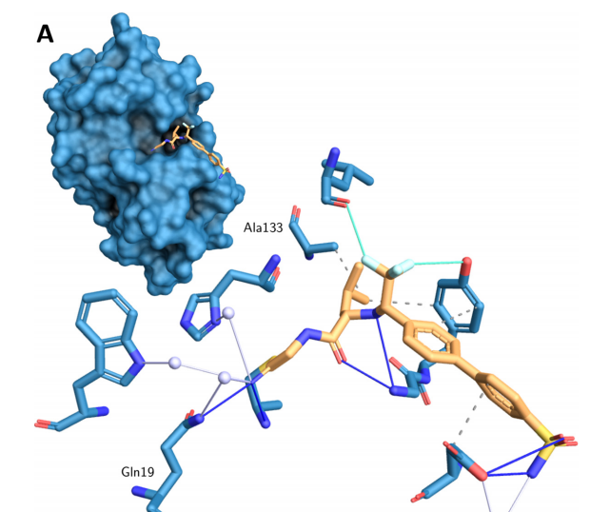
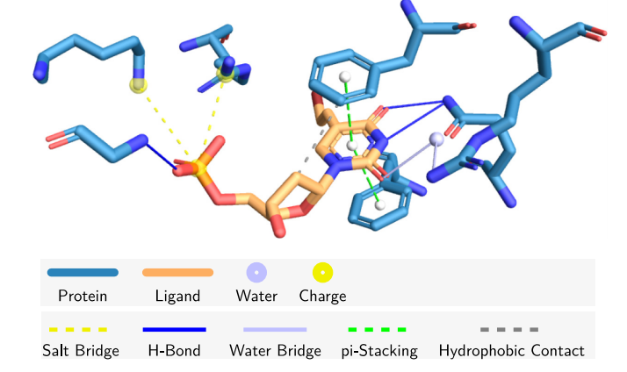
Compound-Protein Interactions
Interactions
Binding Modes
Protein
Compound
Amino Acid residues
How can we predict the interactions and binding modes ?
Salentin, S., et al., PLIP: fully automated protein–ligand interaction profiler. Nucleic Acids Res. 2015 43: W443-W447.

Slide 5
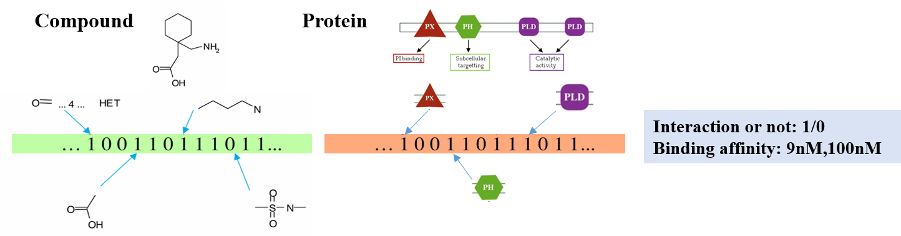
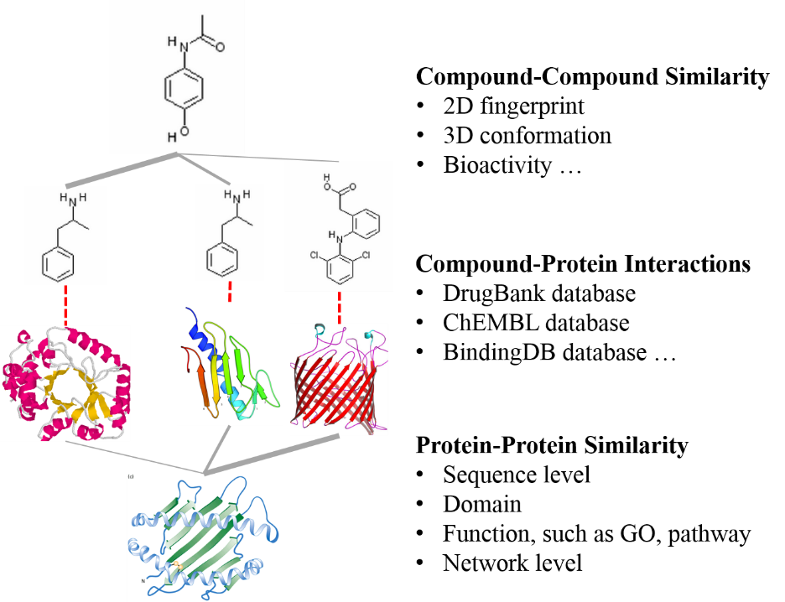
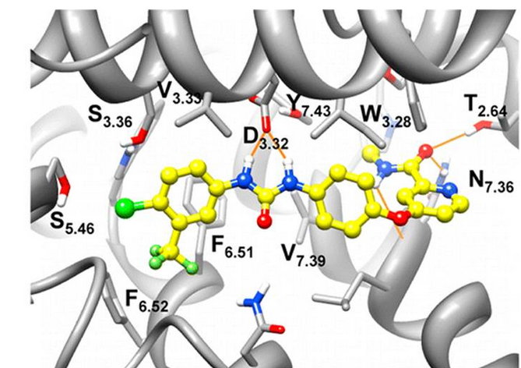
Statistical Modeling
Chemoinformatics
Similarity Network
Molecular Dynamics

Slide 6
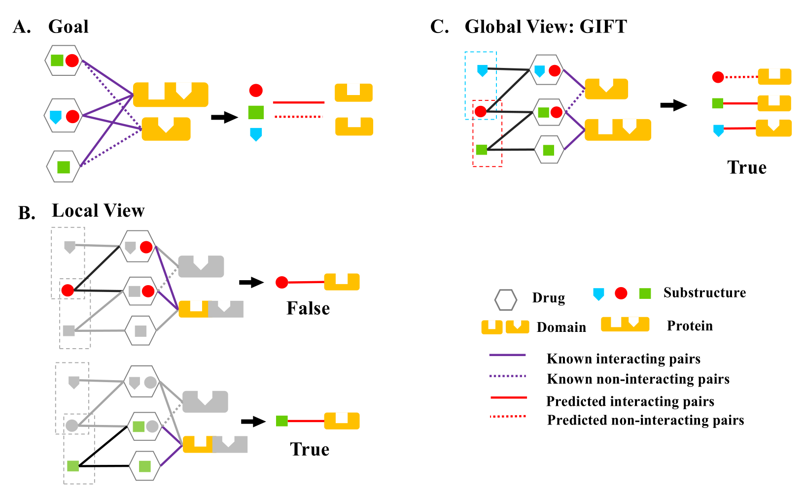
Inference on the latent features
Zu S., et al., Global optimization-based inference of chemogenomic features from drug–target interactions. Bioinformatics. 2015 31 (15): 2523-2529.

Slide 7
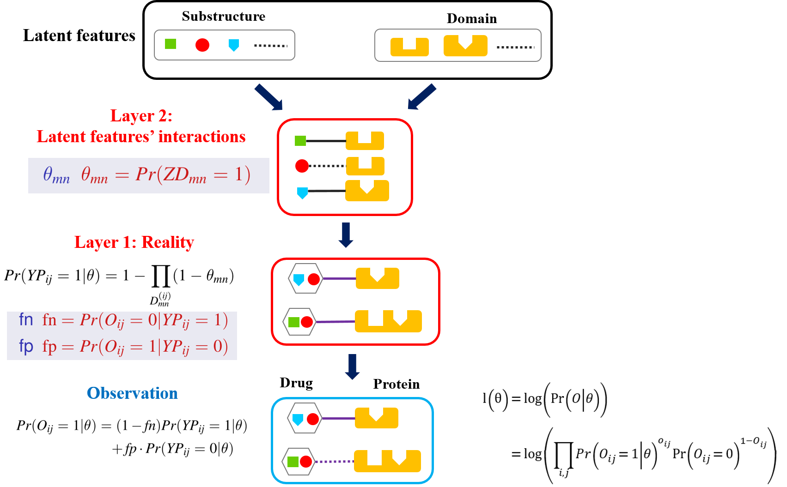
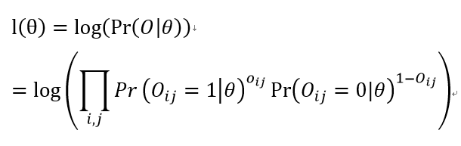
Statistical Modeling
Likelihood function

Slide 8
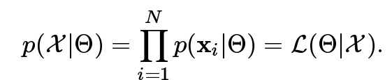
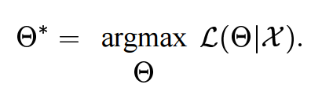
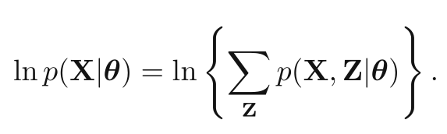
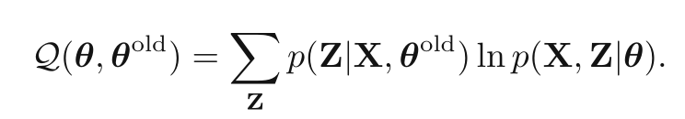
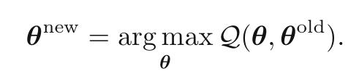
Appendix: EM algorithm
A powerful method to optimize the likelihood function by involving the latent variables (data augmentation).
Maximum Likelihood Estimation (MLE)
Involving the latent variables
EM algorithm

Slide 9

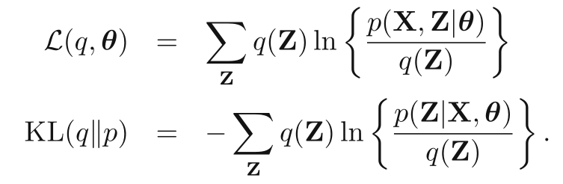
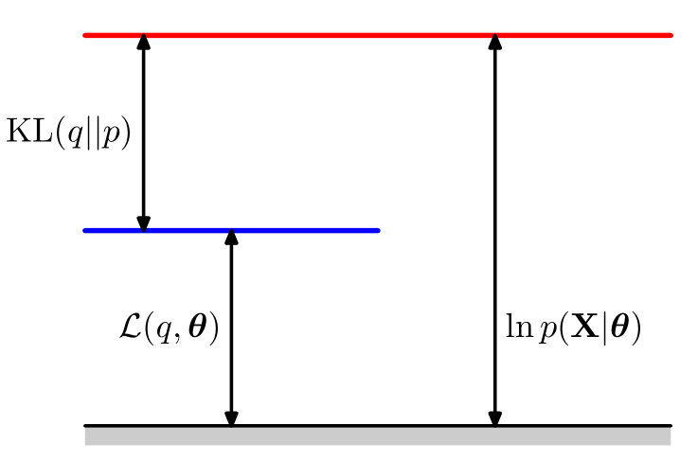
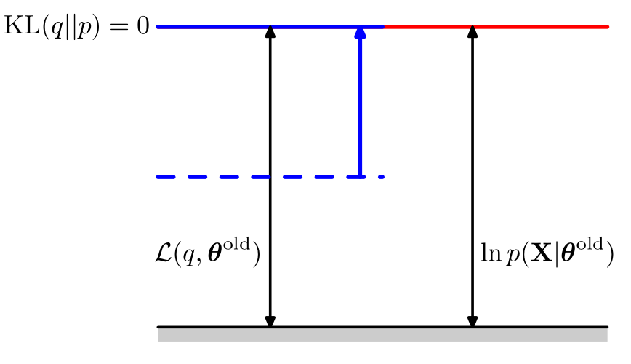
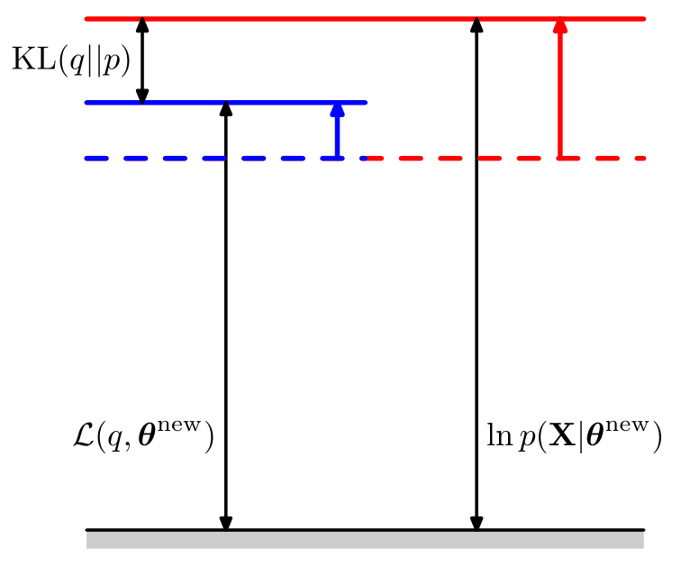
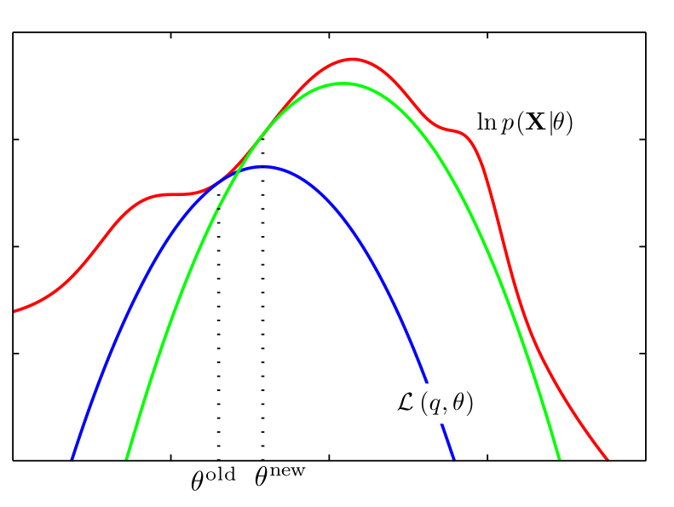
Appendix: Why EM algorithm works

Slide 10
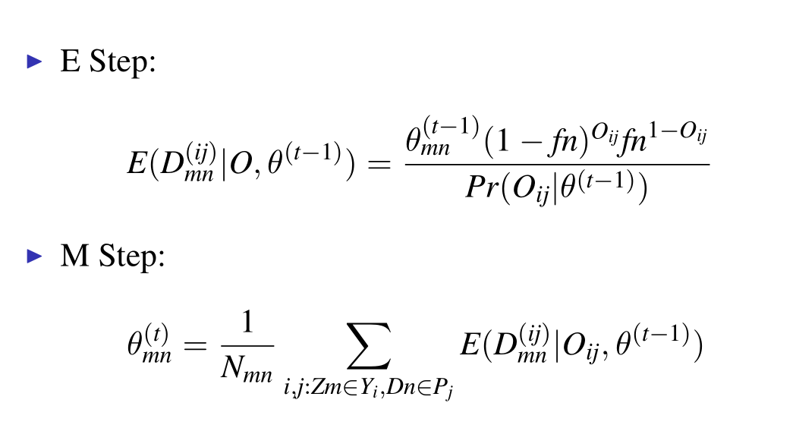
EM algorithm
Likelihood function
EM Algorithm

Slide 11
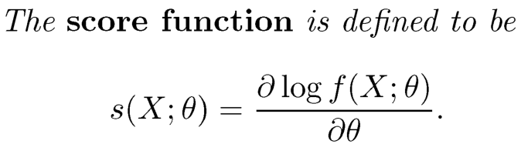
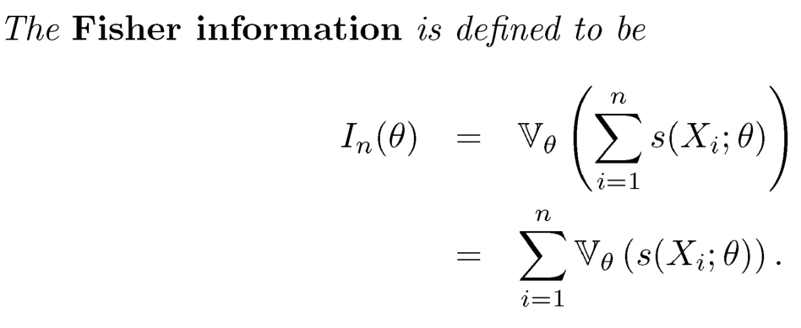
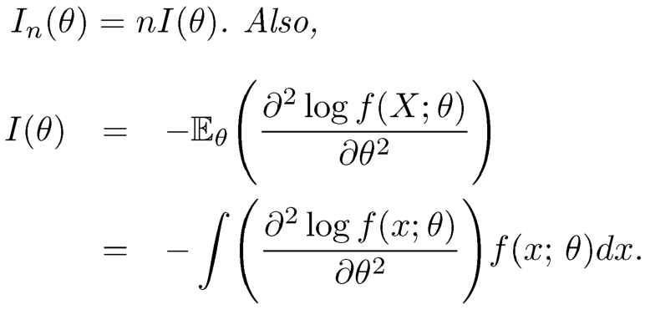

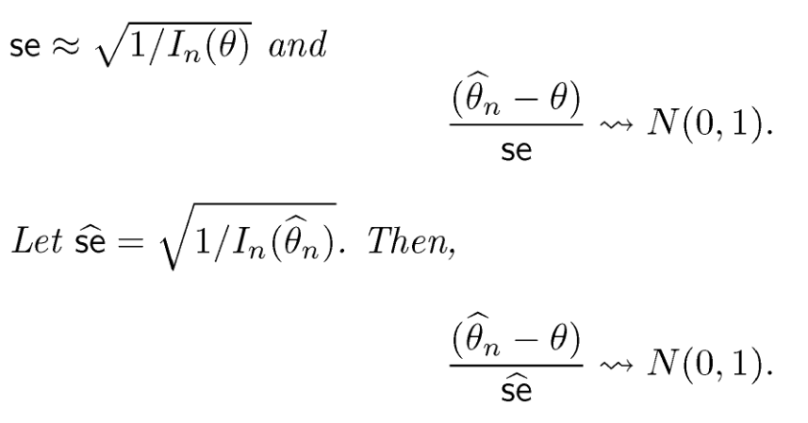
Appendix: Asymptotic Normality of the MLE

Slide 12

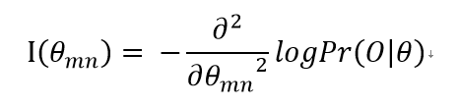
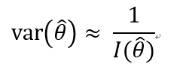
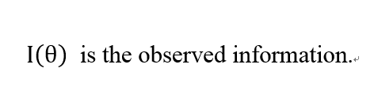
Variance Estimation
EM Algorithm
Variance Estimation
The C++ package can be found at https://github.com/songpeng/GIFT

Slide 13
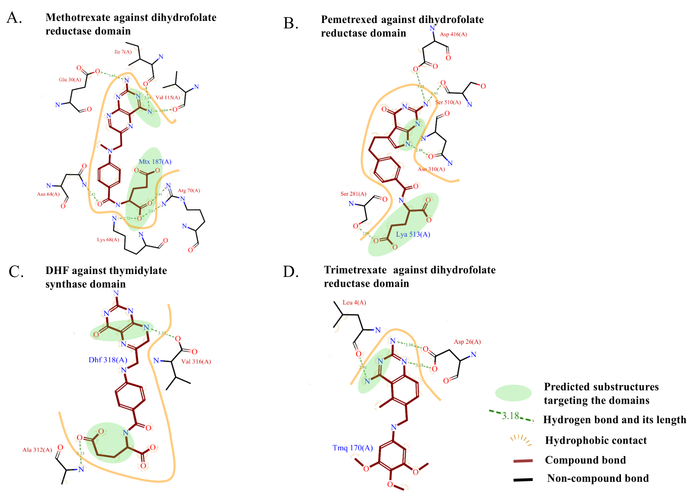
Results
Validated

Slide 14
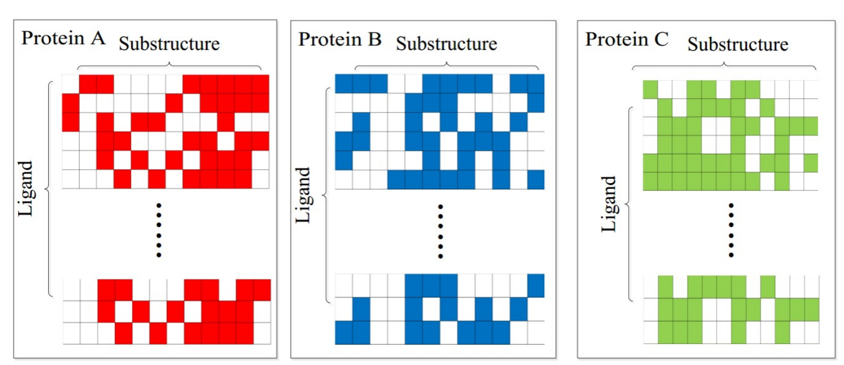
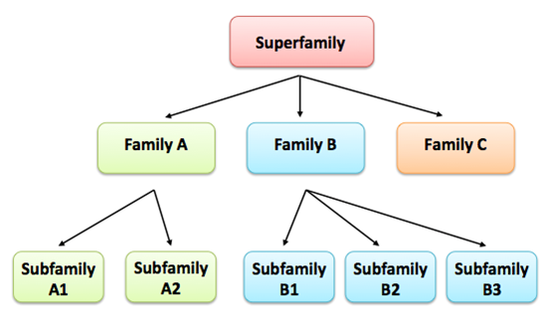
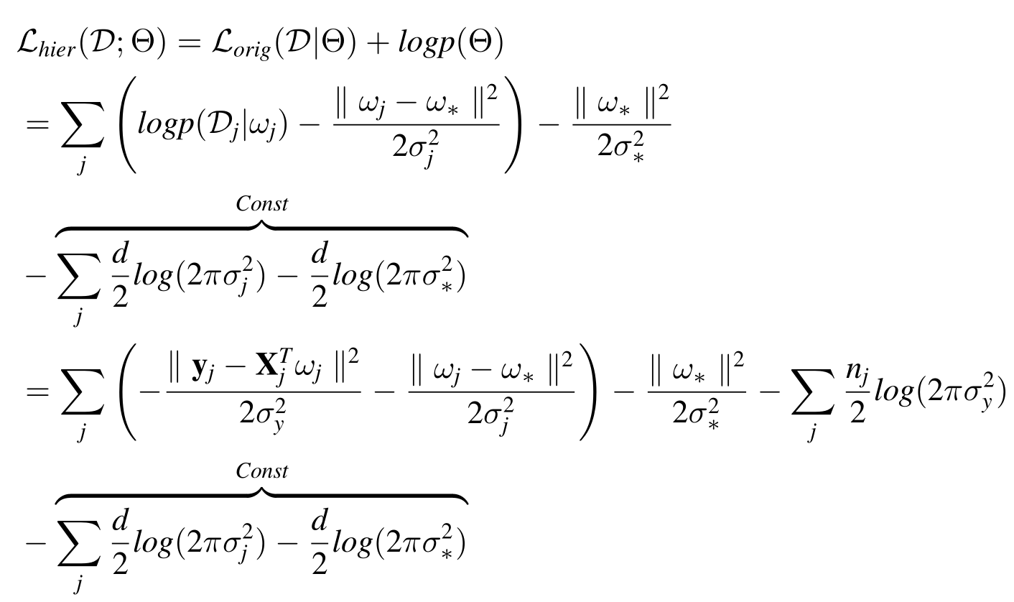
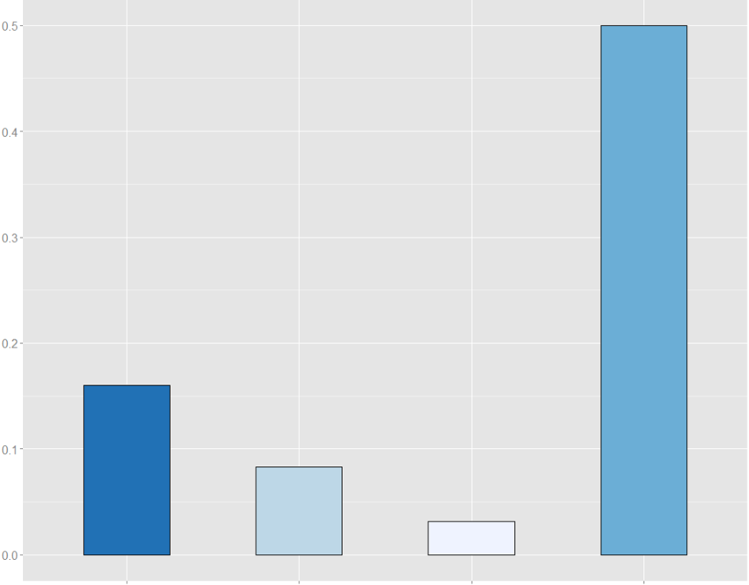
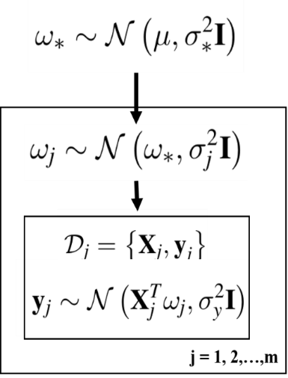
MultiQSAR: Quantitative prediction by multi-task
Comparison with single-task model
Hierarchical Bayesian Model
Log of Joint Probability
Chemoinformatics
Sample Number: 50
About 50% improvement
MSE Reduction
Sample Number: 1000
Less than 10% improvement
Peptide GPCR family

Slide 15
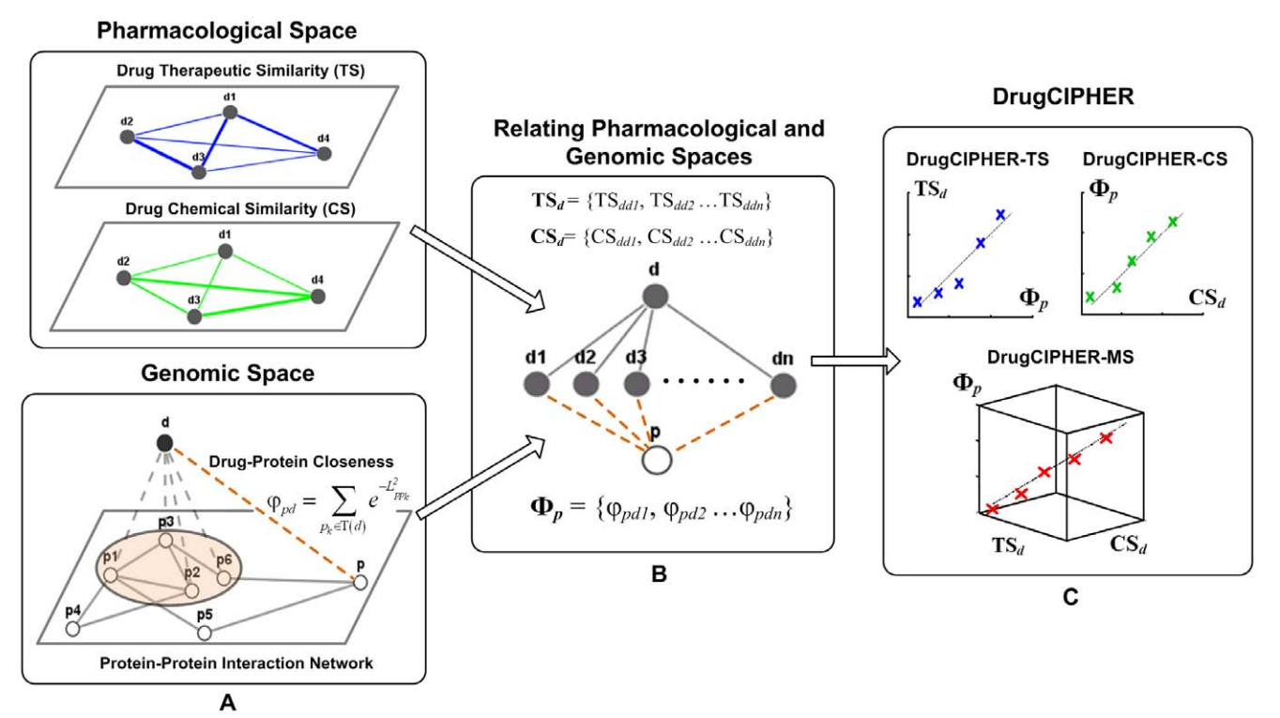
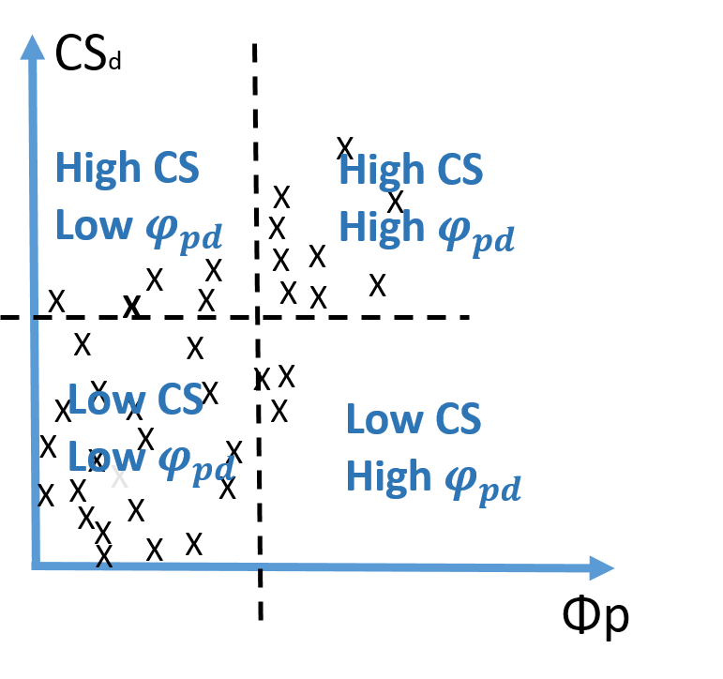
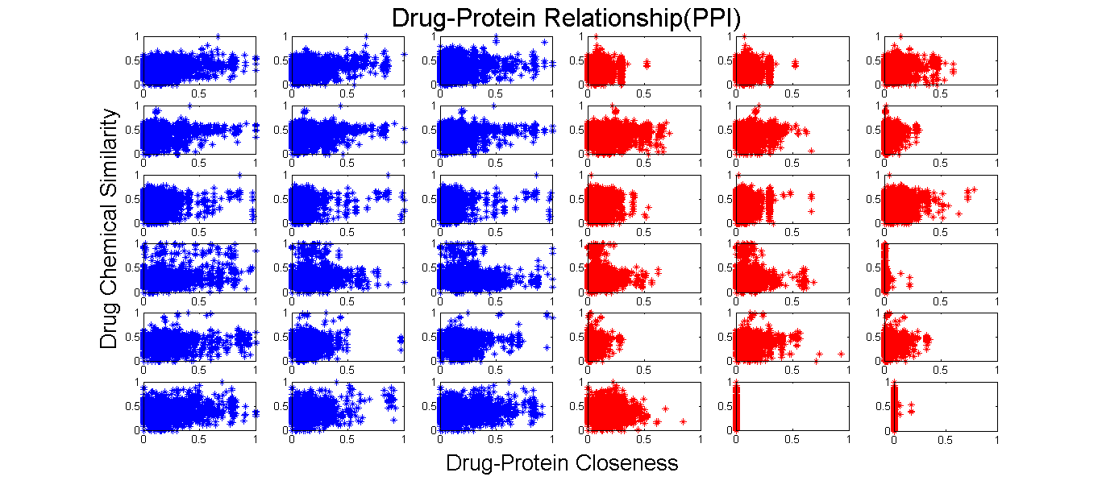
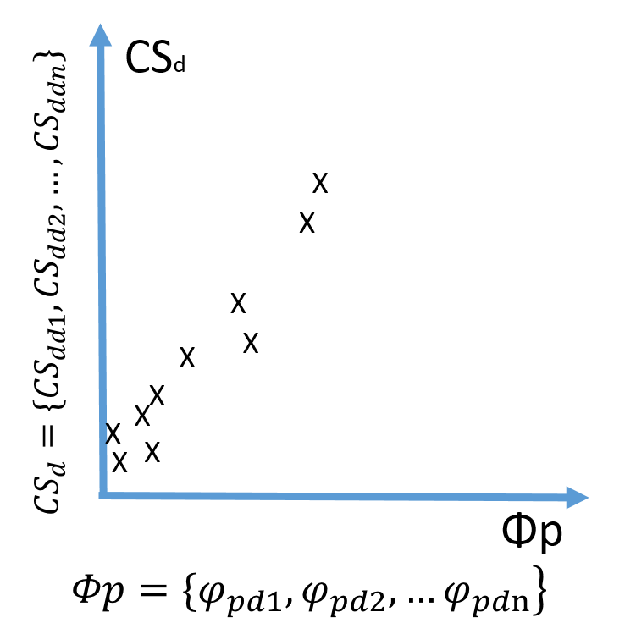
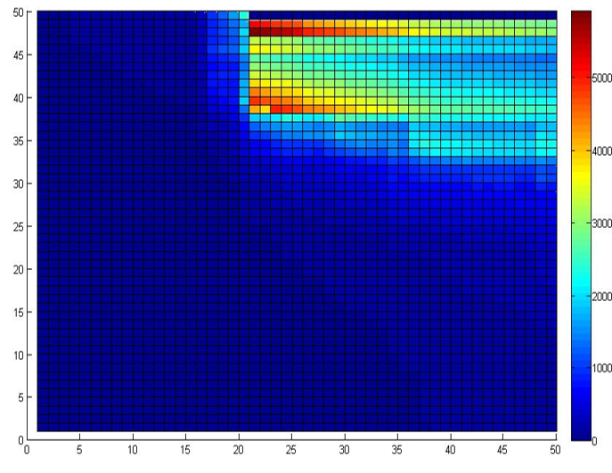
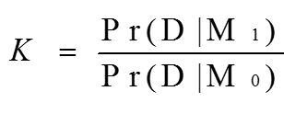
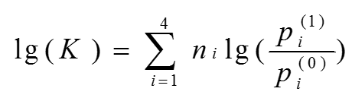
Graph Partition-based Prediction
Real Data
Assumption
Graph Partition
Bayer Factor:
Positive Samples
Negative Samples

Slide 16

Fisher’s method for combination the p-values
Integration of multiple similarities
Fisher’s method with dependence correction
Similarity Network
Combining independent p-value
p-value is uniformly distributed
under null hypothesis
This formula follows a chi-squared
distribution
Yang, 2010 considered the situation of
combining dependent p-values.
Wu, J., et al., Integrating multiple genomic data to predict disease-causing nonsynonymous single nucleotide variants in exome sequencing studies, PLoS Genetics, 2014,10(3): e1004237.

Slide 17
Summary
Structure Learning
Decipher features underlying the models
Thanks and any question ?

