Slide 1
NTUST, CSIE Fall 2016 Practice of Social Media Analytics (CS5128701) Final Report
M10515028 Ye-Yan Zeng
Prof. Ching-Hao Mao
Date: 01.15.2017
Project repo
https://github.com/YudBet/SNA_final

Slide 2
Outline
Background and observation
Methods and purpose
Data statistics
Results
Conclusion

Slide 3
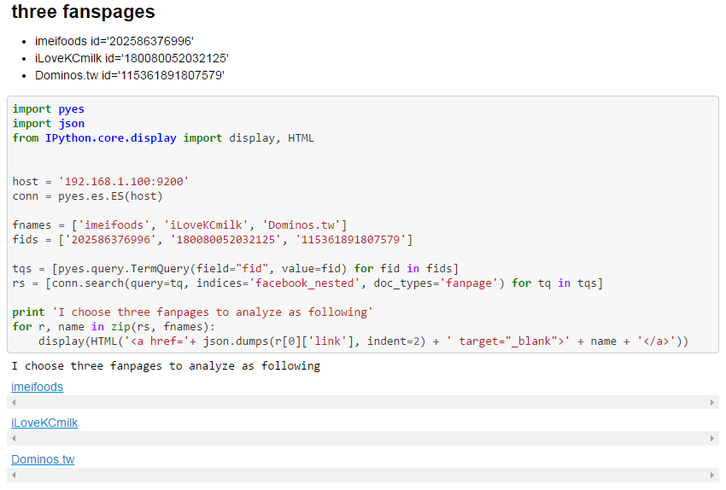
Background and observation ─targets
Category: Food/Beverages
Three fans pages
imeifoods
iLoveKCmilk
Dominos.tw

Slide 4
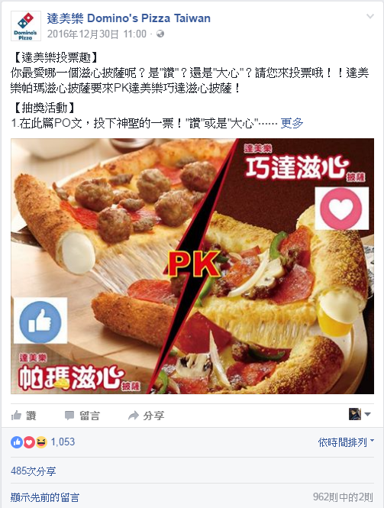
Background and observation ─why target
Three food/beverages fans pages
Compare the social power between…
use sweepstake (抽獎活動)
iLoveKCmilk vs. Dominos.tw
is using sweepstake
imeifoods vs. iLoveKCmilk
imeifoods vs. Dominos.tw

Slide 5
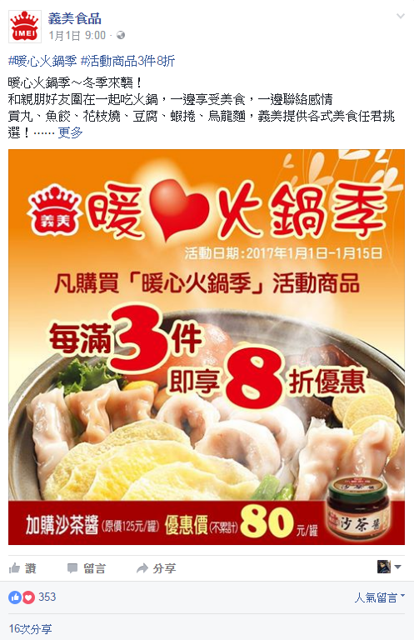
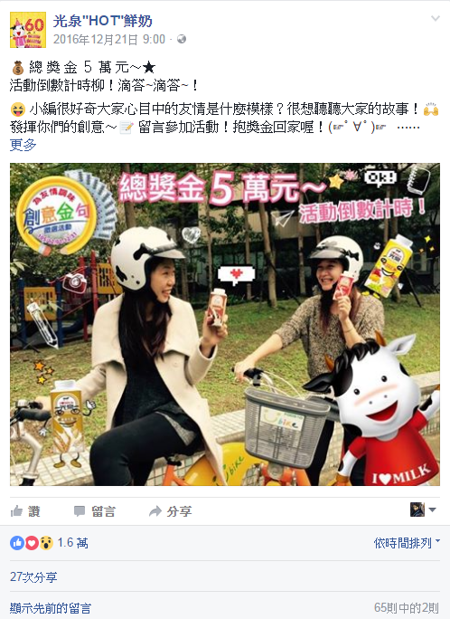
Background and observation ─sweepstake
Pages using sweepstake: iLoveKCmilk & Dominos.tw
Page doesn’t use sweepstake: imeifoods

Slide 6



Methods and purpose
Data: Facebook fans pages
collected with Graph API
stored in Elasticsearch
about 100GB
Program
Ipython Notebook with Python code
visualization: Bokeh & Seaborn
How sweepstake influence fans pages in 2015 whole year?

Slide 7
Data statistics ─comments & posts
Table 1. # of comments in 2015
fans page | Jan | Feb | Mar | Apr | May | Jun | Jul | Aug | Sep | Oct | Nov | Dec | total
imeifoods | 654 | 903 | 5,042 | 1,150 | 1,461 | 1,821 | 5,581 | 480 | 1,149 | 2,685 | 2,560 | 2,055 | 25,541
iLoveKCmilk | 5,747 | 1,237 | 2 | 609 | 2,385 | 2,524 | 339 | 169 | 464 | 1,535 | 22 | 150 | 15,183
Dominos.tw | 1,296 | 679 | 1,797 | 964 | 2,762 | 1,655 | 2,388 | 4,970 | 4,386 | 3,053 | 5,659 | 5,521 | 35,130
Table 2. # of posts in 2015
fans page | Jan | Feb | Mar | Apr | May | Jun | Jul | Aug | Sep | Oct | Nov | Dec | total
imeifoods | 16 | 15 | 15 | 12 | 14 | 15 | 28 | 14 | 17 | 22 | 15 | 24 | 207
iLoveKCmilk | 17 | 8 | 0 | 9 | 10 | 13 | 11 | 10 | 8 | 12 | 1 | 5 | 104
Dominos.tw | 40 | 25 | 26 | 38 | 32 | 33 | 35 | 29 | 25 | 26 | 30 | 25 | 364

Slide 8
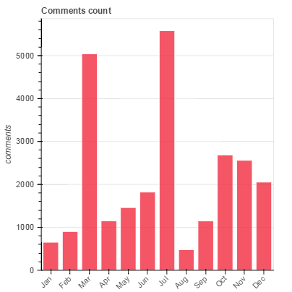
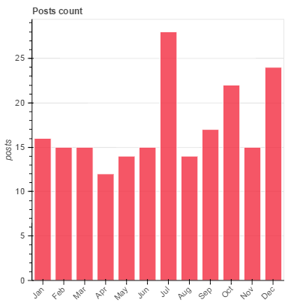
Data statistics ─visualization: imeifoods

Slide 9
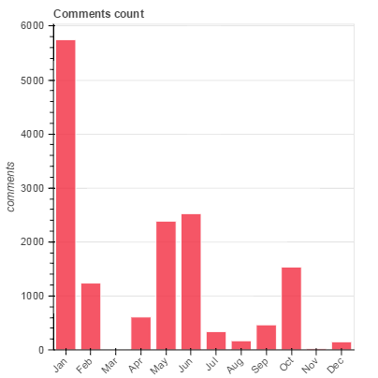
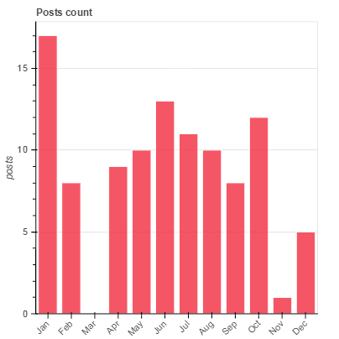
Data statistics ─visualization: iLoveKCmilk

Slide 10
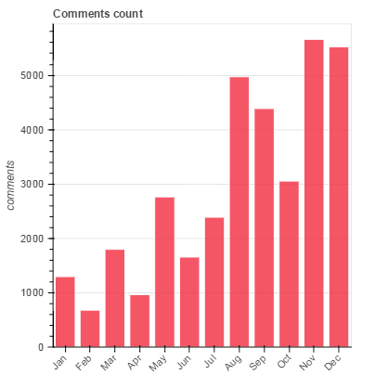
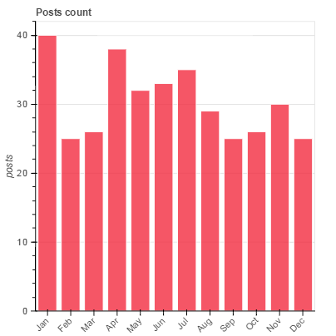
Data statistics ─visualization: Dominos.tw

Slide 11
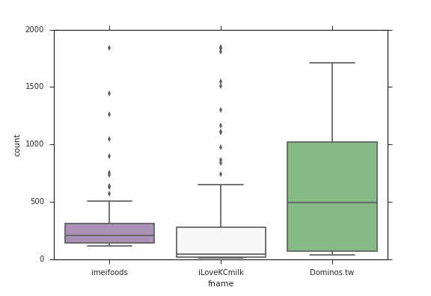
Data statistics ─visualization: #comments/each post

Slide 12
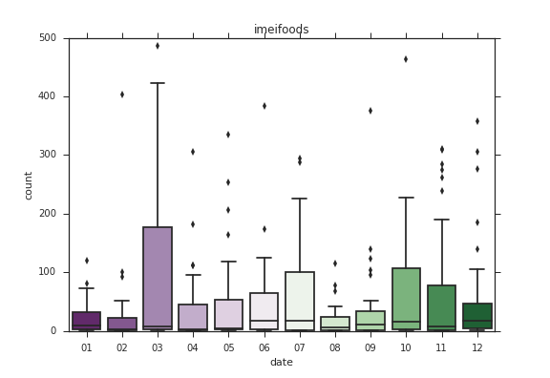
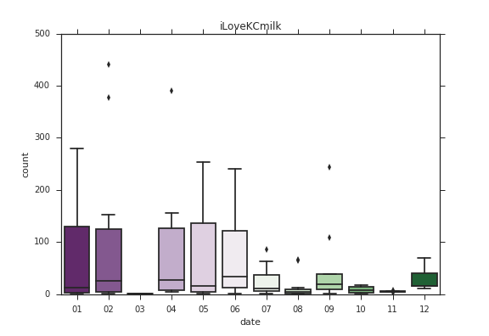
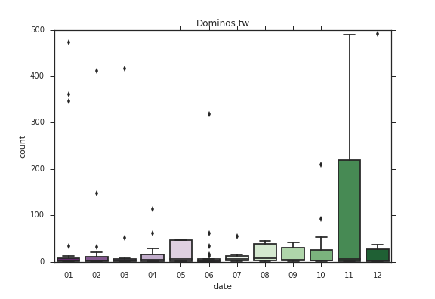
Data statistics ─visualization: #post per month

Slide 13
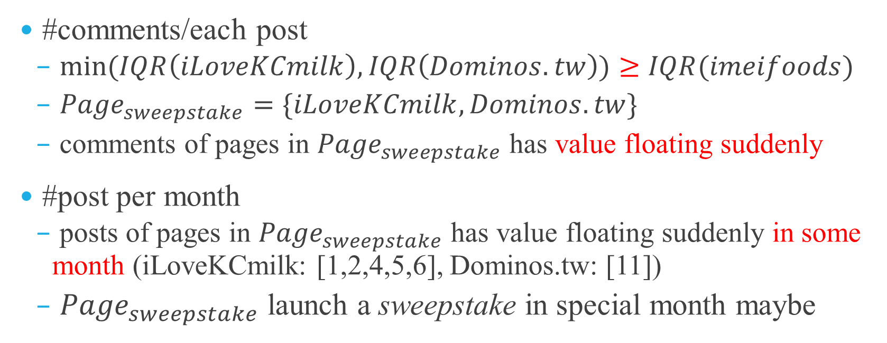
Results
#comments/each post
$min⁡(IQR\left(iLoveKCmilk\right),IQR\left(Dominos.tw\right))≥IQR(imeifoods)$
${Page}_{sweepstake}=\{iLoveKCmilk, Dominos.tw\}$
comments of pages in ${Page}_{sweepstake}$ has value floating suddenly
#post per month
posts of pages in ${Page}_{sweepstake}$ has value floating suddenly in some month (iLoveKCmilk: [1,2,4,5,6], Dominos.tw: [11])
${Page}_{sweepstake}$ launch a sweepstake in special month maybe

Slide 14
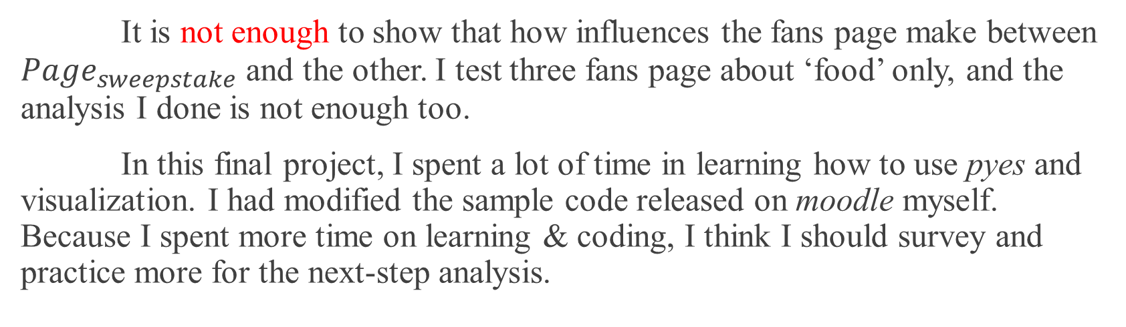
Conclusion
SNA_final.ipynb https://github.com/YudBet/SNA_final
It is not enough to show that how influences the fans page make between ${Page}_{sweepstake}$ and the other. I test three fans page about ‘food’ only, and the analysis I done is not enough too.
In this final project, I spent a lot of time in learning how to use pyes and visualization. I had modified the sample code released on moodle myself. Because I spent more time on learning & coding, I think I should survey and practice more for the next-step analysis.

Slide 15
The end
M10515028 Ye-Yan Zeng
01.15.2016

