Slide 1
NTUST, CSIE Fall 2016 Practice of Social Media Analytics (CS5128701) Homework 1
M10515028 Ye-Yan Zeng
Prof. Ching-Hao Mao
Project repo https://github.com/YudBet/Social-Media-Analytics

Slide 2
Outline
Construct personal analysis platform
Twitter keywords analysis
Decision tree analysis of Twitters

Slide 3
Construct personal analysis platform
OS & hardware information
Installation
Problem & solution
Other packages installation

Slide 4


Construct personal analysis platform
OS & hardware information
Windows 7 with 8G RAM
Installation
Docker Toolbox installation (include VirtualBox)
download the setting files (jupyter+elasticsearch+logstash)
comment to the part of logstach in docker-compose.yml
docker-compose up
everything worked fine!

Slide 5
Construct personal analysis platform
Problem & solution
cannot install Docker: uninstall & install Docker Toolbox
logstash error when docker-compose up: comment in docker-compose.yml
Other packages installation
pyes 0.99.4: for the communication to indices of elasticsearch
bokeh 0.12.0: for data visualization
maybe I forgot…

Slide 6
Twitter keywords analysis
Twitter count
Tweet count
Bar chart of twitter count in month
Bar chart of tweet count in month
Pie chart of exist-url & no-url tweets
Box chart of twitter tweets in month
How to analyze that twitters’ power of Information Security (IS)?

Slide 7
Twitter keywords analysis
Twitter-keywords-analysis.ipynb https://github.com/YudBet/Social-Media-Analytics
KEYWORDS = [‘cve’, ‘vulnerability’, ‘exploit’]
Twitter count & Tweet count
keywords | cve | vulnerability | exploit
Twitter count | 47 | 75 | 69
Tweet count | 265 | 720 | 561

Slide 8
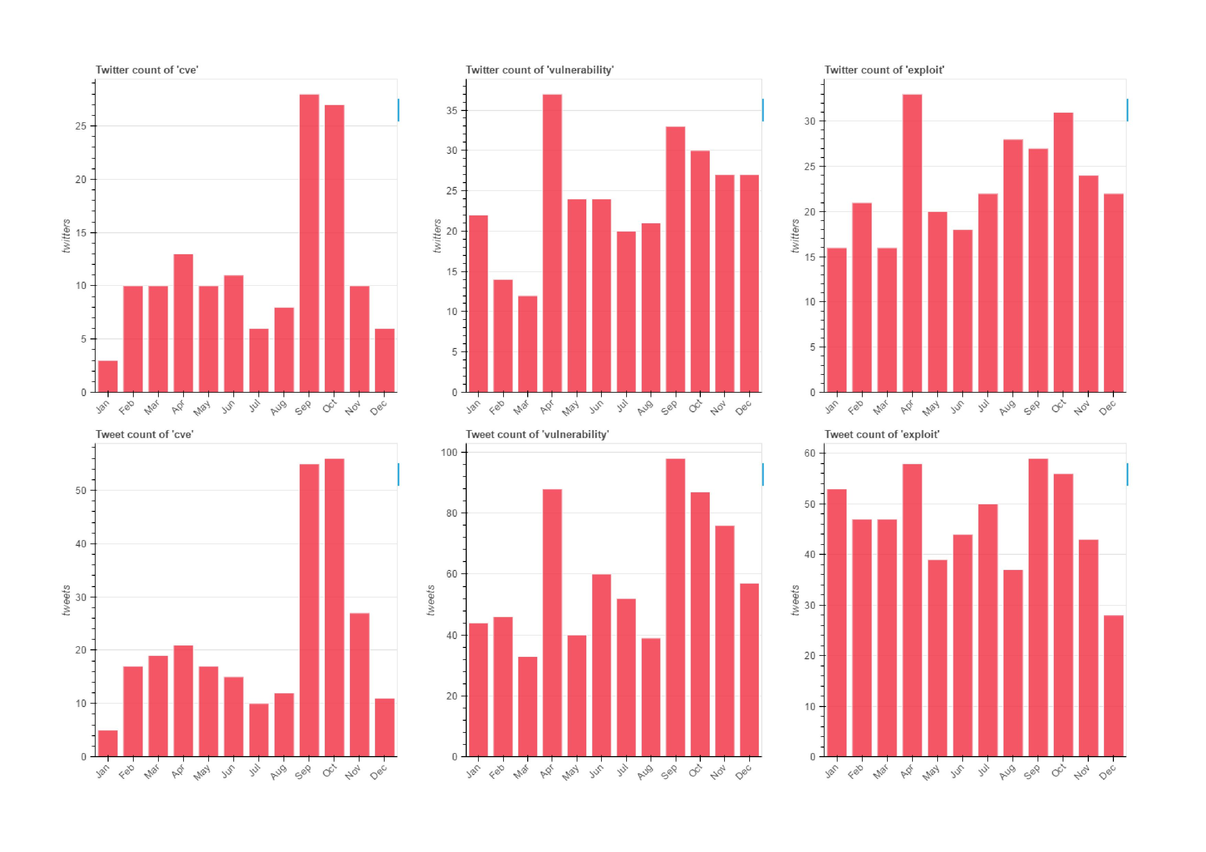
Twitter keywords analysis —bar charts
twitter-tweet-bars.html https://github.com/YudBet/Social-Media-Analytics
Twitter count in month
Tweet count in month

Slide 9
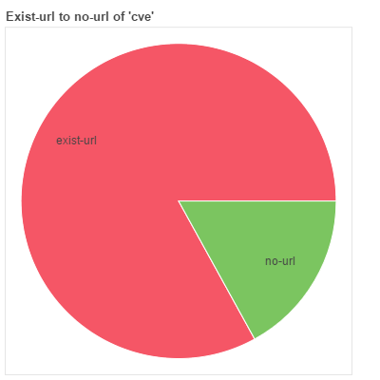
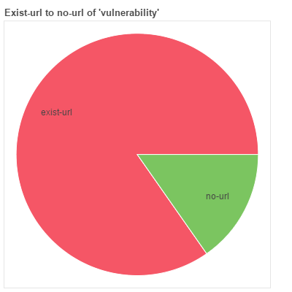

Twitter keywords analysis —pie charts
existUrl-noUrl-pies.html https://github.com/YudBet/Social-Media-Analytics
Exist-url & No-url tweets

Slide 10
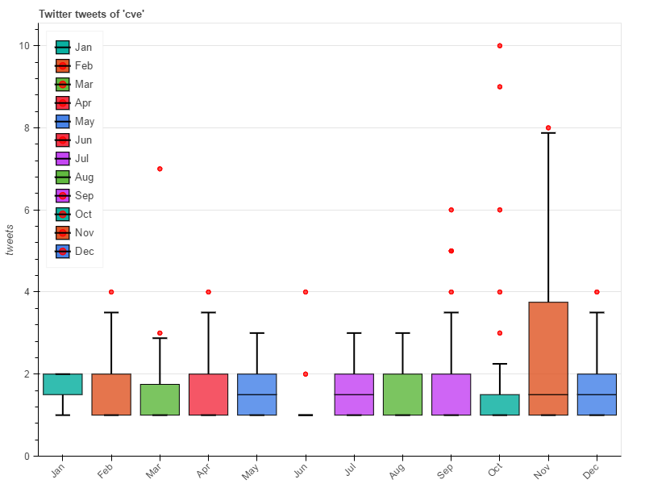
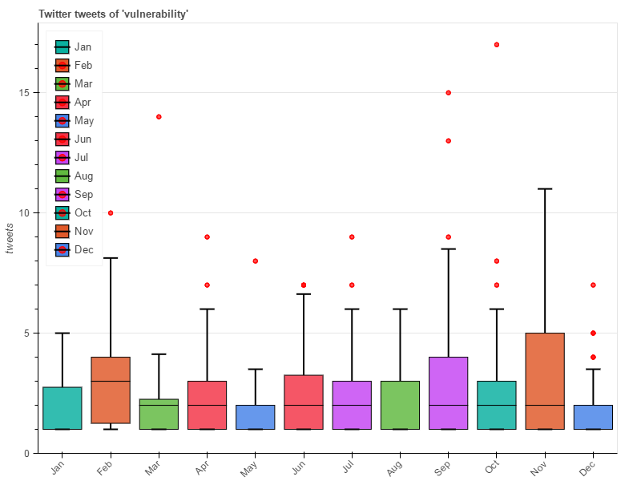
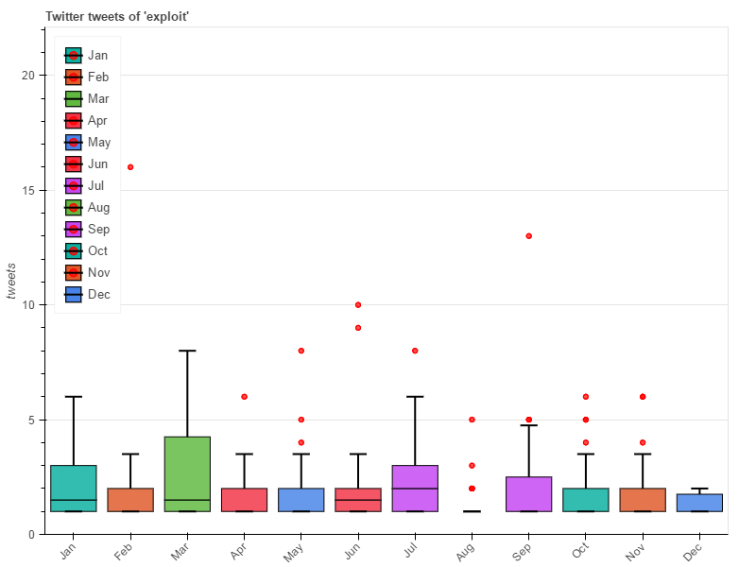
Twitter keywords analysis —box charts
twitter-tweets-boxs.html https://github.com/YudBet/Social-Media-Analytics
Twitter tweets in month

Slide 11
Twitter keywords analysis
How to analyze that twitters’ power of IS?
red points in the box chart (outliers)
Outliers may mean that twitters have more power of IS

Slide 12
Decision tree analysis of Twitters
Twitter selection (at least 20 twitters)
3-class classification definition of twitters selected
Decision tree analysis
Heatmap analysis of decision tree

Slide 13
Decision tree analysis of Twitters
TODO list
define 3 classes
twitter’s features: keywords count, document count of each one, …
maybe I should use not only TF but also DF: TF-IDF (preprocessing)
use scikit-learn for decision tree training
others…

Slide 14
The end
M10515028 Ye-Yan Zeng
11.15.2016

