Slide 1



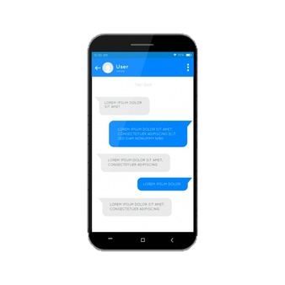



DIAGRAMA DA SOLUÇÃO
CLOUD PLATFORM
APLICAÇÃO WEB
CLOUDFRONT / S3
backend-api
KOTLIN
EXPOSED LIB
HTTP
USER
JAVALIN, KOIN
HTTP
HTTP
HTTP
streams-api
AMAZON RDS
Microsoft
HTTP
SQL Server
JAVALIN, FUEL

Slide 2
DIAGRAMA DA SOLUÇÃO
CLOUD PLATFORM
APLICAÇÃO WEB
CLOUDFRONT / S3
backend-api
KOTLIN
EXPOSED LIB
HTTP
USER
JAVALIN, KOIN
HTTP
HTTP
HTTP
streams-api
AMAZON RDS
Microsoft
HTTP
SQL Server
JAVALIN, FUEL

