Slide 1
Final Project
Yuding Wang | yudingw@andrew.cmu.edu
Yuvraj Mehra | ymehra@andrew.cmu.edu
Peter Previte | pprevite@andrew.cmu.edu

Slide 2
AGENDA
Vision
Problem
Our Product
Market
User Example
Example Output
Other Output
Conclusion

Slide 3
VISION
Our goal is to create a product that can track various metrics regarding stock market performance as well as a specific stock of choice by the user, allowing the user to:
1) Gain a greater understanding of market trends over any time period
2) Compare their stock of choice against the general performance of the market, and
3) See stock performance for any stock over and time period
Notes:
Our vision is to allow our customers to predict prices for a basket of stocks for them to make better decisions on investing

Slide 4
PROBLEM
Customer Pain Points
Many tools available in the market for visualizing stock performance and comparing stocks to market trends are difficult to use or expensive
Not all tools allow a user to search over any given time period – certain applications only allow daily, weekly, monthly, or yearly inputs as time periods for which to search

Slide 5
OUR PRODUCT
Our product – Stock Analysis Python Program
Allows a user to input their stock of choice and any given time range
For the given stock and time range, our program will produce easily understandable plots showing the trends in that stock as well as other market metrics during the time range

Slide 6
MARKET
Describe your market / target customer
Market: a clutter market without any reliable, simple, and free tool to analyze stock prices
Customer: normal people without professional knowledge or sufficient funds to employ professional financial assistance
How big is the market?
The market represents all individuals who buy and sell stock – hundreds of millions of users daily
What are the market forces / drivers?
There is a need for easy-to-use, low-cost stock analysis tool for daily stock traders

Slide 7

USER EXAMPLE
Example: You want to see the trends for Apple Stock (AAPL) from January 1st, 2021 to February 1st, 2021
After running our program, the user will input the following information:
Screenshot of the user input when running the Python Program

Slide 8
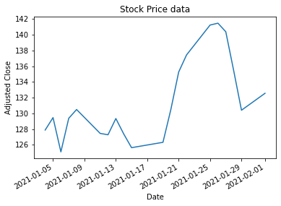
EXAMPLE OUTPUT
If we input the information as is shown on the previous slide, we will see four plots, the first of which is shown on the right
This plot shows the AAPL stock price from 01 January to 01 February of 2021, as input by the user

Slide 9
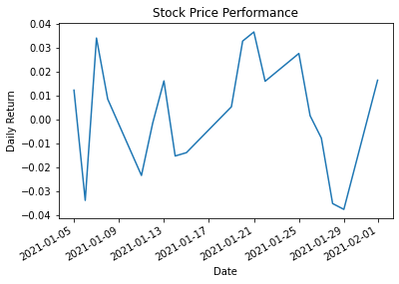
EXAMPLE OUTPUT (cont.)
This next plot shows the daily return value over the same time period for AAPL stock
Two plots shown next to each other provide the user simple metrics by which to compare performance

Slide 10
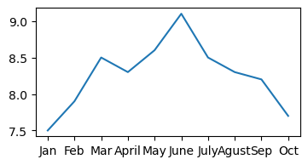
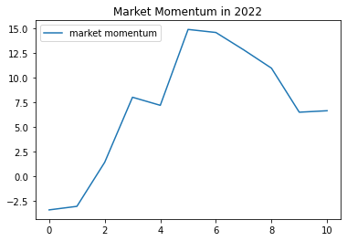
OTHER OUTPUT
The final two plots show data for the US inflation rate as well as the market momentum
Combining these pieces of information along with the stock price and return data allows the user to draw conclusions about potential future performance of stocks
Inflation Rate – JAN-OCT 2022

Slide 11
CONCLUSION
Our Python Stock Analysis program provides an easy-to-use method for comparing a given stock chosen by the user to a few simple market metrics
Users of our product benefit from an easily understandable interface as well as the lack of fees needed on most stock analysis/prediction tools in the current market

