Slide 1
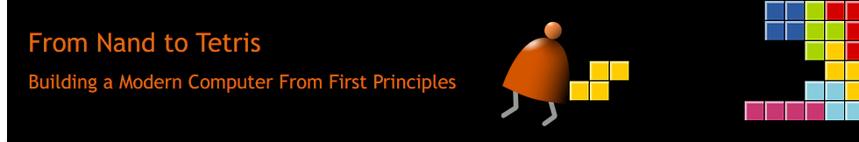
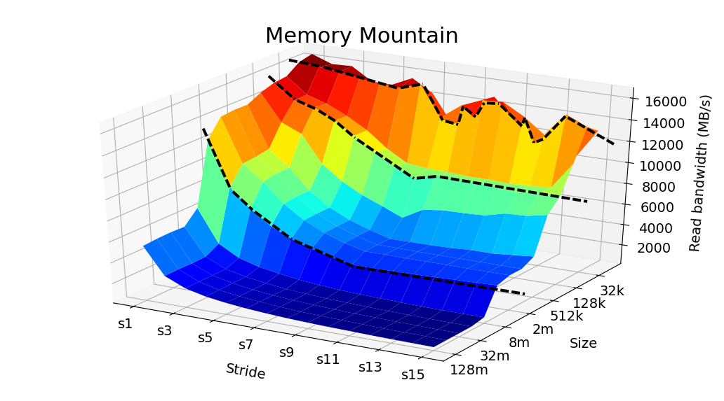

True CS Learning

Slide 2

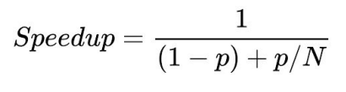
Why Need To Learn
Amdahl’s Law
Iron Law
Amdahl’s Law
The Key To Almost All Areas of CS
教育现状

Slide 3
To Beginner
Two Month
Design and Build A Simple Computer
Run your own program on the computer
Your Will Learn:
A little bit of digital circuit
A little bit of computer architecture
A little bit of compilation principle
A little bit of operation system
And a little bit of programming ......
From Nand to Tetris Part I Course Promo - YouTube

Slide 4
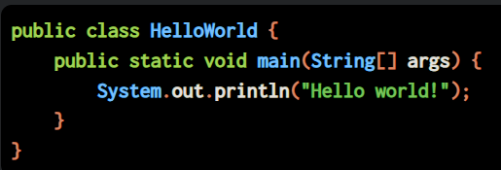
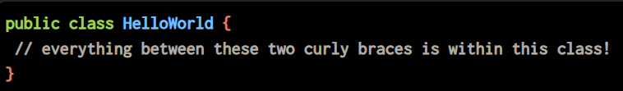
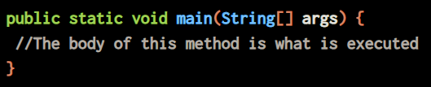


Hello World!

Slide 5
Implement “hello world!”
Don’t worry about the “how”
Only about the “what”
how->Implementation
what->Abstraction

Slide 6
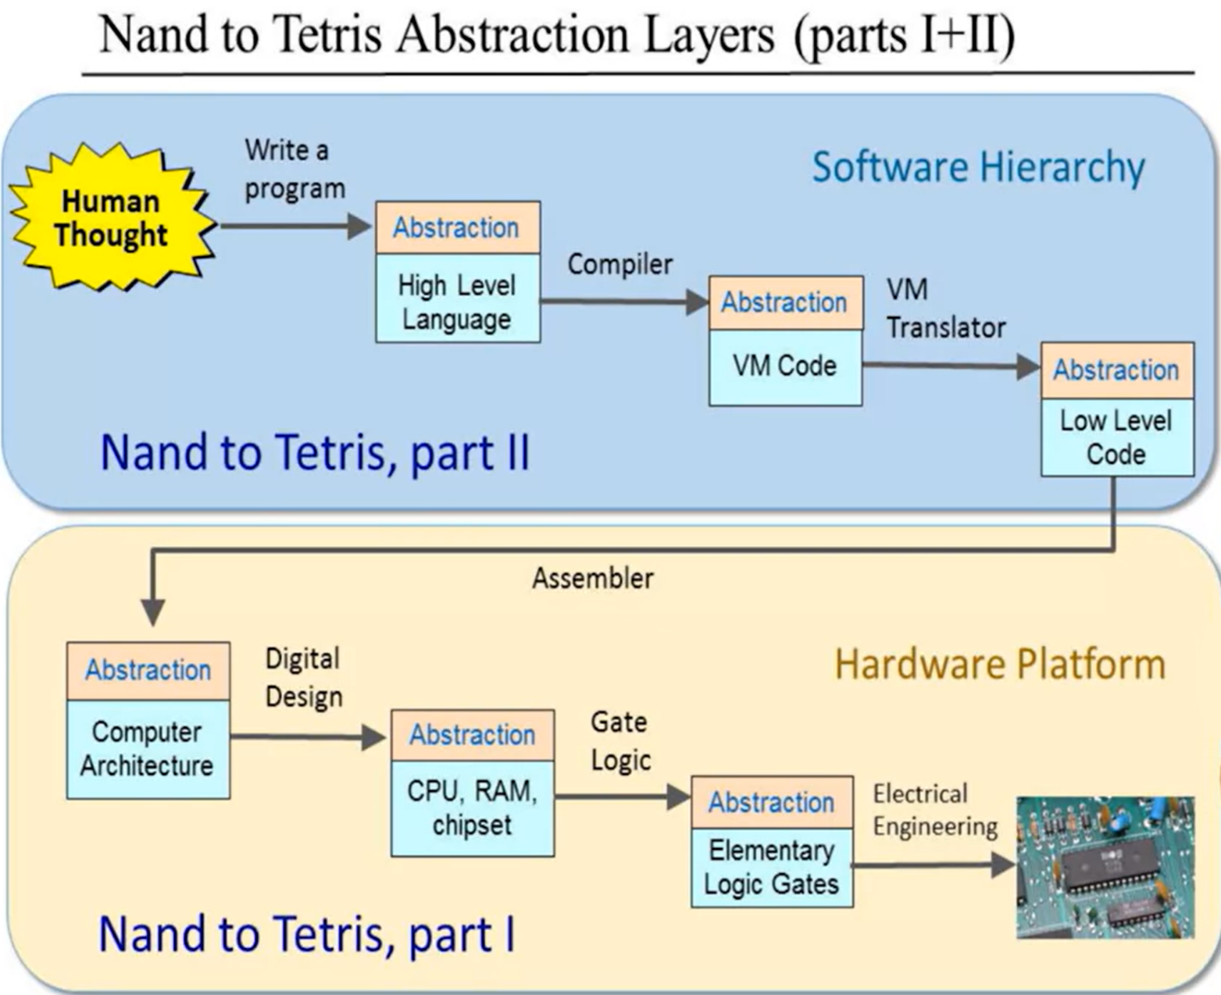
Course Map

Slide 7
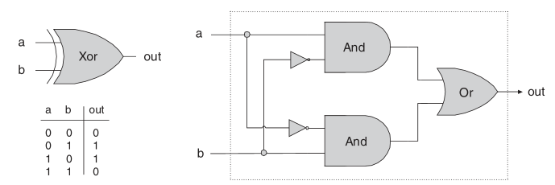
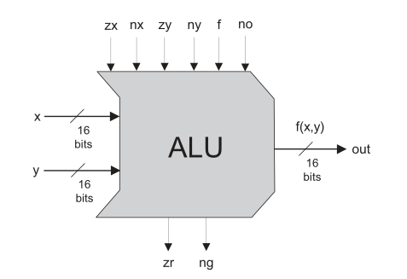
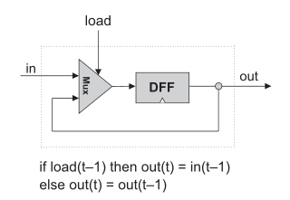
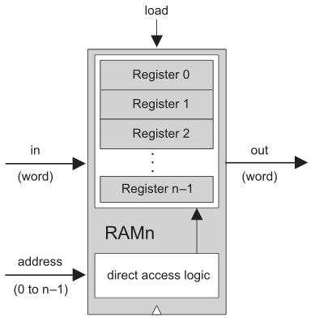
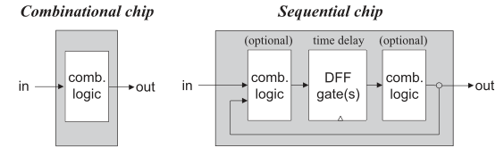
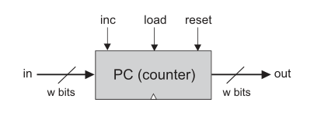
Part1

Slide 8
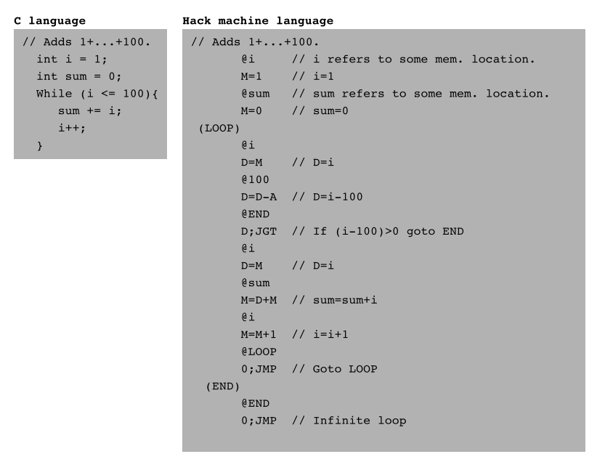
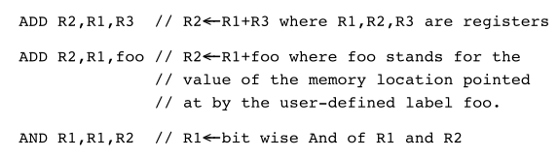
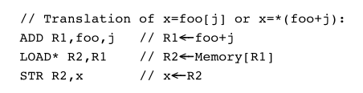
Part1

Slide 9
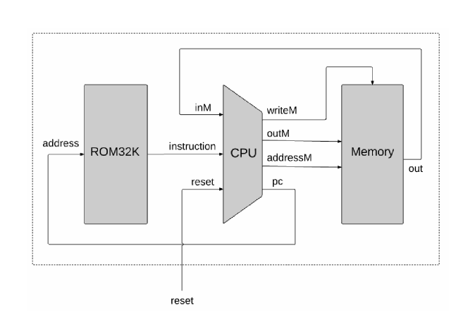
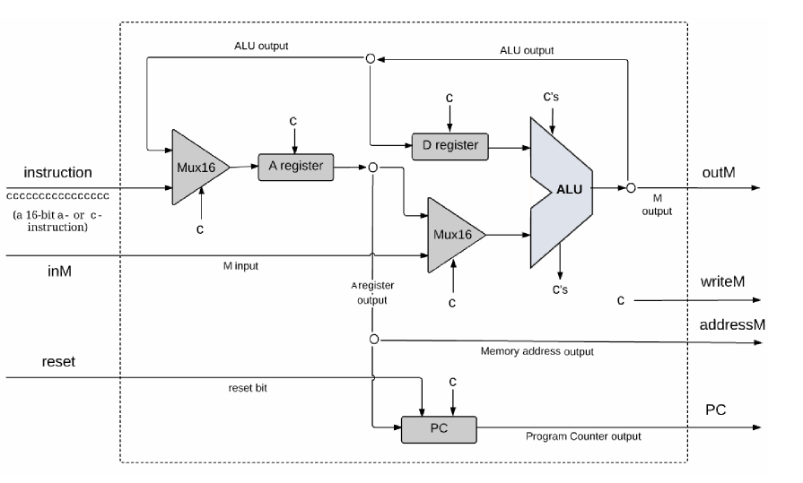
Part1

Slide 10
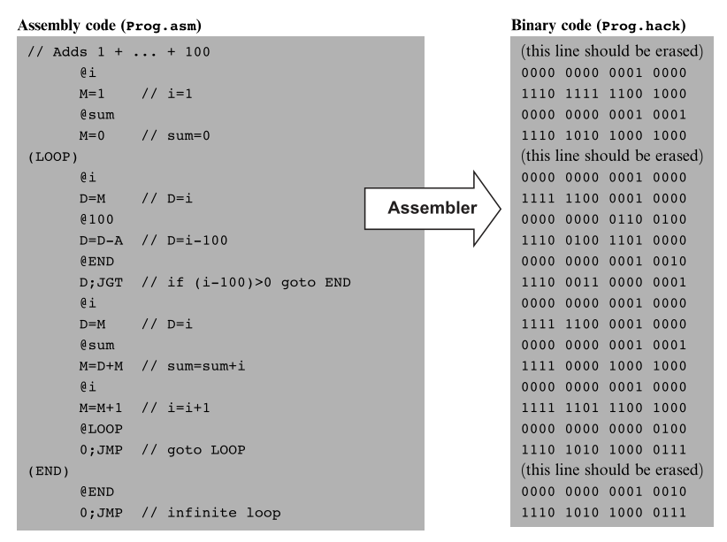
Part1

Slide 11
Part1
Boolean Logic
Logic Gate
ALU
Memory
Machine Language
Computer Architecture
Assembler
Implement basic logic gate
Implement ALU
Implement RAM
Coding with ML
Assemble a computer
Implement Assembler

Slide 12
Part2
Virtual Marchine
Object-Oriented Programming
Compiler
OS
More Fun to Go
Implement VM
Coding with OOP
Implement Compiler
Implement OS

Slide 13

Join Now

