Slide 1



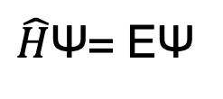
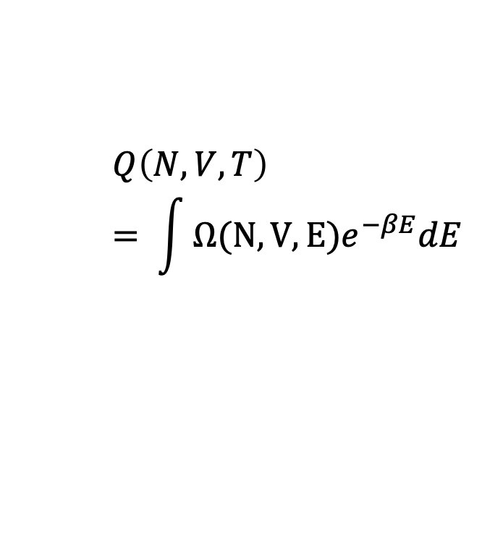
Multi-scale Modeling
Chemical Informatics
MOLECULAR DESIGN FOR WATER AND ENERGY SYSTEMS
Statistical mechanics and quantum mechanics
Molecular fingerprinting and high throughput screening
-
+
-
-
+
Machine-Learning
+
Potential energy surface (PES) development, structure-property relationships, generative design
$$Q\left(N,V,T\right)= \int{Ω(N,V,E)e^{−βE}dE}$$
$\hat{H}$Ѱ= EѰ

Slide 2
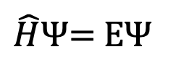
Multi-scale Modeling
Chemical Informatics
MOLECULAR DESIGN FOR WATER AND ENERGY SYSTEMS
-
+
-
-
+
Machine-Learning
+
$$Q\left(N,V,T\right)= \int{Ω(N,V,E)e^{−βE}dE}$$
$\hat{H}$Ѱ= EѰ

Slide 3
-
+
-
-
+
+
MOLECULAR DESIGN FOR WATER AND ENERGY SYSTEMS

Slide 5
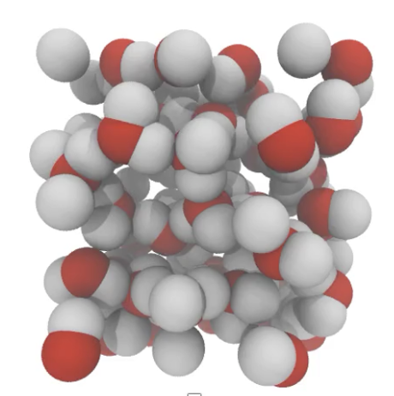
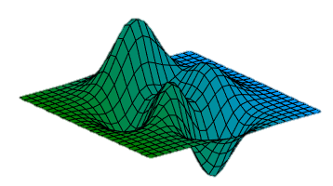
To construct an MLP, we map molecular configurations to QM-based potential energy surfaces using neural networks.
Sample configurational space
Label with DFT energies and forces
Train NN

Slide 6
MOFs and graphene materials
Experimental and hypothetical structures
DFT calculations of ion binding energies to pore walls
Ion selectivity from geometric confinement
Structural assessment to determine pore size and geometry
+
Multi-objective optimization of properties from NNs
+
+
Active learning of design space using expected improvement (EI) criterion
Fluid permeability and transport properties
Material descriptors
Pareto optimization
.…
Predictions of permeability, diffusion, and viscosity of confined fluids from molecular dynamics simulations
Selectivity
NN surrogate model
+
Permeability
+
+
+
+
+
+
+
Viable materials for selective membranes

Slide 7
DFT
ML potential
MD simulation property predictions
+
Surface patterning and chemical functionalization
-
-
+
External pressure, concentration, and charge gradient
+
-
Solid-electrolyte interface

