Slide 1
Supplementary Figure 5

Slide 2
Llama2-7b Drosophila NSM cosine similarity <=0.5 Mmlu21 score <=8

Slide 3
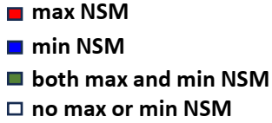
NSM with cosine similarity <=0.5 for Drosophila experiment and
score <=8 for Mmlu21 experiment

Slide 4
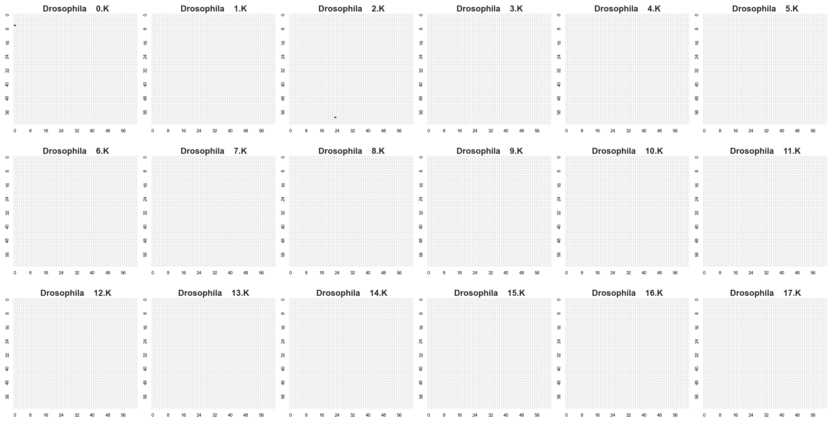

Slide 5
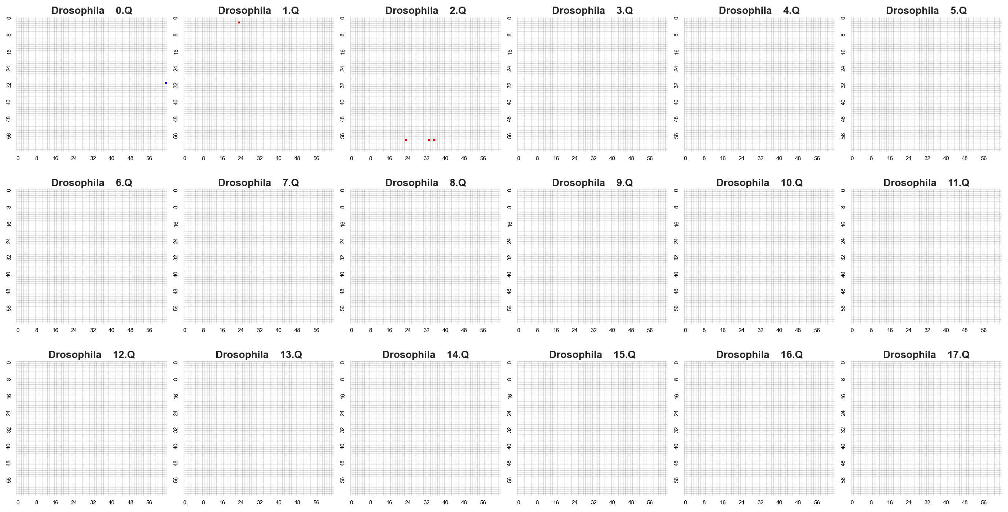

Slide 6
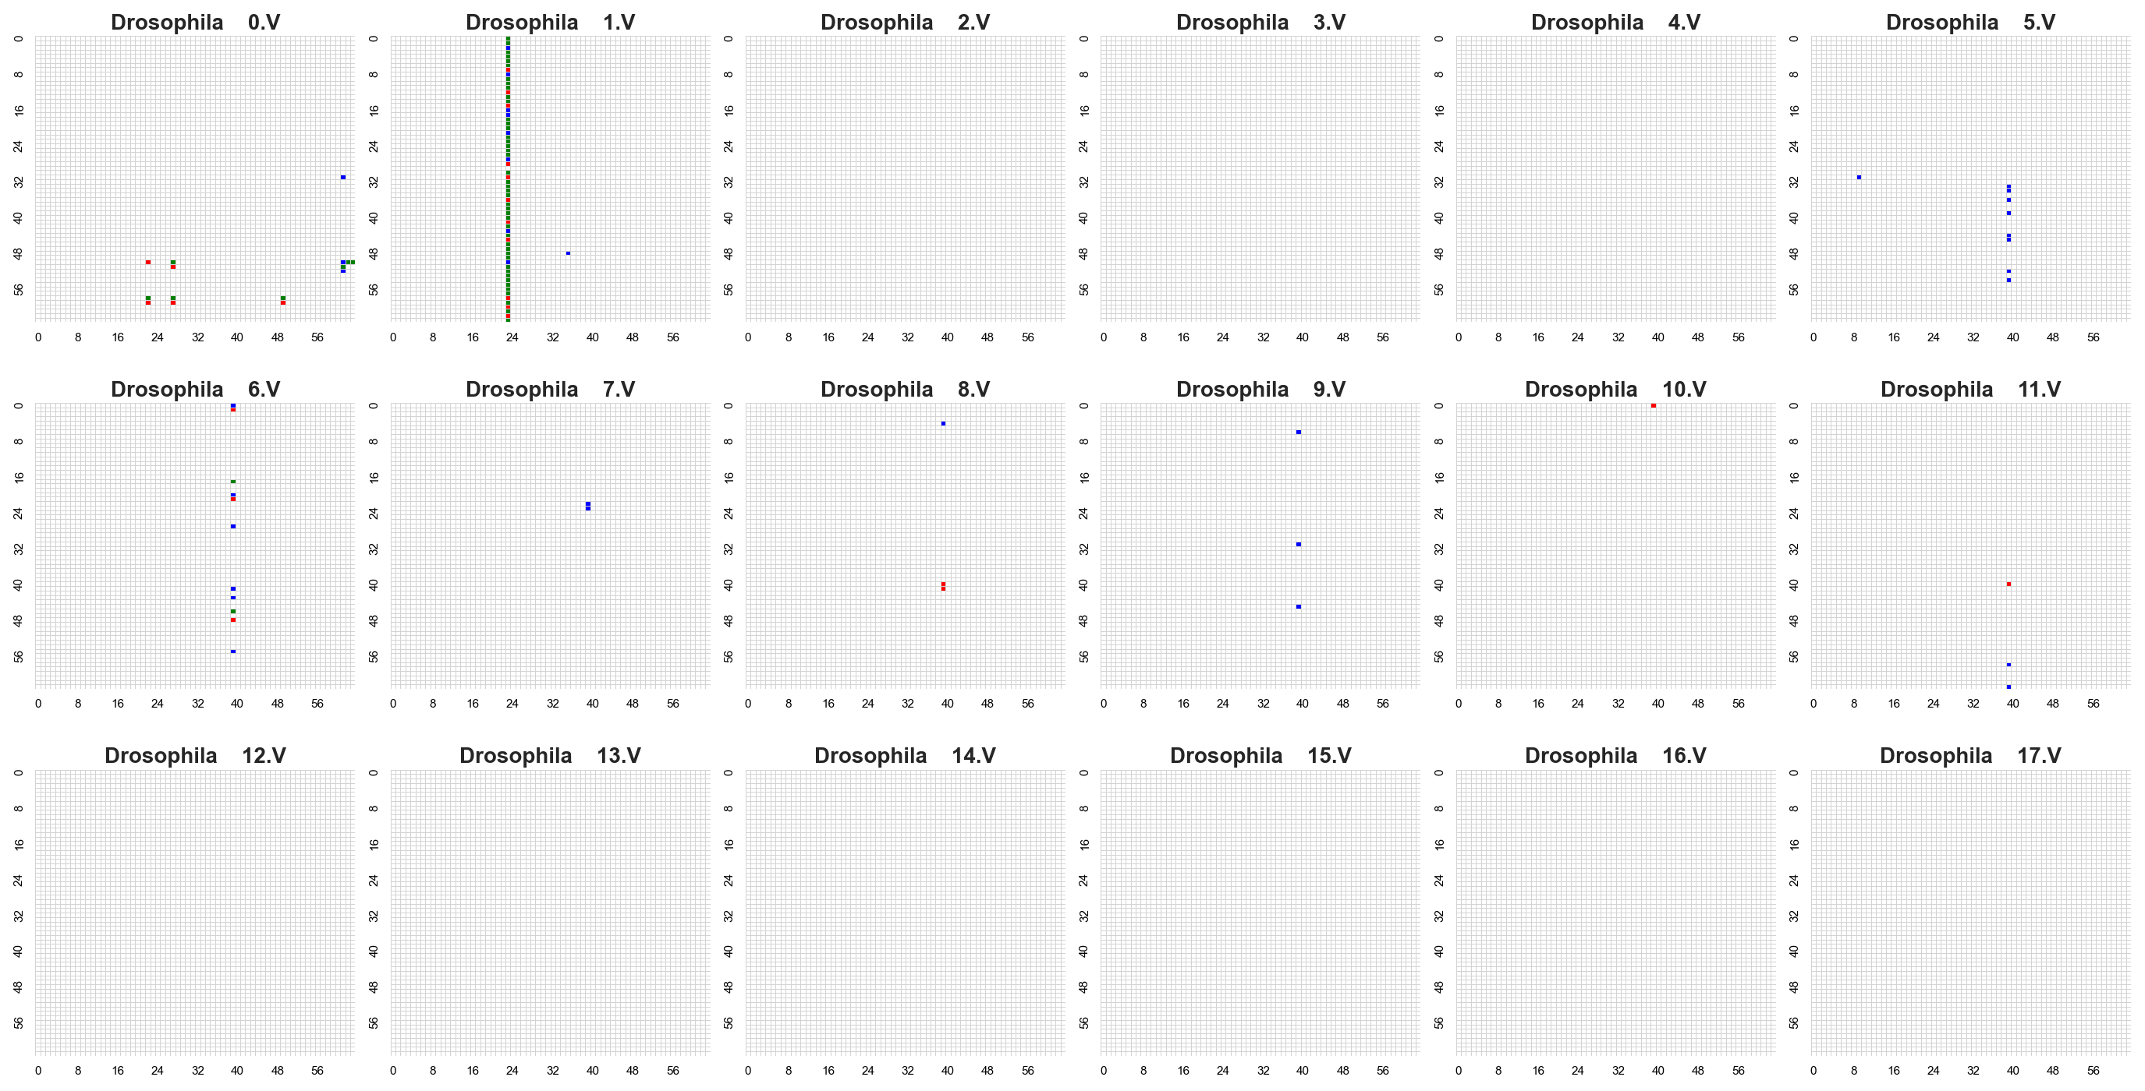

Slide 7
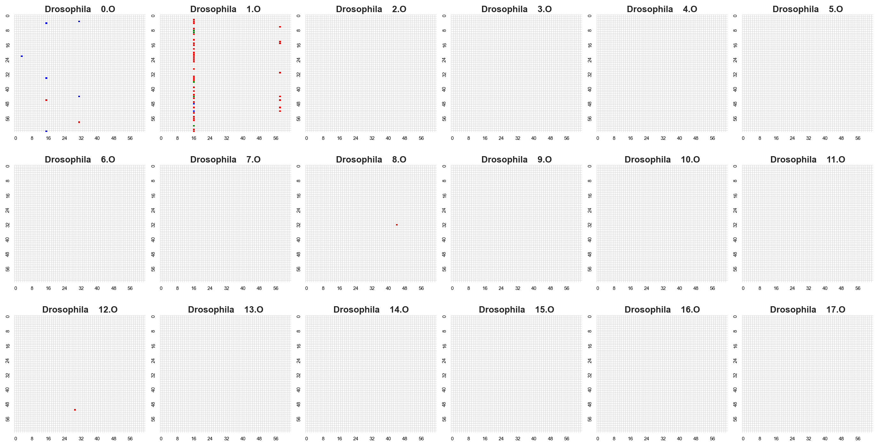

Slide 8
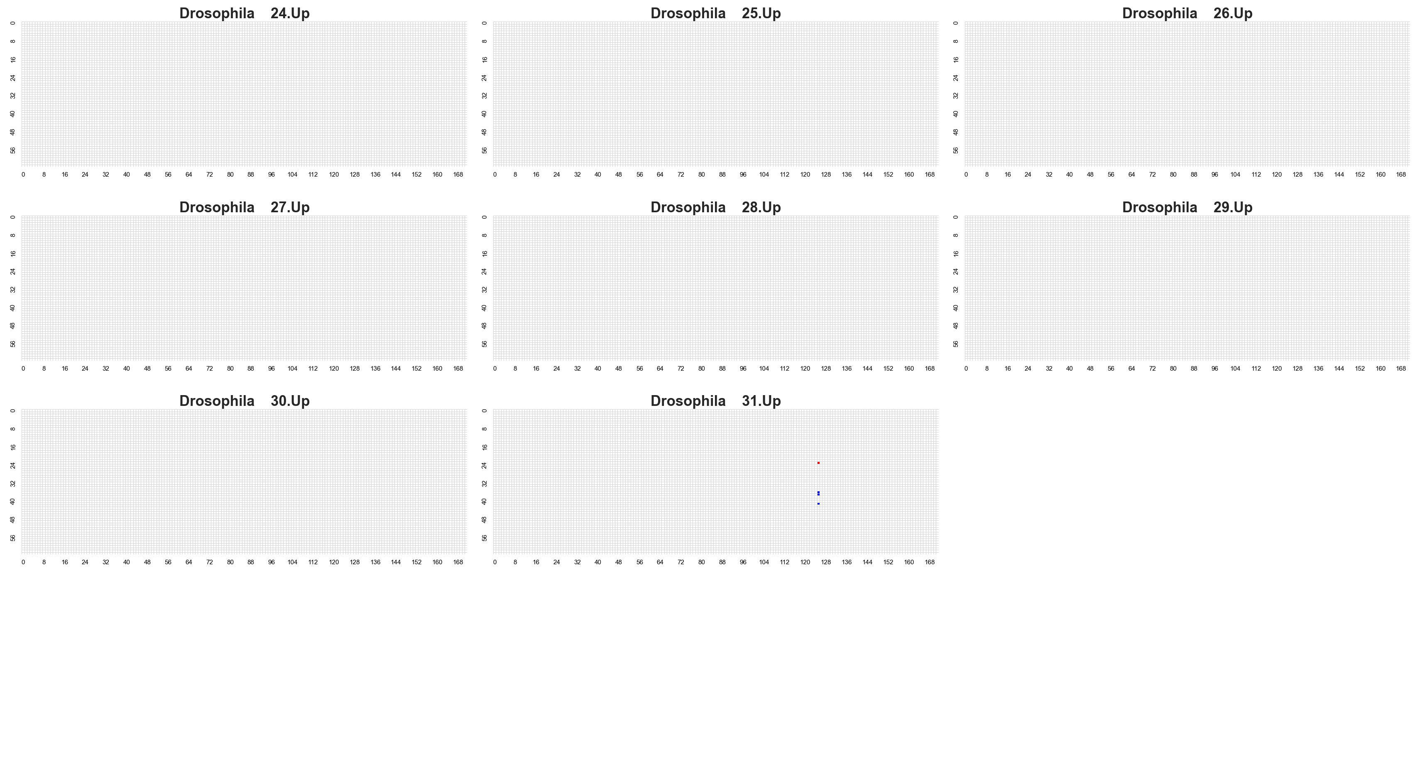

Slide 9
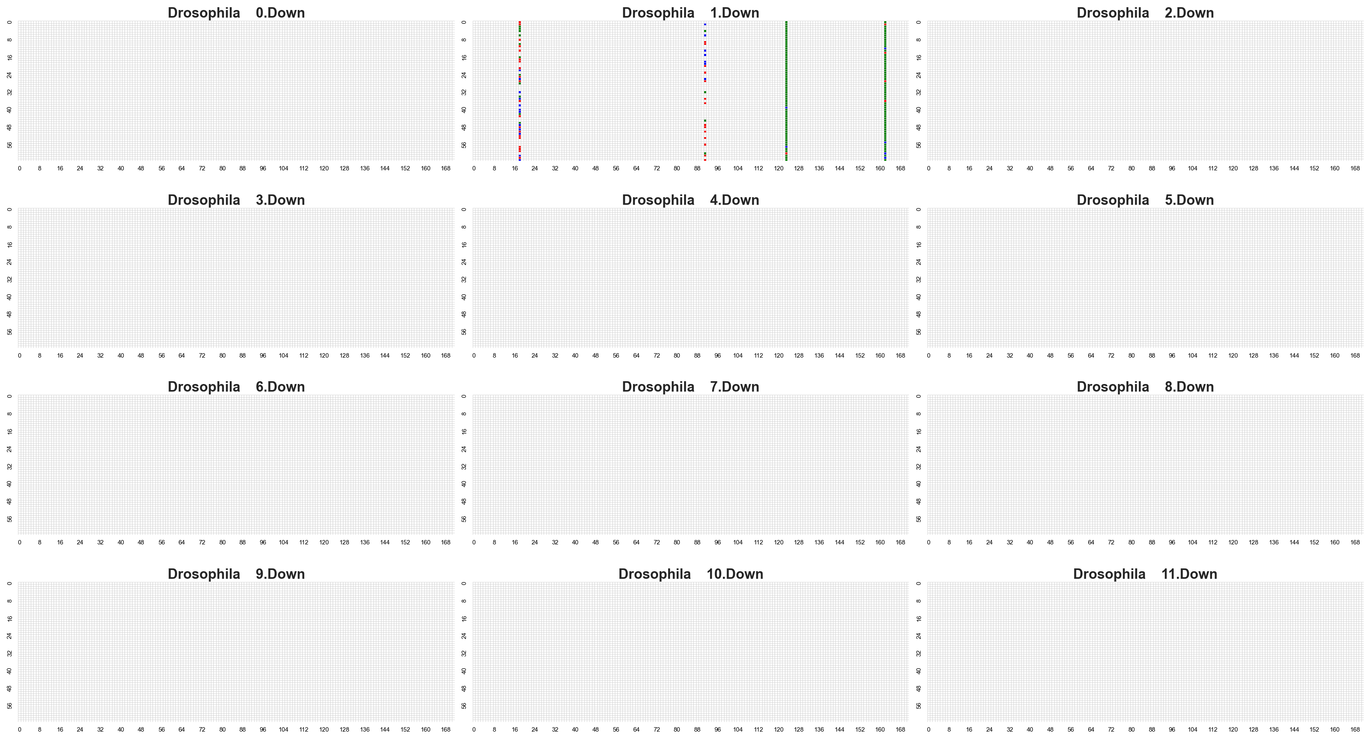

Slide 10
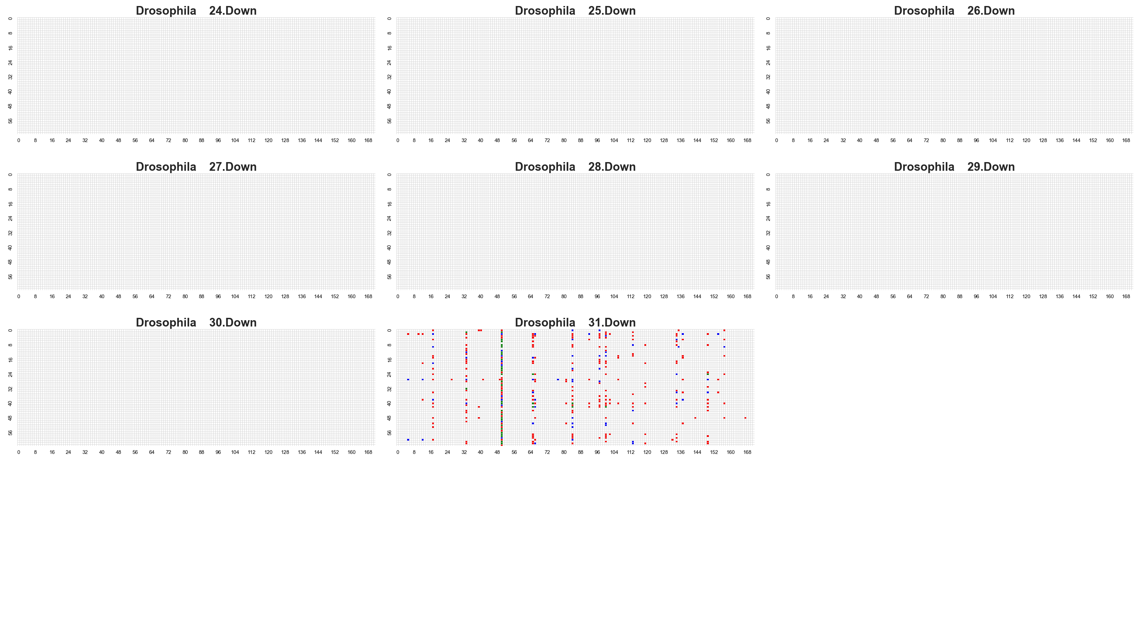

Slide 11
Llama2-7b Newton NSM cosine similarity <=0.5 Mmlu21 score <=8

Slide 12
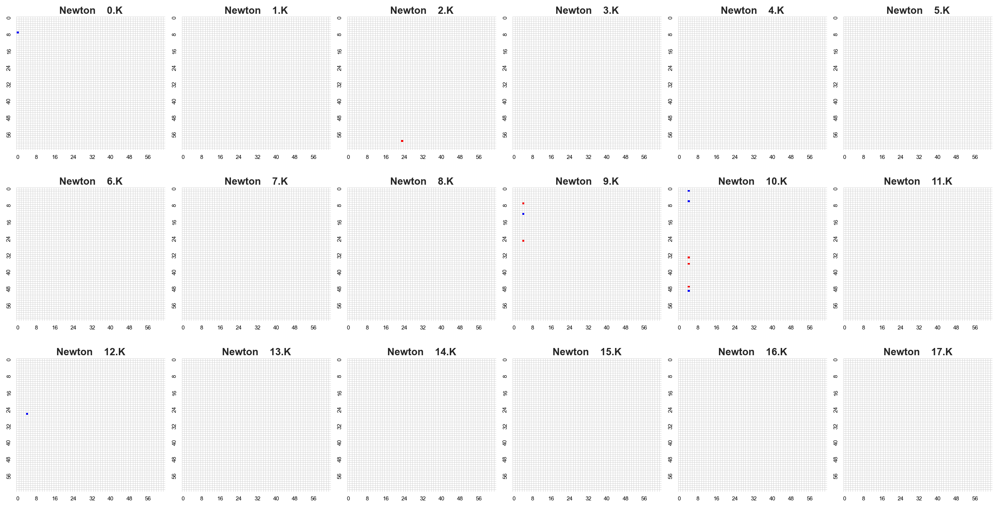

Slide 13
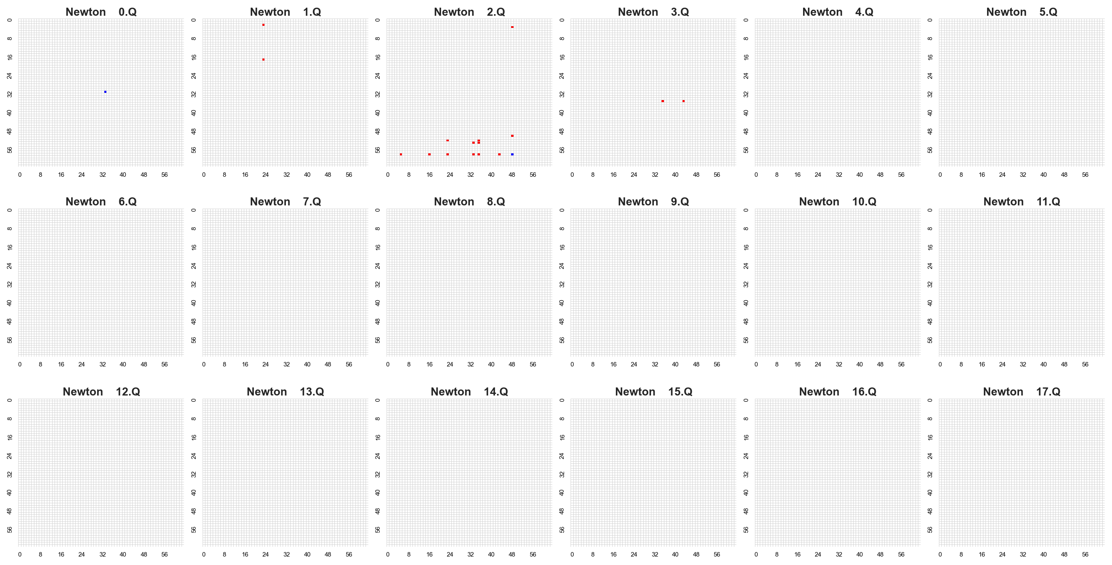

Slide 14
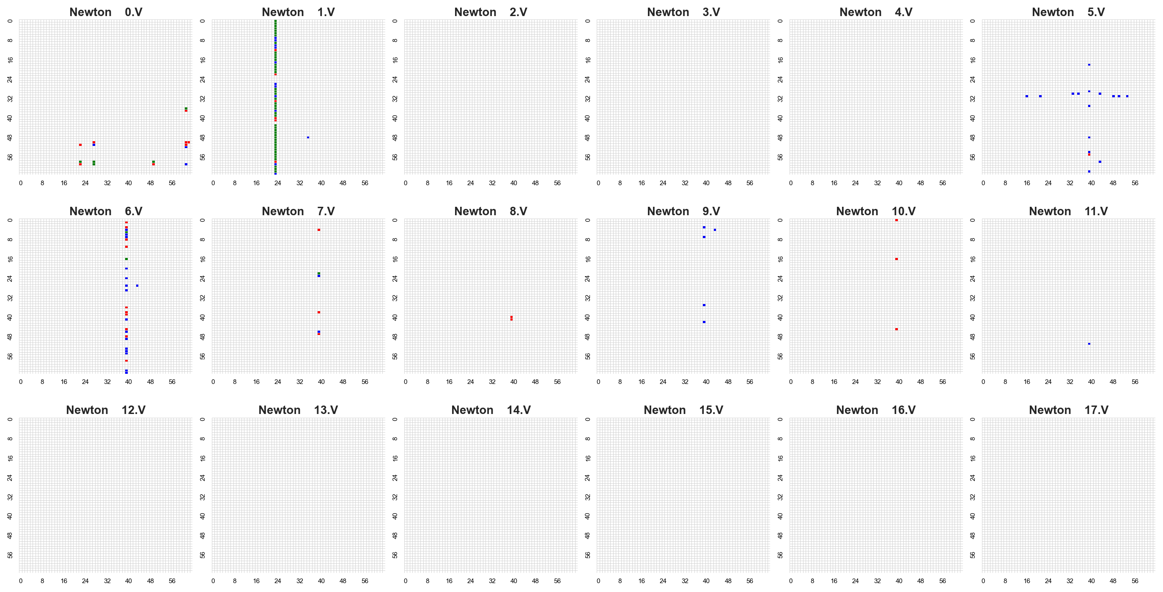

Slide 15
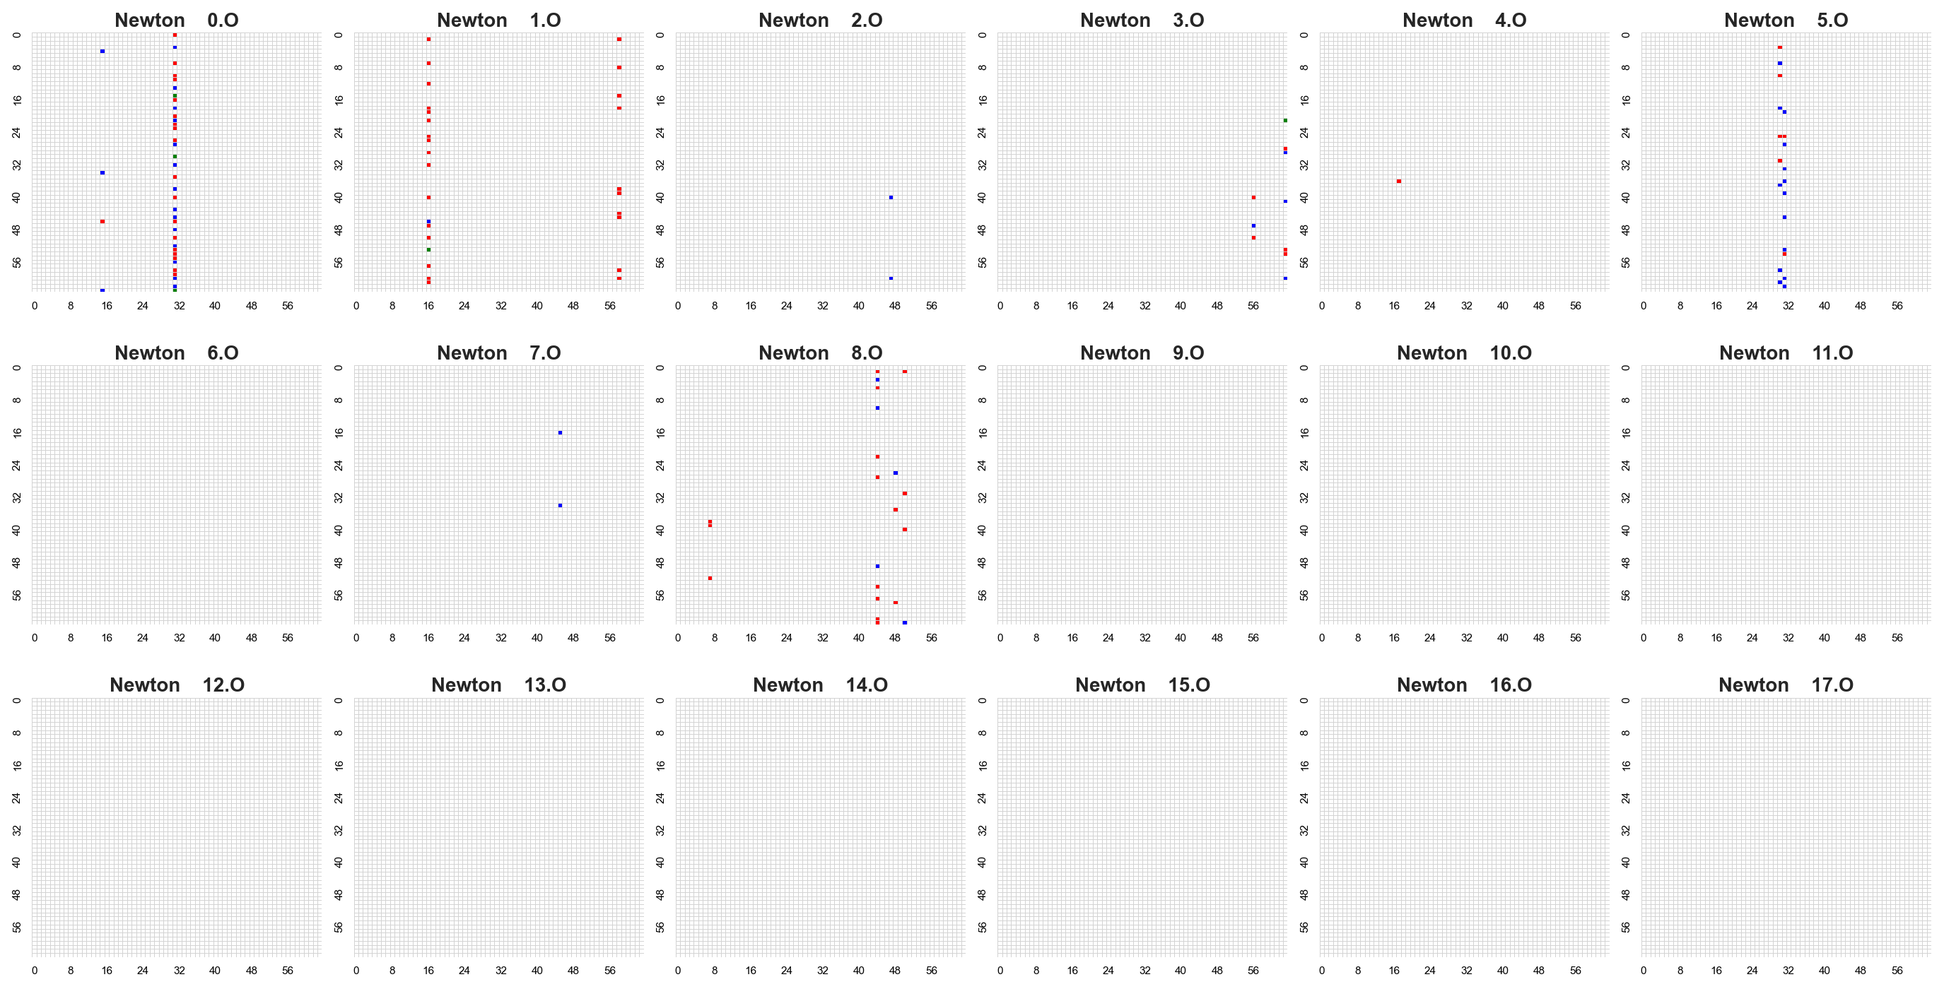

Slide 16
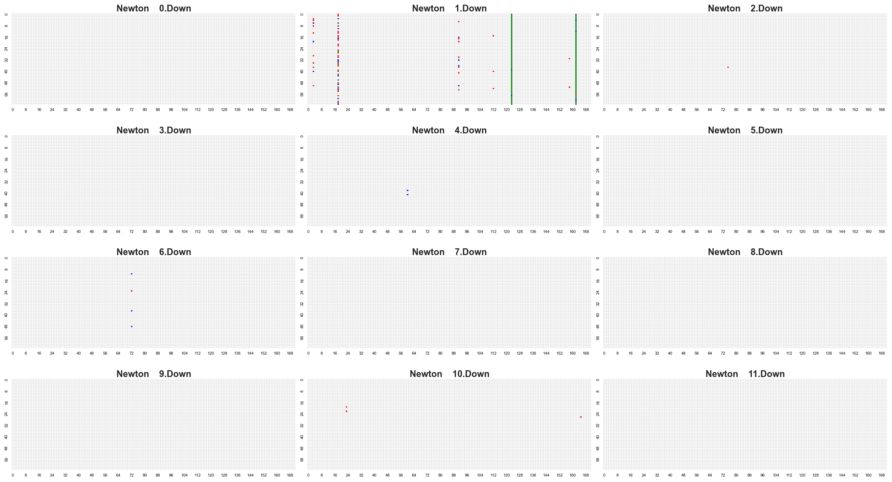

Slide 17
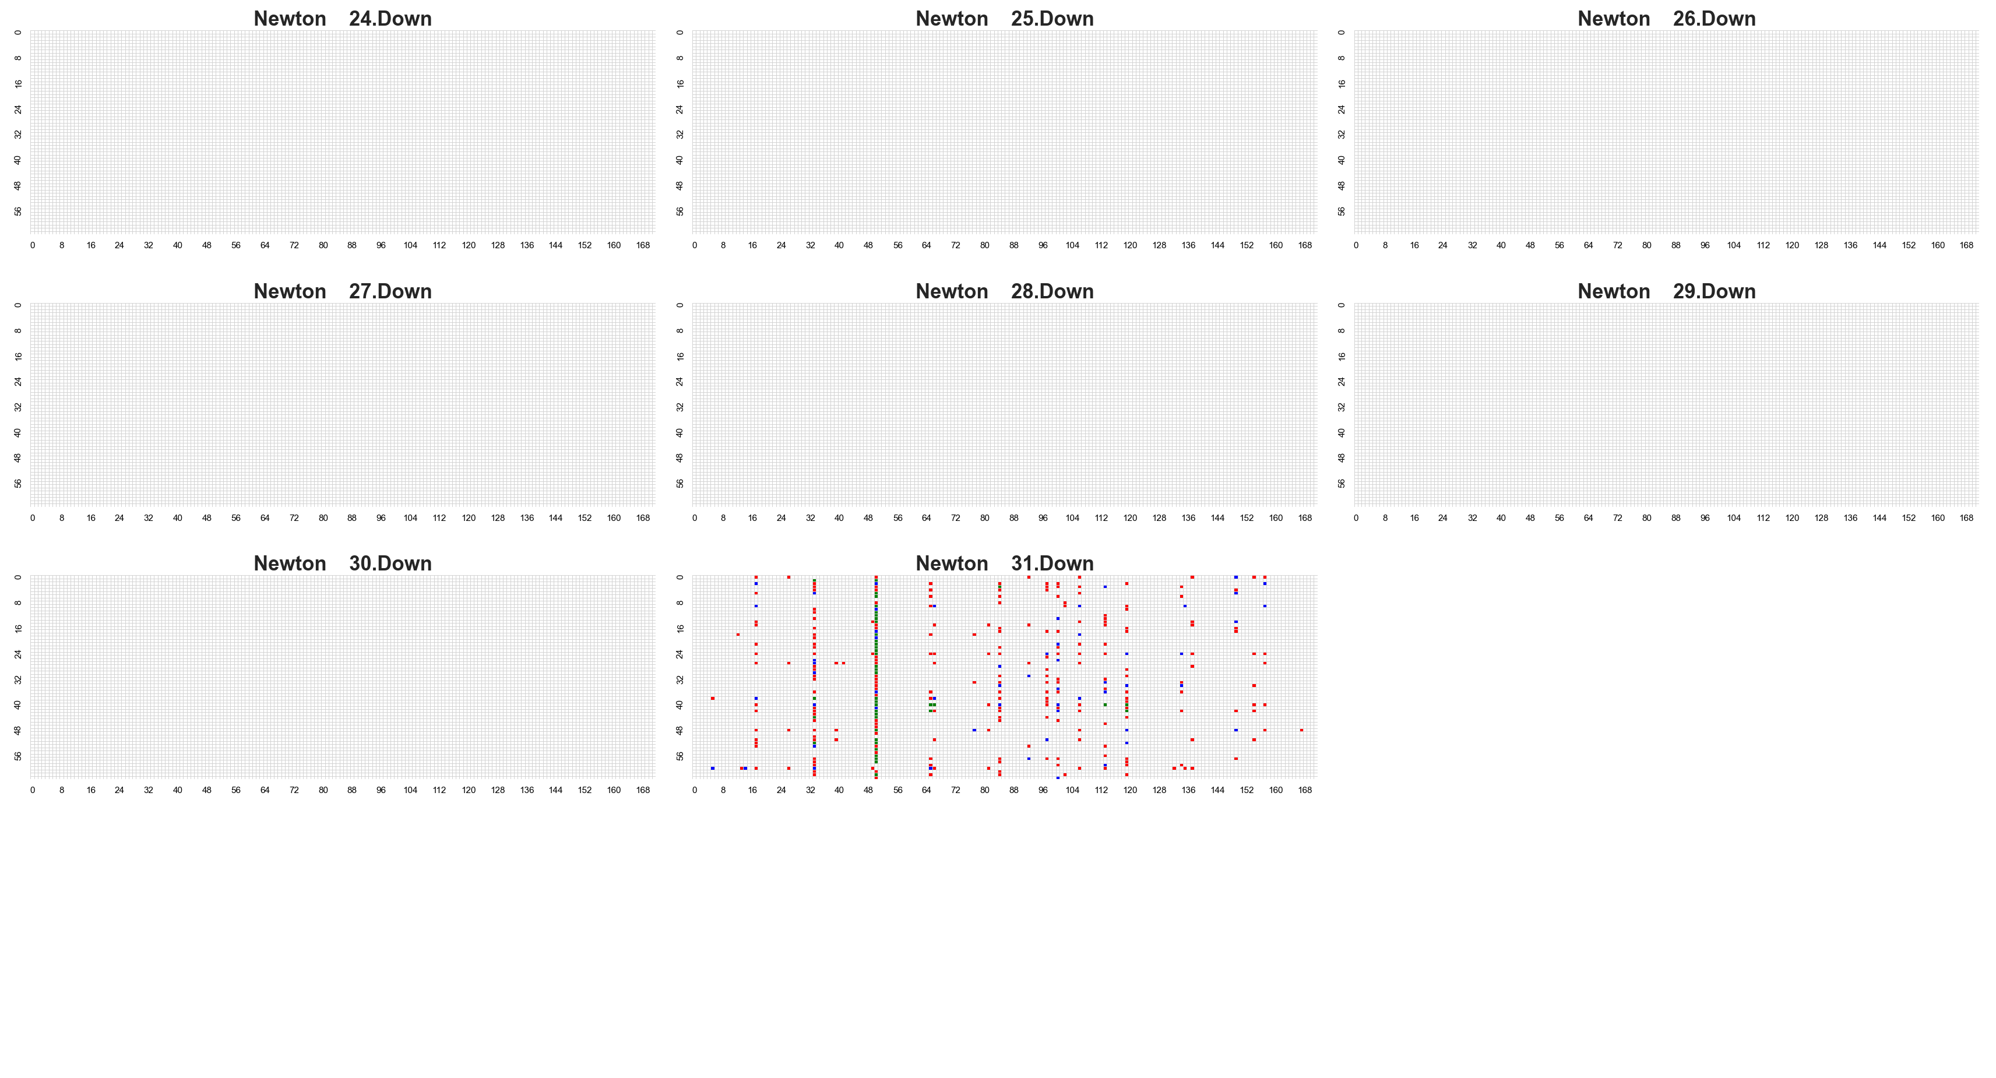

Slide 18
Zephyr Drosophila NSM cosine similarity <=0.5 Mmlu21 score <=8

Slide 19
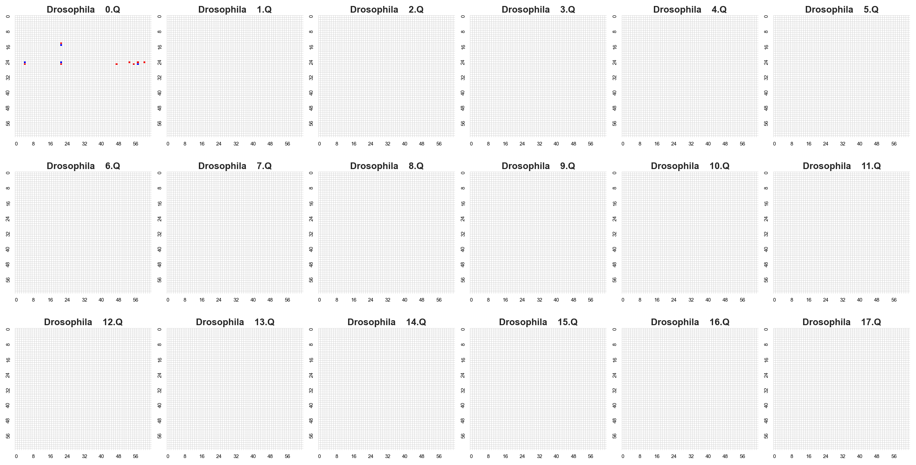

Slide 20
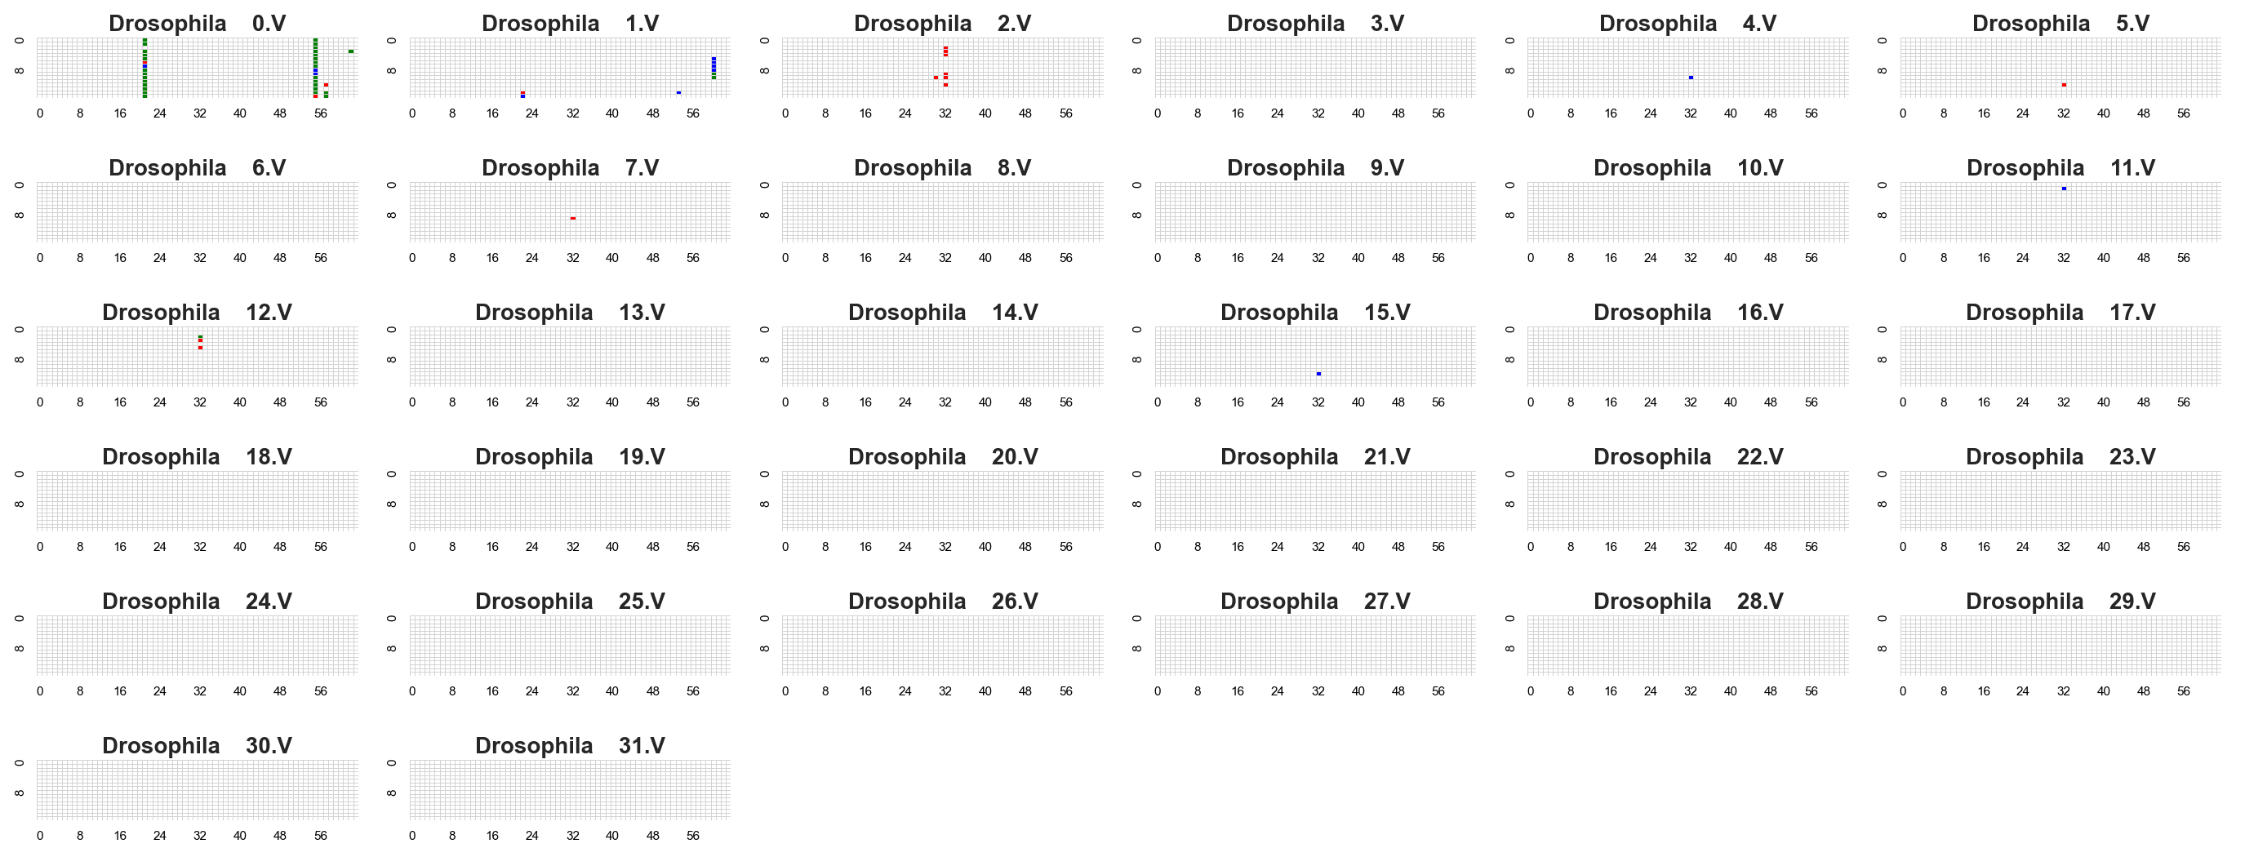

Slide 21
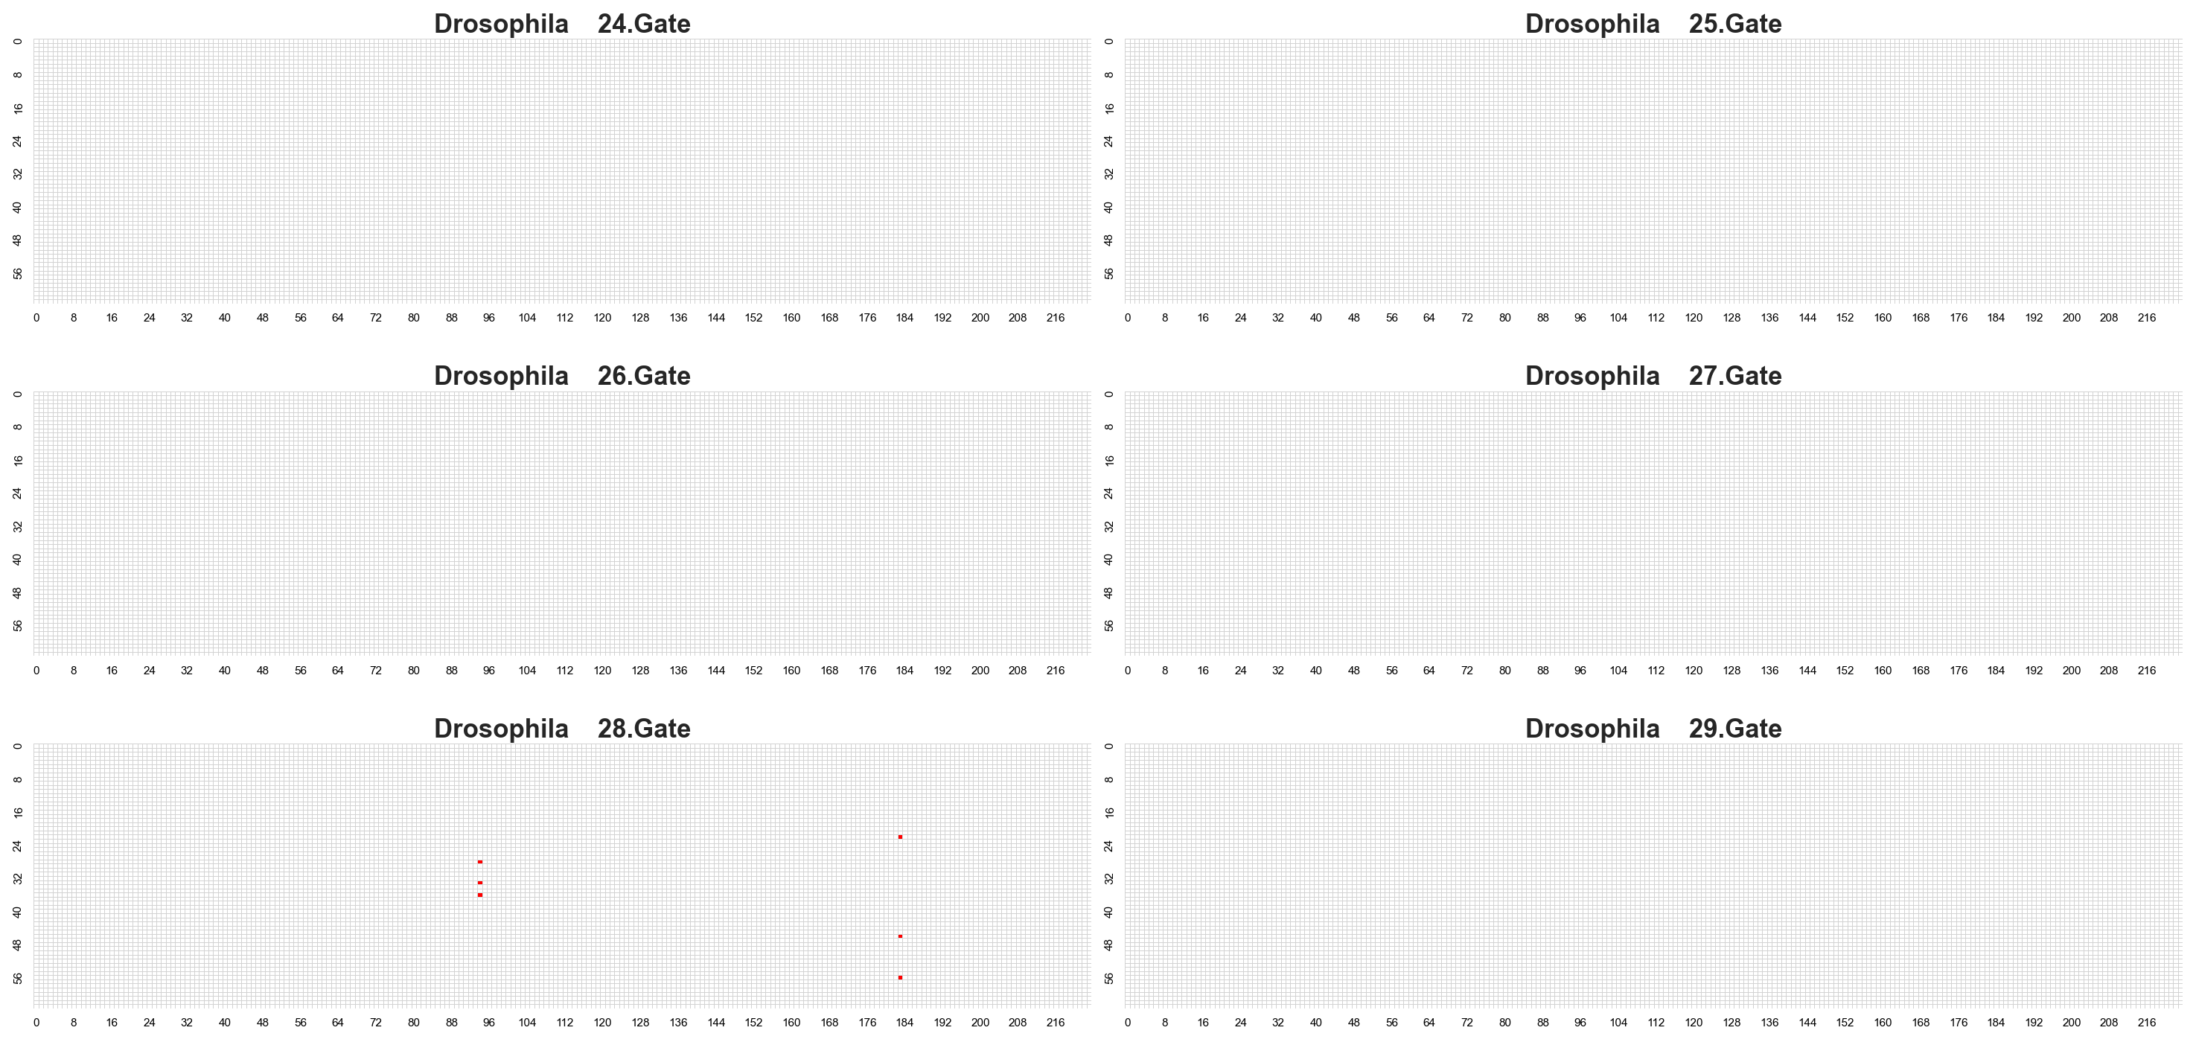

Slide 22
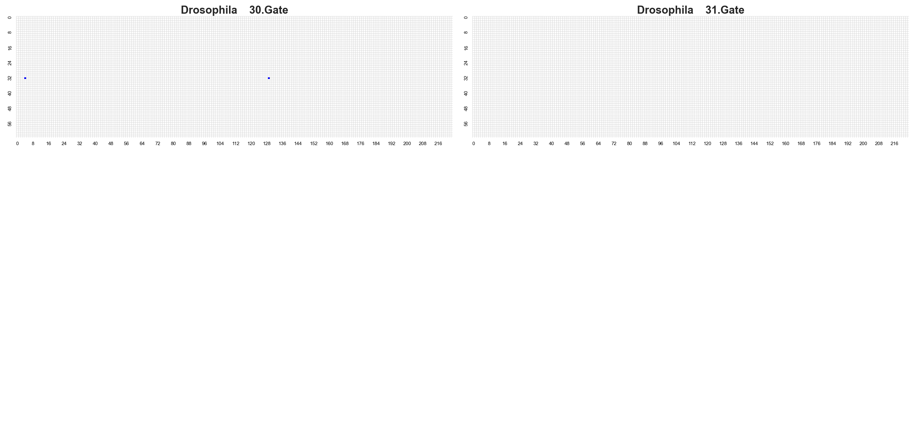

Slide 23
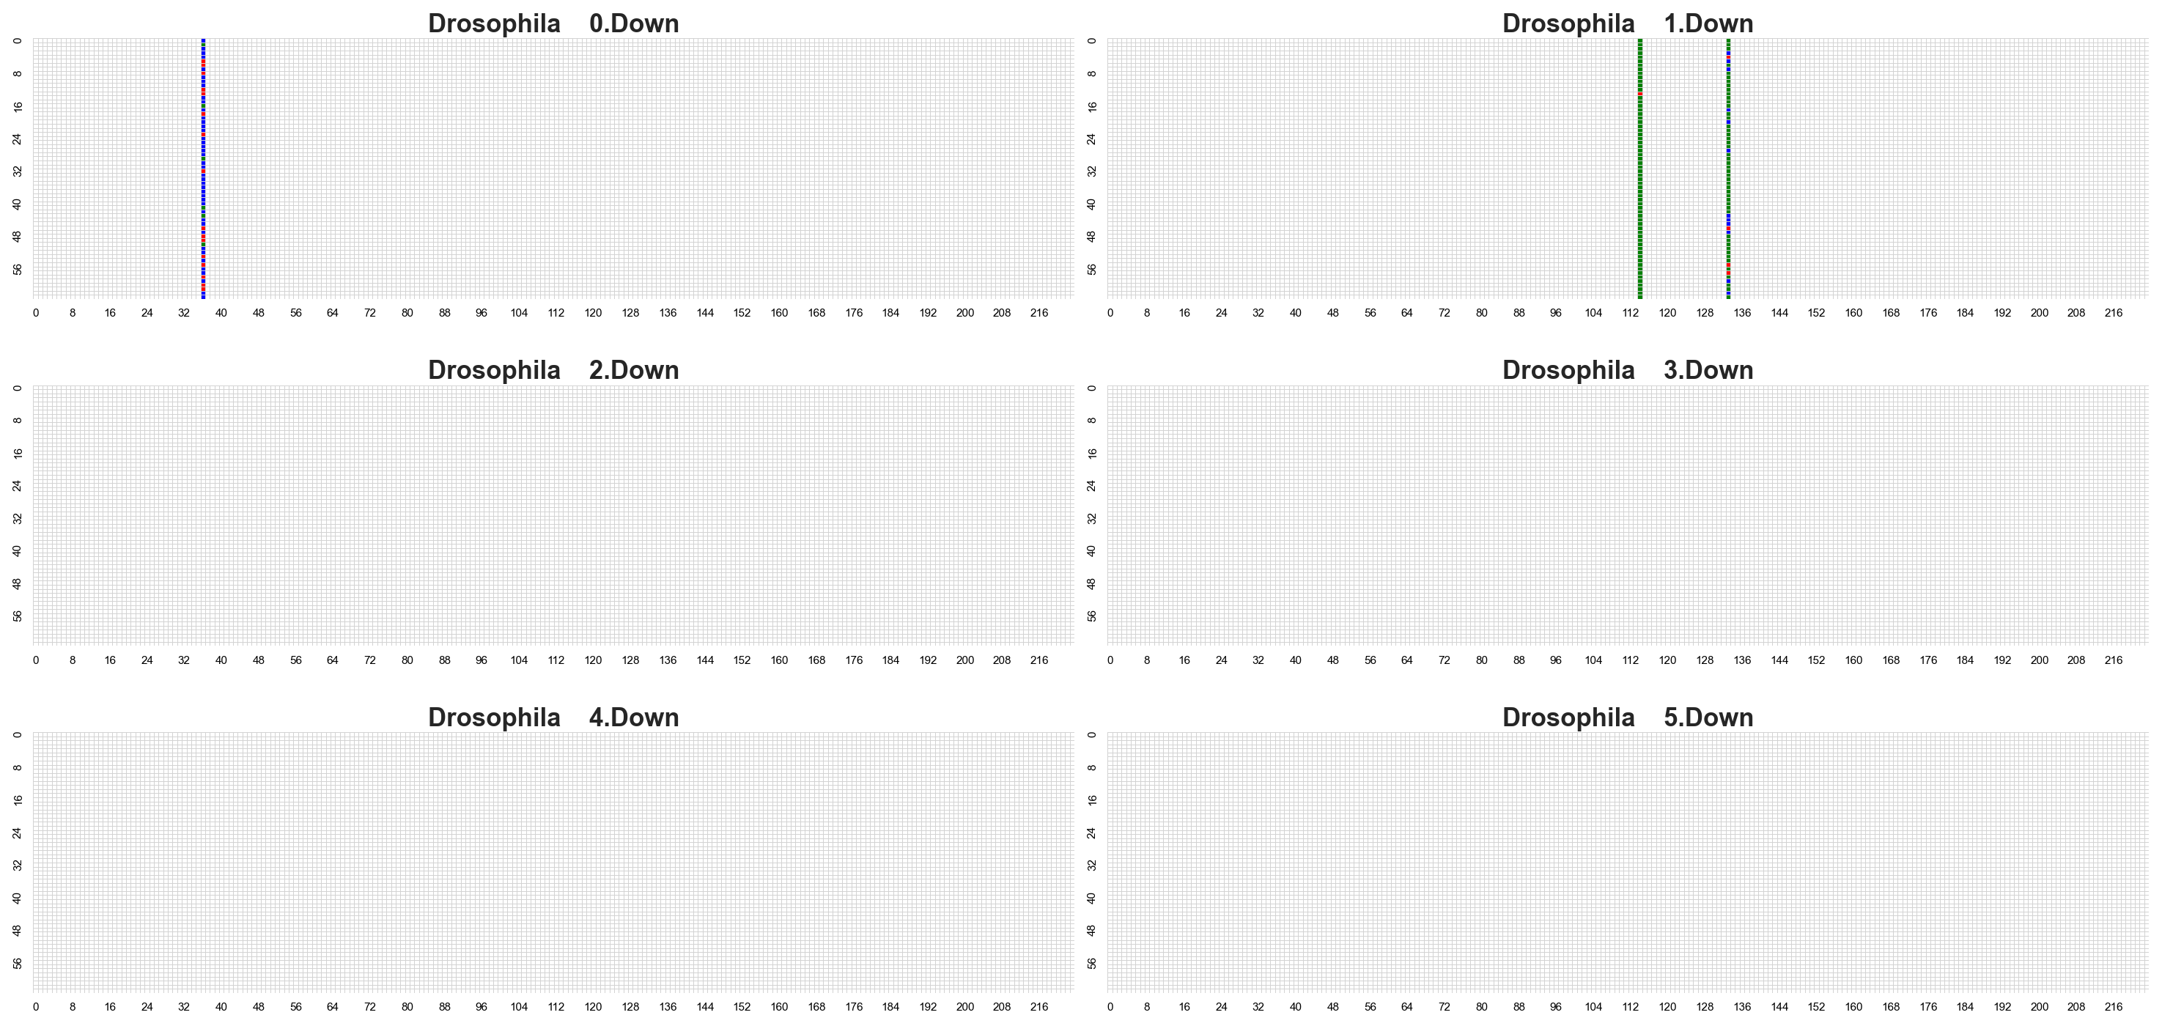

Slide 24
Zephyr Newton NSM cosine similarity <=0.5 Mmlu21 score <=8

Slide 25
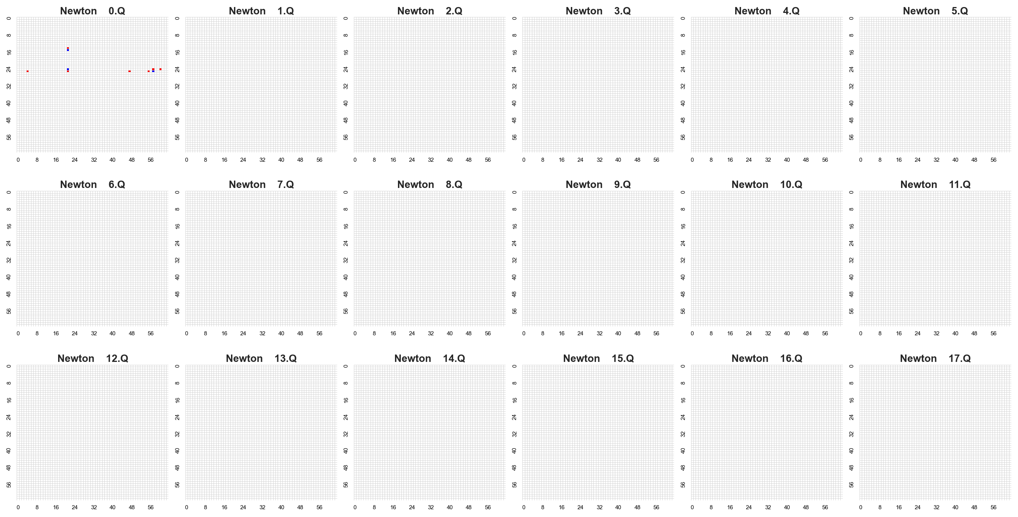

Slide 26
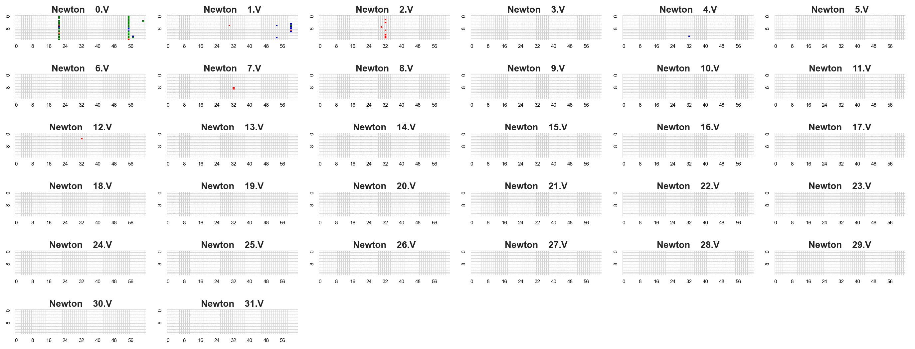

Slide 27
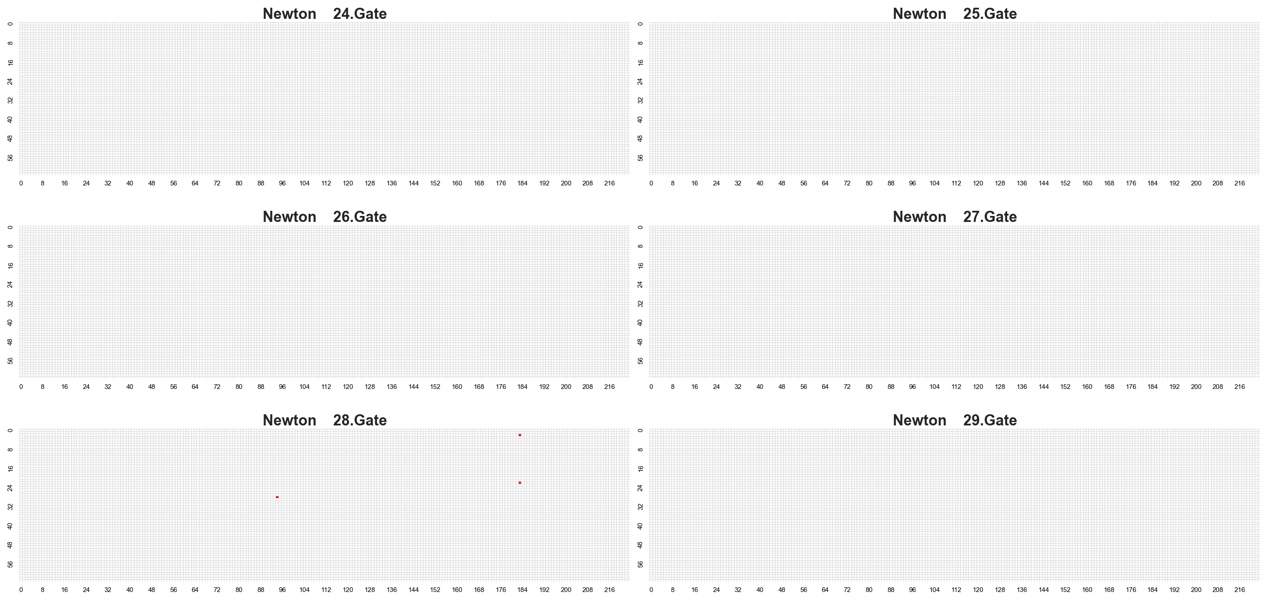

Slide 28
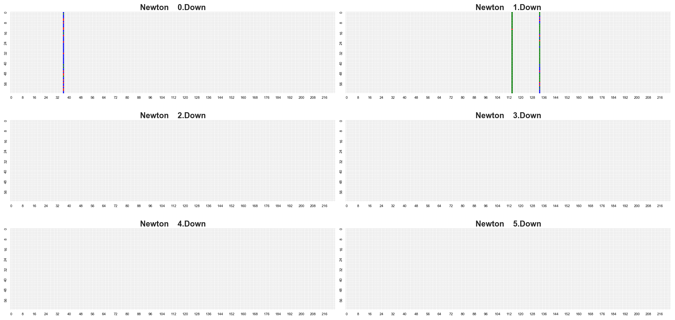

Slide 29
Zephyr P53 NSM cosine similarity <=0.5 Mmlu21 score <=8

Slide 30
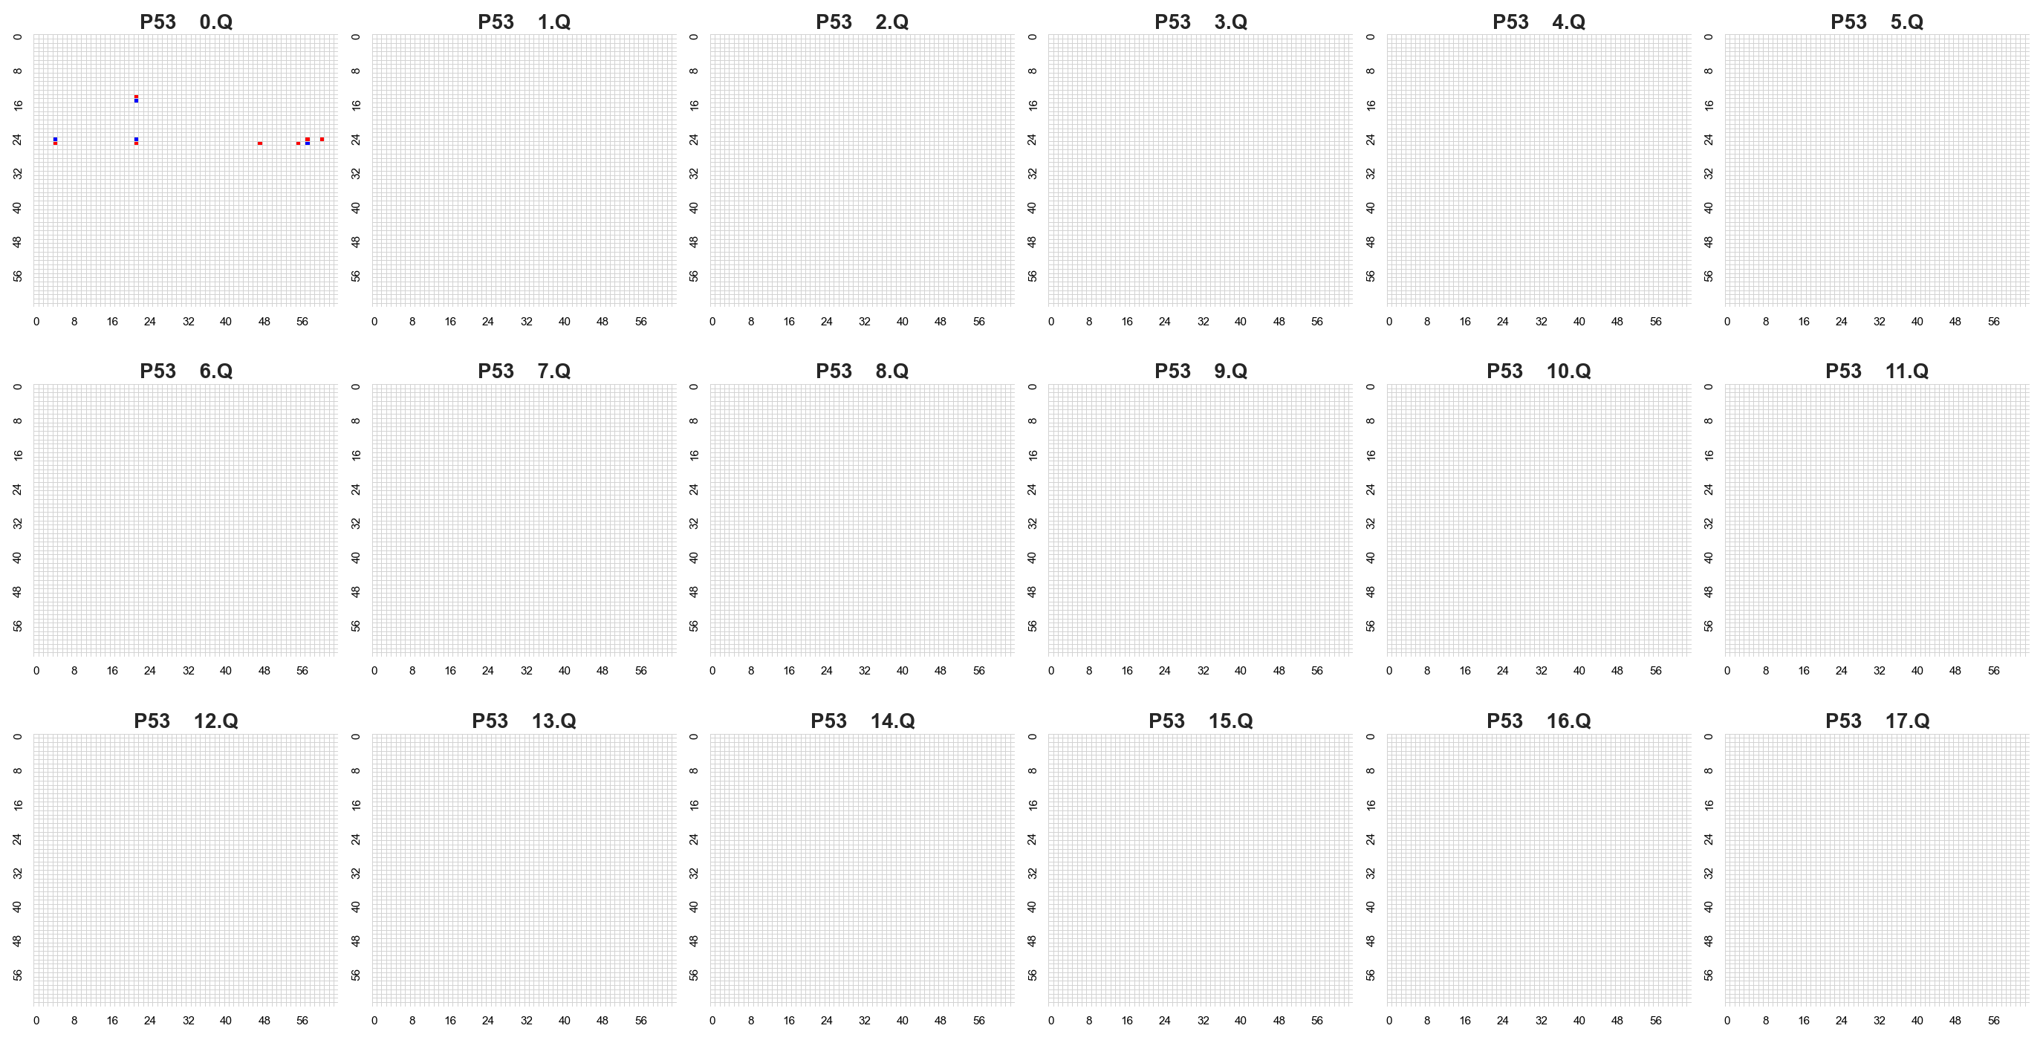

Slide 31
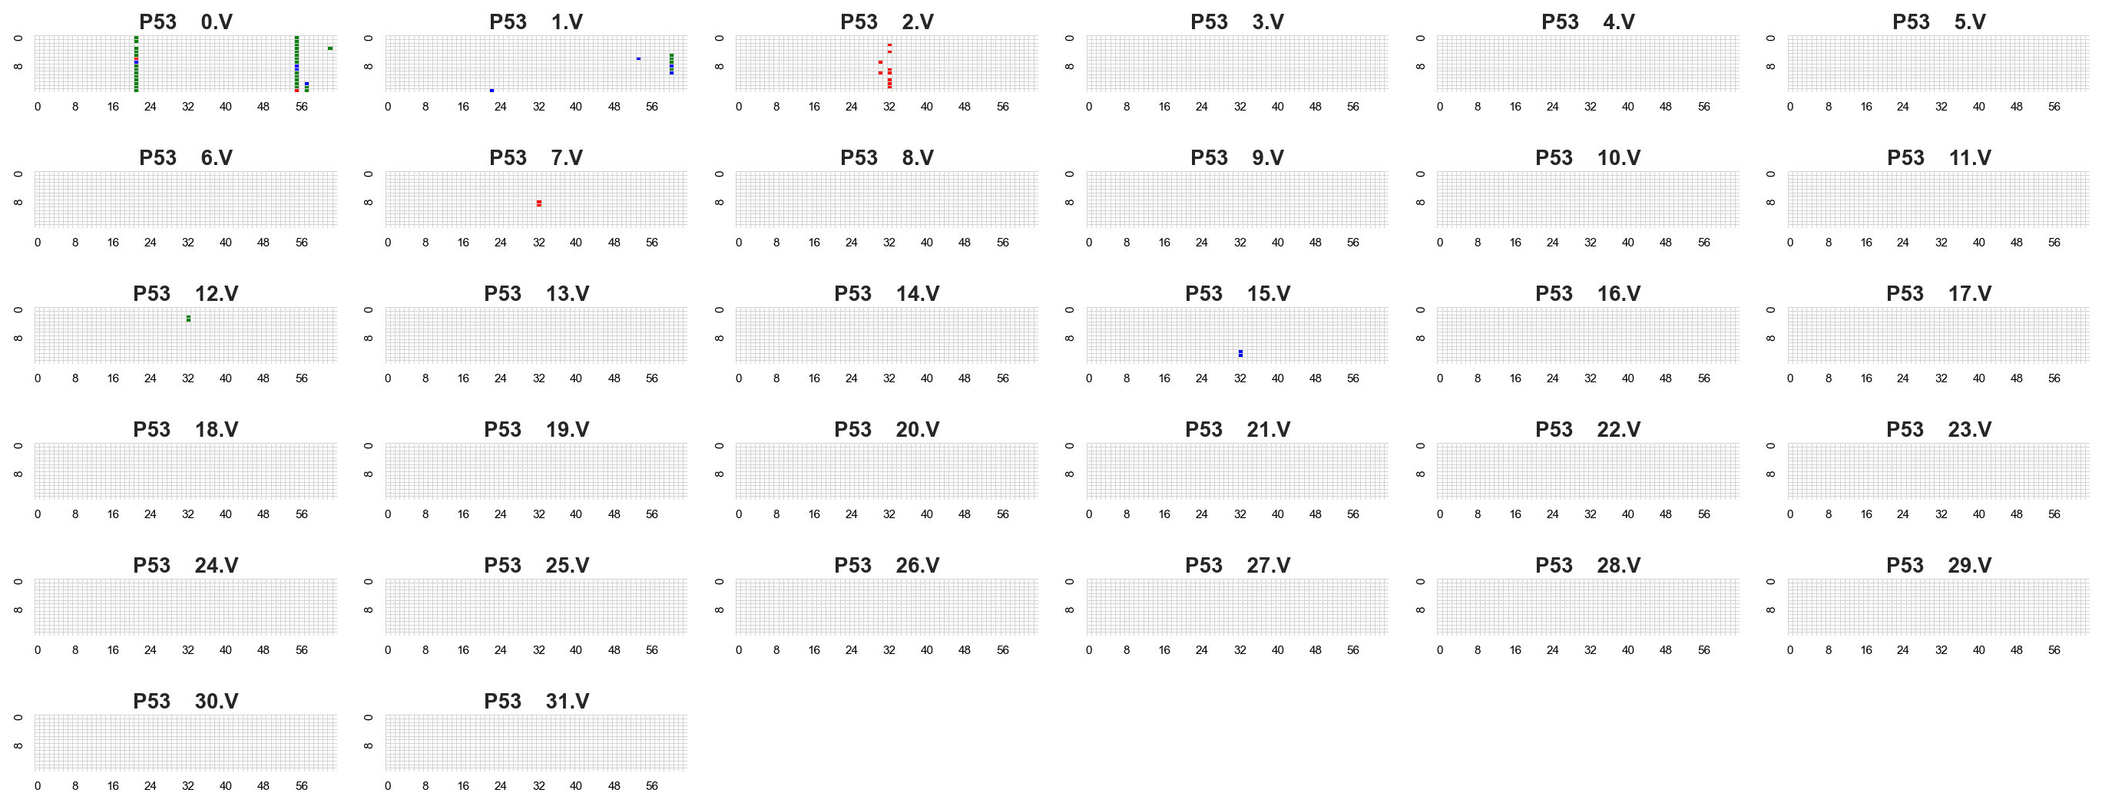

Slide 32
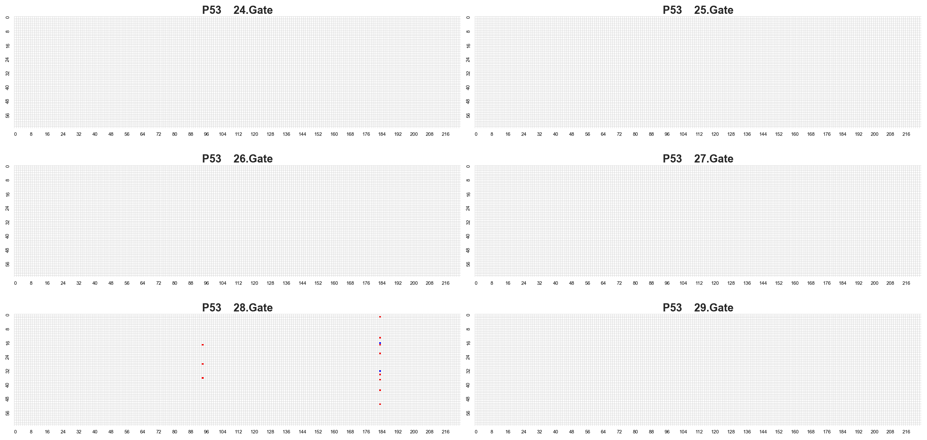

Slide 33
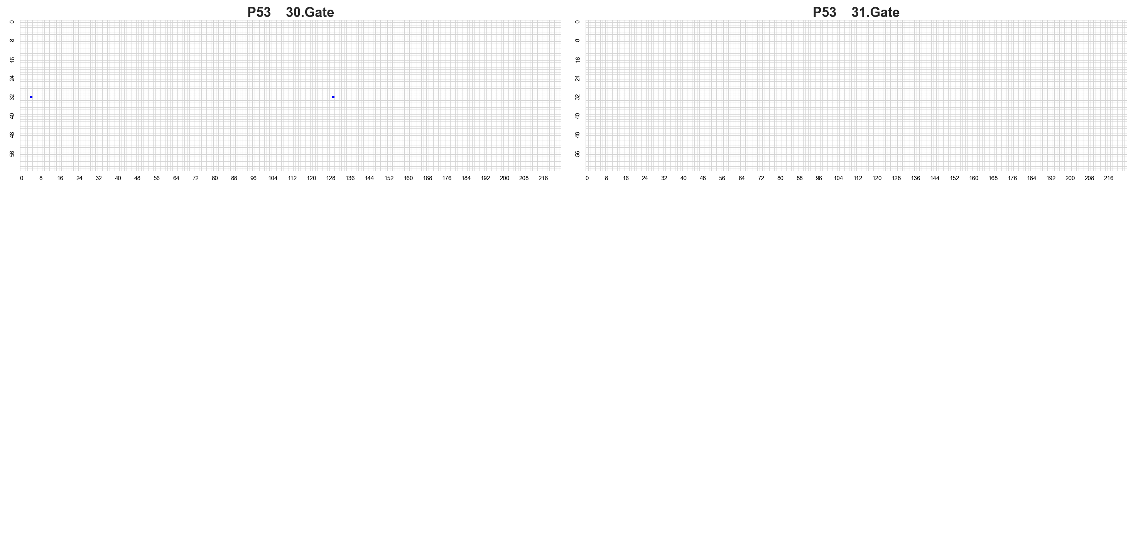

Slide 34
