Slide 1
Policy Agents with MADDPG in SCML2020World
YUE NING, 19.12.2020, Karlsruhe, Germany

Slide 2
Problems, Goal
Problem
Dynamically decide the ranges allowed for negotiation issues based on the market conditions and the status of agents, heuristic policy agent could only consider part of the situation. Many important factors will be ignored or wrongly considered. How to let agents learn to decide range by themselves?
Many problems can arise in multi-agent environments, One problem is that each agent’s policy is changing as training progresses, and the environment becomes non-stationary from the perspective of any individual agent. Traditional RL approaches such as Q-learning or policy gradient are poorly suited to multi-agent environments, and can not solve this problem.
Goal
let agents learn how to decide the range of negotiation issues by observing the market conditions and agent conditions.

Slide 3
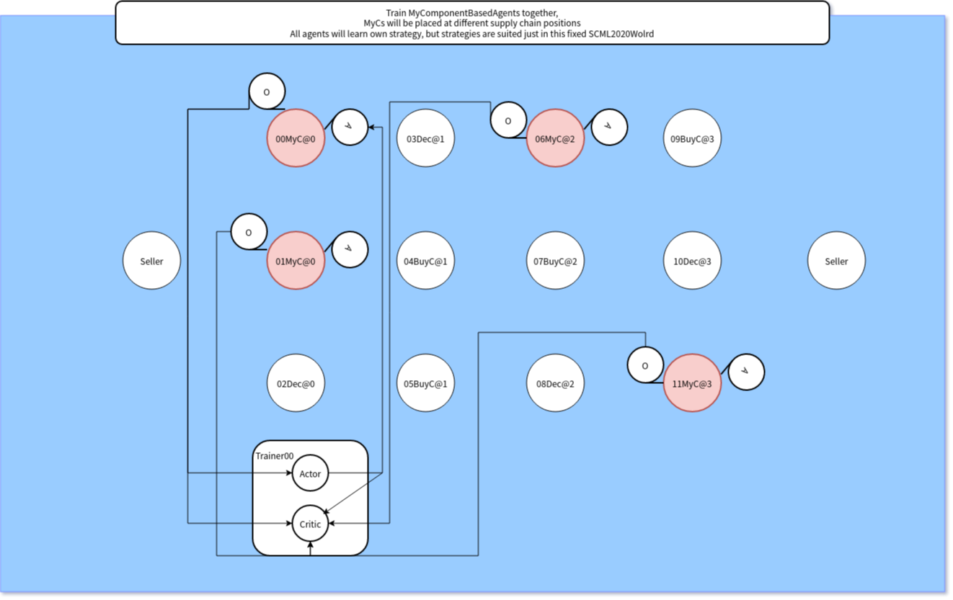
Overview of Model
A: Ranges allowed negotiation issues
O: profile.costs
agent._horizon
catalog_prices
running_negotiations
negotiations_requests
current_step
Economic gap

Slide 4
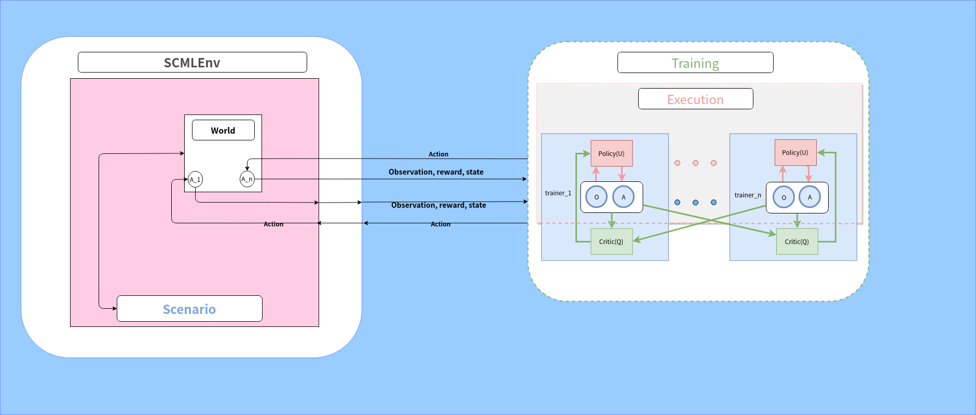
Overview of Model (SCMLEnv + MADDPG)
multi-agent decentralized actor, centralized critic

Slide 5
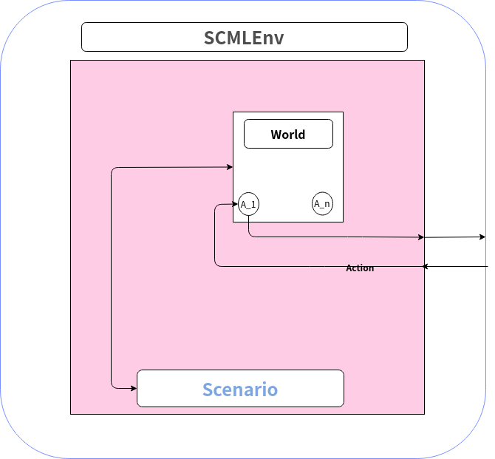
environment
Environement: SCMLEnv <= Gym.env, transfer informations of reward, observation to trainer
World: TrainWorld <= SCML2020World
world running logic
Agent: MyComponentsBasedAgent <= SCML2020Agent
agents with learning capabilities run in the SCML2020World
Scenario:
make environement, make world, reward callback, observation callback, done callback

Slide 6
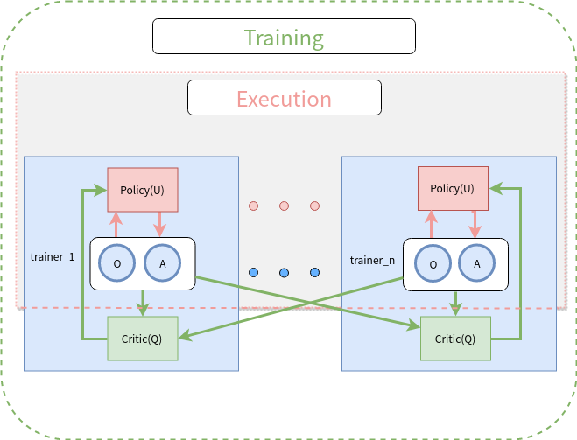
Model of Training, Execution(MADDPG)
Training:
allowing the policies to use extra information to ease training, so long as this information is not used at test time.
Execution:
observe the local information, decide the action of next step (increase or decrease ranges allowed negotiation issues.)

Slide 7
Summary
Solved Problems
learn to decide the ranges allowed negotiation issues
non-stationary environment
Remaining Problems
SCML2020World is not fixed. Does the trained strategy performs well in other world configurations?
2. At the beginning of every step in the world, new ranges allowed negotiation issues are created. But this ranges will not change within one world step.
Possible next step
1. Train agents’ ability: Wisely decide sell negotiation issues.
2. Implement agents’ ability: Wisely decide buy negotiation issues.
3. Expand to different worlds, learning different strategies in different worlds.
4. Implements a predictor to predict the type of world, when running the agent in tournaments.

