Slide 1
Negotiation Agent based on deep reinforcement learning Method
YUE NING, 24.11.2020, Karlsruhe, Germany

Slide 2
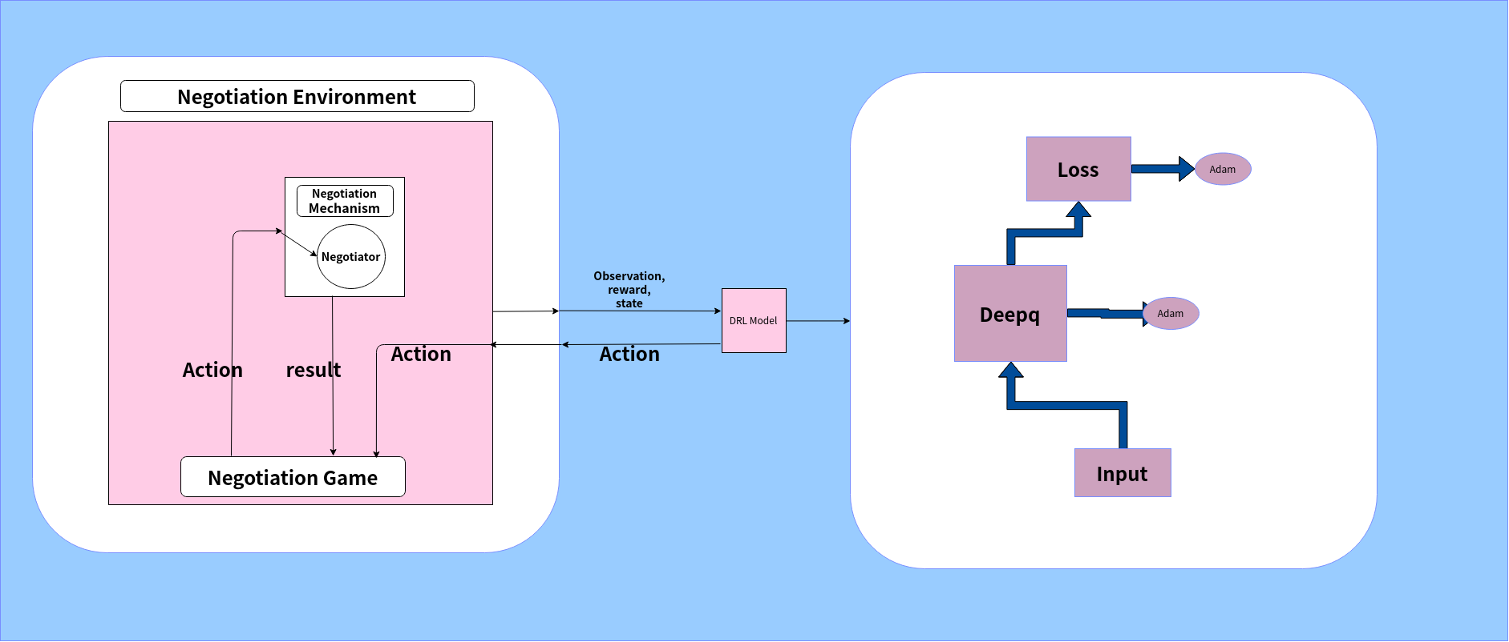
Model (Algorithm) and Policy network
DQN (Deep Q-Networks)：
Features representation，Decision
Features representation, Decision

Slide 3
Introduction of environment and game
Environment: NegotiationEnv
Build on the top of gym.env
source code of environment https://github.com/YueNing/tn_source_code
Observation Space: (Offer_of_Opponent, time)
Action Space:
Learning acceptance strategy:
ResponseType.ACCEPT_OFFER, REJECT_OFFER, END_NEGOTIATION
Learning offer/bidding strategy:
Outcomes of negotiation
Game: NegotiationGame
Wrap the negmas session (using SAOMechainsm)

Slide 4
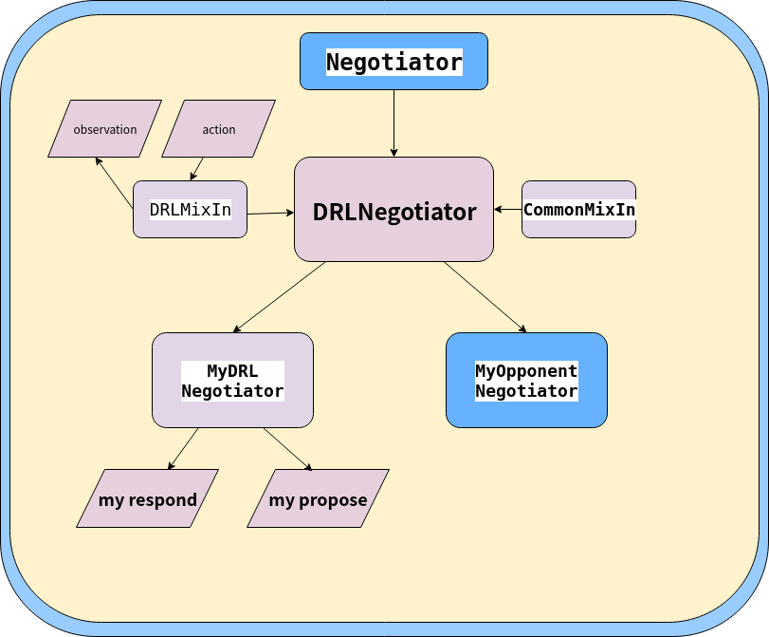
Negotiators

Slide 5
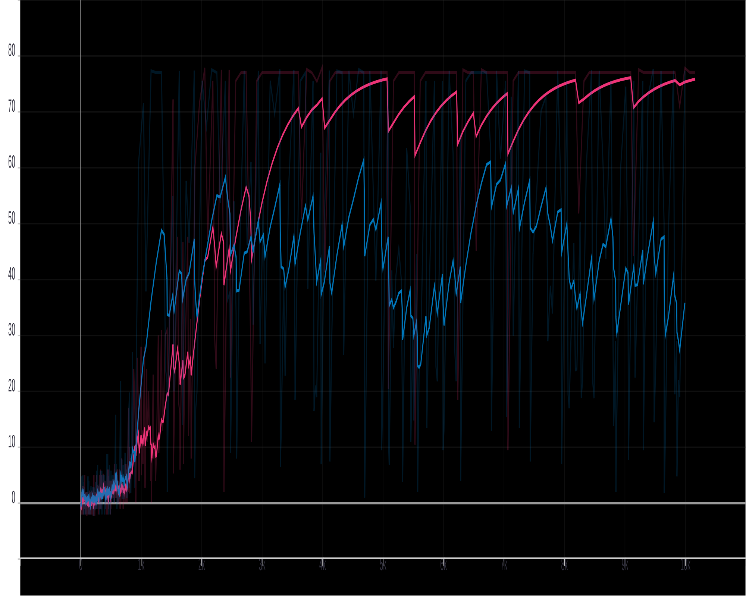
Learned Strategy: Acceptance Strategy (single issue, bilateral)
MyDRLNegotiator vs MyOpponentNegotiator(AspirationNegotiator)
Chart: Episode reward(Y-axis), total 10000 steps(X-axis)
pink line: ppo1, blue line: dqn

Slide 6
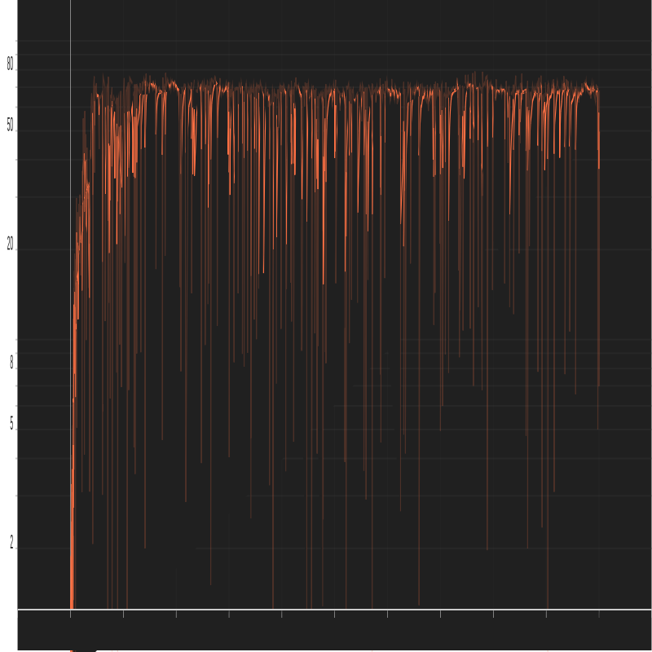
Learned Strategy: Offer/Bidding Strategy (single issue, bilateral)
MyDRLNegotiator vs MyOpponentNegotiator(AspirationNegotiator)
Chart: Episode reward, total 1000 steps

Slide 7
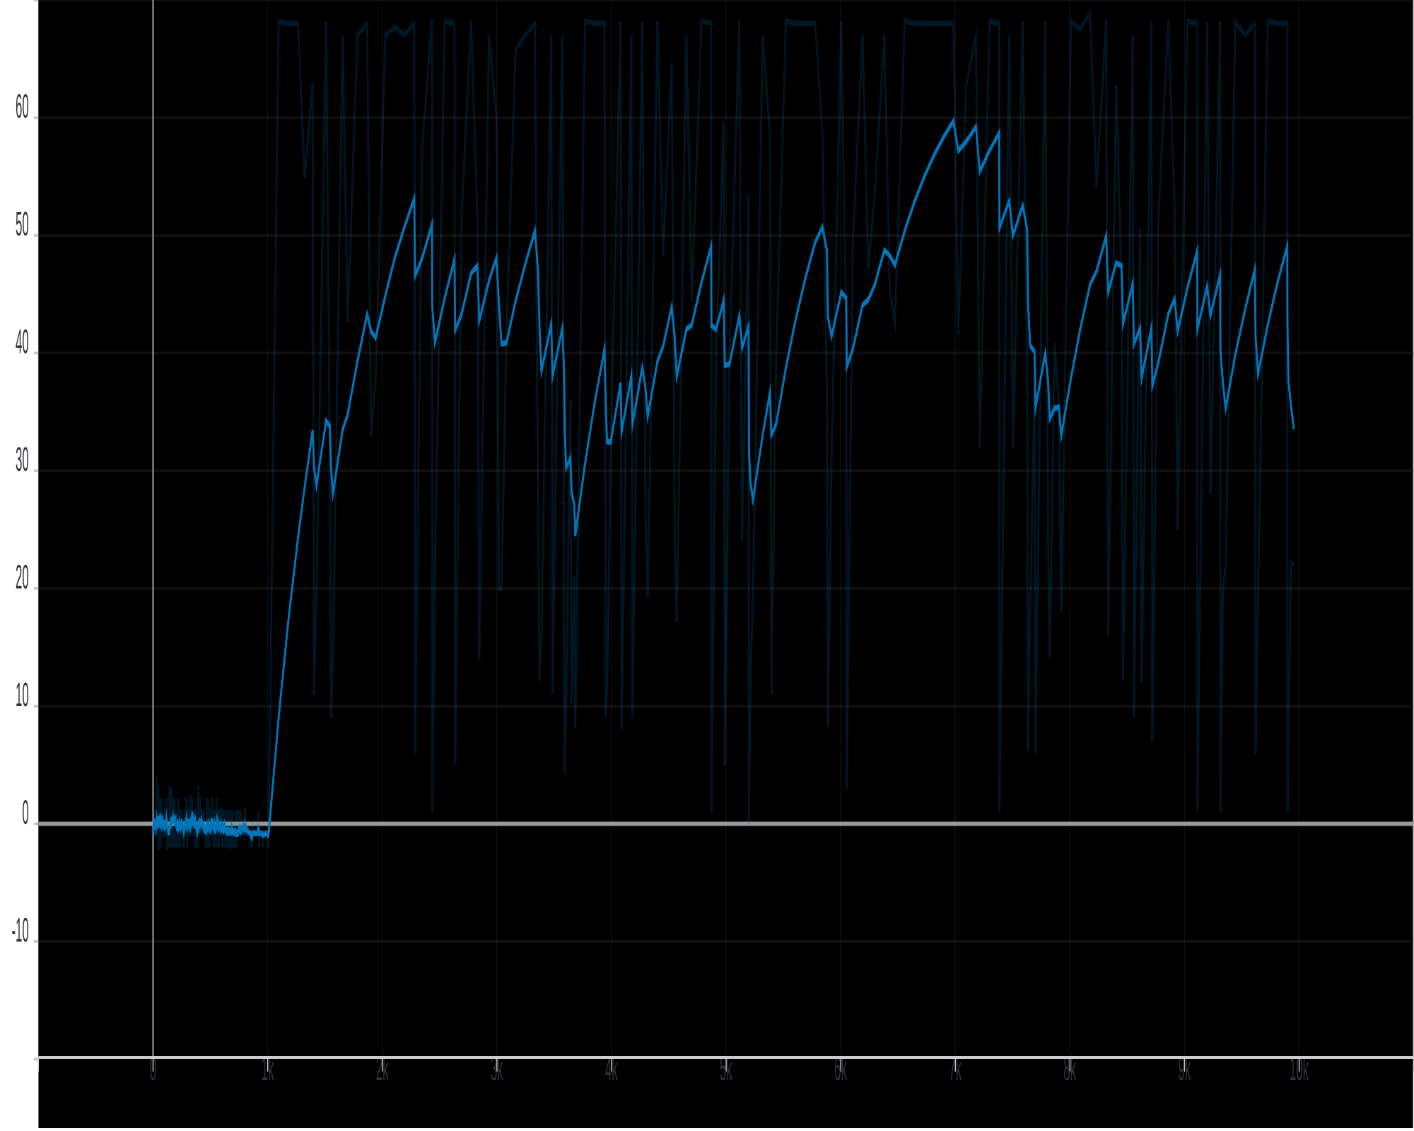
Learned Strategy: Acceptance Strategy (multi issues, bilateral)
MyDRLNegotiator vs MyOpponentNegotiator(AspirationNegotiator)
Chart: Episode reward, total 10000 steps

Slide 8
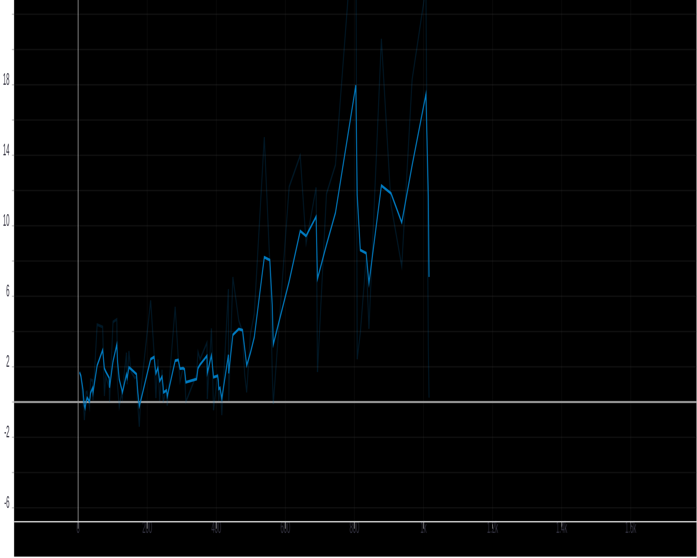
Learned Strategy: Offer/Bidding Strategy (multi issue, bilateral)
MyDRLNegotiator vs MyOpponentNegotiator(AspirationNegotiator)
Chart: Episode reward, total 10000 steps

Slide 9
Questions about bilateral negotiation
Design of reward
too hard to learn the ResponseType.ACCEPT_OFFER
Speed learning under multi issues
Connect two strategies, not just fix one strategy, with method hybrid negotiation
Evaluate the agent and others agents, qualitative and quantitative

Slide 10
Future work
Hybrid Negotiation
(consider both acceptance and offer/bidding strategy)
SCML’s learning environment
SCML’s agent based on deep reinforcement learning method
1. Trading strategy, predict
2. Negotiation Manager, Maily work here, use DRL method
3. Production Strategy

