Slide 1
Negotiation Agent based on deep reinforcement learning Method
YUE NING, 24.11.2020, Karlsruhe, Germany

Slide 2
Introduction of environment and game
Environment: NegotiationEnv
Subclass of gym.env https://github.com/openai/gym
Define and set the observation space and action space, render the environment
in this class. Env is designed as the portal of model, model interacts always diretly with environment.
Game: NegotiationGame
Wrap the negmas session (using SAOMechainsm) so that the environment can easily and securely connect the model with the session.

Slide 3
Introduction of negotiators
DRLNegotiator
Subclass of AspirationNegotiator(Negmas), define some attributes and method that will be used by drl model.
MyDRLNegotiator
Subclass of DRLNegotiator, overrides methods respond and propose, the logic of repsond and propose is related with the drl model.
MyOpponentNegotiator
Subclass of DRLNegotiator, almost similar as the AspirationNegotiator, just set some needed attributes defined in DRLNegotiator.

Slide 4
Model (Algorithm) and Policy network
DQN
Deep Q-Networks, discrete action, continious observation space
MlpPolicy Network:
PPO1
Discrete or continious action space, continiuous observation space
MlpPolicy Network

Slide 5
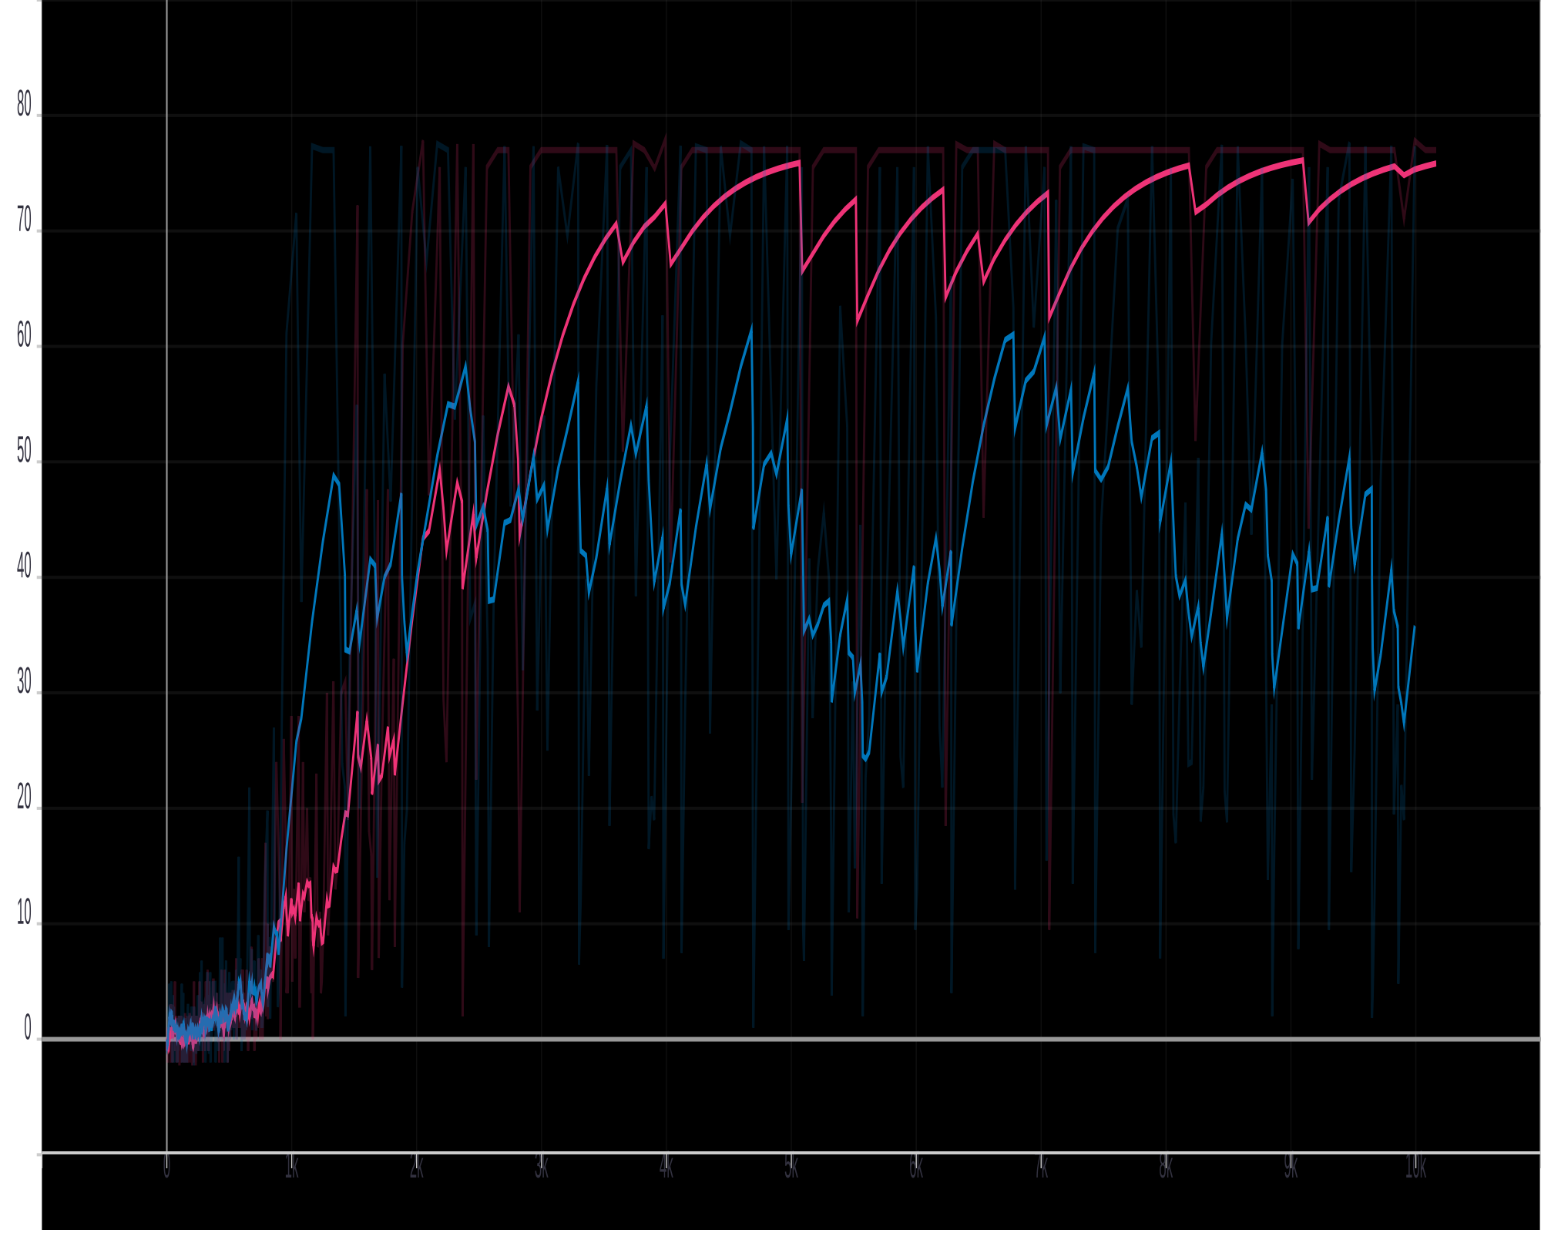
Learned Strategy: Acceptance Strategy (single issue, bilateral)
MyDRLNegotiator vs MyOpponentNegotiator(AspirationNegotiator)
Chart: Episode reward, total 10000 steps
pink line: ppo1, blue line: dqn

Slide 6
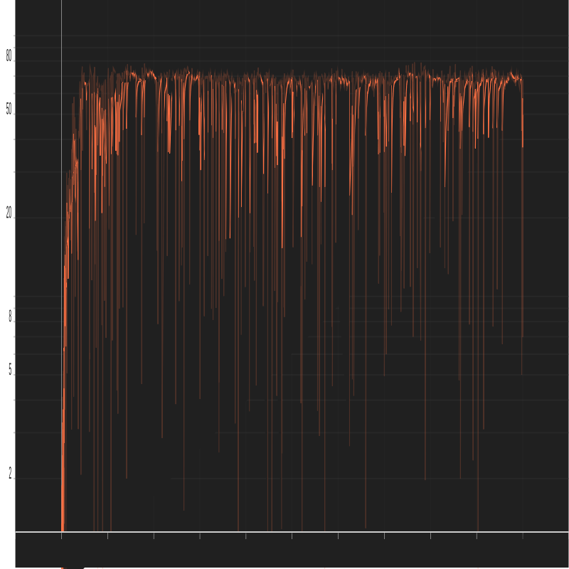
Learned Strategy: Offer/Bidding Strategy (single issue, bilateral)
MyDRLNegotiator vs MyOpponentNegotiator
Chart: Episode reward, total 10000 steps

Slide 7
Learned Strategy: Acceptance Strategy (multi issues, bilateral)
MyDRLNegotiator vs MyOpponentNegotiator(AspirationNegotiator)

Slide 8
Learned Strategy: Offer/Bidding Strategy (multi issue, bilateral)
MyDRLNegotiator vs MyOpponentNegotiator

Slide 9
Questions
Design of reward
Speed learning under multi issues
Connect two strategy

Slide 10
Future work
Hybrid Negotiation (both acceptance and offer/bidding strategy)
SCML agent based on deep reinforcement learning method

