Slide 1
Policy Agents with MADDPG in SCML2020World - Evaluation -- Dynamic range allowed negotiation issues
YUE NING, 10.01.2021, Karlsruhe, Germany

Slide 2
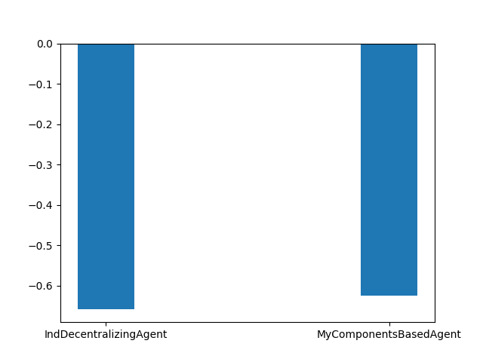
Train and evaluate agents with IndDecentralizingAgent
Good result
Baseline: score of IndDecentralizingAgent
The different between agents:
range of unit price of product for Negotiation
Run in the following World configuration,
n_steps = 100
agents_type = [IndDecentralizingAgent, MyComponentsBasedAgent]

Slide 3
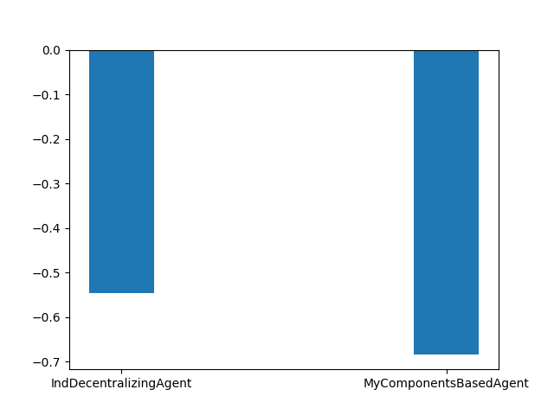
Train and evaluate agents with IndDecentralizingAgent
Bad result
Under configuration,
n_steps = 100
agents_type = [IndDecentralizingAgent, MyComponentsBasedAgent]

Slide 4
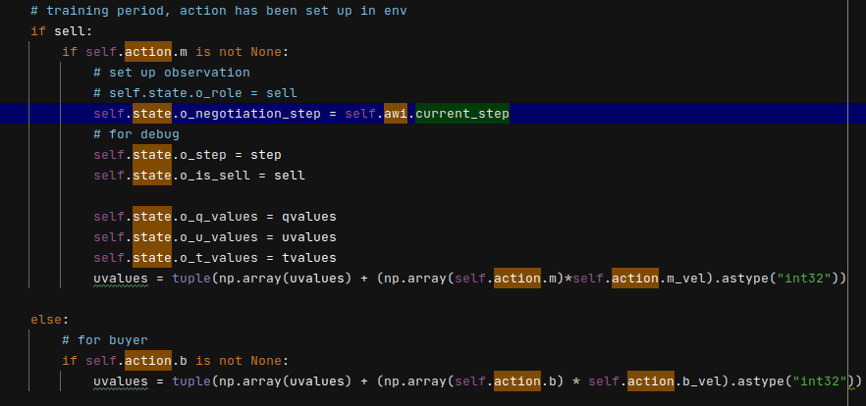
Code, Training
action.m: decided action for sell negotiation
action.b: decided action for buy negotiation

Slide 5
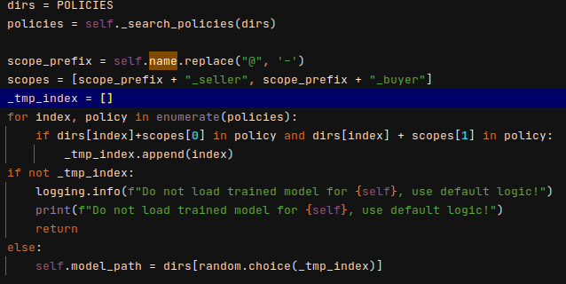
Code, Select Model
Load all learned policies of this Agent(e.g. 00MyC@0), and random choice one from these.

Slide 6
Summary
Dynamic range allowed negotiation issues has little effect on the agent.
Solved Problems
dynamically decide sell and buy range allowed negotiation issues.
Learn different policies in different worlds
Still existing problems
The score is not good. No substantial improvement
Possible reasons
The training steps are not enough. Now there are 100 episodes, and a simulation episode can have up to 100 steps.
Designs of observation, reward of agent are not good enough.
Trained policies are just suitable in a fixed world, although agents learn different policies in different worlds, but just randomly select the policies from learned policies.

Slide 7
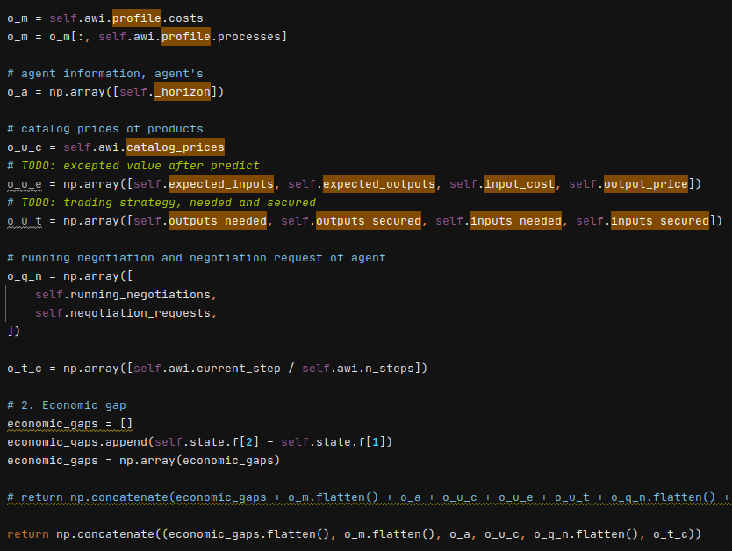
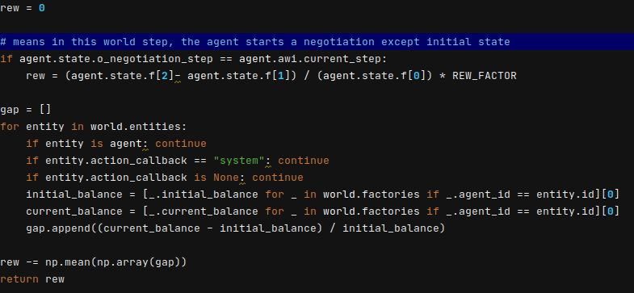
Summary
Questions:
1. What factors affect the ranges allowed negotiation issues, These factors will be regarded as important conditions for designing agents’ observation.
2. Also what factors affect concurrent negotiation issues
Possible next step
1. Implements a predictor to predict the type of world instead random, when running the agent in tournaments.
2. Focus on the Concurrent negotiation control.
observation
reward

