Slide 1
Collect Result
Bilateral, Mulit-agents’ negotiations, Thesis plan
Yue Ning: 2137291

Slide 2
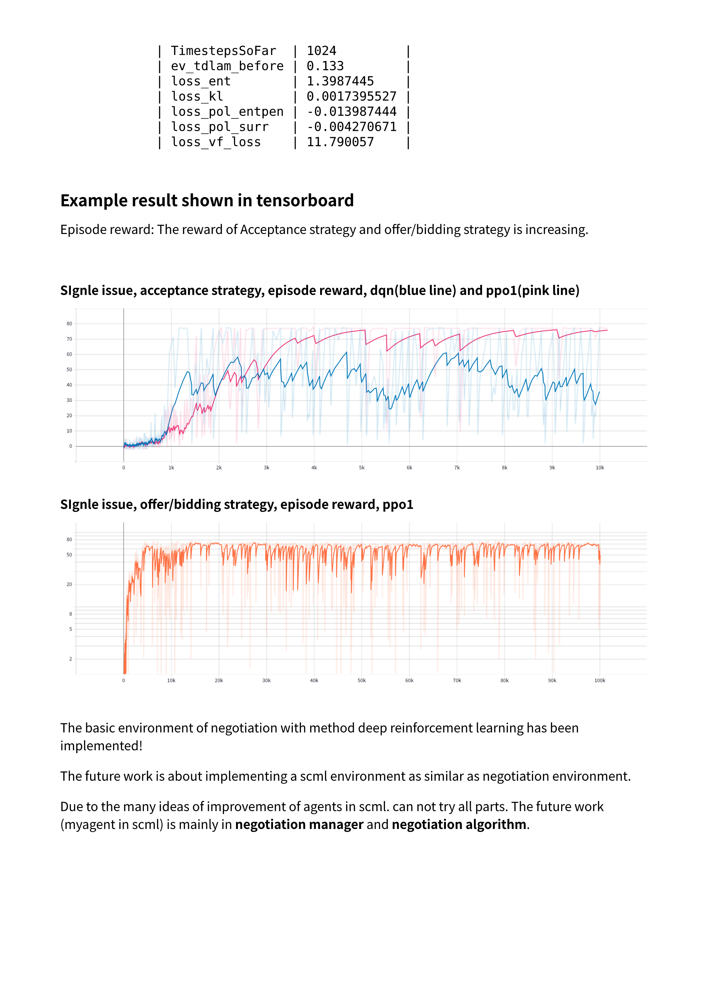
Two agents’ negotiation (Bilateral Negotiation)
Learned Strategies
Strategy of Response
Strategy of Propose
Learning Environments
single issue
multi issues
Algorithms
DQN
PPO1

Slide 3
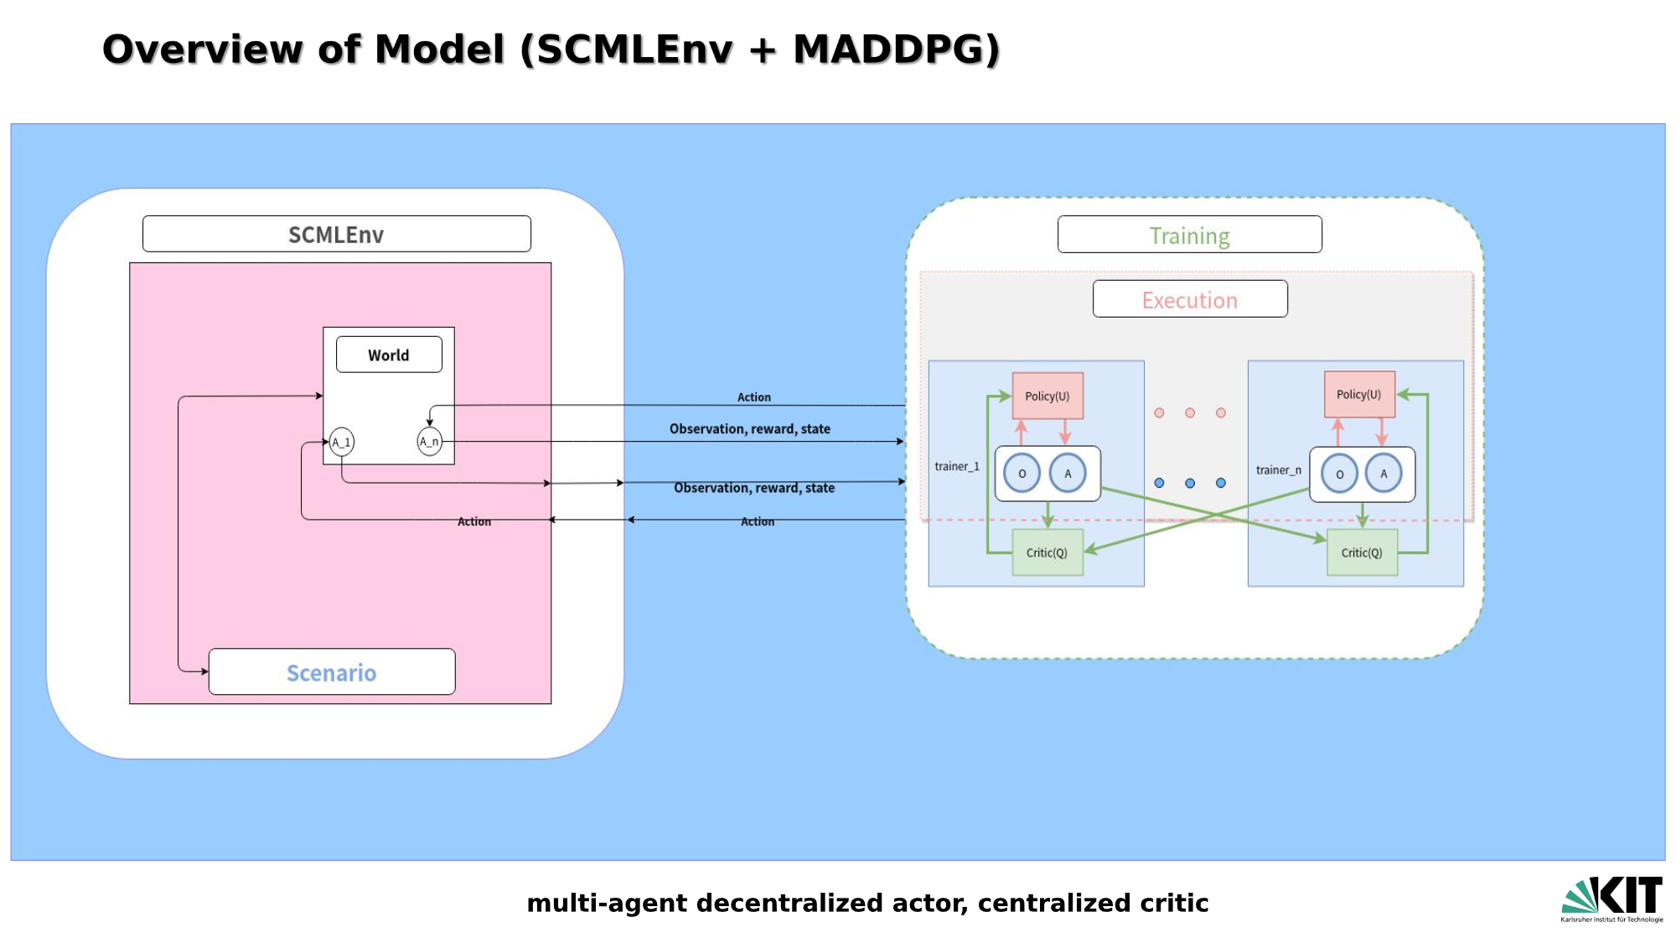
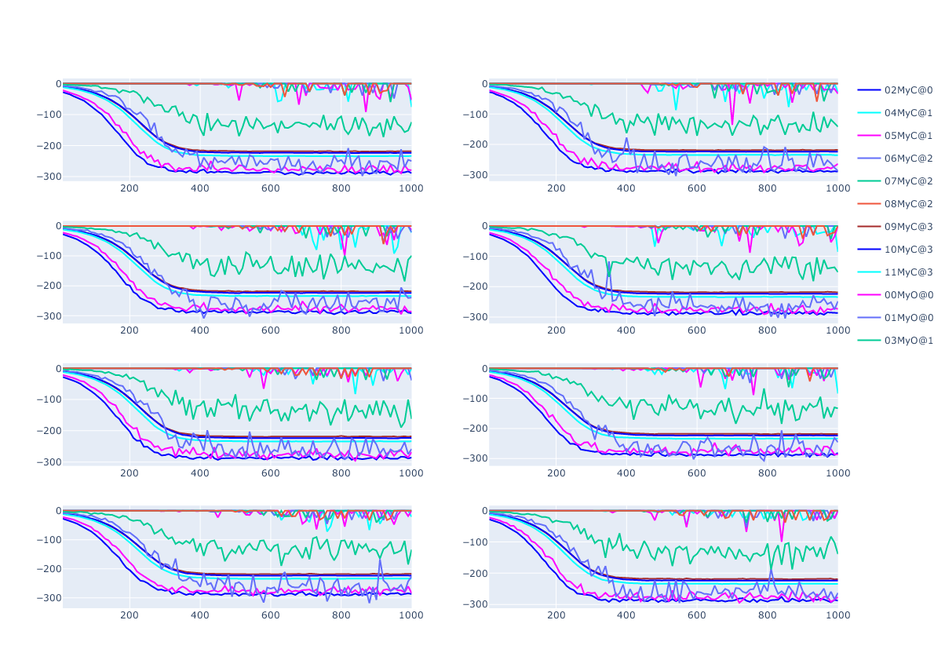
Multi-agents’ negotiations (ongoing)
Algorithm
Multi-Agent Deep Deterministic Policy Gradient (MADDPG)
Learning Environment
SCML2020World
Learned Strategies
Determine the scope of negotiation issues
Strategy of Response

Slide 4
Thesis plan
Time
Middle of february to the end of March
Structure
Knowledge about Negmas and Scml
Two agents, Bilateral negotiation under Negmas
Multi-agents, complex environments negotiations under SCML
Evaluation, RL Algorithms under the Negmas and SCML

