Slide 1
Sharing Android screen for customers service
Team name : Beside You
Yue Sun, Wenpeng Wang, Yu Jun, Aoshuang Wang
Oct 12 2016
Notes:
‹#›

Slide 2
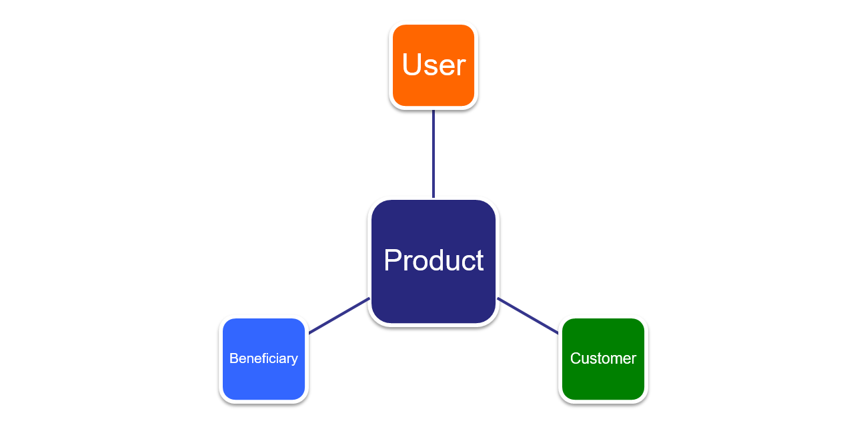
Product : Beside You
Beneficiary : Android User & Tech Supporters(Bestbuy, Mobile Carriers(AT&T, T-Mobile), Mobile phone manufacturer(Samsung, Huawei), Android developer)
Customer : Android Mobile Phone Users
User : Android User & Tech Supporters(Bestbuy, Mobile Carriers(AT&T, T-Mobile), Mobile phone manufacturer(Samsung, Huawei), Android developer)

Slide 3
What's the Project
*
It's an Android and PC platform application.
End-to-end Sharing the screen.
Establish the connection between server and client.
Server supplies service and client gives feedback.
Clients communicate via text or voice.
‹#›

Slide 4
Issues we will meet
How does PC share screen with android device
How to design the relation of user and supporter
How to communicate with each other
How to resolve the log in

Slide 5
Main use cases
*
Customer’s mobile phone has some issue that can not be solved and pull a request.
Supporters received request from one customer and sends request for sharing screen.
Customer receives the request and start sharing screen.
Users end the service and finish feedback.
‹#›

Slide 6
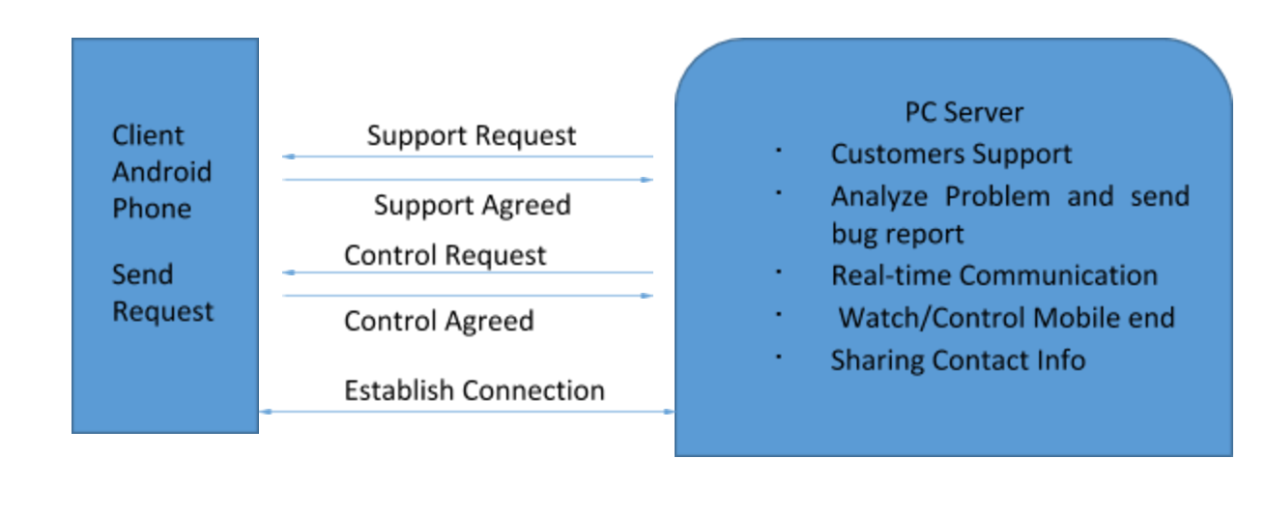
System level diagram level 1
*
‹#›

Slide 7
Specify project design
App on user’s mobile phone
Information the app provides
- Sign in & Sign up
- Up to date tech news
Connect to tech supports
Share screen
Feedback after help session
Ultimately solution
- Google Map to show nearby tech support stores
- Contact info on Android download market

Slide 8
Research on our project
*
Technology: WebRTC
Challenges:
-Build the connection of sharing screen between mobile phone and PC
-Build up the communication.
-How to pull a request and how to accept a request
Describe competition: Unique
‹#›

Slide 9
Sprint 1
*
✓ Determine the use cases of the product
✓ Configure environment of Android
✓ Followed tutorials of sharing screen between the
browsers
✓ Searched tutorial of WebRTC to Android to integrate
the WebRTC into Android Platform
‹#›

Slide 10
Next Sprint
Realise WebRTC on Android peer-to-peer communication and screensharing
Build and test the Android application
- Login page
- Sharing screen
- Feedback rating
Start to learn how to use AWS and MongoDB to
process the database

Slide 11
Q&A

Slide 12
THANK YOU
*
‹#›

