Slide 1

Sharing Android Screen for Customer Service
Sprint 3: Nov 30, 2016
Yue Sun, Wenpeng Wang, Yu Jun, Aoshuang Wang
Github Link Trello Link
Notes:
‹#›

Slide 2
System Diagram
*
WebRTC peer to peer Connection
Between Android device and PC
Log in request
client
Chrome Browser
Verified
AWS:
1. Node.js / npm
2. mongoDB server(27017)
3. Login app(8080)
3. App server(3000)

Slide 3
Original Tasks
*
Feature:
Peer-to-peer live chat(done)
Security & Permission(done)
Communicate with the other end(voice)(done)
Livestream(done)
Hang out on AWS(done)
Peer-to-peer screen sharing(to be continued...)
‹#›

Slide 4
Challenges
*
Build login module and WebRTC module.
Combine two modules into one Android Application and resolve the conflict error.
Install Node.js and npm and MongoDB on linux virtual machine.
Run server and access MongoDB remotely using device.
Access PC camera in Chrome from cloud server.
‹#›

Slide 5
DEMO - App
*
Login Server
Database
Client
WebRTC Server
Node.js
web server serves on port 8080
MongoDB
stores user information
Android Studio application
(2 modules):
Login module
WebRTC module
WebRTC server node on port 3000
‹#›

Slide 6
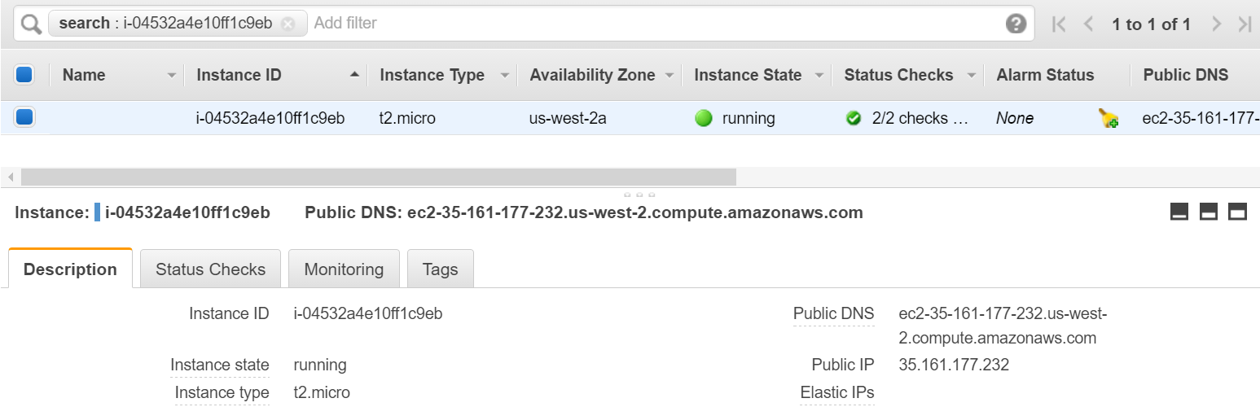
DEMO - AWS
Create an Instance

Slide 7
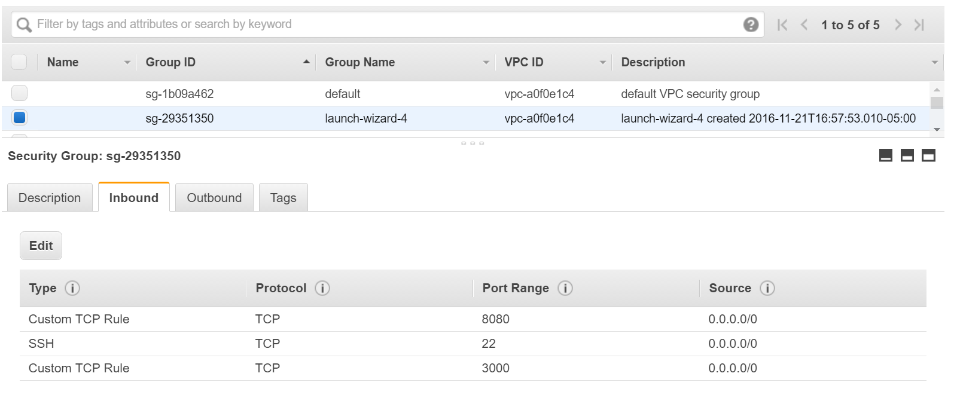
DEMO - AWS
Port Forwarding

Slide 8
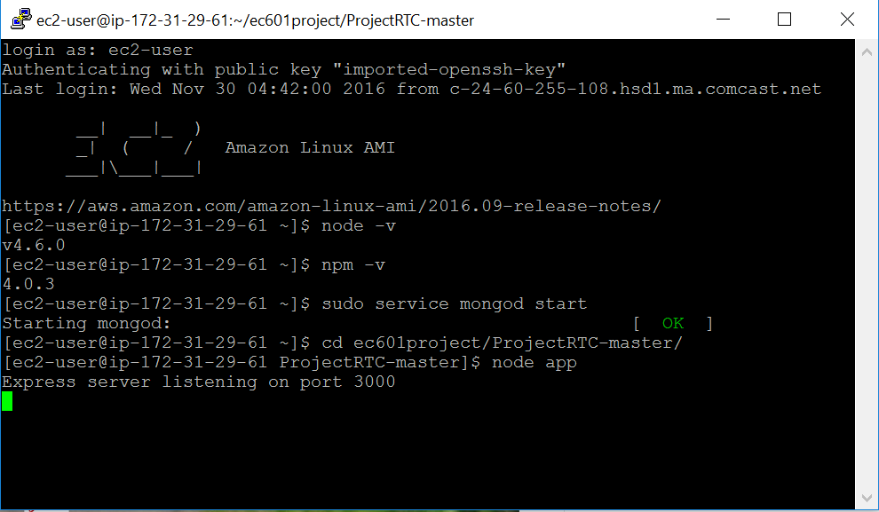
DEMO - AWS
Remote Access and Open Server

Slide 9
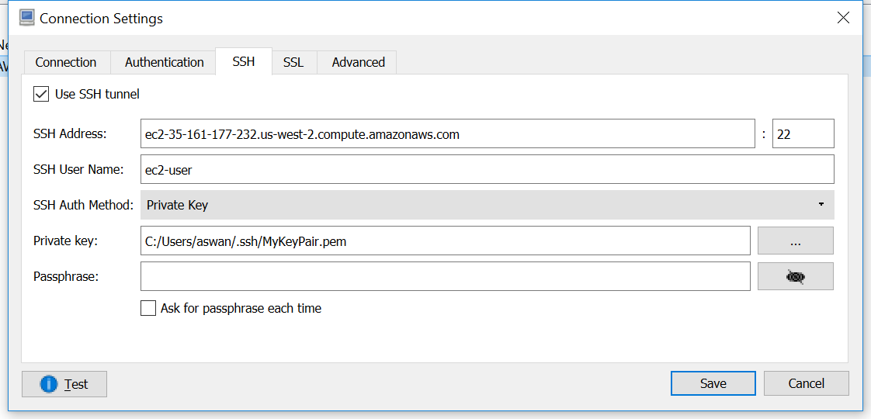
DEMO - AWS
Connect with MongoDB on AWS

Slide 10
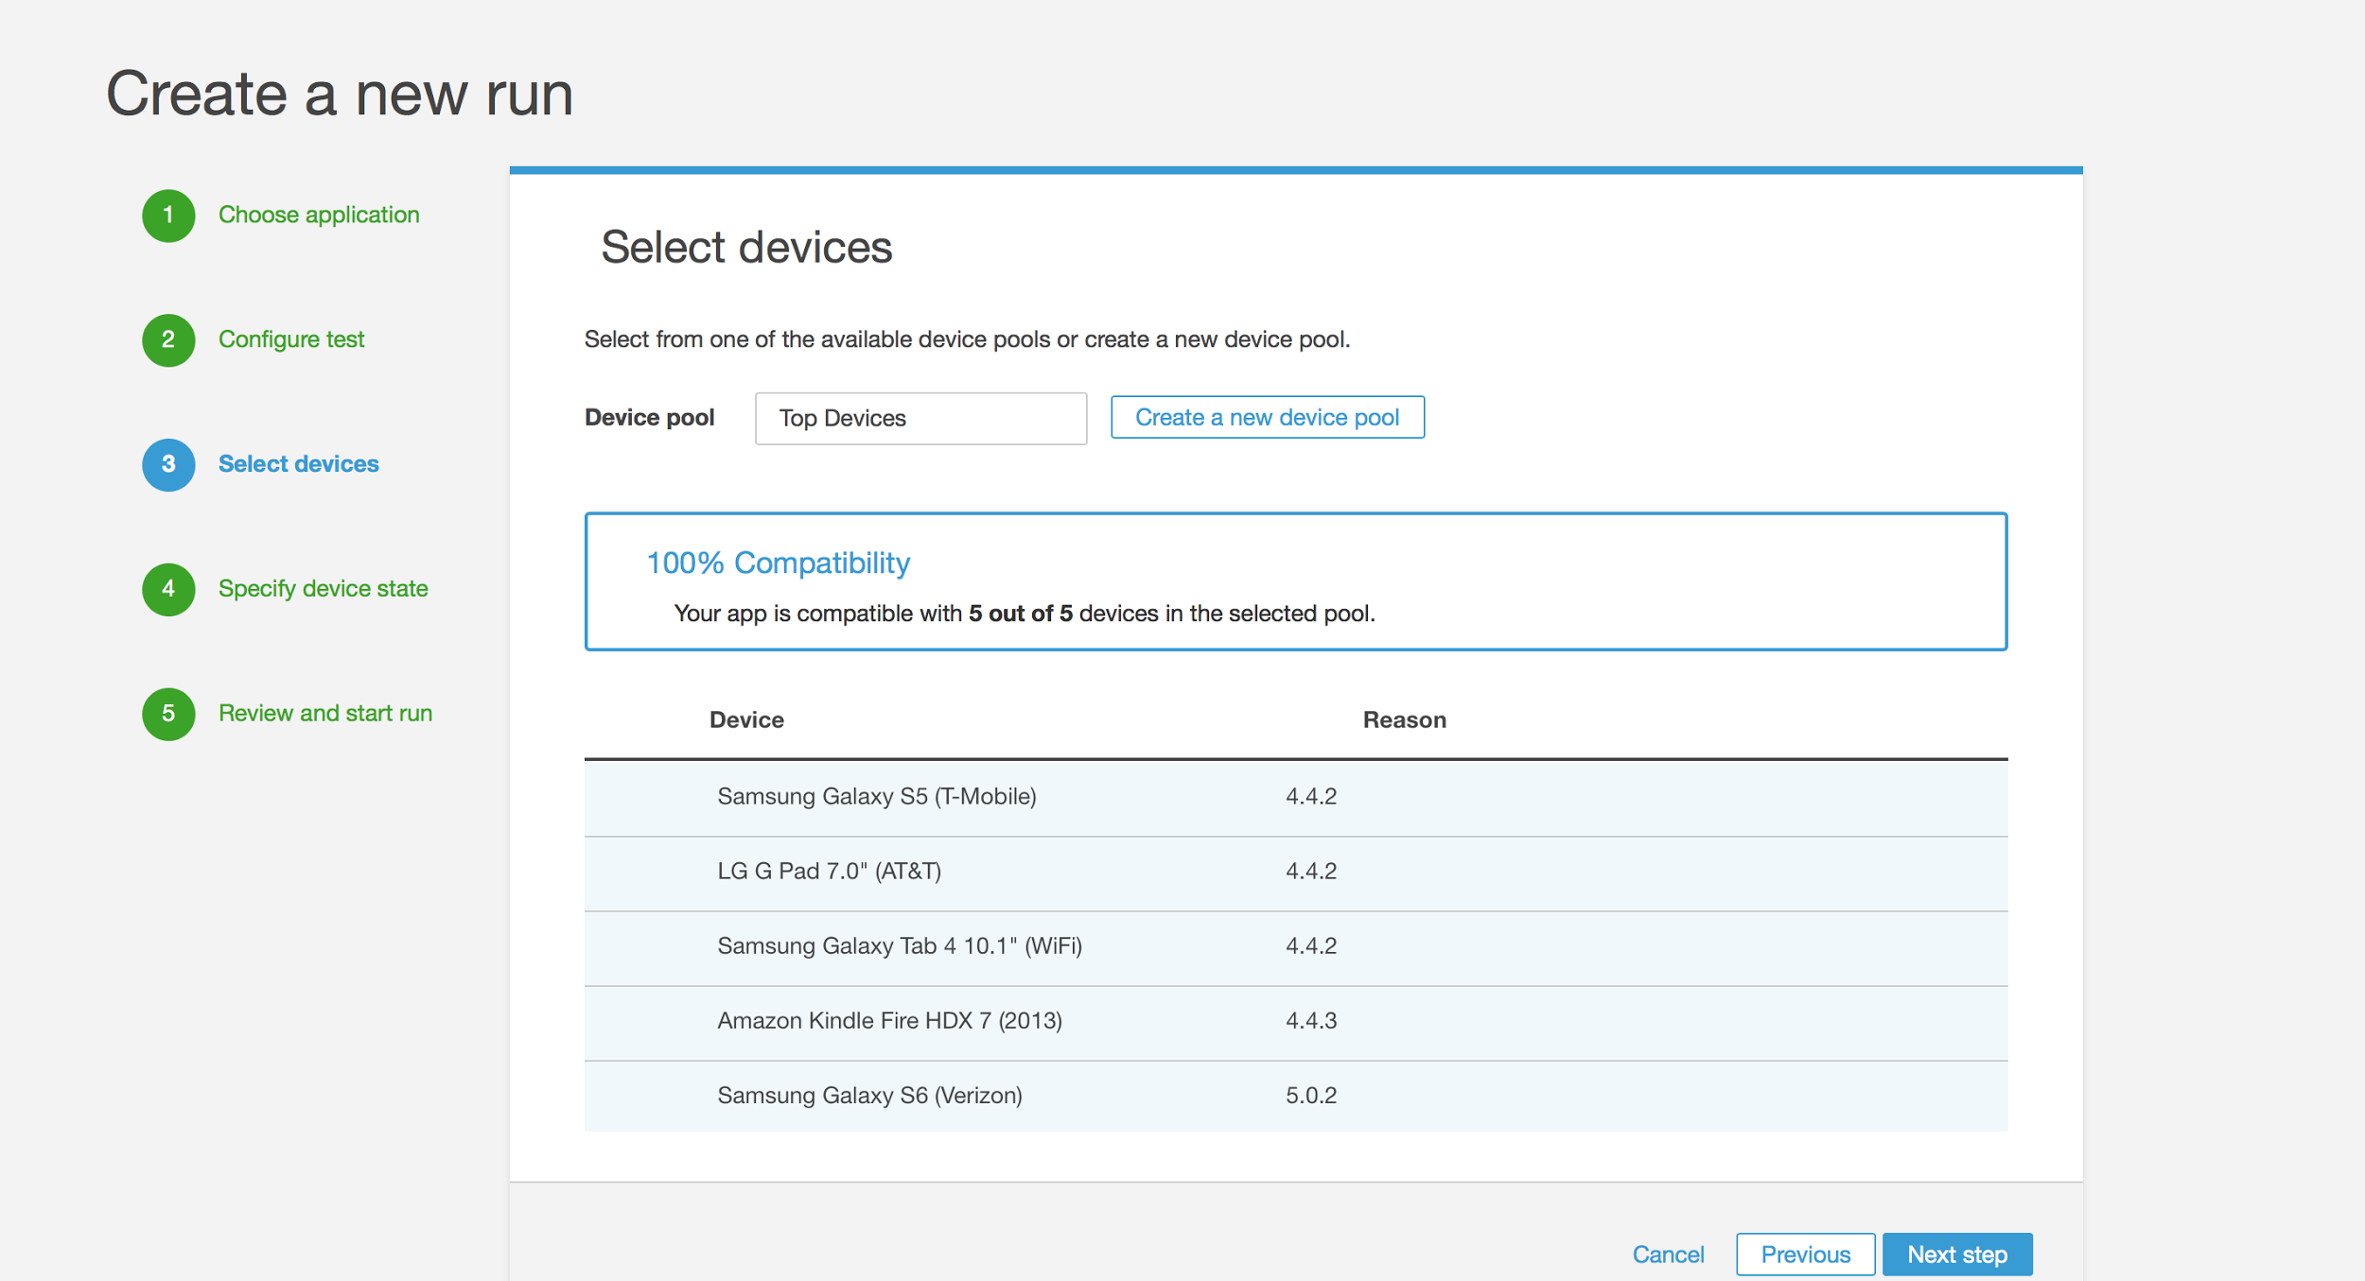
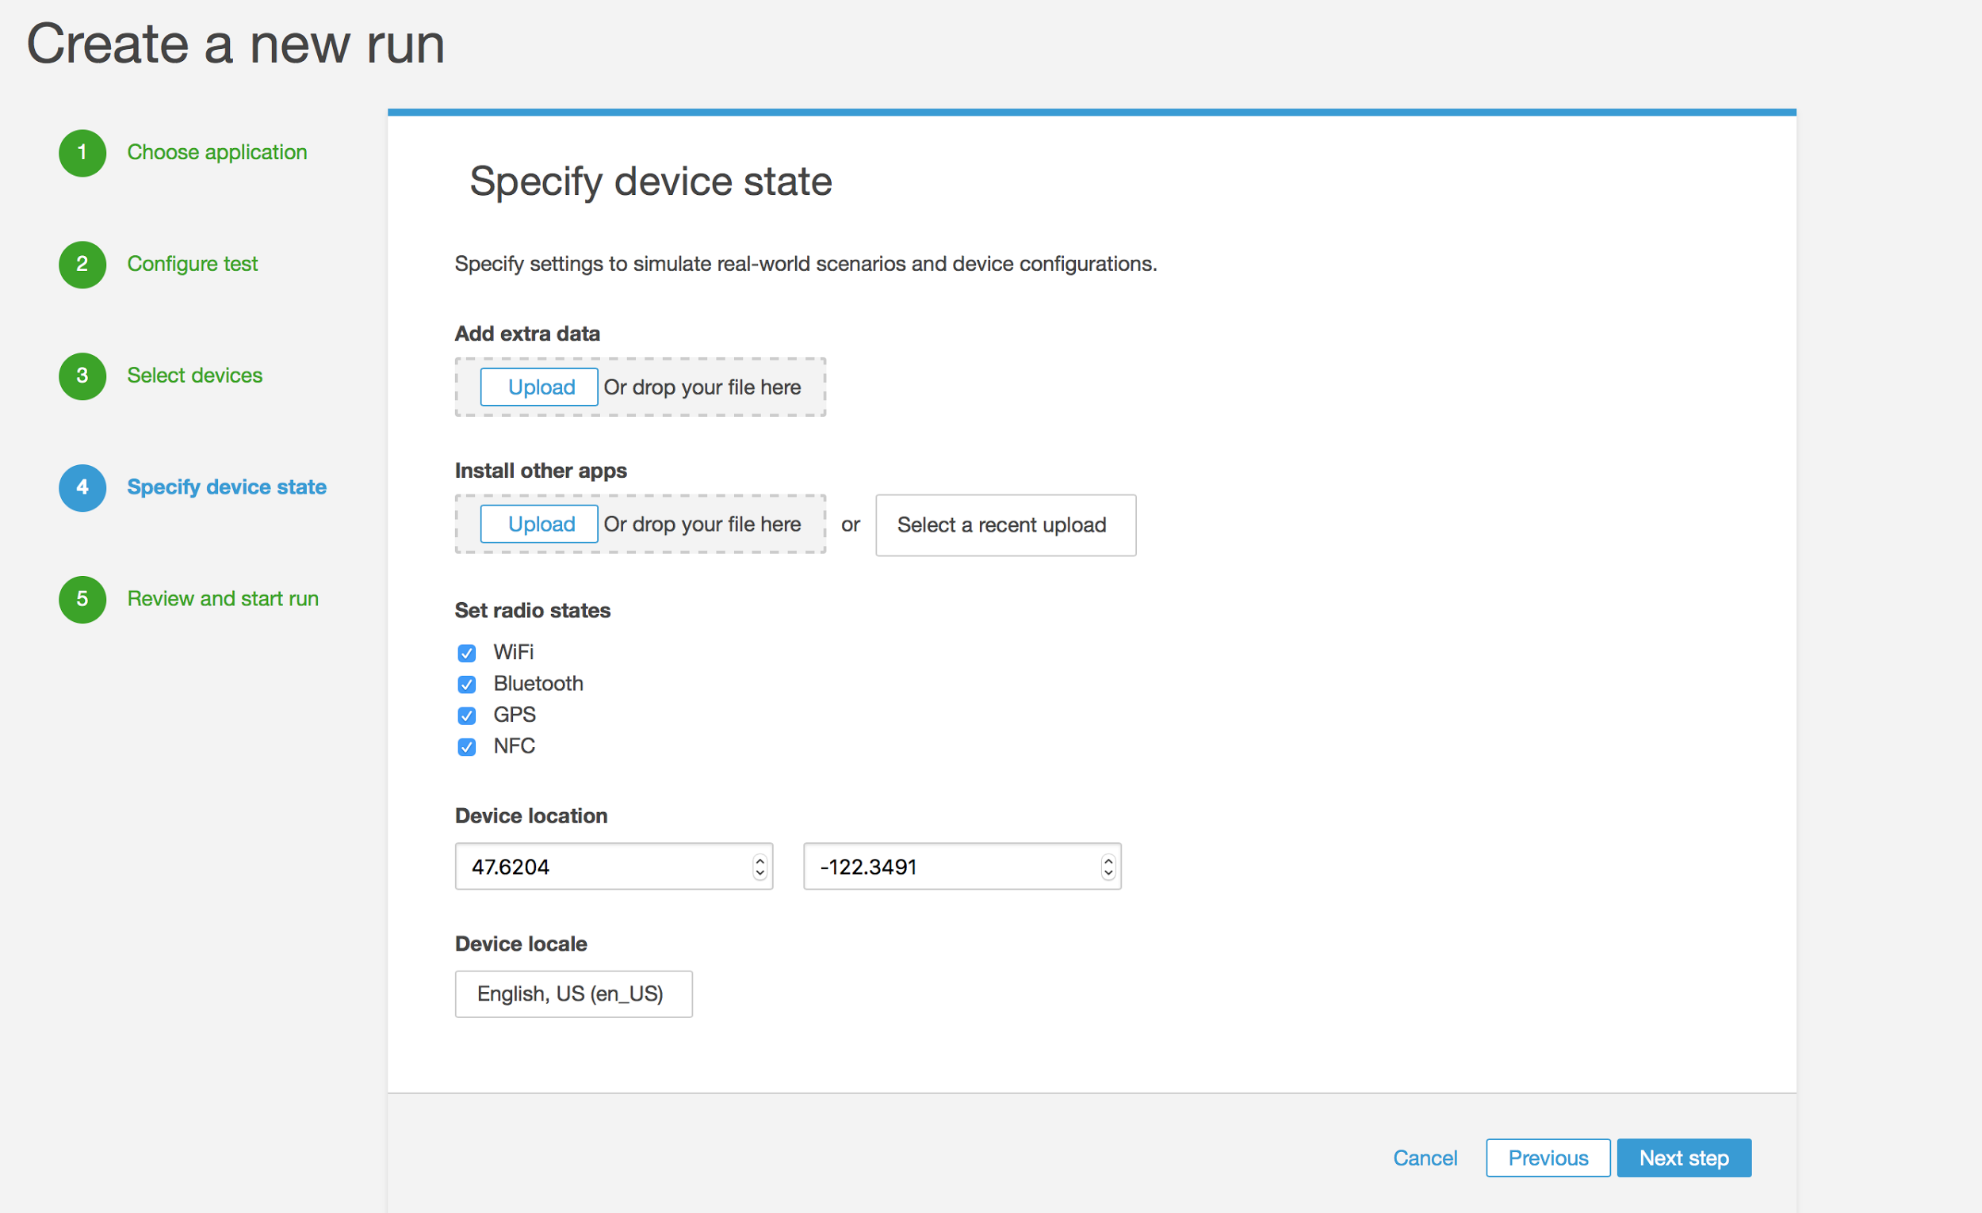
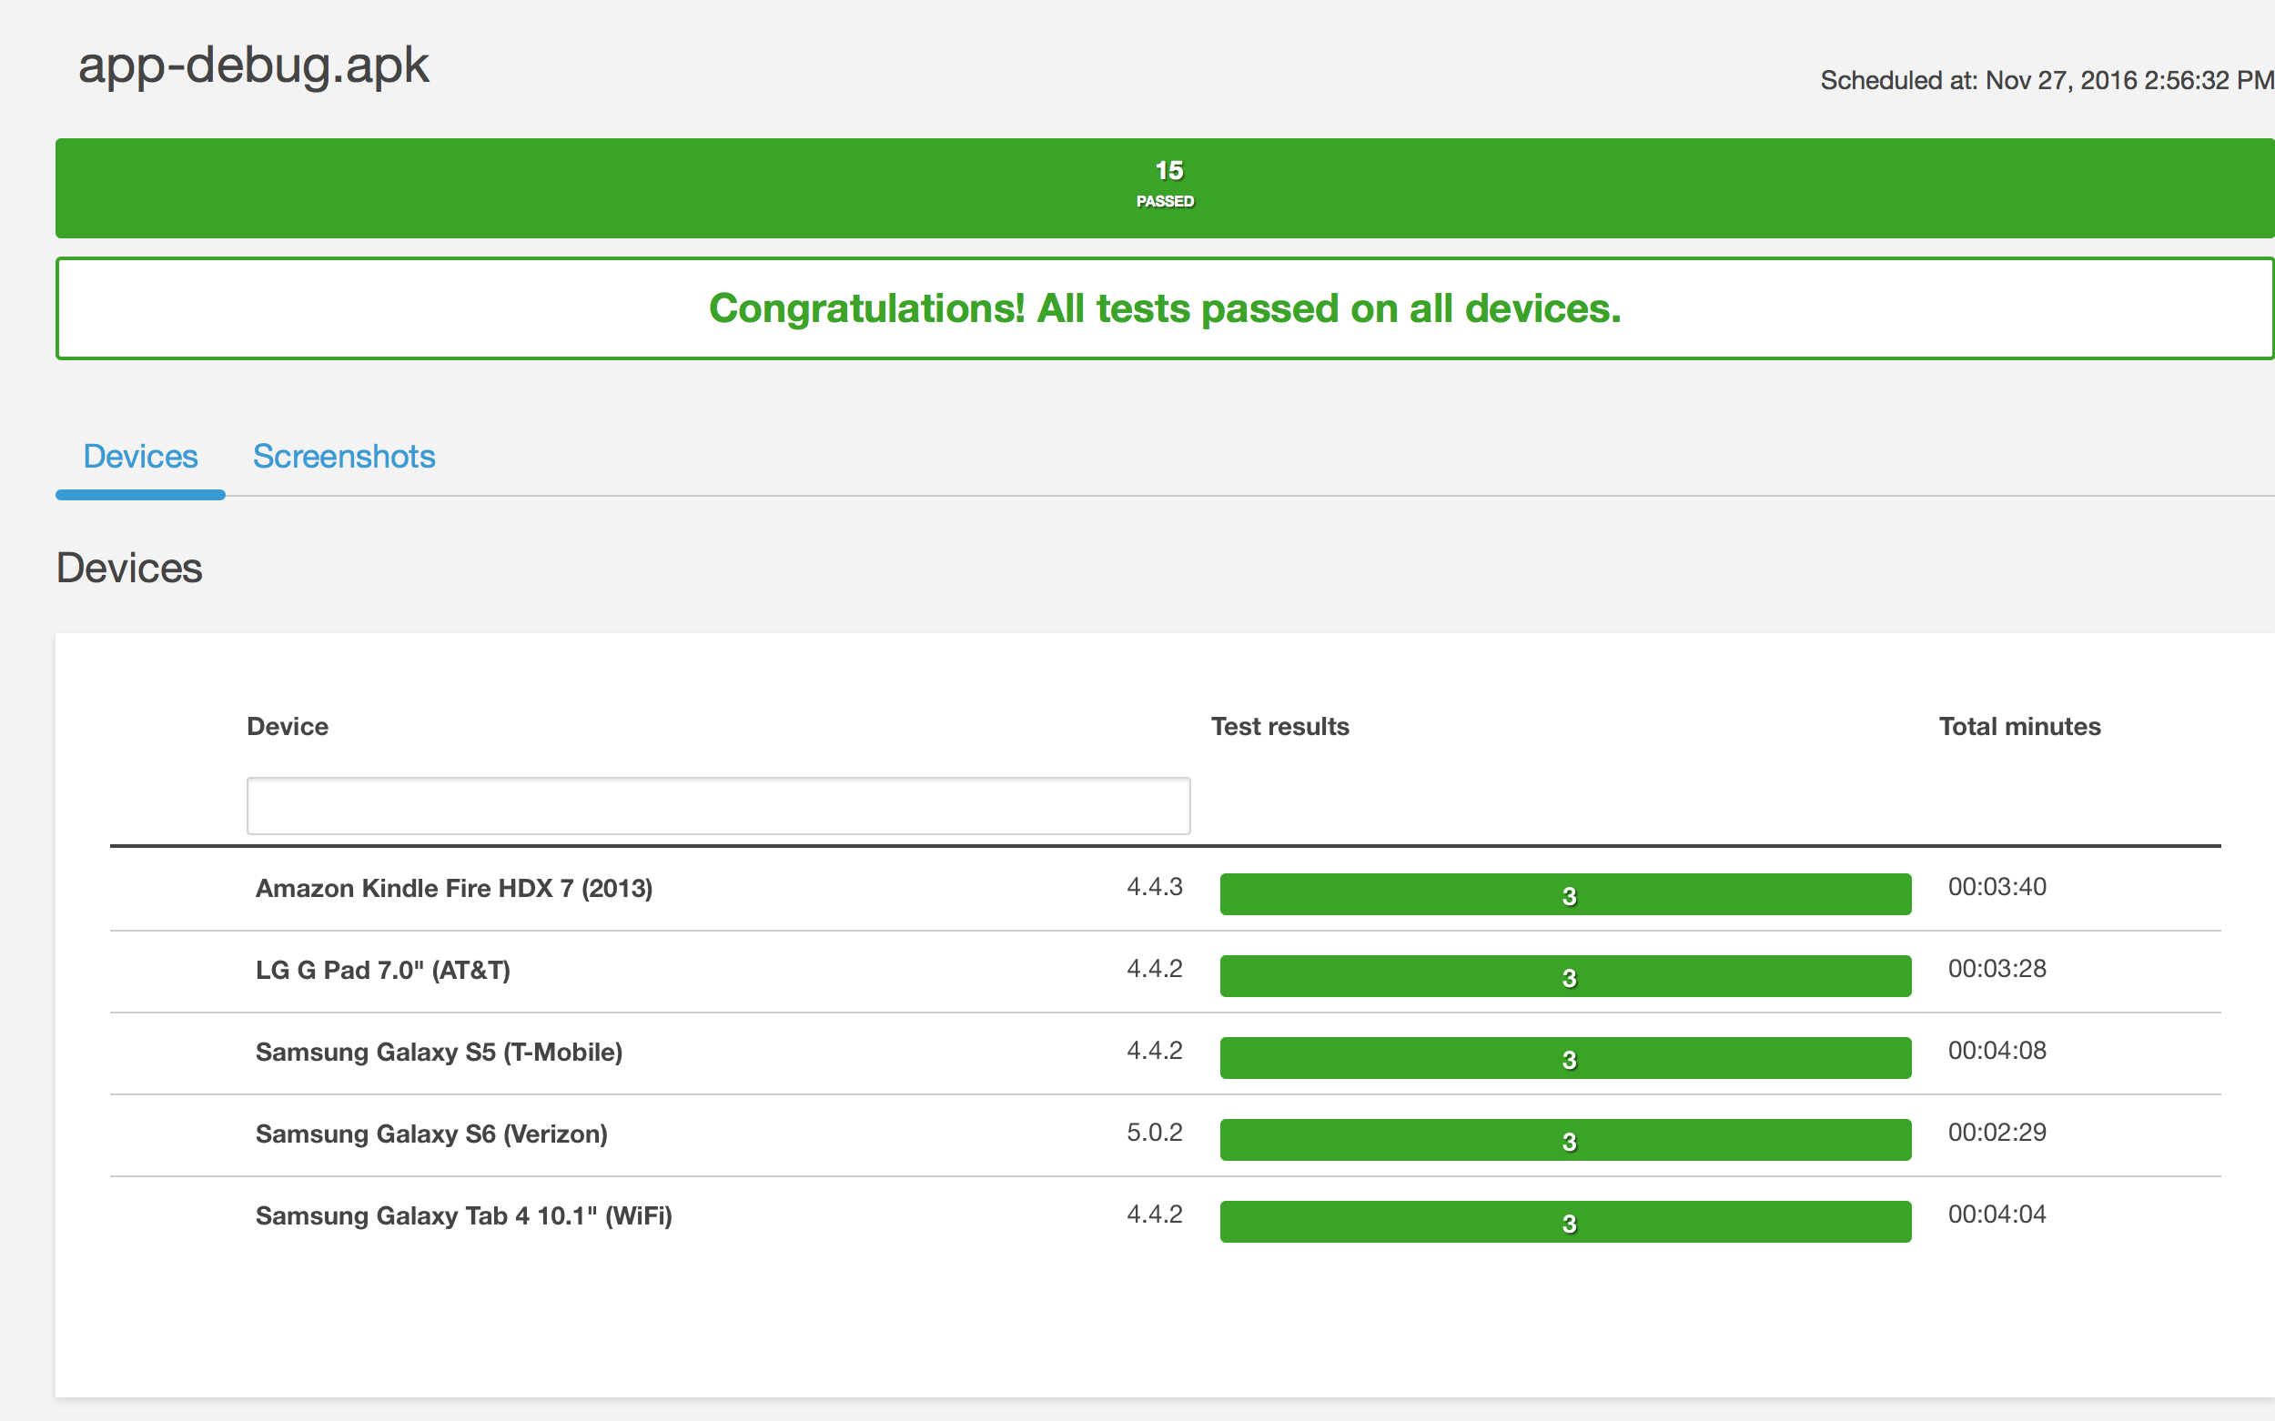
Optional (Testing conducted)

Slide 11
Sprint 4 Plan
1. Fixing the permission issue of using webcam on websites while connecting with AWS server, and completing launching the application on the web service to meet the large scale computing and processing.
2. Optimizing UI design and add Stop Sharing activity for better performance of our application.
3. Using aws device farm, test on different device to improve the compatibility of the application.
4. Using Monkey Test to improve the stability of the application.

Slide 12
Thank You

