Slide 1
Beside You
Sharing Android Screen for Customer Service
Yue Sun, Wenpeng Wang, Yu Jun, Aoshuang Wang
Oct 31, 2016
Github Link Trello Link
Notes:
‹#›

Slide 2
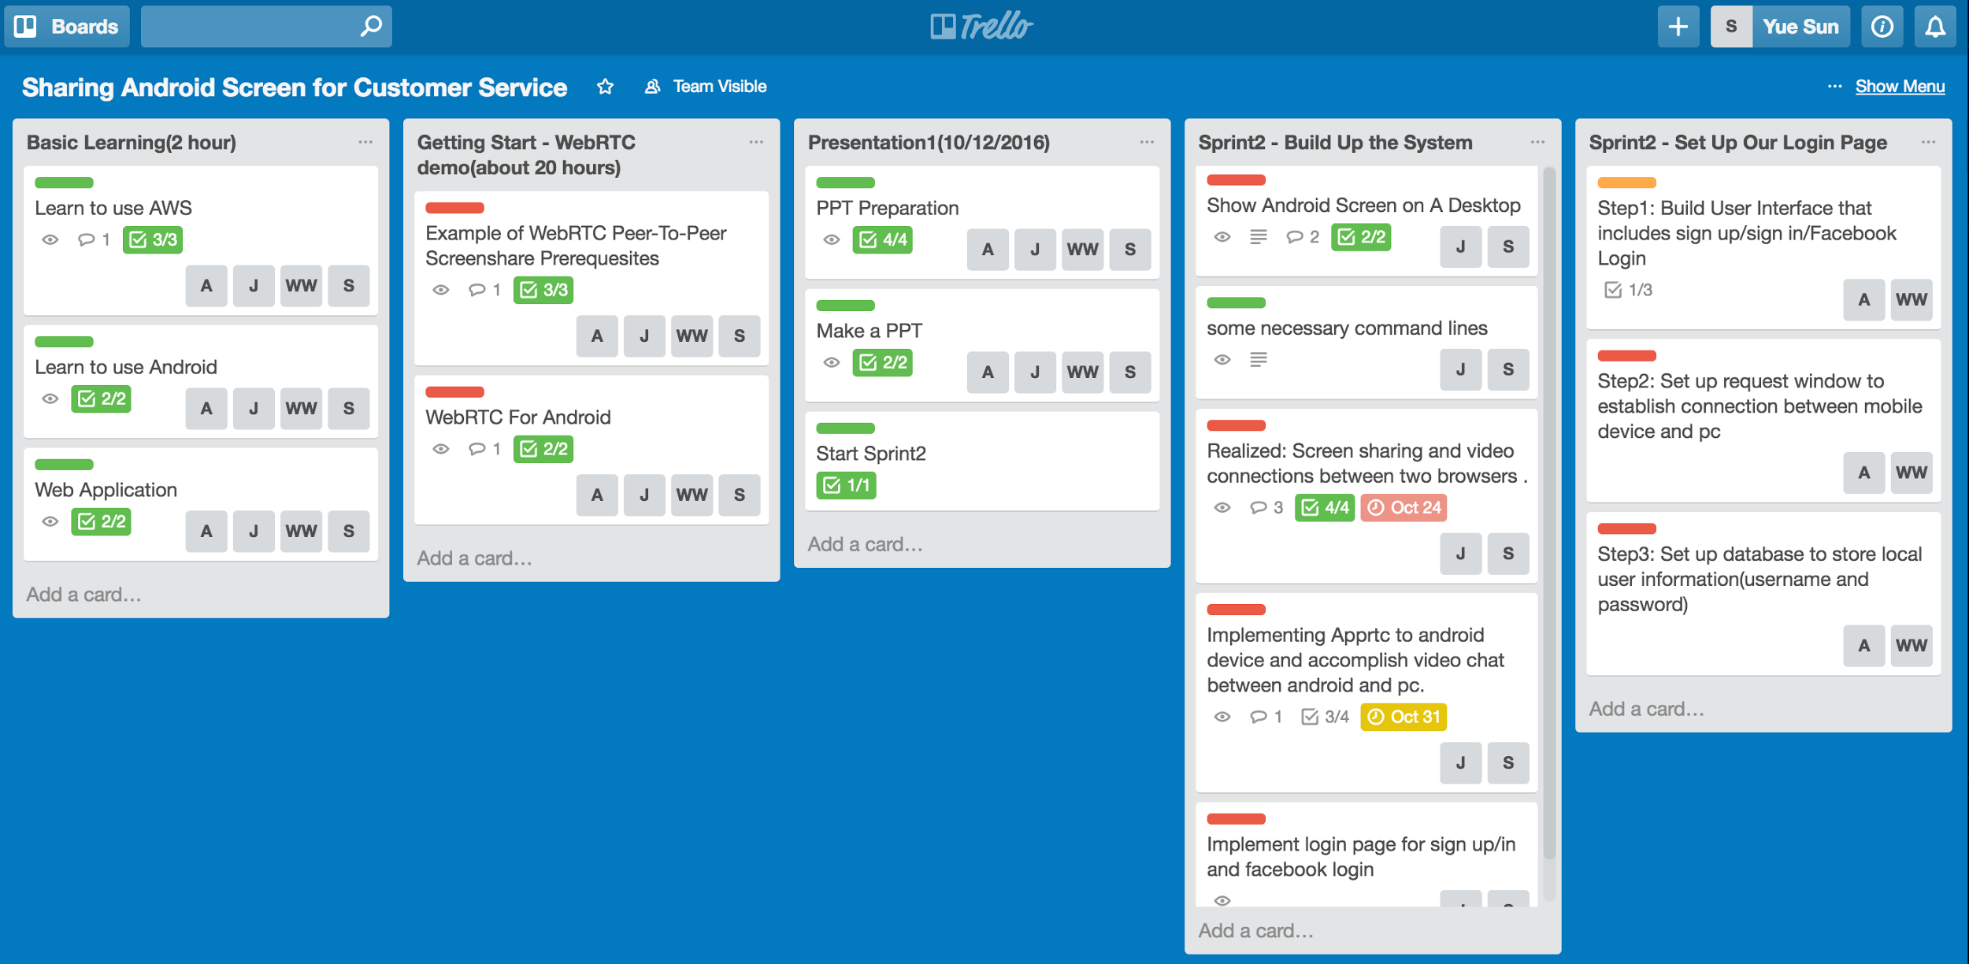
Trello Sprint 2 Diagram
*
‹#›

Slide 3
System Diagram
*
WebRTC PeerConnection
Between 2 PC
client
Attendee
Mirror screen on pc
Server(Node.js)
1
WebRTC PeerConnection
Between Android device and pc
client
2
Server(Node.js)

Slide 4
Accomplishments
*
Implemented an Android application.
Set up local server and enable to connect with android device using WebRTC.
Realizing real-time communication
Developed an easy to use login frontpage for the android application.
Connected login information with MongoDB
Looked over Facebook Login sample and tried to integrate it into our login page
‹#›

Slide 5
Challenges
*
Difficulty of implementing an android application to connect to PC using WebRTC. (We tried to implement a system like diagram 1 so that we can find a way of sharing screen on PC)
Getting used to the usage of Angular.js, node.js
Getting used to the usage of WebRTC package
Implemented log-in feature with the application
Link Database to our user interface.
Deployed to AWS service(next sprint)
‹#›

Slide 6
DEMO - Login Page
*
Server
Client
Database
Node.js
web server serves on port 8080
Android Studio application
MongoDB
stores user information
‹#›

Slide 7
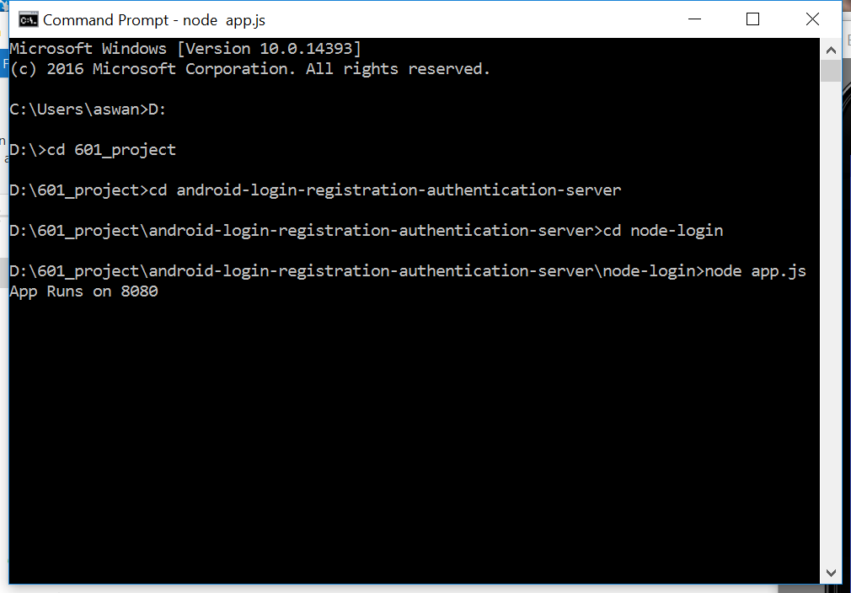
Server End

Slide 8
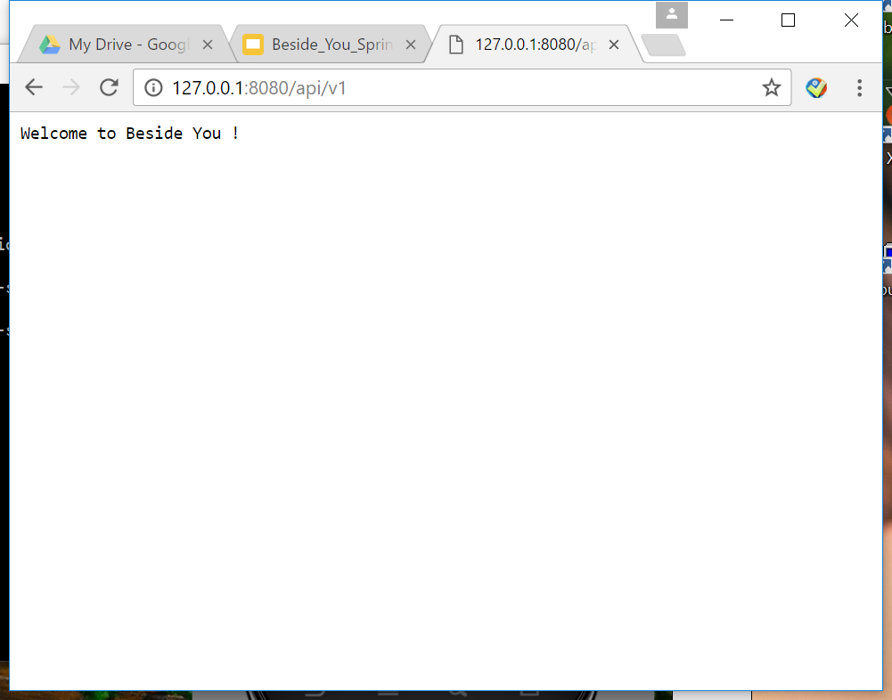
Server End

Slide 9
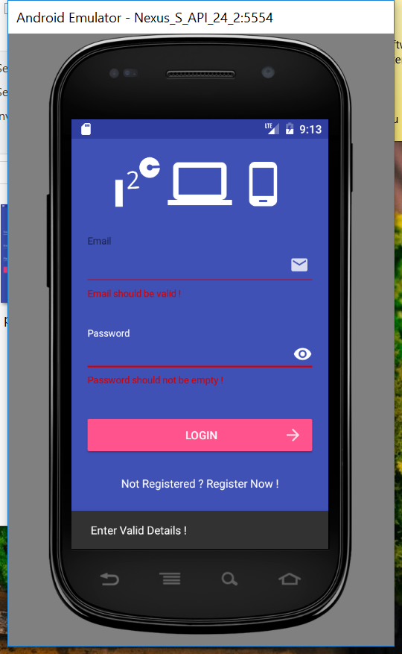
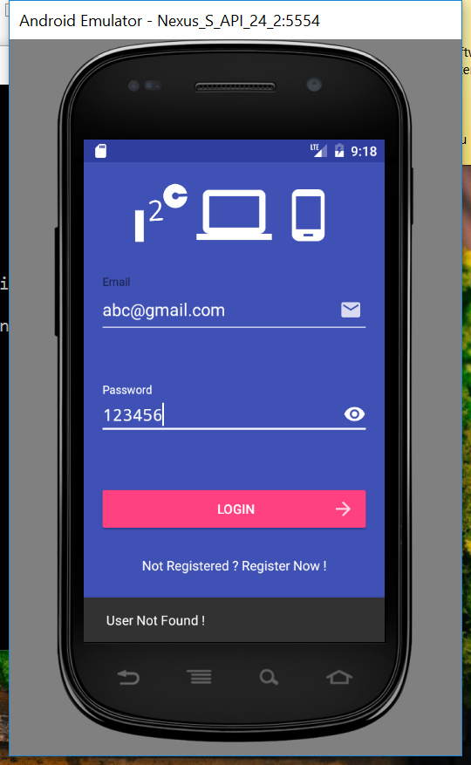
Main Page
Login with email address and password.
Invalid input are detected:
1. Incomplete
input
2. Nonexistent
user
3. Wrong password
Friendly notice is given to users

Slide 10
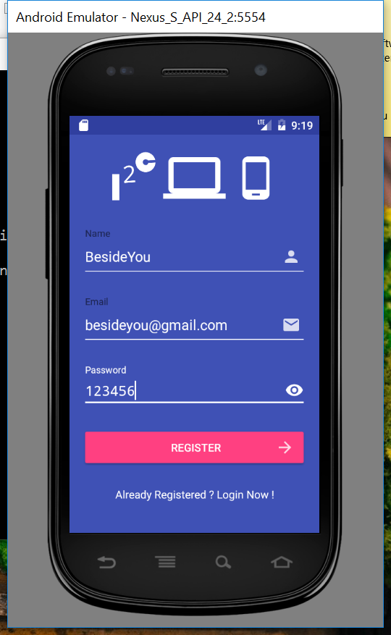
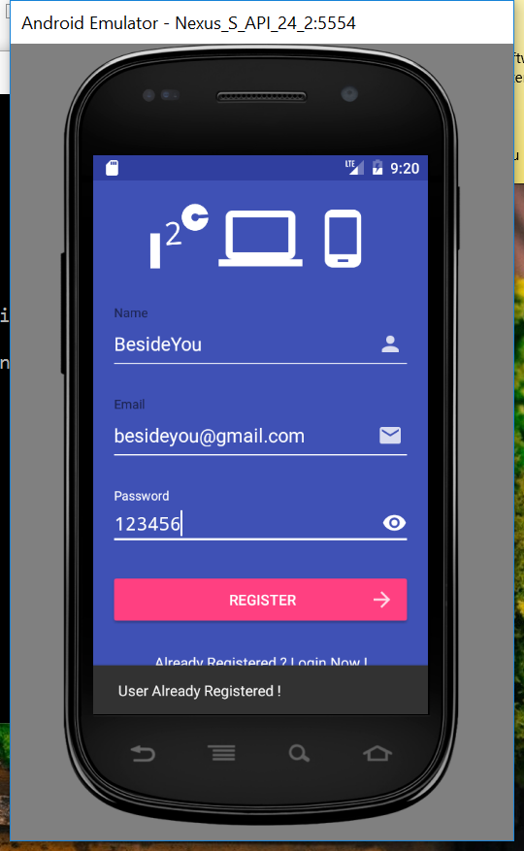
Register New Account
Register needs user name, email address, and password
Invalid input are detected:
1. Incomplete
input
2. Already existed
user
Friendly notice is given to users

Slide 11
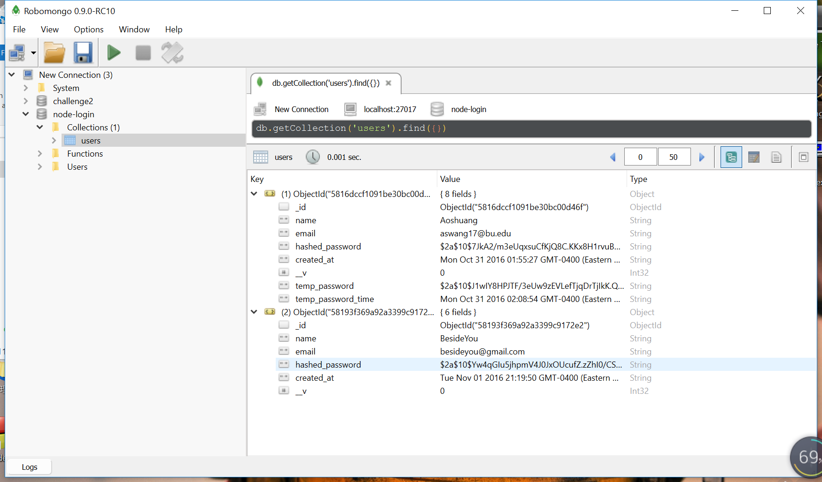
Database at the Same Time
Existed users’ information will be stored in MongoDB.
Password will be created and verified using bcrpyt hasing algorithm.

Slide 12
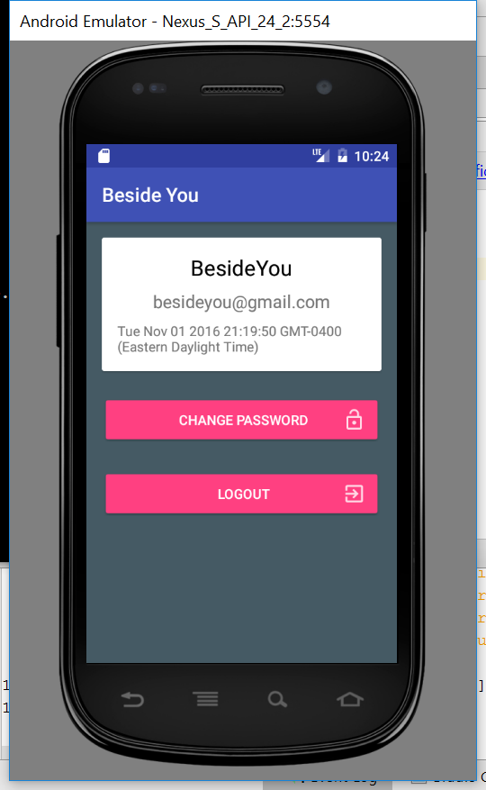
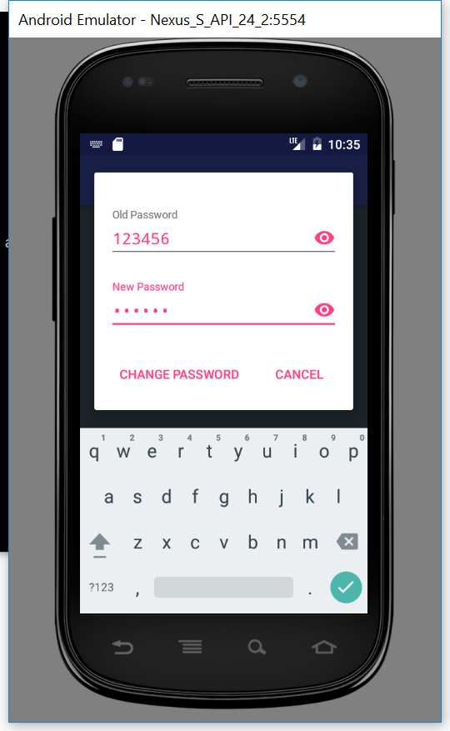
Sign In & Reset Password
Available to change password
Friendly notice is given to users

Slide 13
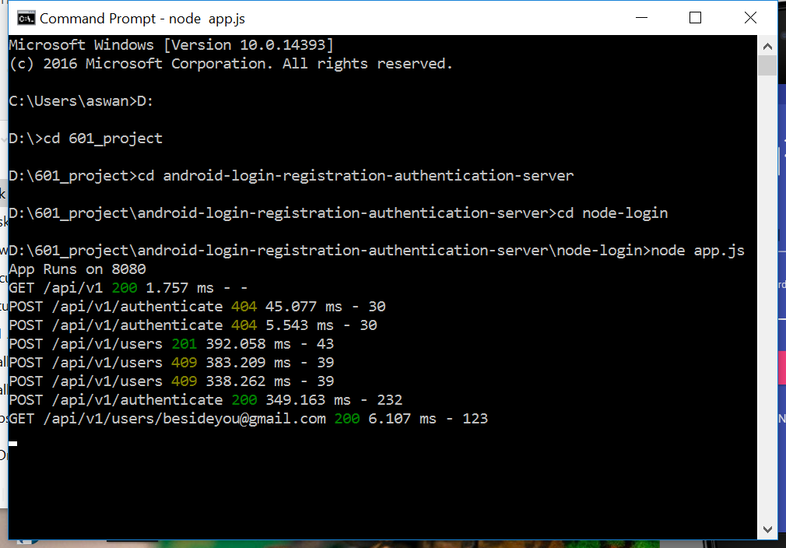
Console Log

Slide 14
Next Sprint Plan
*
Share screen on PC
Deploy our service on aws and implement mongoDB in backend
Improve the stability of the product, especially on android side.
Improve the front-end design (such as adding more intuitive instructions ) to make our product easier to use.
‹#›

Slide 15
Any Questions ?

Slide 16
THANK YOU
*
‹#›

