Slide 1

Employee Compensation & Attrition Analysis
Tiger Zhang, Zoe Chen, Yue Wang

Slide 2
Table of Contents
01
02
03
04
05
Project Introduction
Data
Data Understanding & Preparation
Research Questions
Generalized Linear Model
Linear Regression
Modeling Continuous Outcome
Modeling Discrete - Binary
Conclusion
Further Analysis

Slide 3
Project Introduction
Motivation
Employee attrition is defined as the natural process by which employees leave the workforce.
Data Source
Kaggle – IBM HR Analytics Employee Attrition & Performance
Research Questions
What Factors Affect Monthly Income?
What Factors Affect An Employee's Decision of Attrition?

Slide 4
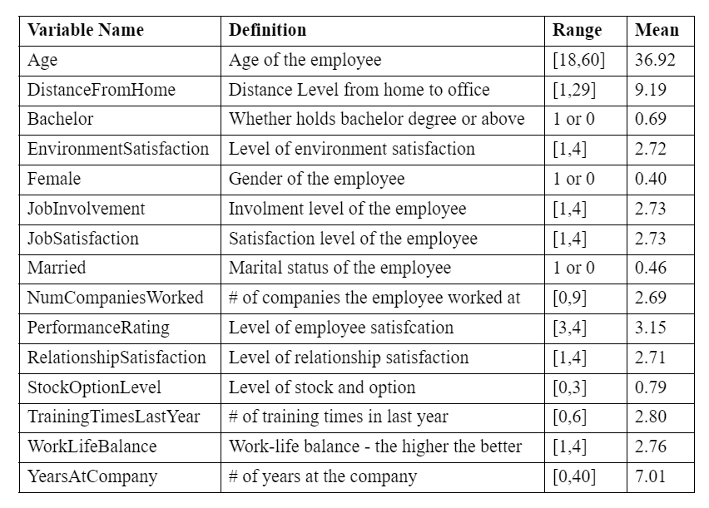
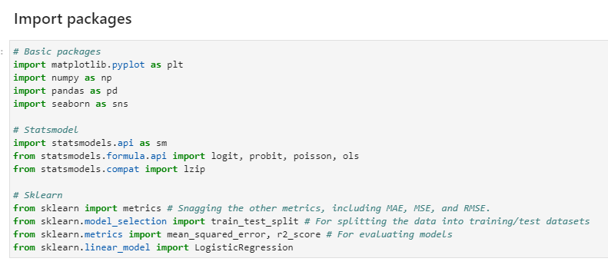
Data
01
02
03
Basics
Statsmodel
Sklearn
numpy, pandas, matplotlib, seaborn
sm, logit
metrics, train_test_split

Slide 5
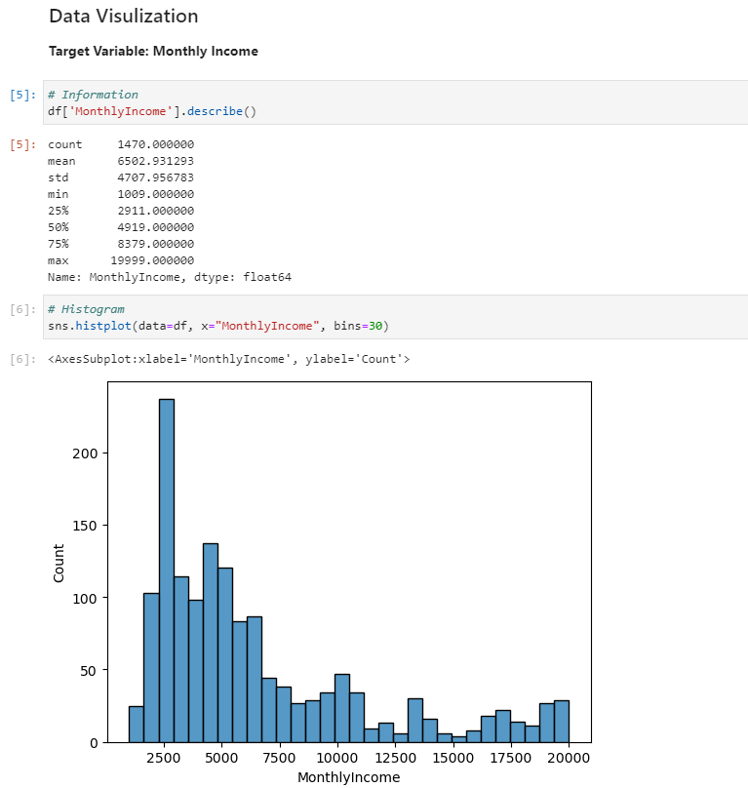
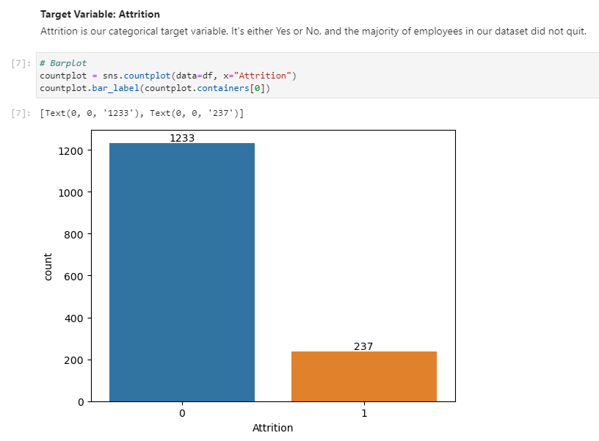
Data
Monthly Income
Attrition

Slide 6
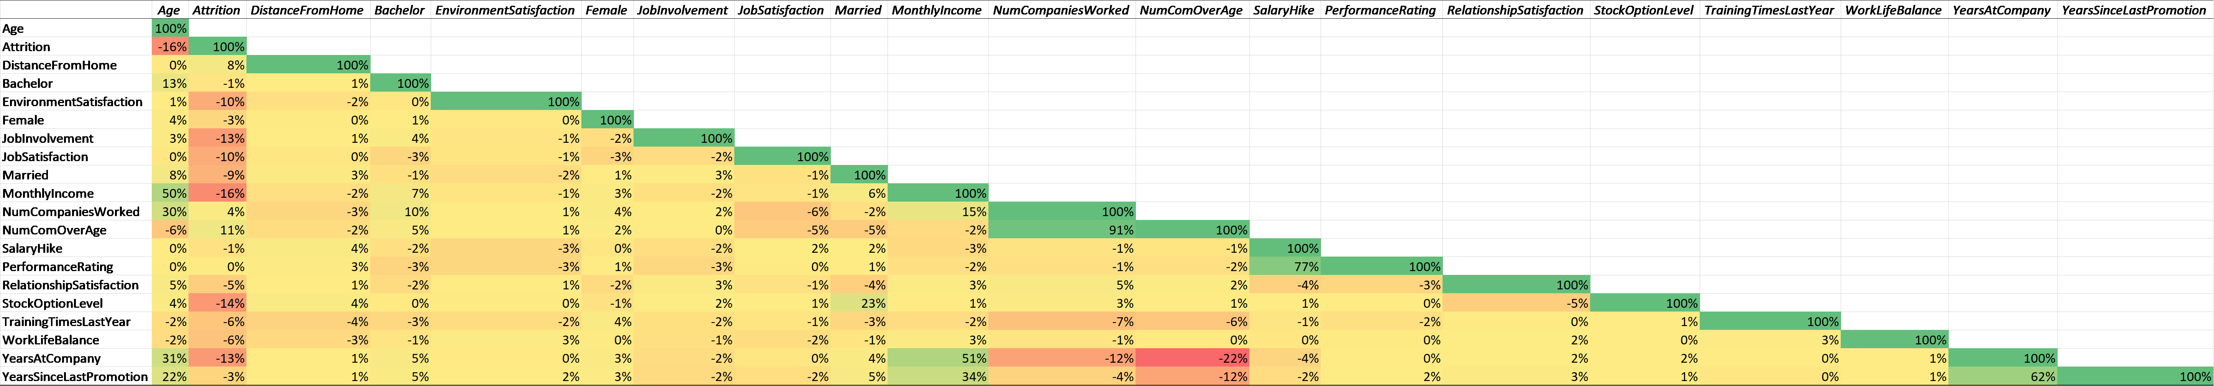
Data
High Correlation Between:
NumComOverAge and NumCompaniesWorked
Salary Hike and Performance Rating
YearsSinceLastPromotion and YearsAtCompany

Slide 7
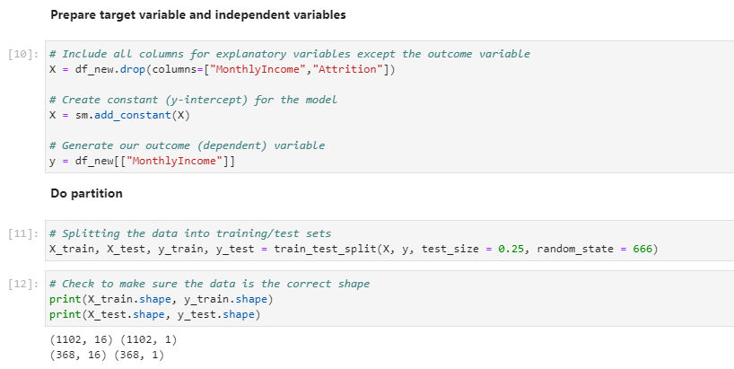
Linear Regression
Preparation
Prepare X and y
Partition
75% - 25%
Notes:
We prepare our data by excluding
It’s enough to do partition, and we do

Slide 8
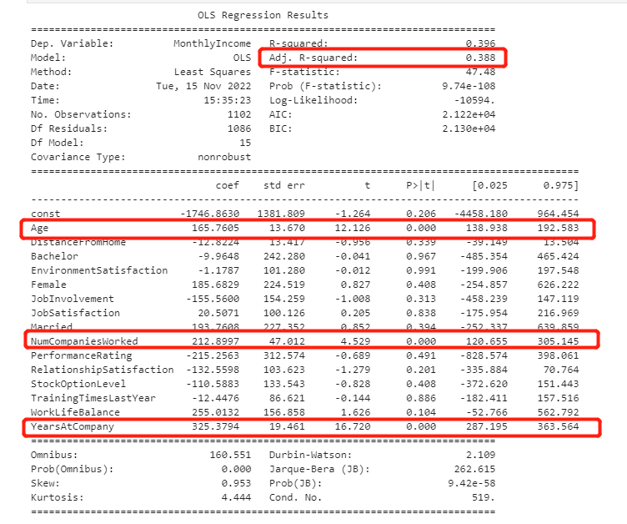
Linear Regression
The accuracy of linear regression model is 38.8%
Variables Significant at alpha = 0.05
Age
NumCompaniesWorked
YearsAtCompany
Notes:
Accuracy
Variables – positive
If you stay in the company for one more year, your monthly salary will increase by $325

Slide 9
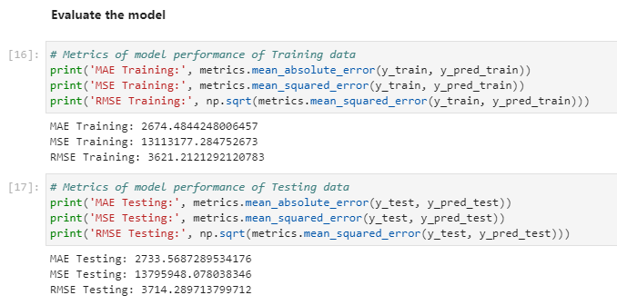
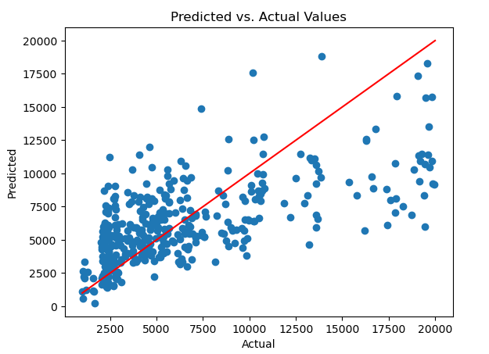
Linear Regression
Visualize predicted vs. actual
Compare Training and Testing
Notes:
And for the model evaluation part, We do visualization and calculate MAE
If we still want to predict monthly income using this dataset, we may need to do some data transformation. Tiger will talk more about this in Further Analysis.

Slide 10
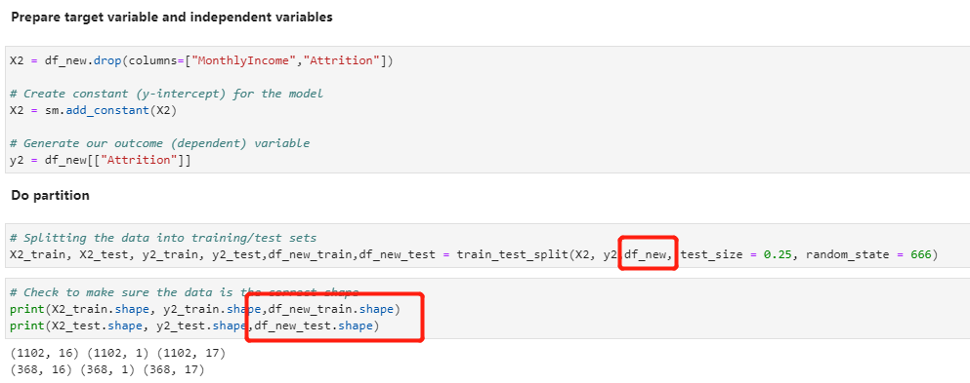
Generalized Linear Model Logit
Preparation
Prepare X and y
Partition
75% - 25%

Slide 11
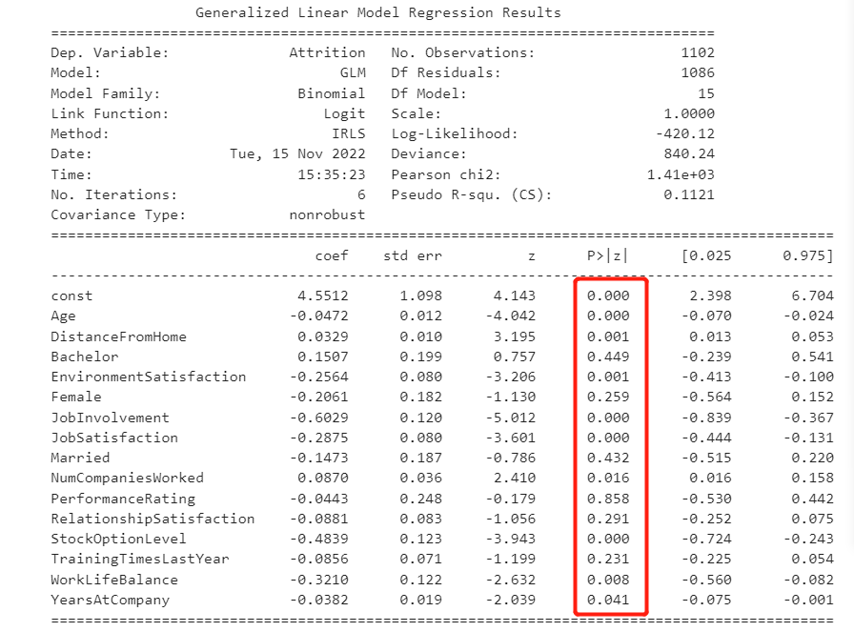
Generalized Linear Model Logit
Variables Significant at alpha = 0.05
Age(-)
DistanceFromHome(+)
EnvironmentSatisfaction(-)
JobInvolvment(-)
JobSatisfaction(-)
NumCompaniesWorked(+)
StockOptionLevel(-)
WorkLifeBalance(-)
YearsAtCompany(-)

Slide 12
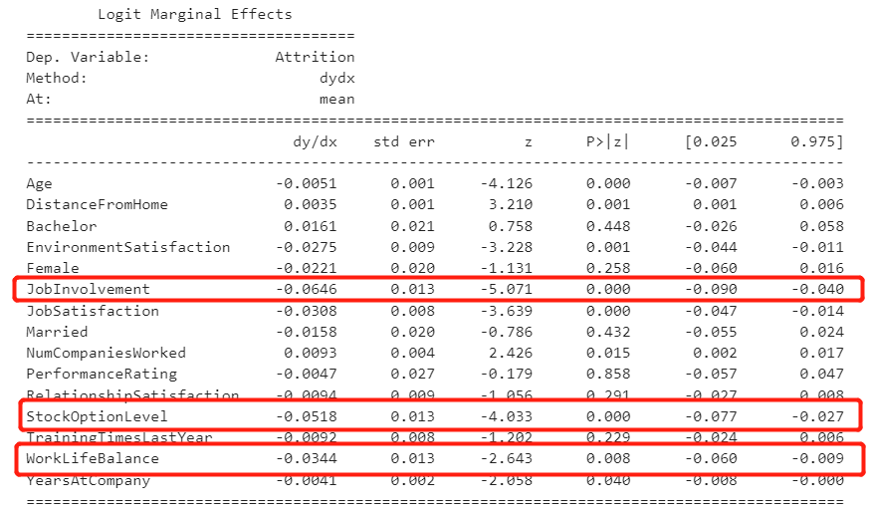
Generalized Linear Model Logit
Marginal effects

Slide 13
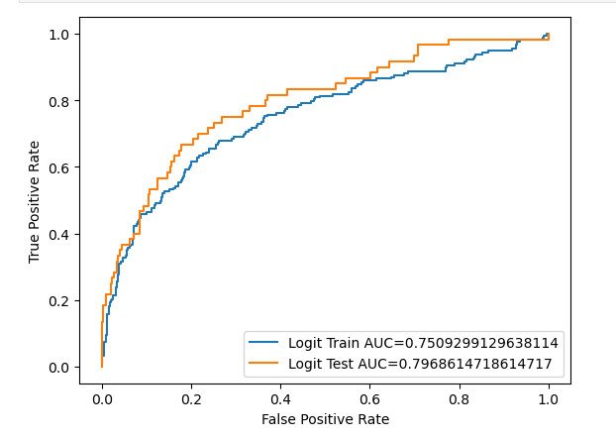
Generalized Linear Model Logit
ROC Curve
AIC & BIC

Slide 14
Conclusions
Monthly Income
Attrition
Experienced employees should get more compensation
Loyal employees should be compensated
Increase employees’ job involvement
Improve employees’ stock option level
Improve employees’ work-life balance

Slide 15
Further Analysis

Slide 16
Thanks!
Any questions?

