Slide 1
Capstone Project : User Churn Rate Prediction
Yue Wen
10/22/2017

Slide 2
Outline
Problem Statement
Data set overview
Features/label extraction
Classification Model
Results and Ddiscussion

Slide 3
Problem Statement
Goal: Predict User churn rate for a music box mobile application
Motivation:
Improve retention rate
send trigger emails to “at-risk” customers
Free subscription/Discount

Slide 4
Data set overview
DATA SET OVERVIEW
User ID | Device | Song ID | Song Type | Song Name
Singer | Play Time | Song Length | Paid Flag | Date
Data set overview:
Challenge: 15.8 GB data -> Google Cloud Platform: Scala spark
Data Cleaning:
Remove invalid type
Remove missing value(small percentage)
Remove outlier: song length/ play time

Slide 5
Features and Labels Extraction
Label:
Churn definition: No activity for the last 8 days
Features:
Device
Song type variety: whether the users are stick to one type of songs?
Behavior Change: # of songs a user listened from time window to time window
Heavy Users: # of songs user listened. indicating how much the user used the product

Slide 6
Classification Models
Logistic regression Classifier
Random Forest Classifier
Gradient boosting classifier
Two layer shallow neural network

Slide 7
Classification Models Results Comparison
Model | Accuracy Rate | AUC
Logistic regression | 0.826 | 0.887
Random Forest | 0.841 | 0.901
Gradient boosting | 0.840 | 0.900
Multilayer feedforward neural network | 0.831 | NA

Slide 8
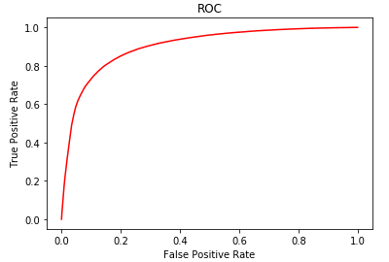
Results and Discussion
Metrics2 | Value
Accuracy | 0.841
Recall | 0.897
Precision | 0.872
F1- Score | 0.885

Slide 9
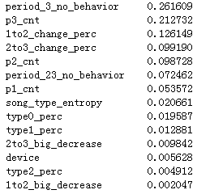
Results and Discussion
Feature importance overview:
:
Insights:
The last window’s behavior matters the most…
Track user behavior changes, then business can intervene early to prevent customer leaving
:

Slide 10
Learnings
Hard skills : Big data processing skills
Domain knowledge: Mobile & User Churn Prediction
Soft skills: Problem-solving skills
Others Inspirations: Think from business side

Slide 11
Thanks for your attention!

