Slide 1



Trend Analysis
12112821 李伯超

Slide 2

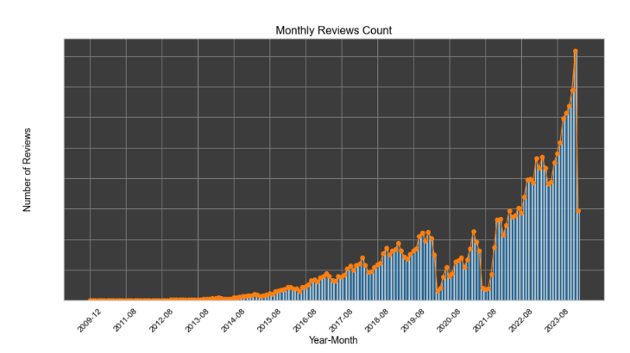
How popular is Airbnb?
As per Airbnb, most of guests review the
listings, hence studying the number of review will
give us a good estimation of the demand.
The number of reviews for Airbnb listings has
shown a significant exponential increase over the
years, indicating a substantial rise in demand since
Airbnb’s inception in 2009.

Slide 3
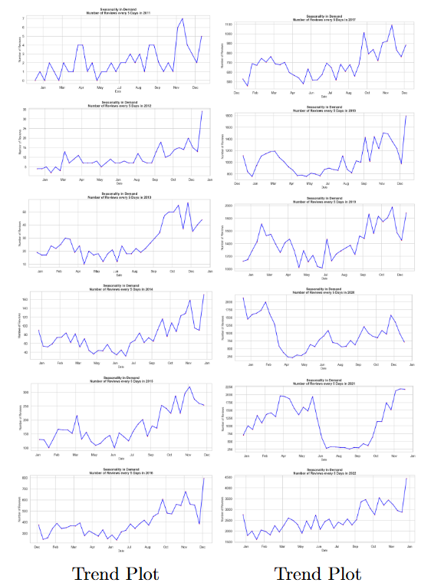
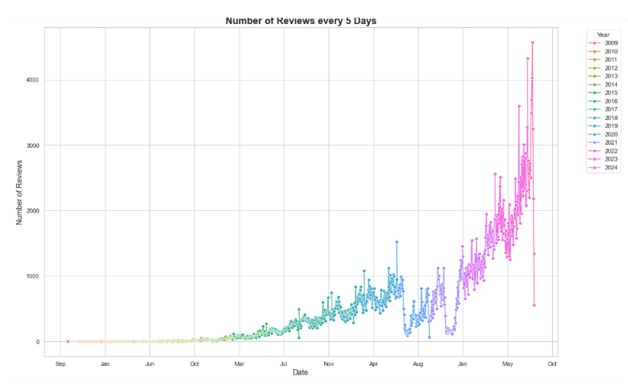
Seasonal Pattern in Demand?
There are noticeable seasonal patterns,
with certain months experiencing higher demand.

Slide 4
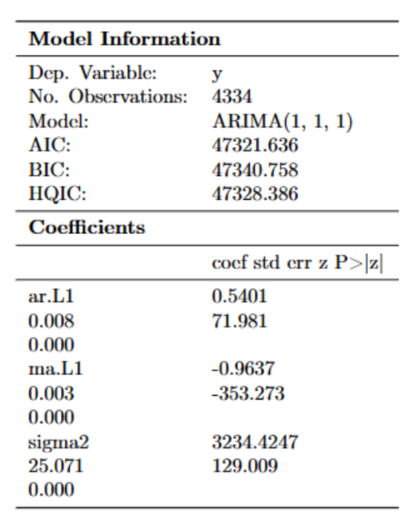
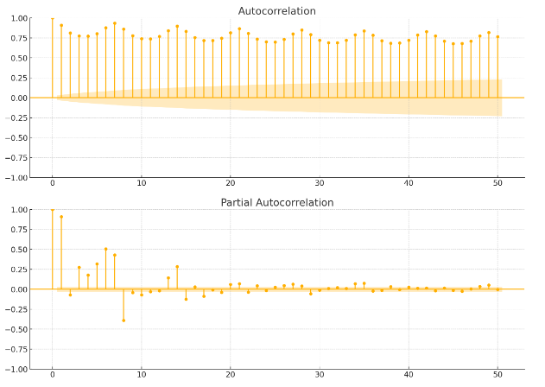
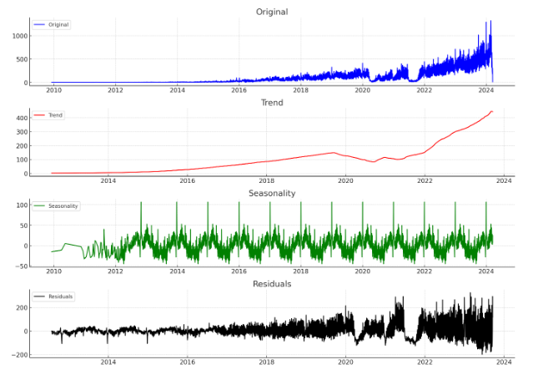
Time Series Decomposition
ACF and PACF Plots Residual plots

Slide 5
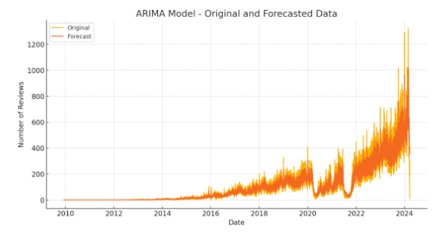
Forcasting Results
The forecast from the ARIMA model
aligns well with the original data,
capturing the upward trend and
seasonal fluctuations.

Slide 6
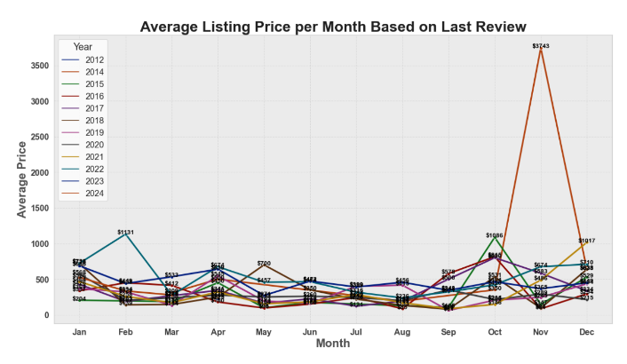
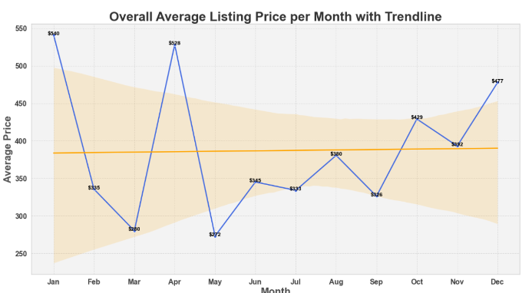
How is Airbnb priced across the year?
1.Lower Prices in Mid-Year 2.Price Increase Towards Year-End 3.Volatility and Stabilization

Slide 7
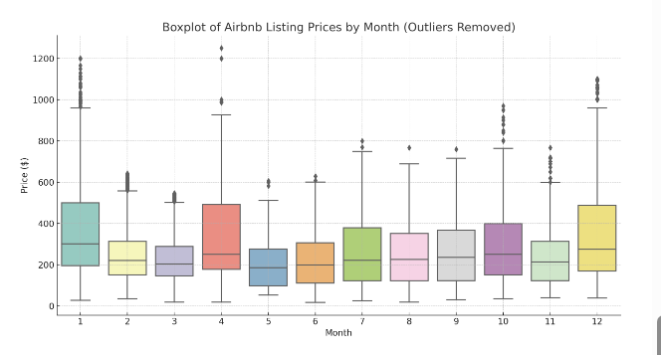
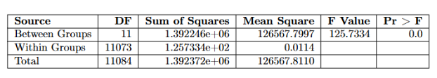
ANOVA Analysis
The results showed significant differences in prices,
indicating that the month of the year does impact
Airbnb listing prices

Slide 8
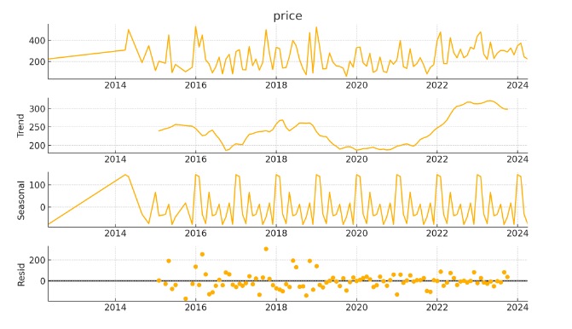
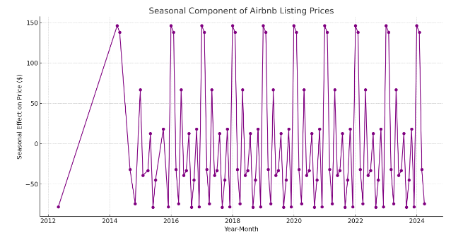
Time series Analysis
The seasonal component clearly shows recurring patterns within the year, indicating higher prices during certain months (e.g., peak holiday seasons)
and lower prices during off-peak months

Slide 9
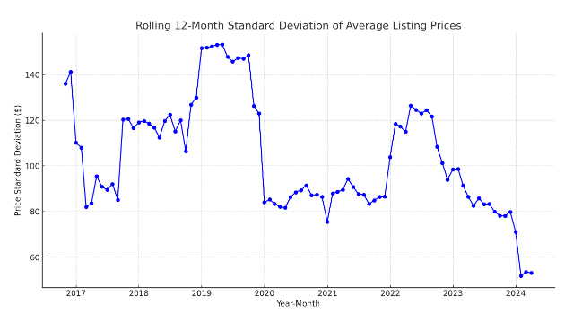
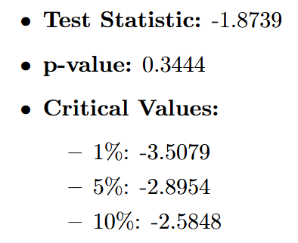
Rolling 12-Month Standard Deviation
Periods with a higher rolling standard deviation indicate greater price volatility, while periods with a lower rolling standard deviation indicate less price volatility. Below is the result of Augmented Dickey-Fuller (ADF) :

Slide 10
Thanks For Watching！

