Slide 1



Regression & Analysis
12112422 武岳

Slide 2

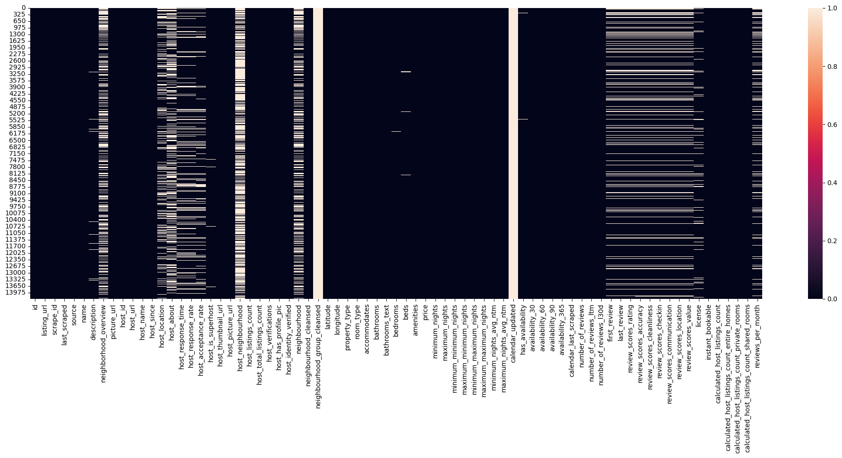
Data preprocessing
14274, 75
Lots of Missing Values
Text data, Drirty data

Slide 3
Data preprocessing
Price -> replace ‘$’, ‘,’
House_response/acceptance_rate -> replace ‘%’
Host_response_time -> ordinal data “within hour / within a day…”
House_vertifications -> email, phone, work_email
Bathsrooms_text -> shared / private ,
First/last_review -> to timestemp, get Airbnbage
Amenities -> get top 20

Slide 4
Data preprocessing
Drop several URL , text (name,id,description), neighborhood(better remove it by experiment, have longitude and latitude)
dropNA
Dummy variable (drop_first to avoid colinearity)
10256,71

Slide 5
Data preprocessing
Randomly reorder data
7:3 – train data : test data
Train: 7179,71

Slide 6
Regression
Y: number_of_reviews_l30
the number of reviews a listing has received in the last 30 days.
Show: recent attractiveness and popularity of a listing

Slide 7
Regression - pipeline
Linear Regression VIF,BoxCox,CookDistance…
Lasso Hyperparameter Selection, Variable importance analysis…
Train model with train-data
RandomForest Hyperparameter Selection, Variable importance analysis…
Ridge Hyperparameter Selection, Variable importance analysis…
Evaluate model with test-data
XGBoost Hyperparameter Selection, Variable importance analysis…

Slide 8
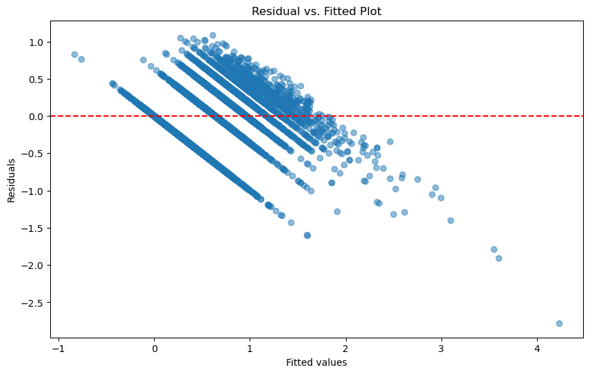
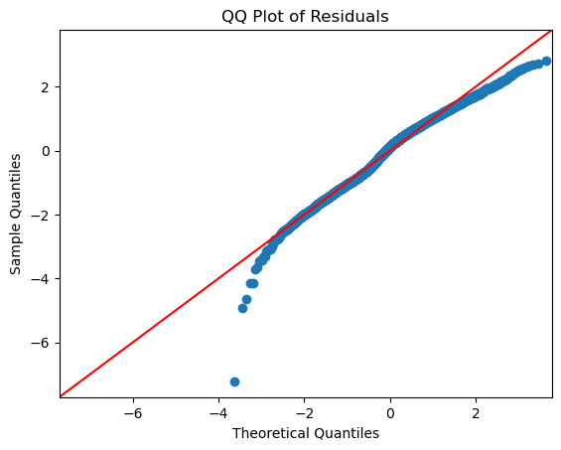
Regression – Linear Regression
R2: 0.748, AdjR2:0.745

Slide 9
Regression – Linear Regression
Linearity – No
Homoscedasticity – No
Breusch-Pagan test p-value = 3.223450077501935e-62,
Normality – No
Shapiro-Wilk test p-value = 2.6064151436441598e-43
Independence – Yes
Durbin-Waston：1.977

Slide 10
Regression – Linear Regression
BoxCox transformation y
Multilinearity detection:
Drop features with VIF>10
R2: 0.792, AdjR2: 0.791

Slide 11
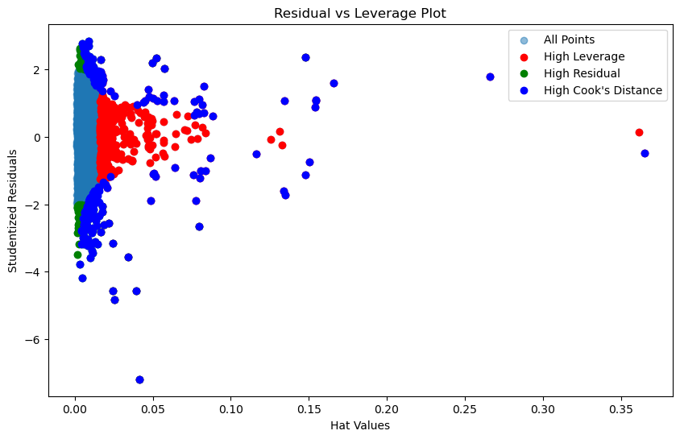
Regression – Linear Regression
Outlier detection
Cook’s distance – Leverage – Residuals

Slide 12
Regression – Linear Regression
Based on experiment, drop high leverage and high residual leads to worse performance on test data
Drop all high cook’s distance
R2: 0.820, AdjR2: 0.818

Slide 13
Regression – Linear Regression
Delete those coefficients that are not significant and are not 0
Final model: 19 variables
R2: 0.818, AdjR2: 0.818
WSL
R2: 0.954, AdjR2: 0.954

Slide 14
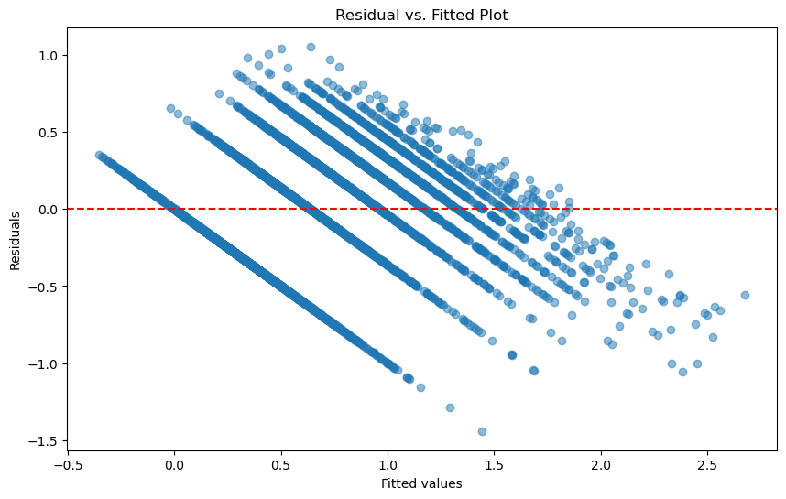
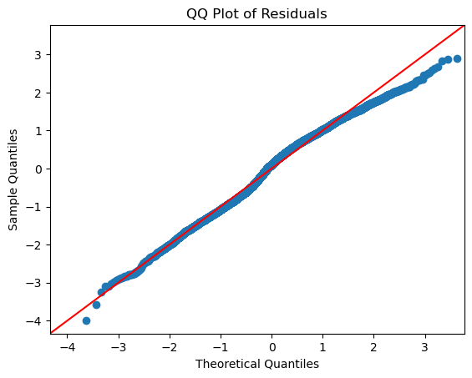
But
Bad performance on test data
R2:0.45 for WSL
R2:0.46 for LinearModel
Assumption still not satisfied

Slide 15
Regression - RandomForest
Hyperparameter selection
Crossvalidation k=5
RandomGridSearch
HalvingRandomSearchCV
Tree-structured Parzen Estimator (TPE)
Multi-core CPU parallel computing

Slide 16
Regression - RandomForest
 | R2 on Train | R2 on Test
Default | 0.94 | 0.57
RandomGridSearch | 0.99 | 0.59
HalvingRandomSearch | 0.97 | 0.59
TPE | 0.98 | 0.60

Slide 17
Regression - RandomForest
TPE a little bit better with less time
Use TPE to select hyperparameter than

Slide 18
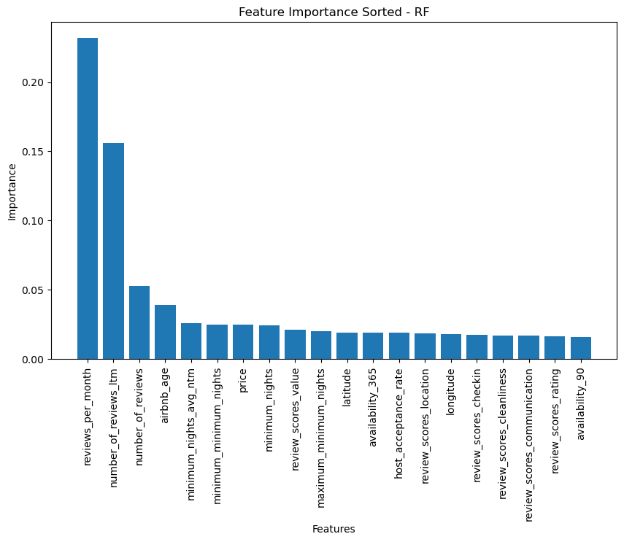
Regression - RandomForest
Past data (reputation) will greatly affect recent performance
Exists location preferences
Shorter rentals - More reviews
Public ratings are important
Price is important

Slide 19
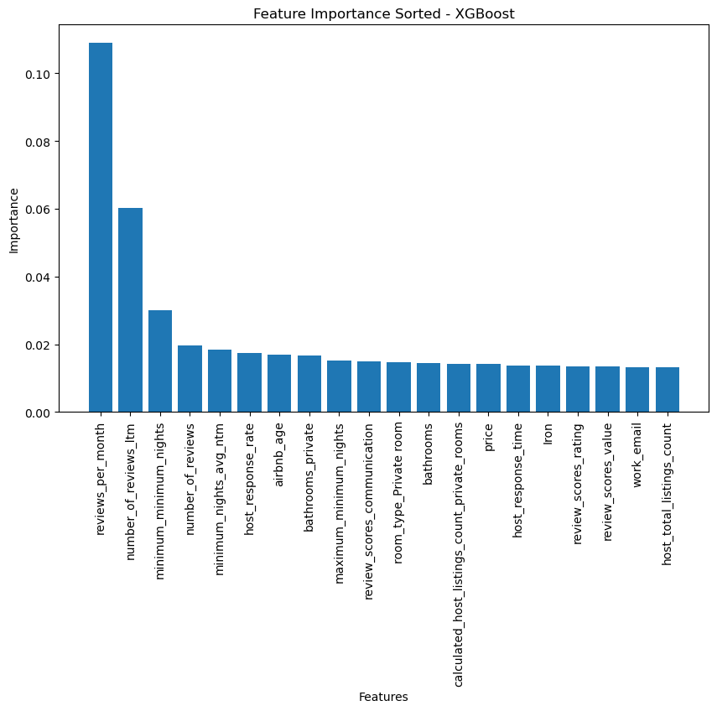
Regression - XGBoost
R2:0.846 on train, 0.61 on test
Past data (reputation)
Shorter rentals - More reviews
Public ratings are important
Price is important
Facilities(bathrooms,iron)
Customer Service(email, response-rate)

Slide 20
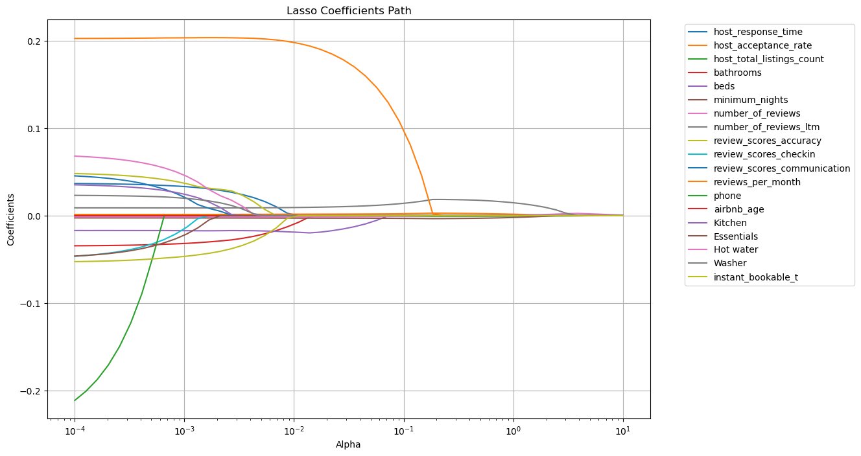
Regression - Lasso
Alpha = 0.0001
R2 0.55 on train, 0.47 on test

Slide 21
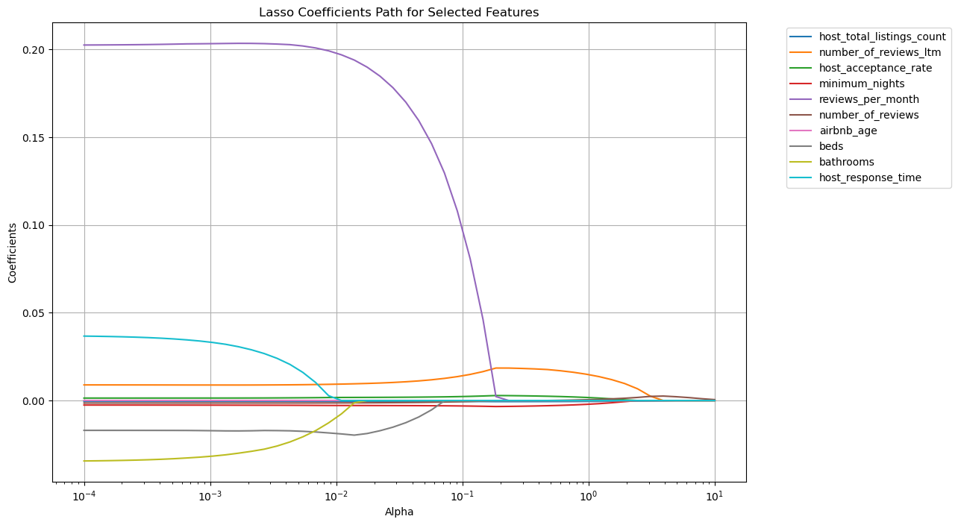
Regression - Lasso
Facilities
Past performance
Rental
Service

Slide 22
Regression – Ridge
Alpha = 0.12
R2 0.55 on train, 0.49 on test

Slide 23
Result analysis
Past performance(reputation) is important
Facilities is important(iron, enough bedrooms bathrooms etc.)
Service is important(response more frequently)
Short rentals bring more reviews

Slide 24
Thanks For Watching！

