Slide 1
PHASE 0 (Welcome)
[THIS SLIDE WON’T BE SHOWN TO SUBJECTS.]

Slide 2

Welcome to the study DACFE!
Click the LEFT or RIGHT mouse buttons to navigate through the instructions.
next

Slide 3

During the experiment, you will be shown different images and will be required to complete a letter memory task.
First, let’s learn how to respond using mouse clicks and practice a bit!
Click the LEFT or RIGHT mouse buttons to navigate through the instructions.
previous
next

Slide 4
In the letter memory task, you will use the LEFT and RIGHT mouse buttons. Now we will learn how to respond with LEFT or RIGHT button in the letter memory task.
When you are ready to start practice, please click the RIGHT button.
previous
Start
Practice

Slide 5
PHASE 1 (Practice-2Back)
[THIS SLIDE WON’T BE SHOWN TO SUBJECTS.]

Slide 6
In the letter memory task, you will see a sequence of letters one at a time.
For each letter, you will need to decide whether it is SAME as or DIFFERENT from the letter you saw 1 letter ago (1-Back), 2 letters ago (2-Back), or 3 letters ago (3-Back).
next

Slide 7
Let’s start with practicing 2-Back letter memory task.
You will see a sequence of letters appear one at a time, then disappear. For each letter, you need to decide whether it is the Same as or Different from the letter which you saw two back from the current one.
The N-back letter will be highlighted in yellow during practice phase.
previous
next

Slide 8
For example, the complete sequence you will see will be:
C L F Q F X N X
For each letter presented on the screen, you will need to click the mouse button to indicate whether the letter you see is the SAME or DIFFERENT than the letter shown two letters ago.
previous
next

Slide 9
For each letter as it appears, you would respond:
C L F Q F X N X
Different,
as there is
no letter
2 back from it.
previous
next

Slide 10
For each letter as it appears, you would respond:
C L F Q F X N X
Different,
as there is
no letter
2 back from it.
previous
next

Slide 11
For each letter as it appears, you would respond:
C L F Q F X N X
Different
previous
next

Slide 12
For each letter as it appears, you would respond:
C L F Q F X N X
Different
previous
next

Slide 13
For each letter as it appears, you would respond:
C L F Q F X N X
Same
previous
next

Slide 14
To indicate that the letter is the SAME, click the LEFT mouse button.
To indicate that the letter is DIFFERENT, click the RIGHT mouse button.
Remember to you need to make a response for each letter. It is important to respond quickly. Please provide your answers as quickly as possible within 1-2 seconds. The task will automatically move to the next letter if you are too slow.
previous
next

Slide 15
You can respond until you see the fixation cross reappears on the screen, even if the letter you are responding to has disappeared.
The previous three letters will be shown to you and the 2-back letter will be highlighted in yellow during practice phase.
REMEMBER:
LEFT Mouse Button = SAME
RIGHT Mouse Button = DIFFERENT
Click the RIGHT button when you are ready to start practice.
previous
Start
Practice

Slide 16
…Practice…
[THIS SLIDE WON’T BE SHOWN TO SUBJECTS.]

Slide 17
PHASE 0 (Redo_2-Back)
[THIS SLIDE WILL BE SHOWN TO SUBJECTS WHILE A MEASURE < 0.75.]

Slide 18
You may need another round of practice because you made some mistakes.
If you have any questions about the task, please ask the experimenter now.
For each letter, you need to decide whether it is the SAME as or DIFFERENT from the letter which you saw two back from the current one.
Please provide your ratings as quickly as possible within 1-2 seconds. You can respond until you see the fixation cross reappears on the screen, even if the letter you are responding to has disappeared.
REMEMBER:
LEFT Mouse Button = SAME
RIGHT Mouse Button = DIFFERENT
Click the RIGHT button when you are ready to practice again.
Practice
Again

Slide 19
PHASE 2 (Ready to start?)
[THIS SLIDE WON’T BE SHOWN TO SUBJECTS.]

Slide 20
Great job!
You seem to have learned well. Are you ready to try a round of faster 2-Back task without reminder and feedback?
Practice Again
with Reminders
Ready
to Try

Slide 21
PHASE 2 (Calibration)
[THIS SLIDE WON’T BE SHOWN TO SUBJECTS.]

Slide 22
Let’s try a round of 2-Back letter memory task!
The previous letters won’t be shown to you anymore. The speed will increase.
Remember to click one of the buttons for each Letter. You can respond until you see the fixation cross reappears on the screen, even if the letter you are responding to has disappeared. Please provide your answers as quickly as possible within 1-2 seconds. The task will automatically move to the next letter if you are too slow.
REMEMBER:
The Left Mouse Button = Same
The Right Mouse Button = Different
Click the RIGHT button when you are ready to start.
Start
the Round

Slide 23
PHASE 3 (Practice-1Back)
[THIS SLIDE WON’T BE SHOWN TO SUBJECTS.]

Slide 24
Great job!
Now you are going to learn about another two levels of letter memory task. They are similar to the 2-Back letter memory task you just learned about.
Firstly, you will do the 1-Back letter memory task, where you need to indicate each letter you see is the SAME as or DIFFERENT from the previous letter you saw.
next

Slide 25
For example, as each letter appears, you would respond:
C L F F Q X N X
Different,
as there is
no letter
1 back from it.
previous
next

Slide 26
For each letter as it appears, you would respond:
C L F F Q X N X
Different
previous
next

Slide 27
For each letter as it appears, you would respond:
C L F F Q X N X
Different
previous
next

Slide 28
For each letter as it appears, you would respond:
C L F F Q X N X
Same
previous
next

Slide 29
To indicate that the letter is the SAME, click the LEFT mouse button.
To indicate that the letter is DIFFERENT, click the RIGHT mouse button.
Remember to you need to make a response for each letter. It is important to respond quickly. Please provide your answers as quickly as possible within 1-2 seconds. The task will automatically move to the next letter if you are too slow.
previous
next

Slide 30
You can respond until you see the fixation cross reappears on the screen, even if the letter you are responding to has disappeared.
The previous three letters will be shown to you and the 1-back letter will be highlighted in yellow during practice phase.
REMEMBER:
LEFT Mouse Button = SAME
RIGHT Mouse Button = DIFFERENT
Click the RIGHT button when you are ready to start practice.
previous
Start
Practice

Slide 31
…Practice…
[THIS SLIDE WON’T BE SHOWN TO SUBJECTS.]

Slide 32
PHASE 0 (Redo_1-Back)
[THIS SLIDE WILL BE SHOWN TO SUBJECTS WHILE A MEASURE < 0.75.]

Slide 33
You may need another round of practice because you made some mistakes.
If you have any questions about the task, please ask the experimenter now.
For each letter, you need to decide whether it is the SAME as or DIFFERENT from the letter which you saw one back from the current one.
Please provide your ratings as quickly as possible within 1-2 seconds. You can respond until you see the fixation cross reappears on the screen, even if the letter you are responding to has disappeared.
REMEMBER:
LEFT Mouse Button = SAME
RIGHT Mouse Button = DIFFERENT
Click the RIGHT button when you are ready to practice again.
Practice
Again

Slide 34
PHASE 3.2 (Practice no reminder)
[THIS SLIDE WON’T BE SHOWN TO SUBJECTS.]

Slide 35
Great job!
You seem to have learned well. Are you ready to try a faster 1-Back task without reminder and feedback?
Practice Again
with Reminders
Ready
to Try

Slide 36
PHASE 4 (Practice-3Back)
[THIS SLIDE WON’T BE SHOWN TO SUBJECTS.]

Slide 37
Great job!
Now you are going to learn the 3-Back letter memory, where you need to indicate each letter you see is the SAME as or DIFFERENT from the letter which you saw three back from the current one.
The 3-Back task can seem hard at first, but remember to stay focused, and to respond as quickly and accurately as possible.
next

Slide 38
For each letter as it appears, you would respond:
C F L Q F X N X
Different,
as there is
no letter
3 back from it.
previous
next

Slide 39
For each letter as it appears, you would respond:
C F L Q F X N X
Different,
as there is
no letter
3 back from it.
previous
next

Slide 40
For each letter as it appears, you would respond:
C F L Q F X N X
Different,
as there is
no letter
3 back from it.
previous
next

Slide 41
For each letter as it appears, you would respond:
C F L Q F X N X
Different
previous
next

Slide 42
For each letter as it appears, you would respond:
C F L Q F X N X
Same
previous
next

Slide 43
To indicate that the letter is the SAME, click the LEFT mouse button.
To indicate that the letter is DIFFERENT, click the RIGHT mouse button.
Remember to you need to make a response for each letter. It is important to respond quickly. Please provide your answers as quickly as possible within 1-2 seconds. The task will automatically move to the next letter if you are too slow.
previous
next

Slide 44
You can respond until you see the fixation cross reappears on the screen, even if the letter you are responding to has disappeared.
The previous three letters will be shown to you and the 3-back letter will be highlighted in yellow during practice phase.
REMEMBER:
LEFT Mouse Button = SAME
RIGHT Mouse Button = DIFFERENT
Click the RIGHT button when you are ready to start practice.
previous
Start
Practice

Slide 45
…Practice…
[THIS SLIDE WON’T BE SHOWN TO SUBJECTS.]

Slide 46
PHASE 0 (Redo_3-Back)
[THIS SLIDE WILL BE SHOWN TO SUBJECTS WHILE A MEASURE < 0.75.]

Slide 47
You may need another round of practice because you made some mistakes.
If you have any questions about the task, please ask the experimenter now.
For each letter, you need to decide whether it is the SAME as or DIFFERENT from the letter which you saw three back from the current one.
Please provide your ratings as quickly as possible within 1-2 seconds. You can respond until you see the fixation cross reappears on the screen, even if the letter you are responding to has disappeared.
REMEMBER:
LEFT Mouse Button = SAME
RIGHT Mouse Button = DIFFERENT
Click the RIGHT button when you are ready to practice again.
Practice
Again

Slide 48
PHASE 4.2 (Practice no reminder)
[THIS SLIDE WON’T BE SHOWN TO SUBJECTS.]

Slide 49
Great job!
You seem to have learned well. Are you ready to try a faster 3-Back task without reminder and feedback?
Practice Again
with Reminders
Ready
to Try

Slide 50
PHASE 5 (Practice main)
[THIS SLIDE WON’T BE SHOWN TO SUBJECTS.]

Slide 51
Well done!
You have now learned all three letter memory tasks.
next

Slide 52
The following phase will require you to view an image before completing each sequence of letter memory task.
next

Slide 53
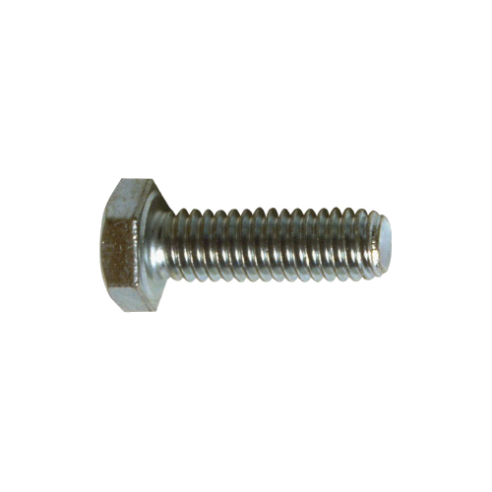
You will see an image presented on the screen for 3 seconds.
Simply view it util it disappears. Just let any thoughts or emotions about that image occur naturally, without trying to control them.
next

Slide 54
Once the image disappears, the letter memory task sequence will begin.
You will be instructed to either do the 1-Back or the 3-Back letter memory task.
When you are ready to start practice, please click the RIGHT button.
previous
Start
Practice

Slide 55
PHASE 5 (Practice END)
[THIS SLIDE WON’T BE SHOWN TO SUBJECTS.]

Slide 56
Well done!
You have completed the practice phase.
Please call the experimenter.
Notes:
Click the RIGHT button by experimenter.

Slide 57
PHASE 7 (OFFLINE RATING – T0)
[THIS SLIDE WON’T BE SHOWN TO SUBJECTS.]

Slide 58
Welcome to the real test!
Firstly, we will ask you to rate how much you like each image that you will see in the following phases.
next

Slide 59
You will see an image presented on the screen for 3 seconds. Simply view it and do not respond until a rating scale appears.
next

Slide 60

Once the visual rating scale appears, you will need to move the slider from the middle to a position on the scale to indicate your liking.
How much do you like this image?
Not at all Very much
previous
next

Slide 61
Please provide your ratings as quickly as possible within 1-2 seconds.
When you are ready to start, please click the RIGHT button.
Start
Rating

Slide 62
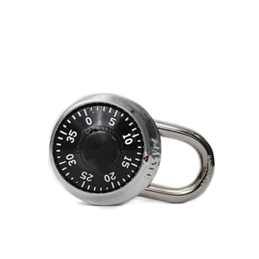
How much do you like this image?
Not at all Very much
[THIS SLIDE IS NOT INSTRUCTION. JUST TO SHOW HOW THE RATING QUESTION LOOKS LIKE IN PROGRAM.]

Slide 63
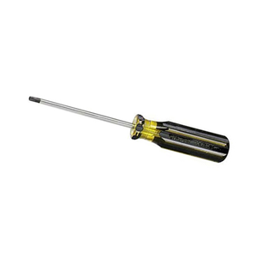
How much do you like this image?
Not at all Very much
[THIS SLIDE IS NOT INSTRUCTION. JUST TO SHOW HOW THE RATING QUESTION LOOKS LIKE IN PROGRAM.]

Slide 64
PHASE 6 (Start test?)
[THIS SLIDE WON’T BE SHOWN TO SUBJECTS.]

Slide 65
Are you ready to start the real task?
REMEMBER:
The 1-Back or 3-Back will be indicated before each letter sequence
LEFT Mouse Button = SAME
RIGHT Mouse Button = DIFFERENT
When you are ready to start, please click the RIGHT button.
Practice
Again
Start Real Task

Slide 66
…Do the main task…
[THIS SLIDE WON’T BE SHOWN TO SUBJECTS.]

Slide 67
PHASE 7 (OFFLINE RATING – T1)
[THIS SLIDE WON’T BE SHOWN TO SUBJECTS.]

Slide 68
Well done!
Now we will ask you to rate how much you like each image that you saw in previous phase.
next

Slide 69
Like before, you will see an image presented on the screen for 3 seconds.
Simply view it and do not respond until a rating scale appears.
Once the visual rating scale appears, you will need to move the slider from the middle to a position on the scale to indicate your liking based your feelings of them during the previous tasks.
next

Slide 70
Please provide your ratings as quickly as possible within 1-2 seconds.
When you are ready to start, please click the RIGHT button.
Start
Rating

Slide 71
How much do you like this image?
Not at all Very much
[THIS SLIDE IS NOT INSTRUCTION. JUST TO SHOW HOW THE RATING QUESTION LOOKS LIKE IN PROGRAM.]

Slide 72
How much do you like this image?
Not at all Very much
[THIS SLIDE IS NOT INSTRUCTION. JUST TO SHOW HOW THE RATING QUESTION LOOKS LIKE IN PROGRAM.]

Slide 73
PHASE 8 (TRUE CHOICE PHASE)
[THIS SLIDE WON’T BE SHOWN TO SUBJECTS.]

Slide 74
Well done!
In the next phase you will make a choice between two images before completing each sequence of letter memory task.
next

Slide 75
When two images appear, please click on the one you choose. Once you make a choice, the letter memory task sequence will begin. You will be required to do the 1-Back, 2-Back or 3-Back letter memory task.
Please choose the one image you prefer.
next

Slide 76
You can always begin by choosing the two images randomly. However, you may notice differences between them. If you develop a preference, you can feel free to choose one image more than the other.
Please avoid using simple rules such as alternating back and forth between the images. Instead, try to make a decision on every trial.
Start
Choice

Slide 77
PHASE 9 (OFFLINE RATING – T2)
[THIS SLIDE WON’T BE SHOWN TO SUBJECTS.]

Slide 78
Well done!
Now we will ask you to rate how much you like each image that you saw in the previous phase.
next

Slide 79
Like before, you will see an image presented on the screen for 3 seconds.
Simply view it and do not respond until a rating scale appears.
Once the visual rating scale appears, you will need to move the slider from the middle to a position on the scale to indicate your liking based your feelings of them during the previous tasks.
next

Slide 80
Please provide your ratings as quickly as possible within 1-2 seconds.
When you are ready to start, please click the RIGHT button.
Start
Rating

Slide 81
How much do you like this image?
Not at all Very much
[THIS SLIDE IS NOT INSTRUCTION. JUST TO SHOW HOW THE RATING QUESTION LOOKS LIKE IN PROGRAM.]

Slide 82
How much do you like this image?
Not at all Very much
[THIS SLIDE IS NOT INSTRUCTION. JUST TO SHOW HOW THE RATING QUESTION LOOKS LIKE IN PROGRAM.]

Slide 83
PHASE 10 (LEARNING CHECK T1)
[THIS SLIDE WON’T BE SHOWN TO SUBJECTS.]

Slide 84
Well done!
Now there will be two questions about the images used in previous tasks.
Please indicate your answer by clicking the one out of two options.
next

Slide 85
Which level of the letter memory task did this image predict?
1-Back Not Sure 3-Back
[THIS SLIDE IS NOT INSTRUCTION. JUST TO SHOW HOW THE RATING QUESTION LOOKS LIKE IN PROGRAM.]

Slide 86
Which level of the letter memory task did this image predict?
1-Back Not Sure 3-Back
[THIS SLIDE IS NOT INSTRUCTION. JUST TO SHOW HOW THE RATING QUESTION LOOKS LIKE IN PROGRAM.]

Slide 87
PHASE 11 (FALSE CHOICE PHASE)
[THIS SLIDE WON’T BE SHOWN TO SUBJECTS.]

Slide 88
Well done!
In the next phase you will make a choice between two images before completing each sequence of letter memory task.
This choice phase will be longer than the previous choice phase.
next

Slide 89
When two images appear, please click on the one you choose. Once you make a choice, the letter memory task sequence will begin. You will be required to do the given-level letter memory task.
Please choose the one image you prefer.
next

Slide 90
You can always begin by choosing the two images randomly. However, you may notice differences between them. If you develop a preference, you can feel free to choose one image more than the other.
Please avoid using simple rules such as alternating back and forth between the images. Instead, try to make a decision on every trial.
Start
Choice

Slide 91
PHASE 12 (OFFLINE RATING – T3)
[THIS SLIDE WON’T BE SHOWN TO SUBJECTS.]

Slide 92
Well done!
Now we will ask you to rate how much you like each image that you saw in the previous phase.
next

Slide 93
Like before, you will see an image presented on the screen for 3 seconds.
Simply view it and do not respond until a rating scale appears.
Once the visual rating scale appears, you will need to move the slider from the middle to a position on the scale to indicate your liking based your feelings of them during the previous tasks.
next

Slide 94
Please provide your ratings as quickly as possible within 1-2 seconds.
When you are ready to start, please click the RIGHT button.
Start
Rating

Slide 95
How much do you like this image?
Not at all Very much
[THIS SLIDE IS NOT INSTRUCTION. JUST TO SHOW HOW THE RATING QUESTION LOOKS LIKE IN PROGRAM.]

Slide 96
How much do you like this image?
Not at all Very much
[THIS SLIDE IS NOT INSTRUCTION. JUST TO SHOW HOW THE RATING QUESTION LOOKS LIKE IN PROGRAM.]

Slide 97
PHASE 13 (LEARNING CHECK T2)
[THIS SLIDE WON’T BE SHOWN TO SUBJECTS.]

Slide 98
Well done!
Now there will be two questions about the images used in previous tasks.
Please indicate your answer by clicking the one out of two options.
next

Slide 99
Which level of the letter memory task did this image predict?
1-Back 2-Back 3-Back
[THIS SLIDE IS NOT INSTRUCTION. JUST TO SHOW HOW THE RATING QUESTION LOOKS LIKE IN PROGRAM.]

Slide 100
Which level of the letter memory task did this image predict?
1-Back 2-Back 3-Back
[THIS SLIDE IS NOT INSTRUCTION. JUST TO SHOW HOW THE RATING QUESTION LOOKS LIKE IN PROGRAM.]

Slide 101
PHASE 14 (DEMAND RATING)
[THIS SLIDE WON’T BE SHOWN TO SUBJECTS.]

Slide 102
Well done!
Now we will ask you to rate your feeling of the 1-Back, 2-Back and 3-Back letter memory tasks you did in previous phase on a rating scale.
You will need to move the slider from the middle to a position on the scale to indicate your feeling of that demand level.
Start
Rating

Slide 103
How mentally demanding was
the 1-Back letter memory task?
Not at all Very much
[THIS SLIDE IS NOT INSTRUCTION. JUST TO SHOW HOW THE RATING QUESTION LOOKS LIKE IN PROGRAM.]

Slide 104
How hard did you have to work in
the 1-Back letter memory task?
Not at all Very much
[THIS SLIDE IS NOT INSTRUCTION. JUST TO SHOW HOW THE RATING QUESTION LOOKS LIKE IN PROGRAM.]

Slide 105
How frustrated were you while performing
the 1-Back letter memory task?
Not at all Very much
[THIS SLIDE IS NOT INSTRUCTION. JUST TO SHOW HOW THE RATING QUESTION LOOKS LIKE IN PROGRAM.]

Slide 106
How mentally demanding was
the 2-Back letter memory task?
Not at all Very much
[THIS SLIDE IS NOT INSTRUCTION. JUST TO SHOW HOW THE RATING QUESTION LOOKS LIKE IN PROGRAM.]

Slide 107
How hard did you have to work in
the 2-Back letter memory task?
Not at all Very much
[THIS SLIDE IS NOT INSTRUCTION. JUST TO SHOW HOW THE RATING QUESTION LOOKS LIKE IN PROGRAM.]

Slide 108
How frustrated were you while performing
the 2-Back letter memory task?
Not at all Very much
[THIS SLIDE IS NOT INSTRUCTION. JUST TO SHOW HOW THE RATING QUESTION LOOKS LIKE IN PROGRAM.]

Slide 109
How mentally demanding was
the 3-Back letter memory task?
Not at all Very much
[THIS SLIDE IS NOT INSTRUCTION. JUST TO SHOW HOW THE RATING QUESTION LOOKS LIKE IN PROGRAM.]

Slide 110
How hard did you have to work in
the 3-Back letter memory task?
Not at all Very much
[THIS SLIDE IS NOT INSTRUCTION. JUST TO SHOW HOW THE RATING QUESTION LOOKS LIKE IN PROGRAM.]

Slide 111
How frustrated were you while performing
the 3-Back letter memory task?
Not at all Very much
[THIS SLIDE IS NOT INSTRUCTION. JUST TO SHOW HOW THE RATING QUESTION LOOKS LIKE IN PROGRAM.]

Slide 112
PHASE 15 (End)
[THIS SLIDE WON’T BE SHOWN TO SUBJECTS.]

Slide 113
THANK YOU!
This part of the study is now completed.
Please call the experimenter.

Slide 114
The following phase will require you to view an image before completing each sequence of letter memory task. You will see an image presented on the screen for 3 seconds. Simply view it and think of “How much you like this image?”.
next

Slide 115
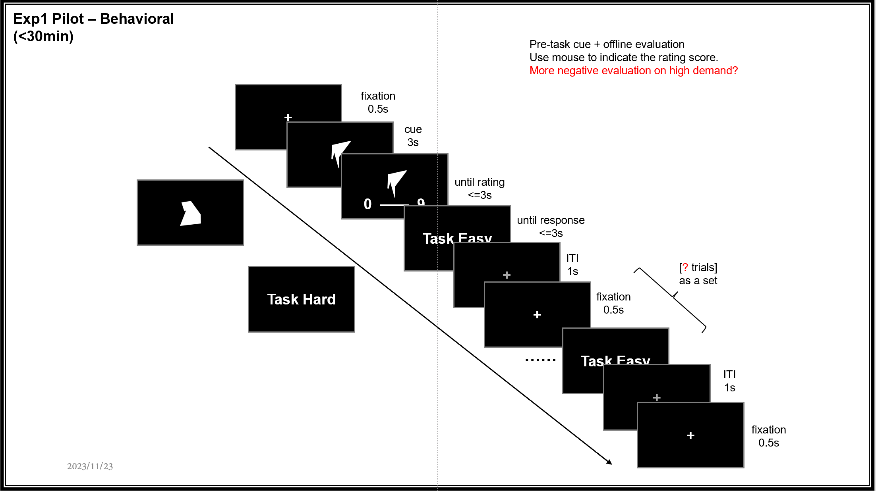
Experiment Design

Slide 116
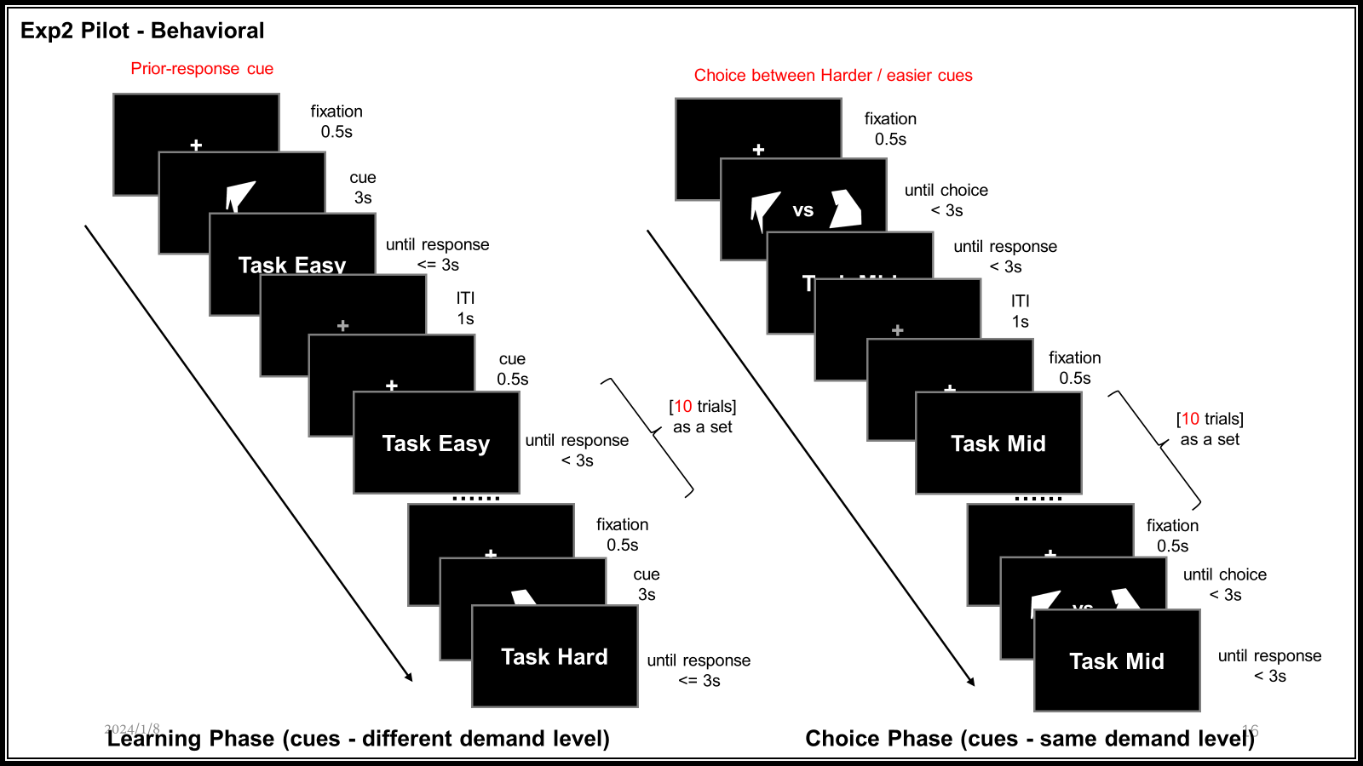
Experiment Design

Slide 117

Experiment Design

