Slide 1

Analysis on Socio-Economic and Geographical Factors that Affect Suicide Rate
Huimin Zeng, Mengfei Lan, Zhenrui Yue
School of Information Sciences
University of Illinois Urbana-Champaign
Presenter: Zhenrui Yue
April 27th, 2022

Slide 2

Background on Suicide Rate
1. It is estimated that around 800,000 people committed suicide every year, suicide is becoming one of the major causes of death in the world.
2. Suicide outranked homicide (ca. 400,000), Parkinson’s disease (ca. 340,000) and many other metal or physical illnesses.

Slide 3
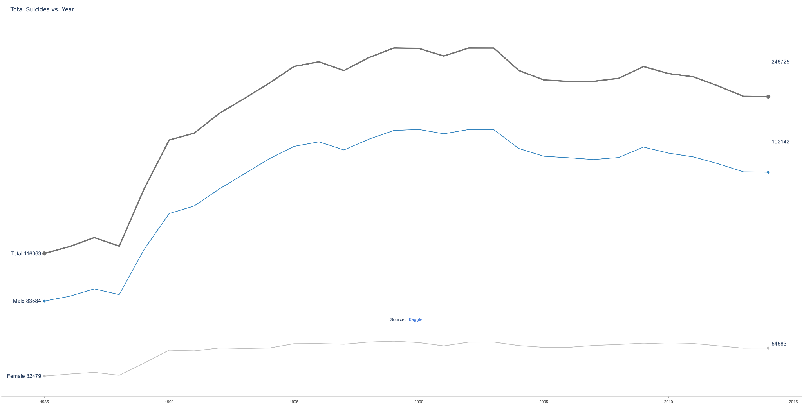
Potential Variables of Suicide Rate
1. Gender, ethnicity
2. Economic development
3. Social welfare
4. Working conditions
5. Climate*
*According to the data from World Health Organization (WHO), it is to observe that the suicide rate is surprisingly high in some developed countries, for instance Finland with 0.0138% compared to only 0.0055% in Italy.

Slide 4
Hypotheses
1. Poor working conditions are positively related with suicide rate.
Pressure and poor working conditions are common in both under-developed
and certain developed countries, where employees are required to work long
hours. Interestingly, we also found out that these countries share high suicide
rates, suggesting that working conditions could be related to suicide ratio.

Slide 5
Hypotheses
1. Poor working conditions are positively related with suicide rate.
Pressure and poor working conditions are common in both under-developed
and certain developed countries, where employees are required to work long
hours. Interestingly, we also found out that these countries share high suicide
rates, suggesting that working conditions could be related to suicide ratio.

Slide 6
Hypotheses
2. Economic development is negatively related to suicide rate.
Improved economic conditions provide better-paid jobs. More importantly,
good economy make people feel secure and hopeful of the future. It is
obvious that a person with increasing financial success and positive
expectations of the future would less likely to have thoughts of suicide.

Slide 7
Hypotheses
3. Social Welfare could reduce the probability of suicide.
Welfare may play a role in the prevention of this phenomenon. With more
financial and supportive help from the society, it is more likely that individuals
with more healthcare and psychological treatment available are more likely to
fight against their suicide tendencies.

Slide 8
Hypotheses
4. Warm and sunny climate could reduce the probability of suicide.
In general, warm weather and sunshine are preferred by most people.
Researches show that sunny and warm climate are beneficial to people's
mental health, while most countries in the tropics have relatively low suicide
ratio. Hence, we assume that warm and sunny climate can reduce the
probability of suicide.

Slide 9
Datsets
[1] https://www.kaggle.com/russellyates88/suicide-rates-overview-1985-to-2016
[2] http://apps.who.int/gho/data/node.main.MHSUICIDEASDR?lang=en
[3] https://en.wikipedia.org/wiki/List_of_countries_by_suicide_rate
[4] https://en.wikipedia.org/wiki/Working_time
[5] https://en.wikipedia.org/wiki/List_of_countries_by_GDP_(PPP)_per_hour_worked
[6] https://en.wikipedia.org/wiki/List_of_countries_by_GDP_(PPP)_per_capita
[7] https://data.oecd.org/earnwage/average-wages
[8] https://en.wikipedia.org/wiki/List_of_countries_by_social_welfare_spending
[9] https://en.wikipedia.org/wiki/List_of_national_capitals_by_latitude
[10] https://en.wikipedia.org/wiki/List_of_cities_by_sunshine_duration

Slide 10
Experiment Design
1. Data loading and merging
2. Normalization
3. Regression analysis
4. Visualization
5. Discussion / Conclusion

Slide 11
Regression Analysis
1. Working Hours vs. Suicide Rate: r=0.1957, p-value: 0.2913
2. Productivity vs. Suicide Rate: r=0.0601, p-value: 0.7482
3. GDP vs. Suicide Rate: r=0.1821, p-value: 0.3269
4. Wages vs. Suicide Rate: r=0.1335, p-value: 0.4740
5. Welfare vs. Suicide Rate: r=0.0913, p-value: 0.6250
6. Latitude vs. Suicide Rate: r=0.1778, p-value: 0.3386
7. Sunshine Hours vs. Suicide Rate: r=0.5600, p-value=0.0011

Slide 12
Regression Analysis
1. (Working Hours, Productivity) vs. Suicide Rate:
r=0.2773, p-value: 0.1310
2. (GDP, Wages) vs. Suicide Rate:
r=0.1835, p-value: 0.3232
3. (Latitude, Sunshine) vs. Suicide Rate:
r=0.5722, p-value: 0.0008
4. (ALL FACTORS) vs. Suicide Rate:
r=0.5940, p-value: 0.0004

Slide 13
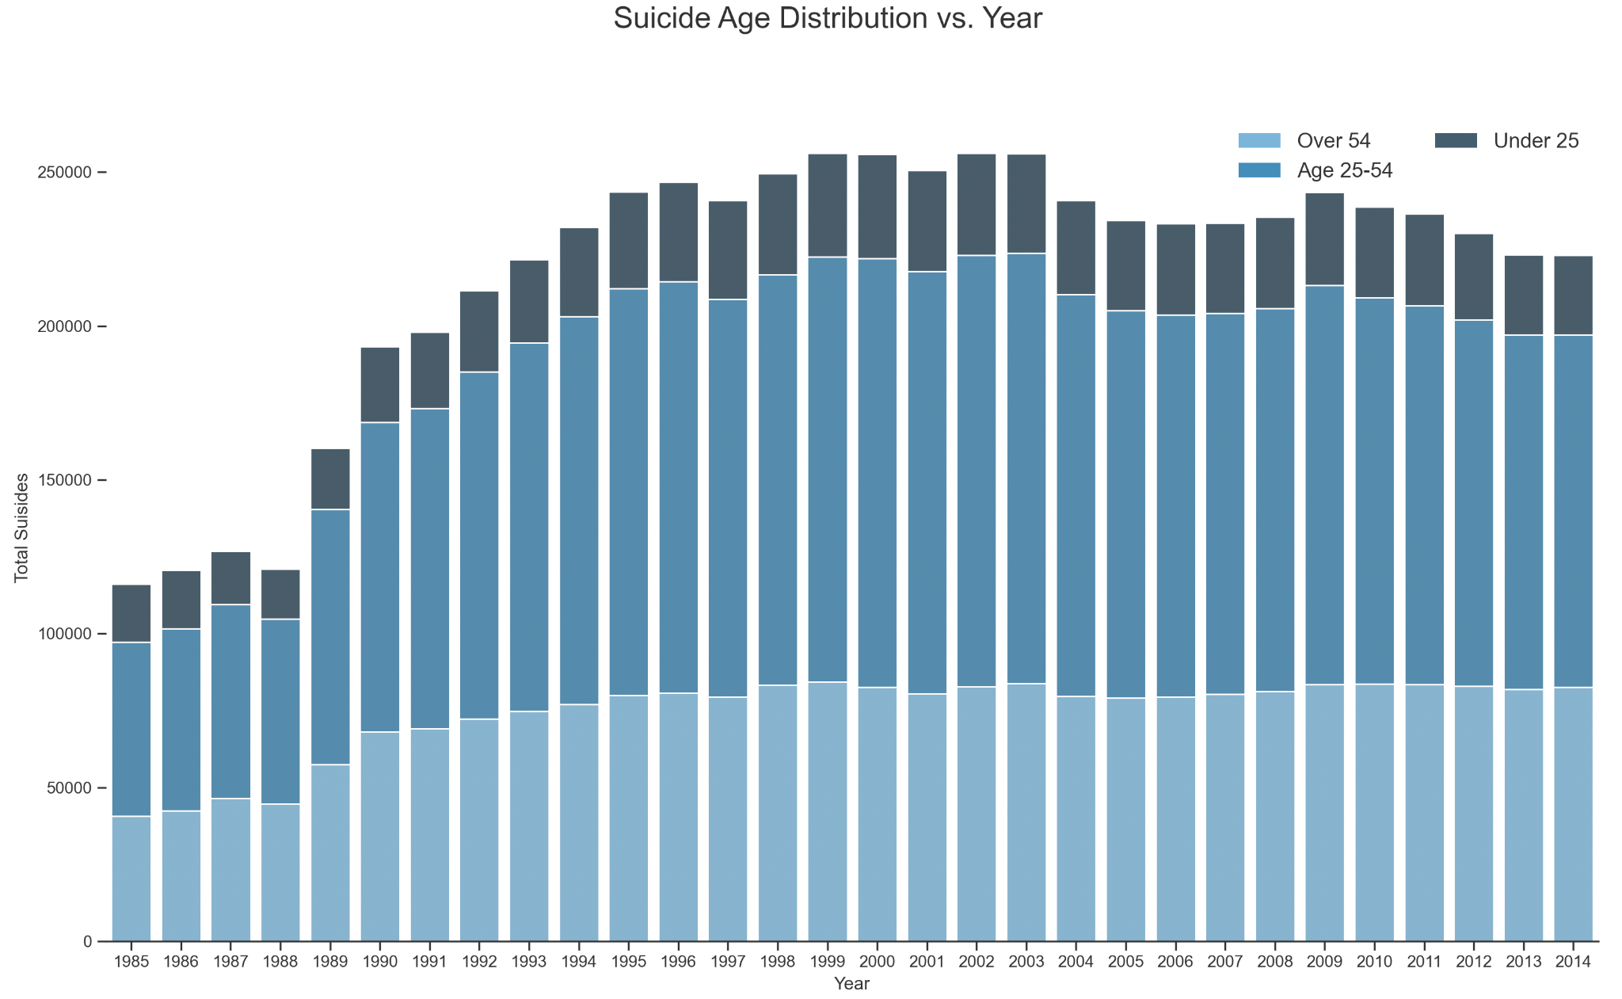
Visualized Results

Slide 14
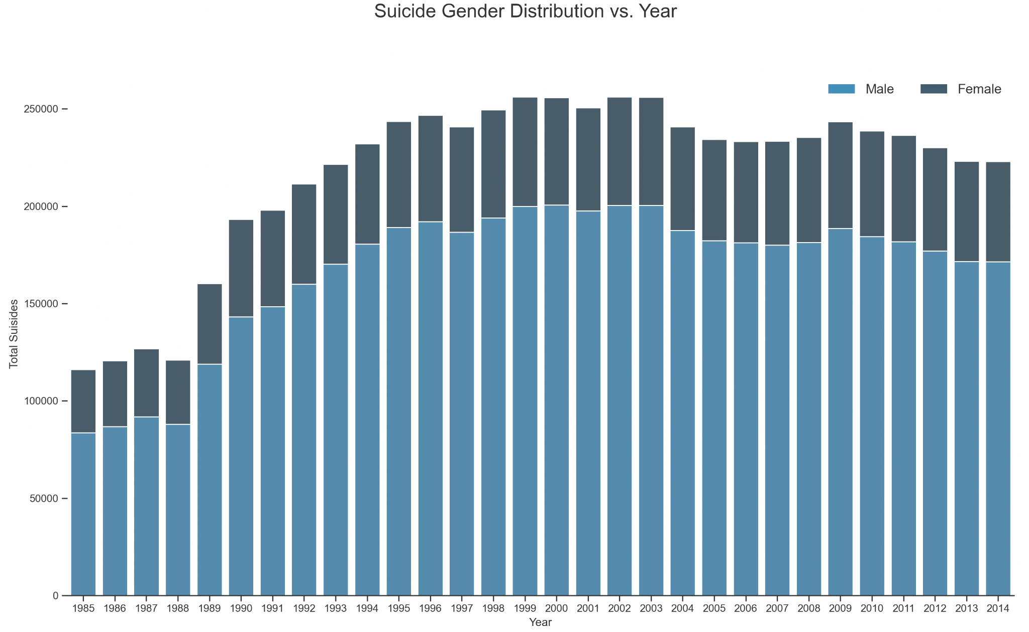
Visualized Results

Slide 15
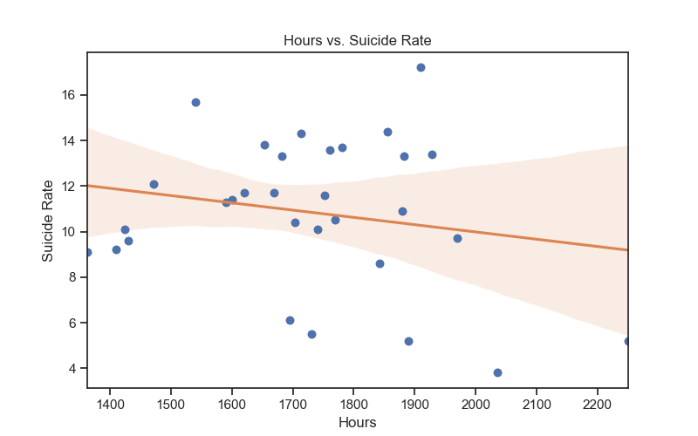
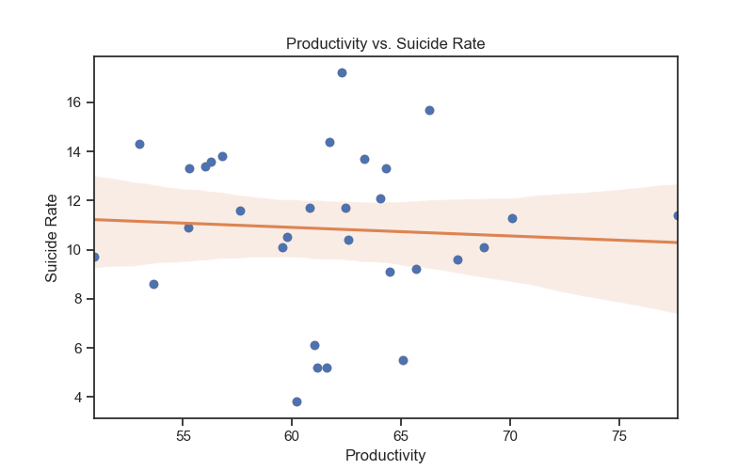
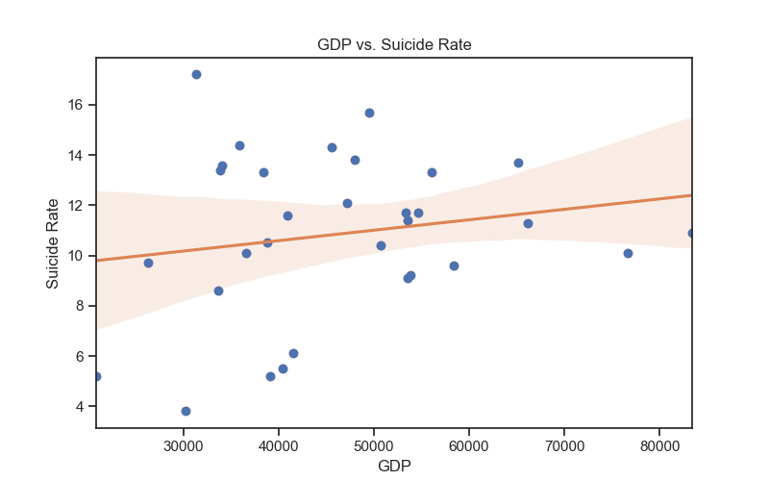
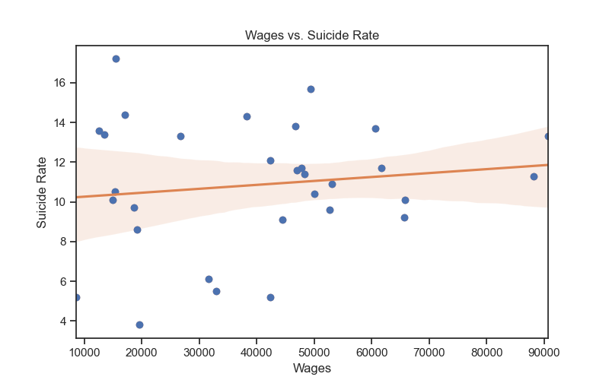
Visualized Results

Slide 16
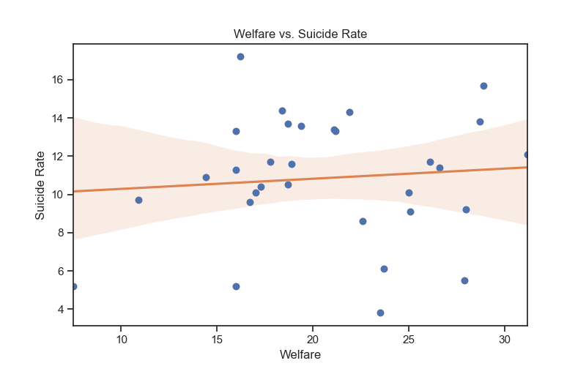
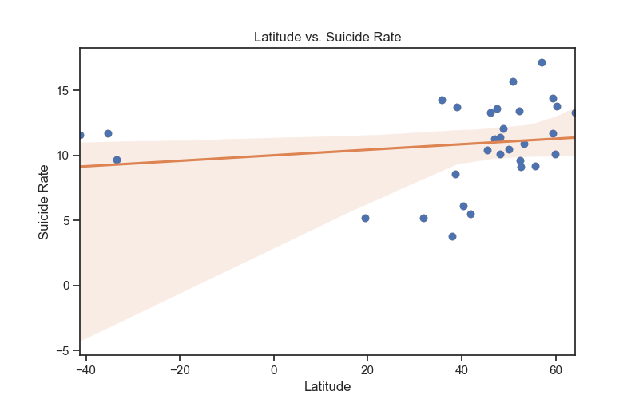
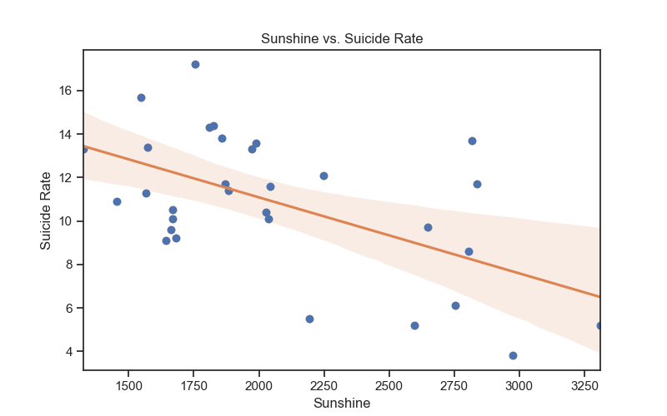
Visualized Results

Slide 17
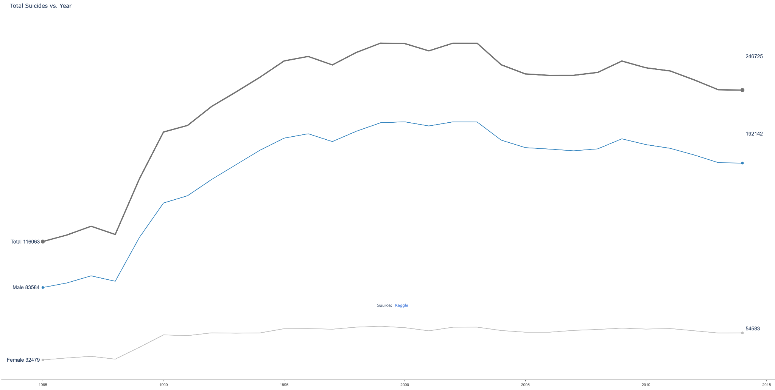
Visualized Results

Slide 18
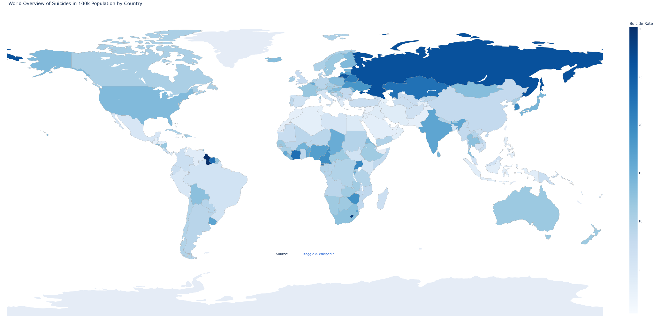
Visualized Results

Slide 19
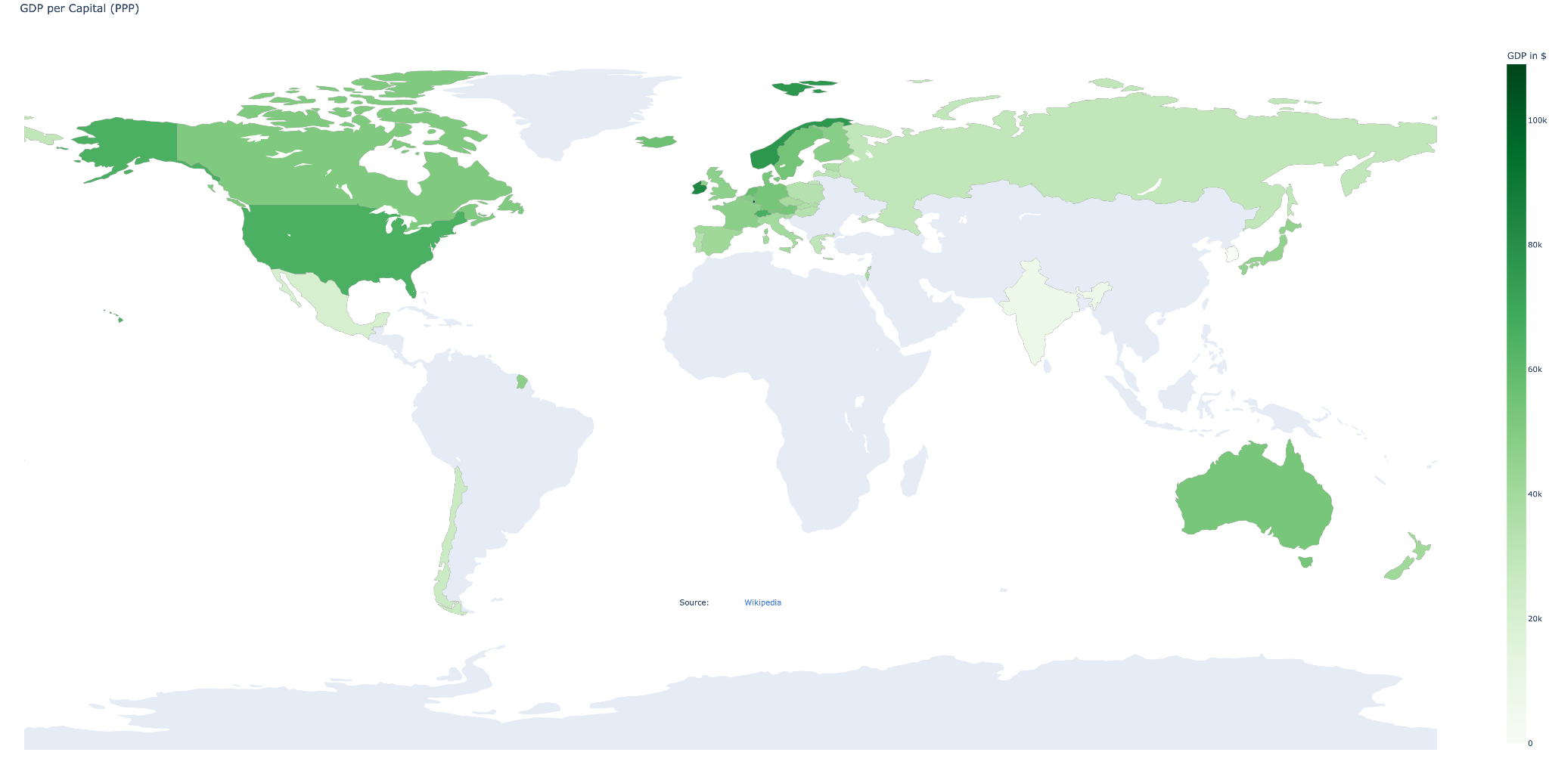
Visualized Results

Slide 20
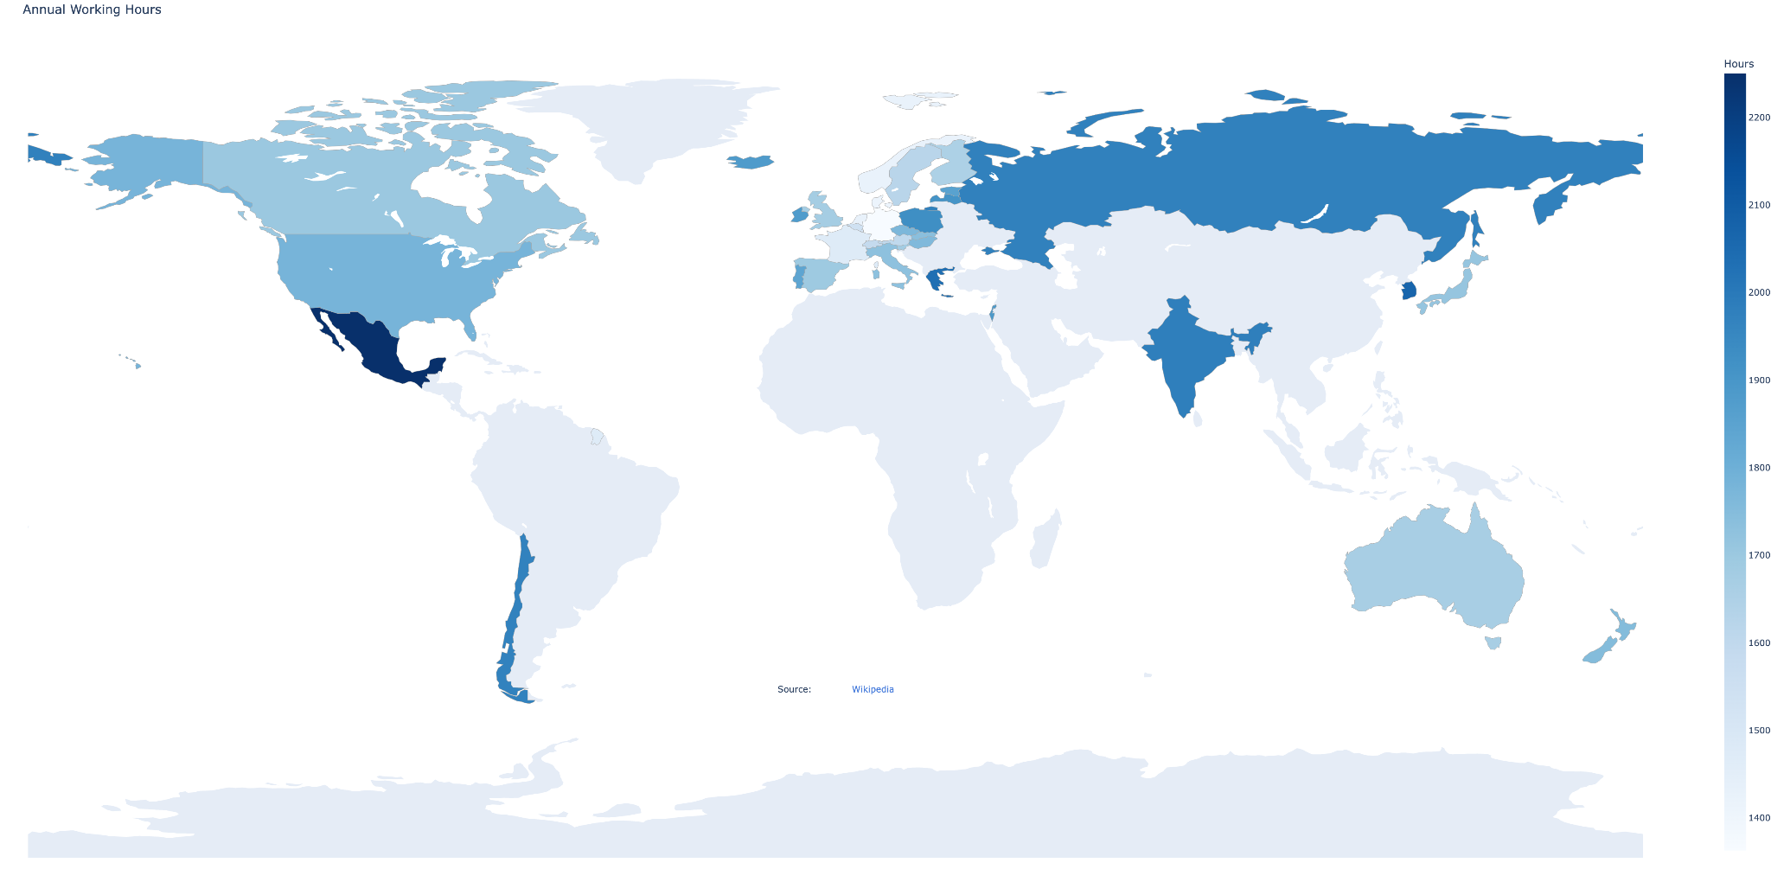
Visualized Results

Slide 21
Conclusion
1. We reject the hypotheses “Poor working conditions are positively related with suicide rate.”, “Economic development is negatively related to suicide rate.” and “Social Welfare could reduce the probability of suicide.”
2. We accept the hypothesis “Warm and sunny climate could reduce the probability of suicide.”. Specifically, sunshine hours is the most important single factor related to suicide rates.
3. Additionally, we observe highest statistical significance by performing regression analysis among all factors and the suicide rate: r=0.5940, p-value: 0.0004

Slide 22
Implementation
Numpy
Pandas
Matplotlib & Plotly
Code: https://github.com/Yueeeeeeee/2022Spring_Finals
Data is not included in repo due to its size, we are happy to send you a
copy if interested
We have a few demos with Plotly

