Slide 1
Topics
Last week summary
Deep dive: LaneDetection.cpp and PrecedingRoverDetection.cpp
Next steps

Slide 2
Last week summary
Autofocus3 Installation
Meeting dates
No common ground → Sub-groups
Tuesday in Garching for Sync
Thursday after official meeting
Test case 1 to 3 breakdown (later)
Programming language choice
C++
Python
Matlab (to C via Coder)

Slide 3


Deep dive: Rover detection
zbar::ImageScanner
4 corner points
Average size in y-direction [px]
$distance=\frac{0.87}{35}×\frac{100mm×480px}{height}$
Rover ID + detected = true
height

Slide 4

Next steps: Test case 1
Stop in front of QR code (rover)
Existing PrecedingRoverDetection.cpp code enough
Getting used to the hardware
Till next Thursday

Slide 5
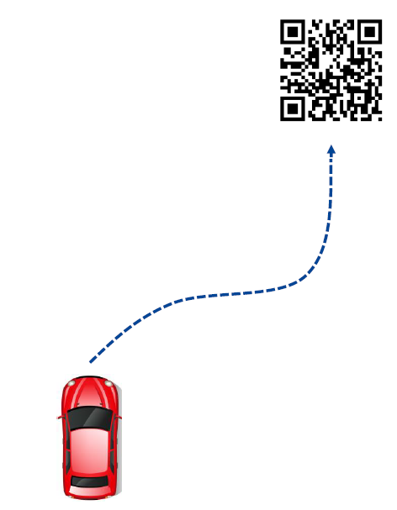
Next steps: Test case 2
Existing code no longer sufficient
Expand vision and interface:
Position (2D) + orientation required
Path planning and path following
Sophisticated environment model not required
Three work packages:
QR code location (sense)
Path planning (plan)
Path following (act)

Slide 6
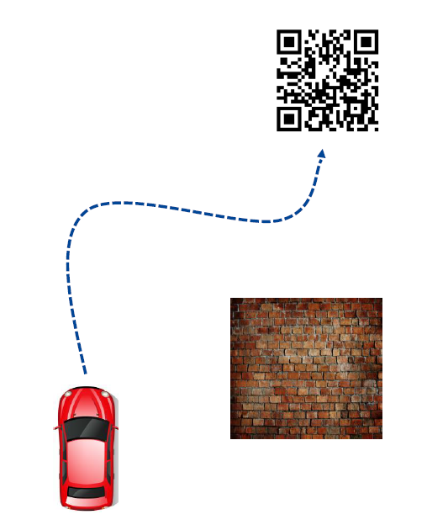
Next steps: Test case 3
Without simplification: Full parking task (static!)
Environment model required
Lidar sensor

