Slide 1

Group status presentation
Platooning Team
May 9th, 2019

Slide 2
Project Progress (from May 2nd to May 9th )
Begin with the part “V2V communication”
Summarize the content of the introduction
Determine the relative AF3 components
Understand the source codes and generate them into the AF3-model

Slide 3
Group communication
Online communication
Trello
Google Slides
WhatsApp
Offline communication
Thursday at Fortiss
Friday at Campus Garching

Slide 4
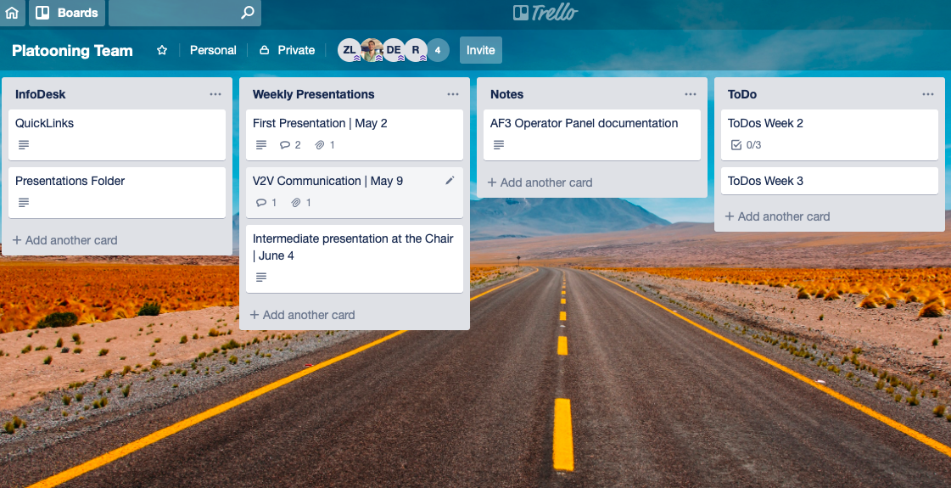
Trello

Slide 5
Outlook
Focus on the practical part
Apply the models into the vehicles
Implement the leader functionality

