Slide 1

Platooning Team
Adaptive Cruise Control (ACC)
May 23, 19

Slide 2
Content
General Overview about ACC
Key Definitions
System Requirements
Relation to AF3-Models

Slide 3
About ACC
vs Conventional Cruise Control(CCC)
Pre-selected time gap
Up to a maximum speed set by the driver

Slide 4
Several Key Definitions
Forward vehicle
Clearance
Maximum Selectable Time Gap τ_{max}
Maximum Set and Operating Speed v_{max}
Minimum Operating Speed for Automatic Positive Acceleration v_{low}
Minimum Set Speed v_{set_min}

Slide 5

Clearance
Distance from the forward vehicle’s trailing surface to the subject vehicle’s leading surface.
c
v
v

Slide 6
V_{low} vs V_{set_min}
V_{low}
ACC not engage
ACC engage
v
0
ACC can be engaged by the driver
V_{set_min}

Slide 7
Several Key Definitions
Steady-State
Minimum Steady-State Following Time Gap τ_{min}
Maximum Sensor Range d_{max}
Time Gap τ = c/v
c
v

Slide 8
System Requirements - Selection of the speed
Minimum Set Speed
v_{set_min} ≥ 7.0 m/s, ±10% for both CCC and ACC
Minimum Operating Speed
v_{low} ≥ 5.0 m/s, ±10%
if v ＜ v_{low} , the driver should be informed.
Maximum Set and Operating Speed
v_{max} ≤ d_{max} / τ

Slide 9
System Requirements - Selection of the time gap
Minimum Steady-State Following Time Gap
τ_{min} ≥ 1.0 s
Time Gap
τ ≥ 1.5s
τ = τ_{min}, if the system is not adjustable by the driver
Default Setting ≥ 1.5s

Slide 10
System Requirements - Operating State Transitions
ACC System States
via Service Brake
via Accelerator pedal
via Clutch
(if v < v_{low})
deactivateACC()
ACC stand-by
ACC engaged
activateACC()
turnOffACC()
turnOffACC()
turnOnACC()
ACC off

Slide 11
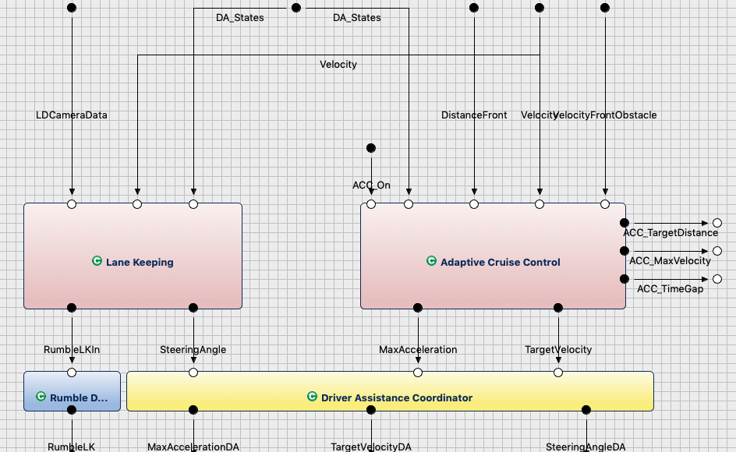
Relation to AF3-Models

Slide 12
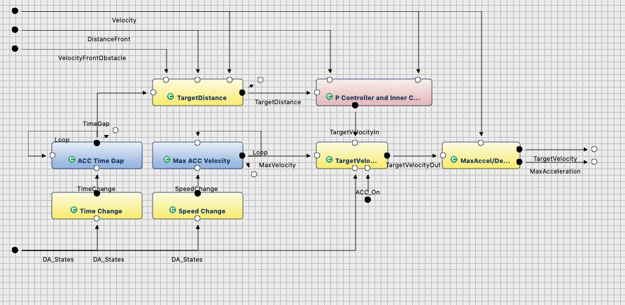
Relation to AF3-Models
Input:
Velocity
DistanceFront
VelocityFrontObstacle
DA_States

Slide 13
Relation to AF3-Models
Output:
TargetVelocity
MaxAcceleration
ACC_MaxVelocity
ACC_TimeGap
ACC_TargetDistance

Slide 14
Relation to AF3-Models
Distance Front
V_{subject}
ACC Time Gap
Target Distance
Error Adjustment
Target Velocity
V_{front}
Max Acceleration

