Slide 1

Platooning Team
Group Status Presentation
June 13, 19

Slide 2
Status
Improve fuse functionality
Implement split and leave functionality
Fix the ACC problems
Hardware & Simulator test
Sprint 2 is done

Slide 3
Sprint 2
Implementing follower functionality
Joining the platoon: fuse message
Leaving the platoon: split and leave messages

Slide 4
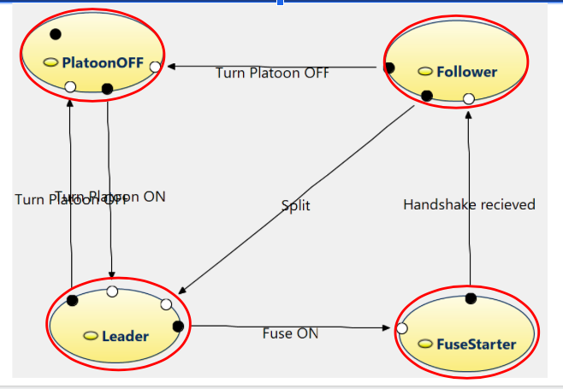
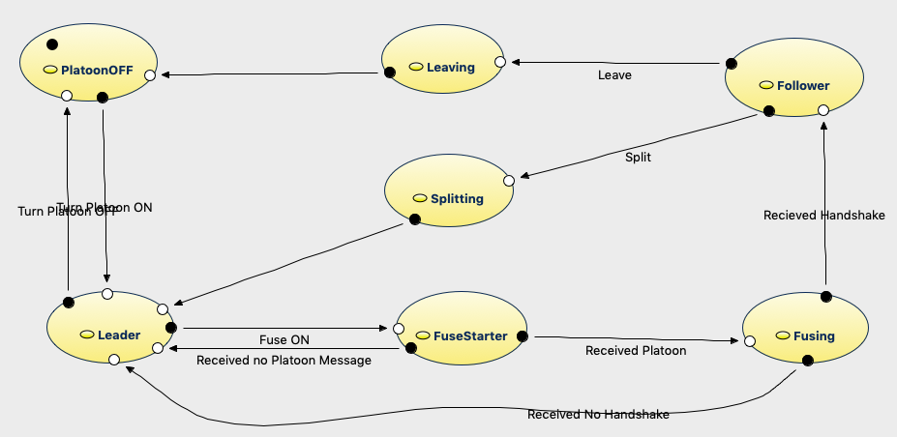
Improve the platoon states
wait for 100 ticks

Slide 5
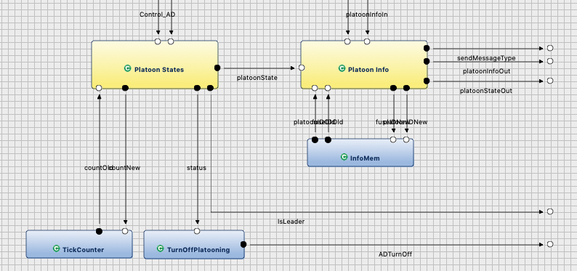
Overview platoon management

Slide 6

Demo

Slide 7
Plan for the next week
Begin with Sprint 3:
Extend functionalities to more cars
Lane keeping

