Slide 1
Data Acquisition & Management
Yuehao Wang

Slide 2
What is my research?
Data helps drive decisions. I'm going to analyze COVID-19 and Real estate prices in NYC, Houston, and Los Angeles.

Slide 3
What is my Hypothesis？
My hypothesis is that the U.S. housing markets are most vulnerable to the impact of the COVID-19 pandemic.

Slide 4
What is my Conclusion?
The COVID-19 affects the property price of big counties(New York and Los Angeles) obviously.
The COVID-19 has a negative influence on the price of Condos and Multi-family, but it has a positive influence on the price of single-family.

Slide 5
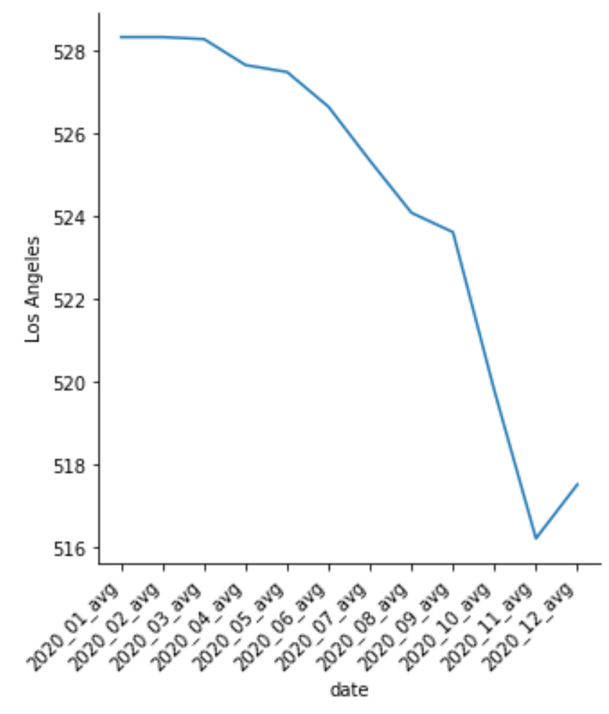
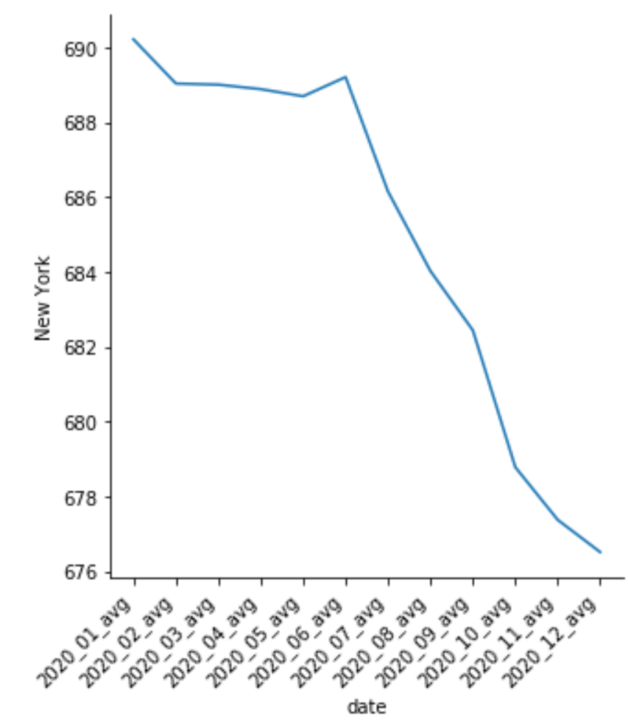
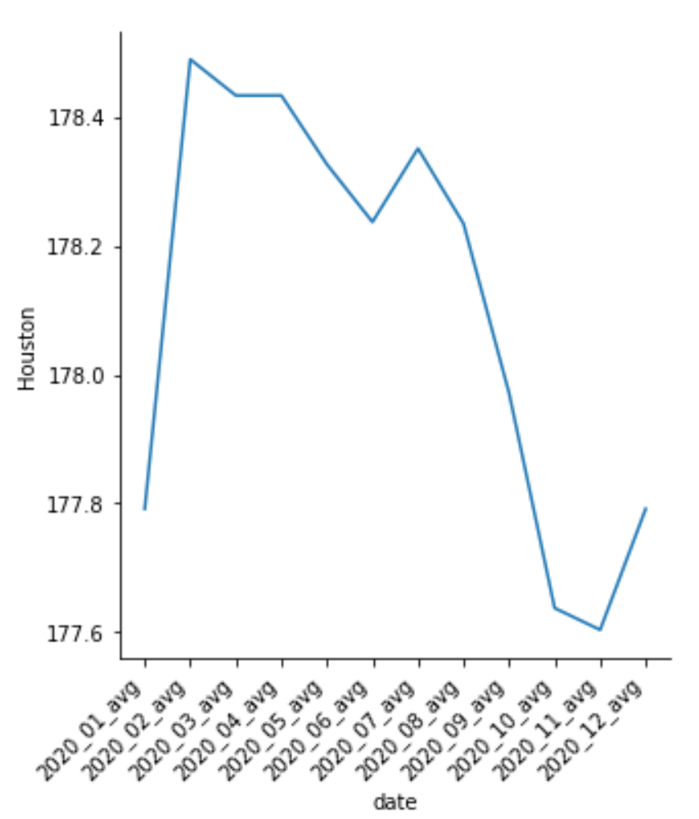
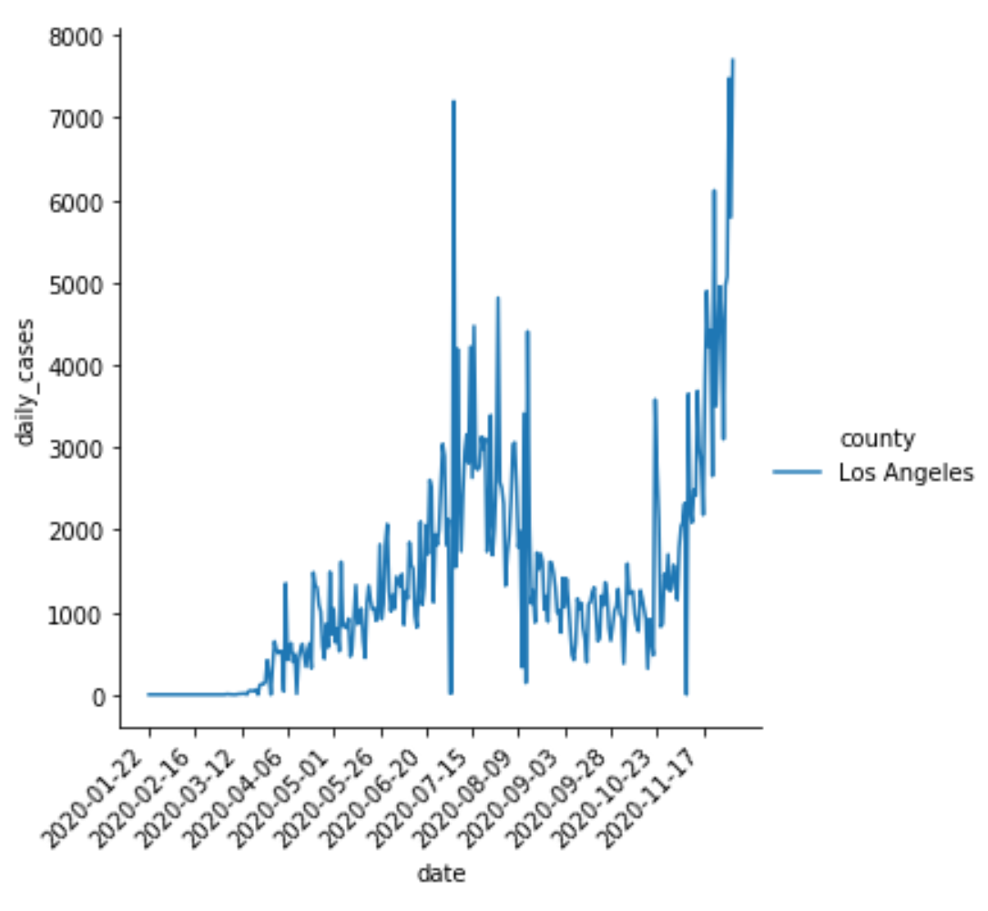
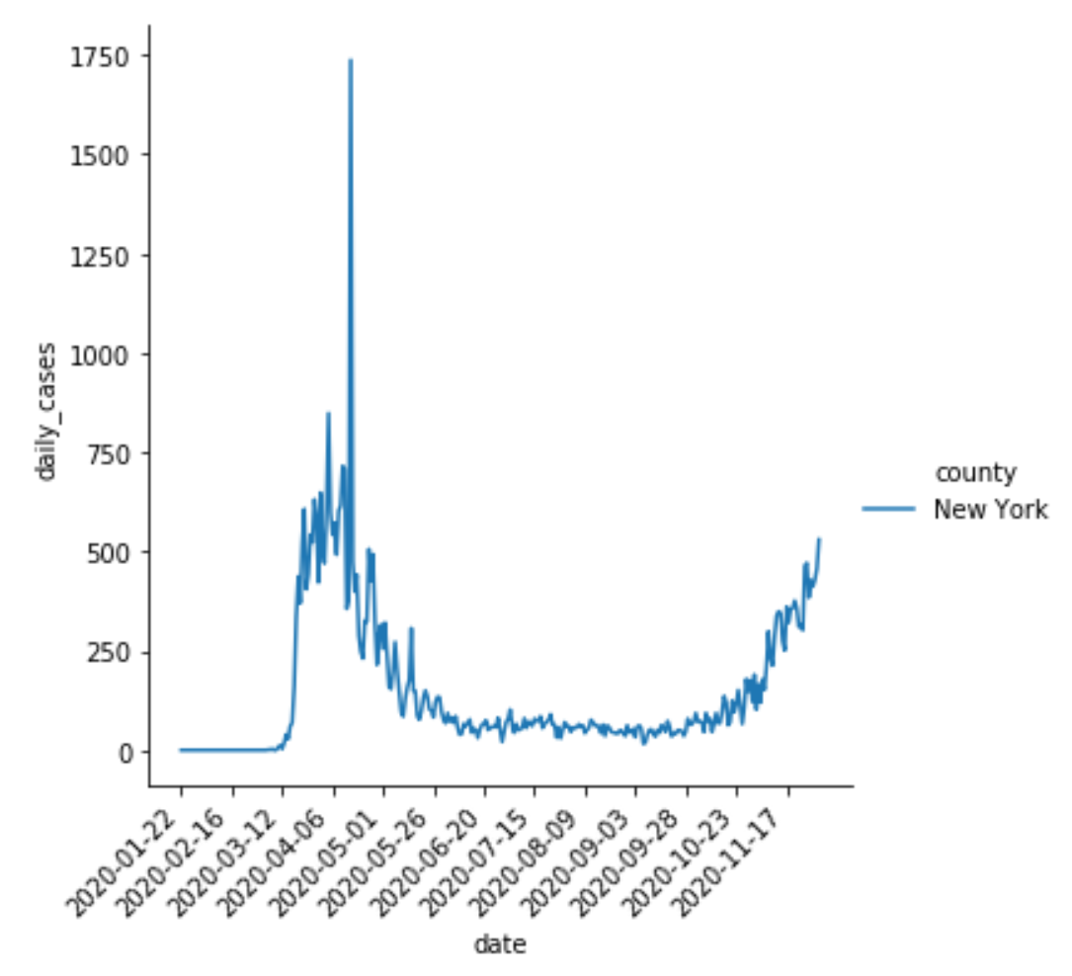
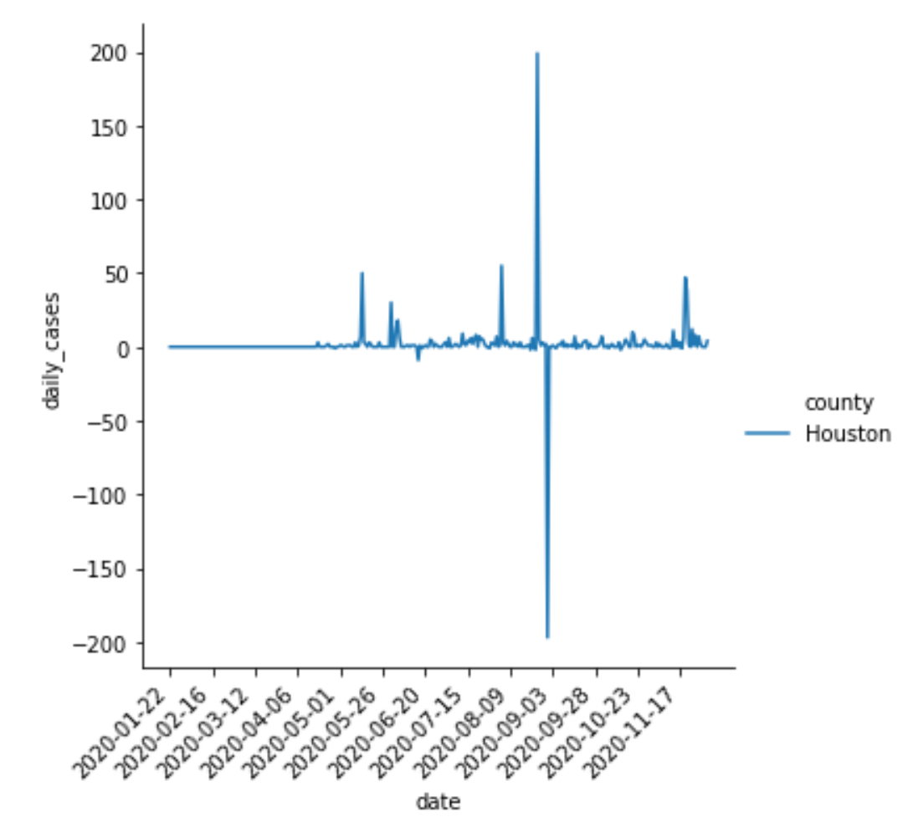
Data Analysis of Counties
Notes:
I use line charts to compare housing prices and daily cases of COVID-19 in three counties.

Slide 6
Q1: Does COVID-19 affects the price of the estate?
The COVID-19 has a positive influence on the property price/sqft of Los Angeles.
The COVID-19 has a positive influence on the property price/sqft of New York.
The COVID-19 does not affect the property price/sqft in Houston.
Notes:
The COVID-19 has a positive influence on the property price/sqft of Los Angeles. With the daily cases increasing to over 7500 from early November. The property market is Rebounding. The price/sqft of Los Angeles is over 517.
The COVID-19 has a positive influence on the property price/sqft of New York. From January to June, the property price/sqft of New York is stability, because COVID-19 is under better control. The daily cases are around 300 cases. The property price/sqft of New York has fallen to 676 because the daily cases have increased to over 500.
The COVID-19 does not affect the property price/sqft in Houston. The change of the property price/sqft is between 177 and 178. Even though the picture seems to be trending up, the change is too small.

Slide 7
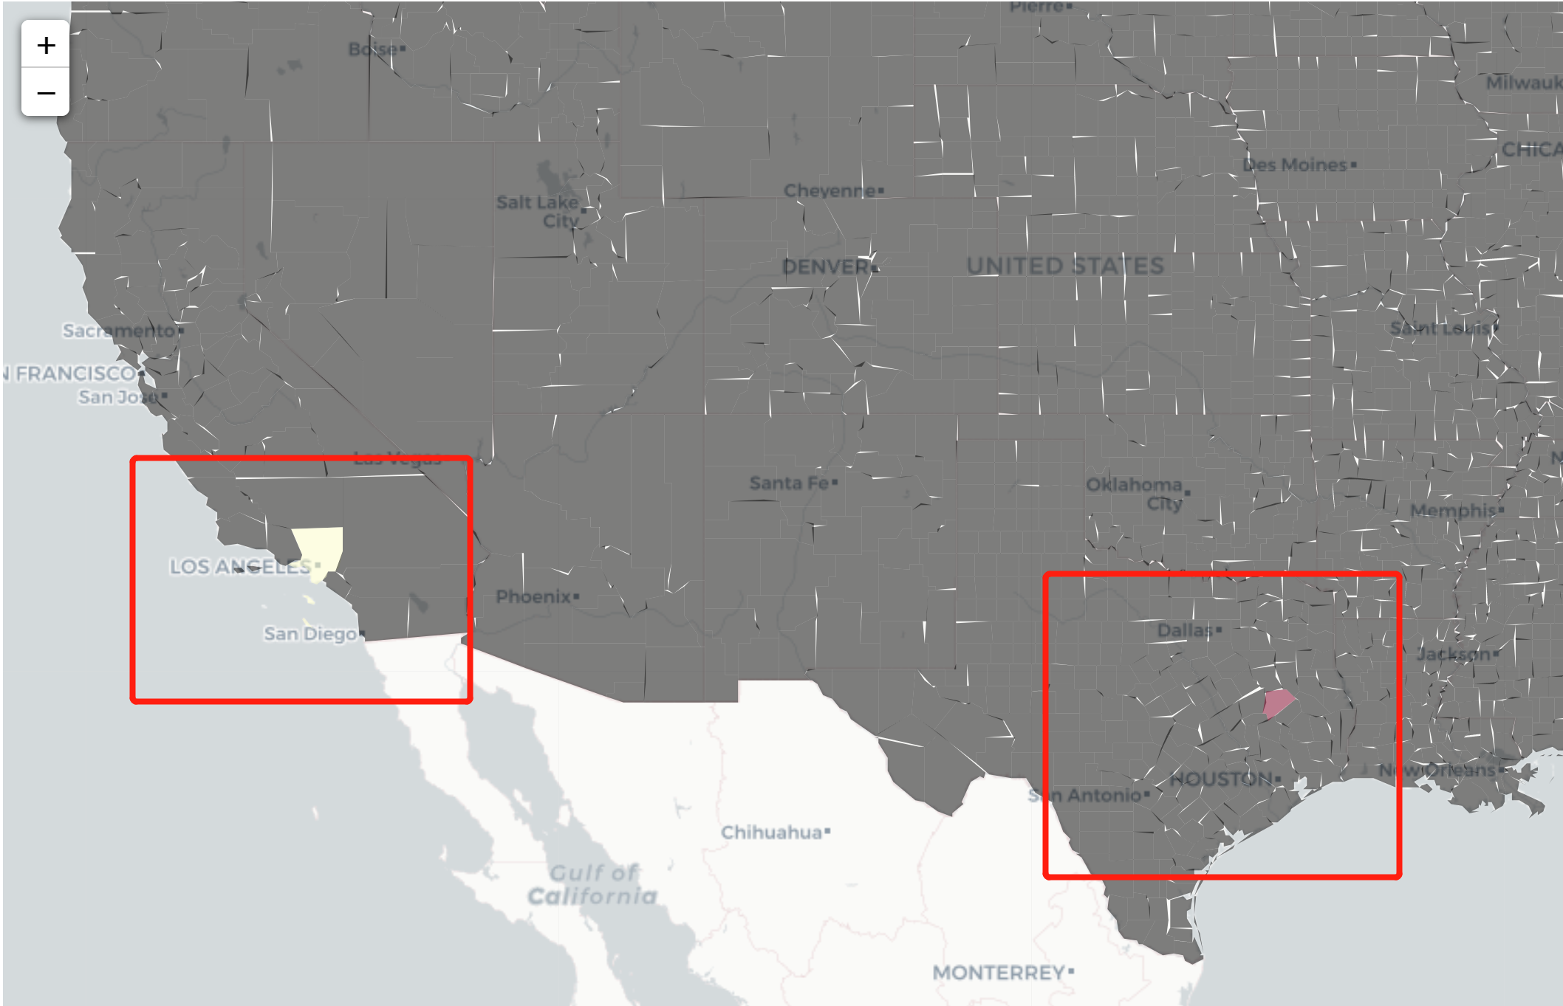
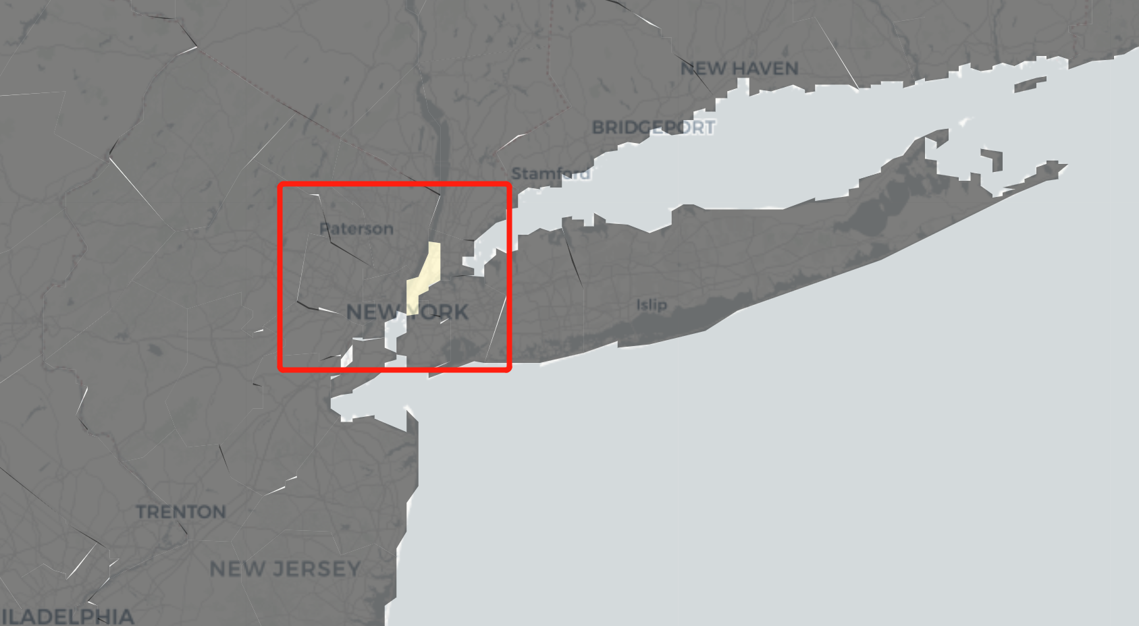
Rate of price change
The Red area means the change rate is higher than other places.
Notes:
If I got data from all counties, this map can be a better visualization.

Slide 8
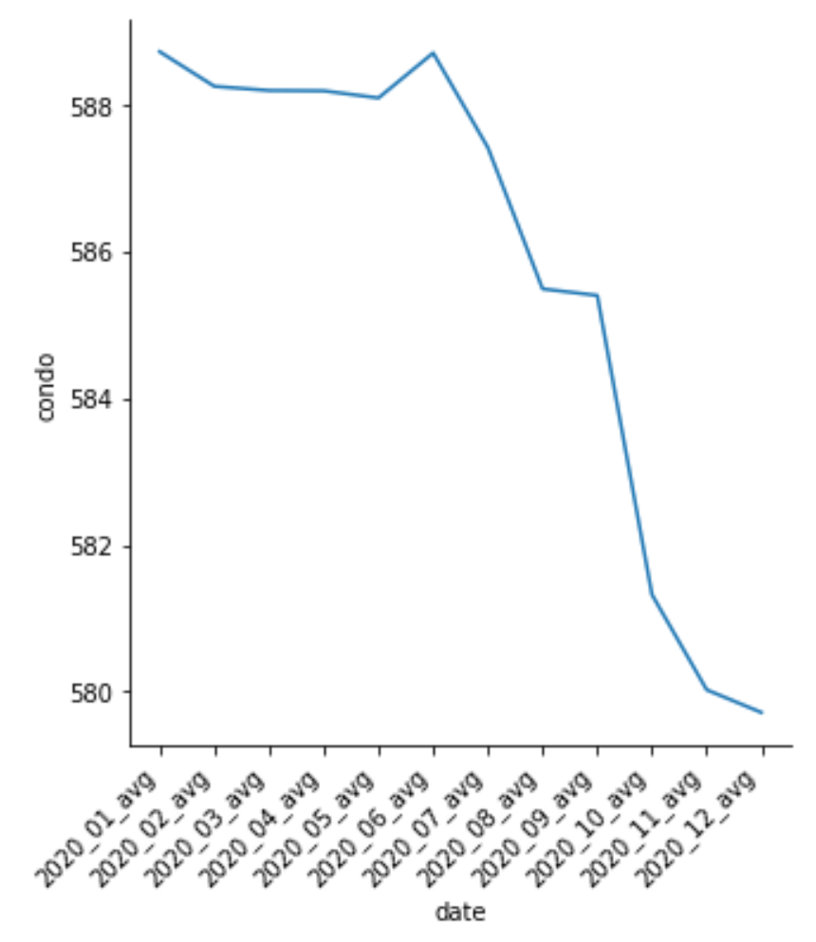
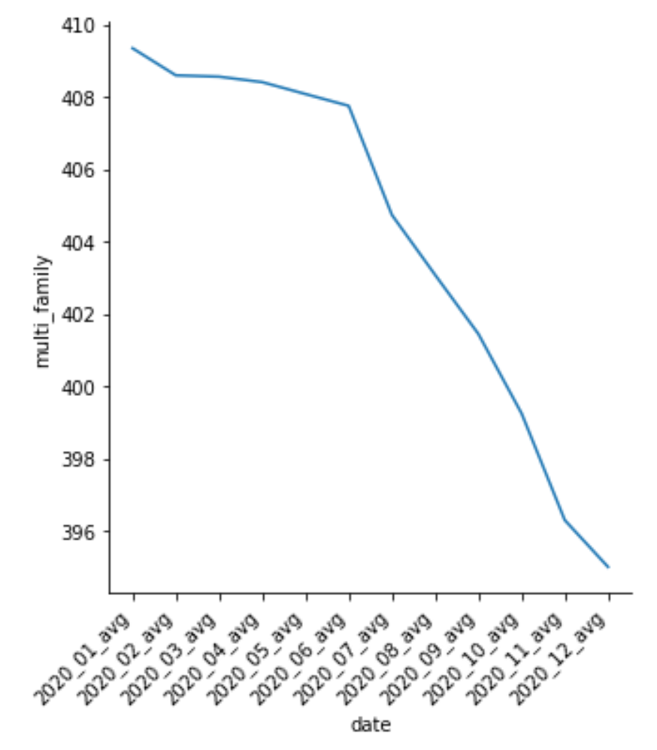
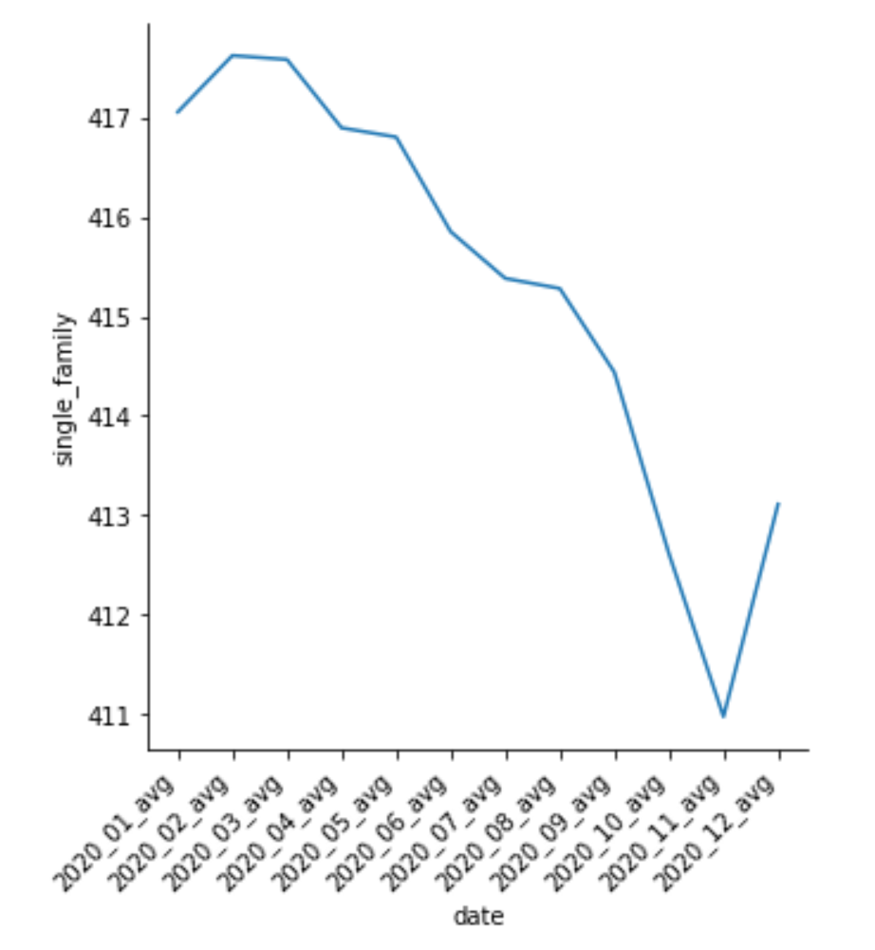
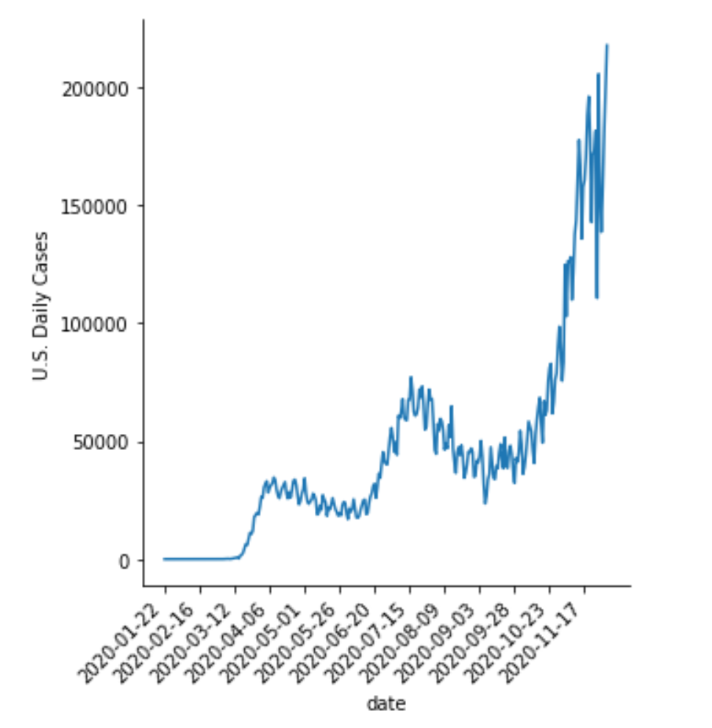
Data Analysis of House Types
Notes:
The average price/sqft of Condo has been falling from over 590 to below 580 since June.
The average price/sqft of Multi_family has been falling from over 409 to around 395 since June.
The average price/sqft of Single_family has been increased to over 418 in March, but it has fallen to 411 in November. In December but it rose to 413.
The daily cases of COVID-19 show an upward trend. It has three peaks.
The first peak is in the middle of April with around 40,000. The second peak is in the middle of July with around 75,000. The third is from late October to December with over 200,000.

Slide 9
Q2: What types of houses have been most affected, Multi-family, Single-family, or Condos?
The COVID-19 has a positive influence on the price/sqft of single-family from November.
The COVID-19 has a negative influence on the price/sqft of the condo in 2020.
The COVID-19 has a negative influence on the price/sqft of multi-family in 2020.
Notes:
The COVID-19 has a positive influence on the price/sqft of single-family from November. In March, the price/sqft of single-family has risen to 418, because of the outbreak of a pandemic. The daily COVID-19 cases have reached over 40000. But the price has fallen to 411 because COVID-19 is under better control from June to late October. From November, the price/sqft risen to 413.
The COVID-19 has a negative influence on the price/sqft of the condo. From January to June, the price/sqft of the condo is between 588 to 589. But the price/sqft of the condo has fallen to 579 because the 3rd peak of daily COVID-19 cases has reached over 200,000.
The COVID-19 has a negative influence on the price/sqft of multi-family. The price/sqft of multi-family kept fall to 395. Because the 3rd peak of daily COVID-19 cases has reached over 200,000 from November.

Slide 10
What are my research steps?
Get COVID-19 data from Kaggle
Get history prices of houses from Realtor
Using API to get data
Using PostgreSQL to store data
Analyze Data
Using Pandas, matplotlib, seaborn to analyze data

Slide 11
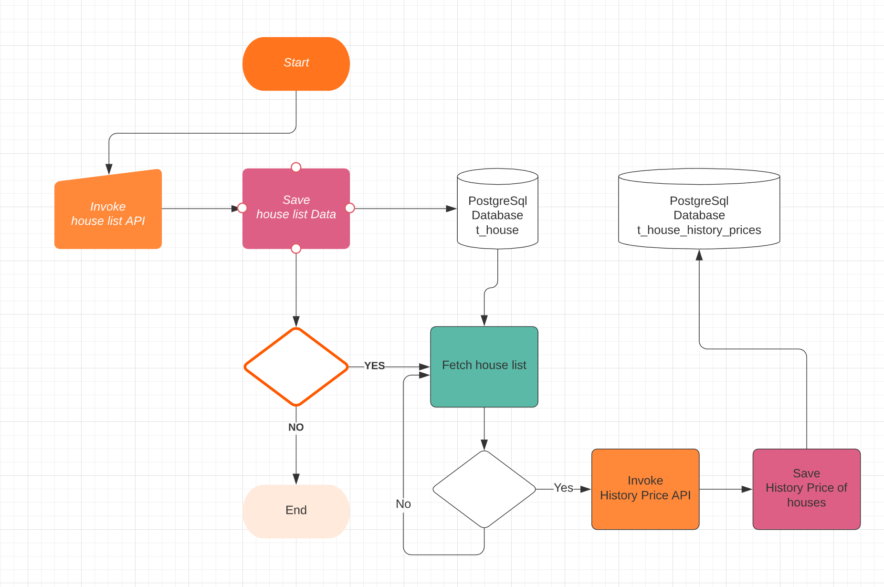
How to use API to get and store my target data?

Slide 12
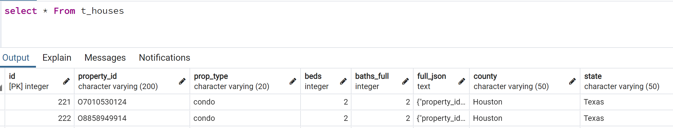
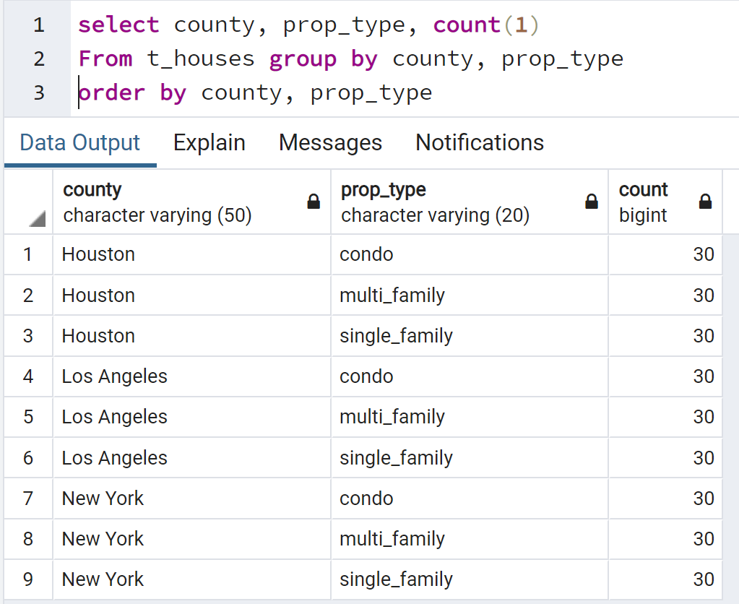
The big challenge 1
How to process these data?
I got
1888 items that have history price.
1472 items that are greater than 0 price/spft.
735 items that event date are greater than 2019-01-01
662 items that event date are greater than 2020-01-01
227 unique houses have 2 history prices after 2019-01-01
I think that it is hard to make accurate predictions with these data.

Slide 13
The big challenge 2
Scrape data from Realtor is illegal
I did not read the robot.txt at the beginning.
I spent 4 days to scrape data before I read the robot.txt.
Use API to get data
Many API can not get history prices
I chose the API that has request times limit (500 times per month)
The history prices are incomplete. (This can lead to unreliable data analysis)

Slide 14
How to solve the big challenge?
Next time, I will use the unfree API to get enough data.
This time, because not all houses have 12 months of 2020 history prices, I use the average price of each house. If one house has only one price of 2020, this price will be its average monthly price. ( This way may lead to inaccurate results).
I use the average price/sqft of 2020 to fill empty data for each house.

Slide 15
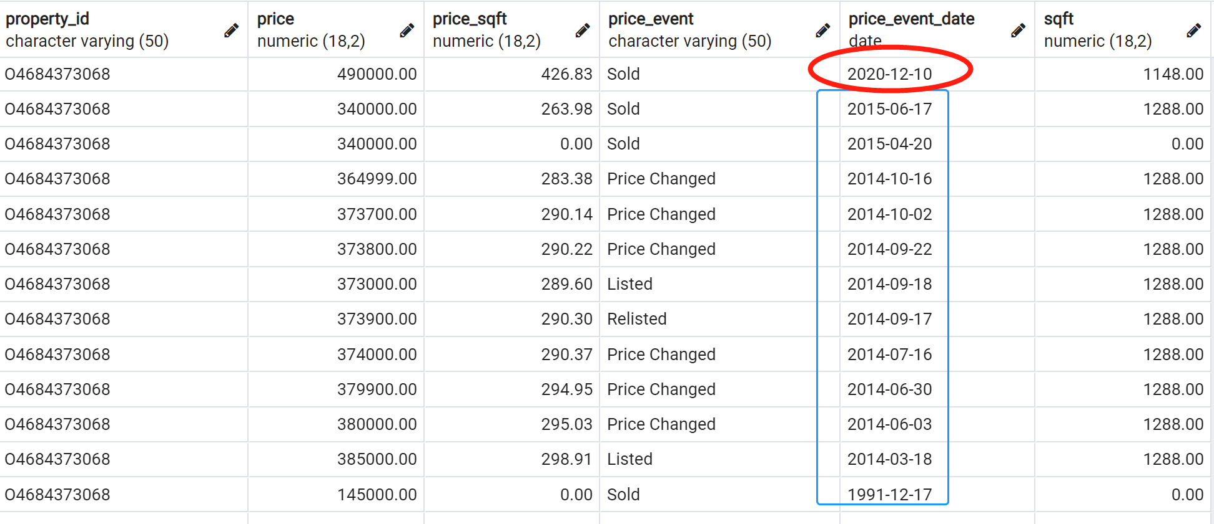
How to solve the big challenge?
For example: bad data sampel

Slide 16
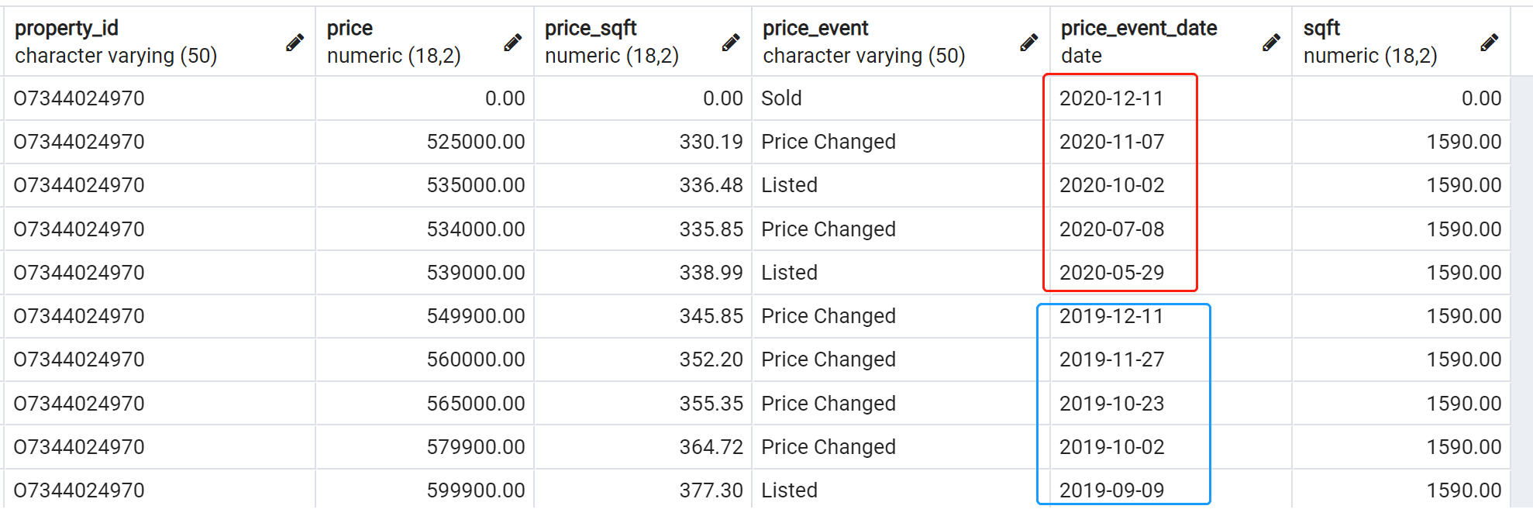
How to solve the big challenge?
For example: good data sample

Slide 17
Unsolved problems
I failed to connect with COVID-19 and price of houses.
I can not show the correlation between them.
I only use two line charts to explain COVID-19 has affected price of houses.

Slide 18
What technologies did I use?
Pandas and Numpy: To analyze data
Matplotlib and seaborn: To visualize data
Folium: To draw US map to show data.
RapidAPI: To download data
Postgresql: To store data

