Slide 1

Chapter 1 Introduction
A note on the use of these ppt slides:
We’re making these slides freely available to all (faculty, students, readers). They’re in PowerPoint form so you can add, modify, and delete slides (including this one) and slide content to suit your needs. They obviously represent a lot of work on our part. In return for use, we only ask the following:
If you use these slides (e.g., in a class) in substantially unaltered form, that you mention their source (after all, we’d like people to use our book!)
If you post any slides in substantially unaltered form on a www site, that you note that they are adapted from (or perhaps identical to) our slides, and note our copyright of this material.
Thanks and enjoy! JFK/KWR
All material copyright 1996-2009
J.F Kurose and K.W. Ross, All Rights Reserved
Computer Networking: A Top Down Approach , 5th edition. Jim Kurose, Keith Ross Addison-Wesley, April 2009.

Slide 2
About Me
Zhuqing Jiang
2014: Ph.D from BUPT.
Visiting Scholar: McGill University, Canada
Research Interest: Computer Vision, Visual SLAM
Research Internships
Industry oriented
CV tasks related to Medicine, Traffic, UAV
Notes:
Any questions

Slide 3
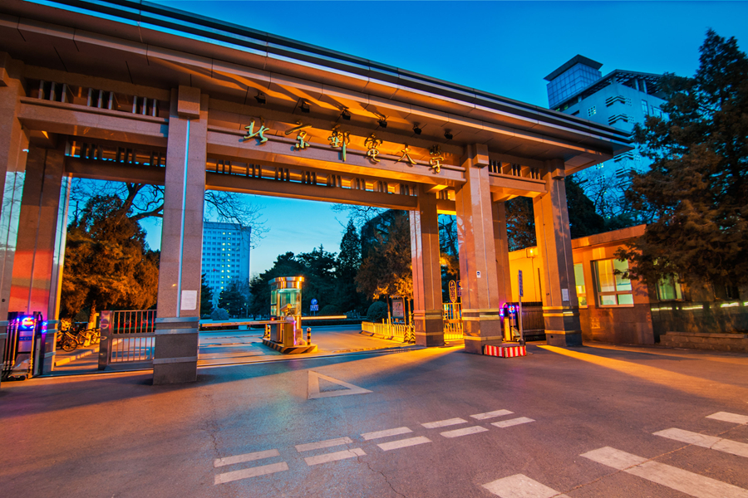

姜竹青

Slide 4
姜竹青
一作/通讯发表的刊物
IJCAI
AAAI
Transaction on Image Processing
Pattern Recognition
Knowledge Based Systems
Information Sciences
IEEE Transaction on Broadcasting
Neuro Computing

Slide 5
IROS
IEEE IOT Journal
IEEE Sensors Journal
IEEE BMSB 2020广播宽带多媒体国际会议共同技术主席
“可信人脸应用守护计划”专家委员会委员
2023年中国人工智能大赛评委
主编专著《计算机视觉中的深度学习》

Slide 6


2016年 2022年 两次在校级教学观摩比赛中获奖
指导同学参加人工智能相关比赛获奖

Slide 7

北斗三号--国防应用证明
承担研制军工项目“导航卫星组网验证系统”
得到项目单位“北京空间飞行器总体设计部”的应用，并产生良好效果

Slide 8
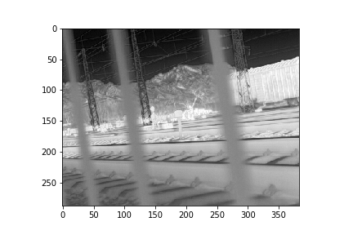
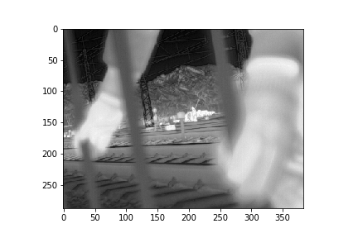
红外图像增强
利用卡尔曼滤波，对红外视频每帧背景亮度进行建模，解决红外视频中，物体在画面中进出导致亮度突变的问题。

Slide 9



图像亮度增强
传统方式
低照度原图
人工智能算法处理后

Slide 10


低清图像增强（超分辨率）
基础超分算法放大4倍
人工智能算法放大4倍

Slide 11
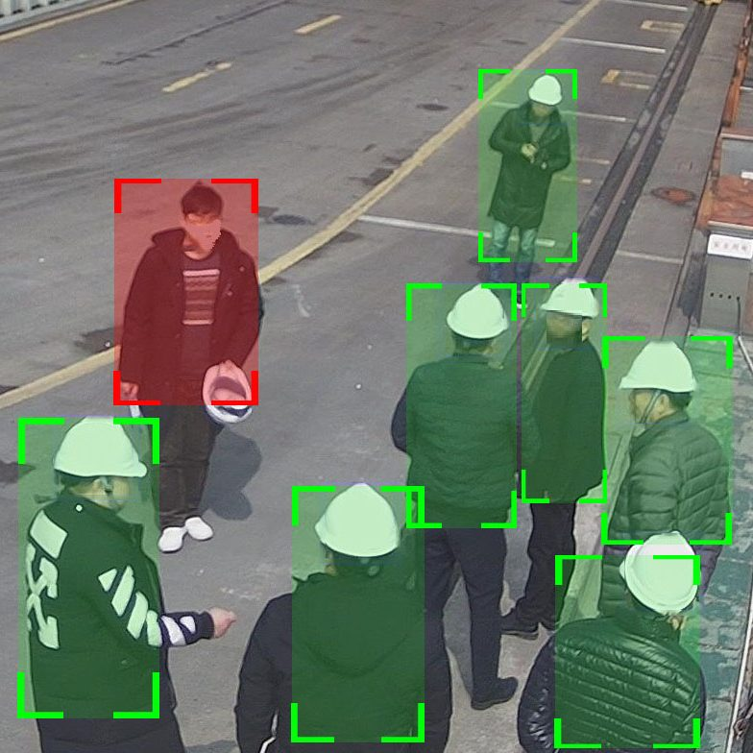
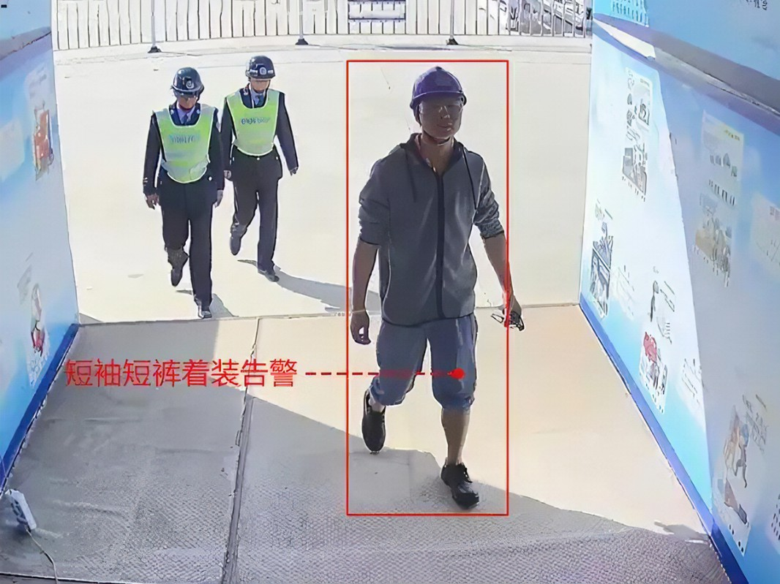
安全生产检测

Slide 12
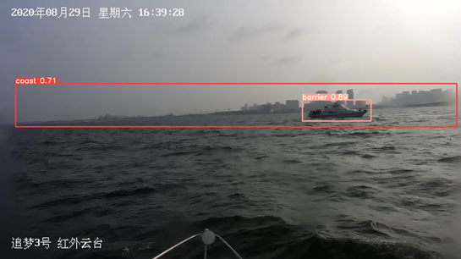
海上目标检测

Slide 13
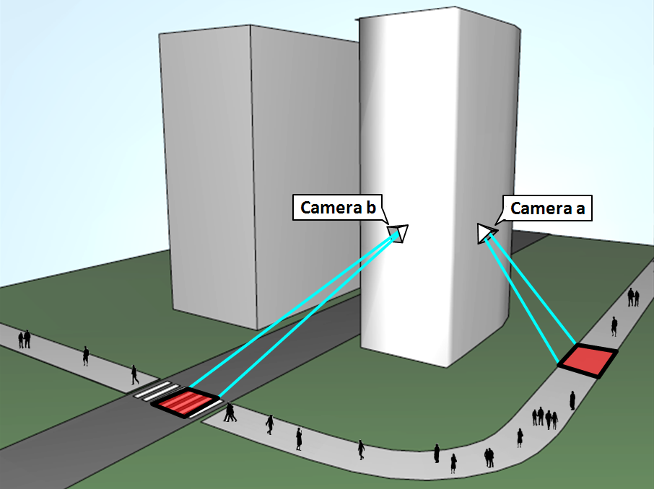
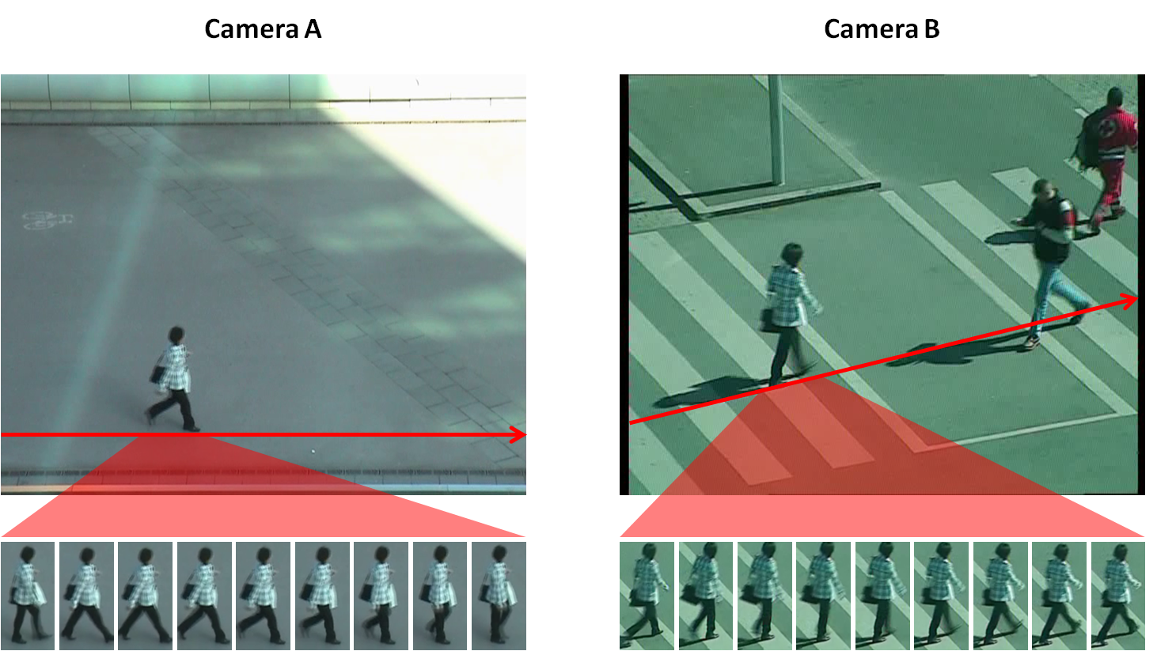
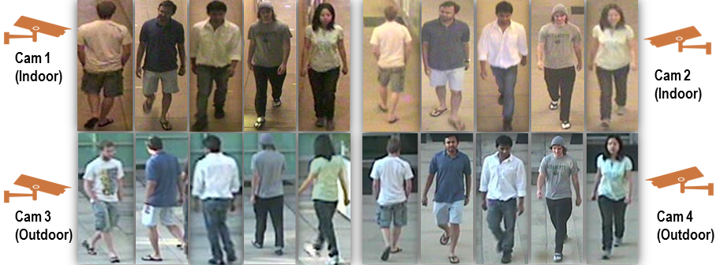
行人重识别

Slide 14

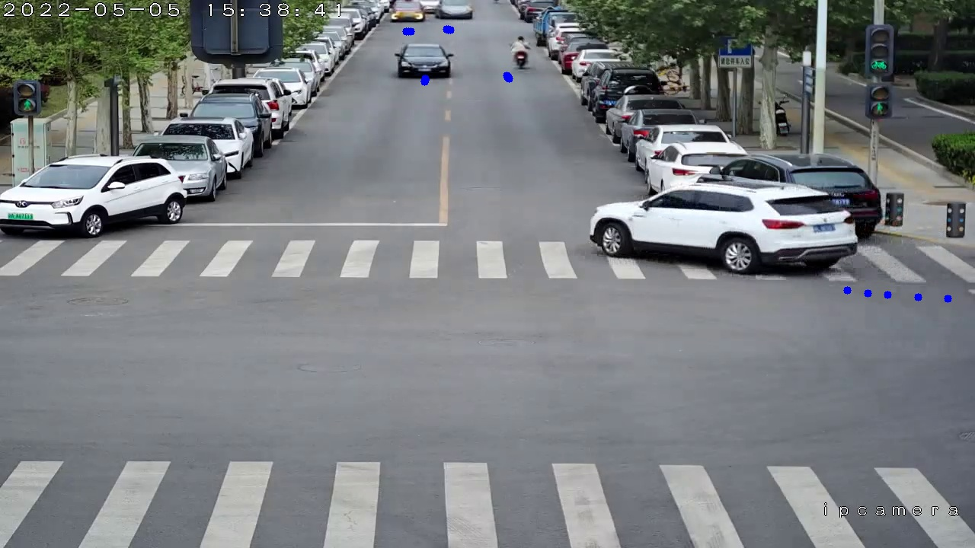
智能交通检测

Slide 15
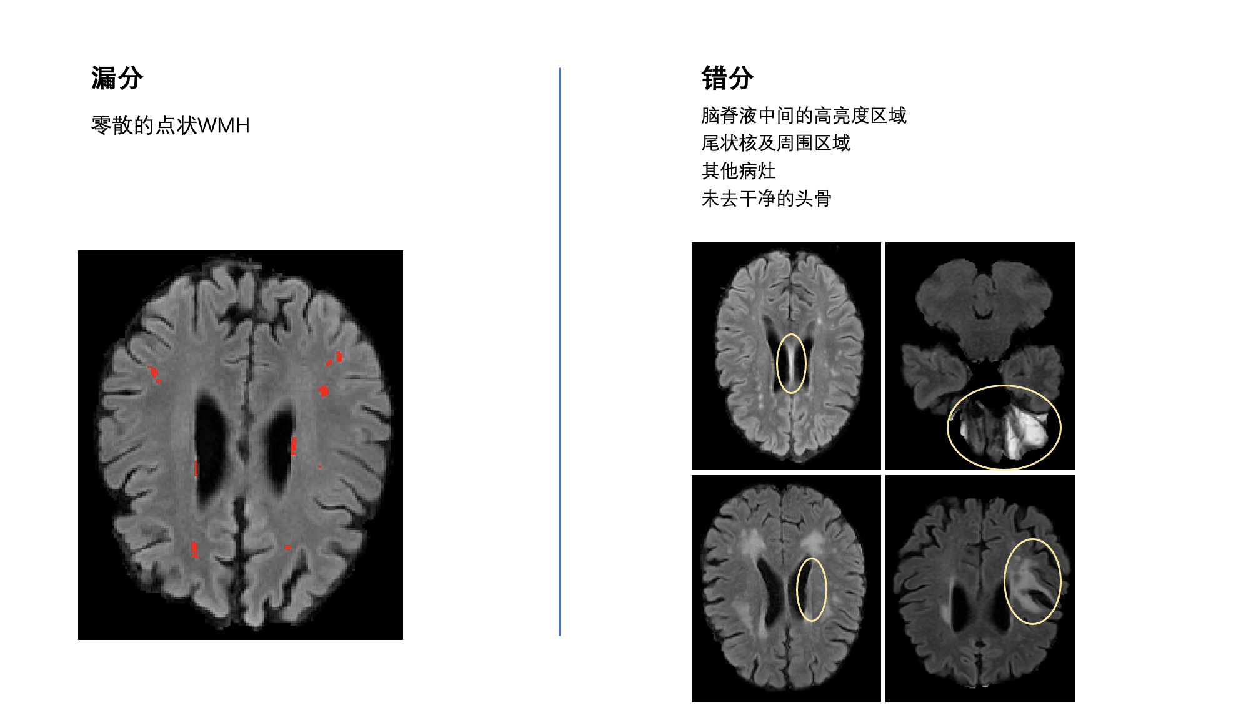
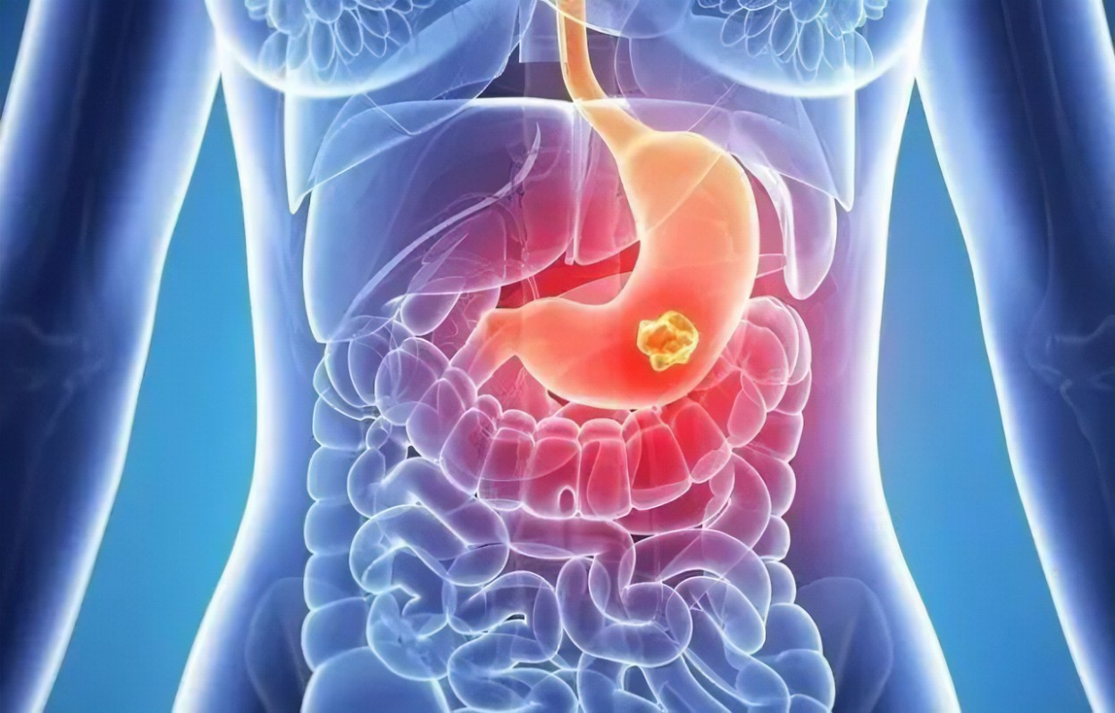
智能医疗图像检测
北师大脑科学国家重点实验室
友谊医院消化内科
北大第一医院肾内科
北医三院神经内科

Slide 16
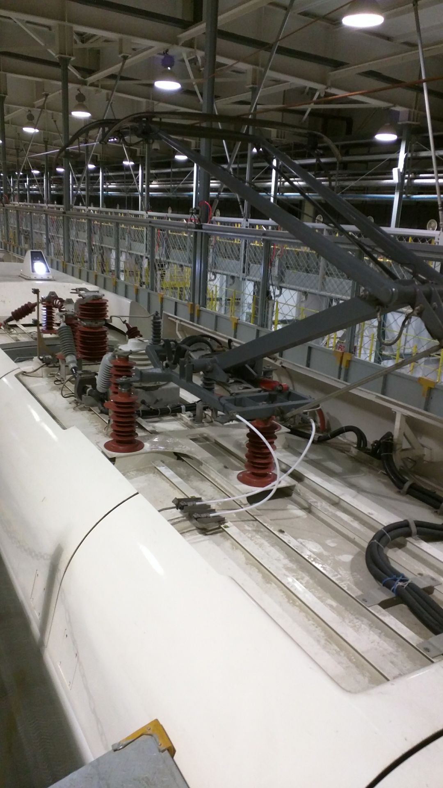
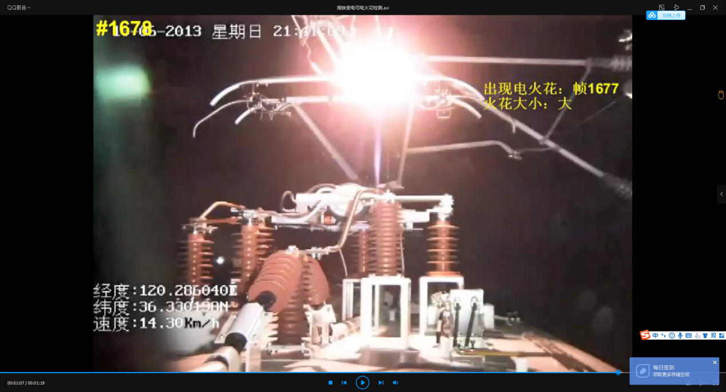
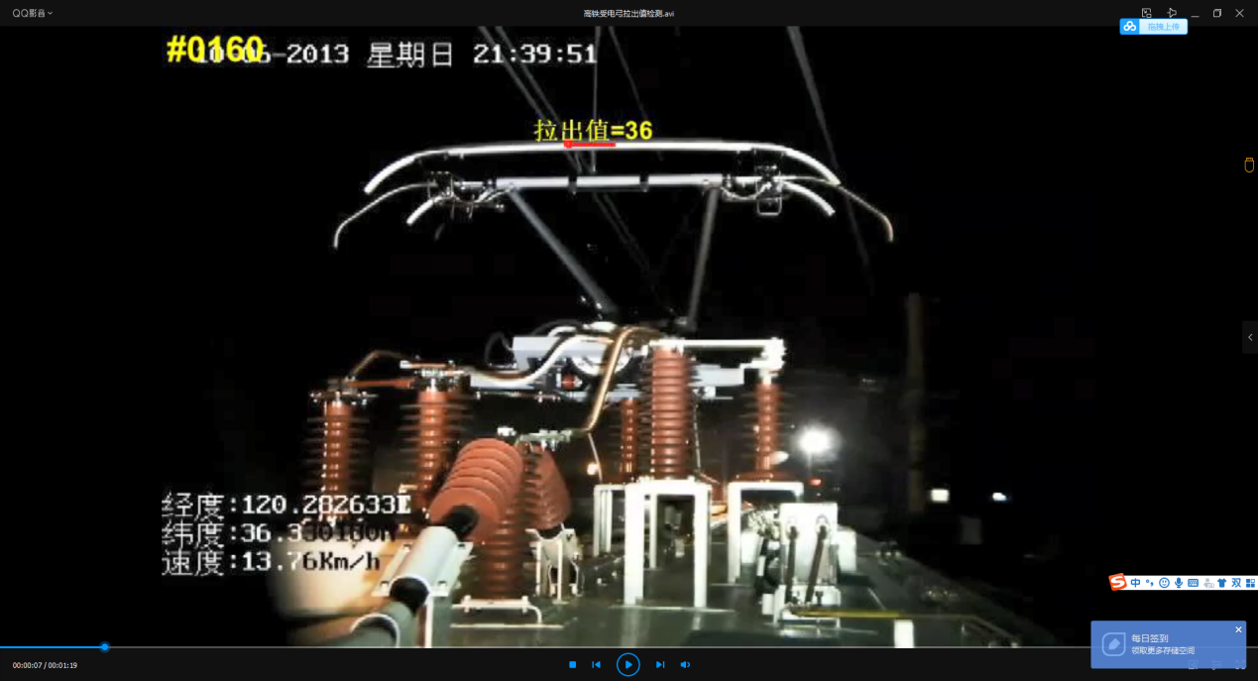
高铁安全检测
高铁列车的受电弓在运行过程中会出现电火花，进而对列车运行安全造成风险。
通过分析视频内容，识别火花的大小和拉出值，并记录发生的经纬度和时间，便于后续的铁路检修维护。
附图分别为电火花识别和拉出值检测。

Slide 17
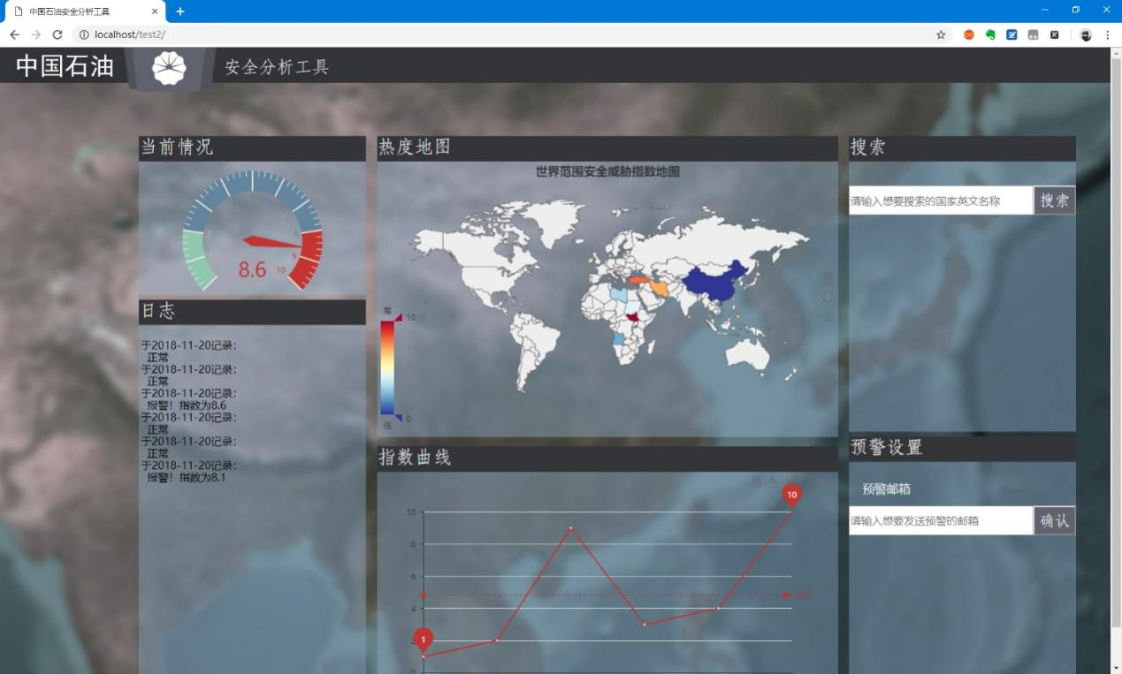
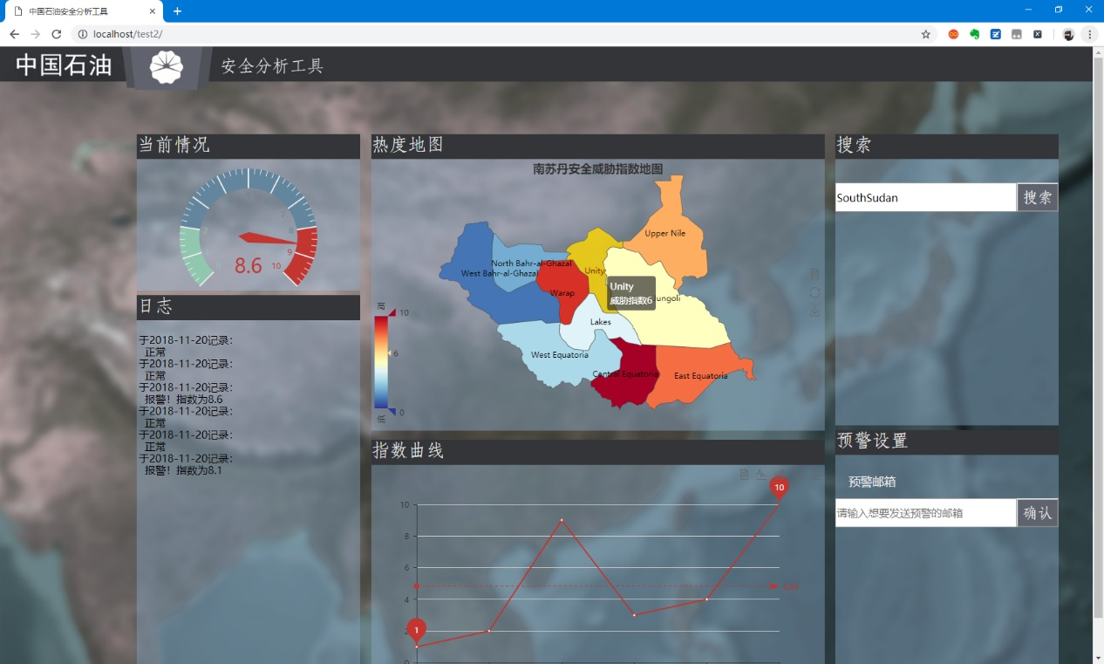
大数据分析
中石油健康安全环境研究院委托开发
社会安全情报分析系统
演示软件1套
EI论文1篇
软件著作权1项
分析报告3份

Slide 19
Sth. Needs to Know
Textbooks:
《 Computer Networking: A Top Down Approach 》 5th edition Jim Kurose, Keith Ross
http://gaia.cs.umass.edu/kurose_ross/
Materials:
链接：https://pan.baidu.com/s/1nJsjUfqTupeZeqRbW63tRA
提取码：3ads
Notes:
Any questions

Slide 20
Sth. Needs to Know
Grade:
Homework+course: 40%
Final exam (in English): 60%
References:
《 Computer Networking: A Top Down Approach 》 5th edition (Chinese) Jim Kurose, Keith Ross
http://wps.pearsoned.com/ecs_kurose_compnetw_6
Notes:
Any questions

Slide 21
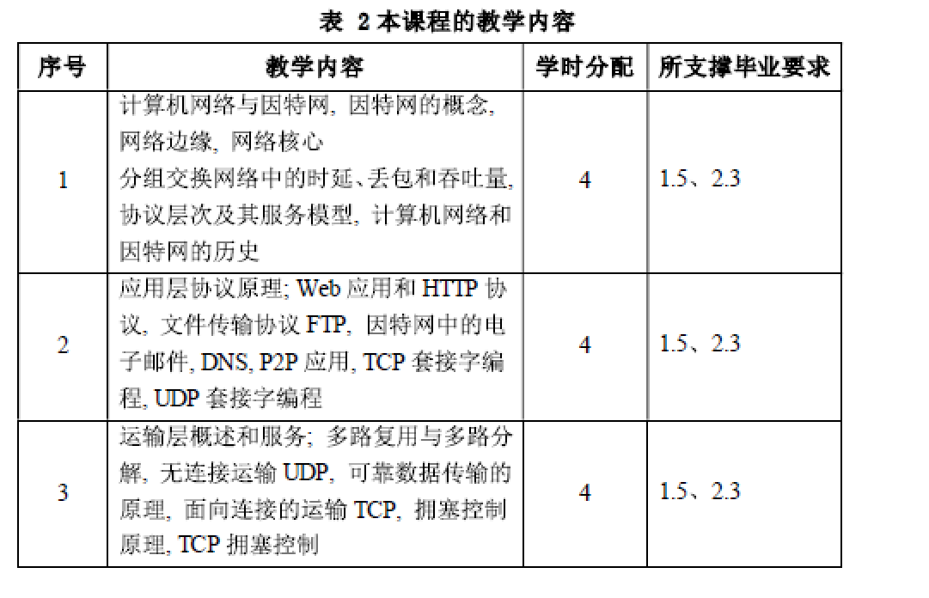
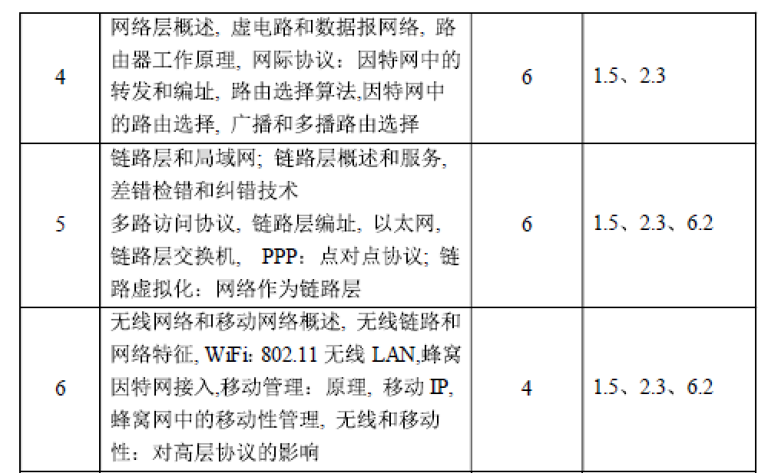
Teaching plan
Notes:
Any questions

Slide 22
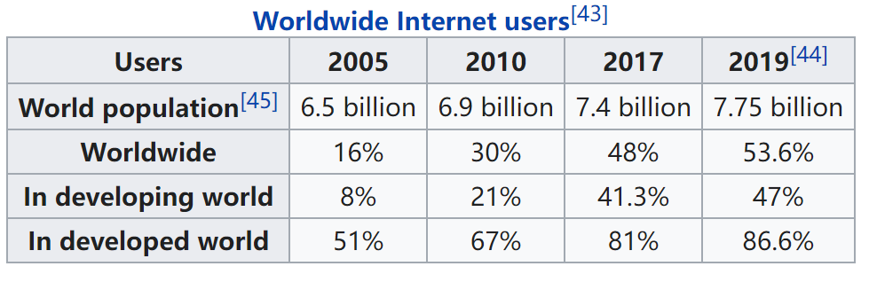
Chapter 1: Introduction
Our goal:
get “feel” and terminology
more depth, detail later in course
approach:
use Internet as example
Overview:
what’s the Internet?
what’s a protocol?
network edge; hosts, access net, physical media
network core: packet/circuit switching, Internet structure
performance: loss, delay, throughput
security
protocol layers, service models
history

Slide 23
Chapter 1: roadmap
1.1 What is the Internet?
1.2 Network edge
end systems, access networks, links
1.3 Network core
circuit switching, packet switching, network structure
1.4 Delay, loss and throughput in packet-switched networks
1.5 Protocol layers, service models
1.6 Networks under attack: security
1.7 History

Slide 24

What’s the Internet: “nuts and bolts” view
PC
millions of connected computing devices: hosts = end systems
running network apps
Mobile network
server
Global ISP
wireless
laptop
cellular
handheld
Home network
communication links
fiber, copper, radio, satellite
transmission rate = bandwidth
Regional ISP
access
points
Institutional network
wired
links
routers: forward packets (chunks of data)
router
Notes:
nuts and bolts 基本组成部分
硬件部分 后续有软件部分

Slide 25

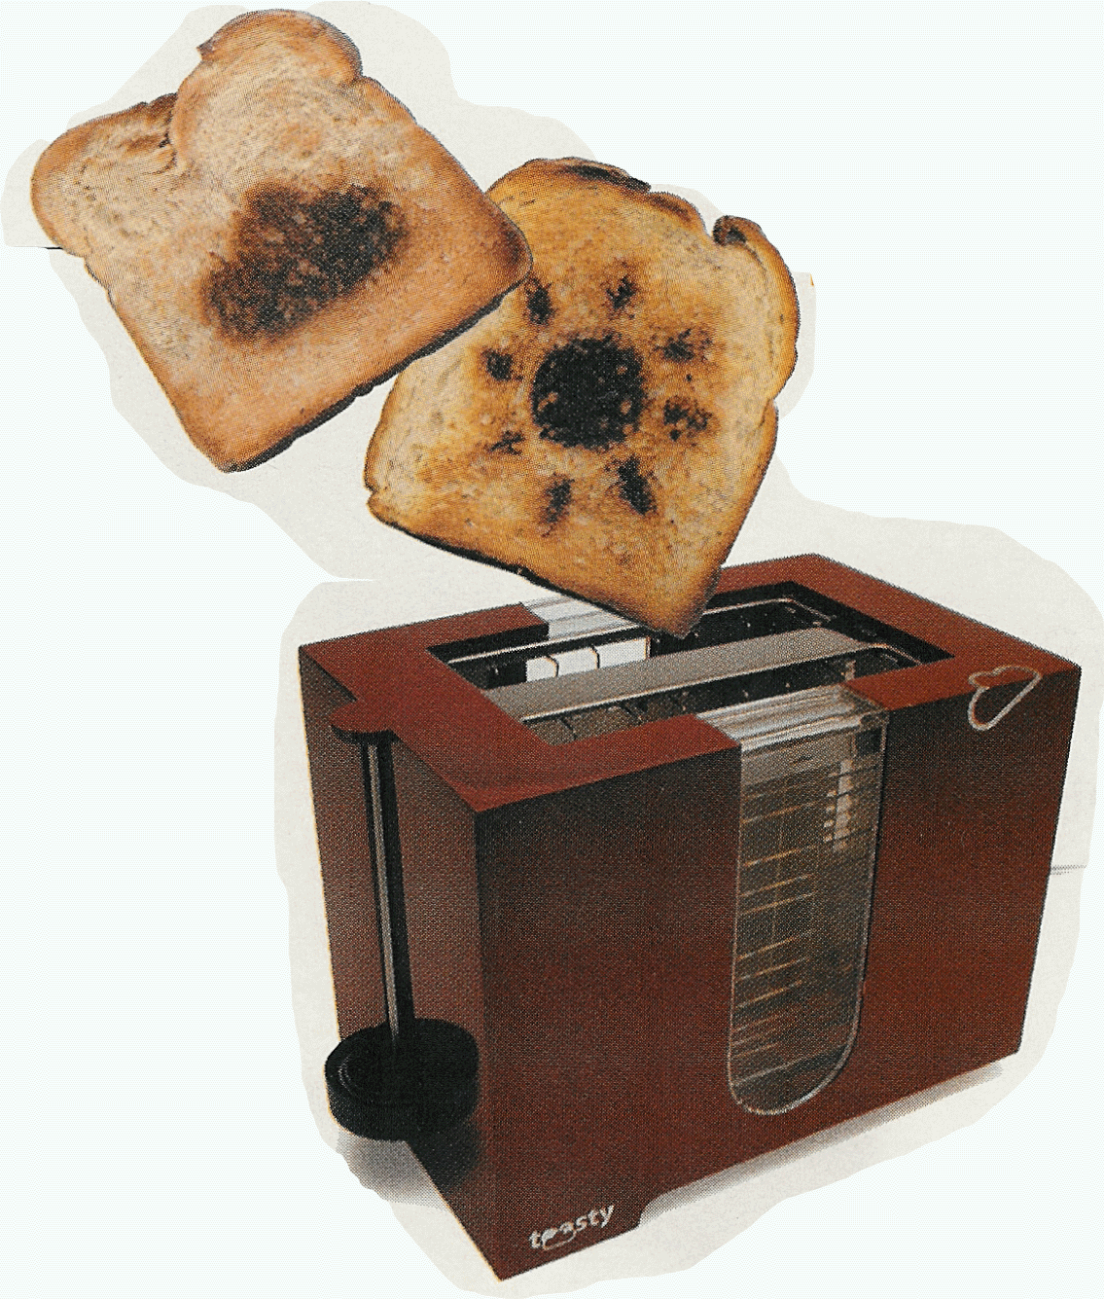
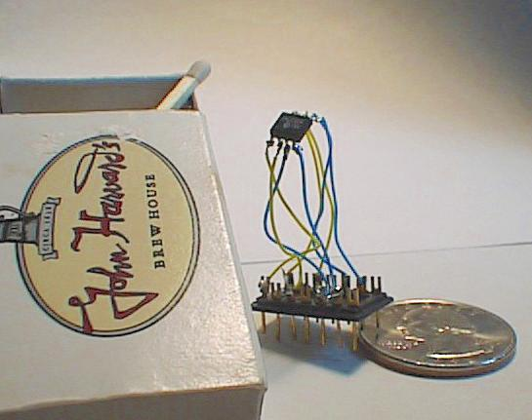

“Cool” internet appliances
Web-enabled toaster +
weather forecaster
IP picture frame
http://www.ceiva.com/
World’s smallest web server
http://www-ccs.cs.umass.edu/~shri/iPic.html
Internet phones
Notes:
智能家居

Slide 26
What’s the Internet: “nuts and bolts” view
protocols control sending, receiving of msgs
e.g., TCP, IP, HTTP, Skype, Ethernet
Internet: “network of networks”
loosely hierarchical
public Internet versus private intranet
Internet standards
RFC: Request for comments
IETF: Internet Engineering Task Force
Mobile network
Global ISP
Home network
Regional ISP
Institutional network
Notes:
软件部分

Slide 27
What’s the Internet: a service view
communication infrastructure enables distributed applications:
Web, VoIP, email, games, e-commerce, file sharing
communication services provided to apps:
reliable data delivery from source to destination
“best effort” (unreliable) data delivery
Notes:
从提供服务的观点

Slide 28
What’s a protocol?
human protocols:
“what’s the time?”
“I have a question”
introductions
… specific msgs sent
… specific actions taken when msgs received, or other events
network protocols:
machines rather than humans
all communication activity in Internet governed by protocols
protocols define format, order of msgs sent and received among network entities, and actions taken on msg transmission, receipt

Slide 29


What’s a protocol?
a human protocol and a computer network protocol:
Hi
TCP connection
request
Hi
TCP connection
response
Got the
time?
Get http://www.awl.com/kurose-ross
2:00
<file>
time
Q: Other human protocols?

Slide 30
Chapter 1: roadmap
1.1 What is the Internet?
1.2 Network edge
end systems, access networks, links
1.3 Network core
circuit switching, packet switching, network structure
1.4 Delay, loss and throughput in packet-switched networks
1.5 Protocol layers, service models
1.6 Networks under attack: security
1.7 History

Slide 31
A closer look at network structure:
network edge: applications and hosts
access networks, physical media: wired, wireless communication links
network core:
interconnected routers
network of networks
Notes:
边缘+接入网+核心网

Slide 32
The network edge:
end systems (hosts):
run application programs
e.g. Web, email
at “edge of network”
peer-peer
client/server model
client host requests, receives service from always-on server
e.g. Web browser/server; email client/server
client/server
peer-peer model:
minimal (or no) use of dedicated servers
e.g. Skype, BitTorrent

Slide 33
Access networks and physical media
Q: How to connect end systems to edge router?
residential access nets
institutional access networks (school, company)
mobile access networks
Keep in mind:
bandwidth (bits per second) of access network?
shared or dedicated?
Notes:
怎么连接边缘路由器和终端？
下边细讲接入网的各个细节

Slide 34
Dial-up Modem
central office
telephone
network
Internet
home
PC
home dial-up
modem
ISP modem
(e.g., AOL)
Uses existing telephony infrastructure
Home is connected to central office
up to 56Kbps direct access to router (often less)
Can’t surf and phone at same time: not “always on”

Slide 35
Digital Subscriber Line (DSL)
Existing phone line: 0-4KHz phone; 4-50KHz upstream data; 50KHz-1MHz downstream data
Internet
home
phone
DSLAM
telephone
network
splitter
DSL
modem
central
office
home
PC
Also uses existing telephone infrastruture
up to 1 Mbps upstream (typically < 256 kbps)
up to 8 Mbps downstream (typically < 1 Mbps)
dedicated physical line to telephone central office

Slide 36
Residential access: cable modems
Does not use telephone infrastructure
Instead uses cable TV infrastructure
HFC: hybrid fiber coax(混合光纤同轴)
asymmetric: up to 30Mbps downstream, 2 Mbps upstream
network of cable and fiber attaches homes to ISP router
homes share access to router
unlike DSL, which has dedicated access

Slide 37
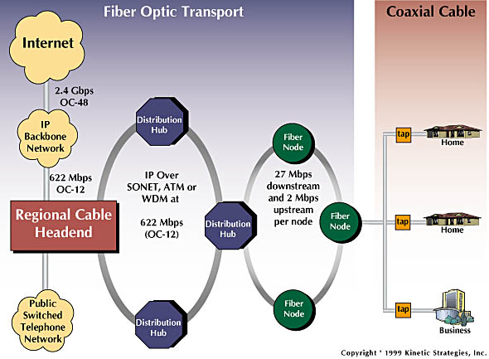
Residential access: cable modems
Diagram: http://www.cabledatacomnews.com/cmic/diagram.html

Slide 38

Cable Network Architecture: Overview
Typically 500 to 5,000 homes
cable headend
cable distribution
network (simplified)
home

Slide 39
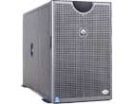
Cable Network Architecture: Overview
server(s)
cable headend
cable distribution
network
home

Slide 40
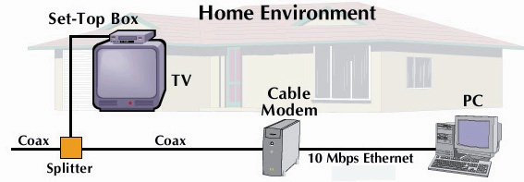
Cable Network Architecture: Overview
cable headend
cable distribution
network (simplified)
home

Slide 41
Cable Network Architecture: Overview
FDM (more shortly):
C
O
N
T
R
O
L
V
I
D
E
O
V
I
D
E
O
V
I
D
E
O
V
I
D
E
O
V
I
D
E
O
V
I
D
E
O
D
A
T
A
D
A
T
A
1
2
3
4
5
6
7
8
9
Channels
cable headend
cable distribution
network
home

Slide 42
Fiber to the Home
ONT
Internet
optical fibers
optical fiber
ONT
OLT
optical
splitter
central office
ONT
Optical links from central office to the home
Two competing optical technologies:
Passive Optical network (PON)
Active Optical Network (PAN)
Much higher Internet rates; fiber also carries television and phone services

Slide 43
Ethernet Internet access
100 Mbps
Institutional
router
Ethernet
switch
To Institution’s ISP
100 Mbps
1 Gbps
100 Mbps
server
Typically used in companies, universities, etc
10 Mbs, 100Mbps, 1Gbps, 10Gbps Ethernet
Today, end systems typically connect into Ethernet switch

Slide 44
Wireless access networks
shared wireless access network connects end system to router
via base station aka “access point”
wireless LANs:
802.11b/g (WiFi): 11 or 54 Mbps
wider-area wireless access
provided by telco operator
~100Mbps over cellular system (4G/5G)
router
base
station
mobile
hosts

Slide 45
Home networks
Typical home network components:
DSL or cable modem
router/firewall/NAT
Ethernet
wireless access
point
wireless
laptops
to/from
cable
headend
cable
modem
router/
firewall
wireless
access
point
Ethernet

Slide 46
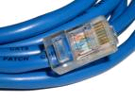
Physical Media
Twisted Pair (TP)（双绞线）
two insulated copper wires
Category 3: traditional phone wires, 10 Mbps Ethernet
Category 5: 100Mbps Ethernet
Bit: propagates between transmitter/rcvr pairs
physical link: what lies between transmitter & receiver
guided media:
signals propagate in solid media: copper, fiber, coax
unguided media:
signals propagate freely, e.g., radio
Notes:
insulated 绝缘

Slide 47


Physical Media: coax, fiber
Coaxial cable（同轴电缆）:
two concentric copper conductors
bidirectional
baseband:
single channel on cable
legacy Ethernet
broadband:
multiple channels on cable
HFC
Fiber optic cable（光纤）:
glass fiber carrying light pulses, each pulse a bit
high-speed operation:
high-speed point-to-point transmission (e.g., 10’s-100’s Gps)
low error rate: repeaters spaced far apart ; immune to electromagnetic noise

Slide 48
Physical media: radio
signal carried in electromagnetic spectrum
no physical “wire”
bidirectional
propagation environment effects:
reflection
obstruction by objects
interference
Radio link types:
terrestrial microwave
e.g. up to 45 Mbps channels
LAN (e.g., Wifi)
11Mbps, 54 Mbps
wide-area (e.g., cellular)
4G, 5G cellular: ~ 100 Mbps
satellite
Kbps to 45Mbps channel (or multiple smaller channels)
270 msec end-end delay
geosynchronous versus low altitude

Slide 49
Chapter 1: roadmap
1.1 What is the Internet?
1.2 Network edge
end systems, access networks, links
1.3 Network core
circuit switching, packet switching, network structure
1.4 Delay, loss and throughput in packet-switched networks
1.5 Protocol layers, service models
1.6 Networks under attack: security
1.7 History

Slide 50
The Network Core
mesh of interconnected routers
the fundamental question: how is data transferred through net?
circuit switching: dedicated circuit per call: telephone net
packet-switching: data sent thru net in discrete “chunks”

Slide 51
Network Core: Circuit Switching
End-end resources reserved for “call”
link bandwidth, switch capacity
dedicated resources: no sharing
circuit-like (guaranteed) performance
call setup required

Slide 52
Network Core: Circuit Switching
network resources (e.g., bandwidth) divided into “pieces”
pieces allocated to calls
resource piece idle if not used by owning call (no sharing)
dividing link bandwidth into “pieces”
frequency division
time division

Slide 53
Circuit Switching: FDM and TDM
Example:
FDM
4 users
frequency
time
TDM
frequency
time
Notes:
Two simple multiple access control techniques.
Each mobile’s share of the bandwidth is divided into portions for the uplink and the downlink. Also, possibly, out of band signaling.
As we will see, used in AMPS, GSM, IS-54/136

Slide 54
Numerical example
How long does it take to send a file of 640,000 bits from host A to host B over a circuit-switched network?
All links are 1.536 Mbps
Each link uses TDM with 24 slots/sec
500 msec to establish end-to-end circuit
Let’s work it out!
Notes:
(640000/1.536M)*24+500
因为只分给A-B一个link，也就是1秒钟之内A-B只能使用一个slot，也就是1/24秒，就算其他23个都空闲。

Slide 55
Network Core: Packet Switching
each end-end data stream divided into packets
user A, B packets share network resources
each packet uses full link bandwidth
resources used as needed
resource contention:
aggregate resource demand can exceed amount available
congestion: packets queue, wait for link use
store and forward: packets move one hop at a time
Node receives complete packet before forwarding
Bandwidth division into “pieces”
Dedicated allocation
Resource reservation
Notes:
resource contention:
资源竞争

Slide 56
Packet Switching: Statistical Multiplexing
100 Mb/s
Ethernet
A
C
statistical multiplexing
1.5 Mb/s
B
queue of packets
waiting for output
link
D
E
Sequence of A & B packets does not have fixed pattern, bandwidth shared on demand ➔ statistical multiplexing.
TDM: each host gets same slot in revolving TDM frame.

Slide 57
Packet-switching: store-and-forward
L
R
R
R
takes L/R seconds to transmit (push out) packet of L bits on to link at R bps
store and forward: entire packet must arrive at router before it can be transmitted on next link
delay = 3L/R (assuming zero propagation delay)
Example:
L = 7.5 Mbits
R = 1.5 Mbps
transmission delay = 15 sec
more on delay shortly …
Notes:
根据存储转发模式，每个路由器必须，先先完整的收下来，再进行转发。所以每次完整的发收，都是L/R。例子中一共经历了三次发收，所以是3L/R

Slide 58

Packet switching versus circuit switching
Packet switching allows more users to use network!
1 Mb/s link
each user:
100 kb/s when “active”
active 10% of time
circuit-switching:
10 users
packet switching:
with 35 users, probability > 10 active at same time is less than .0004
N users
1 Mbps link
Q: how did we get value 0.0004?
A:
Notes:
如果在包交换网络中，按照0.1的活跃概率，还要小于等于10个用户同时在线，那么包交换网络会支持35个用户接入。也就是说，35个用户接入这个网络，按照0.1的活跃概率，0.0096（接近1）的概率，是小于等于10个用户同时在线的。也就是说，35这个数字，是和找出来，它正好和10能搭配起来，算出来小于等于10为近乎1的概率。
https://blog.csdn.net/WZZ_2363173126/article/details/115410208

Slide 59
Packet switching versus circuit switching
Is packet switching a “slam dunk winner?”
great for bursty data(成组数据)
resource sharing
simpler, no call setup
excessive congestion: packet delay and loss
protocols needed for reliable data transfer, congestion control
Q: How to provide circuit-like behavior?
bandwidth guarantees needed for audio/video apps
still an unsolved problem (chapter 7)
Q: human analogies of reserved resources (circuit switching) versus on-demand allocation (packet-switching)?
Notes:
有人喜欢规划好线路，有人喜欢问路

Slide 60
Internet structure: network of networks
roughly hierarchical
at center: “tier-1” ISPs (e.g., Verizon, Sprint, AT&T, Cable and Wireless), national/international coverage
treat each other as equals
Tier-1 providers interconnect (peer) privately
Tier 1 ISP
Tier 1 ISP
Tier 1 ISP

Slide 61
Tier-1 ISP: e.g., Sprint
POP: point-of-presence
to/from backbone
…
peering
….
…
…
…
to/from customers

Slide 62
Internet structure: network of networks
“Tier-2” ISPs: smaller (often regional) ISPs
Connect to one or more tier-1 ISPs, possibly other tier-2 ISPs
Tier-2 ISPs also peer privately with each other.
Tier-2 ISP pays tier-1 ISP for connectivity to rest of Internet
tier-2 ISP is customer of
tier-1 provider
Tier-2 ISP
Tier-2 ISP
Tier 1 ISP
Tier 1 ISP
Tier 1 ISP
Tier-2 ISP
Tier-2 ISP
Tier-2 ISP

Slide 63
Internet structure: network of networks
“Tier-3” ISPs and local ISPs
last hop (“access”) network (closest to end systems)
local
ISP
Tier 3
ISP
local
ISP
local
ISP
local
ISP
Local and tier- 3 ISPs are customers of
higher tier ISPs
connecting them to rest of Internet
Tier-2 ISP
Tier-2 ISP
Tier 1 ISP
Tier 1 ISP
Tier 1 ISP
Tier-2 ISP
Tier-2 ISP
Tier-2 ISP
local
ISP
local
ISP
local
ISP
local
ISP

Slide 64
Internet structure: network of networks
a packet passes through many networks!
local
ISP
Tier 3
ISP
local
ISP
local
ISP
local
ISP
Tier-2 ISP
Tier-2 ISP
Tier 1 ISP
Tier 1 ISP
Tier 1 ISP
Tier-2 ISP
Tier-2 ISP
Tier-2 ISP
local
ISP
local
ISP
local
ISP
local
ISP

Slide 65
Chapter 1: roadmap
1.1 What is the Internet?
1.2 Network edge
end systems, access networks, links
1.3 Network core
circuit switching, packet switching, network structure
1.4 Delay, loss and throughput in packet-switched networks
1.5 Protocol layers, service models
1.6 Networks under attack: security
1.7 History

Slide 66
How do loss and delay occur?
packets queue in router buffers
packet arrival rate to link exceeds output link capacity
packets queue, wait for turn
packet being transmitted (delay)
A
B
packets queueing (delay)
free (available) buffers: arriving packets
dropped (loss) if no free buffers
Notes:
链路报文到达速率超过输出链路容量

Slide 67
Four sources of packet delay
1. nodal processing:
check bit errors
determine output link
2. queueing
time waiting at output link for transmission
depends on congestion level of router
transmission
A
propagation
B
nodal
processing
queueing

Slide 68
Delay in packet-switched networks
3. Transmission delay:
R=link bandwidth (bps)
L=packet length (bits)
time to send bits into link = L/R
4. Propagation delay:
d = length of physical link
s = propagation speed in medium (~2x10⁸ m/sec)
propagation delay = d/s
Note: s and R are very different quantities!
transmission
A
propagation
B
nodal
processing
queueing

Slide 69
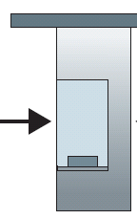
Caravan analogy
100 km
100 km
ten-car
caravan
toll
booth
toll
booth
cars “propagate” at 100 km/hr
toll booth takes 12 sec to service car (transmission time)
car~bit; caravan ~ packet
Q: How long until caravan is lined up before 2nd toll booth?
Time to “push” entire caravan through toll booth onto highway = 12*10 = 120 sec
Time for last car to propagate from 1st to 2nd toll both: 100km/(100km/hr)= 1 hr
A: 62 minutes

Slide 70
Caravan analogy (more)
100 km
100 km
ten-car
caravan
toll
booth
toll
booth
Yes! After 7 min, 1st car at 2nd booth and 3 cars still at 1st booth.
1st bit of packet can arrive at 2nd router before packet is fully transmitted at 1st router!
See Ethernet applet at AWL Web site
Cars now “propagate” at 1000 km/hr
Toll booth now takes 1 min to service a car
Q: Will cars arrive to 2nd booth before all cars serviced at 1st booth?

Slide 71
Nodal delay
d_{proc} = processing delay
typically a few microsecs or less
d_{queue} = queuing delay
depends on congestion
d_{trans} = transmission delay
= L/R, significant for low-speed links
d_{prop} = propagation delay
a few microsecs to hundreds of msecs

Slide 72
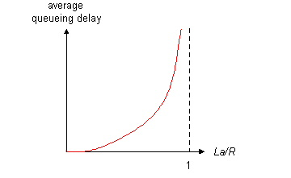
Queueing delay (revisited)
R=link bandwidth (bps)
L=packet length (bits)
a=average packet arrival rate
traffic intensity = La/R
La/R ~ 0: average queueing delay small
La/R -> 1: delays become large
La/R > 1: more “work” arriving than can be serviced, average delay infinite!
Notes:
L（包长度）*a（平均包达到率）/R>1 说明该节点上，每秒钟需要处理的比特数大于发送出去的比特数。所以这个节点会出现丢包，和拥塞。
a 的 单位是 每秒到达的数据包数量。

Slide 73
“Real” Internet delays and routes
What do “real” Internet delay & loss look like?
Traceroute program: provides delay measurement from source to router along end-end Internet path towards destination. For all i:
sends three packets that will reach router i on path towards destination
router i will return packets to sender
sender times(计时) interval between transmission and reply.
3 probes
3 probes
3 probes
Notes:
发三个进行测试，所以会对时延测试3次

Slide 74
“Real” Internet delays and routes
traceroute: gaia.cs.umass.edu to www.eurecom.fr
Three delay measurements from
gaia.cs.umass.edu to cs-gw.cs.umass.edu
1 cs-gw (128.119.240.254) 1 ms 1 ms 2 ms
2 border1-rt-fa5-1-0.gw.umass.edu (128.119.3.145) 1 ms 1 ms 2 ms
3 cht-vbns.gw.umass.edu (128.119.3.130) 6 ms 5 ms 5 ms
4 jn1-at1-0-0-19.wor.vbns.net (204.147.132.129) 16 ms 11 ms 13 ms
5 jn1-so7-0-0-0.wae.vbns.net (204.147.136.136) 21 ms 18 ms 18 ms
6 abilene-vbns.abilene.ucaid.edu (198.32.11.9) 22 ms 18 ms 22 ms
7 nycm-wash.abilene.ucaid.edu (198.32.8.46) 22 ms 22 ms 22 ms
8 62.40.103.253 (62.40.103.253) 104 ms 109 ms 106 ms
9 de2-1.de1.de.geant.net (62.40.96.129) 109 ms 102 ms 104 ms
10 de.fr1.fr.geant.net (62.40.96.50) 113 ms 121 ms 114 ms
11 renater-gw.fr1.fr.geant.net (62.40.103.54) 112 ms 114 ms 112 ms
12 nio-n2.cssi.renater.fr (193.51.206.13) 111 ms 114 ms 116 ms
13 nice.cssi.renater.fr (195.220.98.102) 123 ms 125 ms 124 ms
14 r3t2-nice.cssi.renater.fr (195.220.98.110) 126 ms 126 ms 124 ms
15 eurecom-valbonne.r3t2.ft.net (193.48.50.54) 135 ms 128 ms 133 ms
16 194.214.211.25 (194.214.211.25) 126 ms 128 ms 126 ms
17 * * *
18 * * *
19 fantasia.eurecom.fr (193.55.113.142) 132 ms 128 ms 136 ms
trans-oceanic
link
* means no response (probe lost, router not replying)
Notes:
3个数值是测了三次

Slide 75
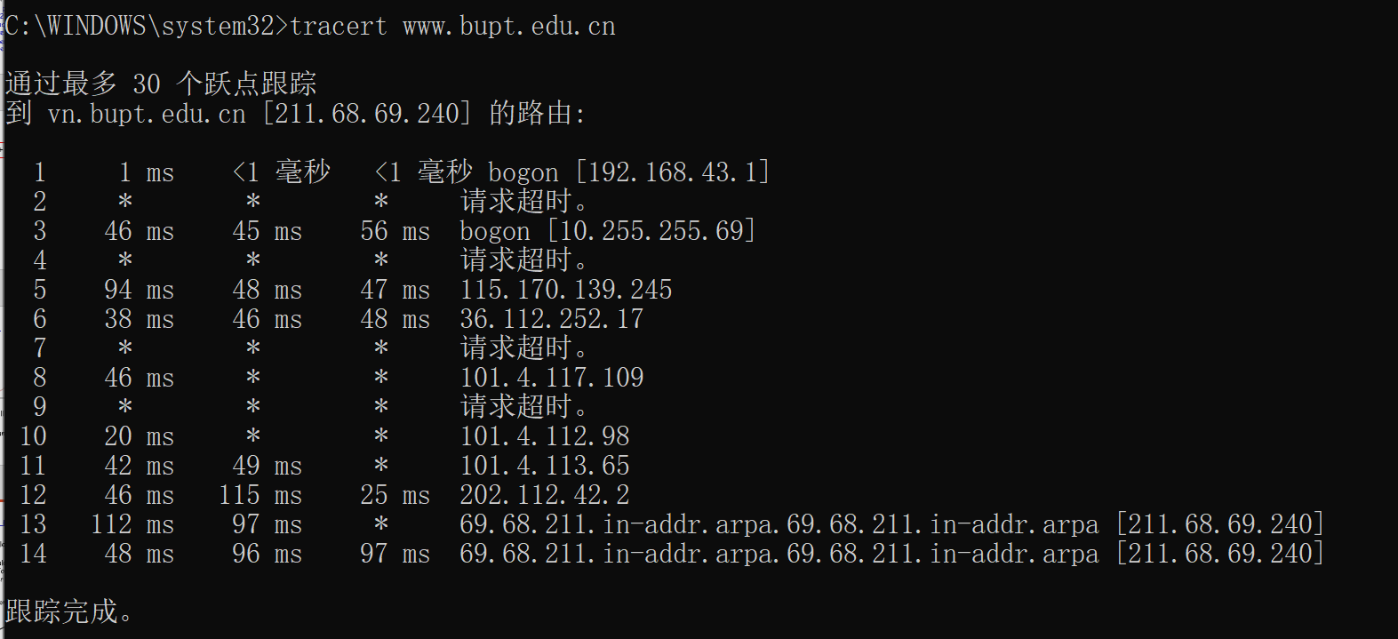
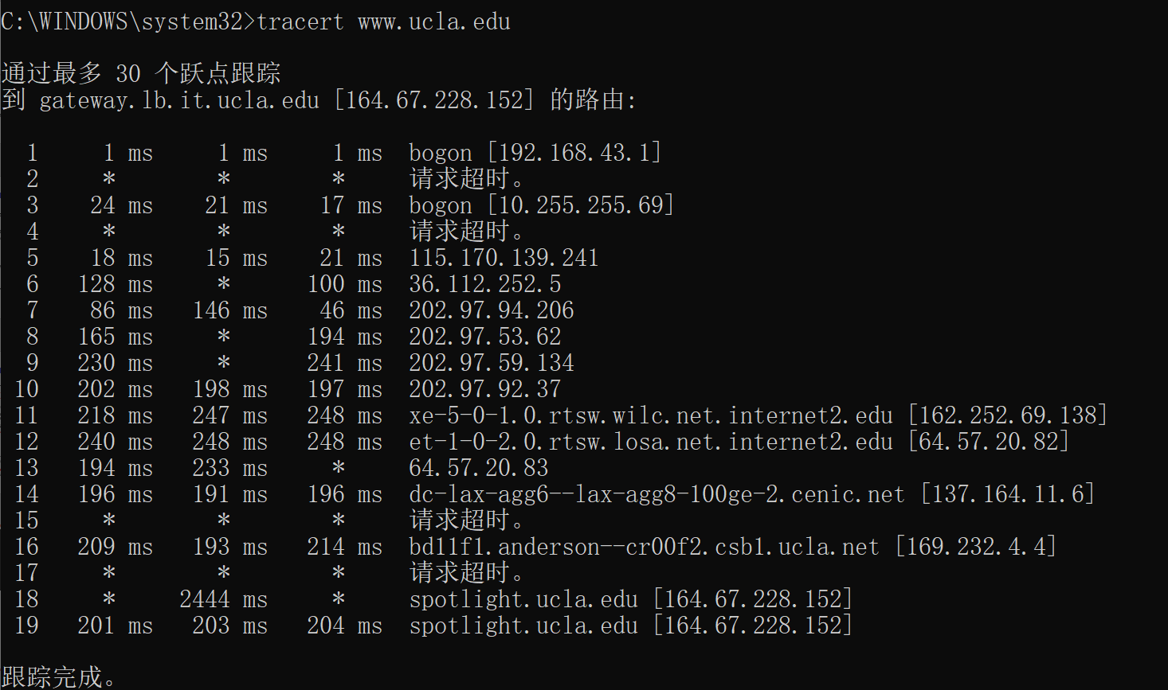

Slide 76
Packet loss
queue (aka buffer) preceding link in buffer has finite capacity
packet arriving to full queue dropped (aka lost)
lost packet may be retransmitted by previous node, by source end system, or not at all
buffer
(waiting area)
packet being transmitted
A
B
packet arriving to
full buffer is lost

Slide 77
Throughput
throughput: rate (bits/time unit) at which bits transferred between sender/receiver
instantaneous: rate at given point in time
average: rate over longer period of time
link capacity
R_{s} bits/sec
link capacity
R_{c} bits/sec
server, with
file of F bits
to send to client
pipe that can carry
fluid at rate
R_{s} bits/sec)
pipe that can carry
fluid at rate
R_{c} bits/sec)
server sends bits
(fluid) into pipe

Slide 78
Throughput (more)
R_{s} < R_{c} What is average end-end throughput?
R_{s} bits/sec
R_{c} bits/sec
R_{s} > R_{c} What is average end-end throughput?
R_{s} bits/sec
R_{c} bits/sec
bottleneck link
link on end-end path that constrains end-end throughput
Notes:
min 取小值

Slide 79
Throughput: Internet scenario
R_{s}
per-connection end-end throughput: min(R_{c},R_{s},R/10)
in practice: R_{c} or R_{s} is often bottleneck
R_{s}
R_{s}
R
R_{c}
R_{c}
R_{c}
10 connections (fairly) share backbone bottleneck link R bits/sec
Notes:
举例 Rs=2Mbps Rc=1Mbs 10对通信连接平分R s代表server c代表client
分别讨论 R=500Mbps时，平均吞吐量
R=5Mbps时，平均吞吐量

Slide 80
Chapter 1: roadmap
1.1 What is the Internet?
1.2 Network edge
end systems, access networks, links
1.3 Network core
circuit switching, packet switching, network structure
1.4 Delay, loss and throughput in packet-switched networks
1.5 Protocol layers, service models
1.6 Networks under attack: security
1.7 History

Slide 81
Protocol “Layers”
Networks are complex!
many “pieces”:
hosts
routers
links of various media
applications
protocols
hardware, software
Question:
Is there any hope of organizing structure of network?
Or at least our discussion of networks?

Slide 82
Organization of air travel
ticket (purchase)
baggage (check)
gates (load)
runway takeoff
airplane routing
ticket (complain)
baggage (claim)
gates (unload)
runway landing
airplane routing
airplane routing
a series of steps

Slide 83
Layering of airline functionality
ticket (purchase)
baggage (check)
gates (load)
runway (takeoff)
airplane routing
ticket (complain)
baggage (claim
gates (unload)
runway (land)
airplane routing
ticket
baggage
gate
takeoff/landing
airplane routing
airplane routing
airplane routing
departure
airport
intermediate air-traffic
control centers
arrival
airport
Layers: each layer implements a service
via its own internal-layer actions
relying on services provided by layer below
Notes:
物流：
寄件人 收件人
揽收快递员 派送快递员
揽收中转站 派送中转站
卡车司机

Slide 84
Why layering?
Dealing with complex systems:
explicit structure allows identification, relationship of complex system’s pieces
layered reference model for discussion
modularization eases maintenance, updating of system
change of implementation of layer’s service transparent to rest of system
e.g., change in gate procedure doesn’t affect rest of system
layering considered harmful?
Notes:
Design Philosophy

Slide 85
Internet protocol stack
application: supporting network applications
FTP, SMTP, HTTP
transport: process-process data transfer
TCP, UDP
network: routing of datagrams from source to destination
IP, routing protocols
link: data transfer between neighboring network elements
PPP, Ethernet
physical: bits “on the wire”
application
transport
network
link
physical

Slide 86
ISO/OSI reference model
presentation: allow applications to interpret meaning of data, e.g., encryption, compression, machine-specific conventions
session: synchronization, checkpointing, recovery of data exchange
Internet stack “missing” these layers!
these services, if needed, must be implemented in application
needed?
application
presentation
session
transport
network
link
physical

Slide 87
Encapsulation
source
message
M
application
transport
network
link
physical
segment
H_{t}
M
H_{t}
datagram
H_{n}
H_{n}
H_{t}
M
frame
H_{l}
H_{n}
H_{t}
M
link
physical
switch
destination
H_{n}
H_{t}
M
network
link
physical
M
application
transport
network
link
physical
H_{l}
H_{n}
H_{t}
M
H_{n}
H_{t}
M
H_{t}
M
H_{n}
H_{t}
M
H_{l}
H_{n}
H_{t}
M
router

Slide 88
Chapter 1: roadmap
1.1 What is the Internet?
1.2 Network edge
end systems, access networks, links
1.3 Network core
circuit switching, packet switching, network structure
1.4 Delay, loss and throughput in packet-switched networks
1.5 Protocol layers, service models
1.6 Networks under attack: security
1.7 History

Slide 89
Network Security
The field of network security is about:
how bad guys can attack computer networks
how we can defend networks against attacks
how to design architectures that are immune to attacks
Internet not originally designed with (much) security in mind
original vision: “a group of mutually trusting users attached to a transparent network” ☺
Internet protocol designers playing “catch-up”
Security considerations in all layers!

Slide 90
Bad guys can put malware into hosts via Internet
Malware can get in host from a virus, worm, or trojan horse.
Spyware malware can record keystrokes, web sites visited, upload info to collection site.
Infected host can be enrolled in a botnet, used for spam and DDoS attacks.
Malware is often self-replicating: from an infected host, seeks entry into other hosts

Slide 91
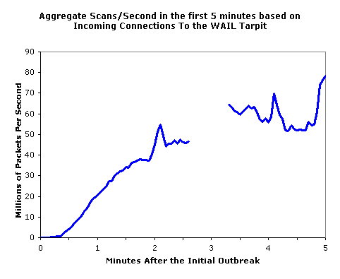
Bad guys can put malware into hosts via Internet
Trojan horse
Hidden part of some otherwise useful software
Today often on a Web page (Active-X, plugin)
Virus
infection by receiving object (e.g., e-mail attachment), actively executing
self-replicating: propagate itself to other hosts, users
Worm:
infection by passively receiving object that gets itself executed
self- replicating: propagates to other hosts, users
Sapphire Worm: aggregate scans/sec
in first 5 minutes of outbreak (CAIDA, UWisc data)

Slide 92
Bad guys can attack servers and network infrastructure
Denial of service (DoS): attackers make resources (server, bandwidth) unavailable to legitimate traffic by overwhelming resource with bogus traffic
select target
break into hosts around the network (see botnet)
send packets toward target from compromised hosts
target

Slide 93
The bad guys can sniff packets
Packet sniffing:
broadcast media (shared Ethernet, wireless)
promiscuous network interface reads/records all packets (e.g., including passwords!) passing by
A
C
src:B dest:A payload
B
Wireshark software used for end-of-chapter labs is a (free) packet-sniffer

Slide 94
The bad guys can use false source addresses
IP spoofing: send packet with false source address
A
C
src:B dest:A payload
B

Slide 95
The bad guys can record and playback
record-and-playback: sniff sensitive info (e.g., password), and use later
password holder is that user from system point of view
C
A
src:B dest:A user: B; password: foo
B

Slide 96
Network Security
more throughout this course
chapter 8: focus on security
crypographic techniques: obvious uses and not so obvious uses

Slide 97
Chapter 1: roadmap
1.1 What is the Internet?
1.2 Network edge
end systems, access networks, links
1.3 Network core
circuit switching, packet switching, network structure
1.4 Delay, loss and throughput in packet-switched networks
1.5 Protocol layers, service models
1.6 Networks under attack: security
1.7 History
Notes:
已有之事后必再有，以行之事后必再行，太阳底下并无新事

Slide 98
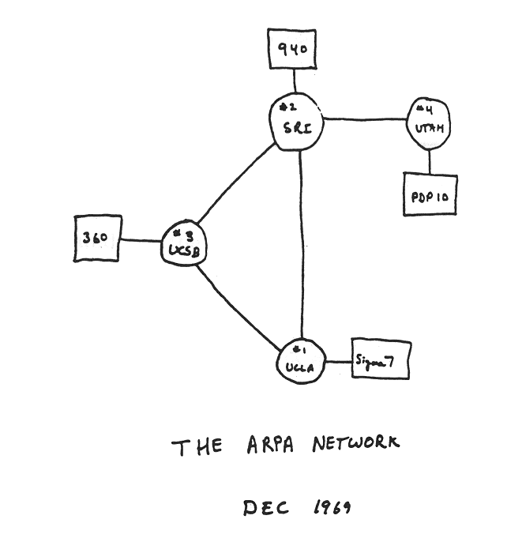
Internet History
1961-1972: Early packet-switching principles
1961: Kleinrock - queueing theory shows effectiveness of packet-switching
1964: Baran - packet-switching in military nets
1967: ARPAnet conceived by Advanced Research Projects Agency
1969: first ARPAnet node operational
1972:
ARPAnet public demonstration
NCP (Network Control Protocol) first host-host protocol
first e-mail program
ARPAnet has 15 nodes
Notes:
时间是线性的，故事的发展是非线性的。三位学者同时开始研究包交换（MIT 兰德 和 英国国家物理实验室）
来自MIT的专家Roberts(Klenrock的同事)，协助美国国防高级研究计划局（Defense Advanced Research Projects Agency）制定了详细的计划，并且付诸实践。
DARPA： GPS 隐形飞机 高级语音识别 物联网 人工智能

Slide 99
Internet History
1972-1980: Internetworking, new and proprietary nets
1970: ALOHAnet satellite network in Hawaii
1974: Cerf and Kahn - architecture for interconnecting networks
1976: Ethernet at Xerox PARC
ate70’s: proprietary architectures: DECnet, SNA, XNA
late 70’s: switching fixed length packets (ATM precursor)
1979: ARPAnet has 200 nodes
Cerf and Kahn’s internetworking principles:
minimalism, autonomy - no internal changes required to interconnect networks
best effort service model
stateless routers
decentralized control
define today’s Internet architecture

Slide 100
Internet History
1980-1990: new protocols, a proliferation of networks
1983: deployment of TCP/IP
1982: smtp e-mail protocol defined
1983: DNS defined for name-to-IP-address translation
1985: ftp protocol defined
1988: TCP congestion control
new national networks: Csnet, BITnet, NSFnet, Minitel
100,000 hosts connected to confederation of networks

Slide 101
Internet History
1990, 2000’s: commercialization, the Web, new apps
Early 1990’s: ARPAnet decommissioned
1991: NSF lifts restrictions on commercial use of NSFnet (decommissioned, 1995)
early 1990s: Web
hypertext [Bush 1945, Nelson 1960’s]
HTML, HTTP: Berners-Lee
1994: Mosaic, later Netscape
late 1990’s: commercialization of the Web
Late 1990’s – 2000’s:
more killer apps: instant messaging, P2P file sharing
network security to forefront
est. 50 million host, 100 million+ users
backbone links running at Gbps

Slide 102
Internet history
2005-present
~5B devices attached to Internet (2016)
smartphones and tablets
aggressive deployment of broadband access
increasing ubiquity of high-speed wireless access
emergence of online social networks:
Facebook: ~ one billion users
service providers (Google, Microsoft) create their own networks
bypass Internet, providing “instantaneous” access to search, video content, email, etc.
e-commerce, universities, enterprises running their services in “cloud” (e.g., Amazon EC2)

Slide 103
Internet History
2007:
~500 million hosts
Voice, Video over IP
P2P applications: BitTorrent (file sharing) Skype (VoIP), PPLive (video)
more applications: YouTube, gaming
wireless, mobility

Slide 104
中国互联网简史
1987年：中国科学院计算机网络信息中心成立，建立了中国第一个互联网节点。
1994年：中国的第一个商业互联网服务提供商——中国互联网络信息中心（CNNIC）成立。
1995年：中国的第一个网站——“中国黄页”上线。
1997年：中国互联网用户突破100万大关。
1998年：中国的第一个搜索引擎——百度成立。
2000年：中国互联网用户突破2000万大关。

Slide 105
中国互联网简史
2003年：中国的第一个在线支付平台——支付宝成立。
2008年：中国互联网用户突破2亿大关。
2011年：微信成立，开始改变人们的社交方式。
2014年：中国互联网用户突破6亿大关。
2016年：中国成为全球最大的互联网市场，互联网普及率达到50%。
2020年：中国互联网用户数达到9.39亿，移动互联网用户数占比超过99%。

Slide 106
中国第一封电子邮件
1987年9月14日
中国科学院计算机应用研究所的邓仁来教授
中国第一个互联网节点“ACADEM1”
向中美数学家
Across the Great Wall, we can reach every corner in the world（真实性待考）

Slide 107
Introduction: Summary
Covered a “ton” of material!
Internet overview
what’s a protocol?
network edge, core, access network
packet-switching versus circuit-switching
Internet structure
performance: loss, delay, throughput
layering, service models
security
history
You now have:
context, overview, “feel” of networking
more depth, detail to follow!

