Slide 1

Chapter 4 Network Layer
A note on the use of these ppt slides:
We’re making these slides freely available to all (faculty, students, readers). They’re in PowerPoint form so you can add, modify, and delete slides (including this one) and slide content to suit your needs. They obviously represent a lot of work on our part. In return for use, we only ask the following:
If you use these slides (e.g., in a class) in substantially unaltered form, that you mention their source (after all, we’d like people to use our book!)
If you post any slides in substantially unaltered form on a www site, that you note that they are adapted from (or perhaps identical to) our slides, and note our copyright of this material.
Thanks and enjoy! JFK/KWR
All material copyright 1996-2009
J.F Kurose and K.W. Ross, All Rights Reserved
Computer Networking: A Top Down Approach 5th edition. Jim Kurose, Keith Ross Addison-Wesley, April 2009.

Slide 2
Chapter 4: Network Layer
Chapter goals:
understand principles behind network layer services:
network layer service models
forwarding versus routing
how a router works
routing (path selection)
dealing with scale
advanced topics: IPv6, mobility
instantiation, implementation in the Internet

Slide 3
Chapter 4: Network Layer
4. 1 Introduction
4.2 Virtual circuit and datagram networks
4.3 What’s inside a router
4.4 IP: Internet Protocol
Datagram format
IPv4 addressing
ICMP
IPv6
4.5 Routing algorithms
Link state
Distance Vector
Hierarchical routing略
4.6 Routing in the Internet
RIP（略）
OSPF（略）
BGP
4.7 Broadcast and multicast routing略

Slide 4

Network layer
transport segment from sending to receiving host
on sending side encapsulates segments into datagrams
on rcving side, delivers segments to transport layer
network layer protocols in every host, router
router examines header fields in all IP datagrams passing through it
application
transport
network
data link
physical
network
data link
physical
network
data link
physical
network
data link
physical
network
data link
physical
network
data link
physical
network
data link
physical
network
data link
physical
network
data link
physical
network
data link
physical
application
transport
network
data link
physical
network
data link
physical
network
data link
physical

Slide 5
Two Key Network-Layer Functions
forwarding: move packets from router’s input to appropriate router output
routing: determine route taken by packets from source to dest.
routing algorithms
analogy:
forwarding: process of getting through single interchange
routing: process of planning trip from source to dest
Notes:
转发是局部的
路由是全局的

Slide 6
Interplay between routing and forwarding
routing algorithm
local forwarding table
header value
output link
0100
0101
0111
1001
3
2
2
1
value in arriving
packet’s header
0111
1
3
2

Slide 7
Connection setup
3rd important function in some network architectures:
ATM, frame relay, X.25
before datagrams flow, two end hosts and intervening routers establish virtual connection
routers get involved
network vs transport layer connection service:
network: between two hosts (may also involve intervening routers in case of VCs)
transport: between two processes
Notes:
不讲

Slide 8
Network service model
Q: What service model for “channel” transporting datagrams from sender to receiver?
Example services for individual datagrams:
guaranteed delivery
guaranteed delivery with less than 40 msec delay
Example services for a flow of datagrams:
in-order datagram delivery
guaranteed minimum bandwidth to flow
restrictions on changes in inter-packet spacing

Slide 9
Network layer service models:
Network
Architecture
Internet
ATM
ATM
ATM
ATM
Service
Model
best effort
CBR
VBR
ABR
UBR
Guarantees ?
Congestion
feedback
no (inferred
via loss)
no
congestion
no
congestion
yes
no
Bandwidth
none
constant
rate
guaranteed
rate
guaranteed
minimum
none
Loss
no
yes
yes
no
no
Order
no
yes
yes
yes
yes
Timing
no
yes
yes
no
no

Slide 10
Chapter 4: Network Layer
4. 1 Introduction
4.2 Virtual circuit and datagram networks
4.3 What’s inside a router
4.4 IP: Internet Protocol
Datagram format
IPv4 addressing
ICMP
IPv6
4.5 Routing algorithms
Link state
Distance Vector
Hierarchical routing
4.6 Routing in the Internet
RIP
OSPF
BGP
4.7 Broadcast and multicast routing

Slide 11
Network layer connection and connection-less service
datagram network provides network-layer connectionless service
VC network provides network-layer connection service
analogous to the transport-layer services, but:
service: host-to-host
no choice: network provides one or the other
implementation: in network core
Notes:
提一句虚拟电路

Slide 12
Datagram networks
no call setup at network layer
routers: no state about end-to-end connections
no network-level concept of “connection”
packets forwarded using destination host address
packets between same source-dest pair may take different paths
application
transport
network
data link
physical
application
transport
network
data link
physical
1. Send data
2. Receive data
Notes:
而数据报网络则使用动态路由，每个数据包可以根据当前的网络状况独立选择路径。

Slide 13
Forwarding table
4 billion
possible entries
Destination Address Range Link Interface
11001000 00010111 00010000 00000000
through 0
11001000 00010111 00010111 11111111
11001000 00010111 00011000 00000000
through 1
11001000 00010111 00011000 11111111
11001000 00010111 00011001 00000000
through 2
11001000 00010111 00011111 11111111
otherwise 3

Slide 14
Longest prefix matching（题）
Prefix Match Link Interface
11001000 00010111 00010 0
11001000 00010111 00011000 1
11001000 00010111 00011 2
otherwise 3
Examples
DA: 11001000 00010111 00010110 10100001
Which interface?
DA: 11001000 00010111 00011000 10101010
Which interface?

Slide 15
Datagram or VC network: why?
Internet (datagram)
data exchange among computers
“elastic” service, no strict timing req.
“smart” end systems (computers)
can adapt, perform control, error recovery
simple inside network, complexity at “edge”
many link types
different characteristics
uniform service difficult
ATM (VC)
evolved from telephony
human conversation:
strict timing, reliability requirements
need for guaranteed service
“dumb” end systems
telephones
complexity inside network

Slide 16
Chapter 4: Network Layer
4. 1 Introduction
4.2 Virtual circuit and datagram networks
4.3 What’s inside a router
4.4 IP: Internet Protocol
Datagram format
IPv4 addressing
ICMP
IPv6
4.5 Routing algorithms
Link state
Distance Vector
Hierarchical routing
4.6 Routing in the Internet
RIP
OSPF
BGP
4.7 Broadcast and multicast routing

Slide 17
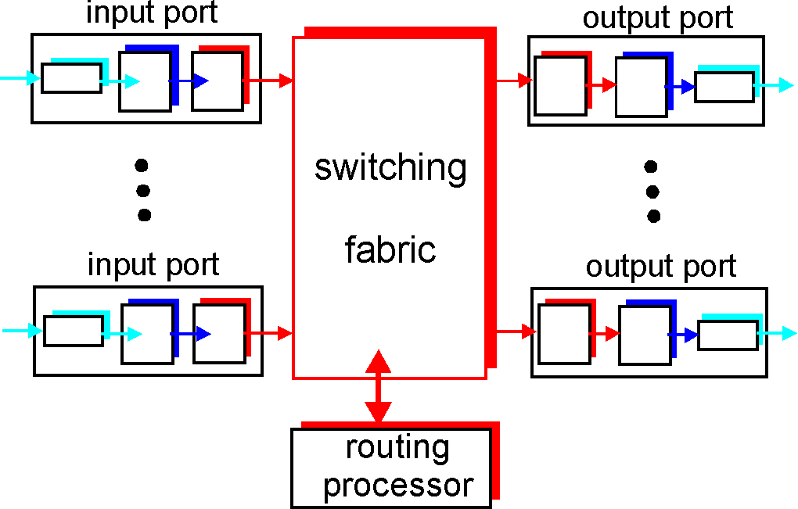
Router Architecture Overview
Two key router functions:
run routing algorithms/protocol (RIP, OSPF, BGP)
forwarding datagrams from incoming to outgoing link

Slide 18
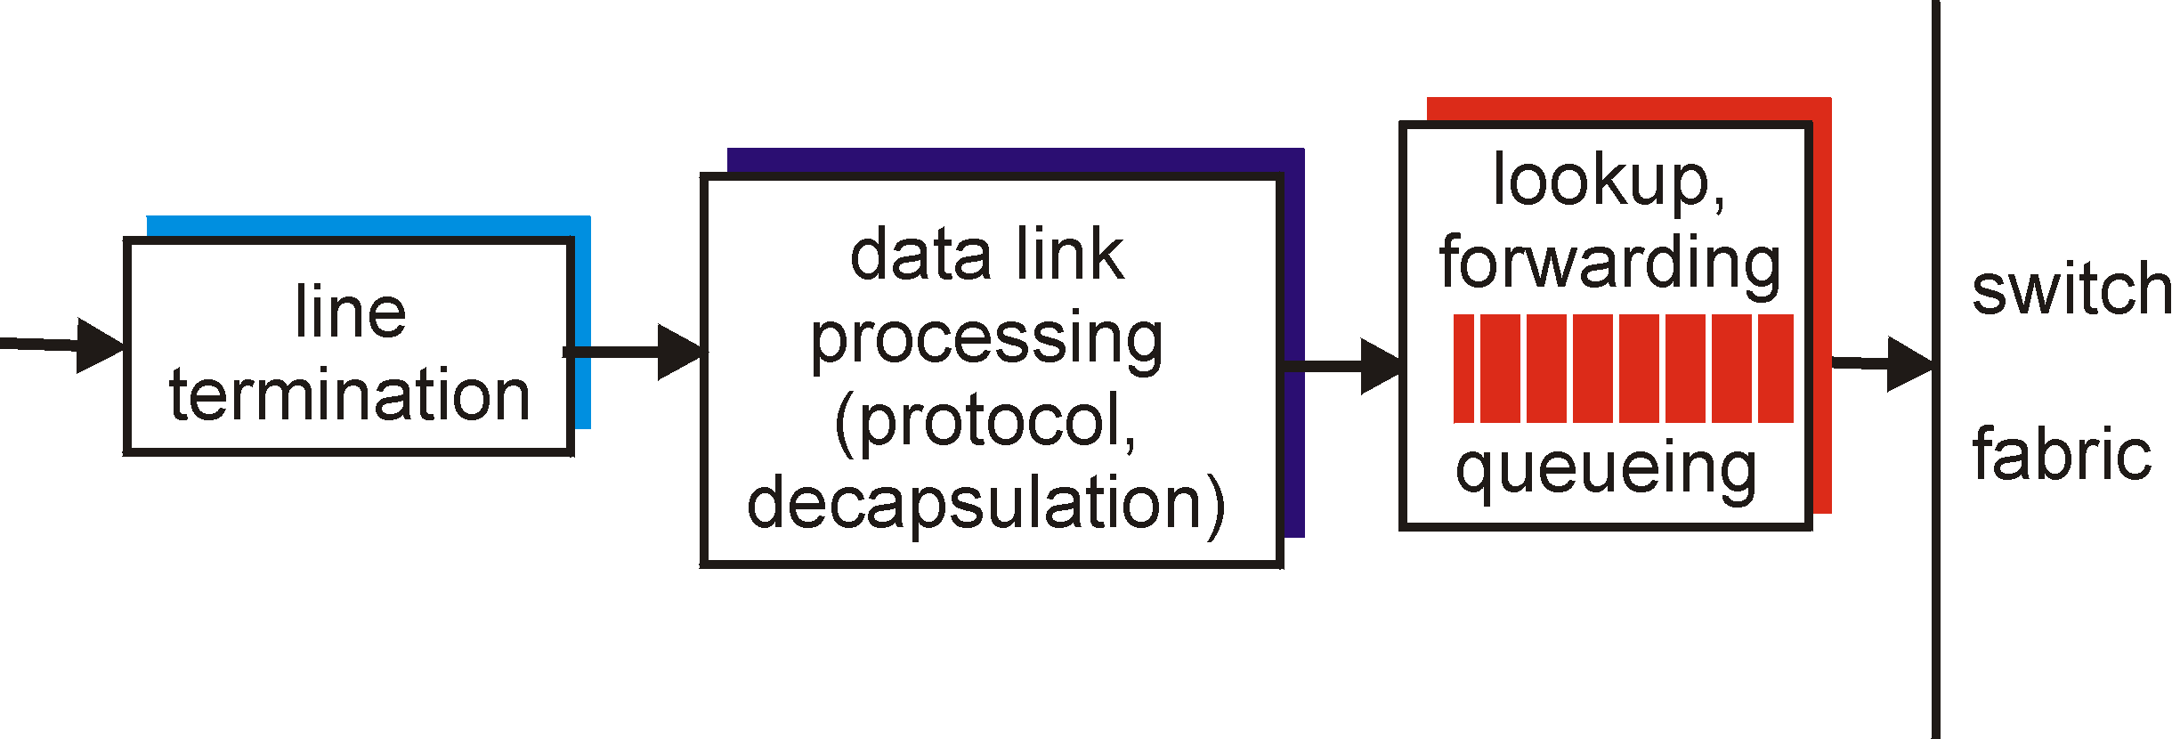
Input Port Functions
Physical layer:
bit-level reception
Data link layer:
e.g., Ethernet
see chapter 5
Decentralized switching:
given datagram dest., lookup output port using forwarding table in input port memory
goal: complete input port processing at ‘line speed’
queuing: if datagrams arrive faster than forwarding rate into switch fabric

Slide 19
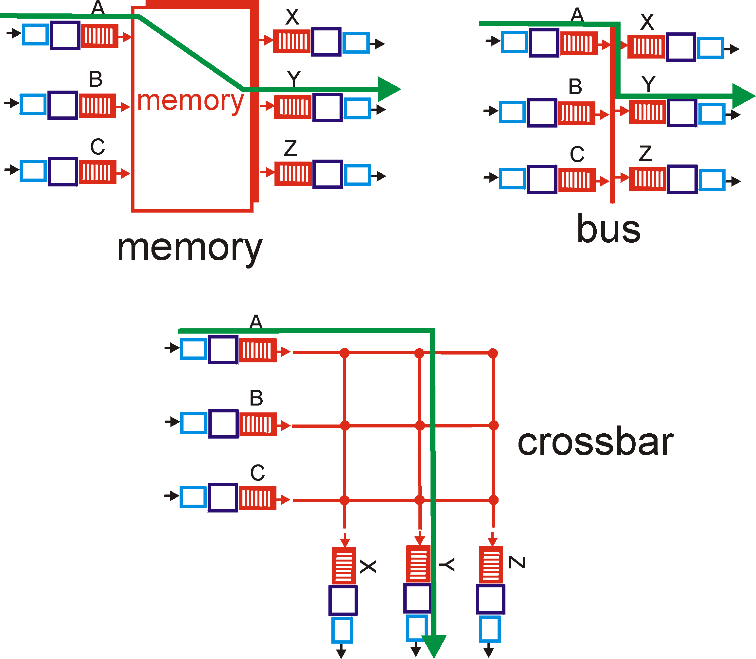
Three types of switching fabrics

Slide 20
Switching Via Memory
First generation routers:
traditional computers with switching under direct control of CPU
packet copied to system’s memory
speed limited by memory bandwidth (2 bus crossings per datagram)
Input
Port
Memory
Output
Port
System Bus

Slide 21
Switching Via a Bus
datagram from input port memory
to output port memory via a shared bus
bus contention: switching speed limited by bus bandwidth
32 Gbps bus, Cisco 5600: sufficient speed for access and enterprise routers

Slide 22
Switching Via An Interconnection Network
overcome bus bandwidth limitations
Banyan networks, other interconnection nets initially developed to connect processors in multiprocessor
advanced design: fragmenting datagram into fixed length cells, switch cells through the fabric.
Cisco 12000: switches 60 Gbps through the interconnection network

Slide 23
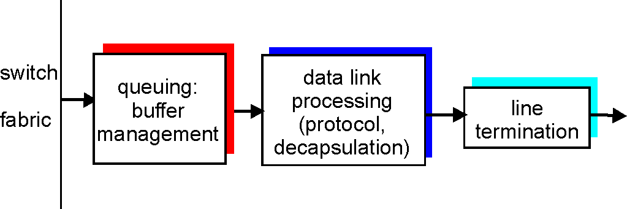
Output Ports
Buffering required when datagrams arrive from fabric faster than the transmission rate
Scheduling discipline chooses among queued datagrams for transmission

Slide 24
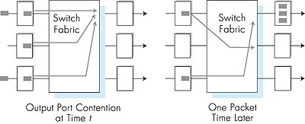
Output port queueing
buffering when arrival rate via switch exceeds output line speed
queueing (delay) and loss due to output port buffer overflow!

Slide 25
How much buffering?
RFC 3439 rule of thumb: average buffering equal to “typical” RTT (say 250 msec) times link capacity C
e.g., C = 10 Gps link: 2.5 Gbit buffer
Recent recommendation: with N flows, buffering equal to
.
RTT C
N

Slide 26
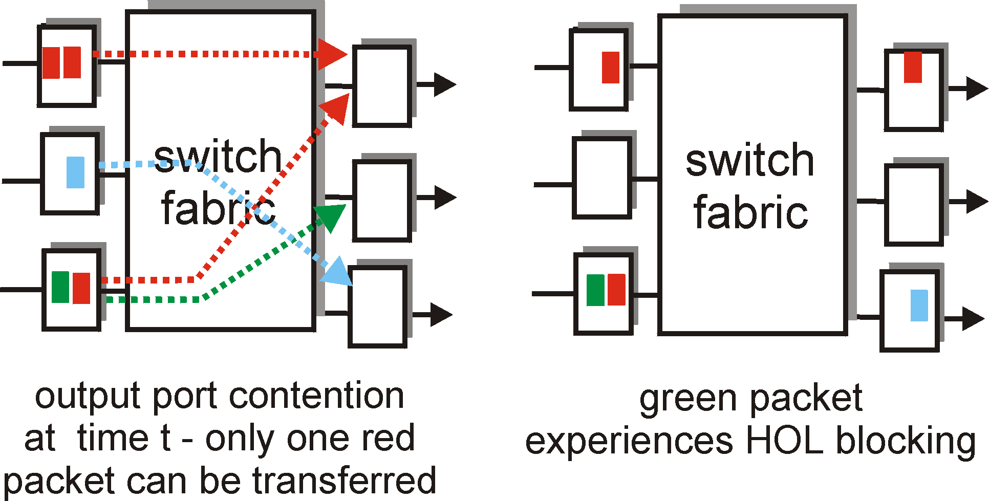
Input Port Queuing
Fabric slower than input ports combined -> queueing may occur at input queues
Head-of-the-Line (HOL) blocking: queued datagram at front of queue prevents others in queue from moving forward
queueing delay and loss due to input buffer overflow!
Notes:
举例：小区门口车排队
左图：左侧上下两个红色都想进入右上，因此产生拥塞，左下的绿色其实是想去右中。
右图：由于左上的红色竞争胜出，所以左下的红色没有出队列，导致左下的绿色也出不去。

Slide 27
Chapter 4: Network Layer
4. 1 Introduction
4.2 Virtual circuit and datagram networks
4.3 What’s inside a router
4.4 IP: Internet Protocol
Datagram format
IPv4 addressing
ICMP
IPv6
4.5 Routing algorithms
Link state
Distance Vector
Hierarchical routing
4.6 Routing in the Internet
RIP
OSPF
BGP
4.7 Broadcast and multicast routing

Slide 28
The Internet Network layer
Host, router network layer functions:
Transport layer: TCP, UDP
Routing protocols
path selection
RIP, OSPF, BGP
IP protocol
addressing conventions
datagram format
packet handling conventions
Network
layer
forwarding
table
ICMP protocol
error reporting
router “signaling”
Link layer
physical layer

Slide 29
Chapter 4: Network Layer
4. 1 Introduction
4.2 Virtual circuit and datagram networks
4.3 What’s inside a router
4.4 IP: Internet Protocol
Datagram format
IPv4 addressing
ICMP
IPv6
4.5 Routing algorithms
Link state
Distance Vector
Hierarchical routing
4.6 Routing in the Internet
RIP
OSPF
BGP
4.7 Broadcast and multicast routing

Slide 30
IP datagram format
IP protocol version
number
32 bits
total datagram
length (bytes)
header length
(bytes)
head.
len
type of
service
ver
length
for
fragmentation/
reassembly
“type” of data
flgs
fragment
offset
16-bit identifier
max number
remaining hops
(decremented at
each router)
time to
live
upper
layer
header
checksum
32 bit source IP address
upper layer protocol
to deliver payload to
32 bit destination IP address
Options (if any)
E.g. timestamp,
record route
taken, specify
list of routers
to visit.
how much overhead with TCP?
20 bytes of TCP
20 bytes of IP
= 40 bytes + app layer overhead
data
(variable length,
typically a TCP
or UDP segment)

Slide 31
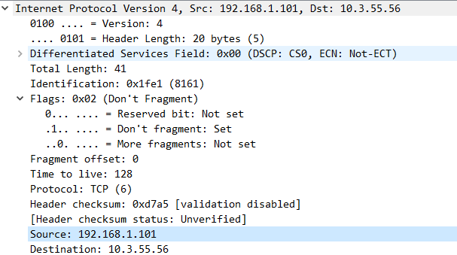
IP Fragmentation & Reassembly

Slide 32
IP Fragmentation & Reassembly
network links have MTU (max.transfer size) - largest possible link-level frame.
different link types, different MTUs
large IP datagram divided (“fragmented”) within net
one datagram becomes several datagrams
“reassembled” only at final destination
IP header bits used to identify, order related fragments
fragmentation:
in: one large datagram
out: 3 smaller datagrams
reassembly
Notes:
MTU是对着IP层，MSS是对着传输层说的
以太网的贞最小为64字节，最大为1518字节。除去14字节头部和4字节 CRC字段，最小的有效载荷为46字节，最大的有效载荷为1500字节这个值就是MTU。
IP协议的数据报最大为65535个字节，这就要fragment
以太网贞是1500字节+14字节的MAC头，TCP头一共是32个字节，可选项占了12字节。所以TCP的MSS=1500-20-20-12=1448字节。
https://zhuanlan.zhihu.com/p/100385612

Slide 33

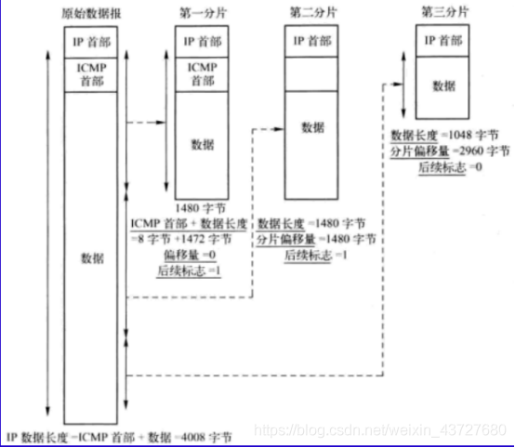
IP Fragmentation & Reassembly
Notes:
ICMP是介乎IP和传输层之间的一个 半层 ICMP的包头是8个字节，只出现在第一个包里头

Slide 34
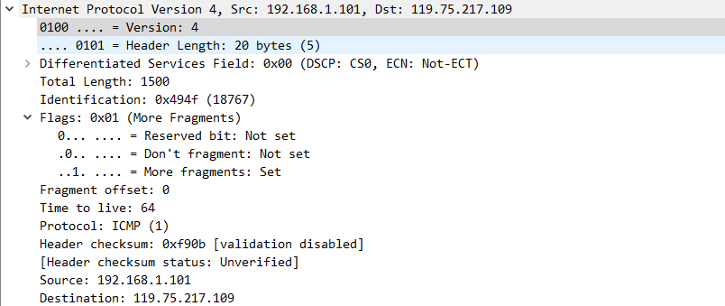
第一个分片
Notes:
4000字节的第一个包，不分段标志置为0，表示分段，更多分段标志置为1，表示有后续分段
一共长度1500字节

Slide 35
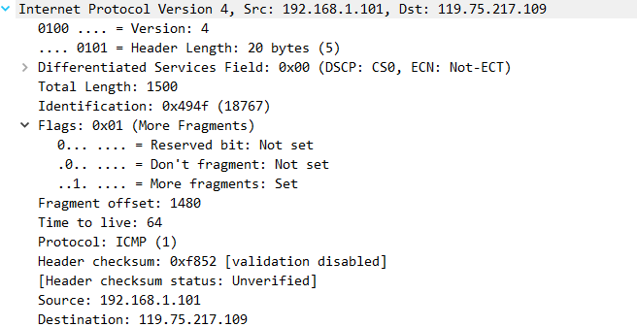
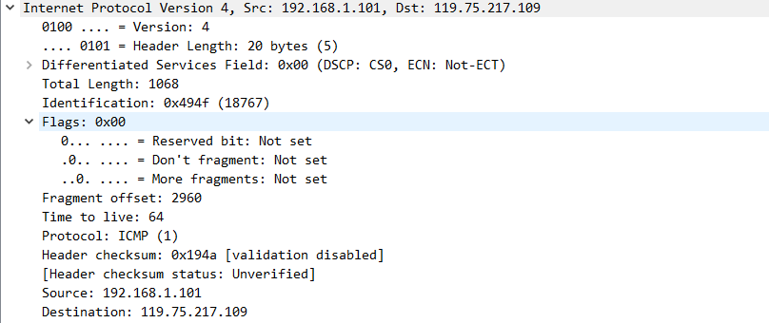
IP Fragmentation & Reassembly
Notes:
wireshark已经将偏移换算过了
需传输的总长度为4000字节+8字节ICMP包头=4008字节
上图：ID 18767 同一段数据，更多分段置为1，表示还有后续，offset是1480，表明是第二个分段，因为上一个分段的有效数据长度为1500-20（包头长度）=1480
下图：ID相同，更多分段置为0，表示这就是最后一个分段。起始点位为2960，分段长度为1068，则有效数据长度为1068-20（IP）=1048.
2960+1048=4008

Slide 36
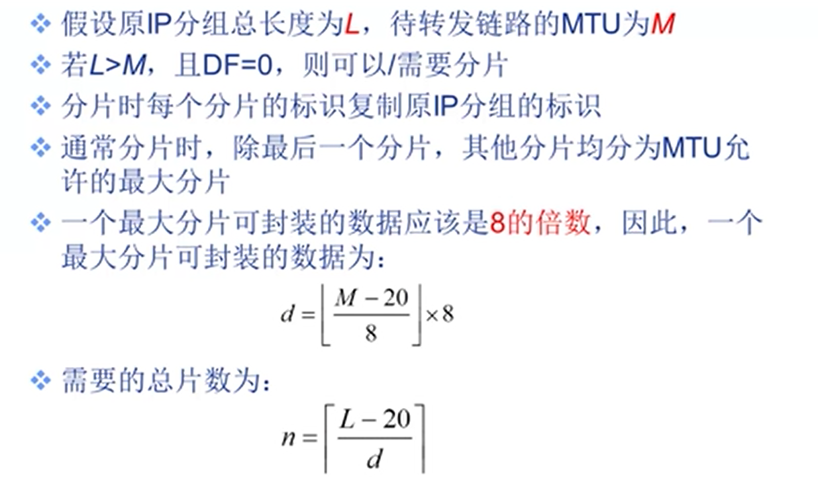
IP Fragmentation & Reassembly（题）
Notes:
向下取整
向上取整

Slide 37
IP Fragmentation and Reassembly
length
=4000
ID
=x
fragflag
=0
offset
=0
Example
4000 byte datagram
MTU = 1500 bytes
One large datagram becomes
several smaller datagrams
length
=1500
ID
=x
fragflag
=1
offset
=0
1480 bytes in data field
length
=1500
ID
=x
fragflag
=1
offset
=185
offset =
1480/8
length
=1040
ID
=x
fragflag
=0
offset
=370
Notes:
cn.voidcc.com/question/p-dgdpiwlg-zb.html
它是由IP头部格式中的“总长度（16bit）”和“偏移（13bit）”两个字段所决定的。总长度定义了IP包的最大长度为2^16=64KB,偏移说明了IP分片时它最多能表示2^13个偏移单位，这样偏移单位就是2^16/2^13=2^3，即为8B了。如果偏移单位不是8B，如选4B，则13bit的"偏移"就不能表示出IP的最大长度了，而如果选16B，只需要12bit的"偏移"就能表示出IP的最大长度了，即偏移单位小于8B时，“偏移”不能够表示出IP的最大长，偏移单位大于8时，“偏移”不会被完全利用。以8B做为偏移单位正好合适。
wireshark已经换算过了

Slide 38
Chapter 4: Network Layer
4. 1 Introduction
4.2 Virtual circuit and datagram networks
4.3 What’s inside a router
4.4 IP: Internet Protocol
Datagram format
IPv4 addressing
ICMP
IPv6
4.5 Routing algorithms
Link state
Distance Vector
Hierarchical routing
4.6 Routing in the Internet
RIP
OSPF
BGP
4.7 Broadcast and multicast routing
Notes:
命名赋权的过程

Slide 39
IP Addressing: introduction
IP address: 32-bit identifier for host, router interface
interface: connection between host/router and physical link
router’s typically have multiple interfaces
host typically has one interface
IP addresses associated with each interface
223.1.1.1
223.1.2.1
223.1.1.2
223.1.1.4
223.1.2.9
223.1.2.2
223.1.1.3
223.1.3.27
223.1.3.1
223.1.3.2
223.1.1.1 = 11011111 00000001 00000001 00000001
223
1
1
1

Slide 40
Subnets
IP address:
subnet part (high order bits)
host part (low order bits)
What’s a subnet ?
device interfaces with same subnet part of IP address
can physically reach each other without intervening router
223.1.1.1
223.1.2.1
223.1.1.2
223.1.1.4
223.1.2.9
223.1.1.3
223.1.2.2
223.1.3.27
subnet
223.1.3.1
223.1.3.2
network consisting of 3 subnets

Slide 41
Subnets
223.1.1.0/24
223.1.2.0/24
Recipe
To determine the subnets, detach each interface from its host or router, creating islands of isolated networks. Each isolated network is called a subnet.
223.1.3.0/24
Subnet mask: /24

Slide 42
Subnets
223.1.1.2
How many?
223.1.1.1
223.1.1.4
223.1.1.3
223.1.9.2
223.1.7.0
223.1.9.1
223.1.7.1
223.1.8.1
223.1.8.0
223.1.2.6
223.1.3.27
223.1.2.1
223.1.2.2
223.1.3.1
223.1.3.2

Slide 43
IP addressing: CIDR
CIDR: Classless InterDomain Routing
subnet portion of address of arbitrary length
address format: a.b.c.d/x, where x is # bits in subnet portion of address
subnet
part
host
part
11001000 00010111 00010000 00000000
200.23.16.0/23

Slide 44
IP addresses: how to get one?
Q: How does a host get IP address?
hard-coded by system admin in a file
Windows: control-panel->network->configuration->tcp/ip->properties
UNIX: /etc/rc.config
DHCP: Dynamic Host Configuration Protocol: dynamically get address from as server
“plug-and-play”

Slide 45
DHCP: Dynamic Host Configuration Protocol
Goal: allow host to dynamically obtain its IP address from network server when it joins network
Can renew its lease on address in use
Allows reuse of addresses (only hold address while connected an “on”)
Support for mobile users who want to join network (more shortly)
DHCP overview:
host broadcasts “DHCP discover” msg [optional]
DHCP server responds with “DHCP offer” msg [optional]
host requests IP address: “DHCP request” msg
DHCP server sends address: “DHCP ack” msg

Slide 46
DHCP client-server scenario
A
223.1.1.1
DHCP
223.1.2.1
server
223.1.1.2
223.1.1.4
223.1.2.9
B
223.1.2.2
E
arriving DHCP
client needs
address in this
network
223.1.1.3
223.1.3.27
223.1.3.1
223.1.3.2
Notes:
餐厅服务员领座

Slide 47
DHCP client-server scenario
DHCP server: 223.1.2.5
arriving
client
DHCP discover
src : 0.0.0.0, 68
dest.: 255.255.255.255,67
yiaddr: 0.0.0.0
transaction ID: 654
DHCP offer
src: 223.1.2.5, 67
dest: 255.255.255.255, 68
yiaddrr: 223.1.2.4
transaction ID: 654
Lifetime: 3600 secs
DHCP request
src: 0.0.0.0, 68
dest:: 255.255.255.255, 67
yiaddrr: 223.1.2.4
transaction ID: 655
Lifetime: 3600 secs
time
DHCP ACK
src: 223.1.2.5, 67
dest: 255.255.255.255, 68
yiaddrr: 223.1.2.4
transaction ID: 655
Lifetime: 3600 secs

Slide 48
DHCP: more than IP address
DHCP can return more than just allocated IP address on subnet:
address of first-hop router for client
name and IP address of DNS sever
network mask (indicating network versus host portion of address)

Slide 49
DHCP: example
DHCP
DHCP
UDP
IP
Eth
Phy
connecting laptop needs its IP address, addr of first-hop router, addr of DNS server: use DHCP
DHCP
DHCP
DHCP
DHCP
DHCP request encapsulated in UDP, encapsulated in IP, encapsulated in 802.1 Ethernet
DHCP
DHCP
UDP
IP
Eth
Phy
DHCP
168.1.1.1
DHCP
DHCP
Ethernet frame broadcast (dest: FFFFFFFFFFFF) on LAN, received at router running DHCP server
DHCP
router
(runs DHCP)
Ethernet demux’ed to IP demux’ed, UDP demux’ed to DHCP

Slide 50
DHCP: example
DHCP
DHCP
UDP
IP
Eth
Phy
DHCP server formulates DHCP ACK containing client’s IP address, IP address of first-hop router for client, name & IP address of DNS server
DHCP
DHCP
DHCP
encapsulation of DHCP server, frame forwarded to client, demux’ing up to DHCP at client
client now knows its IP address, name and IP address of DNS server, IP address of its first-hop router
DHCP
DHCP
UDP
IP
Eth
Phy
DHCP
DHCP
DHCP
router
(runs DHCP)
DHCP

Slide 51
DHCP: wireshark output (home LAN)
reply
Message type: Boot Reply (2)
Hardware type: Ethernet
Hardware address length: 6
Hops: 0
Transaction ID: 0x6b3a11b7
Seconds elapsed: 0
Bootp flags: 0x0000 (Unicast)
Client IP address: 192.168.1.101 (192.168.1.101)
Your (client) IP address: 0.0.0.0 (0.0.0.0)
Next server IP address: 192.168.1.1 (192.168.1.1)
Relay agent IP address: 0.0.0.0 (0.0.0.0)
Client MAC address: Wistron_23:68:8a (00:16:d3:23:68:8a)
Server host name not given
Boot file name not given
Magic cookie: (OK)
Option: (t=53,l=1) DHCP Message Type = DHCP ACK
Option: (t=54,l=4) Server Identifier = 192.168.1.1
Option: (t=1,l=4) Subnet Mask = 255.255.255.0
Option: (t=3,l=4) Router = 192.168.1.1
Option: (6) Domain Name Server
Length: 12; Value: 445747E2445749F244574092;
IP Address: 68.87.71.226;
IP Address: 68.87.73.242;
IP Address: 68.87.64.146
Option: (t=15,l=20) Domain Name = "hsd1.ma.comcast.net."
Message type: Boot Request (1)
Hardware type: Ethernet
Hardware address length: 6
Hops: 0
Transaction ID: 0x6b3a11b7
Seconds elapsed: 0
Bootp flags: 0x0000 (Unicast)
Client IP address: 0.0.0.0 (0.0.0.0)
Your (client) IP address: 0.0.0.0 (0.0.0.0)
Next server IP address: 0.0.0.0 (0.0.0.0)
Relay agent IP address: 0.0.0.0 (0.0.0.0)
Client MAC address: Wistron_23:68:8a (00:16:d3:23:68:8a)
Server host name not given
Boot file name not given
Magic cookie: (OK)
Option: (t=53,l=1) DHCP Message Type = DHCP Request
Option: (61) Client identifier
Length: 7; Value: 010016D323688A;
Hardware type: Ethernet
Client MAC address: Wistron_23:68:8a (00:16:d3:23:68:8a)
Option: (t=50,l=4) Requested IP Address = 192.168.1.101
Option: (t=12,l=5) Host Name = "nomad"
Option: (55) Parameter Request List
Length: 11; Value: 010F03062C2E2F1F21F92B
1 = Subnet Mask; 15 = Domain Name
3 = Router; 6 = Domain Name Server
44 = NetBIOS over TCP/IP Name Server
……
request

Slide 52
IP addresses: how to get one?
Q: How does network get subnet part of IP addr?
A: gets allocated portion of its provider ISP’s address space
ISP's block 11001000 00010111 00010000 00000000 200.23.16.0/20
Organization 0 11001000 00010111 00010000 00000000 200.23.16.0/23
Organization 1 11001000 00010111 00010010 00000000 200.23.18.0/23
Organization 2 11001000 00010111 00010100 00000000 200.23.20.0/23
... ….. …. ….
Organization 7 11001000 00010111 00011110 00000000 200.23.30.0/23

Slide 53
Hierarchical addressing: route aggregation
Hierarchical addressing allows efficient advertisement of routing
information:
Organization 0
200.23.16.0/23
Organization 1
200.23.18.0/23
“Send me anything
with addresses
beginning
200.23.16.0/20”
Organization 2
200.23.20.0/23
.
Fly-By-Night-ISP
.
.
.
.
Internet
Organization 7
.
200.23.30.0/23
ISPs-R-Us
“Send me anything
with addresses
beginning
199.31.0.0/16”
Notes:
路由汇聚
slash后面的数字，越往高层路由，越小

Slide 54
Hierarchical addressing: more specific routes
ISPs-R-Us has a more specific route to Organization 1
Organization 0
200.23.16.0/23
“Send me anything
with addresses
beginning
200.23.16.0/20”
Organization 2
200.23.20.0/23
.
Fly-By-Night-ISP
.
.
.
.
Internet
Organization 7
.
200.23.30.0/23
ISPs-R-Us
“Send me anything
with addresses
beginning 199.31.0.0/16
or 200.23.18.0/23”
Organization 1
200.23.18.0/23

Slide 55
IP addressing: the last word...
Q: How does an ISP get block of addresses?
A: ICANN: Internet Corporation for Assigned
Names and Numbers
allocates addresses
manages DNS
assigns domain names, resolves disputes

Slide 56
NAT: Network Address Translation（题）
rest of
Internet
local network
(e.g., home network)
10.0.0/24
10.0.0.1
10.0.0.4
10.0.0.2
138.76.29.7
10.0.0.3
All datagrams leaving local
network have same single source NAT IP address: 138.76.29.7,
different source port numbers
Datagrams with source or
destination in this network
have 10.0.0/24 address for
source, destination (as usual)
Notes:
右边：局域网内通信，使用内部地址：10.0.0/24
左边：同外网通信，共用唯一地址

Slide 57
NAT: Network Address Translation
Motivation: local network uses just one IP address as far as outside world is concerned:
range of addresses not needed from ISP: just one IP address for all devices
can change addresses of devices in local network without notifying outside world
can change ISP without changing addresses of devices in local network
devices inside local net not explicitly addressable, visible by outside world (a security plus).
Notes:
躲进小楼成一统 任尔东南西北风

Slide 58
NAT: Network Address Translation
Implementation: NAT router must:
outgoing datagrams: replace (source IP address, port #) of every outgoing datagram to (NAT IP address, new port #)
. . . remote clients/servers will respond using (NAT IP address, new port #) as destination addr.
remember (in NAT translation table) every (source IP address, port #) to (NAT IP address, new port #) translation pair
incoming datagrams: replace (NAT IP address, new port #) in dest fields of every incoming datagram with corresponding (source IP address, port #) stored in NAT table
Notes:
外出：换身衣服
登记
回来：换回衣服
举例：警号，警枪

Slide 59
NAT: Network Address Translation
NAT translation table
WAN side addr LAN side addr
1: host 10.0.0.1
sends datagram to
128.119.40.186, 80
2: NAT router
changes datagram
source addr from
10.0.0.1, 3345 to
138.76.29.7, 5001,
updates table
138.76.29.7, 5001 10.0.0.1, 3345
…… ……
S: 10.0.0.1, 3345
D: 128.119.40.186, 80
10.0.0.1
1
2
S: 138.76.29.7, 5001
D: 128.119.40.186, 80
10.0.0.4
10.0.0.2
138.76.29.7
S: 128.119.40.186, 80
D: 10.0.0.1, 3345
4
S: 128.119.40.186, 80
D: 138.76.29.7, 5001
3
10.0.0.3
4: NAT router
changes datagram
dest addr from
138.76.29.7, 5001 to 10.0.0.1, 3345
3: Reply arrives
dest. address:
138.76.29.7, 5001

Slide 60
NAT: Network Address Translation
16-bit port-number field:
60,000 simultaneous connections with a single LAN-side address!
NAT is controversial:
routers should only process up to layer 3
violates end-to-end argument
NAT possibility must be taken into account by app designers, eg, P2P applications
address shortage should instead be solved by IPv6
Notes:
16bit对应60000个（内部ip地址+端口号的组合）

Slide 61
NAT traversal problem（略）
client wants to connect to server with address 10.0.0.1
server address 10.0.0.1 local to LAN (client can’t use it as destination addr)
only one externally visible NATted address: 138.76.29.7
solution 1: statically configure NAT to forward incoming connection requests at given port to server
e.g., (123.76.29.7, port 2500) always forwarded to 10.0.0.1 port 25000
10.0.0.1
Client
?
10.0.0.4
138.76.29.7
NAT
router
Notes:
如果服务器是NAT的内网地址，怎么办？

Slide 62
NAT traversal problem（略）
solution 2: Universal Plug and Play (UPnP) Internet Gateway Device (IGD) Protocol. Allows NATted host to:
learn public IP address (138.76.29.7)
add/remove port mappings (with lease times)
i.e., automate static NAT port map configuration
10.0.0.1
IGD
10.0.0.4
138.76.29.7
NAT
router

Slide 63


NAT traversal problem
solution 3: relaying (used in Skype)
NATed client establishes connection to relay
External client connects to relay
relay bridges packets between to connections
2. connection to
relay initiated
by client
1. connection to
relay initiated
by NATted host
10.0.0.1
3. relaying
established
Client
138.76.29.7
NAT
router

Slide 64
Chapter 4: Network Layer
4. 1 Introduction
4.2 Virtual circuit and datagram networks
4.3 What’s inside a router
4.4 IP: Internet Protocol
Datagram format
IPv4 addressing
ICMP
IPv6
4.5 Routing algorithms
Link state
Distance Vector
Hierarchical routing
4.6 Routing in the Internet
RIP
OSPF
BGP
4.7 Broadcast and multicast routing

Slide 65
ICMP: Internet Control Message Protocol（略）
used by hosts & routers to communicate network-level information
error reporting: unreachable host, network, port, protocol
echo request/reply (used by ping)
network-layer “above” IP:
ICMP msgs carried in IP datagrams
ICMP message: type, code plus first 8 bytes of IP datagram causing error
Type Code description
0 0 echo reply (ping)
3 0 dest. network unreachable
3 1 dest host unreachable
3 2 dest protocol unreachable
3 3 dest port unreachable
3 6 dest network unknown
3 7 dest host unknown
4 0 source quench (congestion
control - not used)
8 0 echo request (ping)
9 0 route advertisement
10 0 router discovery
11 0 TTL expired
12 0 bad IP header

Slide 66
Traceroute and ICMP
Source sends series of UDP segments to dest
First has TTL =1
Second has TTL=2, etc.
Unlikely port number
When nth datagram arrives to nth router:
Router discards datagram
And sends to source an ICMP message (type 11, code 0)
Message includes name of router& IP address
When ICMP message arrives, source calculates RTT
Traceroute does this 3 times
Stopping criterion
UDP segment eventually arrives at destination host
Destination returns ICMP “host unreachable” packet (type 3, code 3)
When source gets this ICMP, stops.

Slide 67
Chapter 4: Network Layer
4. 1 Introduction
4.2 Virtual circuit and datagram networks
4.3 What’s inside a router
4.4 IP: Internet Protocol
Datagram format
IPv4 addressing
ICMP
IPv6
4.5 Routing algorithms
Link state
Distance Vector
Hierarchical routing
4.6 Routing in the Internet
RIP
OSPF
BGP
4.7 Broadcast and multicast routing

Slide 68
IPv6（略）
Initial motivation: 32-bit address space soon to be completely allocated.
Additional motivation:
header format helps speed processing/forwarding
header changes to facilitate QoS
IPv6 datagram format:
fixed-length 40 byte header
no fragmentation allowed
IPv6地址格式：2001:0db8:3c4d:0015:0000:0000:1a2f:1a2b

Slide 69
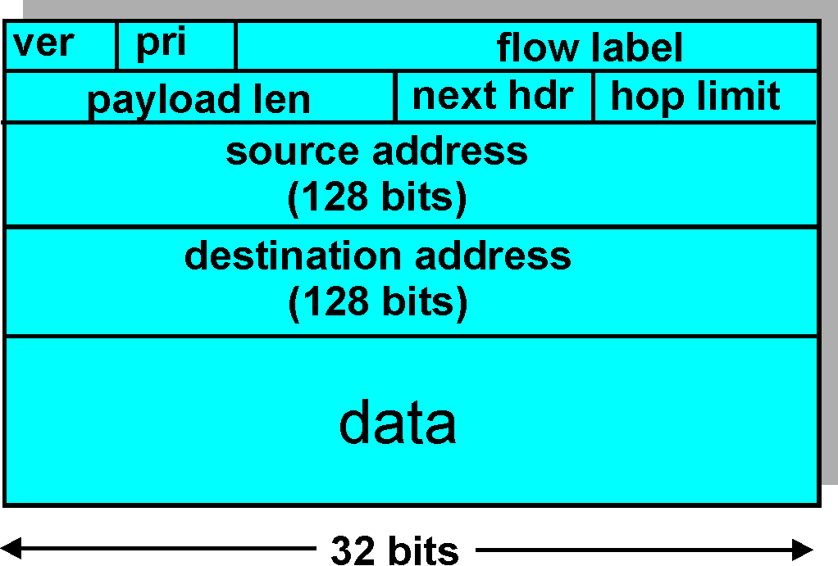
IPv6 Header (Cont)
Priority: identify priority among datagrams in flow
Flow Label: identify datagrams in same “flow.”
(concept of“flow” not well defined).
Next header: identify upper layer protocol for data

Slide 70
Other Changes from IPv4
Checksum: removed entirely to reduce processing time at each hop
Options: allowed, but outside of header, indicated by “Next Header” field
ICMPv6: new version of ICMP
additional message types, e.g. “Packet Too Big”
multicast group management functions

Slide 71
Transition From IPv4 To IPv6
Not all routers can be upgraded simultaneous
no “flag days”
How will the network operate with mixed IPv4 and IPv6 routers?
Tunneling: IPv6 carried as payload in IPv4 datagram among IPv4 routers

Slide 72
Tunneling
A
B
E
F
Logical view:
tunnel
IPv6
IPv6
IPv6
IPv6
A
B
E
F
Physical view:
IPv6
IPv6
IPv4
IPv4
IPv6
IPv6

Slide 73
Tunneling
A
B
E
F
Logical view:
tunnel
IPv6
IPv6
IPv6
IPv6
A
B
C
D
E
F
Physical view:
IPv6
IPv6
IPv4
IPv4
IPv6
IPv6
Flow: X
Src: A
Dest: F
data
Src:B
Dest: E
Src:B
Dest: E
Flow: X
Src: A
Dest: F
data
Flow: X
Src: A
Dest: F
data
Flow: X
Src: A
Dest: F
data
A-to-B:
IPv6
B-to-C:
IPv6 inside
IPv4
B-to-C:
IPv6 inside
IPv4
E-to-F:
IPv6

Slide 74
Chapter 4: Network Layer
4. 1 Introduction
4.2 Virtual circuit and datagram networks
4.3 What’s inside a router
4.4 IP: Internet Protocol
Datagram format
IPv4 addressing
ICMP
IPv6
4.5 Routing algorithms
Link state
Distance Vector
Hierarchical routing
4.6 Routing in the Internet
RIP
OSPF
BGP
4.7 Broadcast and multicast routing

Slide 75
Interplay between routing, forwarding
routing algorithm
local forwarding table
header value
output link
0100
0101
0111
1001
3
2
2
1
value in arriving
packet’s header
0111
1
3
2

Slide 76
Graph abstraction
5
v
3
w
2
5
u
2
1
z
3
1
2
x
y
1
Graph: G = (N,E)
N = set of routers = { u, v, w, x, y, z }
E = set of links ={ (u,v), (u,x), (v,x), (v,w), (x,w), (x,y), (w,y), (w,z), (y,z) }
Remark: Graph abstraction is useful in other network contexts
Example: P2P, where N is set of peers and E is set of TCP connections

Slide 77
Graph abstraction: costs
5
c(x,x’) = cost of link (x,x’)
- e.g., c(w,z) = 5
cost could always be 1, or
inversely related to bandwidth,
or inversely related to
congestion
v
3
w
2
5
u
2
1
z
3
1
2
x
y
1
Cost of path (x₁, x₂, x₃,…, x_{p}) = c(x₁,x₂) + c(x₂,x₃) + … + c(x_{p-1},x_{p})
Question: What’s the least-cost path between u and z ?
Routing algorithm: algorithm that finds least-cost path

Slide 78
Routing Algorithm classification
Global or decentralized information?
Global:
all routers have complete topology, link cost info
“link state” algorithms
Decentralized:
router knows physically-connected neighbors, link costs to neighbors
iterative process of computation, exchange of info with neighbors
“distance vector” algorithms
Static or dynamic?
Static:
routes change slowly over time
Dynamic:
routes change more quickly
periodic update
in response to link cost changes
Notes:
静态：火车运行图

Slide 79
Chapter 4: Network Layer
4. 1 Introduction
4.2 Virtual circuit and datagram networks
4.3 What’s inside a router
4.4 IP: Internet Protocol
Datagram format
IPv4 addressing
ICMP
IPv6
4.5 Routing algorithms
Link state
Distance Vector
Hierarchical routing
4.6 Routing in the Internet
RIP
OSPF
BGP
4.7 Broadcast and multicast routing

Slide 80
A Link-State Routing Algorithm
Dijkstra’s algorithm
net topology, link costs known to all nodes
accomplished via “link state broadcast”
all nodes have same info
computes least cost paths from one node (‘source”) to all other nodes
gives forwarding table for that node
iterative: after k iterations, know least cost path to k dest.’s
Notation:
c(x,y): link cost from node x to y; = ∞ if not direct neighbors
D(v): current value of cost of path from source to dest. v
p(v): predecessor node along path from source to v
N': set of nodes whose least cost path definitively known

Slide 81
Dijsktra’s Algorithm（题）
1 Initialization:
2 N' = {u}
3 for all nodes v
4 if v adjacent to u
5 then D(v) = c(u,v)
6 else D(v) = ∞
7
8 Loop
9 find w not in N' such that D(w) is a minimum
10 add w to N'
11 update D(v) for all v adjacent to w and not in N' :
12 D(v) = min( D(v), D(w) + c(w,v) )
13 /* new cost to v is either old cost to v or known
14 shortest path cost to w plus cost from w to v */
15 until all nodes in N'
Notes:
https://www.bilibili.com/video/BV1jE411W7tT

Slide 82
Dijkstra’s algorithm: example
Step
0
1
2
3
4
5
N'
u
ux
uxy
uxyv
uxyvw
uxyvwz
D(v),p(v)
2,u
2,u
2,u
D(w),p(w)
5,u
4,x
3,y
3,y
D(x),p(x)
1,u
D(y),p(y)
∞
2,x
D(z),p(z)
∞
∞
4,y
4,y
4,y
5
v
3
w
2
5
u
2
1
z
3
1
2
x
y
1
Notes:
表是怎么形成的
u为起点，找和u最近的，ux=1，所以是x，把x纳入u，构成一个集合。剩余点，和ux最近的是y或者v，u到x到y=2, u到v是2。这里选择把y，纳入ux组合。（当然可以把v加入，最终结果是一样的）
这个表形成之后，可以查询从u到其他所有点的最短路径
比如说 x 到 z，看最后一列，最小值是 4，y，说明是从y到的z，最短路径是4.
再看倒数第二列，是从x到的y，最短路是2
再看倒数第三列

Slide 83
Dijkstra’s algorithm: example (2)
Resulting shortest-path tree from u:
v
w
u
z
x
y
Resulting forwarding table in u:
destination
link
v
(u,v)
x
(u,x)
y
(u,x)
w
(u,x)
z
(u,x)

Slide 84
Dijkstra’s algorithm, discussion
Algorithm complexity: n nodes
each iteration: need to check all nodes, w, not in N
n(n+1)/2 comparisons: O(n²)
more efficient implementations possible: O(nlogn)
Oscillations possible:
e.g., link cost = amount of carried traffic
1
A
A
A
A
1+e
2+e
0
0
2+e
2+e
0
D
0
0
B
D
B
D
B
D
B
1+e
1
0
0
1+e
1
0
e
0
0
1
1+e
0
e
C
C
C
C
1
1
e
… recompute
routing
… recompute
… recompute
initially
Notes:
n+(n-1)+(n-2)+...+1=(n+1)*n/2
类比于高斯从1+到100
振荡：已承载的流量作为链路开销，则出现潮汐式流量，要么都挤过来，要么就空着

Slide 85
Chapter 4: Network Layer
4. 1 Introduction
4.2 Virtual circuit and datagram networks
4.3 What’s inside a router
4.4 IP: Internet Protocol
Datagram format
IPv4 addressing
ICMP
IPv6
4.5 Routing algorithms
Link state
Distance Vector
Hierarchical routing
4.6 Routing in the Internet
RIP
OSPF
BGP
4.7 Broadcast and multicast routing

Slide 86
Distance Vector Algorithm（题）
Bellman-Ford Equation (dynamic programming)
Define
d_{x}(y) := cost of least-cost path from x to y
Then
d_{x}(y) = min {c(x,v) + d_{v}(y) }
where min is taken over all neighbors v of x
v
Notes:
B-F算法，类似于Dij算法，但优势是可以处理负值权重的边，是一个递归算法。

Slide 87
Bellman-Ford example
5
Clearly, d_{v}(z) = 5, d_{x}(z) = 3, d_{w}(z) = 3
v
3
w
2
5
u
z
B-F equation says:
2
1
3
1
2
d_{u}(z) = min { c(u,v) + d_{v}(z),
c(u,x) + d_{x}(z),
c(u,w) + d_{w}(z) }
= min {2 + 5,
1 + 3,
5 + 3} = 4
x
y
1
Node that achieves minimum is next
hop in shortest path ➜ forwarding table
Notes:
dv(z) v-x-y-z 5
dx(z) x-y-z 3
dw(z) w-y-z 3
一切向前看，本页验证BF算法的成立

Slide 88
Distance Vector Algorithm
D_{x}(y) = estimate of least cost from x to y： D_{x}(y)≥ d_{x}(y)
Node x knows cost to each neighbor v: c(x,v)
Node x maintains distance vector D_{x} = [D_{x}(y): y є N ]
Node x also maintains its neighbors’ distance vectors
For each neighbor v, x maintains D_{v} = [D_{v}(y): y є N ]
Notes:
我知道自己的密友，我还知道自己密友的密友
举例：o可以分别通过x和y到达z，o会比较通过x或y，谁到达z的距离更短。货比三家，再做决定

Slide 89
Distance vector algorithm (4)
Basic idea:
From time-to-time, each node sends its own distance vector estimate to neighbors
Asynchronous
When a node x receives new DV estimate from neighbor, it updates its own DV using B-F equation:
D_{x}(y) ← min_{v}{c(x,v) + D_{v}(y)} for each node y ∊ N
Under minor, natural conditions, the estimate D_{x}(y) converge to the actual least cost d_{x}(y)
Notes:
对于x来说，他的邻居v，告诉了他（x）关于v到y的距离向量（路径代价）的变化，x就根据x到v的成本，加上更新后的v到y的成本，重新计算x到y的成本
苟日新，日日新，又日新

Slide 90
Distance Vector Algorithm (5)
Iterative, asynchronous: each local iteration caused by:
local link cost change
DV update message from neighbor
Distributed:
each node notifies neighbors only when its DV changes
neighbors then notify their neighbors if necessary
Each node:
wait for (change in local link cost or msg from neighbor)
recompute estimates
if DV to any dest has changed, notify neighbors

Slide 91
D_{x}(y) = min{c(x,y) + D_{y}(y), c(x,z) + D_{z}(y)} = min{2+0 , 7+1} = 2
D_{x}(z) = min{c(x,y) + D_{y}(z), c(x,z) + D_{z}(z)}
= min{2+1 , 7+0} = 3
node x table
cost to
cost to
x y z
x y z
x
0 2 7
x
0
2
3
y
y
from
∞
∞
∞
from
2 0 1
z
∞
∞
∞
z
7 1 0
node y table
cost to
x y z
y
2
1
x
∞
∞
z
∞
2 0 1
x
y
7
from
z
∞
∞
∞
node z table
cost to
x y z
x
∞ ∞ ∞
y
from
∞
∞
∞
z
7
1
0
time
Notes:
先看左上，再看左中，再看中上，更新 x-y x-z的距离，随着左中信息的加入，x-z的距离发生了变化，由7变3
再看左下，再看中上，更新 x-y x-z的距离，随着左下信息的加入，距离最小值没有发生变化

Slide 92
D_{x}(y) = min{c(x,y) + D_{y}(y), c(x,z) + D_{z}(y)} = min{2+0 , 7+1} = 2
D_{x}(z) = min{c(x,y) + D_{y}(z), c(x,z) + D_{z}(z)}
= min{2+1 , 7+0} = 3
node x table
cost to
cost to
cost to
x y z
x y z
x y z
x
0 2 7
x
0 2 3
x
0 2 3
y
y
from
∞
∞
∞
from
2 0 1
y
from
2 0 1
z
∞
∞
∞
z
7 1 0
z
3 1 0
node y table
cost to
cost to
cost to
x y z
x y z
x y z
y
2
1
x
∞
∞
x
0 2 7
z
∞
2 0 1
x
0 2 3
x
y
y
7
from
from
2 0 1
y
from
2 0 1
z
∞
∞
∞
z
7 1 0
z
3 1 0
node z table
cost to
cost to
cost to
x y z
x y z
x y z
x
∞ ∞ ∞
x
0 2 7
x
0 2 3
y
y
2 0 1
y
from
2 0 1
from
from
∞
∞
∞
z
z
3 1 0
z
3 1 0
7
1
0
time
Notes:
随着时间的演进，左上左中的信息加入进中下，中下的表发生了变化，z-x的距离由7变为3
最后形成对称矩阵

Slide 93
Distance Vector: link cost changes
Link cost changes:
node detects local link cost change
updates routing info, recalculates distance vector
if DV changes, notify neighbors
1
y
4
1
x
z
50
At time t₀, y detects the link-cost change, updates its DV,
and informs its neighbors.
“good
news
travels
fast”
At time t₁, z receives the update from y and updates its table.
It computes a new least cost to x and sends its neighbors its DV.
At time t₂, y receives z’s update and updates its distance table.
y’s least costs do not change and hence y does not send any
message to z.
Notes:
setting ：y和z分别计算到x的路由
好事传千里
过程的开始：1 y检测到链路变化，y重新计算到x的路由，2 y告诉z z重新计算到x的路由 3 z告诉y

Slide 94
Distance Vector: link cost changes
Link cost changes:
good news travels fast
bad news travels slow - “count to infinity” problem!
44 iterations before algorithm stabilizes: see text
Poisoned reverse:
If Z routes through Y to get to X :
Z tells Y its (Z’s) distance to X is infinite (so Y won’t route to X via Z)
will this completely solve count to infinity problem?
60
y
4
1
x
z
50
Notes:
坏消息传的慢，因此收敛的很慢
1 y检测到链路变化 4-》60 y重新计算到x的路由，min（60,6）6是因为z之前告诉y的：z可以通过z-y-x=1+4=5 所以y到x可以用y-z-y-x=6 这样就形成黑洞 y-z z又发回给y
2 接下来y将y-x是6的“事实”告诉z，z又更新，min（50,7）
3 以此类推 每轮增加1，6-7-8-...-50，所以是44轮
计数到无穷

Slide 95
Comparison of LS and DV algorithms
Message complexity
LS: with n nodes, E links, O(nE) msgs sent
DV: exchange between neighbors only
convergence time varies
Speed of Convergence
LS: O(n²) algorithm requires O(nE) msgs
may have oscillations
DV: convergence time varies
may be routing loops
count-to-infinity problem
Robustness: what happens if router malfunctions?
LS:
node can advertise incorrect link cost
each node computes only its own table
DV:
DV node can advertise incorrect path cost
each node’s table used by others
error propagate thru network
Notes:
LS更健壮 DV的属性要看情况
LS和DV的主要区别来自于输入：一个是输入网络拓扑，一个是输入邻居的路由表

Slide 96
Chapter 4: Network Layer
4. 1 Introduction
4.2 Virtual circuit and datagram networks
4.3 What’s inside a router
4.4 IP: Internet Protocol
Datagram format
IPv4 addressing
ICMP
IPv6
4.5 Routing algorithms
Link state
Distance Vector
Hierarchical routing
4.6 Routing in the Internet
RIP
OSPF
BGP
4.7 Broadcast and multicast routing

Slide 97
Hierarchical Routing
Our routing study thus far - idealization
all routers identical
network “flat”
… not true in practice
scale: with 200 million destinations:
can’t store all dest’s in routing tables!
routing table exchange would swamp links!
administrative autonomy
internet = network of networks
each network admin may want to control routing in its own network
Notes:
类比于NAT进行理解，都是一簇有个簇头

Slide 98
Hierarchical Routing
aggregate routers into regions, “autonomous systems” (AS)
routers in same AS run same routing protocol
“intra-AS” routing protocol
routers in different AS can run different intra-AS routing protocol
Gateway router
Direct link to router in another AS

Slide 99
Interconnected ASes
3c
3a
2c
3b
2a
AS3
2b
1c
AS2
1a
1b
1d
AS1
forwarding table configured by both intra- and inter-AS routing algorithm
intra-AS sets entries for internal dests
inter-AS & intra-As sets entries for external dests
Intra-AS
Routing
algorithm
Inter-AS
Routing
algorithm
Forwarding
table

Slide 100
Inter-AS tasks
AS1 must:
learn which dests are reachable through AS2, which through AS3
propagate this reachability info to all routers in AS1
Job of inter-AS routing!
suppose router in AS1 receives datagram destined outside of AS1:
router should forward packet to gateway router, but which one?
3c
3a
2c
3b
2a
AS3
2b
1c
AS2
1a
1b
1d
AS1

Slide 101
Example: Setting forwarding table in router 1d
suppose AS1 learns (via inter-AS protocol) that subnet x reachable via AS3 (gateway 1c) but not via AS2.
inter-AS protocol propagates reachability info to all internal routers.
router 1d determines from intra-AS routing info that its interface I is on the least cost path to 1c.
installs forwarding table entry (x,I)
…
x
3c
3a
2c
3b
2a
AS3
2b
1c
AS2
1a
1b
1d
AS1

Slide 102
Example: Choosing among multiple ASes
now suppose AS1 learns from inter-AS protocol that subnet x is reachable from AS3 and from AS2.
to configure forwarding table, router 1d must determine towards which gateway it should forward packets for dest x.
this is also job of inter-AS routing protocol!
…
…
x
3c
3a
2c
3b
2a
AS3
2b
1c
AS2
1a
1b
1d
AS1

Slide 103
Example: Choosing among multiple ASes
now suppose AS1 learns from inter-AS protocol that subnet x is reachable from AS3 and from AS2.
to configure forwarding table, router 1d must determine towards which gateway it should forward packets for dest x.
this is also job of inter-AS routing protocol!
hot potato routing: send packet towards closest of two routers.
Use routing info
from intra-AS
protocol to determine
costs of least-cost
paths to each
of the gateways
Determine from
forwarding table the
interface I that leads
to least-cost gateway.
Enter (x,I) in
forwarding table
Learn from inter-AS
protocol that subnet
x is reachable via
multiple gateways
Hot potato routing:
Choose the gateway
that has the
smallest least cost

Slide 104
Chapter 4: Network Layer
4. 1 Introduction
4.2 Virtual circuit and datagram networks
4.3 What’s inside a router
4.4 IP: Internet Protocol
Datagram format
IPv4 addressing
ICMP
IPv6
4.5 Routing algorithms
Link state
Distance Vector
Hierarchical routing
4.6 Routing in the Internet
RIP
OSPF
BGP
4.7 Broadcast and multicast routing

Slide 105
Intra-AS Routing
also known as Interior Gateway Protocols (IGP)
most common Intra-AS routing protocols:
RIP: Routing Information Protocol
OSPF: Open Shortest Path First
IGRP: Interior Gateway Routing Protocol (Cisco proprietary)

Slide 106
Chapter 4: Network Layer
4. 1 Introduction
4.2 Virtual circuit and datagram networks
4.3 What’s inside a router
4.4 IP: Internet Protocol
Datagram format
IPv4 addressing
ICMP
IPv6
4.5 Routing algorithms
Link state
Distance Vector
Hierarchical routing
4.6 Routing in the Internet
RIP
OSPF
BGP
4.7 Broadcast and multicast routing

Slide 107
RIP ( Routing Information Protocol)
distance vector algorithm
included in BSD-UNIX Distribution in 1982
distance metric: # of hops (max = 15 hops)
From router A to subnets:
u
v
destination hops
u 1
v 2
w 2
x 3
y 3
z 2
A
B
w
x
z
C
D
y

Slide 108
RIP advertisements
distance vectors: exchanged among neighbors every 30 sec via Response Message (also called advertisement)
each advertisement: list of up to 25 destination subnets within AS

Slide 109
RIP: Example(略)
z
w
x
y
A
D
B
C
Destination Network Next Router Num. of hops to dest.
w A 2
y B 2
z B 7
x -- 1
…. …. ....
Routing/Forwarding table in D

Slide 110
RIP: Example
Dest Next hops
w - 1
x - 1
z C 4
…. … ...
Advertisement
from A to D
z
w
x
y
A
D
B
C
Destination Network Next Router Num. of hops to dest.
w A 2
y B 2
z B A 7 5
x -- 1
…. …. ....
Routing/Forwarding table in D

Slide 111
RIP: Link Failure and Recovery（略）
If no advertisement heard after 180 sec --> neighbor/link declared dead
routes via neighbor invalidated
new advertisements sent to neighbors
neighbors in turn send out new advertisements (if tables changed)
link failure info quickly (?) propagates to entire net
poison reverse used to prevent ping-pong loops (infinite distance = 16 hops)

Slide 112
RIP Table processing
RIP routing tables managed by application-level process called route-d (daemon)
advertisements sent in UDP packets, periodically repeated
routed
routed
Transprt
(UDP)
Transprt
(UDP)
network forwarding
(IP) table
network
(IP)
forwarding
table
link
link
physical
physical

Slide 113
Chapter 4: Network Layer
4. 1 Introduction
4.2 Virtual circuit and datagram networks
4.3 What’s inside a router
4.4 IP: Internet Protocol
Datagram format
IPv4 addressing
ICMP
IPv6
4.5 Routing algorithms
Link state
Distance Vector
Hierarchical routing
4.6 Routing in the Internet
RIP
OSPF
BGP
4.7 Broadcast and multicast routing

Slide 114
OSPF (Open Shortest Path First)
“open”: publicly available
uses Link State algorithm
LS packet dissemination
topology map at each node
route computation using Dijkstra’s algorithm
OSPF advertisement carries one entry per neighbor router
advertisements disseminated to entire AS (via flooding)
carried in OSPF messages directly over IP (rather than TCP or UDP
Notes:
和RIP的区别是，度量指标不只是跳数

Slide 115
OSPF “advanced” features (not in RIP)
security: all OSPF messages authenticated (to prevent malicious intrusion)
multiple same-cost paths allowed (only one path in RIP)
For each link, multiple cost metrics for different TOS (e.g., satellite link cost set “low” for best effort; high for real time)
integrated uni- and multicast support:
Multicast OSPF (MOSPF) uses same topology data base as OSPF
hierarchical OSPF in large domains.

Slide 116
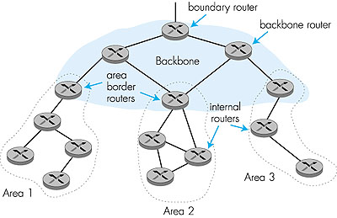
Hierarchical OSPF

Slide 117
Hierarchical OSPF
two-level hierarchy: local area, backbone.
Link-state advertisements only in area
each nodes has detailed area topology; only know direction (shortest path) to nets in other areas.
area border routers: “summarize” distances to nets in own area, advertise to other Area Border routers.
backbone routers: run OSPF routing limited to backbone.
boundary routers: connect to other AS’s.

Slide 118
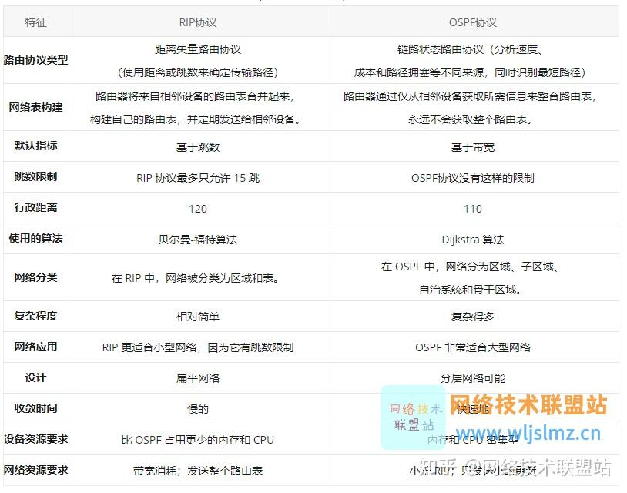

Slide 119
Chapter 4: Network Layer
4. 1 Introduction
4.2 Virtual circuit and datagram networks
4.3 What’s inside a router
4.4 IP: Internet Protocol
Datagram format
IPv4 addressing
ICMP
IPv6
4.5 Routing algorithms
Link state
Distance Vector
Hierarchical routing
4.6 Routing in the Internet
RIP
OSPF
BGP
4.7 Broadcast and multicast routing

Slide 120
Internet inter-AS routing: BGP
BGP (Border Gateway Protocol): the de facto standard
BGP provides each AS a means to:
Obtain subnet reachability information from neighboring ASs.
Propagate reachability information to all AS-internal routers.
Determine “good” routes to subnets based on reachability information and policy.
allows subnet to advertise its existence to rest of Internet: “I am here”
Notes:
de facto 实际上的

Slide 121
BGP basics
pairs of routers (BGP peers) exchange routing info over semi-permanent TCP connections: BGP sessions
BGP sessions need not correspond to physical links.
when AS2 advertises a prefix to AS1:
AS2 promises it will forward datagrams towards that prefix.
AS2 can aggregate prefixes in its advertisement
eBGP session
3c
iBGP session
2c
3a
3b
2a
AS3
2b
1c
AS2
1a
1b
AS1
1d
Notes:
以3c--2b举例，说明3c-3a-1c-1b-2a-2b，每个节点都通知上一节点自己的路由前缀是多少

Slide 122
Distributing reachability info
using eBGP session between 3a and 1c, AS3 sends prefix reachability info to AS1.
1c can then use iBGP do distribute new prefix info to all routers in AS1
1b can then re-advertise new reachability info to AS2 over 1b-to-2a eBGP session
when router learns of new prefix, it creates entry for prefix in its forwarding table.
eBGP session
3c
iBGP session
2c
3a
3b
2a
AS3
2b
1c
AS2
1a
1b
AS1
1d

Slide 123
Path attributes & BGP routes
advertised prefix includes BGP attributes.
prefix + attributes = “route”
two important attributes:
AS-PATH: contains ASs through which prefix advertisement has passed: e.g, AS 67, AS 17
NEXT-HOP: indicates specific internal-AS router to next-hop AS. (may be multiple links from current AS to next-hop-AS)
when gateway router receives route advertisement, uses import policy to accept/decline.
Notes:
两个属性：
宏观属性：AS-PATH
围观属性：NEXT-HOP

Slide 124
BGP route selection（以后略 ）
router may learn about more than 1 route to some prefix. Router must select route.
elimination rules:
local preference value attribute: policy decision
shortest AS-PATH
closest NEXT-HOP router: hot potato routing
additional criteria

Slide 125
BGP messages
BGP messages exchanged using TCP.
BGP messages:
OPEN: opens TCP connection to peer and authenticates sender
UPDATE: advertises new path (or withdraws old)
KEEPALIVE keeps connection alive in absence of UPDATES; also ACKs OPEN request
NOTIFICATION: reports errors in previous msg; also used to close connection

Slide 126
BGP routing policy
legend:
provider
B
network
X
W
A
customer
C
network:
Y
A,B,C are provider networks
X,W,Y are customer (of provider networks)
X is dual-homed: attached to two networks
X does not want to route from B via X to C
.. so X will not advertise to B a route to C

Slide 127
BGP routing policy (2)
legend:
provider
B
network
X
W
A
customer
C
network:
Y
A advertises path AW to B
B advertises path BAW to X
Should B advertise path BAW to C?
No way! B gets no “revenue” for routing CBAW since neither W nor C are B’s customers
B wants to force C to route to w via A
B wants to route only to/from its customers!

Slide 128
Why different Intra- and Inter-AS routing ?
Policy:
Inter-AS: admin wants control over how its traffic routed, who routes through its net.
Intra-AS: single admin, so no policy decisions needed
Scale:
hierarchical routing saves table size, reduced update traffic
Performance:
Intra-AS: can focus on performance
Inter-AS: policy may dominate over performance

Slide 129
Chapter 4: Network Layer
4. 1 Introduction
4.2 Virtual circuit and datagram networks
4.3 What’s inside a router
4.4 IP: Internet Protocol
Datagram format
IPv4 addressing
ICMP
IPv6
4.5 Routing algorithms
Link state
Distance Vector
Hierarchical routing
4.6 Routing in the Internet
RIP
OSPF
BGP
4.7 Broadcast and multicast routing

Slide 130
Broadcast Routing
deliver packets from source to all other nodes
source duplication is inefficient:
duplicate
duplicate
creation/transmission
R1
R1
duplicate
R2
R2
R3
R4
R3
R4
source duplication
in-network
duplication
source duplication: how does source determine recipient addresses?

Slide 131
In-network duplication
flooding: when node receives brdcst pckt, sends copy to all neighbors
Problems: cycles & broadcast storm
controlled flooding: node only brdcsts pkt if it hasn’t brdcst same packet before
Node keeps track of pckt ids already brdcsted
Or reverse path forwarding (RPF): only forward pckt if it arrived on shortest path between node and source
spanning tree
No redundant packets received by any node

Slide 132
Spanning Tree
First construct a spanning tree
Nodes forward copies only along spanning tree
A
A
B
B
c
c
D
D
F
E
F
E
G
G
(a) Broadcast initiated at A
(b) Broadcast initiated at D

Slide 133
Spanning Tree: Creation
Center node
Each node sends unicast join message to center node
Message forwarded until it arrives at a node already belonging to spanning tree
A
A
3
B
B
c
c
4
2
D
D
F
E
F
E
1
5
G
G
Stepwise construction of spanning tree
(b) Constructed spanning tree

Slide 134
Multicast Routing: Problem Statement
Goal: find a tree (or trees) connecting routers having local mcast group members
tree: not all paths between routers used
source-based: different tree from each sender to rcvrs
shared-tree: same tree used by all group members
Shared tree
Source-based trees
Notes:
Notes:
3.3 Network Layer: Multicast Routing Algorithms 3-9

Slide 135
Approaches for building mcast trees
Approaches:
source-based tree: one tree per source
shortest path trees
reverse path forwarding
group-shared tree: group uses one tree
minimal spanning (Steiner)
center-based trees
…we first look at basic approaches, then specific protocols adopting these approaches
Notes:
Notes:
3.3 Network Layer: Multicast Routing Algorithms 3-11

Slide 136
Shortest Path Tree
mcast forwarding tree: tree of shortest path routes from source to all receivers
Dijkstra’s algorithm
S: source
LEGEND
R1
2
1
R4
router with attached
group member
R2
5
3
router with no attached
group member
4
R5
R3
6
i
link used for forwarding,
i indicates order link
added by algorithm
R6
R7
Notes:
Notes:
3.3 Network Layer: Multicast Routing Algorithms 3-12

Slide 137
Reverse Path Forwarding
rely on router’s knowledge of unicast shortest path from it to sender
each router has simple forwarding behavior:
if (mcast datagram received on incoming link on shortest path back to center)
then flood datagram onto all outgoing links
else ignore datagram
Notes:
Notes:
3.3 Network Layer: Multicast Routing Algorithms 3-13

Slide 138
Reverse Path Forwarding: example
S: source
LEGEND
R1
R4
router with attached
group member
R2
router with no attached
group member
R5
R3
datagram will be forwarded
R6
R7
datagram will not be
forwarded
result is a source-specific reverse SPT
may be a bad choice with asymmetric links
Notes:
Notes:
3.3 Network Layer: Multicast Routing Algorithms 3-14

Slide 139
Reverse Path Forwarding: pruning
forwarding tree contains subtrees with no mcast group members
no need to forward datagrams down subtree
“prune” msgs sent upstream by router with no downstream group members
S: source
LEGEND
R1
router with attached
group member
R4
R2
router with no attached
group member
P
R5
P
prune message
R3
P
links with multicast
forwarding
R6
R7
Notes:
Notes:
3.3 Network Layer: Multicast Routing Algorithms 3-15

Slide 140
Shared-Tree: Steiner Tree
Steiner Tree: minimum cost tree connecting all routers with attached group members
problem is NP-complete
excellent heuristics exists
not used in practice:
computational complexity
information about entire network needed
monolithic: rerun whenever a router needs to join/leave
Notes:
Notes:
1. See L. Wei and D. Estrin, “A Comparison of multicast trees and algorithms,” TR USC-CD-93-560, Dept. Computer Science, University of California, Sept 1993 for a comparison of heuristic approaches.
3.3 Network Layer: Multicast Routing Algorithms 3-16

Slide 141
Center-based trees
single delivery tree shared by all
one router identified as “center” of tree
to join:
edge router sends unicast join-msg addressed to center router
join-msg “processed” by intermediate routers and forwarded towards center
join-msg either hits existing tree branch for this center, or arrives at center
path taken by join-msg becomes new branch of tree for this router
Notes:
Notes:
1. It’s always nice to see a PhD dissertation with impact. The earliest discussion of center-based trees for multicast appears to be D. Wall, “Mechanisms for Broadcast and Selective Broadcast,” PhD dissertation, Stanford U., June 1980.
3.3 Network Layer: Multicast Routing Algorithms 3-17

Slide 142
Center-based trees: an example
Suppose R6 chosen as center:
LEGEND
R1
router with attached
group member
R4
3
R2
router with no attached
group member
2
R5
1
path order in which join messages generated
R3
1
R6
R7
Notes:
Notes:
3.3 Network Layer: Multicast Routing Algorithms 3-18

Slide 143
Internet Multicasting Routing: DVMRP
DVMRP: distance vector multicast routing protocol, RFC1075
flood and prune: reverse path forwarding, source-based tree
RPF tree based on DVMRP’s own routing tables constructed by communicating DVMRP routers
no assumptions about underlying unicast
initial datagram to mcast group flooded everywhere via RPF
routers not wanting group: send upstream prune msgs
Notes:
Notes:
D. Waitzman, S. Deering, C. Partridge, “Distance Vector Multicast Routing Protocol,” RFC 1075, Nov. 1988. The version of DVMRP in use today is considerably enhanced over the RFC1075 spec.
A more up-to-date “work-in-progress” defines a version 3 of DVMRP: T. Pusateri, “Distance Vector Multicast Routing Protocol,” work-in-progress, draft-ietf-idmr-v3-05.ps
3.4 Network Layer: Internet Multicast Routing Algorithms 3-20

Slide 144
DVMRP: continued…
soft state: DVMRP router periodically (1 min.) “forgets” branches are pruned:
mcast data again flows down unpruned branch
downstream router: reprune or else continue to receive data
routers can quickly regraft to tree
following IGMP join at leaf
odds and ends
commonly implemented in commercial routers
Mbone routing done using DVMRP
Notes:
Notes:
1. See www.mbone.com/mbone/routers.html for a (slightly outdatet) list of multicast capable routers (supporting DVMPR as well as other protocols) from various vendors.
2. ftp://parcftp.xerox.com/pub/net-research/ipmulti for circa 1996 public copy “mrouted” v3.8 of DVMRP routing software for various workstation routing platforms.
3.4 Network Layer: Internet Multicast Routing Algorithms 3-21

Slide 145
Tunneling
Q: How to connect “islands” of multicast routers in a “sea” of unicast routers?
physical topology
logical topology
mcast datagram encapsulated inside “normal” (non-multicast-addressed) datagram
normal IP datagram sent thru “tunnel” via regular IP unicast to receiving mcast router
receiving mcast router unencapsulates to get mcast datagram
Notes:
Notes:
For a general discussion of IP encapsulation, see C. Perkins, “IP Encapsulation within IP,” RFC 2003, Oct. 1996.
The book S. Bradner, A Mankin, “Ipng: Internet protocol next generation,” Addison Wesley, 1995 has a very nice discussion of tunneling
Tunneling can also be used to connect islands of IPv6 capable routers in a sea IPv4 capable routers. The long term hope is that the sea evaporates leaving only lands of IPv6!
3.4 Network Layer: Internet Multicast Routing Algorithms 3-22

Slide 146
PIM: Protocol Independent Multicast
not dependent on any specific underlying unicast routing algorithm (works with all)
two different multicast distribution scenarios :
Dense:
group members densely packed, in “close” proximity.
bandwidth more plentiful
Sparse:
# networks with group members small wrt # interconnected networks
group members “widely dispersed”
bandwidth not plentiful
Notes:
Notes:
a very readable discussion of the PIM architecture is S. Deering, D. Estrin, D. Faranacci, V. Jacobson, C. Liu, L. Wei, “The PIM Architecture for Wide Area Multicasting,” IEEE/ACM Transactions on Networking, Vol. 4, No. 2, April 1996.
D. Estrin et al, PIM-SM: Protocol Specification, RFC 2117, June 1997
S. Deering et al, PIM Version 2, Dense Mode Specification, work in progress, draft-ietf-idmr-pim-dm-05.txt
PIM is implemented in Cisco routers and has been deployed in UUnet as part of their streaming multimedia delivery effort. See S. LaPolla, “IP Multicast makes headway among ISPs,” PC Week On-Line, http://www.zdnet.com/pcweek/news/1006/06isp.html
3.4 Network Layer: Internet Multicast Routing Algorithms 3-25

Slide 147
Consequences of Sparse-Dense Dichotomy:
Dense
group membership by routers assumed until routers explicitly prune
data-driven construction on mcast tree (e.g., RPF)
bandwidth and non-group-router processing profligate
Sparse:
no membership until routers explicitly join
receiver- driven construction of mcast tree (e.g., center-based)
bandwidth and non-group-router processing conservative
Notes:
Notes:
3.4 Network Layer: Internet Multicast Routing Algorithms 3-26

Slide 148
PIM- Dense Mode
flood-and-prune RPF, similar to DVMRP but
underlying unicast protocol provides RPF info for incoming datagram
less complicated (less efficient) downstream flood than DVMRP reduces reliance on underlying routing algorithm
has protocol mechanism for router to detect it is a leaf-node router
Notes:
Notes:
3.4 Network Layer: Internet Multicast Routing Algorithms 3-27

Slide 149
PIM - Sparse Mode
center-based approach
router sends join msg to rendezvous point (RP)
intermediate routers update state and forward join
after joining via RP, router can switch to source-specific tree
increased performance: less concentration, shorter paths
R1
R4
join
R2
join
R5
join
R3
R7
R6
all data multicast
from rendezvous
point
rendezvous
point
Notes:
Notes:
3.4 Network Layer: Internet Multicast Routing Algorithms 3-28

Slide 150
PIM - Sparse Mode
sender(s):
unicast data to RP, which distributes down RP-rooted tree
RP can extend mcast tree upstream to source
RP can send stop msg if no attached receivers
“no one is listening!”
R1
R4
join
R2
join
R5
join
R3
R7
R6
all data multicast
from rendezvous
point
rendezvous
point
Notes:
Notes:
3.4 Network Layer: Internet Multicast Routing Algorithms 3-29

Slide 151
Chapter 4: summary
4. 1 Introduction
4.2 Virtual circuit and datagram networks
4.3 What’s inside a router
4.4 IP: Internet Protocol
Datagram format
IPv4 addressing
ICMP
IPv6
4.5 Routing algorithms
Link state
Distance Vector
Hierarchical routing
4.6 Routing in the Internet
RIP
OSPF
BGP
4.7 Broadcast and multicast routing

