Slide 1

Chapter 6 Wireless and Mobile Networks
A note on the use of these ppt slides:
We’re making these slides freely available to all (faculty, students, readers). They’re in PowerPoint form so you can add, modify, and delete slides (including this one) and slide content to suit your needs. They obviously represent a lot of work on our part. In return for use, we only ask the following:
If you use these slides (e.g., in a class) in substantially unaltered form, that you mention their source (after all, we’d like people to use our book!)
If you post any slides in substantially unaltered form on a www site, that you note that they are adapted from (or perhaps identical to) our slides, and note our copyright of this material.
Thanks and enjoy! JFK/KWR
All material copyright 1996-2009
J.F Kurose and K.W. Ross, All Rights Reserved
Computer Networking: A Top Down Approach 5th edition. Jim Kurose, Keith Ross Addison-Wesley, April 2009.

Slide 2
Chapter 6: Wireless and Mobile Networks
Background:
# wireless (mobile) phone subscribers now exceeds # wired phone subscribers!
computer nets: laptops, palmtops, PDAs, Internet-enabled phone promise anytime untethered Internet access
two important (but different) challenges
wireless: communication over wireless link
mobility: handling the mobile user who changes point of attachment to network

Slide 3
Chapter 6 outline
6.1 Introduction
Wireless
6.2 Wireless links, characteristics
CDMA
6.3 IEEE 802.11 wireless LANs (“wi-fi”)
6.4 Cellular Internet Access
architecture
standards (e.g., GSM)
Mobility
6.5 Principles: addressing and routing to mobile users
6.6 Mobile IP
6.7 Handling mobility in cellular networks
6.8 Mobility and higher-layer protocols
6.9 Summary

Slide 4
Elements of a wireless network
wireless hosts
laptop, PDA, IP phone
run applications
may be stationary (non-mobile) or mobile
wireless does not always mean mobility
network
infrastructure

Slide 5
Elements of a wireless network
base station
typically connected to wired network
relay - responsible for sending packets between wired network and wireless host(s) in its “area”
e.g., cell towers, 802.11 access points
network
infrastructure
Notes:
relay 中继

Slide 6
Elements of a wireless network
wireless link
typically used to connect mobile(s) to base station
also used as backbone link
multiple access protocol coordinates link access
various data rates, transmission distance
network
infrastructure

Slide 7
Characteristics of selected wireless link standards
200
802.11n
54
802.11a,g
802.11a,g point-to-point
data
5-11
802.11b
802.16 (WiMAX)
4
UMTS/WCDMA-HSPDA, CDMA2000-1xEVDO
3G cellular
enhanced
Data rate (Mbps)
1
802.15
.384
UMTS/WCDMA, CDMA2000
3G
.056
IS-95, CDMA, GSM
2G
Indoor
10-30m
Outdoor
50-200m
Mid-range
outdoor
200m – 4 Km
Long-range
outdoor
5Km – 20 Km

Slide 8
Elements of a wireless network（题）
infrastructure mode
base station connects mobiles into wired network
handoff: mobile changes base station providing connection into wired network
network
infrastructure

Slide 9
Elements of a wireless network
ad hoc mode
no base stations
nodes can only transmit to other nodes within link coverage
nodes organize themselves into a network: route among themselves

Slide 10
Wireless network taxonomy_T
single hop
multiple hops
host connects to
base station (WiFi,
WiMAX, cellular)
which connects to
larger Internet
host may have to
relay through several
wireless nodes to
connect to larger
Internet: mesh net
infrastructure
(e.g., APs)
no base station, no
connection to larger
Internet. May have to
relay to reach other
a given wireless node
MANET, VANET
no
infrastructure
no base station, no
connection to larger
Internet (Bluetooth,
ad hoc nets)

Slide 11
Wireless Link Characteristics (1)_T
Differences from wired link ….
decreased signal strength: radio signal attenuates as it propagates through matter (path loss)
interference from other sources: standardized wireless network frequencies (e.g., 2.4 GHz) shared by other devices (e.g., phone); devices (motors) interfere as well
multipath propagation: radio signal reflects off objects ground, arriving at destination at slightly different times
…. make communication across (even a point to point) wireless link much more “difficult”

Slide 12
Wireless Link Characteristics (2)
SNR: signal-to-noise ratio
larger SNR – easier to extract signal from noise (a “good thing”)
SNR versus BER tradeoffs
given physical layer: increase power -> increase SNR->decrease BER
given SNR: choose physical layer that meets BER requirement, giving highest thruput
SNR may change with mobility: dynamically adapt physical layer (modulation technique, rate)
10⁻¹
10⁻²
10⁻³
BER
10⁻⁴
10⁻⁵
10⁻⁶
10⁻⁷
10
20
30
40
SNR(dB)
QAM256 (8 Mbps)
QAM16 (4 Mbps)
BPSK (1 Mbps)

Slide 13
Wireless network characteristics
Multiple wireless senders and receivers create additional problems (beyond multiple access):
A
B
C
C
A’s signal
strength
C’s signal
strength
B
A
Hidden terminal problem
B, A hear each other
B, C hear each other
A, C can not hear each other
means A, C unaware of their interference at B
space
Signal attenuation:
B, A hear each other
B, C hear each other
A, C can not hear each other interfering at B

Slide 14
Code Division Multiple Access (CDMA)
used in several wireless broadcast channels (cellular, satellite, etc) standards
unique “code” assigned to each user; i.e., code set partitioning
all users share same frequency, but each user has own “chipping” sequence (i.e., code) to encode data
encoded signal = (original data) X (chipping sequence)
decoding: inner-product of encoded signal and chipping sequence
allows multiple users to “coexist” and transmit simultaneously with minimal interference (if codes are “orthogonal”)

Slide 15
CDMA Encode/Decode
channel output Z_{i,m}
Z_{i,m}= d_{i}.c_{m}
data
bits
d₀ = 1
1
1
1
1
1
d₁ = -1
1
1
1
-
-
-
-
1
-
-
-
1
-
1
1
1
1
1
sender
1
1
slot 1
channel
output
slot 0
channel
output
1
1
1
1
1
code
1
1
-
-
-
1
-
1
1
1
-
-
-
1
-
1
1
1
slot 1
slot 0
M
D_{i} = Σ Z_{i,m}.c_{m}
m=1
M
received
input
1
1
1
1
1
1
1
1
d₀ = 1
-
-
-
-
1
-
-
-
1
-
1
1
1
1
1
1
d₁ = -1
1
slot 1
channel
output
slot 0
channel
output
1
1
1
1
1
code
1
1
-
-
-
1
-
1
1
1
-
-
-
1
-
1
1
1
receiver
slot 1
slot 0

Slide 16
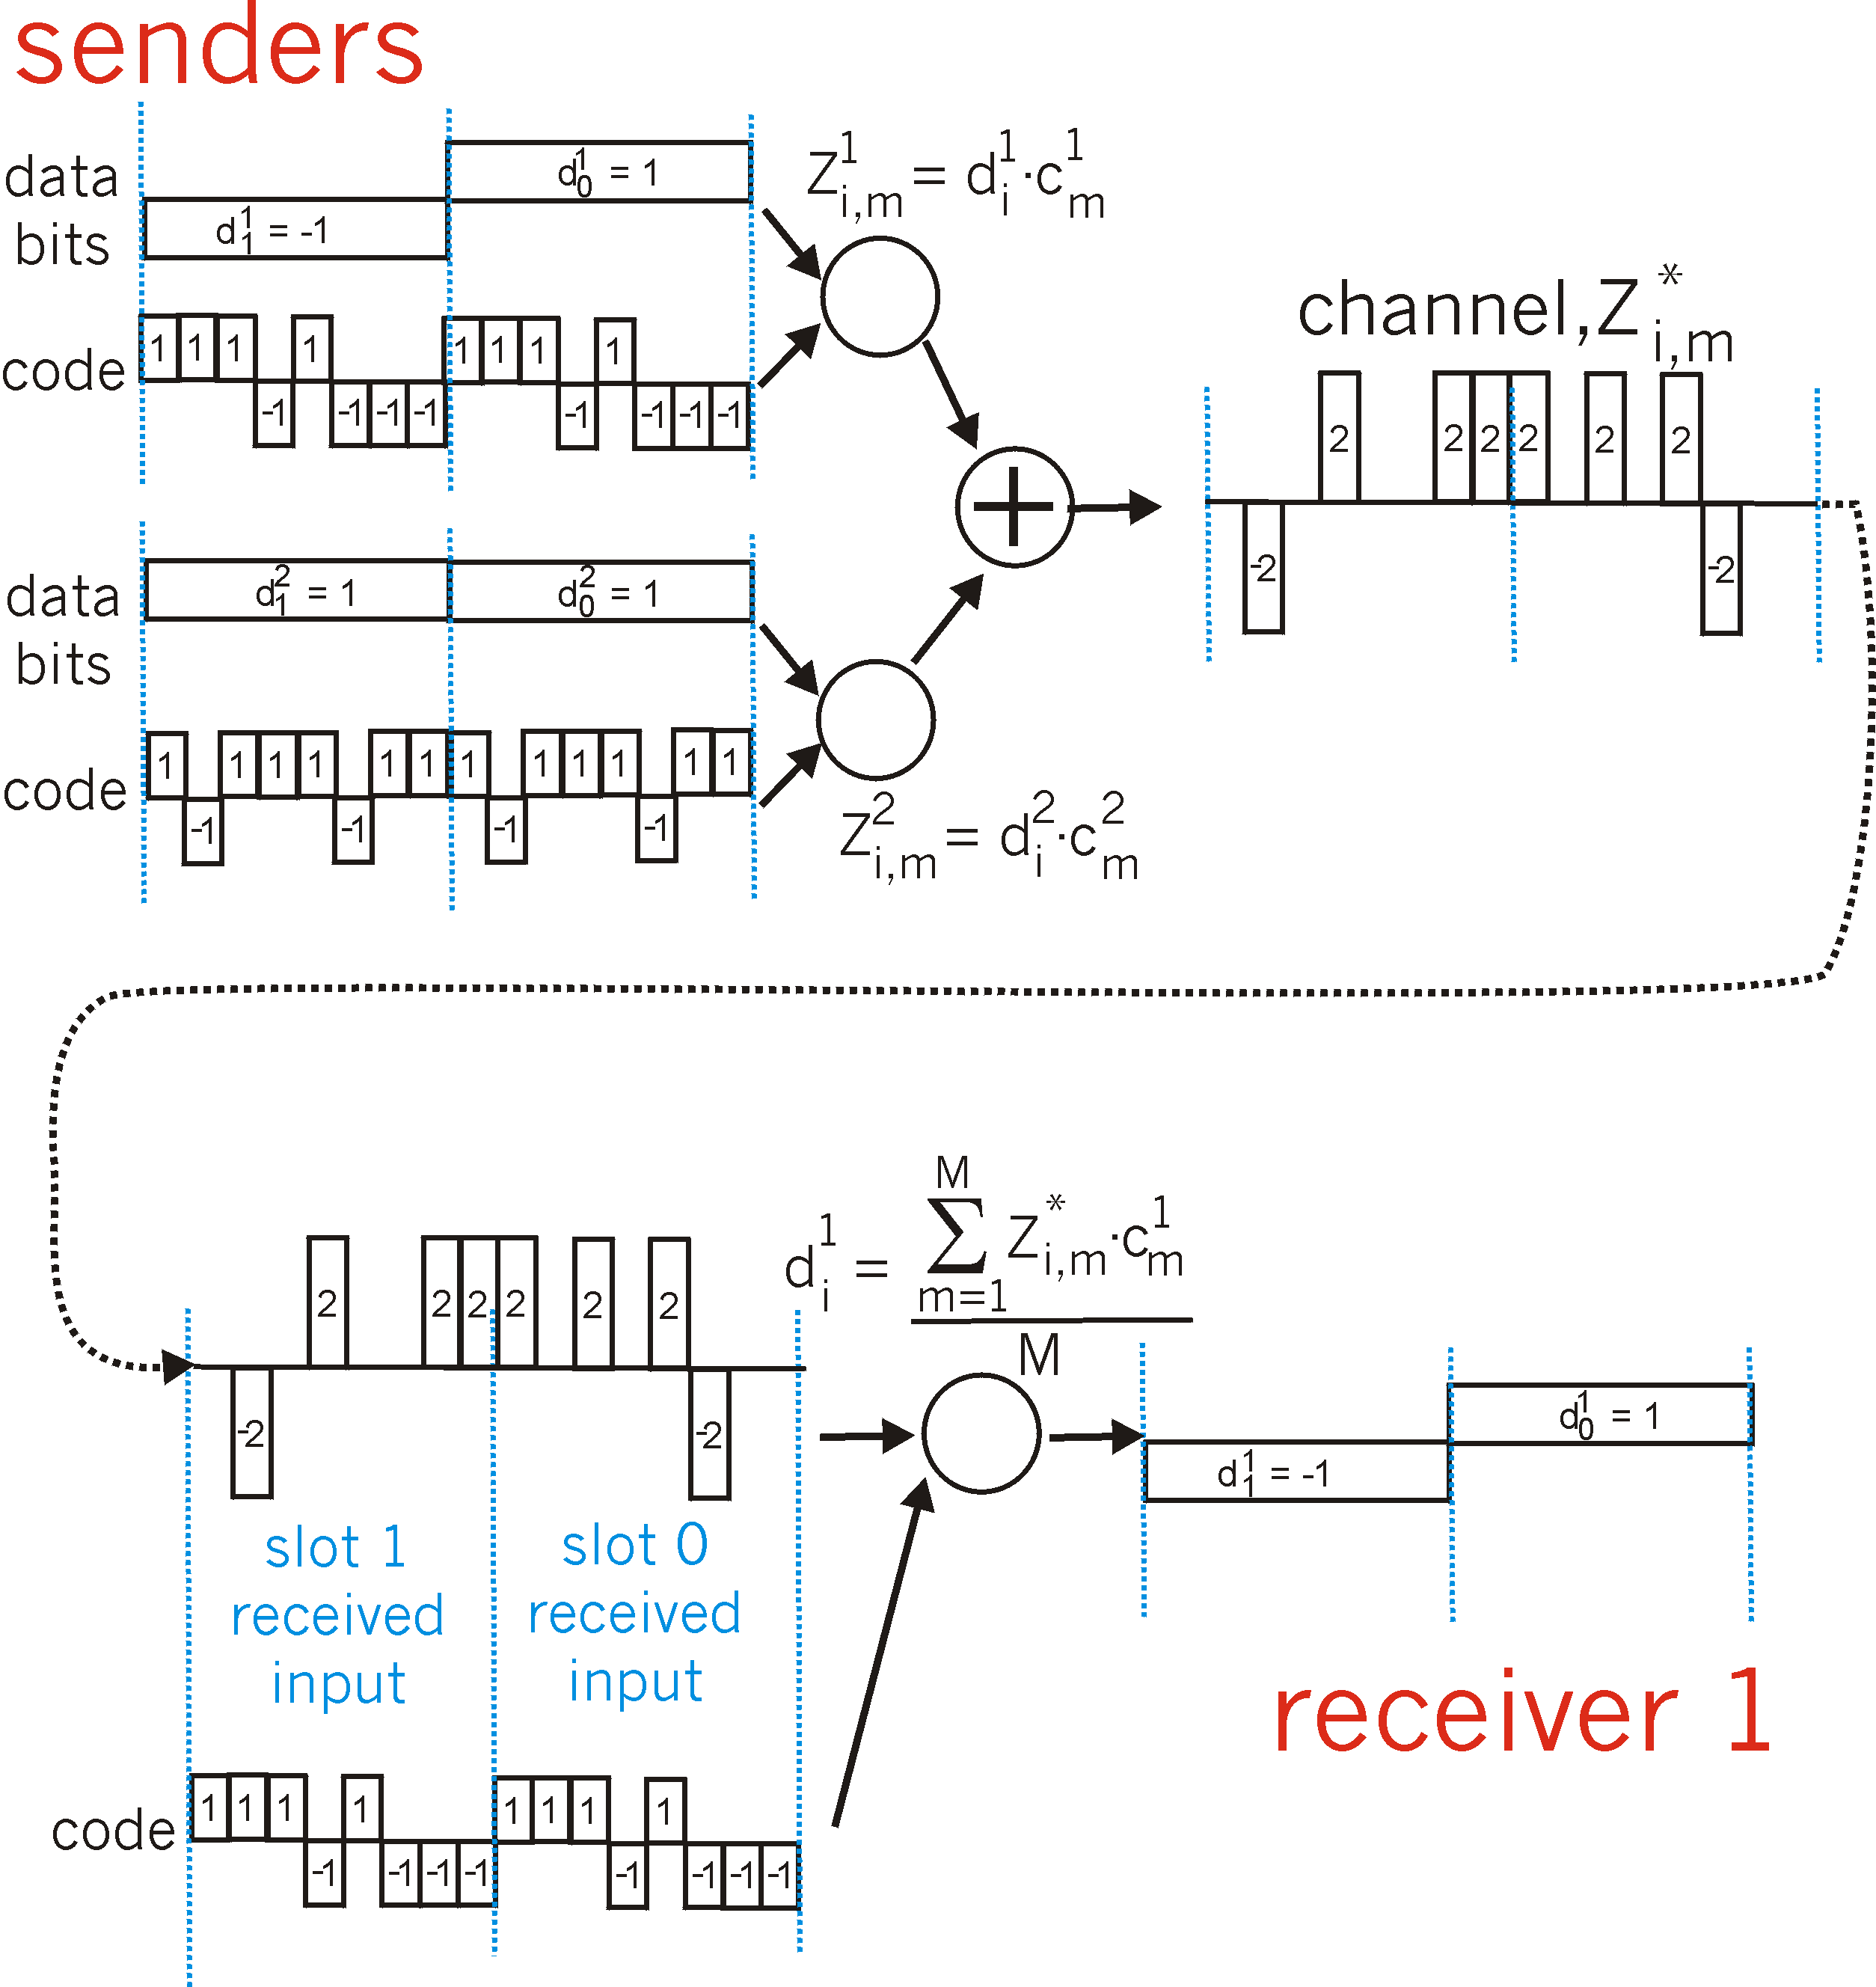
CDMA: two-sender interference

Slide 17
Chapter 6 outline
6.1 Introduction
Wireless
6.2 Wireless links, characteristics
CDMA
6.3 IEEE 802.11 wireless LANs (“wi-fi”)
6.4 cellular Internet access
architecture
standards (e.g., GSM)
Mobility
6.5 Principles: addressing and routing to mobile users
6.6 Mobile IP
6.7 Handling mobility in cellular networks
6.8 Mobility and higher-layer protocols
6.9 Summary

Slide 18
IEEE 802.11 Wireless LAN
802.11b
2.4-5 GHz unlicensed spectrum
up to 11 Mbps
direct sequence spread spectrum (DSSS) in physical layer
all hosts use same chipping code
802.11a
5-6 GHz range
up to 54 Mbps
802.11g
2.4-5 GHz range
up to 54 Mbps
802.11n: multiple antennae
2.4-5 GHz range
up to 200 Mbps
all use CSMA/CA for multiple access
all have base-station and ad-hoc network versions

Slide 19
802.11 LAN architecture
wireless host communicates with base station
base station = access point (AP)
Basic Service Set (BSS) (aka “cell”) in infrastructure mode contains:
wireless hosts
access point (AP): base station
ad hoc mode: hosts only
Internet
hub, switch
or router
AP
BSS 1
AP
BSS 2

Slide 20
802.11: Channels, association
802.11b: 2.4GHz-2.485GHz spectrum divided into 11 channels at different frequencies
AP admin chooses frequency for AP
interference possible: channel can be same as that chosen by neighboring AP!
host: must associate with an AP
scans channels, listening for beacon frames containing AP’s name (SSID) and MAC address
selects AP to associate with
may perform authentication [Chapter 8]
will typically run DHCP to get IP address in AP’s subnet

Slide 21
802.11: passive/active scanning
BBS 1
BBS 2
BBS 1
BBS 2
AP 1
AP 2
AP 1
1
AP 2
1
1
2
2
2
3
3
4
H1
H1
Passive Scanning:
beacon frames sent from APs
association Request frame sent: H1 to selected AP
association Response frame sent: selected AP to H1
Active Scanning:
Probe Request frame broadcast from H1
Probes response frame sent from APs
Association Request frame sent: H1 to selected AP
Association Response frame sent: selected AP to H1

Slide 22
IEEE 802.11: multiple access
avoid collisions: 2⁺ nodes transmitting at same time
802.11: CSMA - sense before transmitting
don’t collide with ongoing transmission by other node
802.11: no collision detection!
difficult to receive (sense collisions) when transmitting due to weak received signals (fading)
can’t sense all collisions in any case: hidden terminal, fading
goal: avoid collisions: CSMA/C(ollision)A(voidance)
A
B
C
C
A’s signal
strength
C’s signal
strength
B
A
space

Slide 23
IEEE 802.11 MAC Protocol: CSMA/CA
802.11 sender
1 if sense channel idle for DIFS then
transmit entire frame (no CD)
2 if sense channel busy then
start random backoff time
timer counts down while channel idle
transmit when timer expires
if no ACK, increase random backoff interval, repeat 2
802.11 receiver
- if frame received OK
return ACK after SIFS (ACK needed due to hidden terminal problem)
sender
receiver
DIFS
data
SIFS
ACK

Slide 24
Avoiding collisions (more)(题)
idea: allow sender to “reserve” channel rather than random access of data frames: avoid collisions of long data frames
sender first transmits small request-to-send (RTS) packets to BS using CSMA
RTSs may still collide with each other (but they’re short)
BS broadcasts clear-to-send CTS in response to RTS
CTS heard by all nodes
sender transmits data frame
other stations defer transmissions
avoid data frame collisions completely
using small reservation packets!

Slide 25
Collision Avoidance: RTS-CTS exchange
A
B
AP
RTS(B)
RTS(A)
reservation collision
RTS(A)
CTS(A)
CTS(A)
DATA (A)
defer
time
ACK(A)
ACK(A)

Slide 26
802.11 frame: addressing
2
2
6
6
6
2
6
0 - 2312
4
frame
control
duration
address
1
address
2
address
3
seq
control
address
4
payload
CRC
Address 4: used only in ad hoc mode
Address 1: MAC address
of wireless host or AP
to receive this frame
Address 3: MAC address
of router interface to which AP is attached
Address 2: MAC address
of wireless host or AP
transmitting this frame

Slide 27
802.11 frame: addressing
Internet
H1
R1
router
AP
R1 MAC addr H1 MAC addr
dest. address
source address
802.3 frame
AP MAC addr H1 MAC addr R1 MAC addr
address 1
address 2
address 3
802.11 frame

Slide 28
802.11 frame: more
frame seq #
(for RDT)
duration of reserved
transmission time (RTS/CTS)
2
2
6
6
6
2
6
0 - 2312
4
frame
control
duration
address
1
address
2
address
3
seq
control
address
4
payload
CRC
2
2
4
1
1
1
1
1
1
1
1
Protocol
version
Type
Subtype
To
AP
From
AP
More
frag
Retry
Power
mgt
More
data
WEP
Rsvd
frame type
(RTS, CTS, ACK, data)

Slide 29
802.11: mobility within same subnet
H1 remains in same IP subnet: IP address can remain same
switch: which AP is associated with H1?
self-learning (Ch. 5): switch will see frame from H1 and “remember” which switch port can be used to reach H1
router
hub or
switch
BBS 1
AP 1
AP 2
H1
BBS 2

Slide 30
802.11: advanced capabilities
Rate Adaptation
base station, mobile dynamically change transmission rate (physical layer modulation technique) as mobile moves, SNR varies
10⁻¹
10⁻²
10⁻³
BER
10⁻⁴
10⁻⁵
10⁻⁶
10⁻⁷
10
20
30
40
SNR(dB)
1. SNR decreases, BER increase as node moves away from base station
QAM256 (8 Mbps)
QAM16 (4 Mbps)
2. When BER becomes too high, switch to lower transmission rate but with lower BER
BPSK (1 Mbps)
operating point

Slide 31
802.11: advanced capabilities
Power Management
node-to-AP: “I am going to sleep until next beacon frame”
AP knows not to transmit frames to this node
node wakes up before next beacon frame
beacon frame: contains list of mobiles with AP-to-mobile frames waiting to be sent
node will stay awake if AP-to-mobile frames to be sent; otherwise sleep again until next beacon frame

Slide 32
802.15: personal area network
less than 10 m diameter
replacement for cables (mouse, keyboard, headphones)
ad hoc: no infrastructure
master/slaves:
slaves request permission to send (to master)
master grants requests
802.15: evolved from Bluetooth specification
2.4-2.5 GHz radio band
up to 721 kbps
S
P
P
radius of
coverage
M
S
S
P
P
M
Master device
Slave device
Parked device (inactive)
S
P

Slide 33
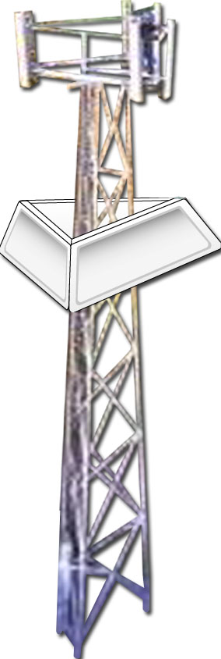

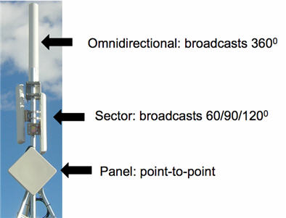
802.16: WiMAX
point-to-point
like 802.11 & cellular: base station model
transmissions to/from base station by hosts with omnidirectional antenna
base station-to-base station backhaul with point-to-point antenna
unlike 802.11:
range ~ 6 miles (“city rather than coffee shop”)
~14 Mbps
point-to-multipoint

Slide 34
802.16: WiMAX: downlink, uplink scheduling
transmission frame
down-link subframe: base station to node
uplink subframe: node to base station
…
…
pream.
DL-
MAP
UL-
MAP
DL
burst 1
DL
burst 2
DL
burst n
Initial
maint.
request
conn.
SS #1
SS #2
SS #k
…
…
downlink subframe
uplink subframe
base station tells nodes who will get to receive (DL map)
and who will get to send (UL map), and when
WiMAX standard provide mechanism for scheduling, but not scheduling algorithm

Slide 35
Chapter 6 outline
6.1 Introduction
Wireless
6.2 Wireless links, characteristics
CDMA
6.3 IEEE 802.11 wireless LANs (“wi-fi”)
6.4 Cellular Internet Access
architecture
standards (e.g., GSM)
Mobility
6.5 Principles: addressing and routing to mobile users
6.6 Mobile IP
6.7 Handling mobility in cellular networks
6.8 Mobility and higher-layer protocols
6.9 Summary

Slide 36
Components of cellular network architecture
MSC
connects cells to wide area net
manages call setup (more later!)
handles mobility (more later!)
cell
covers geographical region
base station (BS) analogous to 802.11 AP
mobile users attach to network through BS
air-interface: physical and link layer protocol between mobile and BS
Mobile
Switching
Center
Public telephone
network, and
Internet
Mobile
Switching
Center
wired network

Slide 37
Cellular networks: the first hop
Two techniques for sharing mobile-to-BS radio spectrum
combined FDMA/TDMA: divide spectrum in frequency channels, divide each channel into time slots
CDMA: code division multiple access
time slots
frequency
bands

Slide 38
Cellular standards: brief survey
2G systems: voice channels
IS-136 TDMA: combined FDMA/TDMA (north america)
GSM (global system for mobile communications): combined FDMA/TDMA
most widely deployed
IS-95 CDMA: code division multiple access
CDMA-2000
TDMA/FDMA
GPRS
EDGE
UMTS
Don’t drown in a bowl
of alphabet soup: use this
for reference only
IS-136
GSM
IS-95

Slide 39
Cellular standards: brief survey
2.5 G systems: voice and data channels
for those who can’t wait for 3G service: 2G extensions
general packet radio service (GPRS)
evolved from GSM
data sent on multiple channels (if available)
enhanced data rates for global evolution (EDGE)
also evolved from GSM, using enhanced modulation
data rates up to 384K
CDMA-2000 (phase 1)
data rates up to 144K
evolved from IS-95

Slide 40
Cellular standards: brief survey
3G systems: voice/data
Universal Mobile Telecommunications Service (UMTS)
data service: High Speed Uplink/Downlink packet Access (HSDPA/HSUPA): 3 Mbps
CDMA-2000: CDMA in TDMA slots
data service: 1xEvolution Data Optimized (1xEVDO) up to 14 Mbps
4G systems: voice/data
Long Term Evolution (LTE)
Employ OFDM, MIMO techniques to enhance packet delivery rate: 100Mbps for downlink, 50Mbps for uplink
….. more (and more interesting) cellular topics due to mobility (stay tuned for details)

Slide 41
2G (voice) network architecture
Base station system (BSS)
MSC
BTS
BSC
G
Public
telephone
network
Gateway
MSC
Legend
Base transceiver station (BTS)
Base station controller (BSC)
Mobile Switching Center (MSC)
Mobile subscribers

Slide 42
2.5G (voice+data) network architecture
MSC
BSC
G
Public
telephone
network
Gateway
MSC
G
Public
Internet
Key insight: new cellular data
network operates in parallel
(except at edge) with existing
cellular voice network
voice network unchanged in core
data network operates in parallel
SGSN
GGSN
Serving GPRS Support Node (SGSN)
Gateway GPRS Support Node (GGSN)

Slide 43
3G (voice+data) network architecture
MSC
G
Public
telephone
network
radio
network
controller
Gateway
MSC
G
Public
Internet
SGSN
Key insight: new cellular data
network operates in parallel
(except at edge) with existing
cellular voice network
voice network unchanged in core
data network operates in parallel
GGSN
Serving GPRS Support Node (SGSN)
Gateway GPRS Support Node (GGSN)

Slide 44
3G (voice+data) network architecture
MSC
G
Public
telephone
network
radio
network
controller
Gateway
MSC
G
Public
Internet
SGSN
GGSN
radio interface
(WCDMA, HSPA)
radio access network
Universal Terrestrial Radio
Access Network (UTRAN)
core network
General Packet Radio Service
(GPRS) Core Network
public
Internet

Slide 45
3G versus 4G LTE network architecture
MSC
G
Public
telephone
network
3G
radio
network
controller
Gateway
MSC
G
Public
Internet
SGSN
GGSN
4G-LTE
HSS
MME
G
G
Public
Internet
S-GW
P-GW
radio access network
Universal Terrestrial Radio
Access Network (UTRAN)
Evolved Packet Core
(EPC)

Slide 46
4G: differences from 3G
all IP core: IP packets tunneled (through core IP network) from base station to gateway
no separation between voice and data – all traffic carried over IP core to gateway
Mobility
Management
Entity (MME)
Home Subscriber
Server(HSS)
(like HLR+VLR)
Serving
Gateway
(S-GW)
Packet data
network
Gateway
(P-GW)
UE
(user element)
eNodeB
(base station)
HSS
MME
control
G
G
Public
Internet
data
S-GW
P-GW
radio access network
Universal Terrestrial Radio
Access Network (UTRAN)
Evolved Packet Core
(EPC)

Slide 47
Chapter 6 outline
6.1 Introduction
Wireless
6.2 Wireless links, characteristics
CDMA
6.3 IEEE 802.11 wireless LANs (“wi-fi”)
6.4 Cellular Internet Access
architecture
standards (e.g., GSM)
Mobility
6.5 Principles: addressing and routing to mobile users
6.6 Mobile IP
6.7 Handling mobility in cellular networks
6.8 Mobility and higher-layer protocols
6.9 Summary

Slide 48
What is mobility?
spectrum of mobility, from the network perspective:
no mobility
high mobility
mobile wireless user,
using same access
point
mobile user, connecting/ disconnecting from network using DHCP.
mobile user, passing through multiple access point while maintaining ongoing connections (like cell phone)

Slide 49
Mobility: Vocabulary（题）
home network: permanent “home” of mobile
(e.g., 128.119.40/24)
home agent: entity that will perform mobility functions on behalf of mobile, when mobile is remote
wide area network
Permanent address: address in home network, can always be used to reach mobile
e.g., 128.119.40.186
correspondent
Notes:
注：Mobile IP其实没有发展起来，这是一种构想，和移动通信网的漫游思路很像
https://www.zhihu.com/question/314835771
关于计算机网络和通信网络的区别

Slide 50
Mobility: more vocabulary
visited network: network in which mobile currently resides (e.g., 79.129.13/24)
Permanent address: remains constant (e.g., 128.119.40.186)
Care-of-address: address in visited network.
(e.g., 79,129.13.2)
wide area network
foreign agent: entity in visited network that performs mobility functions on behalf of mobile.
correspondent: wants to communicate with mobile

Slide 51

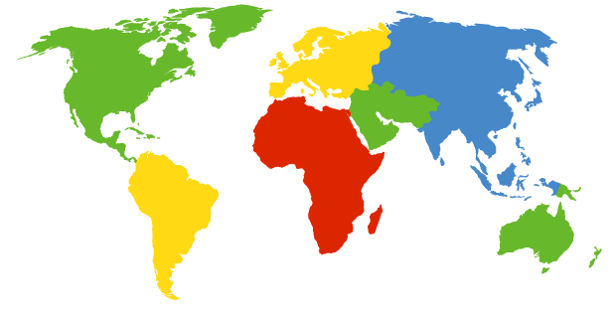

How do you contact a mobile friend:
Consider friend frequently changing addresses, how do you find her?
I wonder where Alice moved to?
search all phone books?
call her parents?
expect her to let you know where he/she is?

Slide 52
Mobility: approaches
Let routing handle it: routers advertise permanent address of mobile-nodes-in-residence via usual routing table exchange.
routing tables indicate where each mobile located
no changes to end-systems
Let end-systems handle it:
indirect routing: communication from correspondent to mobile goes through home agent, then forwarded to remote
direct routing: correspondent gets foreign address of mobile, sends directly to mobile

Slide 53
Mobility: approaches
Let routing handle it: routers advertise permanent address of mobile-nodes-in-residence via usual routing table exchange.
routing tables indicate where each mobile located
no changes to end-systems
let end-systems handle it:
indirect routing: communication from correspondent to mobile goes through home agent, then forwarded to remote
direct routing: correspondent gets foreign address of mobile, sends directly to mobile
not
scalable
to millions of
mobiles

Slide 54
Mobility: registration
visited network
home network
1
2
wide area network
mobile contacts foreign agent on entering visited network
foreign agent contacts home agent home: “this mobile is resident in my network”
End result:
Foreign agent knows about mobile
Home agent knows location of mobile

Slide 55
Mobility via Indirect Routing
foreign agent receives packets, forwards to mobile
home agent intercepts packets, forwards to foreign agent
visited
network
home
network
3
wide area network
2
1
correspondent addresses packets using home address of mobile
4
mobile replies directly to correspondent

Slide 56
Indirect Routing: comments
Mobile uses two addresses:
permanent address: used by correspondent (hence mobile location is transparent to correspondent)
care-of-address: used by home agent to forward datagrams to mobile
foreign agent functions may be done by mobile itself
triangle routing: correspondent-home-network-mobile
inefficient when
correspondent, mobile
are in same network

Slide 57
Indirect Routing: moving between networks
suppose mobile user moves to another network
registers with new foreign agent
new foreign agent registers with home agent
home agent update care-of-address for mobile
packets continue to be forwarded to mobile (but with new care-of-address)
mobility, changing foreign networks transparent: on going connections can be maintained!

Slide 58
Mobility via Direct Routing
foreign agent receives packets, forwards to mobile
correspondent forwards to foreign agent
visited
network
home
network
4
wide area network
2
3
correspondent requests, receives foreign address of mobile
1
4
mobile replies directly to correspondent

Slide 59
Mobility via Direct Routing: comments
overcome triangle routing problem
non-transparent to correspondent: correspondent must get care-of-address from home agent
what if mobile changes visited network?

Slide 60
Accommodating mobility with direct routing
anchor foreign agent: FA in first visited network
data always routed first to anchor FA
when mobile moves: new FA arranges to have data forwarded from old FA (chaining)
foreign net visited
at session start
anchor
foreign
agent
wide area network
2
1
4
5
3
new
foreign
network
correspondent
agent
new foreign
agent
correspondent

Slide 61
Chapter 6 outline
6.1 Introduction
Wireless
6.2 Wireless links, characteristics
CDMA
6.3 IEEE 802.11 wireless LANs (“wi-fi”)
6.4 Cellular Internet Access
architecture
standards (e.g., GSM)
Mobility
6.5 Principles: addressing and routing to mobile users
6.6 Mobile IP
6.7 Handling mobility in cellular networks
6.8 Mobility and higher-layer protocols
6.9 Summary

Slide 62
Mobile IP
RFC 3344
has many features we’ve seen:
home agents, foreign agents, foreign-agent registration, care-of-addresses, encapsulation (packet-within-a-packet)
three components to standard:
indirect routing of datagrams
agent discovery
registration with home agent

Slide 63
Mobile IP: indirect routing
foreign-agent-to-mobile packet
packet sent by home agent to foreign agent: a packet within a packet
dest: 128.119.40.186
dest: 79.129.13.2
dest: 128.119.40.186
Permanent address: 128.119.40.186
Care-of address: 79.129.13.2
dest: 128.119.40.186
packet sent by correspondent

Slide 64
Mobile IP: agent discovery
agent advertisement: foreign/home agents advertise service by broadcasting ICMP messages (typefield = 9)
H,F bits: home and/or foreign agent
R bit: registration required

Slide 65
Mobile IP: registration example

Slide 66
Components of cellular network architecture
recall:
correspondent
wired public telephone
network
MSC
MSC
MSC
MSC
MSC
different cellular networks,
operated by different providers
Notes:
MSC: 移动业务交换中心（mobile switching center），是网路的核心，它提供交换功能以及面向系统其他功能实体。MSC可以从三种数据库（HLR,VLR,AUC）获取处理用户位置登记和呼叫请求所需的全部数据。反之，MSC也根据其最新获取的信息请求更新数据库的部分数据。MSC具有号码储存译码、呼叫处理、路由选择、回波抵消、超负荷控制等功能；MSC作为网路核心，应能支持位置登记、越区切换和自动漫游等移动管理功能；MSC还应支持信道管理、数据传输，以及包括鉴权、信息加密、移动台设备识别等安全保密功能。

Slide 67
Handling mobility in cellular networks（题）
home network: network of cellular provider you subscribe to (e.g., Sprint PCS, Verizon)
home location register (HLR): database in home network containing permanent cell phone #, profile information (services, preferences, billing), information about current location (could be in another network)
visited network: network in which mobile currently resides
visitor location register (VLR): database with entry for each user currently in network
could be home network

Slide 68
GSM: indirect routing to mobile
HLR
home
network
2
correspondent
home
Mobile
Switching
Center
home MSC consults HLR,
gets roaming number of
mobile in visited network
1
call routed
to home network
3
Public switched
telephone
network
VLR
Mobile
Switching
Center
4
home MSC sets up 2nd leg of call
to MSC in visited network
mobile
user
MSC in visited network completes
call through base station to mobile
visited
network
Notes:
MSC: 移动业务交换中心（mobile switching center），是网路的核心，它提供交换功能以及面向系统其他功能实体。MSC可以从三种数据库（HLR,VLR,AUC）获取处理用户位置登记和呼叫请求所需的全部数据。反之，MSC也根据其最新获取的信息请求更新数据库的部分数据。MSC具有号码储存译码、呼叫处理、路由选择、回波抵消、超负荷控制等功能；MSC作为网路核心，应能支持位置登记、越区切换和自动漫游等移动管理功能；MSC还应支持信道管理、数据传输，以及包括鉴权、信息加密、移动台设备识别等安全保密功能。

Slide 69
GSM: handoff with common MSC
Handoff goal: route call via new base station (without interruption)
reasons for handoff:
stronger signal to/from new BSS (continuing connectivity, less battery drain)
load balance: free up channel in current BSS
GSM doesn’t mandate why to perform handoff (policy), only how (mechanism)
handoff initiated by old BSS
VLR
Mobile
Switching
Center
old
routing
new
routing
old BSS
new BSS

Slide 70
GSM: handoff with common MSC
1. old BSS informs MSC of impending handoff, provides list of 1⁺ new BSSs
2. MSC sets up path (allocates resources) to new BSS
3. new BSS allocates radio channel for use by mobile
4. new BSS signals MSC, old BSS: ready
5. old BSS tells mobile: perform handoff to new BSS
6. mobile, new BSS signal to activate new channel
7. mobile signals via new BSS to MSC: handoff complete. MSC reroutes call
8 MSC-old-BSS resources released
VLR
Mobile
Switching
Center
4
2
1
8
7
3
old BSS
5
6
new BSS

Slide 71
GSM: handoff between MSCs
anchor MSC: first MSC visited during cal
call remains routed through anchor MSC
new MSCs add on to end of MSC chain as mobile moves to new MSC
IS-41 allows optional path minimization step to shorten multi-MSC chain
home network
correspondent
Home MSC
anchor MSC
PSTN
MSC
MSC
MSC
(a) before handoff

Slide 72
GSM: handoff between MSCs
anchor MSC: first MSC visited during cal
call remains routed through anchor MSC
new MSCs add on to end of MSC chain as mobile moves to new MSC
IS-41 allows optional path minimization step to shorten multi-MSC chain
home network
correspondent
Home MSC
anchor MSC
PSTN
MSC
MSC
MSC
(b) after handoff

Slide 73
Mobility: GSM versus Mobile IP
GSM element |  | Comment on GSM element | Mobile IP element
Home system | Network to which mobile user’s permanent phone number belongs |  |  | Home network
Gateway Mobile Switching Center, or “home MSC”. Home Location Register (HLR) | Home MSC: point of contact to obtain routable address of mobile user. HLR: database in home system containing permanent phone number, profile information, current location of mobile user, subscription information |  |  | Home agent
Visited System | Network other than home system where mobile user is currently residing |  |  | Visited network
Visited Mobile services Switching Center. Visitor Location Record (VLR) | Visited MSC: responsible for setting up calls to/from mobile nodes in cells associated with MSC. VLR: temporary database entry in visited system, containing subscription information for each visiting mobile user |  |  | Foreign agent
Mobile Station Roaming Number (MSRN), or “roaming number” | Routable address for telephone call segment between home MSC and visited MSC, visible to neither the mobile nor the correspondent. |  |  | Care-of-address

Slide 74
Wireless, mobility: impact on higher layer protocols
logically, impact should be minimal …
best effort service model remains unchanged
TCP and UDP can (and do) run over wireless, mobile
… but performance-wise:
packet loss/delay due to bit-errors (discarded packets, delays for link-layer retransmissions), and handoff
TCP interprets loss as congestion, will decrease congestion window un-necessarily
delay impairments for real-time traffic
limited bandwidth of wireless links

Slide 75
Chapter 6 Summary
Wireless
wireless links:
capacity, distance
channel impairments
CDMA
IEEE 802.11 (“wi-fi”)
CSMA/CA reflects wireless channel characteristics
cellular access
architecture
standards (e.g., GSM, CDMA-2000, UMTS)
Mobility
principles: addressing, routing to mobile users
home, visited networks
direct, indirect routing
care-of-addresses
case studies
mobile IP
mobility in GSM
impact on higher-layer protocols

