Slide 1
Sales of summer clothes in E-commerce Wish
Predict Sales Performance of summer clothes
Yueling Wu
Notes:
Hi everyone, I'm Yueling Wu.
For ML_lab final proj, i choose 'Sales of summer cloths in E-commerce Wish' Dataset, use features to predict sales performance.

Slide 2
Dataset
Sales of summer clothes in E-commerce Wish dataset on kaggle
This dataset contains product listings as well as products ratings and sales performance
Analytic goal: Use two Machine Learning models to predict sales performance.
Original data: 1573 rows and 43 columns
24 numeric columns and 19 string-type columns (some of them are website link, images, which can be deleted)
Data size: 1.2MB
Use 90% data for training and 10% data for testing.
Notes:
The dataset is from Kaggle, it contains features like price, product rating, color, size, shipping options, unit sold etc, for each product.
Megabite

Slide 3
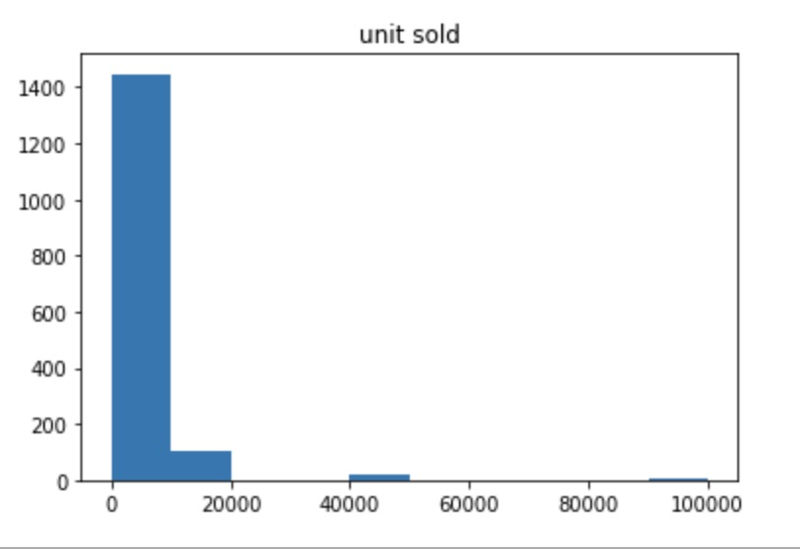
Preprocessing
Response Variable: sales performance (unit sold)
925 products have at least 1000 unit sold,
648 products have less than 1000 unit sold.
The sales performance is 1 if unit sold>= 1000, otherwise is 0.
Binary Classification
Notes:
I choose unit sold as my response variable to measure sales performance.

Slide 4
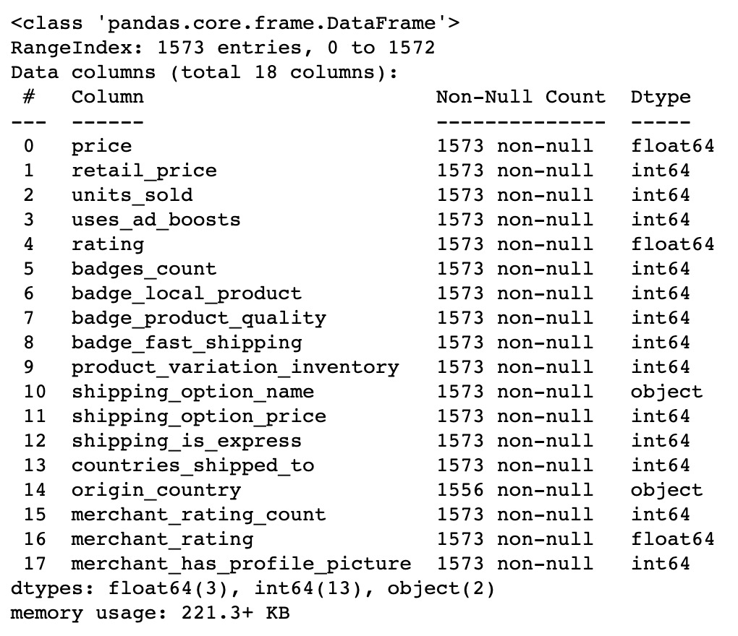
Preprocessing
Features: Manually pick 18 features that can be used for training.
16 Numeric features
2 categorical features
‘origin _country’ has 17 missing values
Tried PCA but the accuracy isn’t improved, so the number of features cannot be reduced.
Notes:
Delete features with ids, website links, images, and context.

Slide 5
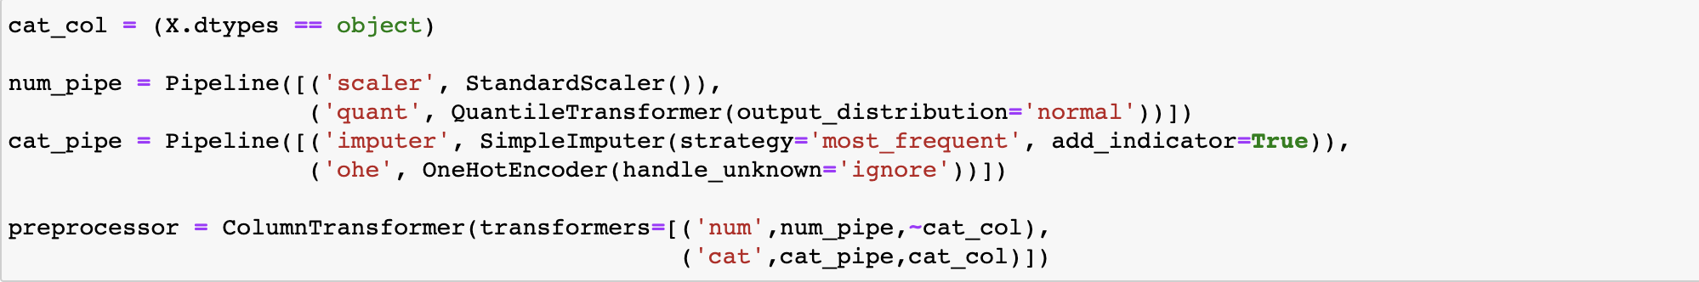
Preprocessing
Workflow
Next: Try a traditional classification model and creatively transform a regression model for binary classification. Compare the model performance.
(Custom Transformer)
Change response variable ‘unit sold’ to 0,1.
Standardize numeric features, and fit into a normal distribution.
Use most frequent country name ‘CN’ to fill in missing values. One hot encode categorical features.
Notes:
Preprocessing Workflow
Firstly,
Secondly,
Thirdly,
I combine the preprocessing process in the ColumnTransformer.
Next: I will train two Machine Learning Models
One is a traditional classification.
The other one is actually a reg model. I transformed the learning process to see if it is possible to use reg model for classification and how the performance can be.

Slide 6
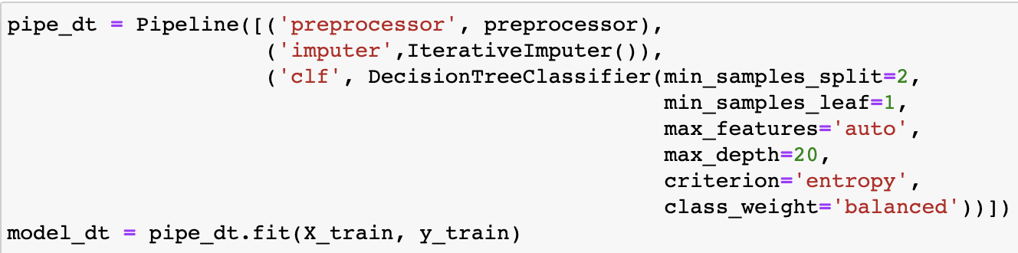
Model Training
Decision Tree
Random search the best parameters for 10 times, pick the parameters with the best cross validation score.
Pipeline:

Slide 7
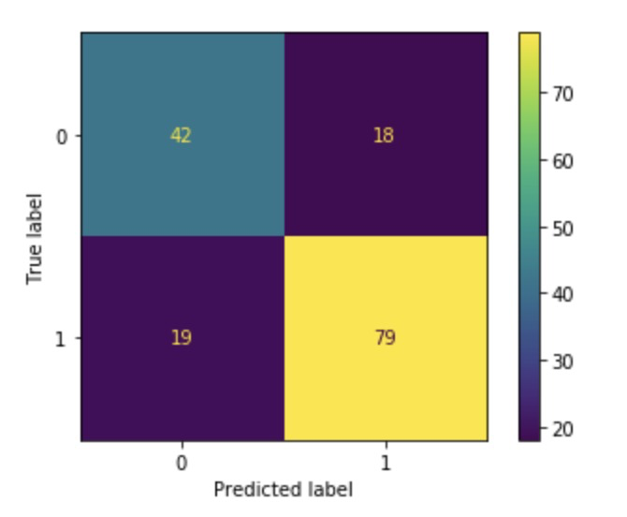
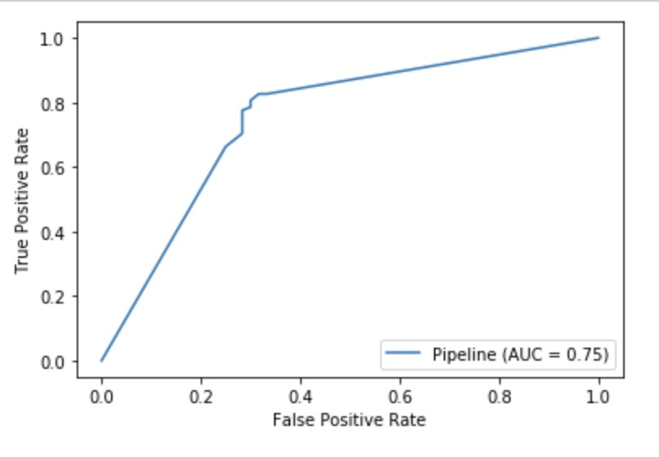
Model Performance
Among 158 testing records, 121 are correctly predicted.
F1 score = 0.810
roc_auc score = 0.755
Notes:
After testing on the validation set, the performance is visualized on the Confusion Matrix and PR curve.
念

Slide 8
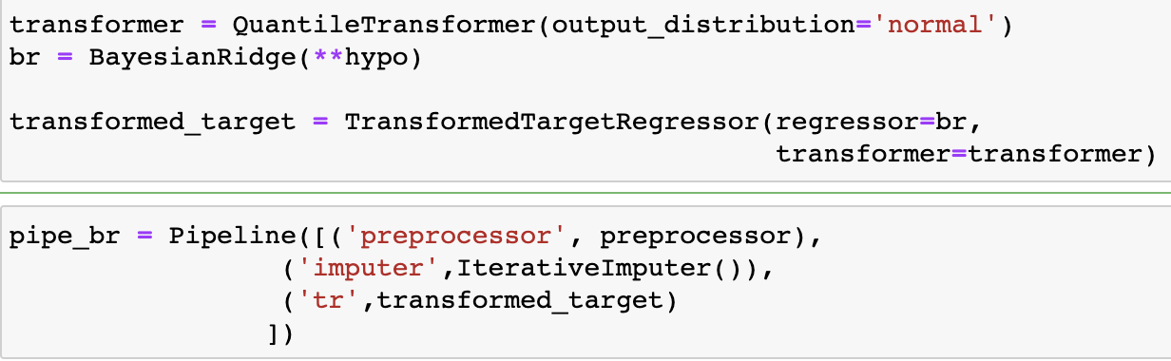
Model Training
BayesianRidge
Normally BayesianRidge is used for regression. But I first transform the response variable to a normal distribution series, then fit the regression model and transform the result back to 0-1.
hypo = {'alpha_1': 1e-06, 'alpha_2': 1e-06, 'alpha_init': None, 'compute_score': False, 'copy_X': True, 'fit_intercept': True, 'lambda_1': 1e-06, 'lambda_2': 1e-06, 'lambda_init': None, 'n_iter': 3000,'normalize': False, 'tol': 0.001,'verbose': False}
Pipeline:
Notes:
by using QuantileTransfrom in TransformedTargetRegressor.
then fit the model....
hyperparameters are found by Randomsearch.

Slide 9
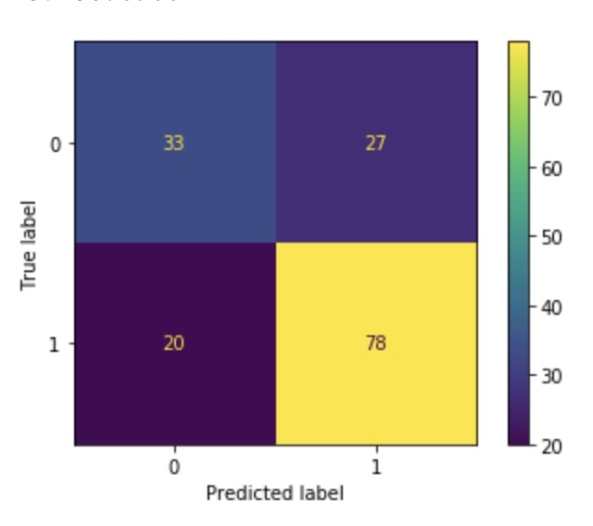
Model Performance
Among 158 testing records, 111 are correctly predicted.
F1 score = 0.768
Since this is not a classification, there is no probability scores, we cannot get roc_auc_score and PR curve.
Notes:
but the accuracy is close to the DT

Slide 10
Conclusion
After using the most frequent country name to impute the ‘origin_country’, the 18 features can be used to predict if a product is sold well.
The regular classification model Decision Tree performs better than the regression model BayesianRidge. But we verified that after transforming the response variable, regression models can also be used for classification and the accuracy is close.
Notes:
So Thank you, that's all for today's presentation/

