Slide 1




$$a$$
$$a=b+c$$
$$b=c$$
$$c=b−a$$
$$b$$
$$c$$

Slide 2
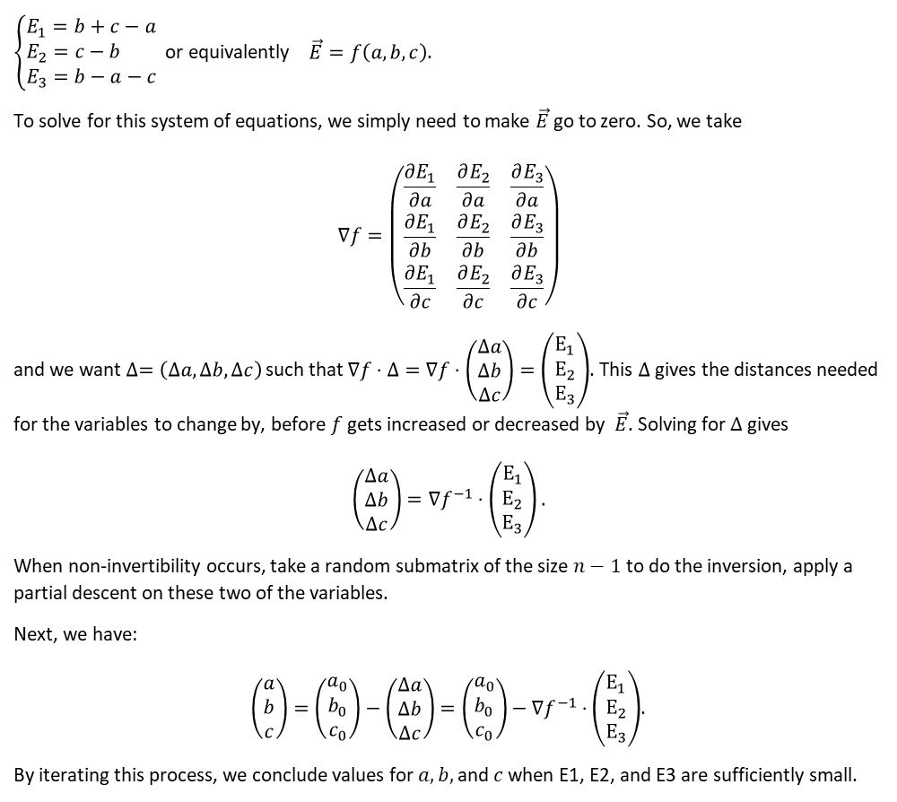
$\left\{\begin{aligned}E_{1}=b+c−a \\ E_{2}=c−b \\ E_{3}=b−a−c\end{aligned}\right.$ or equivalently $\vec{E}=f\left(a, b, c\right)$.
To solve for this system of equations, we simply need to make $\vec{E}$ go to zero. So, we take
$$∇f=\left(\begin{matrix}\frac{∂E_{1}}{∂a} & \frac{∂E_{2}}{∂a} & \frac{∂E_{3}}{∂a} \\ \frac{∂E_{1}}{∂b} & \frac{∂E_{2}}{∂b} & \frac{∂E_{3}}{∂b} \\ \frac{∂E_{1}}{∂c} & \frac{∂E_{2}}{∂c} & \frac{∂E_{3}}{∂c}\end{matrix}\right)$$
and we want $∆=\left(Δa, Δb, Δc\right)$ such that $∇f⋅Δ=∇f⋅\left(\begin{matrix}Δa \\ Δb \\ Δc\end{matrix}\right)=\left(\begin{matrix}E_{1} \\ E_{2} \\ E_{3}\end{matrix}\right)$. This $Δ$ gives the distances needed for the variables to change by, before $f$ gets increased or decreased by $\vec{E}$. Solving for $Δ$ gives
$$\left(\begin{matrix}Δa \\ Δb \\ Δc\end{matrix}\right)=∇f^{−1}⋅\left(\begin{matrix}E_{1} \\ E_{2} \\ E_{3}\end{matrix}\right).$$
When non-invertibility occurs, take a random submatrix of the size $n−1$ to do the inversion, apply a partial descent on these two of the variables.
Next, we have:
$\left(\begin{matrix}a \\ b \\ c\end{matrix}\right)=\left(\begin{matrix}a_{0} \\ b_{0} \\ c_{0}\end{matrix}\right)−\left(\begin{matrix}Δa \\ Δb \\ Δc\end{matrix}\right)=\left(\begin{matrix}a_{0} \\ b_{0} \\ c_{0}\end{matrix}\right)−∇f^{−1}⋅\left(\begin{matrix}E_{1} \\ E_{2} \\ E_{3}\end{matrix}\right)$.
By iterating this process, we conclude values for $a, b,$and $c$ when E1, E2, and E3 are sufficiently small.

Slide 3



$$\frac{dy}{dx}=y+x cos\left(y\right)−e^{y}$$
Recommended, low time complexity.
$$\frac{x^{2}}{\frac{dy}{dx}}+12y^{2}=cos⁡(x+y)$$
Unrecommended, high time complexity and unnecessarily implicit.
$$x{\left(\frac{dy}{dx}\right)}^{3}−\sin\left(\frac{dy}{dx}\right)=y^{2}+\cos\left(x\right)$$
Acceptable, high time complexity but necessarily implicit.

Slide 4
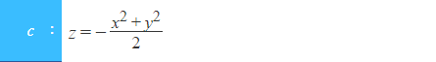

Slide 5
Macro dictionary
Output
Input
\
s
i
i
n
u
m
d
i
n
f
t
y
v
^
+
-
[]
[sum, ‘(’ ]
[sum, ‘(’, ‘i’, ‘=’, ‘0’]
[sum, ‘(’, ‘i’, ‘=’, ‘0’, ‘,’]
…
[sum, ‘(’, ‘i’, ‘=’, ‘0’, ‘,’, ‘infinity’, ‘)’]
\sum _{i=0}^{\infty }i^2
\sum _{i=0}^{\infty }i^2
\sum _{i=0}^{\infty }i^2
\sum _{i=0}^{\infty }i^2
…
\sum _{i=0}^{\infty }i^2
Format = “_{ }^{ }”

Slide 6
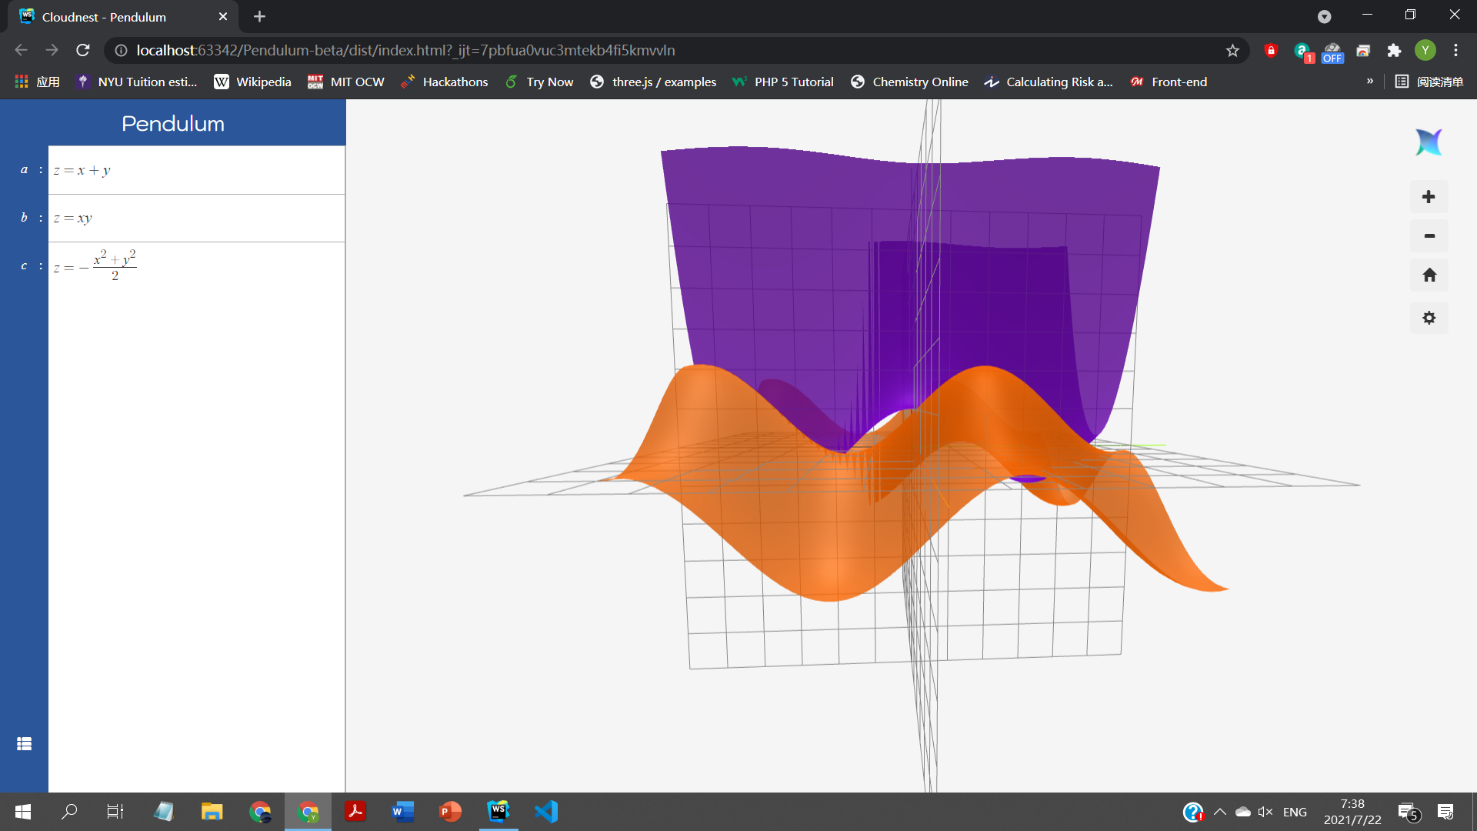

$$∀i∈\left[|U|\right], ∀j∈\left[|V|\right], vertices.add(f(M\left(u_{i}, v_{i}\right))$$
$$\left(x,y\right)=M\left(u,v\right)=\left(−l+\frac{v}{2}, +l−\frac{u}{2}\right)$$

Slide 7







$$y$$
$$v$$
$$−y±45°$$
$$x$$
$$+\hat{x}±45°$$
$$u$$
$$l$$
±

Slide 8





$$y$$
$$v$$
Camera
$$x$$
$$u$$
$$l$$

Slide 9



$$y$$
$$v$$
$$x$$
$$u$$
$$l$$

Slide 10
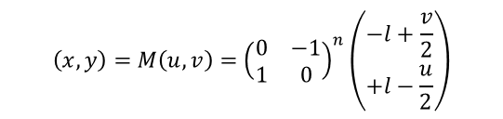
2
n =
3
1
$$\left(x,y\right)=M\left(u,v\right)={\left(\begin{matrix}0 & −1 \\ 1 & 0\end{matrix}\right)}^{n}\left(\begin{matrix}−l+\frac{v}{2} \\ +l−\frac{u}{2}\end{matrix}\right)$$
0

Slide 11
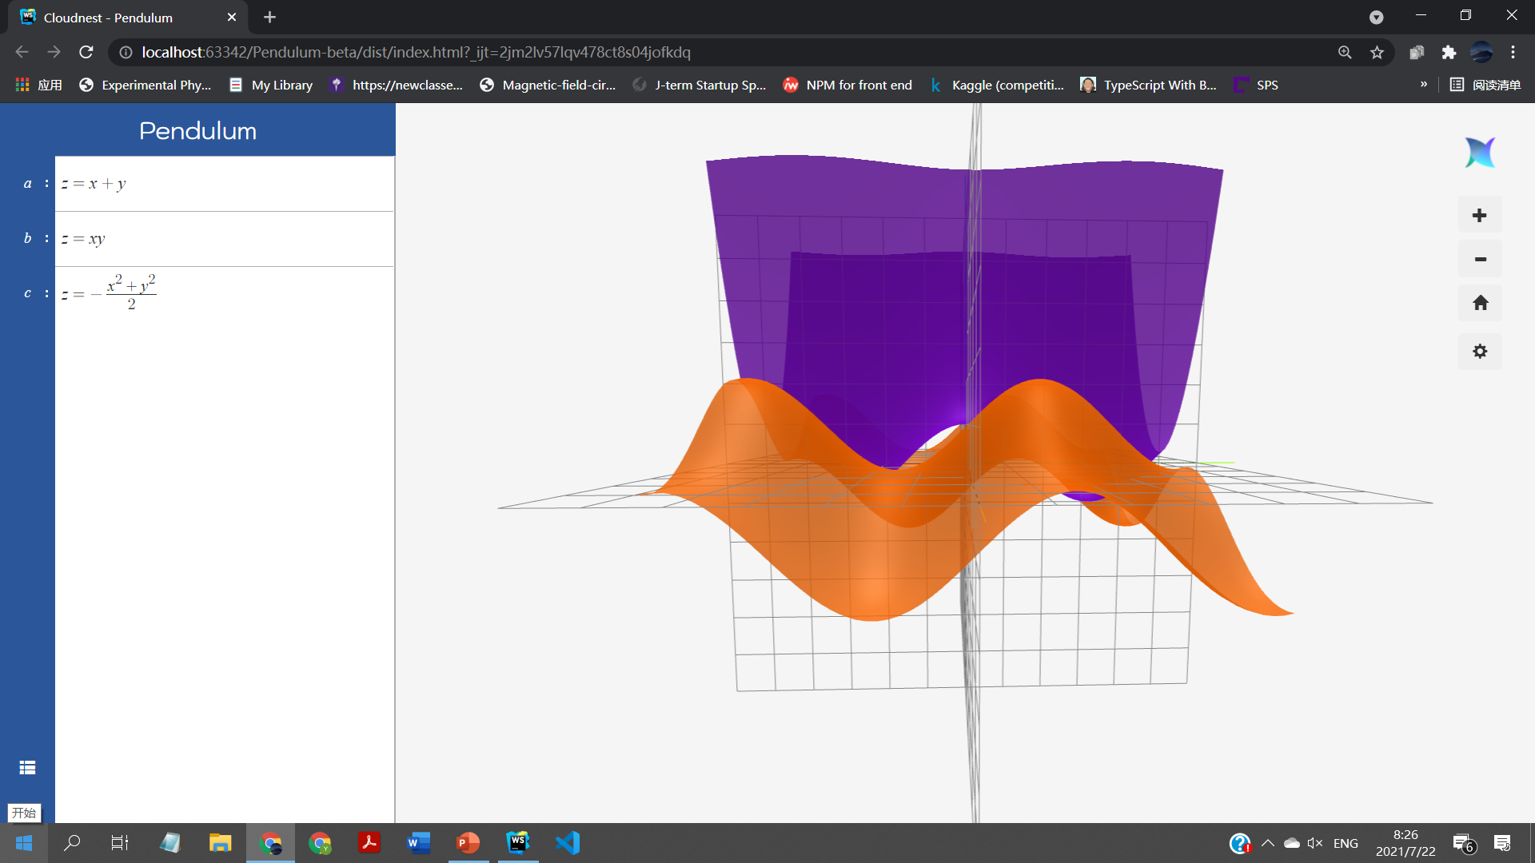
With orientation updates vs Without orientation updates

Slide 13
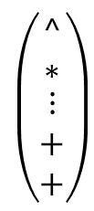
first
# or $
[#,…,$,#]
[-,#,…,^,#]
RPN List
tokenList
$$\left(\begin{matrix}^ \\ ∗ \\ \begin{aligned}⋮ \\ + \\ +\end{aligned}\end{matrix}\right)$$
top
Associativity up
shuntingYard

Slide 14
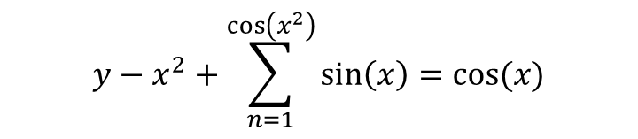
$$y−x^{2}+\sum_{n=1}^{\cos\left(x^{2}\right)}{\sin\left(x\right)}=cos⁡(x)$$
parsestack
y-x+\sin\left(x\right)
let i=0
For:
let token = new Token()
token.readFrom(i):
let char = tex[i] = y
…
i = token.end

Slide 15

Class Token{
let state = ‘init’;
…
function readFrom(tex, start):
let i = start;
while(!terminating){
let char = tex[i];
char = ‘y’;
if(state = init):
chartype $∈[digit, letter, ., symbol]$
symbol $∈[\backslash \backslash , +, −, ∗…]$
if(letter):
type = ‘variable;
state = ‘var;
content += char;
if(digit||.):
type = ‘number;
state = ‘number;
content + char;
if(\\):
..
}
i++;
}
.124
y-x+\sin\left(x\right)

Slide 16

Class Token{
let state = ‘init’;
let end = 0
…
function readFrom(tex, start):
let i = start;
while(!terminating){
this.end = i;
let char = tex[i];
char = ‘-’;
if(state = init):
chartype $∈[digit, letter, ., symbol]$
symbol $∈[\backslash \backslash , +, −, ∗…]$
if(letter):
type = ‘variable;
state = ‘var;
content += char;
if(digit||.):
type = ‘number;
state = ‘number;
content + char;
if(symbol):
..
}
if(state = ‘var’):
if(chartype = symbol && char!= ‘_’):
terminating = true;
if(char == ‘_’):
state = ‘var_’;
if(chartype = digit …)
terminating = true;
if(state = ‘var_’):
i++;
}
Return 0;
}

Slide 17

Class Token{
let state = ‘init’;
let end = 0
…
function readFrom(tex, start):
let i = start;
let macro=;
while(!terminating){
this.end = i;
let char = tex[i];
char = ‘-’;
if(state = init):
chartype $∈[digit, letter, ., symbol]$
symbol $∈[\backslash \backslash , +, −, ∗…]$
if(letter):
type = ‘variable;
state = ‘var;
content += char;
if(digit||.):
type = ‘number;
state = ‘number;
content + char;
if(symbol):
state = ‘macro’;
macro = macros[char];
macro = undefined ? return 1;
if(macro typeof Array):
content =~
type = macro [1]
~
state = ‘terminating’
}
if(state = ‘macro’):
macro = macro[char];
macro =undefined? return 1;
~
if(macro typeof Array):
content =~
type = macro [1]
~
state = ‘terminating’
clauseCount != 0?:
this.end=readClauses(i, tex);
…
return 0
if(state = ‘var’):
if(chartype = symbol && char!= ‘_’):
terminating = true;
if(char == ‘_’):
state = ‘var_’;
if(chartype = digit …)
terminating = true;
if(state = ‘var_’):
if(chartype = letter)
content+=char;
state = ‘terminating’;
if(chartype == symbol && char == ‘{‘}{
state = ‘var_{‘;
if(state = ‘var_{‘):
if(chartype = letter||digit):
content += char;
if(char == ‘}’):
state = terminating;
if(state = ‘terminating’):
terminating = true;
i++;
}
Return 0;
}

Slide 18
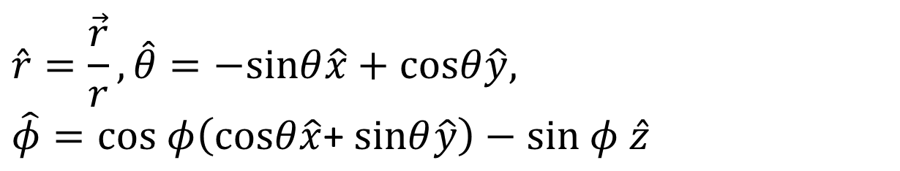

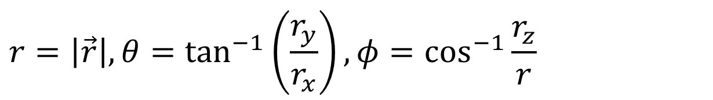



$$r=\left|\vec{r}\right|, θ=\tan^{−1}\left(\frac{r_{y}}{r_{x}}\right), φ=\cos^{−1}{\frac{r_{z}}{r}}$$
$$θ$$
$$φ$$
$$\hat{r}=\frac{\vec{r}}{r}, \hat{θ}=−sinθ\hat{x}+cosθ\hat{y},$$
$$\hat{φ}=cos φ\left(cosθ\hat{x}\text{+ }sinθ\hat{y}\right)−sin φ \hat{z}$$
$$φ$$
$$\vec{ρ}$$

Slide 19
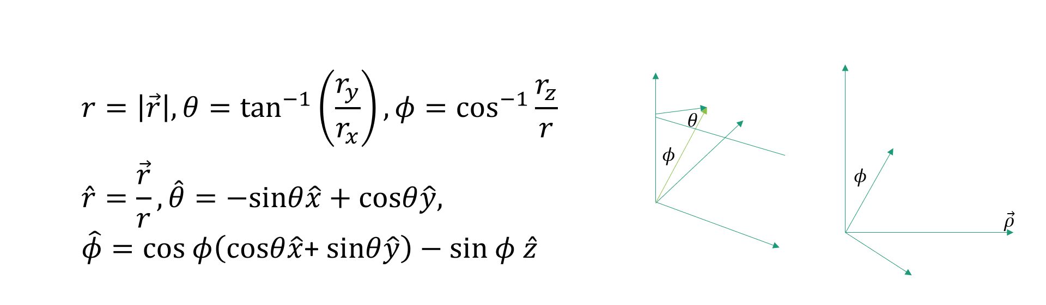

Slide 20

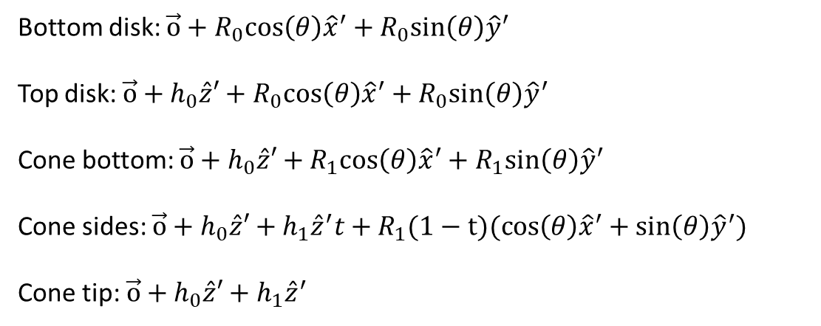



$$h_{1}$$
Bottom disk: $\vec{o}+R_{0}cos\left(θ\right){\hat{x}}^{′}+R_{0}sin\left(θ\right){\hat{y}}^{′}$
Top disk: $\vec{o}+h_{0}\hat{z}′+R_{0}cos\left(θ\right){\hat{x}}^{′}+R_{0}sin\left(θ\right){\hat{y}}^{′}$
Cone bottom: $\vec{o}+h_{0}\hat{z}′+R_{1}cos\left(θ\right){\hat{x}}^{′}+R_{1}sin\left(θ\right){\hat{y}}^{′}$
Cone sides: $\vec{o}+h_{0}\hat{z}′+h_{1}{\hat{z}}^{′}t+R_{1}(1−t)(cos\left(θ\right){\hat{x}}^{′}+sin\left(θ\right){\hat{y}}^{′})$
Cone tip: $\vec{o}+h_{0}\hat{z}′+h_{1}{\hat{z}}^{′}$
$$R_{1}$$
$$h_{0}$$
$$R_{0}$$

Slide 21
PiScript
call
Arithmetics.func(a: Number, b:Number){
If(a & b typeof vector){
holder = RC.getVector(3);
holder.data[0] = …
…
holder.data[2] = …
a.recycle();
b.recycle();
return holder;
}
…
}
Recycle Center
[v0, v1, …, vn]
.getVector(dim: number)
.getArray(size: number)
.getComplex
RC
Quantity
.locked//boolean
.recycle() //Releases memory and passes this into recycle center, bypass if locked is true
.lock()
.release()

Slide 22
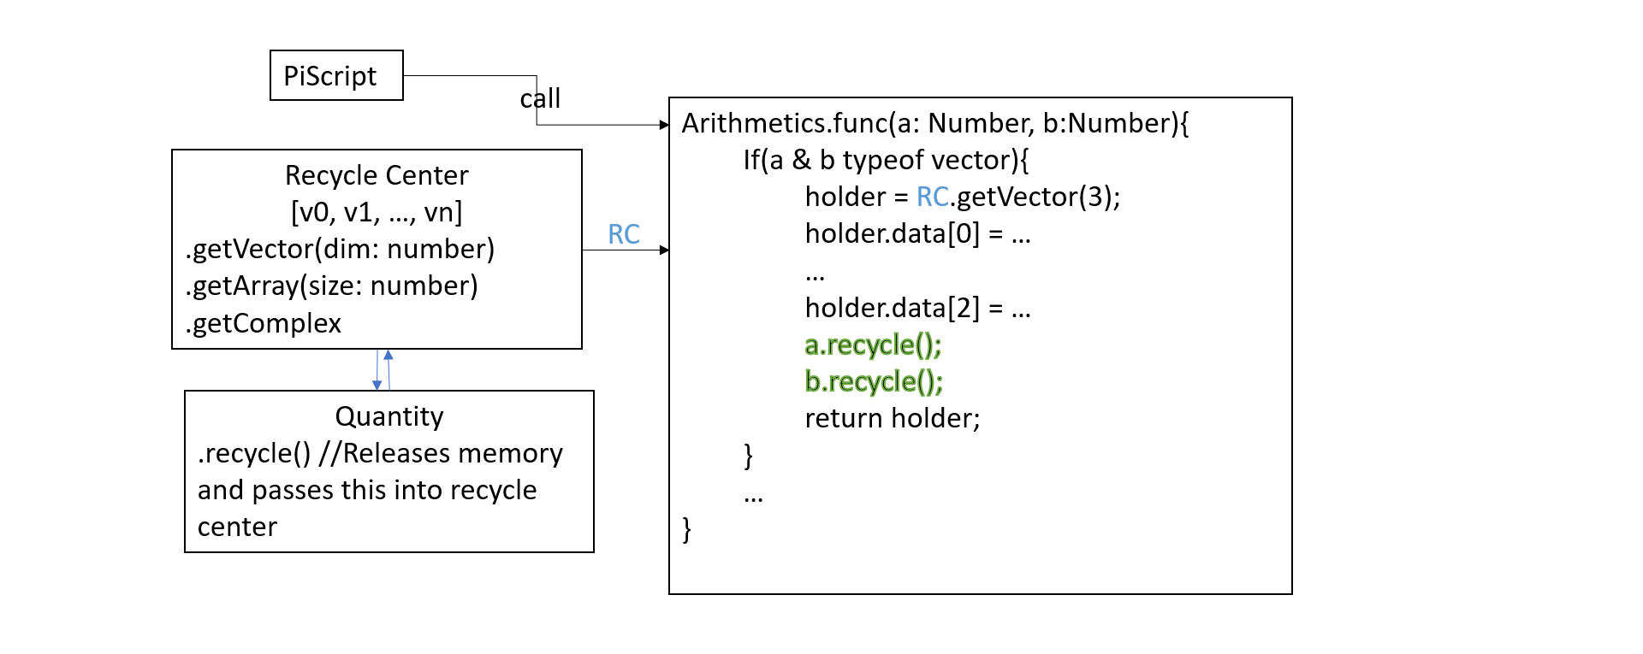

Slide 23
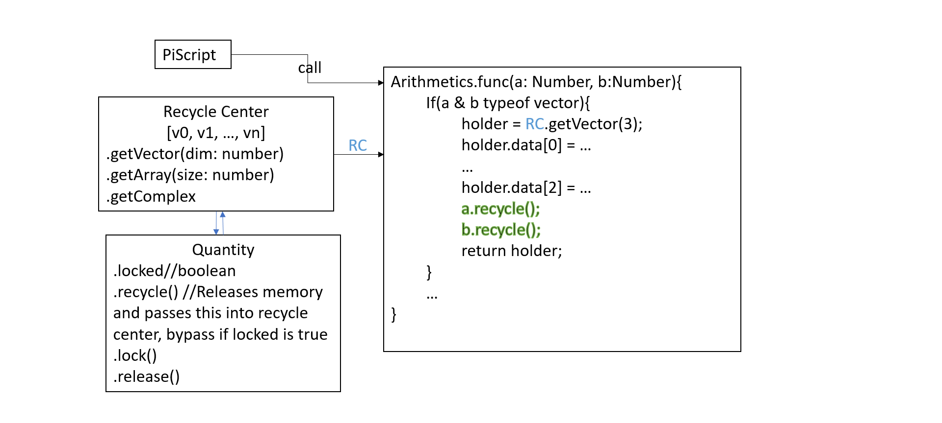

Slide 24
Recycle Center
.getVector(dim: number)
.getArray(size: number)
.getComplex()
Array/Vector stacks
Complex Stacks
Stack 0:
S0 = [Q(1,2,3), Q(2,3),…]
Complex Stack:
SC = [Q(1,2), Q(2,3),…]
Stack 1…n: dynamically allocated
[S1,
S2,
S3…]
Access, pop
Access, pop

Slide 25





$$z=f\left(x^{2}\right)+x$$
return a.add(get(1, c)(c, [a.pow(get(0, c), 2)], [24]), get(0, c))
.evaluate(c, p=[$x^{2}$], pm=[24])
for(let index in pm) { c[pm[index]][0].push(p[index]); }
$c=[…$[$x$=2]$]$
$$f\left(x\right)=\sin\left(x\right)+x$$
let r = a.add(a.sin(get(0, c)), get(0, c))
for(let index in pm) { c[pm[index]][0].pop(); }
$c=[…$[$x$=4]$]$
return r;

