Slide 1

Momento
——An indispensable, valuable, and meaningful platform for sharing and social interaction in daily life.
2024.10.23

Slide 2
Momento Development Team
项目地址：https://github.com/Yuen647/Momento
Name | ID | Division of Labor
李沅衡 | 2253551 | Project Coordination, Technical Development
李俊旻 | 2250286 | Framework Construction, Technical Development
赵子毅 | 2254272 | Requirements Research, Technical Development

Slide 3
1
Project Overview
2
Main Functionalities
Contents
3
Preliminary Logical Architecture
4
Technology Stack
5
Project Schedule

Slide 4

01
Project Overview

Slide 5


Project Overview
1.1 Background and Motivation
Background
Motivation
The rapid rise of social media and content platforms has led users to increasingly rely on online platforms to share their lives, thoughts, and experiences. This has driven a growing demand for personalization, real-time interaction, and high availability.
Existing platforms face shortcomings in handling high concurrency, providing personalized recommendations, protecting user privacy, and ensuring data security. This project addresses these limitations by utilizing advanced architecture and microservice design.
Notes:
1.政策支持：国家出台多项政策和规划支持学前教育，提供资金支持，如《国家中长期教育改革和发展规划纲要》。
2.人口结构变化：二孩和三孩政策的实施预计将提高出生率，扩大早教市场的目标用户群体。
3.家长教育观念的转变：当代父母重视孩子早期教育，认识到其对孩子未来发展的重要性，愿意投入更多资源。
4.经济条件的改善：国民经济的稳健发展和居民收入的提升使家庭拥有更多可支配收入用于教育投资。
5.社会竞争压力：家长希望孩子在竞争激烈的社会中“不输在起跑线上”，增强了早教需求。
6.技术融合与创新：人工智能和互联网技术的发展为早教带来新的教学方式和工具，提高教育质量和效率。

Slide 6
Project Overview
1.2 Purpose and Scope
Note Management
Purpose
1
Tags and Topics
8
2
User Interaction
01
Efficient Content Sharing Platform
02
Multi-level Social Network Construction
Project Delivery
Authentication and Authorization
7
3
Notification Service
03
Personalized Recommendations to Enhance User Experience
04
Convenient Note Management and Interaction Features
Backend Management System
6
4
Search Functionality
5
05
System Stability
Distributed Storage and Caching
Notes:
1.政策支持：国家出台多项政策和规划支持学前教育，提供资金支持，如《国家中长期教育改革和发展规划纲要》。
2.人口结构变化：二孩和三孩政策的实施预计将提高出生率，扩大早教市场的目标用户群体。
3.家长教育观念的转变：当代父母重视孩子早期教育，认识到其对孩子未来发展的重要性，愿意投入更多资源。
4.经济条件的改善：国民经济的稳健发展和居民收入的提升使家庭拥有更多可支配收入用于教育投资。
5.社会竞争压力：家长希望孩子在竞争激烈的社会中“不输在起跑线上”，增强了早教需求。
6.技术融合与创新：人工智能和互联网技术的发展为早教带来新的教学方式和工具，提高教育质量和效率。

Slide 7
Project Overview
Boundaries
Constraints and Assumptions
Acceptance Criteria
To ensure focus, the development of the Momento platform will concentrate on the aforementioned functional modules. The following items are excluded from the project scope:
Integration with third-party social platforms
Support for live streaming and other media formats
E-commerce
Advertising management and other business expansion features。
Constraints:
The platform must ensure high availability and data consistency. It must remain stable under high user concurrency.
Data privacy and security are top priorities for the project. All user interactions and data storage must comply with relevant security standards.
Assumptions:
It is assumed that users expect enhanced platform interactivity through personalized recommendations and real-time notifications.
It is assumed that the system can effectively handle high concurrency demands through a distributed architecture.
The system's core functions must operate stably under high-concurrency scenarios.
Data consistency and the real-time responsiveness of user operations must meet expectations.
The user experience should be smooth, and the system should have complete functionality.
The backend management system must effectively manage users and content.
The project must pass performance testing and be capable of supporting the intended user scale.。

Slide 8
02
Main Functionalities

Slide 9
Main Functionalities
Note and Comment Service
Users can publish, edit, and delete notes, as well as set visibility permissions. The platform supports pinned notes and nested comments to facilitate user interaction.
Like and Favorite Service
Users can like, unlike, and favorite notes. The favorite feature supports category management, ensuring interaction data is accurately updated.
User Relationship Service
Enables users to follow and unfollow others, view followers and following lists, and synchronize with the recommendation service for personalized adjustments.
Notification Service
Sends real-time interaction notifications to users, supports real-time message push and bulk sending, and provides read/unread status management.
Authentication Service
Supports user registration, login, and password modification. JWT is used for identity verification, and multiple login methods and security features are integrated.
Tag and Topic Service
Users can add tags to notes, create and participate in topic discussions. This service is integrated with the search functionality.
Content Recommendation Service
Provides personalized recommendations based on user behavior data. The recommendation service interacts with user relationships, likes, and favorites data.
Search Service
Users can search for notes, users, tags, and topics, supporting multi-criteria combination search. It also offers content review support for administrators.
Backend Management Service
Administrators can review notes and comments, manage user account permissions, view data statistics, and handle content reviews and violations.
Distributed ID Generation Service
Integrates Meituan's Leaf solution, offering segment-based ID and Snowflake algorithm ID generation to ensure the uniqueness of system operations.
Object Storage Service
Stores user-uploaded images, videos, and other data, supporting Minio as a storage type with the flexibility to extend to other types. It supports distributed configuration management.
Counting Service
Tracks user interactions such as likes, favorites, follows, and follower counts. It ensures accurate data counting even under high concurrency scenarios.
Notes:
1.政策支持：国家出台多项政策和规划支持学前教育，提供资金支持，如《国家中长期教育改革和发展规划纲要》。
2.人口结构变化：二孩和三孩政策的实施预计将提高出生率，扩大早教市场的目标用户群体。
3.家长教育观念的转变：当代父母重视孩子早期教育，认识到其对孩子未来发展的重要性，愿意投入更多资源。
4.经济条件的改善：国民经济的稳健发展和居民收入的提升使家庭拥有更多可支配收入用于教育投资。
5.社会竞争压力：家长希望孩子在竞争激烈的社会中“不输在起跑线上”，增强了早教需求。
6.技术融合与创新：人工智能和互联网技术的发展为早教带来新的教学方式和工具，提高教育质量和效率。

Slide 10
03
Preliminary Logical Architecture

Slide 11
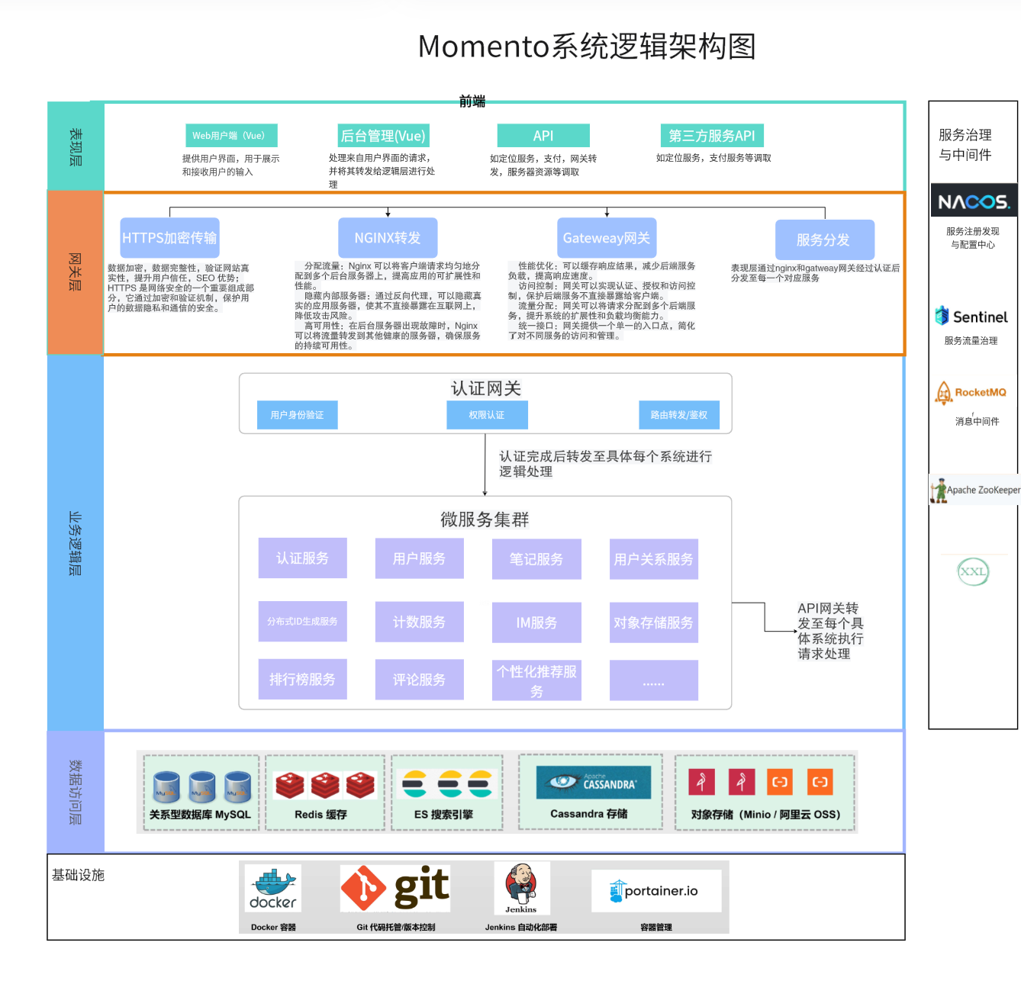
Notes:
1.政策支持：国家出台多项政策和规划支持学前教育，提供资金支持，如《国家中长期教育改革和发展规划纲要》。
2.人口结构变化：二孩和三孩政策的实施预计将提高出生率，扩大早教市场的目标用户群体。
3.家长教育观念的转变：当代父母重视孩子早期教育，认识到其对孩子未来发展的重要性，愿意投入更多资源。
4.经济条件的改善：国民经济的稳健发展和居民收入的提升使家庭拥有更多可支配收入用于教育投资。
5.社会竞争压力：家长希望孩子在竞争激烈的社会中“不输在起跑线上”，增强了早教需求。
6.技术融合与创新：人工智能和互联网技术的发展为早教带来新的教学方式和工具，提高教育质量和效率。

Slide 12
Logical Architecture
Presentation Layer
Web Client
Mobile Interface (if available)
Nginx Reverse Proxy
Developed based on the Vue framework, it provides a desktop user interface, allowing users to publish notes, view content, interact, and perform other operations.
Developed using the uni-app framework, it offers a mobile user interface, ensuring users can easily access the platform via mobile devices.
User requests are distributed to backend microservices through the Nginx reverse proxy server, achieving front-end and back-end decoupling and load balancing. This ensures reliable distribution of user requests and fast access speeds.
Notes:
1.政策支持：国家出台多项政策和规划支持学前教育，提供资金支持，如《国家中长期教育改革和发展规划纲要》。
2.人口结构变化：二孩和三孩政策的实施预计将提高出生率，扩大早教市场的目标用户群体。
3.家长教育观念的转变：当代父母重视孩子早期教育，认识到其对孩子未来发展的重要性，愿意投入更多资源。
4.经济条件的改善：国民经济的稳健发展和居民收入的提升使家庭拥有更多可支配收入用于教育投资。
5.社会竞争压力：家长希望孩子在竞争激烈的社会中“不输在起跑线上”，增强了早教需求。
6.技术融合与创新：人工智能和互联网技术的发展为早教带来新的教学方式和工具，提高教育质量和效率。

Slide 13
Logical Architecture
Gateway Layer
Service Gateway Layer
Request Routing and Load Balancing
Unified Authentication
Spring Cloud Gateway is used as the unified entry point for microservices, providing request routing and load balancing functionality.
User requests are routed to the corresponding microservices, ensuring efficient distribution. It supports dynamic routing and canary releases.
SaToken is used for user authentication and authorization, parsing tokens and passing user information to downstream services, ensuring system security.
Notes:
1.政策支持：国家出台多项政策和规划支持学前教育，提供资金支持，如《国家中长期教育改革和发展规划纲要》。
2.人口结构变化：二孩和三孩政策的实施预计将提高出生率，扩大早教市场的目标用户群体。
3.家长教育观念的转变：当代父母重视孩子早期教育，认识到其对孩子未来发展的重要性，愿意投入更多资源。
4.经济条件的改善：国民经济的稳健发展和居民收入的提升使家庭拥有更多可支配收入用于教育投资。
5.社会竞争压力：家长希望孩子在竞争激烈的社会中“不输在起跑线上”，增强了早教需求。
6.技术融合与创新：人工智能和互联网技术的发展为早教带来新的教学方式和工具，提高教育质量和效率。

Slide 14
Logical Architecture
Authentication Service
Based on the RBAC (Role-Based Access Control) model, it supports user login, registration, logout, password modification, and other operations, ensuring the legitimacy of user identities.
Based on Apache Cassandra, it stores short text content on the platform, such as note bodies and comments, supporting high-concurrency read and write requirements to ensure fast data access.
1
KV Short Text Storage Service
8
2
User Service
Manages user information, supporting modification, query, and registration of user details. It utilizes a Redis + Caffeine dual-level cache to handle high-concurrency access.
Stores unstructured data such as images and videos for the platform. It uses factory and strategy patterns to support the Minio storage type, allowing for flexible expansion to meet different storage needs.
Object Storage Service
Business Logic Layer
Supports functionalities such as note publishing, editing, querying, pinning, and permission modifications. RocketMQ is used for data broadcasting and cache updates to ensure data consistency.
7
3
Note Service
6
4
Manages follow and unfollow operations between users, maintaining the social relationship graph. Redis cache and message queues are used to support high-concurrency write operations.
Used for counting metrics like follows, followers, and likes. It consumes user behavior data through message queues to ensure high performance and availability in high-concurrency scenarios.
Counting Service
User Relationship Service
5
Distributed ID Generation Service
Based on the Meituan Leaf project, it provides unique identifiers for the system, supporting unique ID generation in high-concurrency environments to avoid ID conflicts.
Notes:
1.政策支持：国家出台多项政策和规划支持学前教育，提供资金支持，如《国家中长期教育改革和发展规划纲要》。
2.人口结构变化：二孩和三孩政策的实施预计将提高出生率，扩大早教市场的目标用户群体。
3.家长教育观念的转变：当代父母重视孩子早期教育，认识到其对孩子未来发展的重要性，愿意投入更多资源。
4.经济条件的改善：国民经济的稳健发展和居民收入的提升使家庭拥有更多可支配收入用于教育投资。
5.社会竞争压力：家长希望孩子在竞争激烈的社会中“不输在起跑线上”，增强了早教需求。
6.技术融合与创新：人工智能和互联网技术的发展为早教带来新的教学方式和工具，提高教育质量和效率。

Slide 15
Logical Architecture
Data Access Layer
MySQL MySQL is used to store relational business data, providing transactional guarantees to ensure data consistency and durability.
Redis
Redis is used for caching frequently accessed data, significantly improving system response speed and reducing the load on the database.
Elasticsearch (ES)
Elasticsearch (ES) is used for full-text search and efficient data querying, enabling fast retrieval of note content and user data.
Apache Cassandra
Apache Cassandra is utilized for storing short text data, supporting high-concurrency read and write operations to ensure data accessibility under large-scale user interactions.
对象存储（Minio）
Object storage (Minio) is used to store unstructured data such as images and videos, ensuring the reliability and scalability of large-scale file storage.

Slide 16
Logical Architecture
Service Governance and Middleware Layer
01
02
03
04
05
Nacos
Sentinel
RocketMQ
ZooKeeper
XXL-JOB
Nacos is used for service registration and configuration management, supporting dynamic configuration and service discovery to ensure the high availability of microservices.
Sentinel is used for traffic control and circuit breaking, providing rate limiting to protect the system's stability during peak traffic, preventing overload.
RocketMQ is used for asynchronous message transmission, enabling loose coupling and efficient communication between microservices, ensuring data consistency and real-time processing.
ZooKeeper is used for coordination tasks in distributed systems, ensuring the consistency of distributed services and managing distributed locks and configurations.
XXL-JOB is used for scheduling tasks, supporting the execution and management of distributed scheduled tasks, ensuring reliable task execution.

Slide 17
04
Technology Stack

Slide 18








Technology Stack
Java&Maven
Vue
Java is a powerful, platform-independent programming language, and Maven is a build automation tool that simplifies dependency management and project configuration for Java applications.
Vue is a progressive JavaScript framework used for building user interfaces, focusing on flexibility, ease of integration, and reactive data binding.
Spring Boot&Spring Cloud
Redis
Spring Boot simplifies Java application development with embedded servers and auto-configuration, while Spring Cloud provides tools for building and managing microservices architectures.
Redis is an in-memory data structure store used for caching, real-time analytics, and high-performance data storage, supporting operations like key-value storage, pub/sub messaging, and more.
IntelliJ IDEA
Visual Studio Code
IntelliJ IDEA is a powerful, feature-rich integrated development environment (IDE) for Java and other languages, known for its intelligent code assistance and developer productivity tools.
Visual Studio Code is a lightweight, versatile code editor with support for multiple programming languages, offering features like debugging, version control, and extensions for enhanced development productivity.
MySQL
Docker
MySQL is a popular open-source relational database management system known for its reliability, scalability, and support for structured data with SQL queries.
Docker is a platform that enables developers to automate the deployment and management of applications within lightweight, portable containers, ensuring consistency across different environments.

Slide 19
05
Project Schedule

Slide 20
Project Schedule
Planning Phase
Development Phase
Implementation Phase
Testing Phase
Timeline | Week 8-9 | Week 10 | Week 11 | Week 12 | Week 13 | Week 14 | Week 15 | Week 16
Planning
Framework Construction
Core functionality development
Backend service interface development
Frontend development
Perform system integration and testing
Software Testing

Slide 21
Momento
——An indispensable, valuable, and meaningful platform for sharing and social interaction in daily life.
2024.10.23

