Slide 1

Rockbuster Stealth LLC
Data Analytics
Prepared by: Gearld Yuen

Slide 2
Objectives:
● Which movies contributed the most/least to revenue gain?
● What was the average rental duration for all videos?
● Which countries are Rockbuster customers based in?
● Where are customers with a high lifetime value based?
● Do sales figures vary between geographic regions?

Slide 3
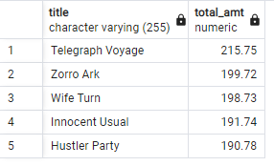
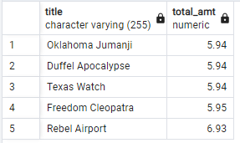
Movies revenue
Top five films
Bottom five films

Slide 4
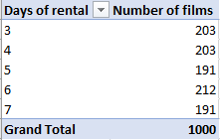
Customers rental duration
Average rental days | Maximum days of rental | Minimum days of rental | Most customers days of rental
5 | 7 | 3 | 6
Rental days are between 3 days to 7 days. Even though the average rental days are 5 days and most rental days are 6 days, from the chart on the left shows all five choices are pretty even out.

Slide 5
High Lifetime Value Customers
Country | Last Name | First Name | Total
Runion | Hunt | Eleanor | $ 211.55
United States | Seal | Karl | $ 208.58
Brazil | Snyder | Marion | $ 194.61
Netherlands | Kennedy | Rhonda | $ 191.62
Belarus | Shaw | Clara | $ 189.60
Country | Customer count | Total Revenue
India | 1422 | $6034.78
China | 1297 | $5251.03
United States | 869 | $3685.31
Japan | 749 | $3122.51
Mexico | 718 | $2984.82
Brazil | 681 | $2919.19
Russian Federation | 638 | $2765.62
Philippines | 530 | $2219.70
Turkey | 351 | $1498.49
Indonesia | 331 | $1352.69
The high lifetime value customers are from all over the world. However, most customers are from Asia especially in India and China.

Slide 6
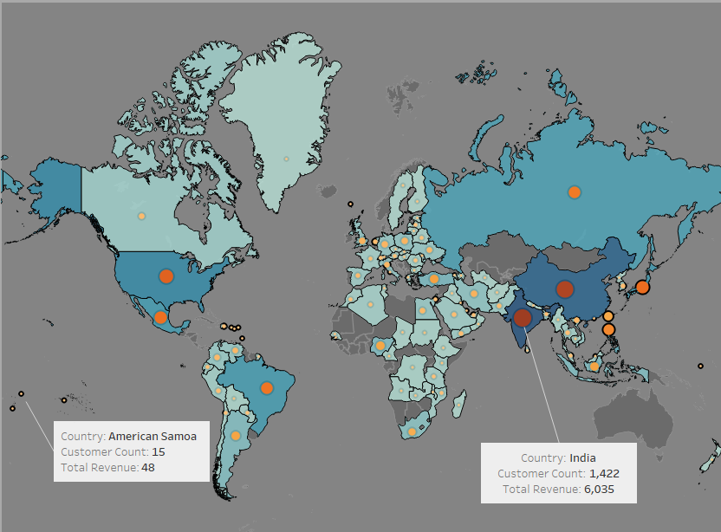
Highest and Lowest Countries: (Revenue and customers)
Highest revenue country: India
Lowest revenue country: American Samoa

Slide 7
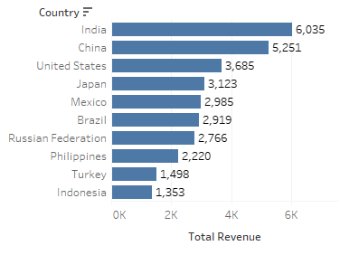
Sales based on Countries:
Total Revenue
$61312.04
Countries | Revenue | % of Total Revenue
India | $ 6,034.78 | 9.84%
China | $ 5,251.03 | 8.56%
United States | $ 3,685.31 | 6.01%
Japan | $ 3,122.51 | 5.09%
Mexico | $ 2,984.82 | 4.87%
Brazil | $ 2,919.19 | 4.76%
Russian Federation | $ 2,765.62 | 4.51%
Philippines | $ 2,219.70 | 3.62%
Turkey | $ 1,498.49 | 2.44%
Indonesia | $ 1,352.69 | 2.21%
TOTAL of top ten countries | $ 31,834.14 | 51.92%
There are more than 100 countries in the list and the top ten countries contribute over 50% of the sales. Half of the countries in the list are from Asia.

Slide 8
Insight Summary:
Recommandations:
Asia seems to have a bigger market we can focus on. We can also explore more options to other countries like Australia and some of the Africa countries.
Do more marketing in the top ten countries and acqurie more films based on their liking to generate higher profit.
Next Steps:
Research for the trance of future films and expend the selection for the customers.

