Slide 1
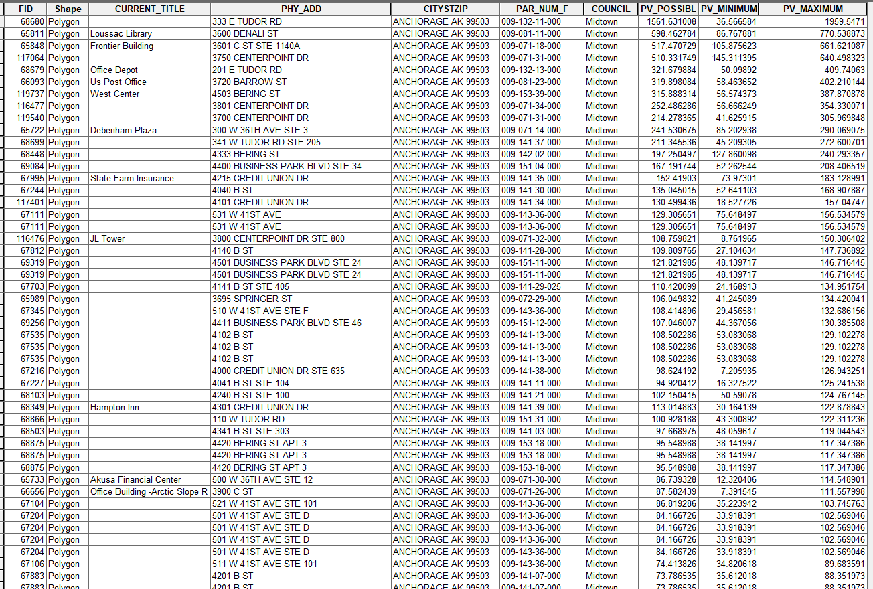
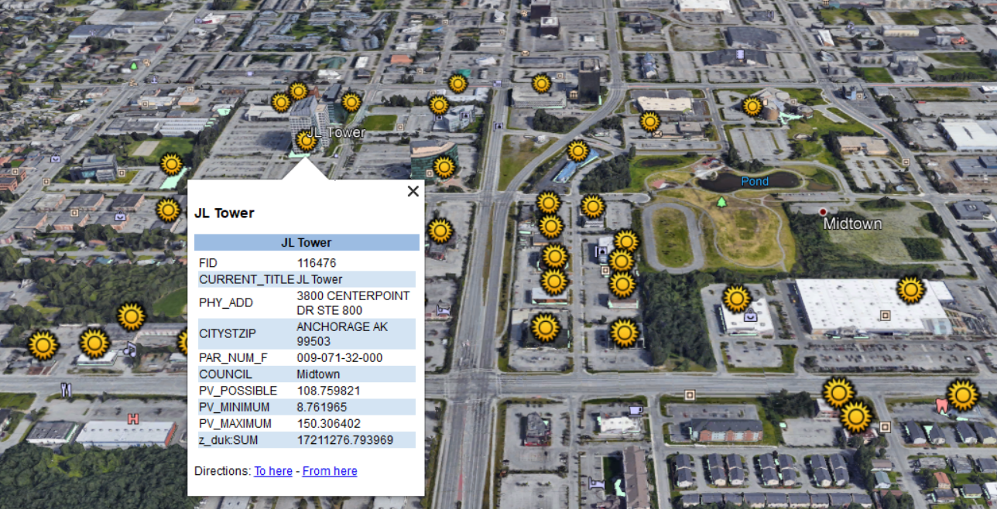
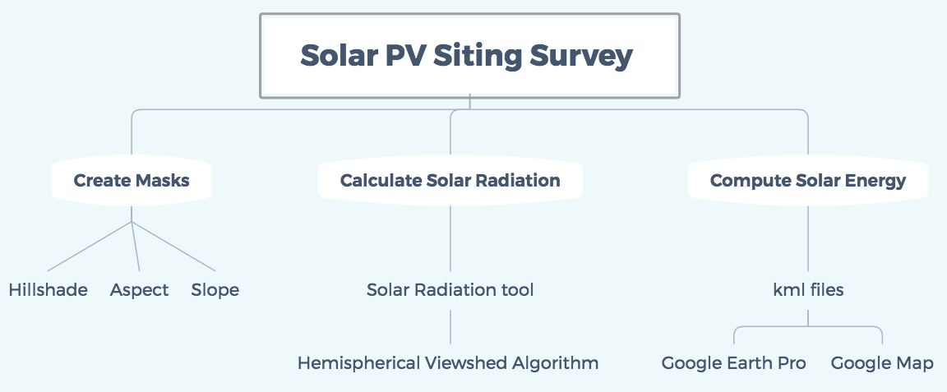
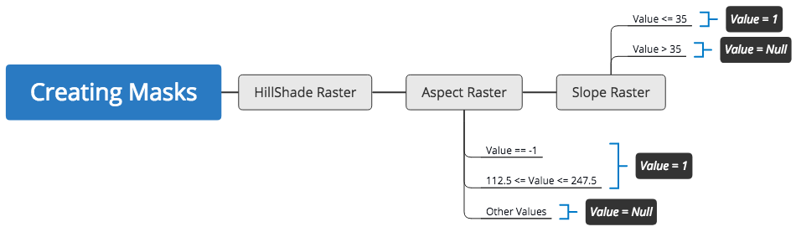


Solar PV Siting Survey for Anchorage, Alaska
Jingtian Zhang, Cheng Zeng, Yuening Wang
https://github.com/Yueningwang/ASAP
Results and Conclusion
Background and Introduction
2. Calculate Solar Radiation
After masking, the remaining areas are used to calculate solar radiation. Arcgis has a powerful tool -- Solar Radiation tool, which can derive incoming solar radiation during a year. This is based on hemispherical viewshed algorithm developed by Rich and Fu, taking into account direct radiation and diffuse radiation. However, compared to System Advisor Model (SAM), this tool neglects local meteorological data, making the results less accurate.
3. Compute Solar Energy
Combining area of rooftops or parking lots and solar radiation they collect, we can attain the overall solar energy they produce. When converting into kml files, which can open by Google Earth Pro and Google Map, one can easily decide if it is worthwhile to planting solar panels in this specific location.
Solar energy, one of the green energy, has attracted much attention because of its abundance. The most commonly used device to convert solar energy to electricity is solar panels. However, locating suitable place to install solar panels is time-consuming and inefficient.
In this project, we focus on predicting potential solar sites, including rooftops, parking lots and parking structures for commercial photovoltaics. Solar energy calculation model is built based on packages in Arcgis Desktop software, such as aspect, slope and solar radiation. The input is Light Detection and Ranging (LIDAR) data, a remote sensing method utilized by the government. The output is kml files, which can be displayed in Google Earth Pro and Google Map. Unlike other PV estimation projects, our project takes HVAC systems, vents and pipes on rooftops, and parking lots on the ground into consideration.
Table 1 Study Case in Midtown Council Displayed in Spreadsheet
Methods and Approaches
In order to compute solar energy, three steps are followed to complete the workflow:
1. Create Masks
First, we need to filter location generating high solar energy. In this case, three conditions are chosen to consider, i.e. hillshade, aspect and slope. Hillshade eliminates places where the sun is blocked by other buildings so they cannot receive high solar radiation. The aspect of the solar panels should be south facing or horizontal to have a higher solar power output because Anchorage is located in the northern hemisphere. Slope allows for installing solar panels, which means slope should be less than 35 degrees. All three conditions create masks to detect spots proper to obtain solar energy.
Figure 3 Study Case in Midtown Council Displayed in Google Earth Pro
We take Midtown Council in Anchorage as a study case, other councils and locations can use similar methods, or apply the python module on our GitHub Repository. From the Table 1, a number of potential solar sites are identified, ranging from 70 W to 1500 W during Year 2018. Furthermore, displaying kml files in Google Earth Pro and Google Map makes it easy to locate the sites. For example, in Figure 3, the address of JL Tower, the possible PV solar energy can be readily seen.
In a word, we successfully build Solar Energy Calculation module to identify and compute potential solar energy.
Figure 1 Flowchart of Methods and Approaches
Figure 2 Model Builder of Creating Masks
Reference:
[1] Andrea Chaves and A. Terry Bahill. Locating Sites for Photovoltaic Solar Panels Pilot study uses DEM derived from LiDAR. ArcUser Fall 2010.
[2] Clean Coalition. Solar Siting Survey Draft Final Summary Report: Solar Photovoltaic (PV) Commercial-Scale Sites for 1,000 kW (AC) and Larger. August 2017. www.clean-coalition.org

