Slide 1



OASIS: Object-Aware Page Management for Multi-GPU Systems
Yueqi Wang¹, Bingyao Li¹, Mohamed Tarek Ibn Ziad², Lieven Eeckhout³,
Jun Yang¹, Aamer Jaleel², Xulong Tang¹
¹University of Pittsburgh, ²NVIDIA , ³Ghent University

Slide 2
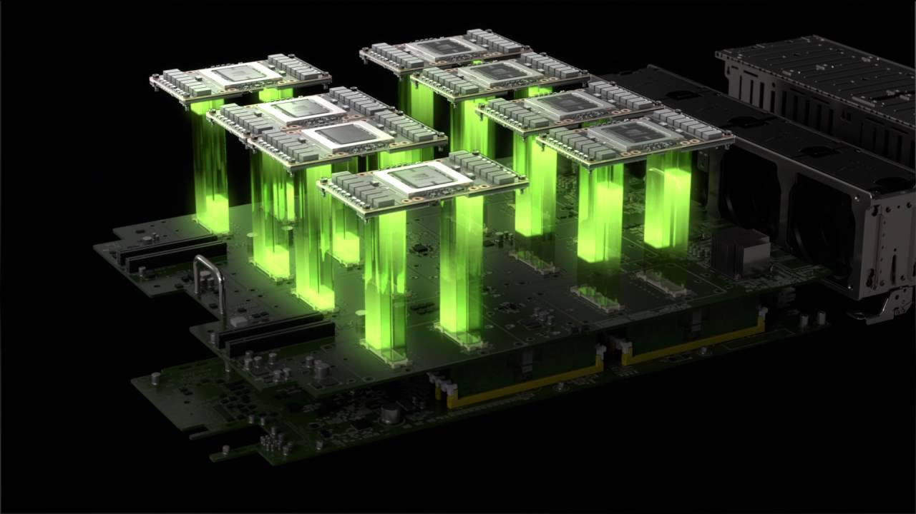
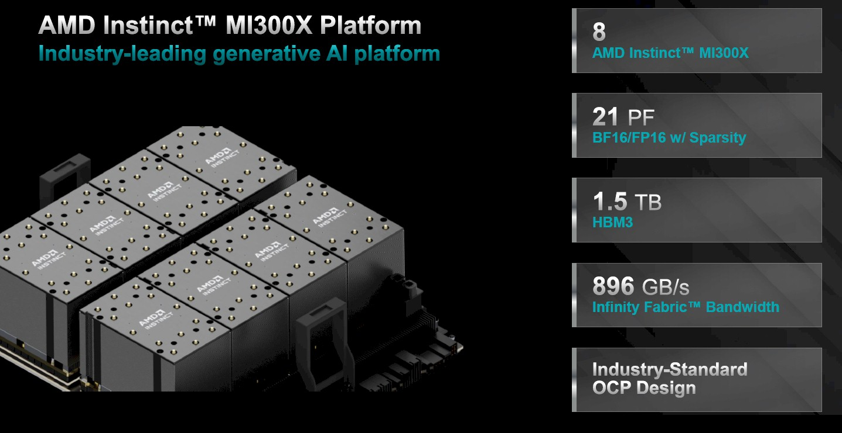
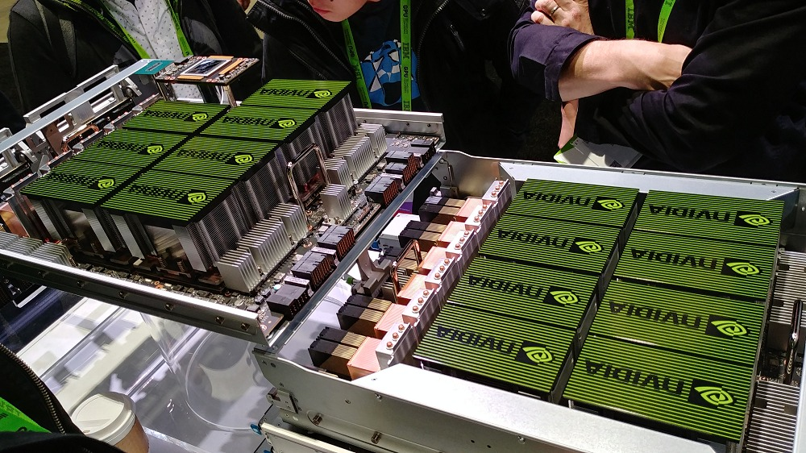
Multi-GPU Systems Are Pervasive
Multi-GPU systems deliver performance and scalability

Slide 3

Multi-GPUs
Mem
GPU
GPU
Mem
NUMA Overheads
- Data transfer
- Remote data access
…
Mem
GPU
GPU
Mem
CPU

Slide 4


On-Touch Page Migration
Page immediately migrated to the requesting GPU
GPU₀
Local memory access
GPU₁
Ping-Pong effect
GPU₀
GPU₁
Best suited for private pages (i.e., pages accessed by a single GPU)
GPU₀

Slide 5
Access Counter-Based Page Migration
Page migrated when access counter reaches threshold
GPU₀
Access counter
Reduced ping-pong effect
+1
+1
+1
Migrate
Remote access
> Threshold
GPU₁
Best suited for shared pages (i.e., pages frequently accessed by different GPUs)
Page
Page

Slide 6
Page Duplication
Replicate frequently accessed pages across multi-GPU
GPU₀
Read,
Duplicate
Reduced migration & remote access
GPU₁
Page
Page
Collapsing overhead
Write, Collapse
Best suited for read-only shared pages
GPU₀
GPU₁
GPU₂
Page
Page
Page

Slide 7
Performance of Page Management Policies
Simulated 4-GPU system
No “one-size-fits-all” page management policy

Slide 8
Re-Thinking Page Management: Make Object Level Decisions
Conventional page management decisions made at page granularity
Requires learning the access pattern for each page!
Problem:
Make page management decisions at object level
(Object: An application data structure created at runtime using malloc routine)
Proposal:
Objects typically consist of many pages
Different pages of an object have similar access characteristics
Reduces learning overhead of each page
Benefits:

Slide 9
Effectiveness of Object Granularity
Matrix Multiplication (Total memory footprint: 64 MB)
16,384 pages
VS
3 objects
Matrix A Matrix B Matrix C
Make page management decisions:
Page-granularity: High learning overhead & complexity
Object-granularity: Few objects can cover a wide range of pages

Slide 10
Effectiveness of Object Granularity
On-Touch
Private
Write
Application | #Pages
MM | 16,384
MM | 65,536
MM | ...
#Objects
3
3
3
Share
Read
Share
Read
Duplication
Proposal: Object-aware Page Management (OASIS)

Slide 11
Overview of Object-aware Page Management (OASIS)
1
Identify Objects at Runtime
Learn Object Access Pattern
2
Determine Best Page Management Policy for each Object
3

Slide 12
OASIS – How to Perform Page Management at Object Granularity?
Identify object at runtime:
Encode Object-ID in the virtual address
cudaMallocManaged(&ptr_a, ...);
Wrapper
Unused | Object Virtual Address
… | Object ID
Learning object access pattern
Hardware on-chip Object-Table
CPU
O-Table
Object ID | Policy
0000 | Access counter
0001 | Duplication
… | …

Slide 13
OASIS – Determining the Best Page Management Policy for Object
On-touch
Use table-recorded policy
Page fault
YES
Hit
PRIVATE?
NO
Object Table
Host Page Table
Miss
Is READ?
Access-counter
NO
Insert Object Table
YES
Duplication

Slide 14
Handling Dynamic Changes to Object Access Pattern
Kernel 0
Kernel 1
Kernel 2
Object 0
Write, shared
Read, shared
Write, shared
Remote access
Access counter-based migration
Access counter-based migration
Access counter
Duplication
Access counter
Object access patterns change across kernels but remain constant within each kernel.
Reset O-Table at Kernel Boundary, Re-determine Policy

Slide 15
Methodology
Simulator: MGPUSim [ISCA 2019]
Baseline: 4-GPU system
16-entry Object Table
Workloads: 11 applications
Benchmarks: Hetero-Mark, AMDAPPSDK , SHOC, DNN Mark
Access Patterns: random, adjacent, and scatter-gather
Please refer to paper for further details on methodology

Slide 16
Evaluation – Overall Performance
Simulated 4-GPU system
OASIS outperforms On-touch, Access counter & Duplication by 64%, 35%, and 42%

Slide 17
Evaluation – Comparison to the state-of-the-art GRIT
OASIS outperforms GRIT by 12% at reduced complexity!
[1] Y. Wang, B. Li, A. Jaleel, J. Yang and X. Tang, "GRIT: Enhancing Multi-GPU Performance with Fine-Grained Dynamic Page Placement," 2024 IEEE International Symposium on High-Performance Computer Architecture (HPCA).

Slide 18
More Design Details and Results
A scalable software alternative (OASIS-InMem)
Detailed workload characterization
Design details, overhead analysis, sensitivity studies
GPU Count
Input Size
Comparison with state-of-the art

Slide 19
Summary
Problem:
No “one-size-fits-all” page management policy
Observation:
Pages in the same object tend to exhibit similar patterns
OASIS - object-aware dynamic page management
Improves performance by 64% on average with negligible storage overhead (24 Bytes)
Proposal:

Slide 20
OASIS: Object-Aware Page Management for Multi-GPU Systems
Thanks! Q&A
Yueqi Wang¹, Bingyao Li¹, Mohamed Tarek Ibn Ziad²,
Lieven Eeckhout³, Jun Yang¹, Aamer Jaleel², Xulong Tang¹
¹University of Pittsburgh, ²NVIDIA , ³Ghent University

