Slide 1

Discovering Heavy Hitters in Wikipedia Clickstream under Local Differential Privacy
Yueran Cao yc1306
Kang Zhao kz262
Date: 4/30/2025
GitHub Repository: github.com/YueranCao2001/DP_Final_Project

Slide 2
Outline
Motivation & Problem Statement
Initial Plan and Approach
Algorithms Implemented (LDP Heavy Hitters)
Difficulties & Plan Deviations
Results – Top-K F1 Score vs. K (ε=4)
Result Observations
Lessons Learned
Conclusion

Slide 3
Motivation & Problem Statement
Heavy Hitters:
most frequent items in a dataset (e.g. popular search queries or visited pages)
Challenge:
Finding global heavy hitters without violating individual user privacy
Local Differential Privacy (LDP)
ensures each user’s data is randomized before sharing (protecting personal info)
Goal:
Explore an LDP solution for heavy hitters – identify top trends privately

Slide 4
Initial Plan and Approach
Simulate the client-server pipeline in one program (no actual network needed)
Generate synthetic user data to fine-tune conditions (control domain size, distribution shape, known heavy hitters)
Planned to evaluate under various scenarios:
Different data distributions (uniform vs. skewed frequency)
Different domain sizes (number of unique items)
Different privacy levels (varying ε values)
Why: Understand how privacy settings and data characteristics affect heavy-hitter detection accuracy

Slide 5
Algorithms Implemented (LDP Heavy Hitters)
TrieHH (AISTATS 2020) – interactive, prefix-trie based algorithm – Builds strings character by character, keeping only prefixes with enough votes (post-noise) each round
SFP – Sequence Frequency Puzzle (Apple 2022) – batch (non-interactive) algorithm – Each user reports to a Count-Min Sketch per character position + a Bayesian inference to reconstruct frequent strings
Implemented both protocols to compare their performance on the same data under LDP

Slide 6
Difficulties & Plan Deviations
Data pivot – Used a real dataset (Wikipedia clickstream) instead of purely synthetic data ↳ More realistic evaluation, but reduced time for trying diverse synthetic scenarios
Scope adjustment – Focused on one privacy setting ε = 4, δ ≈ 10^(−12) due to time ↳ Did not exhaustively test multiple ε values as initially intended
Technical challenges – SFP algorithm was complex to implement & debug ↳ Required extra debugging (unexpected edge cases), causing slight delays
Timeline constraints – Midterm exams and other coursework slowed early progress ↳ Had to catch up in later weeks; prioritized core features over “nice-to-haves” (Despite changes, main goal – comparing TrieHH vs SFP under LDP – stayed on track.)

Slide 7
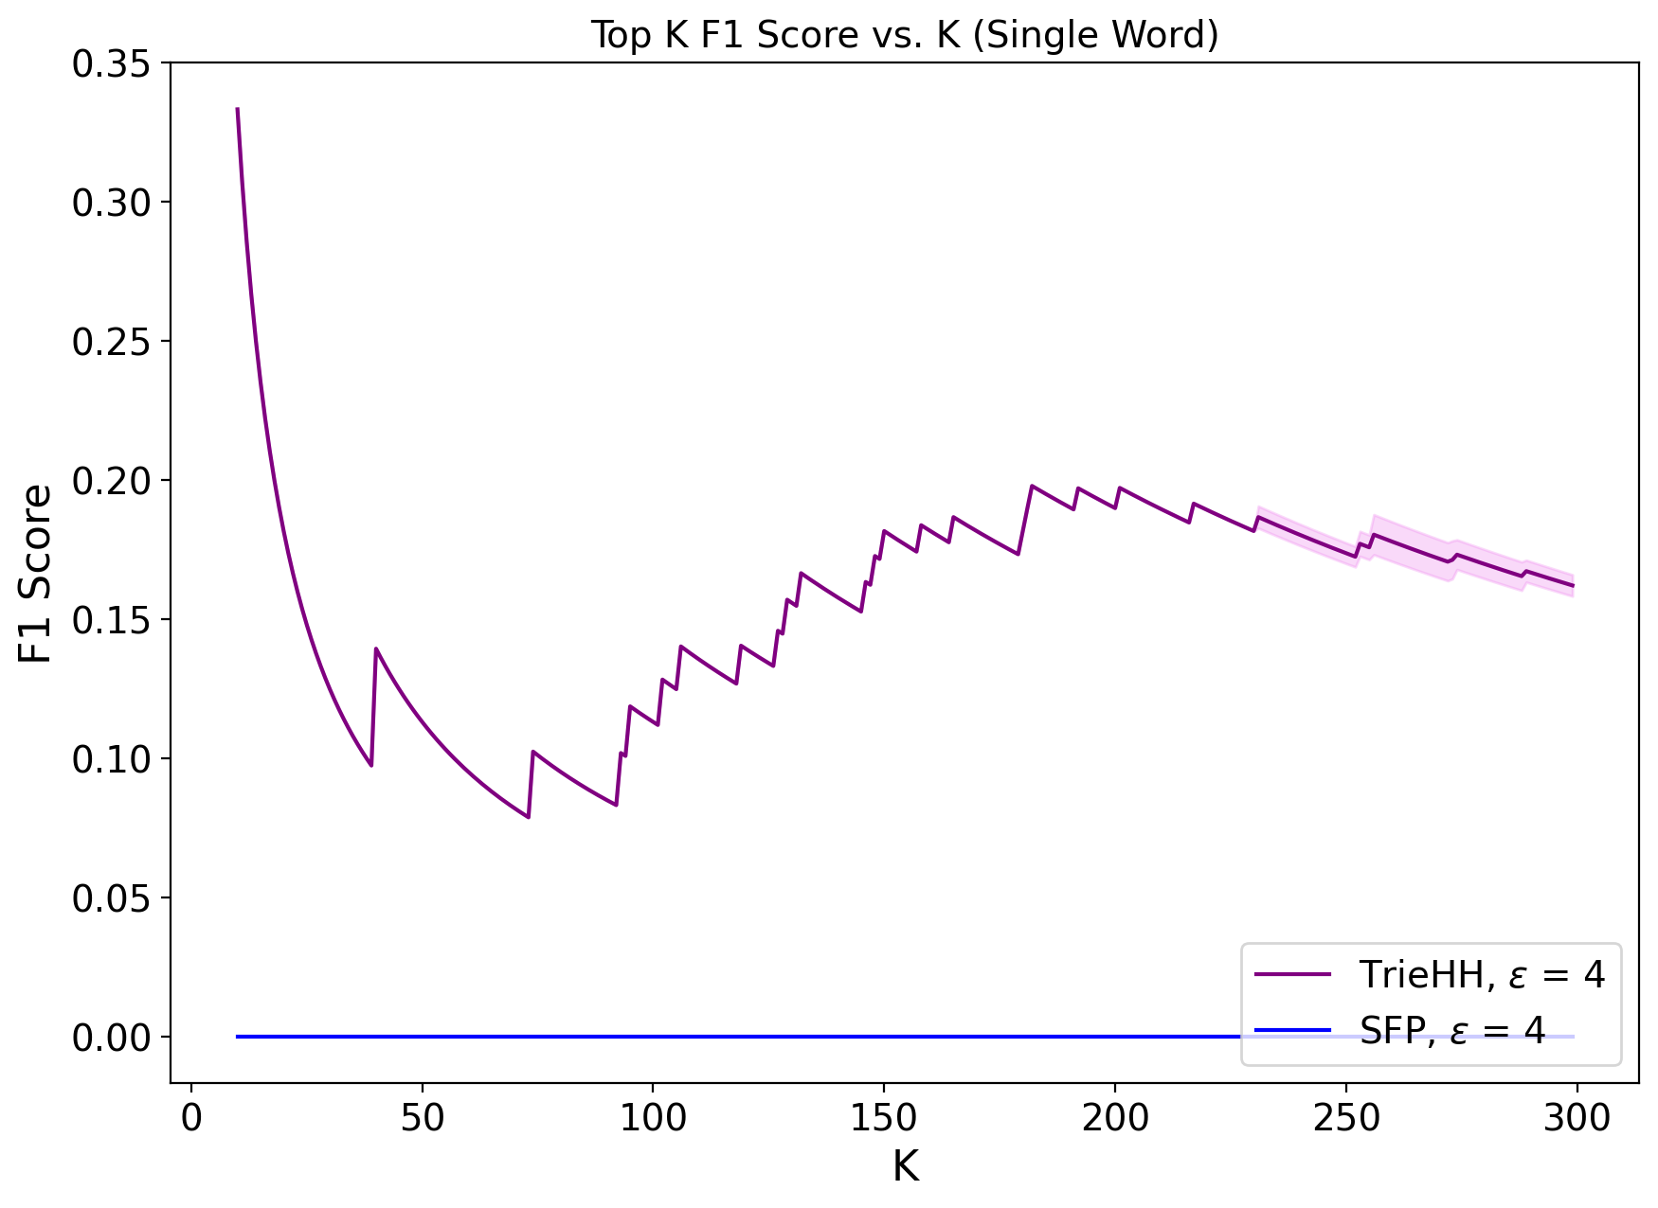
Results – Top-K F1 Score vs. K (ε=4)
Description:
TrieHH (purple) shows a peak around K = 20–30.
F1 score rises initially, peaks ~0.34, and gradually decreases as K increases.
SFP (blue) remains flat at F1 = 0 across all K (no heavy hitters detected).

Slide 8
Result Observations
TrieHH Performance:
Achieves a peak F1 ≈ 0.34 when K is small (~10–20 heavy hitters).
After K ≈ 30, F1 slowly declines as more noise and false positives accumulate.
Overall better robustness under ε = 4 compared to expected.
SFP Performance:
Consistently 0 across all K.
Did not recover any heavy hitters under strict (ε=4, δ≈10^-12) settings.
Key Takeaways:
Interactive approach (TrieHH) succeeds modestly despite noise.
Non-interactive method (SFP) too conservative to detect true signals.

Slide 9
Lessons Learned
Privacy–Utility Trade-off – Stronger privacy (low δ, moderate ε) drastically reduced accuracy ↳ Our experiment highlights how challenging it is to get useful results under strict LDP
Algorithm Design Matters – Interactive methods (TrieHH) can extract signal where one-shot methods (SFP) may fail ↳ Different approaches have different strengths; context (data size, noise) is key
Implementing Research – Gained hands-on experience turning complex DP algorithms from papers into working code ↳ Improved our understanding of each step (and the pitfalls) of TrieHH and SFP
Adaptability – Learned to adjust our plan and scope on the fly ↳ Chose realistic data over idealized tests, focused on core comparison when time was limited, and ensured we met the main objectives

Slide 10
Conclusion
Implemented two LDP heavy-hitter algorithms
Faced and overcame practical challenges
Found that TrieHH outperformed SFP on real data under strict privacy

Slide 11
Thank You !

