Slide 1




FB
GAMES
第四組
許又元/李悅 /王品琪

Slide 2


contents
遊戲說明
程式設計
1
3
遊戲架構
未來發展規劃
2
4

Slide 3
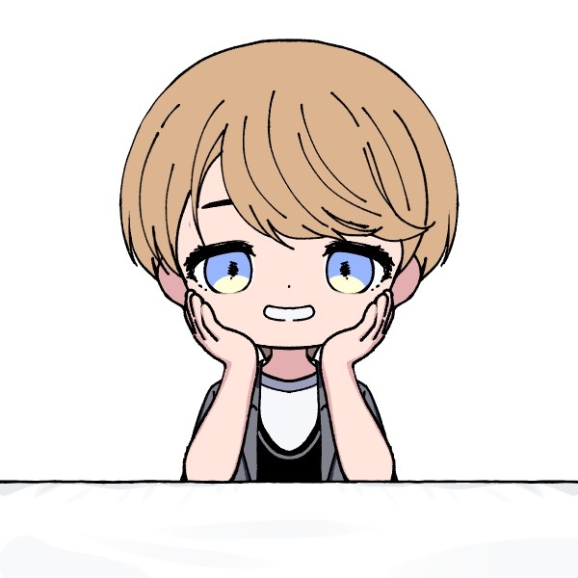





Name
@百科
Meet
the
Name
@派森
Players
Name
@伊瑟爾

Slide 4







遊戲動機

Slide 5


遊戲規則

Slide 6


about
code

Slide 7


未
來
發
展
與
規
劃
The Great future

Slide 8
future
plans
1.增加遊戲腳本
2.擴充遊戲互動功能

Slide 9



round
one
A
L
T
E
B
Hurry! Write your answers. The clock is ticking.

Slide 10


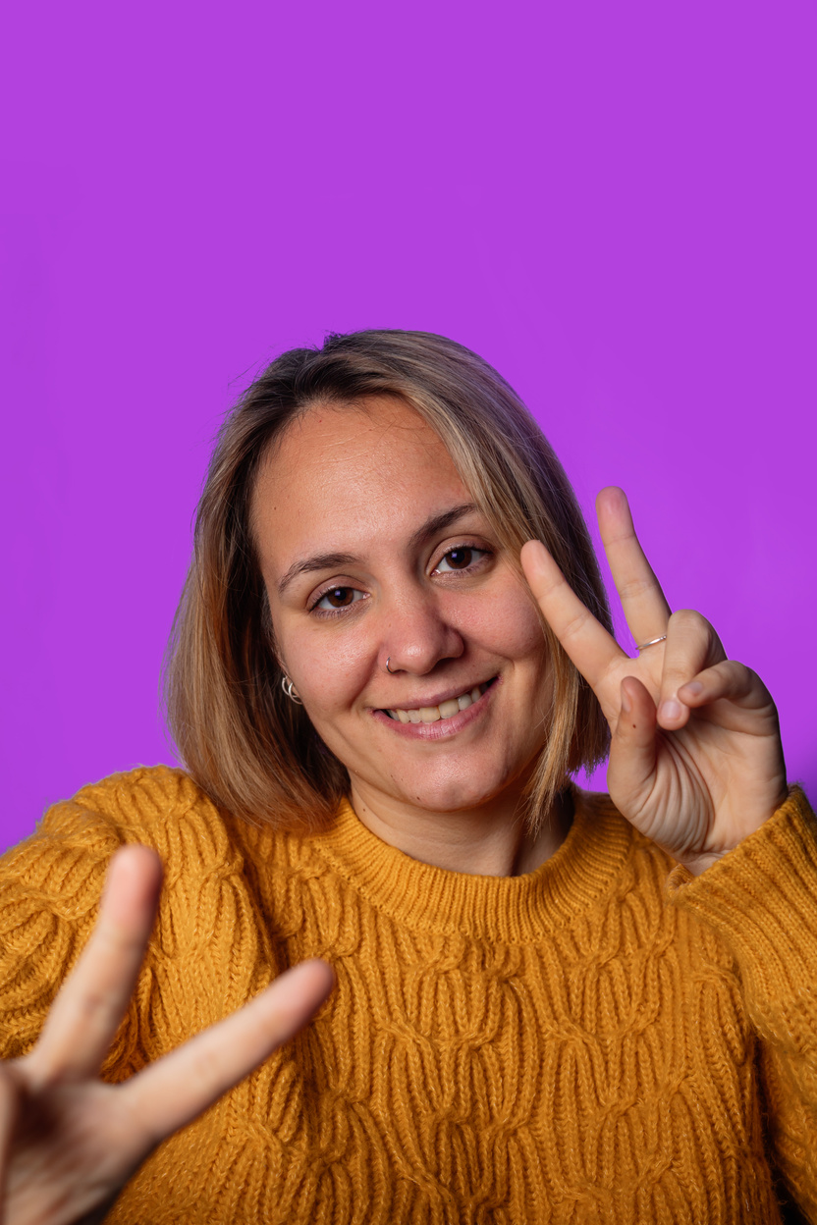
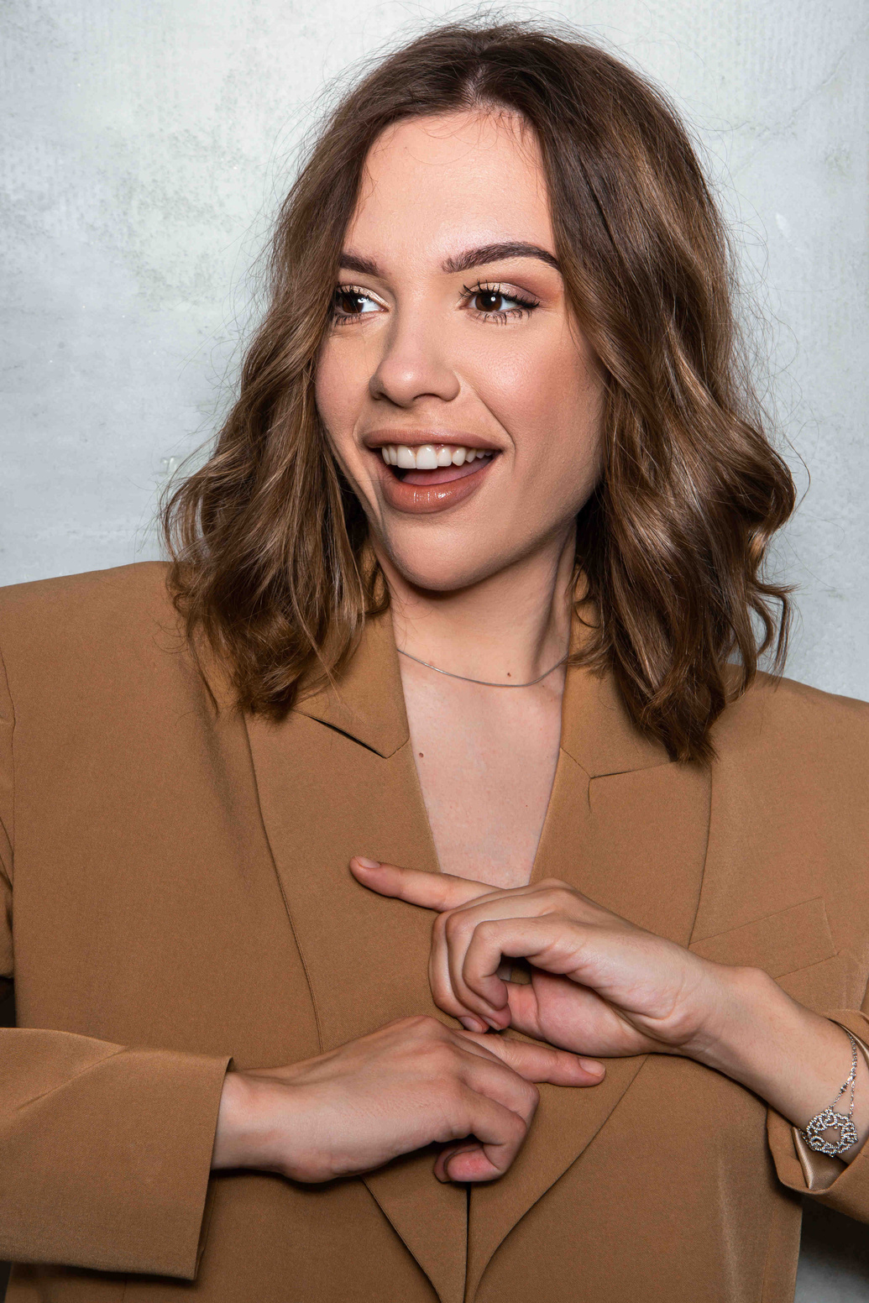
Round 1
answer
sheet
Award this star to the winner of the round!
Answer
Answer
Answer
Answer
Answer
Answer
Answer
Answer
Answer
Answer
Answer
Answer
Answer
Answer
Answer
Answer
Answer
Answer
Answer
Answer
Answer
Answer
Answer
Answer
Answer
Answer
Answer
Answer
Answer
Answer
Answer
Answer
Answer
Answer
Answer
Answer
Answer
Answer
Answer
Answer
Answer
Answer

Slide 11

average
round
6 letter word

Slide 12

round
two
R
E
L
E
T
T
Hurry! Write your answers. The clock is ticking.

Slide 13
Round 2
answer
sheet
Award this star to the winner of the round!
Answer
Answer
Answer
Answer
Answer
Answer
Answer
Answer
Answer
Answer
Answer
Answer
Answer
Answer
Answer
Answer
Answer
Answer
Answer
Answer
Answer
Answer
Answer
Answer
Answer
Answer
Answer
Answer
Answer
Answer
Answer
Answer
Answer
Answer
Answer
Answer
Answer
Answer
Answer
Answer
Answer
Answer

Slide 14
are
you
ready?

Slide 15
Round 3
answer
Award this star to the winner of the round!
sheet
Answer
Answer
Answer
Answer
Answer
Answer
Answer
Answer
Answer
Answer
Answer
Answer
Answer
Answer
Answer
Answer
Answer
Answer
Answer
Answer
Answer
Answer
Answer
Answer
Answer
Answer
Answer
Answer
Answer
Answer
Answer
Answer
Answer
Answer
Answer
Answer
Answer
Answer
Answer
Answer
Answer
Answer

Slide 16



score
board
Count how many stars each player has won in the rounds. The player with the most star wins.
Kindly delete this note after editing this page.

Slide 17

congratulations
You are such a word genius!
Mark Twain is trembling.

Slide 18

thank
you
for
playing

Slide 19










Game
Resource
Page
Use these icons in your game. Enjoy!

Slide 20
Game
Resource
Page
B for blur
C for confetti
D for a drumroll
O for bubbles
Q for quiet
X to close
Any number from 0-9 for a timer
Find the magic and fun in presenting with Canva Presentations. Press the following keys while on Present mode!

