Slide 1
MA4M4: Bow-tie Decomposition of Vaccination Views in Social Media
Yueting Han
Mathematics for Real-World Systems CDT,
University of Warwick
Notes:
Hi Marya! This is Yueting Han from MathSys. Here I am to give you a presentation of my MA4M4 Essay, titled with Bow-tie Decomposition of Vaccination Views in Social Media.

Slide 2
Presentation Structure
Introduction of Bow-tie Structure
Algorithm for Bow-tie Decomposition
Evaluation of Bow-tie Component
Data Background and Analysis
Summary and Limitations

Slide 3
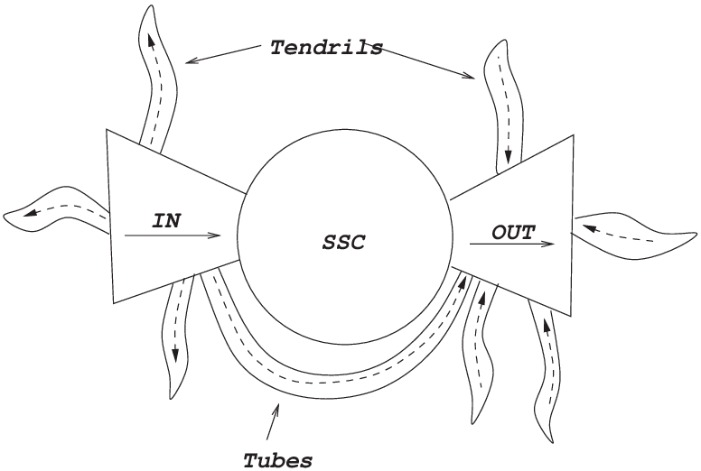


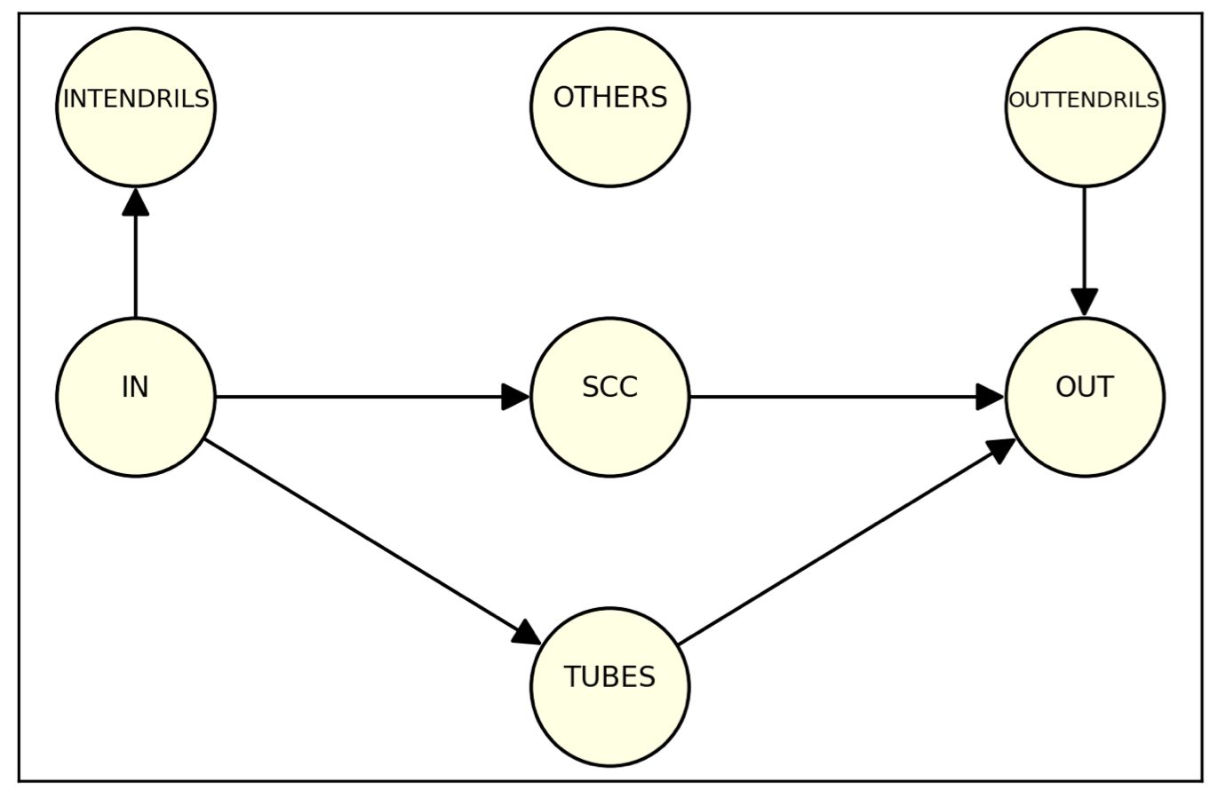
Introduction of Bow-tie Structure
What is bow-tie structure?
Why interesting?
Provide a systematic understanding of behaviour ecology
IN - Listeners, OUT - Producers, SCC - Broadcast
Large OUT:
  open to information
  more democratic
  prone to misinformation
Large SCC:
  messages keep being repeat
  trap people inside an information bubble

Slide 4
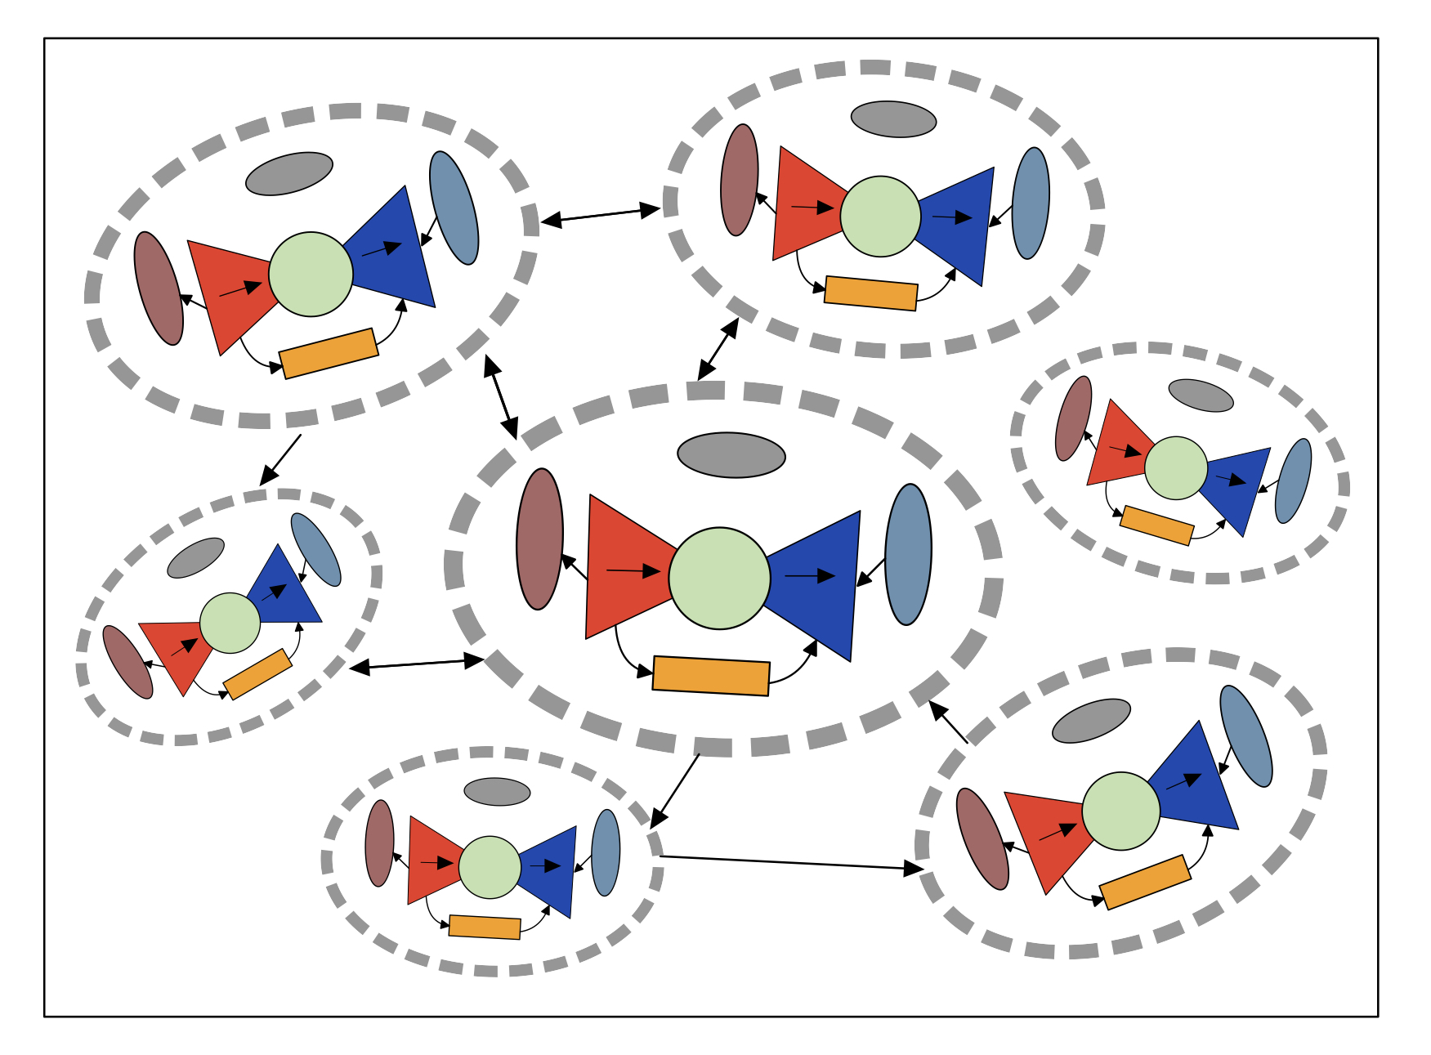
Algorithm for Bow-tie Decomposition
Primitive bow-tie detection algorithm is provided by Yang in 2011.
Current recursive bow-tie decomposition either relies on different choices of SCC or community detection.
Choose Infomap community detection over Modularity Maximization.

Slide 5
Evaluation of Bow-tie Component
Empirical Criterion
  Informative
  Strong/Weak
Statistical Significance
  Benchmark: Newman’s directed configuration model
  Rank for each bow-tie component

Slide 6
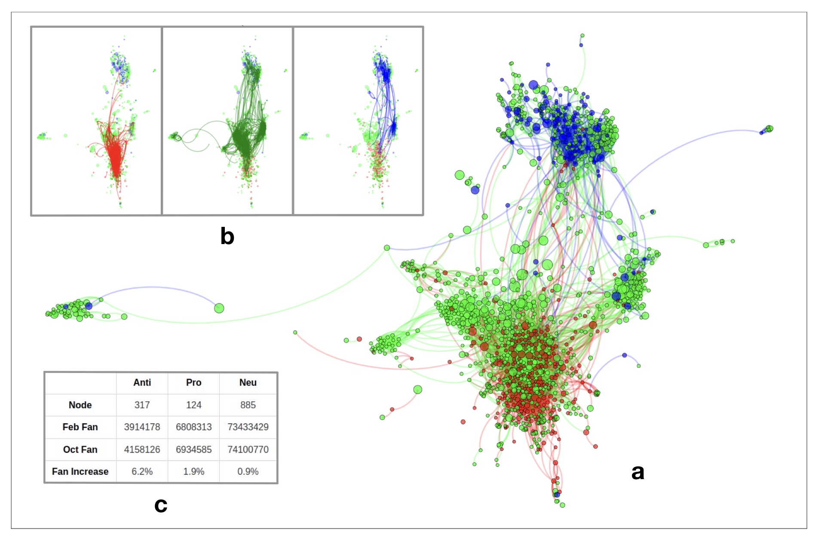
Data Background
Sociology Term
Discursive Community
Echo Chamber/Filter Bubble
  Difference: initiative/passive
  Similarity: Information bubble,
  ➔ less democratic and less prone to misinformation
Application of Bow-tie?
Assess impact of echo chamber/filter bubble on different vaccine view groups
Large SCC with small OUT tends to produce such impact

Slide 7
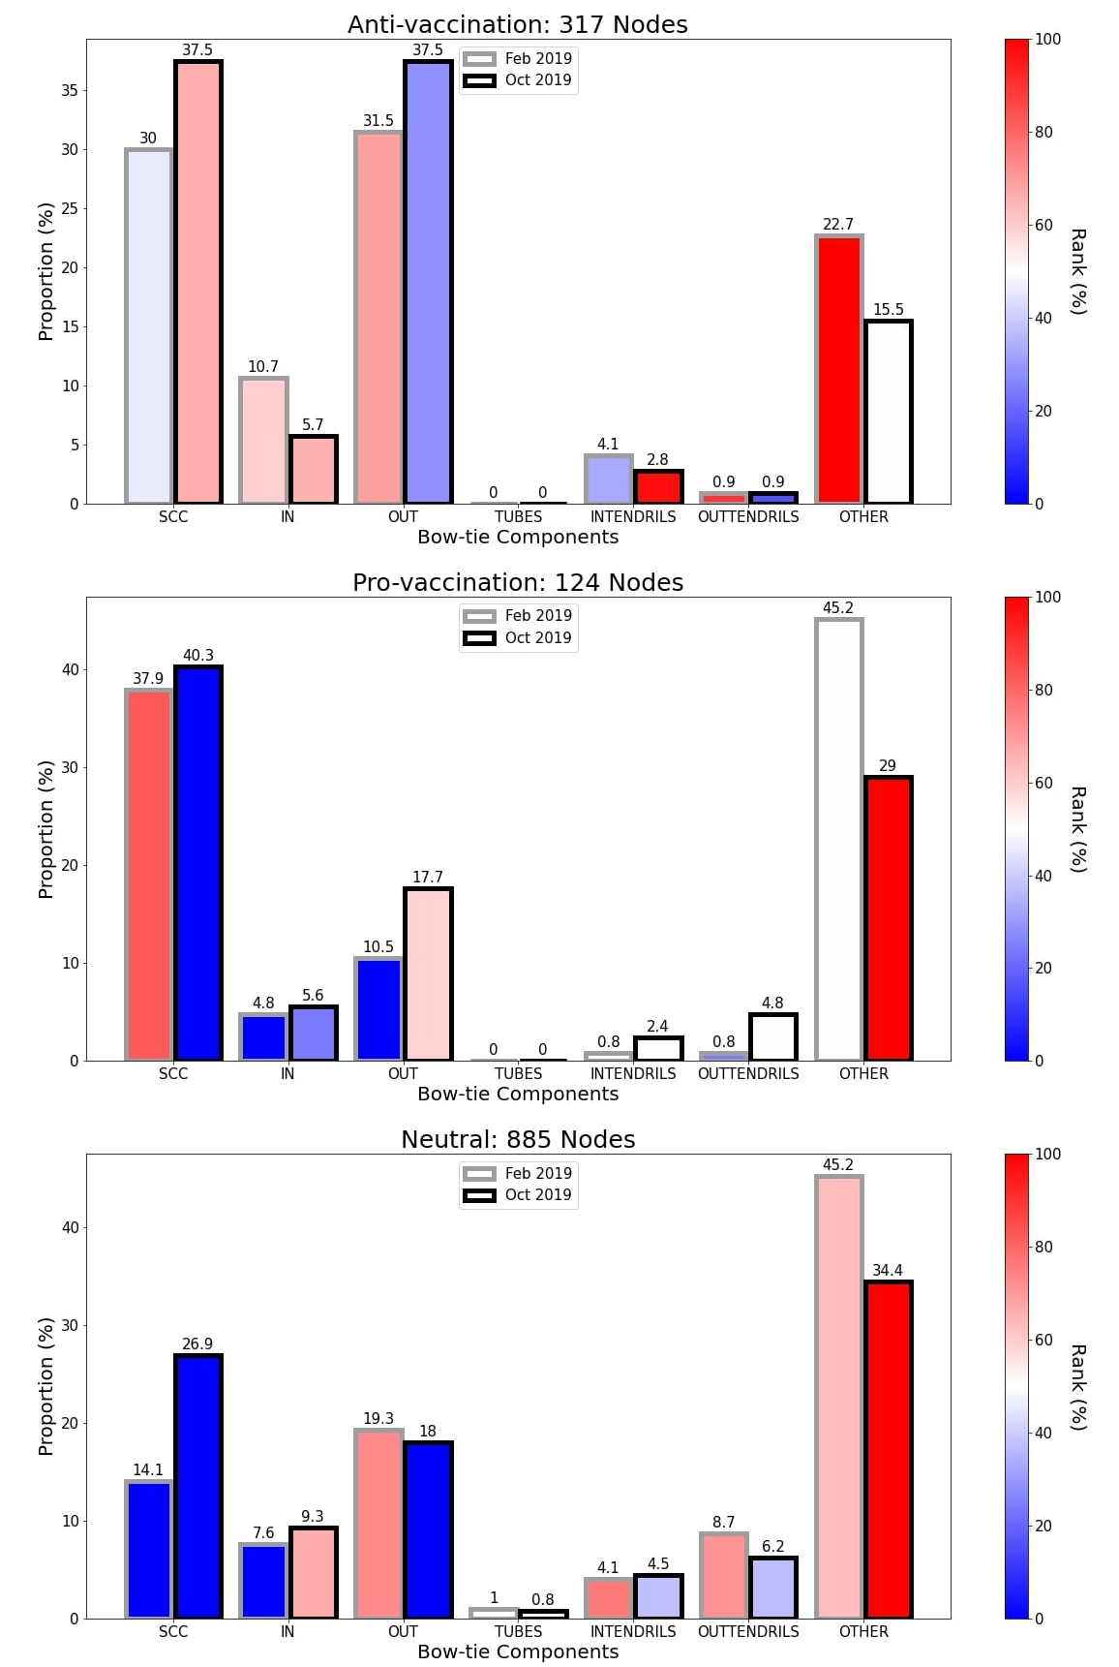
Data Analysis
Multi-scale Bow-tie Decomposition
  Discursive community
  Recursive detection by including interactions between
  discursive communities
Analysis based on discursive community
  Anti: SCC and OUT dominate
  ➔ active in content production +
  quick message transmission
  Pro: Large SCC and small OUT
  ➔ less content production
  ➔ echo chamber/filter bubble
  Neu: OTHER dominates
  ➔ less involved in vaccine topic

Slide 8
Summary and Limitations
Summary
Organize a systematic framework for analysis based on bow-tie decomposition
Explain its application in online social network, particularly about echo chamber and filter bubble effect
Limitations
Newman’s directed configuration model is used without checking its robustness
Extension in bow-tie component interpretations currently has no empirical evidence to support

