Slide 1

Real Estate
Peter Han
Yuetong Liu
Xuechun Lu
Yuting Wen
https://www.tourismvancouver.com/
Notes:
Hi, We are the Real Estate Group. I’m Peter, I’m Yuting, I’m Yuetong and I’m Leonie

Slide 2
Summary
Objective: predict mill rate given past data (2016-2019) in metro vancouver
What have we done:
Data cleaning
EDA (exploratory data analysis)
Models construction
Notes:
Our client is a Real Estate Property Tax Analyst in Metro Vancouver. The main objective of our project is to accurately predict future mill rate (property tax) in metro Vancouver for the following 3 property tax classes.
Tax class 1: Residential
Tax class 5: Light industry
Tax class 6: Business and other
The Client has provided property assessment data for the past 4 years (from 2016 - 2019)

Slide 3
Introduction
Mill Rate in Vancouver is released in Spring
Mill rate prediction is useful for current property owners and future potential buyers
Mill rate is adjusted by the Government to balance their budget
Notes:
Every year, assessment value of a property is released in the beginning of the year, however, mill rate is still unknown until Spring.
Prediction of mill rate is a focus of interest because it gives an approximate property tax to pay (assessment * mill rate) for property owners. It is important because it might affect future buyer’s incentive.
The property tax rate has a fairly small margin to change. It only changes by a very small amount per year
Mill rate is adjusted based on the total assessment in each city so the municipal government can use tax earning (total assessment * mill rate) to match their annual expense in order to balance the city’s budget. Later you will see how these factors (assessment, budget) are being used in our model

Slide 4
Data Description and Collection
Raw Data: 2 million data entries * 30 features.
Subset:
Metro Vancouver and 3 Tax Class (700,000)
Relevant features (Assessment Type, Assessment Value, Tax Class, Area, Year)
Imputation:
1801 missing data, 292 removed
Tax Class + Area + Year
Aggregate: 283 groups * 9 features
Notes:
Now we are going to talk about how our data looks like.
Our client provides us the past 5 years properties’ data in BC. The raw data has around 2 million data entries and 30 features.
Since we are only interested in predicting mill rate for metro Vancouver and specific class code, we get a subset of properties that satisfy our interest. There are around 7 hundred thousand entries left. Moreover, we select 5 features that could be relevant to mill rate, which are
Tax Year
Municipality (Property location)
Tax Class(Type of the properties)
Assessment Type:
Assessment Value:
Normally, one properties could have two type of assessments. Land is the value of the land of property, and improvement is the construction value.
After that, we found 1800 missing value in our response variable. To impute them, we gather properties with same region, classcode, and year into a group. Based on client information, all properties in the same region, classcode, and year should have a unique mill rate. For properties without a mill rate, they will be assigned a mill rate in the group they belong to. However there are 10 groups that none of the properties in the group has mill rate. Since this is a small portion of the population, all properties in these 10 groups are removed from the data set.

Slide 5
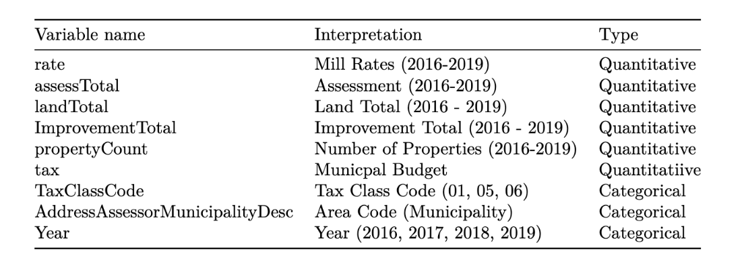
Data Description and Collection
Notes:
After imputation, all properties in a group are condensed into one data row and we final get 283 groups with 9 features. Here are some specification on these features:
Mill rate
Total Assessment in group
Total Land Assessment in group
Total Improvement Assessment in group
Total number of properties
Municipal budget is a new data source. Our client assumes that the mill rate is associate with municipal budget, since this kind of tax is the major income of the government. Therefore, we search the budget for different municipalities every year from BC gov website, and add this variable to our data frame.
Taxclasscode
Municipality
Year: tax year

Slide 6
Exploratory Data Analysis
Correlation between Mill Rate & Continuous Variables
No Clear Trend:
Number of Properties
Municipal Budgets
Total Assessment Value
Total Land Value
Total Improvement Value
Notes:
With all the explanatory variables, we want to see if they are correlated with mill rates
For the 5 continuous variables, we made some scatter plots to visualize their relationships
We found out that there is no clear relationship between mill rate and continuous variables,
that includes number of properties, municipal budgets
and total assessment value, which is the sum of total land value and total improvement value,

Slide 7
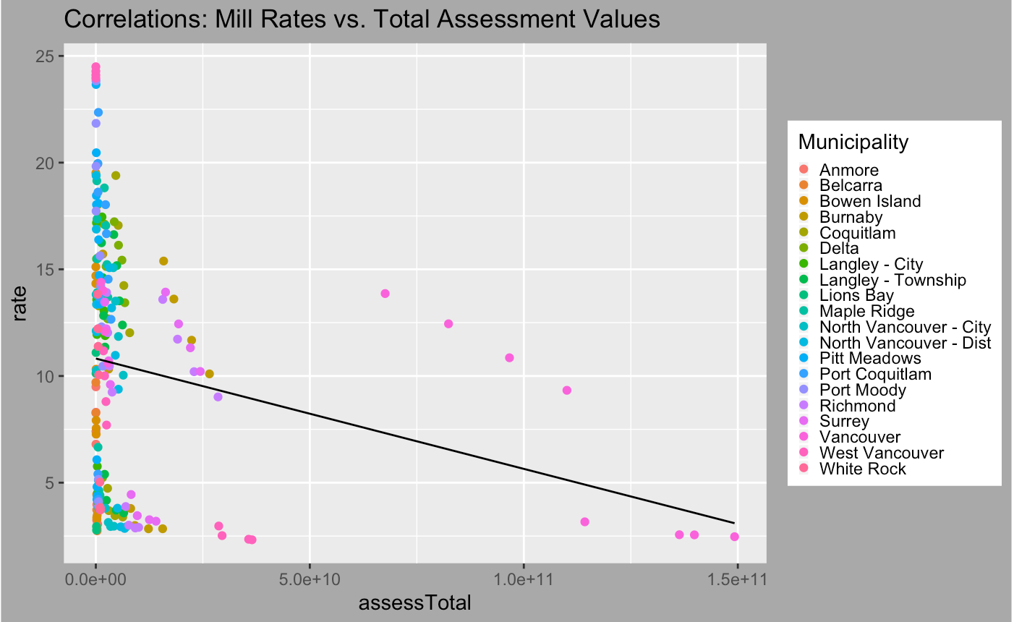
Notes:
This scatter plot has shown the correlation between mill rate and total assessment value.
Each color belongs to three tax classes of one municipality.
We can see that the total assessment value of Vancouver is large, so the correlations between total assessment value of other municipalities and mill rate have been overshadowed by its value, and this plot does not show clear trend between two variables
The correlations between mill rate and other explanatory variables except municipal budget all have similar plots
After second client meeting, the client suggested that we should transform the data, so we chose to take the average of total assessment value for each municipality, and made a scatterplot. We got the average of assessment value by total assessment value dividing by number of properties for each municipality

Slide 8
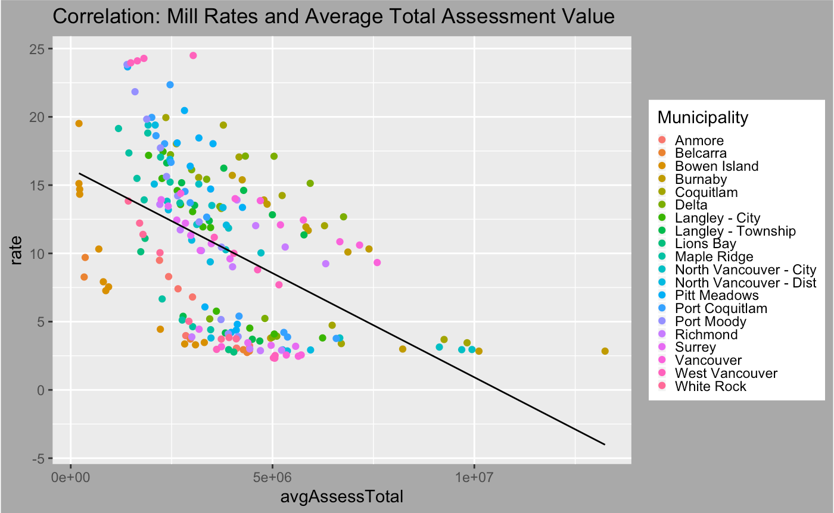
(EDA Graphs)
Notes:
The new plot has shown that average total assessment value is negatively correlated with mill rate, and it has moderately strong correlation, the outlier of last plot disappear here
So we plan to use this as a variable to fit model in the future

Slide 9
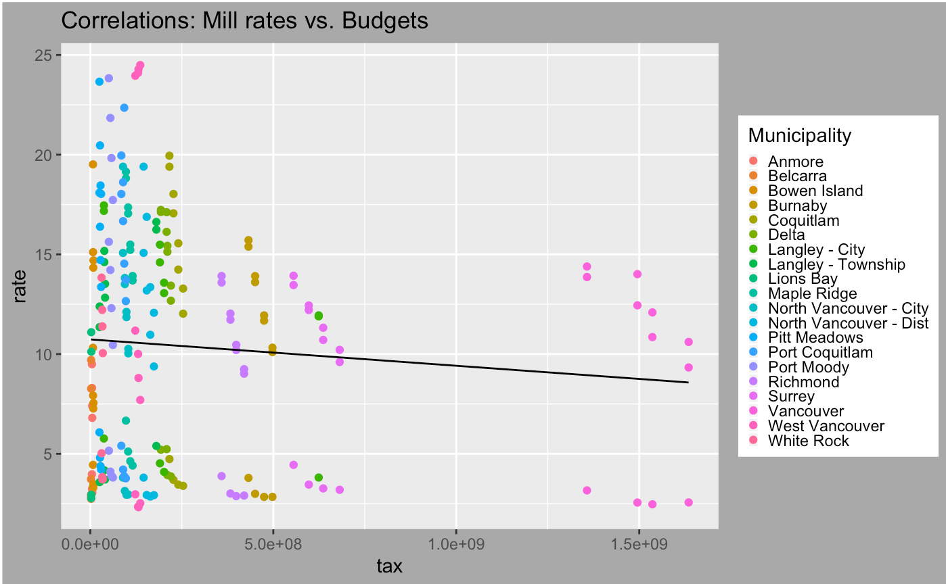
Notes:
As for the correlation between mill rate and budgets,
Each color belongs to 3 tax classes of one municipality
the plot has shown that there is no correlation, and obviously Vancouver is an outlier

Slide 10
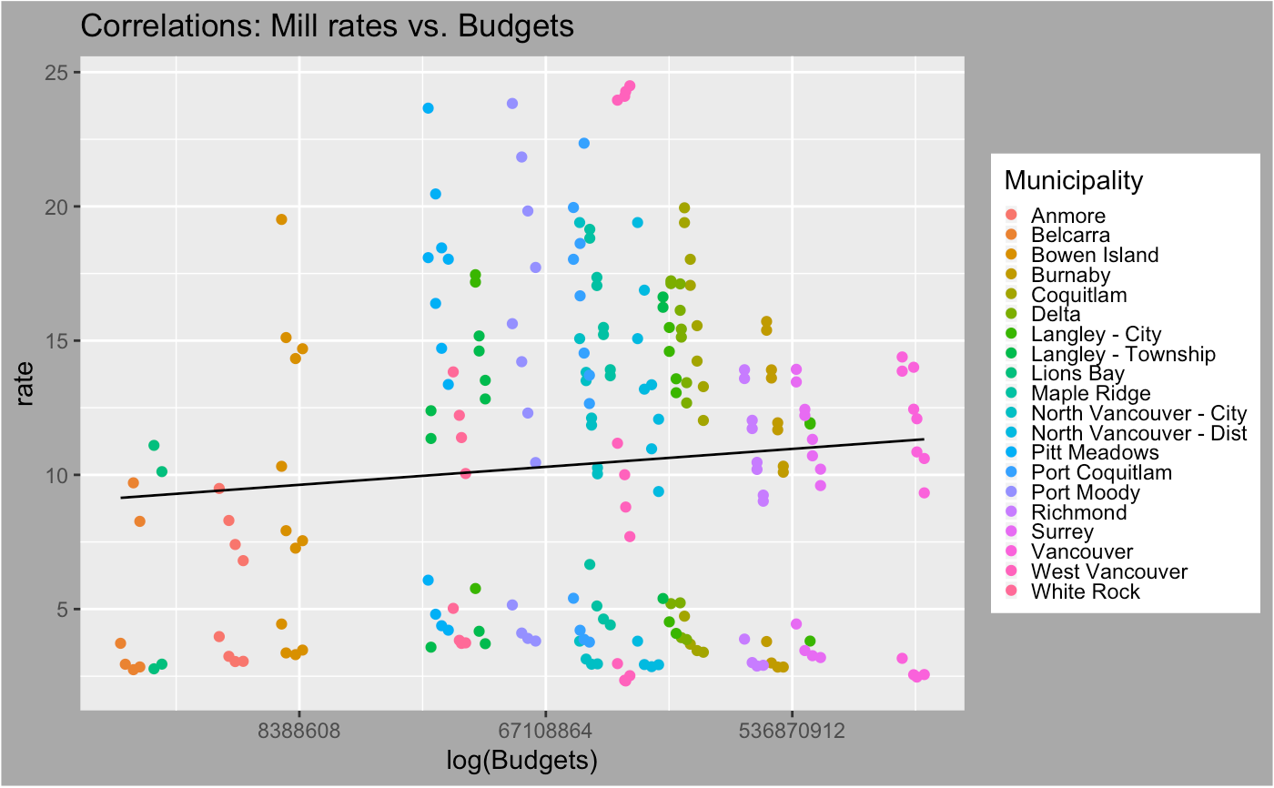
Notes:
To reduce the effect of outlier, we first tried to get average budget of each municipality, but there is still outlier since some municipalities have fewer number of properties
Then we chose to do log transformation for budgets, but there is also no clear correlation in the new plot

Slide 11
Exploratory Data Analysis
Correlation between Mill Rate & Categorical Variables
Significant:
Tax Class
Year
Insignificant:
Municipality
Notes:
Then we consider the categorical variables
We found out that tax class and year are significant variables, but there is no clear difference for mean and variance of all municipalities
we made some boxplots to visualize the distribution of each factor of each category

Slide 12
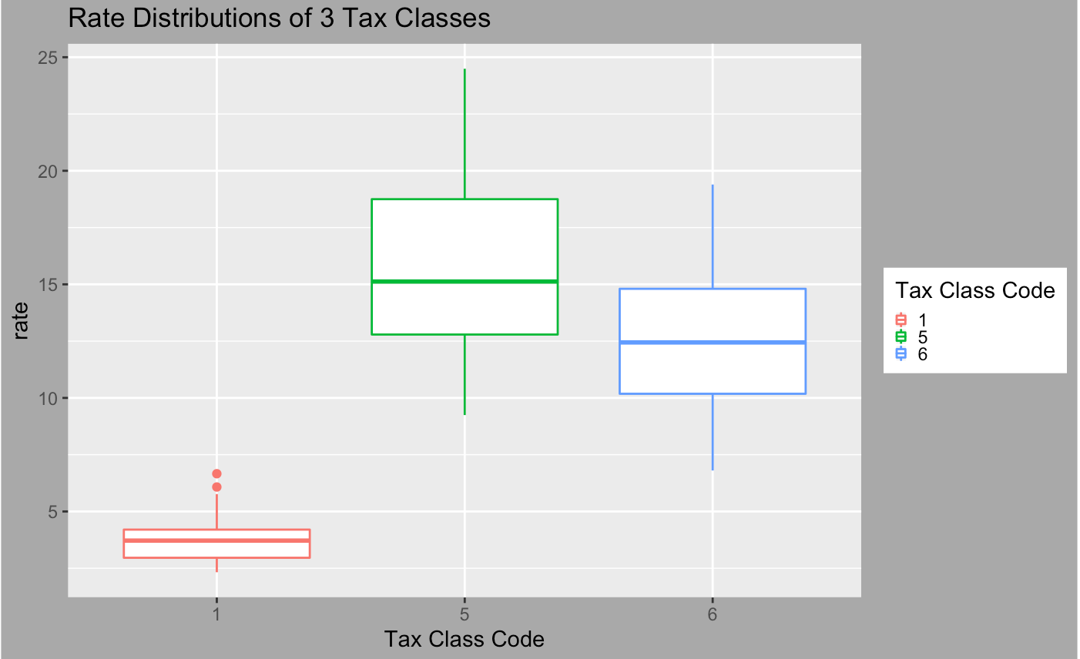
Notes:
The plot has shown the distributions of mill rate for each tax class
From the plot, we suggest that the mean mill rate of each tax class are different
And there is Unequal variance across tax class
Tax class seems to be a significant variable

Slide 13
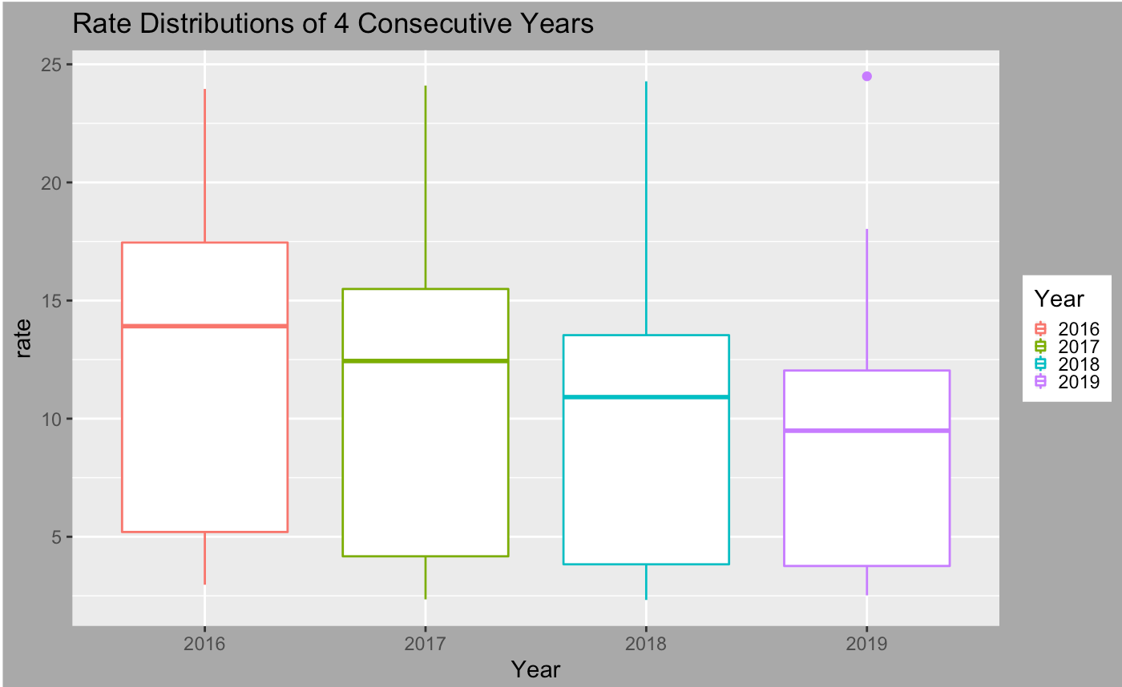
Notes:
The plot has shown the distributions of mill rate for each year from 2016 to 2019
From the plot, we can see that there is decreasing trend of mean mill rate from 2016 to 2019.
And also there is unequal variance across years.
So Year seems to be a significant variable.

Slide 14
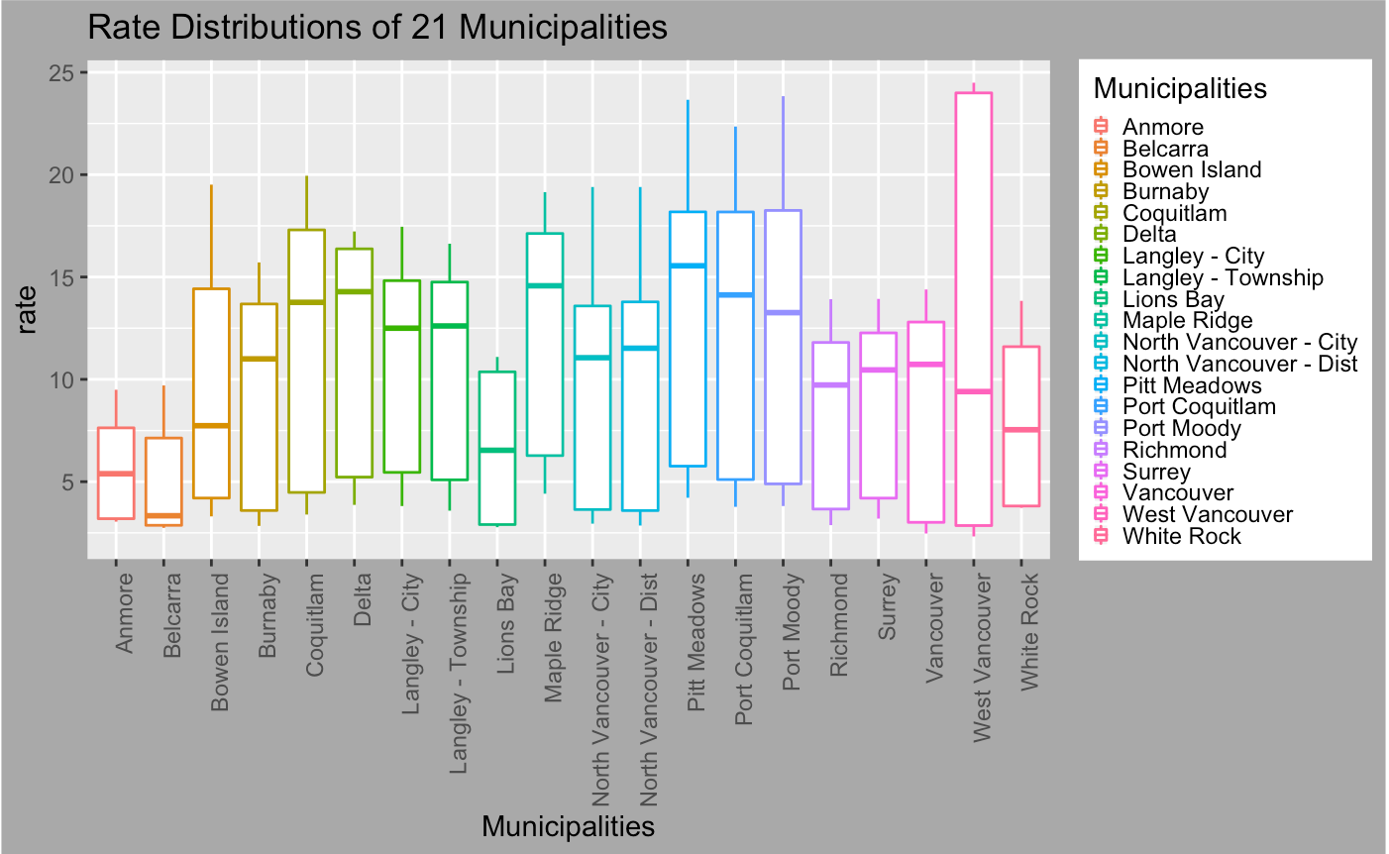
Notes:
The plot has shown the distributions of mill rate for each municipality
From the plot, we think that the mean mill rate of each municipality are close
and noticed that Anmore, Belcarra and West Vancouver are outliers.
We also suggest that No obvious difference in variance between the rest of municipalities.

Slide 15
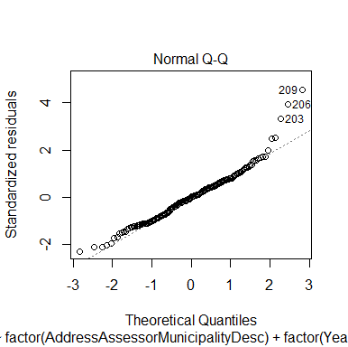
Assumptions of Linear Regression
Statistical Methods and Results
Normality of Residuals
2. Equal Variance
Fligner-Killeen’s Test:
Factor | p-value
Municipality | 0.1254
Year | 0.01079
Tax Class | 9.487e-16
Notes:
Most of data are normal distributed but there are a few outliers present.
Fligner Killeen's test (test of homogeneity of variances) is robust to non-normal data.
At 5% level, p-value is non-significiant for factor Municipality and significant for Year and TaxClass.
=> which means a non significant difference between the group variances of Municipality, but a significant difference of variance in Year and Tax Class. This confirms our previous analysis in EDA.
Violation of unequal variance => biased T/F statistics, underestimated significance level and thus falsely reject the null.

Slide 16
Models
Ordinary Linear Regression
Features: Municipality, Year, TaxClass, assessTotal, landTotal, propertyCount and Budget
Ordinary Linear Regression with Reduced Features
Features: Municipality, Year, TaxClass, assessTotal and landTotal
Ridge
Lasso
Elastic Net
Notes:
Except for ordinary linear regression, we are also interested in the performance of advanced linear regressions
like Ridge, Lasso and Elastic Net as they are also in the linear regression family, but have a different objection
function to optimize. Among the three models, weights are assigned to features, and we are interested in
minimizing the sum of squares of errors plus a penalty term. Ridge regression takes penalty in sum of absolute
values of weights, whereas Lasso takes penalty in sum of squared absolute values of weights. Elastic net is a
combination of Ridge and Lasso.
The reason for considering advanced linear regressions is that assigning weights to features might improve
the goodness of fit and prediction power as each feature might influence the mill rate to a different extent.

Slide 17
 | Multiple R-squared | Adjusted R-squared | MSE | MSPE
OLR full | 0.8874 | 0.8707 | 1.9843 | 2.5237
OLR reduced | 0.8874 | 0.8721 | 1.9845 | 2.5237
Ridge | 0.8868 | NA | 1.9896 | 2.5675
Lasso | 0.8873 | NA | 1.9855 | 2.5280
Elastic Net | 0.8625 | NA | 2.2366 | 2.5486
Notes:
We examine our models mainly in 2 aspects, goodness of fit and prediction power.
Goodness of fit: how well models explain the data. Measured by R-squared, adjusted R-squared. The greater the better.
Prediction power: how well our models can predict the future values. Measured by MSPE. the smaller the better.
As for goodness of fit, we fit the model using all our data and obtained the first three columns. And we can see there’s not too much difference in R-squared for all the models but the group of OLR seem to perform slightly better.
Similarly as for MSPE, OLR seem to perform slightly better.

Slide 18
Conclusions
EDA: assessment total, land total
Model Fitting
Prediction Power
Notes:
Without data transformation there is no strong relationship between continuous variables and mill rate and outliers are present in our data.
Variables that were chosen in our model tells client the main factors that contribute to the generation of mill rate
Not too much difference between the five models as for goodness of fit and prediction power, however, Ordinary Linear Regression outperforms the others slightly. Because the difference between full model and reduced model is marginal, we prefer the reduced model

Slide 19
Further Discussion
Data transform -> Model
Correlated variables
CV problem, need to write cv function on our own
Client's expectation
Notes:
Because we have found out that applying some transformation to the data can eliminate the outliers, we are going to refit our models using the transformed data and assessed them
We have found that some variables are correlated with others so we are going to fit a model using a reduced set explanatory variables (Tax class and Total Assessment)
Others have pointed we need to write our own cross validation method by picking one data point from each city for each fold. We are going to explore a little more on that.
Overall the client is happy with the result. But he has also pointed out that the model needs to be as simple as possible (less explanatory variable). So from our previous point we are going to omit some explanatory variable based on future EDA
The Client also really want us to fit a regression tree model. But we will only work on this if time permits

Slide 20
Thank You!!!

Slide 21
Q&A

