Slide 2

Basic files
Put lipid17.itp into this folder
atomtypes.atp
ffbonded.itp
ffnonbonded.itp
Wrire
#include "lipid17.itp"
in forcefield.itp

Slide 3


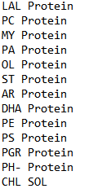
Definition for POPC
In this project, both choices are acceptable.
Definition for all existed Lipids

Slide 4
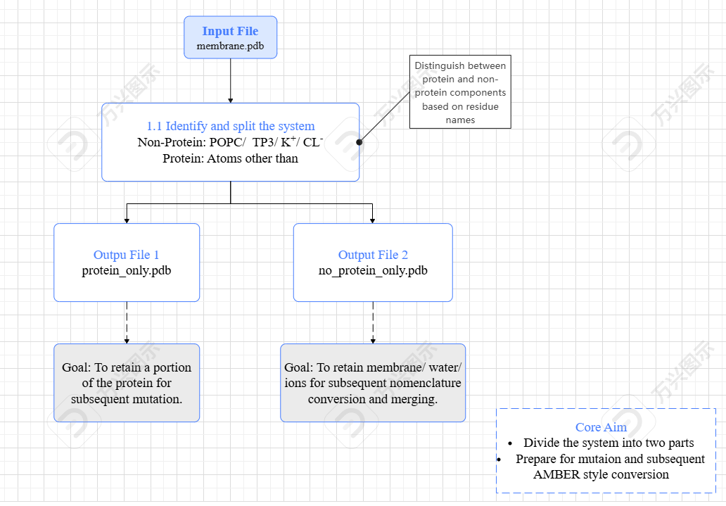

Slide 5
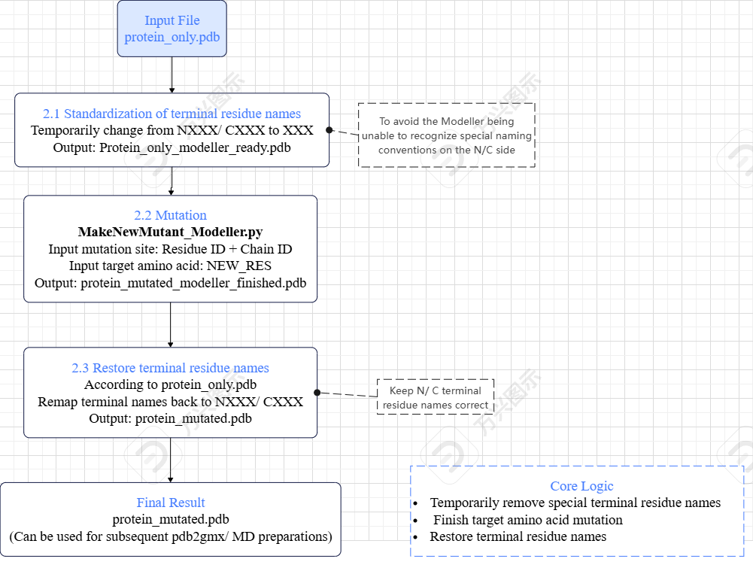

Slide 6
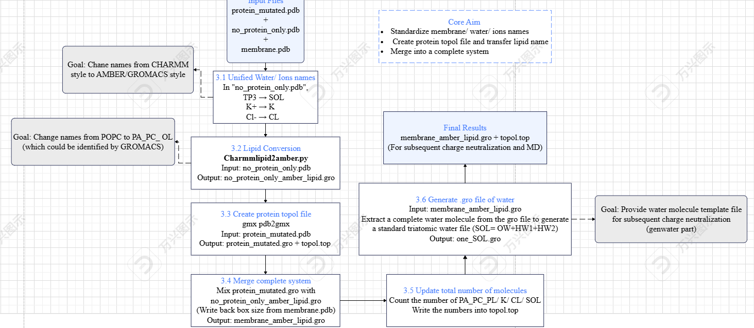

Slide 7
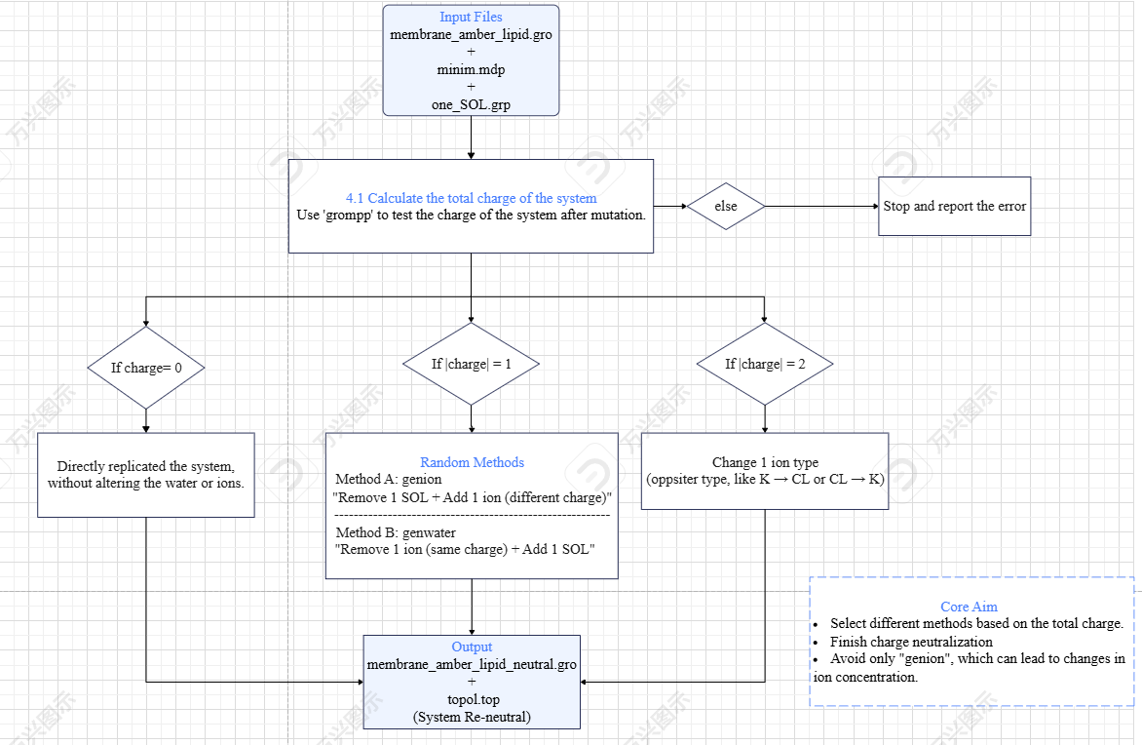

Slide 9
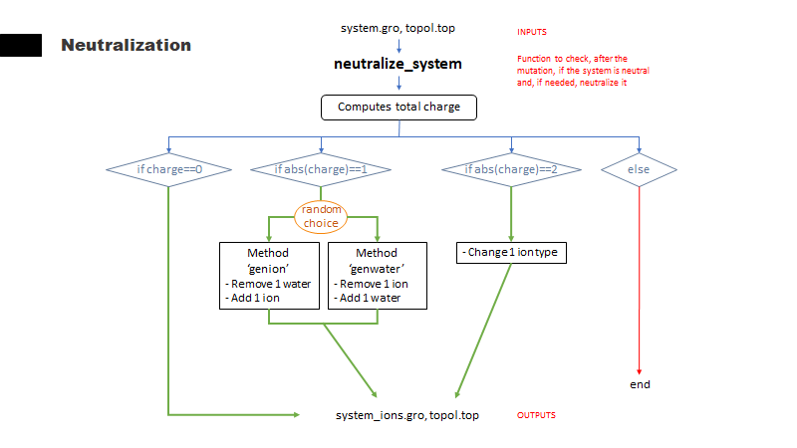

Slide 10
K 207
CL 250
SOL 75811
ASP
Δcharge=|-1|
genwater
K 208
CL 251
SOL 75809
ASP
Δcharge=|-1|
Example 1: H 2 VAL
K 207
CL 251
SOL 75810
LEU
Δcharge=|0|
K 207
CL 252
SOL 75809
LYS
Δcharge=|+1|
genion
K 206
CL 252
SOL 75810
LYS
Δcharge=|+2|
Example 2: H 10 GLU
K 208
CL 250
SOL 75810
ASP
Δcharge=|-2|

