Slide 1
Test Harness Project GUI Client
Yuexin Yu

Slide 2
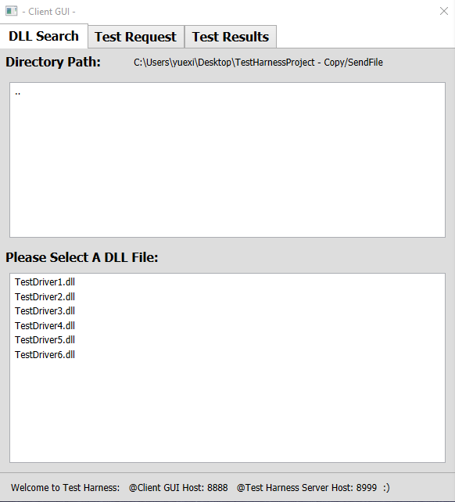
TAB 1: DLL Search
Features:
SW defines default DLL library folder directory, and GUI displays default directory;
User can double-clicks “..” to select a different directory on ListBox 1;
GUI will display contents from the selected library directory on ListBox2;
User can select any library file on the ListBox2, and GUI will pop-up a window to User to confirm the file selection. Please check next page;

Slide 3
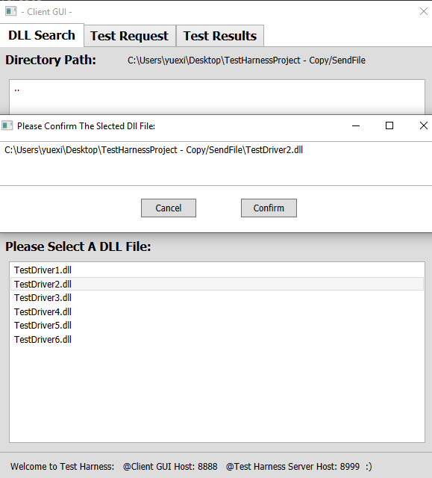
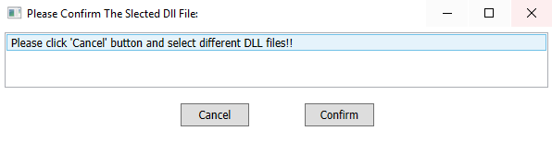
User can confirm or cancel the file selection from the pop-up window;
User can select multiple files, all the selected files will display on the TAB2 “Test Request”;
GUI will warn User to Cancel if the same DLL file has been selected twice;
Status Bar on the bottom of GUI will automatically update the test status.

Slide 4
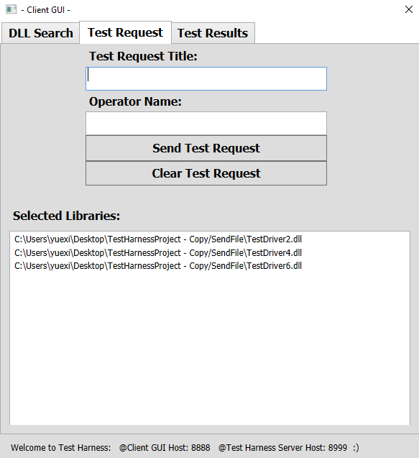
Tab 2: Test Request
Features:
GUI will display the selected libraries from User on the TAB 1;
User can input the Test Request Title of the message from Client to Server;
User can input Operator’s name of the message from Client to Server;
User clicks to send Test Request message from Client to Server;
User clicks to clear selected libraries in history.

Slide 5
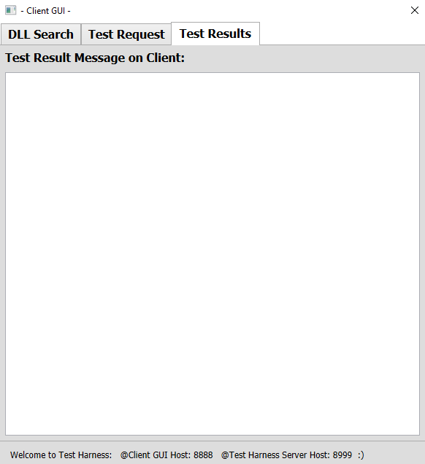
TAB 3: Test Results
Features:
TextBox will display the test result on GUI from Server testing.

Slide 6
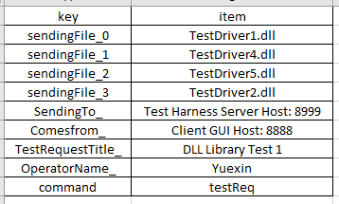
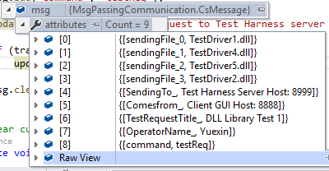
Message Type:
Client software will define the port addresses of Client and Server, and send and receive messages to communicate with each other;
Temporary Test Request Message type is: dictionary type;
Our team is still working on XML message format conversion and message communication between Client and server.

