Slide 1
Project Test harness
Yuexin Yu

Slide 2
oVERVIEW
Project Source Code: https://drive.google.com/file/d/1nMumZ9Jv6bcLNePKspaO1g8DV4VznRWU/view?usp=sharing
Contribution:
Client GUI
Test Harness Server
Child Tester
DLL Test Driver
File Management, Test Log, System Communication(comm, message, task request, translator)
Github Reference:
https://github.com/Yuexin-Gary-Yu/TestHarnessProject

Slide 3
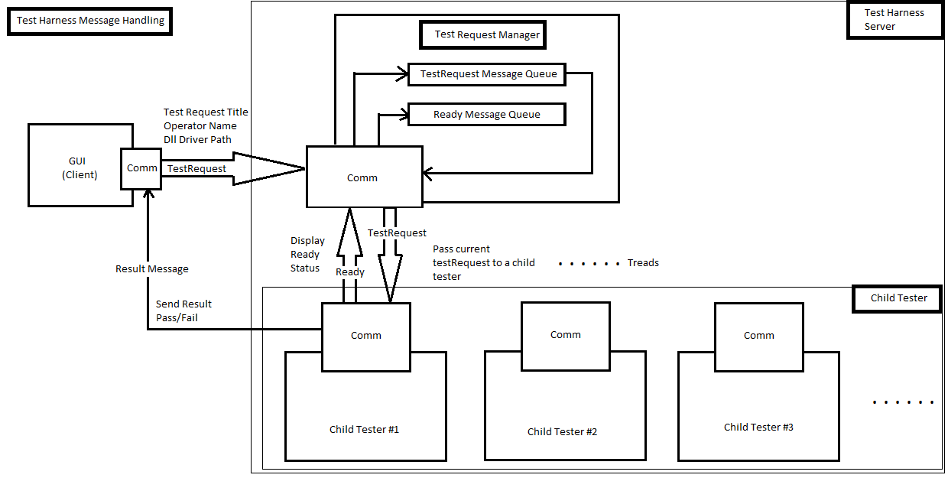

Slide 4
CLIENT Gui DESIGN
TAB 1: DLL Search
Features:
SW defines default DLL library folder directory, and GUI displays default directory;
User can double-clicks “..” to select a different directory on ListBox 1;
GUI will display contents from the selected library directory on ListBox2;
User can select any library file on the ListBox2, and GUI will pop-up a window to User to confirm the file selection. Please check next page;

Slide 5
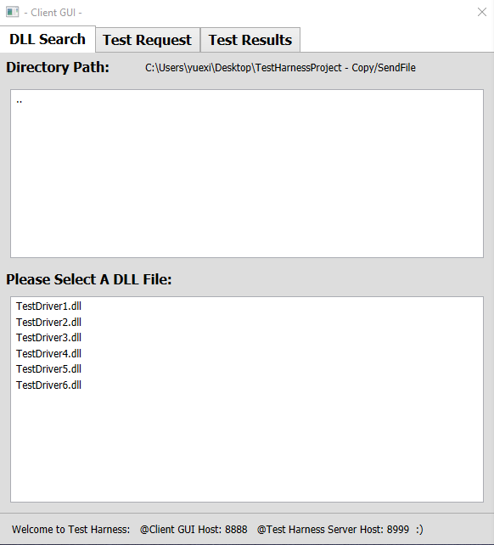
TAB 1: DLL Search
Features:
SW defines default DLL library folder directory, and GUI displays default directory;
User can double-clicks “..” to select a different directory on ListBox 1;
GUI will display contents from the selected library directory on ListBox2;
User can select any library file on the ListBox2, and GUI will pop-up a window to User to confirm the file selection. Please check next page;

Slide 6
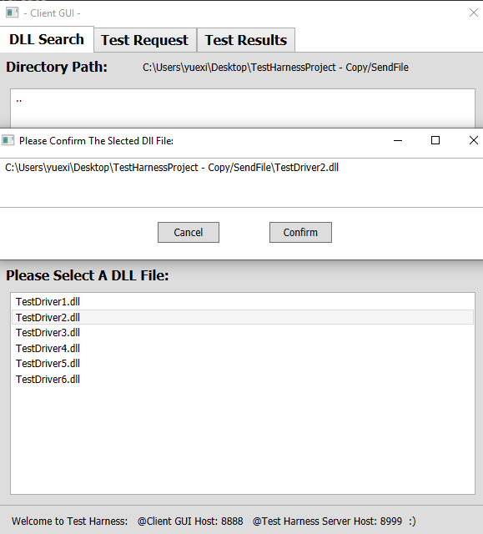
User can confirm or cancel the file selection from the pop-up window;
User can select multiple files, all the selected files will display on the TAB2 “Test Request”;
GUI will warn User to Cancel if the same DLL file has been selected twice;
Status Bar on the bottom of GUI will automatically update the test status

Slide 7
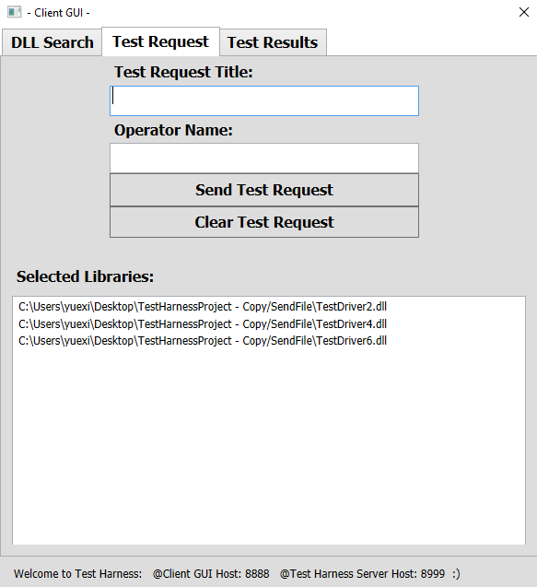
Tab 2: Test Request
Features:
GUI will display the selected libraries from User on the TAB 1;
User can input the Test Request Title of the message from Client to Server;
User can input Operator’s name of the message from Client to Server;
User clicks to send Test Request message from Client to Server;
User clicks to clear selected libraries in history.

Slide 8
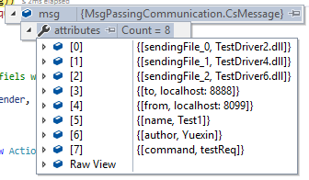
Message Type:
Client software will define the port addresses of Client and Server, and send and receive messages to communicate with each other;

Slide 9
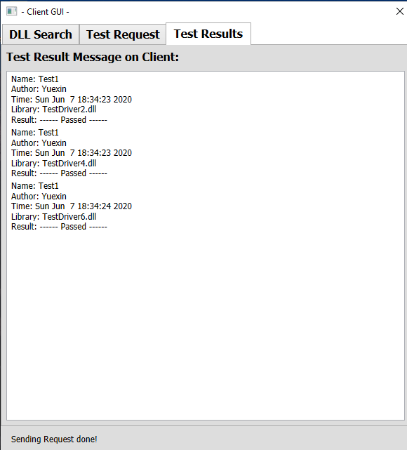
TAB 3: Test Results
Features:
TextBox will display the test result on GUI from Server testing.

Slide 10
Single test GUI Log:
creating an instance of Comm on the native heap – Creating Comm for GUI
Starting A ClientHandler – Start a client handler for the comm sending out a message
Getting Message In Translater – Getting a message in the translater
Posting Message In Translater – Posting a message in the translater
A ClientHandler Has Been Destroyed – Exit the client handler
TXT LOG:

Slide 11
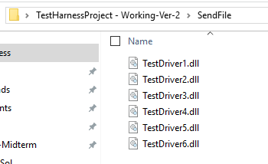
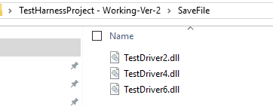
File management System design
Features:
From GUI, user can select available test drivers in repository folder: “SendFile”
File management system will transfer the selected DLL drivers file to the testing folder: “SaveFile”
for testing.

Slide 12

Test Harness server design

Slide 13
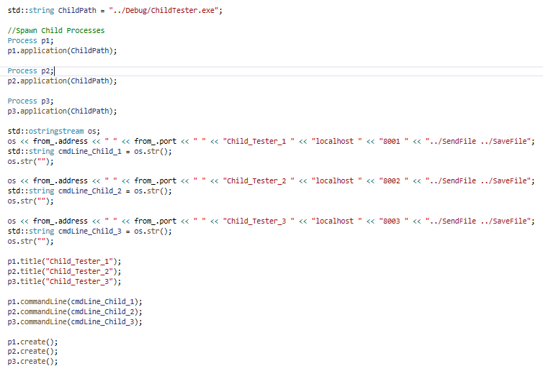
Process pooling for child tester
Test Harness server spawns Client process and Child processes by using the Process poll framework, configuration data, like IP address, physical port number, server name and file pathes, are sent by Test harness server to each child processes

Slide 14
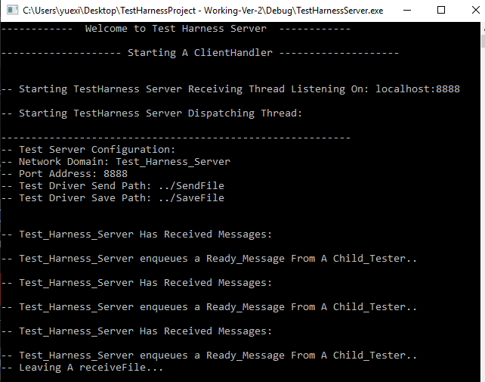
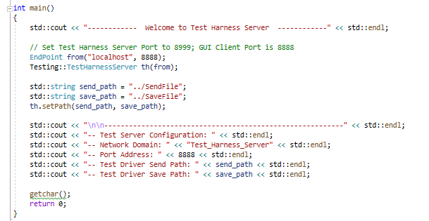
Test harness Main code
Main code to setup server’s comm port, test driver’s repository location and executive location
Print out the availability of child testers, check the test harness receiver and you will see more details

Slide 15
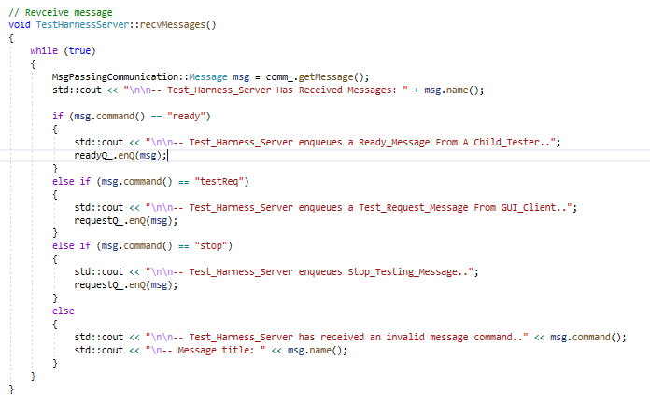
Test harness receiver code
Receiver message comm will enqueue Ready Message from Child Testers,
Test Request message from Client GUI
Stop Request from Child Testers

Slide 16
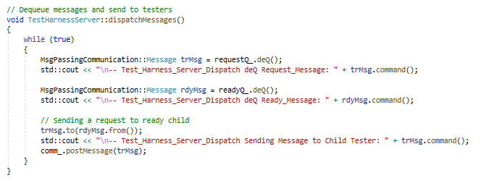
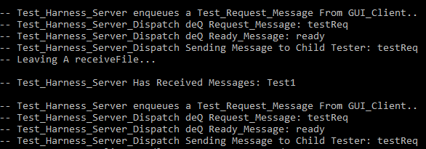
Test harness dispatcher code
Dequeue to dispatch task request to child testers in a parallel thread

Slide 17
Child tester design
Loads TestRequests from requestPath.
Each TestRequest provides names of Dlls to load and test
Loads Test Dynamic Link Libraries (Dlls) from libPath.
Executes tests defined in each Dll.
Each tests logs ouputs using Tester class's logger

Slide 18
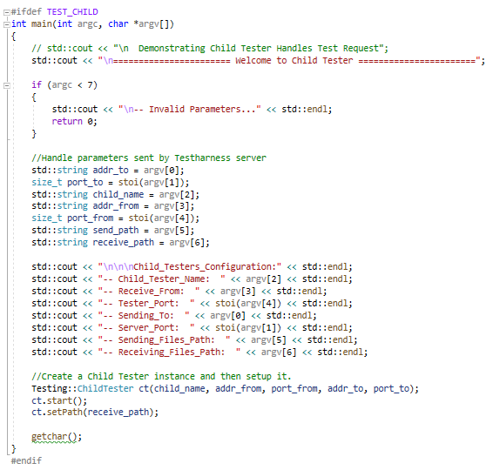
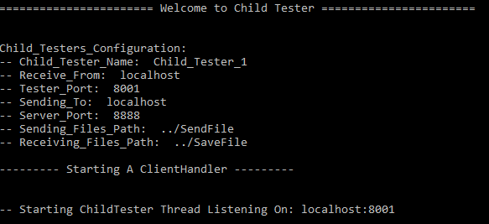
Child tester main code
Child Tester comm is set in the Test Harness Server process pooling;
Handle parameters sent by Test Harness Server;
Create a Child Tester instance and then set it up.

Slide 19
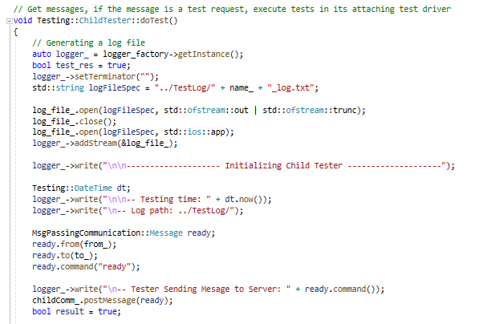
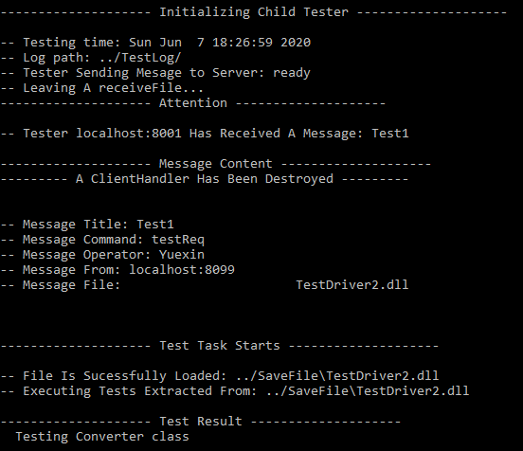
DLL testing
Uses DllLoader to load libraries and extract tests;
Provides pointer to its member logger to each test, then executes it, using the infrastructure from TestUtilities.

Slide 20
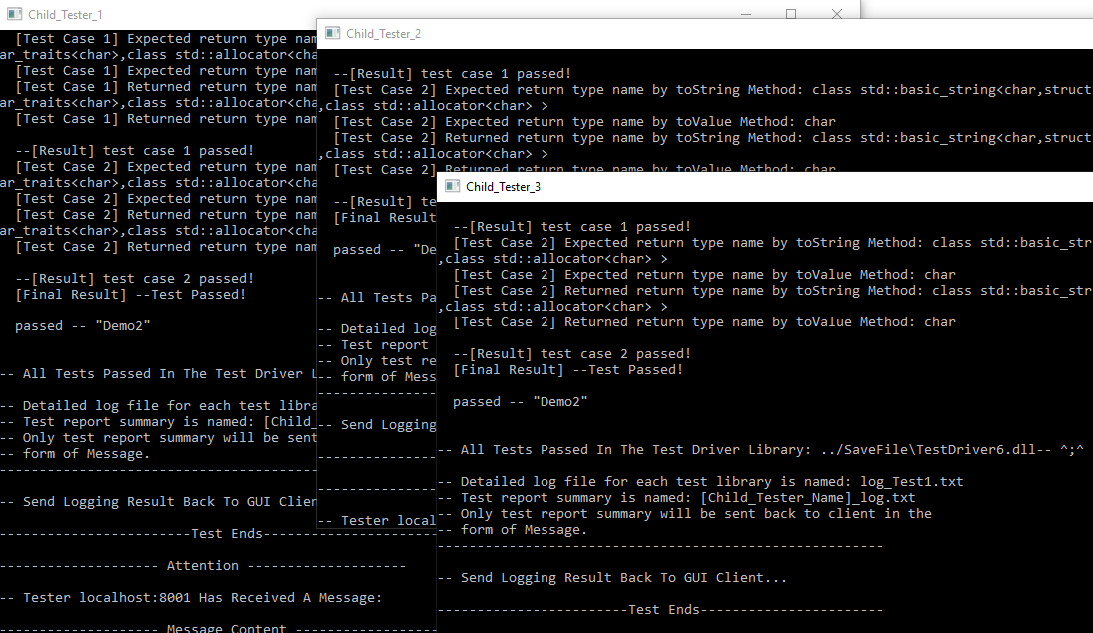
Mulithreading testing

Slide 21
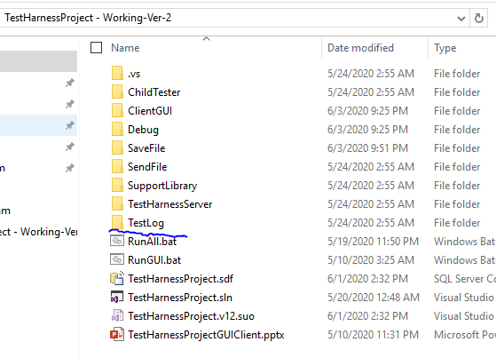
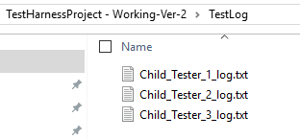
Child tester test log
CHILD TESTER will send the test result to Client GUI, generate Test log file and save to the TestLog folder.

Slide 22
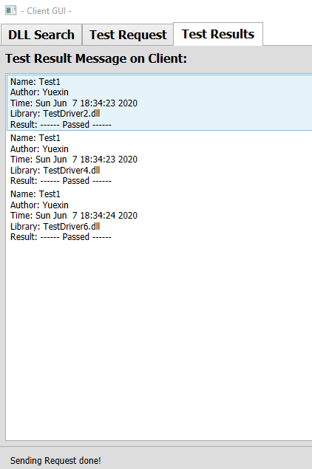
Test complete!

